Slide 1




Lithium Sulfur Battery: Current Status and Future Prospects.
Dr. Toru Hara^{1,2,3}
Mr. Aishuak Konarov¹
Dr. Almagul Mentbayeva^{1,3}
Dr. Indira Kurmanbayeva¹
Prof. Zhumabay Bakenov^{1,2,3}
¹Institute of Batteries
²Nazarbayev University Research and Innovation System
³Nazarbayev University
Ministry of Education and Science of Republic of Kazakhstan

Slide 2
Lithium Sulfur Battery: Current Status and Future Prospects.
This publication has been made within the Sub-project #157-2013 which is funded under the Technology Commercialization Project, supported by the World Bank and the Government of the Republic of Kazakhstan.
Ministry of Education and Science of Republic of Kazakhstan

Slide 3
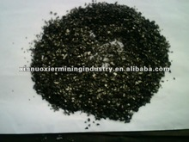
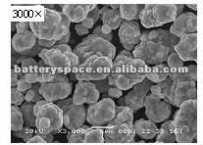
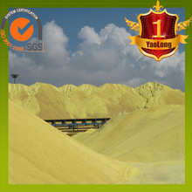
Motivation for Research: Sulfur is almost free.
Material | Theoretical Capacity (mAh/g) | Available capacity (mAh/g) | Cost/capacity (USD/kAh)
Graphite | 372 | 372 | 1.9
LiCoO₂ | 274 | 140 | 110
Sulfur | 1672 | 1000 | 1.0×10⁻³
Price: http://www.alibaba.com/

Slide 4
Challenging issues
Li dendrite growth at Li metal anode | Short circuit failure
Insulating nature of sulfur | Low utilization of sulfur (low capacity)
Low mass-loading of sulfur (≤ 2 mg/cm²) | Low capacity
Polysulfides dissolution | Capacity fading

Slide 5
Challenging issues | Solutions
Li dendrite growth | Pre-lithiation of anode
Insulating nature | Conducting agent
Low mass-loading (≤ 2mg/cm²) | high specific-area carbon-based current collector
Polysulfides dissolution | Stabilizing agent

Slide 6
Challenging issues | Solutions
Li dendrite growth | Pre-lithiation of anode
Short-circuiting anode materials to Li metal foil before assembly
R. Koksbang, I. Olsen, and J. Barker, U.S. Patent 5,753,388 A, Apr 12, 1995.
A. Zhamu and B. Z. Jang, U.S. Patent 8,158,282 B2, Nov 13, 2008.
Electrolyte solution
Li foil
Anode

Slide 7
Challenging issues | Solutions
Li dendrite growth | Pre-lithiation of anode
Voltage profile and cycle performance of pre-lithiated graphite (10.8-mg-graphite/cm², 4 mAh/cm²)|1 M LiPF₆/EC+DEC+EMC (1/1/1, v/v/v)|S/PAN/KB (2-mg-sulfur/cm², 2.9 mAh/cm²) cell at 0.2 C.

Slide 8
Challenging issues | Solutions
Insulating nature | Conducting agent
sulfur/poly(acrylonitrile) composite (S/PAN composite)
Plus carbon black, acetylene black etc.
J. Wang, J. Yang, J. Xie, and N. Xu, Adv. Mater., 14, 963 (2002).
J. Wang, J. Yang, C. Wan, K. Du, J. Xie, and N. Xu, Adv. Funct. Mater., 13, 487 (2003).

Slide 9
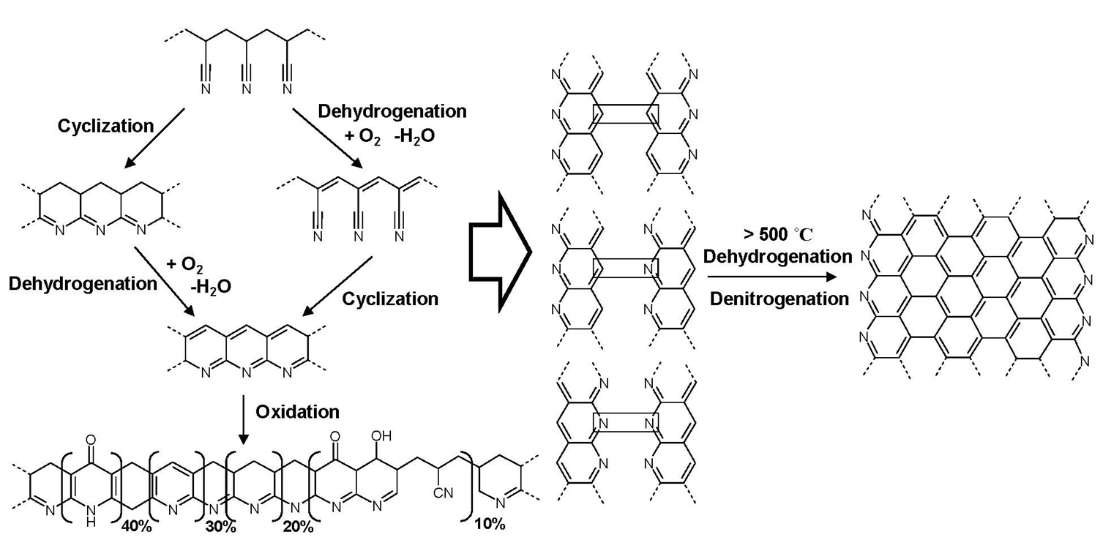
Challenging issues | Solutions
Insulating nature | Conducting agent
Cyclized poly(acrylonitrile)
http://www.cmu.edu/maty/materials/Nanostructured-materials/carbon-nanostructures.html

Slide 10
Challenging issues | Solutions
Low mass-loading | high specific-area carbon-based current collector
Cathode composite coating onto/into high specific-area carbon-based current collector

Slide 11
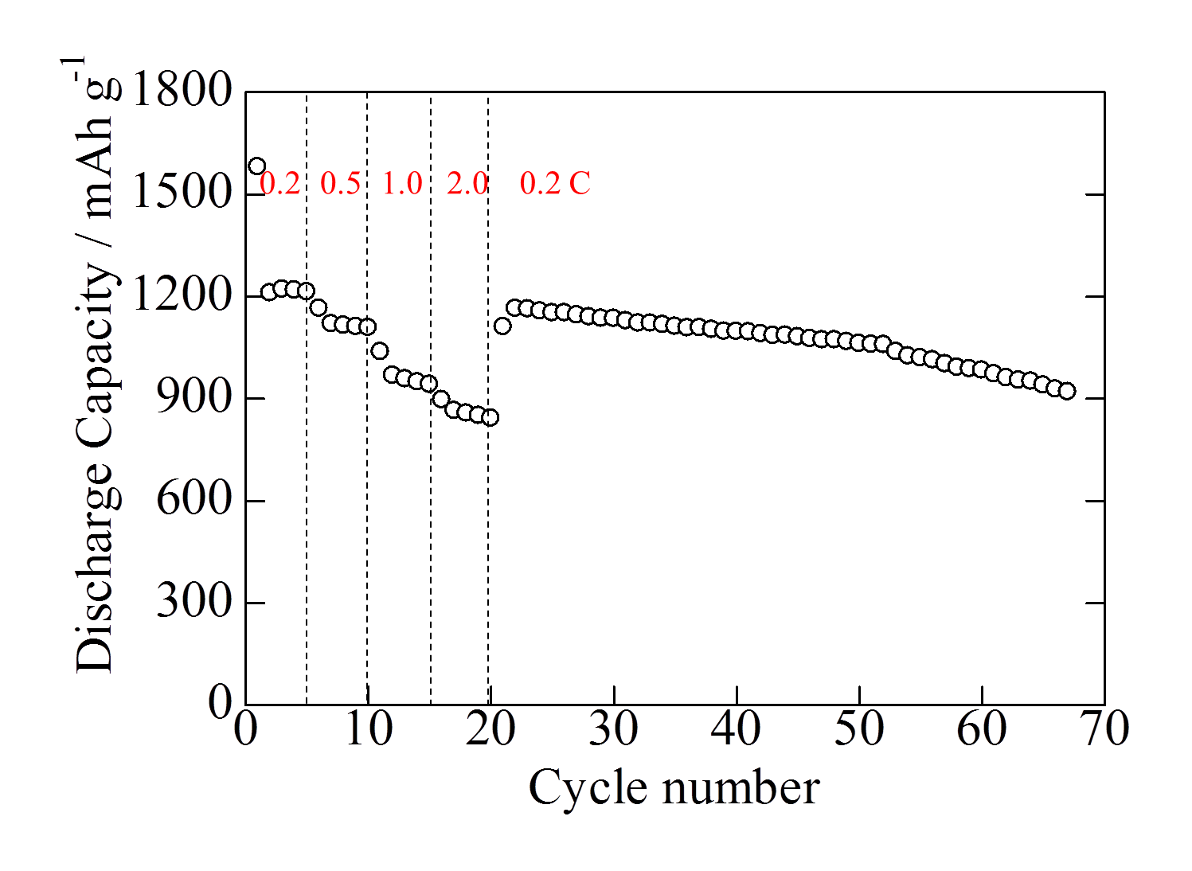
Challenging issues | Solutions
Low mass-loading | high specific-area carbon-based current collector
Cycle performance of Li metal foil | 1.0 M LiPF₆ / EC+DEC+EMC (1/1/1, v/v/v) | S/PAN/KB
(3-mg-sulfur/cm²▪300 μm, 3.6 mAh/cm²) cell at 0.2 C.

Slide 12
Challenging issues | Solutions
Polysulfides dissolution | Stabilizing agent
Sulfur/poly(acrylonitrile) composite (S/PAN composite) cathode
S/PAN can be used in LiPF₆/carbonate-based electrolyte solutions; however, cycle life tends to be around 200-300 cycles (depending on the mass-loading of sulfur, and on anode/cathode mass-loading ratio).
Cycle life improvement is required.

Slide 13
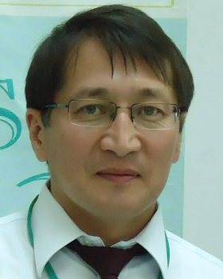
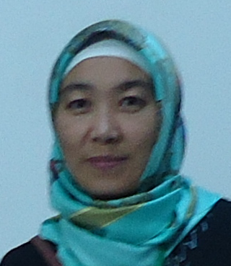
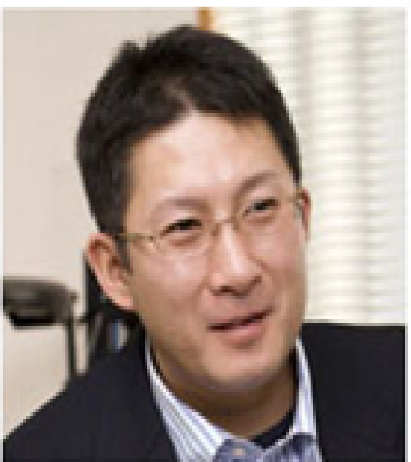
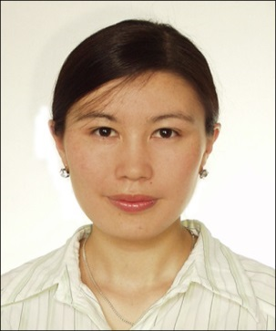
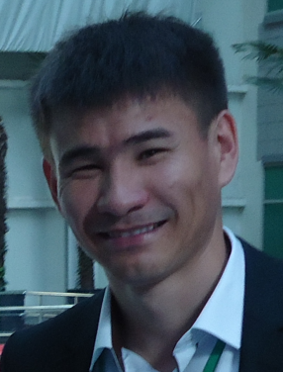
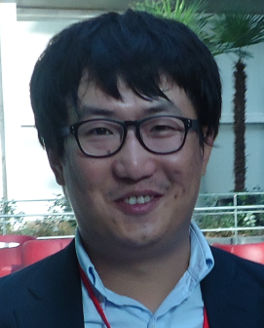
Thank you all very much.
From Kazakhstan with gratitude.
Thank you Prof. Yongguang Zhang (Hebei University of Technology) for your great effort for initiating this project.

