Slide 1
APPLICATION OF STOCKPILED BASIC OXYGEN FURNACE (BOF) SLAG IN RAILWAY BALLAST MATERIAL
by
Sakiru Olarewaju Olagunju
Supervisor: Dr. Sung-Woo Moon
Co-Supervisor: Prof Jong Kim
April 26, 2022

Slide 2
Outline
Introduction
BOF slag Characterization
BOF Slag Usage
Railway Ballast Material
Research Objectives
Hypothesis
Literature Review
Materials
Methodology
Experimental Procedure
Results & Discussion
Conclusions
References

Slide 3
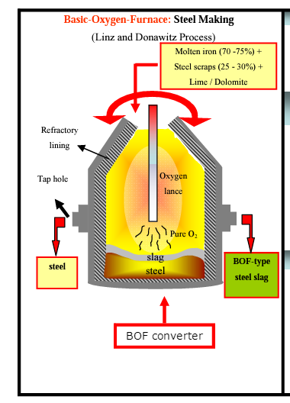
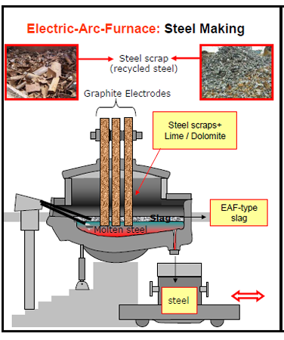
Introduction
Steel-making process:
3 main stages; steel making, refining & continuous casting (Tang et al., 2010)
Steel making - BOS & EAS
The end-product: molten metal (transformed to steel) and slag.
Figure 1. BOS steel making
Figure 2. EAS steel making
Notes:
for BOS -- Iron ore, limestone, and coal are mixed in the blast furnace. The molten iron from this process are not pure, they are further burn with oxygen to desirable pure state.
- EAS recycles steel scraps by melting them in an electric arc furnace.

Slide 4
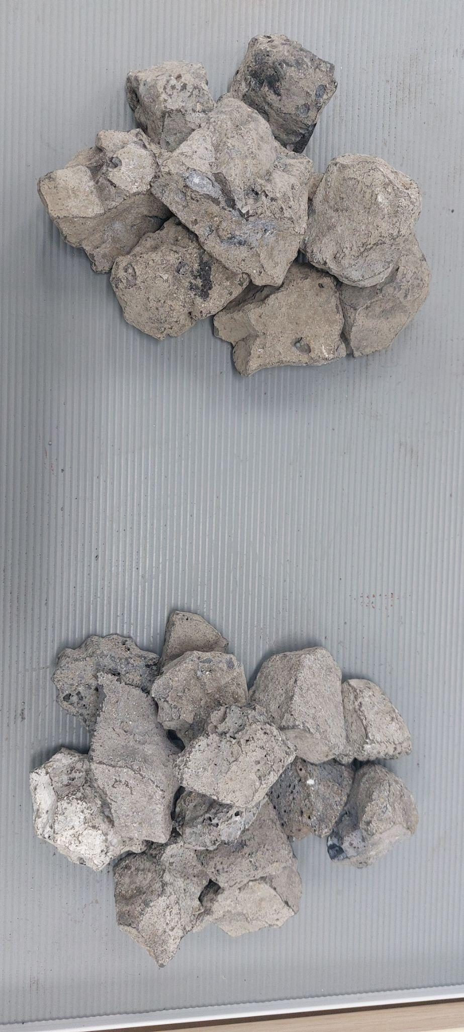
BOF Slag Characterization
The main components: 55% CaO, 15% SiO, 15% Iron & Manganese (Chen & Lin 2020)
Amount: 200-250 kg of slag produced per tone of steel (Kumar et al. 2018)
Waste material: High alkalinity and high iron oxide (Delgado et al. 2019)
Figure 3. BOF Slag

Slide 5
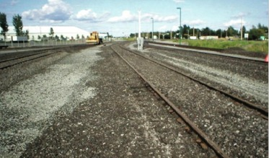
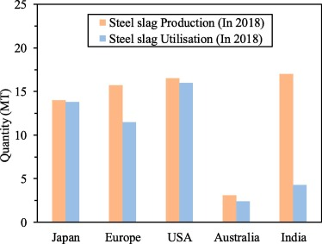
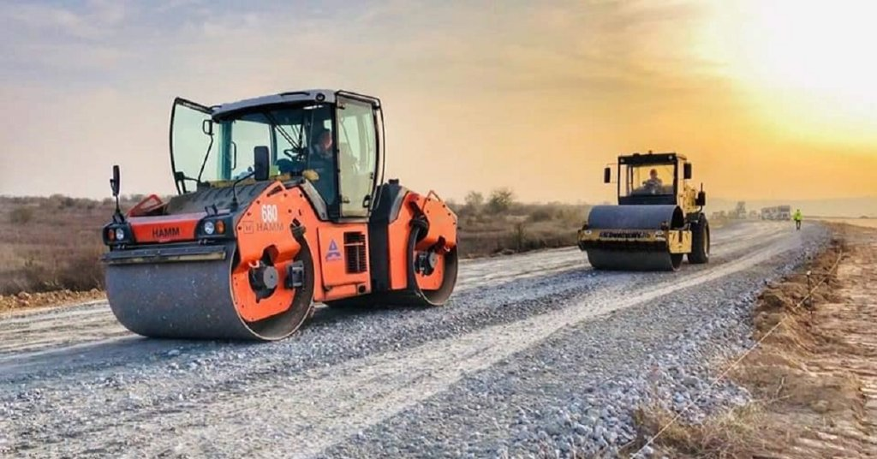
BOF Slag Usage
Railway Ballast – Brazil, Canada & USA
Soil Stabilization, Embankment
Road construction, Cement production, Landfilling, Agriculture
Figure 4. BOF Slag as RBM in Canada
Figure 6. Production & Utilization of BOF slag (Hussain & Hussaini, 2022)
Figure 5. BOF Slag for road construction
Notes:
Japan and Australia use BOF slag as a fill layer in transportation or highway engineering
Norway uses it as soil fertilizer in agriculture
In USA it has been used as RBM.
RBM?

Slide 6
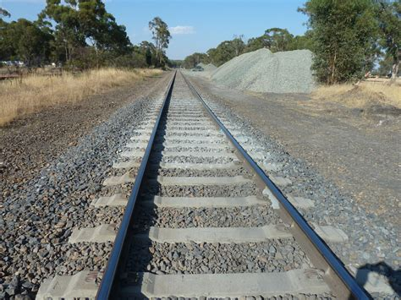
Railway Ballast Materials (RBM)
Usage: To distribute train load along the rails and sleepers to the roadbed
(Koh et.al., 2018)
Main Challenges of BOF slag as RBM:
Volumetric Expansion
Fouling
Solution:
Aging
Regular Maintenance
Figure 7. Fouled Ballast
Notes:
- The primary structural part of a rail track is the ballast. Its primary purpose is to carry distribute load to the roadbed without failure while ensuring proper drainage

Slide 7
Research Objectives
Conversion of BOF slag into valuable material in KZ
Characterization of BOF slag as RBM in KZ in terms of physical, mechanical, environmental and chemical properties.
Preparing the appropriate test methods to assess the BOF slag for railway ballast
(b)

Slide 8
Hypothesis
Undesirability of reusing fresh BOF slag in the construction industries due to volumetric expansion.
Volumetric expansion issue can be solved by naturally or artificially aging of the fresh BOF slag.
The hypothesis of this research is that stockpiled BOF slag already satisfies the railway ballast requirements according to GOST standards.
Notes:
Classifying BOF slag in term of age – Fresh and stockpiled. Stockpiled (Top and Bottom)
Fresh BOF slag – Freshly disposed off
Top BOF slag is a BOF slag that has been stockpiled for 3-4 years,
Bottom BOF slag has been stockpiled for at least ten years.

Slide 9
Literature Review
Table 1. Various Standard for RBM
Test | BS | ARTC | AREMA | AS | CN | EN | IS | GOST
LA Abrasion, % | 20 | 25 | 35 | 20 | 30 | 25 | 30 | <12
Flakiness index, % | 40 | 30 | - | - | - | - | - | <15
ACV, % | 22 | 25 | - | 25 | - | - | <25 | -
AIV, % | <22 | - | - | - | - | - | < 20 | <4
Soundness Test, % | - | - | 5 | - | 7 | - | - | <5
Freeze and thawing resistance, % | - | - | < 5 | - | < 5 | - |  | <5
Specific Gravity | - | - | - | >2.5 | >2.6 | - | - | >2.4
Nominal aggregate size, mm | - | - | 37.5-45 | 36 | - | 32-63 | - | 22.4 -63
Micro Deval, % | < 15 | - | - | - | < 9 | - | - | -
BS – British Standard; ARTC – Australian Railway Track Corporation; AREMA – American Railway Engineering Maintenance-of-Way Association; AS – Australian Standard; CN – Canadian Standard; GOST – Kazakhstani Standard; IS – Indian Standard
Notes:
General specifications for railway ballast material differ from country to country
Different guidelines for tests used to evaluate the quality of railway ballast material
Literature review was done to establish the relevant tests and requirements to Kazakhstan

Slide 10
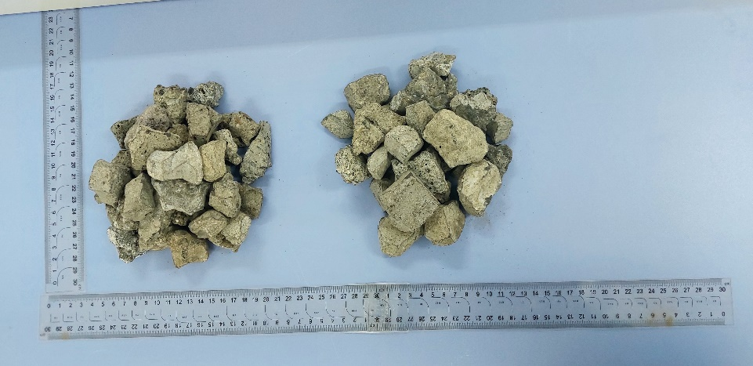
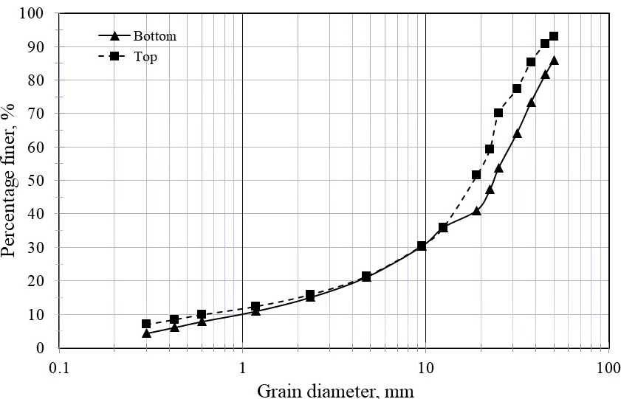
Materials
(a)
(b)
Figure 8. (a) TOP &, (b) Bottom Stockpiled BOF slag
Figure 9. Particle size distribution curve of Stockpiled BOF slag
Table 2. Chemical composition of Stockpiled BOF slag
Notes:
Top Stockpiled and Bottom stockpiled
Top - 3-4 years,
Bottom BOF slag has been stockpiled for at least ten years.
Similar physical appearances, differences can be seen in their chemical composition

Slide 11
Methodology
Sample Collection
Experimental Program/Property Investigation
Physical
Mechanical
Environmental
Chemical
Particle size distribution
LA Abrasion
Freeze and Thaw
X-ray fluorescence
Specific Gravity & Absorption Capacity
Micro Deval Abrasion
Soundness by sodium sulfate
X-ray diffraction
Flakiness Index
Aggregate Crushing Value
Organic Impurity
Scanning electron microscope
Lightweight particles
Aggregate Impact Value
Expansion test
Compatibility of Results with Standards
Figure 10. Testing Details of BOF slag assessment
Conclusion
Notes:
After review of previous research on BOF slag as shown in previous slides, samples were collected from the steel yard in the Karaganda region, Kazakhstan. The sample was analyzed for physical, mechanical, environmental, and chemical properties. The outcome of these tests was compared with the GOST standards for the properties of RBM.

Slide 12
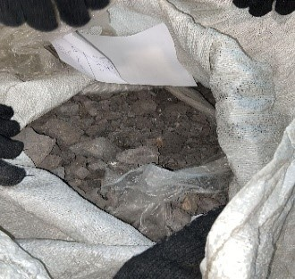
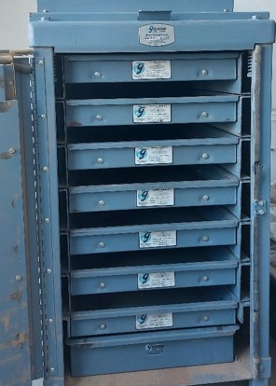
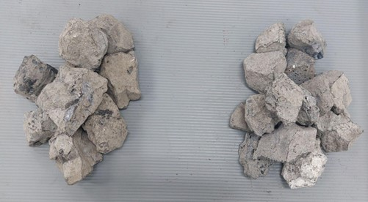

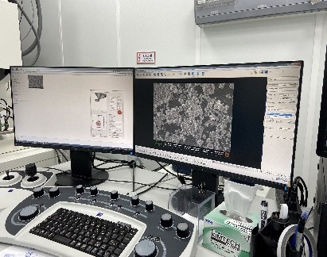
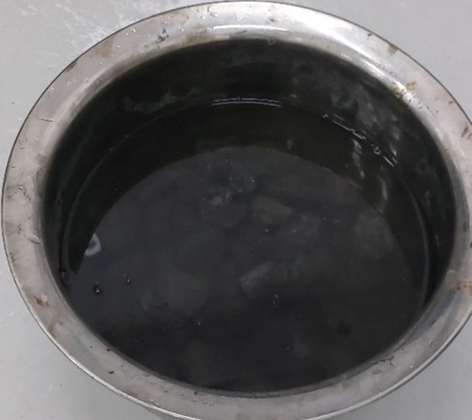
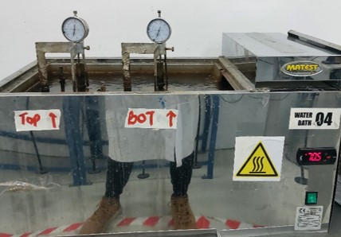
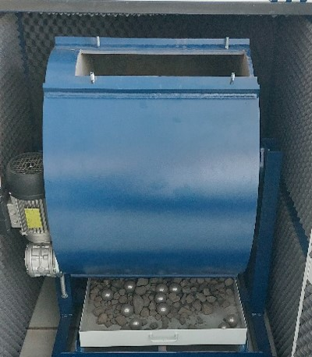
Experimental Procedure
Figure 11. Experimental Procedure

Slide 13
Results & Discussion
Table 3. Physical Properties of Stockpiled BOF slag
Test | Top, % | Bottom, % | Requirement, % | Testing method | Standard | Verdict
Specific Gravity | 3.29 | 3.25 | > 2.4 | GOST 7392-2014 | GOST | Satisfied
Absorption Capacity | 1.18 | 1.15 | < 2 % | GOST 7392-2014 | GOST | Satisfied
Flakiness Index | 9.67 | 10.12 | < 15 | GOST 7392-2014 | GOST | Satisfied
Lightweight Particles | 0.5 | 0.5 | < 3.5 | ASTM C123M-11 | AREMA | Satisfied
The stockpiled BOF slag has a low permeability.
Can offer lateral track support without becoming saturated.
Low FI, contains more of spherical/angular material.
Good interlocking ability.
No significant lightweight particles.
Notes:
- Specific gravity quantifies the density of ballast and is a crucial factor in determining its strength
Absorption capacity is the quantity of water ballast can absorb before it becomes saturated
The flakiness index is a metric that characterizes the shape of the stockpiled BOF
Lightweight aggregates are porous in nature, low in density, and have poor strength, so they are undesirable.

Slide 14
Results & Discussion
Table 4. Mechanical Properties of Stockpiled BOF slag
Test | Top, % | Bottom, % | Requirement, % | Testing Method | Standard | Verdict
LAA Abrasion | 11.7 | 11.4 | < 12 | GOST 7392-2014 | GOST | Satisfied
 | 18.7 | 17.9 | < 30 | ASTM C535-16 | AREMA
Micro Deval | 8.4 | 7.4 | < 9 | CS LS-618 | CN | Satisfied
Aggregate Crushing Value (ACV) | 19.3 | 20.5 | < 22 | BS 812-110: 1990 | BS EN | Satisfied
 |  |  | < 25 | T-205 | AS
Aggregate Impact Value (AIV) | 16.1 | 15.5 | < 22 | BS 812-112:1990 | BS EN | Satisfied
 |  |  | < 20 | IS.-2386 | IS
Low Abrasion value, can withstand significant wear and tear without getting damaged
Low degradation in wet condition (MD)
Low ACV; strong and durable
Low AIV, Exceptionally strong according to IS.
Impact of sudden loading caused minimal destruction
Notes:
Good Abrasion value because stockpiled BOF slag had a better LAA value when compared with some references (Indian ballasts, China natural aggregates) and dolomites

Slide 15
Results & Discussion
Table 5. Environmental Properties of Stockpiled BOF slag results
Test | Top, % | Bottom, % | Requirement,% | Test Method | Standard | Verdict
Freeze & Thaw | 3.9 | 4.3 | < 5 | GOST 7392-2014 | GOST | Satisfied
Soundness by Na₂SO₄ | 3.8 | 3.6 | < 5 | ASTM C88M-18 | AREMA | Satisfied
Exhibit remarkable durability against F&T
Can endure harsh climate of KZ
Low soundness mass loss, resistant to SA.
Can provide long term performance in sulphate affected area
Does not contain any organic impurities
Figure 12. Expansion behavior of stockpiled BOF slag
Satisfied the minimum 3% acceptable limit by (BS_EN, 2011) & (Japanese Industrial Standard, 2017)

Slide 16
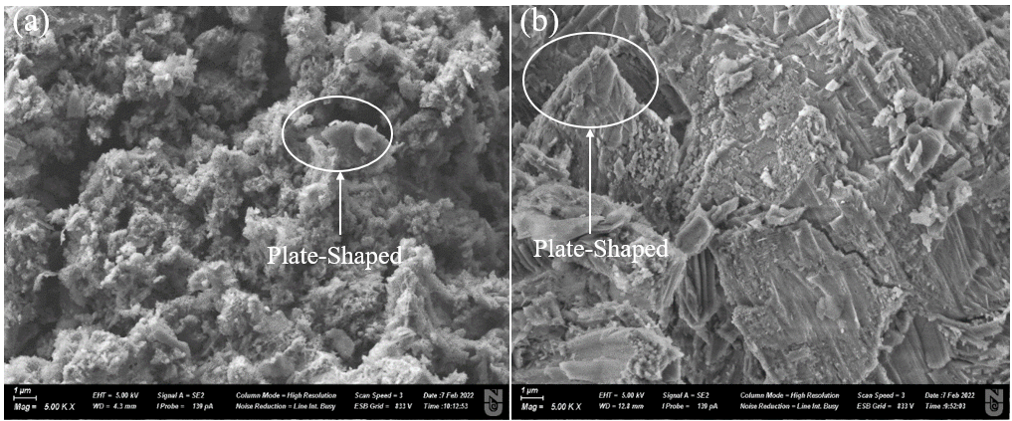
Results & Discussion
Stockpiled BOF slag has grains with a needle shape and surfaces with a plate shape.
Plate shapes are more prominent in the Bottom than Top BOF slag
Figure 13. XRD pattern Top BOF slag and Bottom stockpiled BOF slag
The most prevalent phases are Portlandite (Ca(OH)₂) and Silicon Oxide (SiO₂)
Figure 14. Stockpiled BOFS surface picture (a) Top, (b) Bottom
Notes:
The plate shape is dictated by the aging of the material that is typical for portlandite (Ca(OH)₂)
The presence of portlandite (Ca(OH)2), a product of the hydration process of free lime, indicates that a significant portion of the free lime present on the material has undergone hydration.
CaO + H2O

Slide 17
Conclusions
All the obtained results were found within limits as per the GOST requirement of railway ballast materials in Kazakhstan.
Stockpiled BOF slag will provide for proper drainage because of minimal flaky materials in the sample.
Stockpiled BOF slag aggregates were found to have good resistance against fragmentation, crushing, surface abrasion, and sudden loading.
The expansion rate is much lower than the minimum requirement of British and Japanese standard. This indicates that it is enough for stockpiled BOF slag to have natural aging processes.
Stockpiled BOF did not show vulnerability to the change in condition when subjected to freeze and thaw under sodium sulfate solution
Stockpiled BOF did not weather easily; it is ideal for usage as railway ballast in the harsh Kazakhstan climate condition.

Slide 18
References
Chen, Y.-L., & Lin, C.-T. (2020). Recycling of Basic Oxygen Furnace Slag as a Raw Material for Autoclaved Aerated Concrete Production. Sustainability, 12, 5896. doi:10.3390/su12155896
Delgado, B. G., Viana da Fonseca, A., Fortunato, E., & Maia, P. (2019). Mechanical behavior of inert steel slag ballast for heavy haul rail track: Laboratory evaluation. Transportation Geotechnics, 20, 100243. doi:https://doi.org/10.1016/j.trgeo.2019.100243
Tang, L., Guan, J., Hu, G. J. C., & Engineering, I. (2010). Steelmaking and refining coordinated scheduling problem with waiting time and transportation consideration. 58(2), 239-248.
Hussain, A., & Hussaini, S. K. K. (2022). Use of steel slag as railway ballast: A review. Transportation Geotechnics, 35, 100779. doi:https://doi.org/10.1016/j.trgeo.2022.100779
Koh, T., Moon, S.-W., Jung, H., Jeong, Y., & Pyo, S. (2018). A Feasibility Study on the Application of Basic Oxygen Furnace (BOF) Steel Slag for Railway Ballast Material. Sustainability, 10, 287. doi:10.3390/su10020287
Kumar, D. S., Sah, R., Sanyal, S., & Prasad, G. J. M. (2019). Measurement of metallic iron in steel making slags. 131, 156-161.

Slide 19
Thank you for listening!

