Slide 1
Journals Ranking based on Web of Science metrics: Impact Factor, Quartile
Open IL Session entitled Reputable vs Predatory: How to Spot the Difference? on 7 September 2022, Wednesday, 10:30AM - 12:00PM
Inesh Kenzhina, PhD,
Official representative of Clarivate in Central Asia region

Slide 2
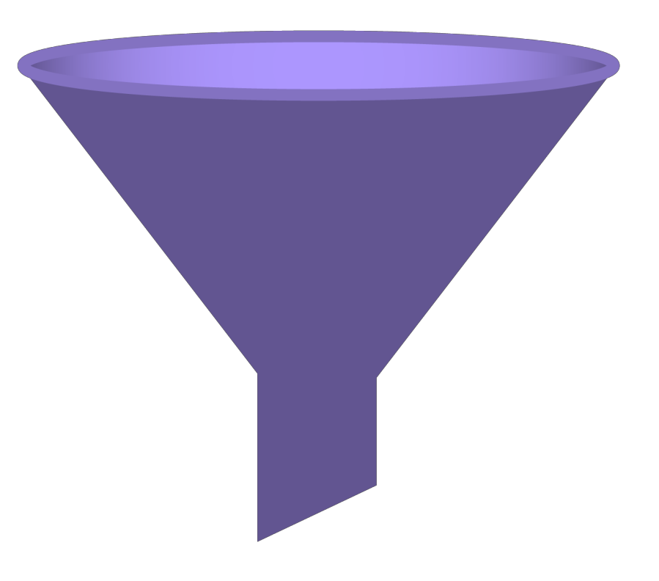
The best filter for journals
> 100 000
scientific journals in the world
*Clarivate is a publisher neutral
We have a fair and objective selection
Web of Science
Core Collection
> 21 000
selected reliable journals

Slide 3
Metrics in different databases
Quartile, impact factor, Journal Citation Reports, Science Citation Index Expanded, Social Science Citation Index, Arts and Humanities Citation Index – Web of Science Core Collection
Percentile, SJR, SNIP and others – Scopus
There is no direct correlation between the indicators in different databases

Slide 4




Web of Science Journal Citation Reports (JCR)
Make confident decisions with objective, unbiased journal statistics from publisher-neutral experts
Selectivity
Quickly find a list of the most influential journals in the sciences and social sciences. Each journal profiled in JCR has met the rigorous quality and impact standards documented in the Web of Science Core Collection editorial selection process.
Quality control
Work with credible metrics derived from accurate and complete data. Journals displaying evidence of influential self-citation and citation stacking are suppressed from Journal Citation Reports to support research integrity in scholarly publishing.
Transparency
Easily uncover the relationship between article and journal citations to better understand a journal’s role in the network of scholarly communications. Access to article data helps you follow best practices for research evaluation.
Multiple ways to define value
Evaluate journals with a multidimensional view of a journal’s impact and influence. View citation metrics alongside descriptive open access statistics and contributor information that provide a holistic picture of each journal.
© 2020 Clarivate Analytics
5

Slide 5


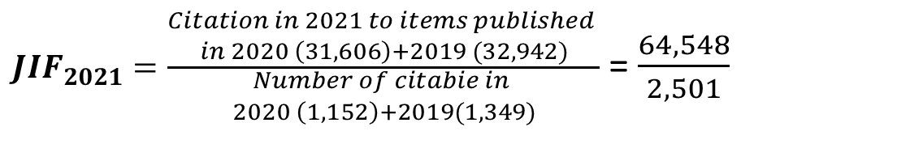
How to calculate IF?
Citable items – Article and Review
Can be checked in
Journal Citation Reports
$JIF_{2021}=\frac{\begin{aligned}Citation in 2021 to items published \\ in 2020 \left(31,606\right)+2019 (32,942)\end{aligned}}{\begin{aligned}Number of citabie in \\ 2020 \left(1,152\right)+2019(1,349)\end{aligned}}$ = $\frac{64,548}{2,501}$
N-1 (2021)
N-2 (2020)
N-3 (2019)

Slide 6
Why do we need quartiles of journals?
The rank of scientific journal
Q1 - quartile
Q2 - quartile
Q3 - quartile
Q4 - quartile
The numerical value of the impact factor of the journal is not so important
Different subject areas have different average citation levels
Important is the quartile of a journal in its subject area
This is the perfect guide to where to publish

Slide 7
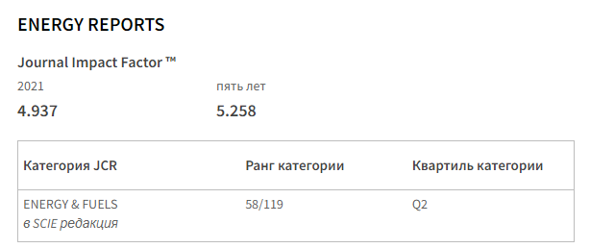
What is important in IF of journals?
The most important thing is the place among journals of one subject – it defines by quartiles (Q1, Q2, Q3, Q4)

Slide 8
Live Demonstration in Web of Science
Webofscience.com

Slide 9
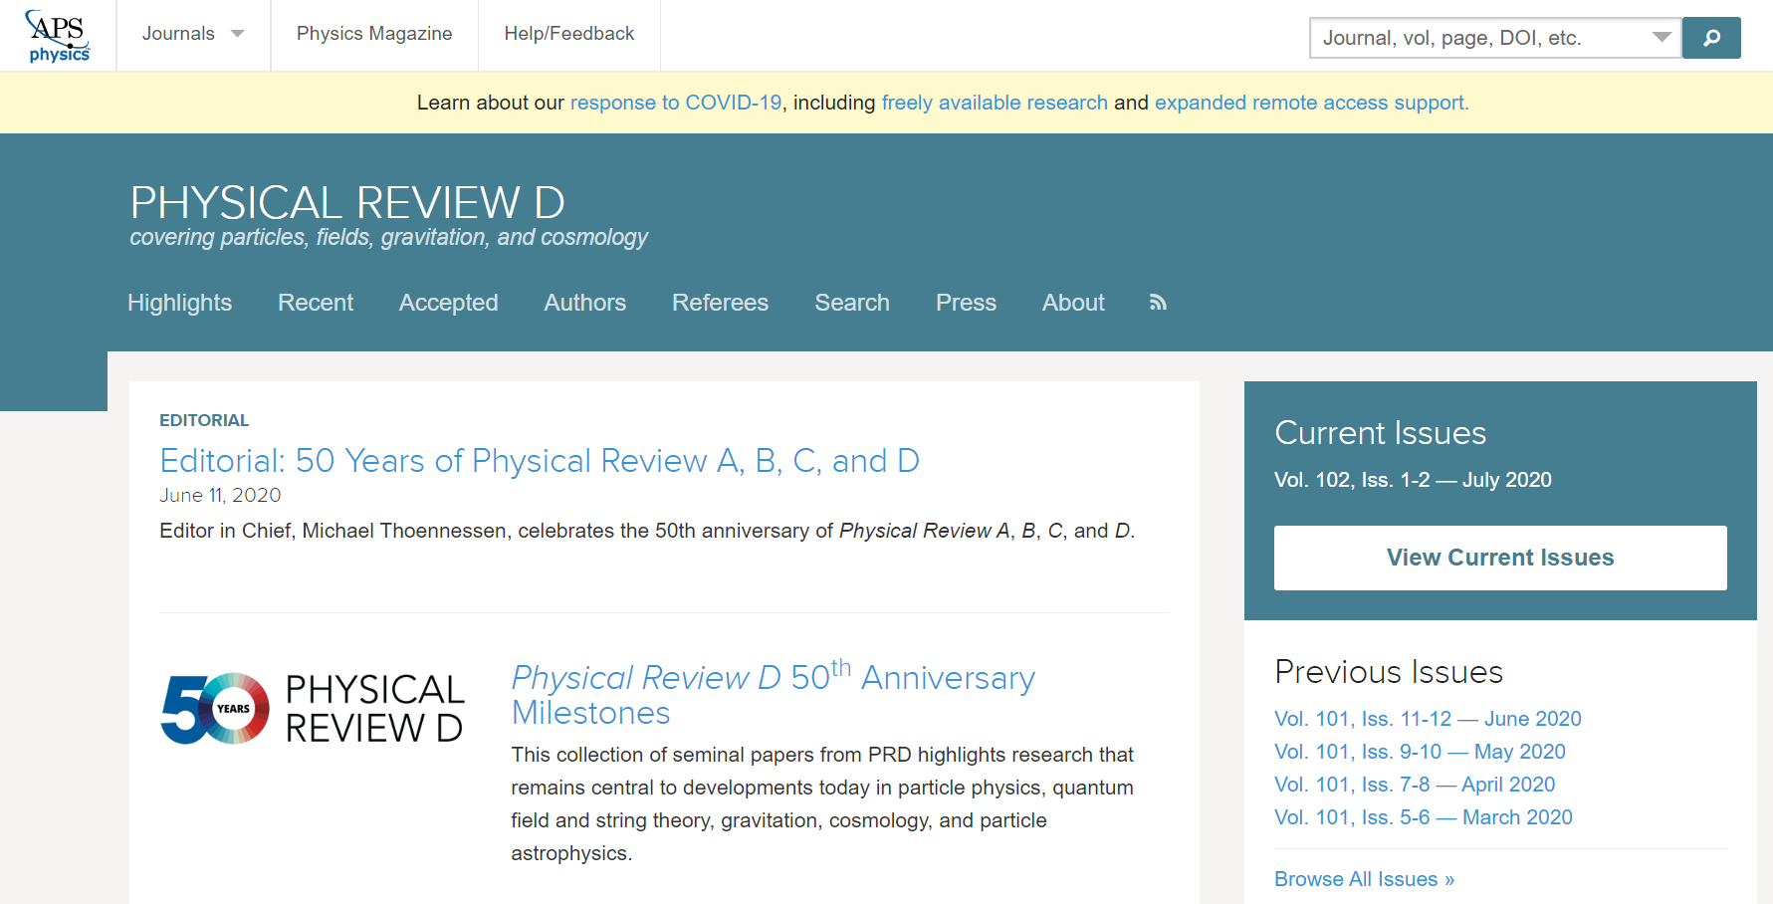
Who will know about your discovery or new scientific results?
Good reliable results – you have a chance to publish in Q1, Q2 journals

Slide 10
Useful links

Slide 11

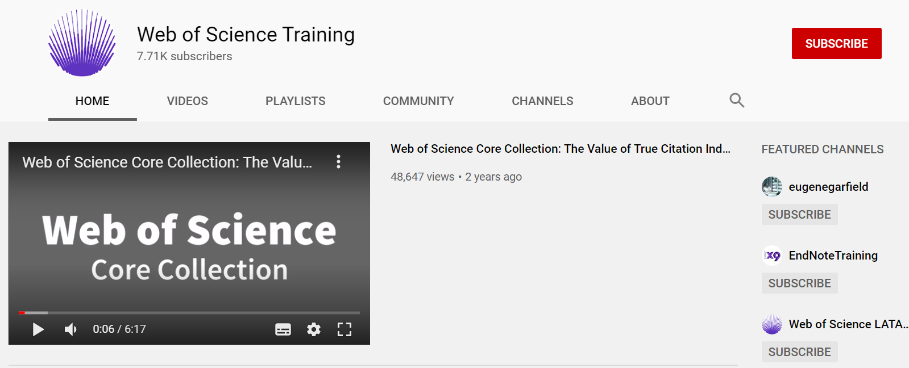

https://clarivate.com/
webofscience.com
https://jcr.clarivate.com/
https://mjl.clarivate.com/
my.endnote.com
https://www.youtube.com/user/WoSTraining
https://clarivate.libguides.com/CA?fbclid=IwAR3u9dzYAoYhXV9PUHqFcBOUFJpEf6_ubz4M3ra1euJ1SagpVn9imXACUxE

Slide 12
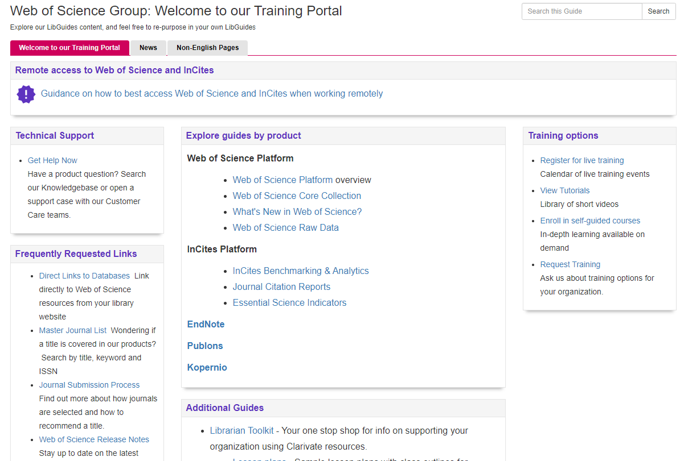
Information in English
http://clarivate.libguides.com/

Slide 13
Thank you for attention!
Inesh Kenzhina

