Slide 1
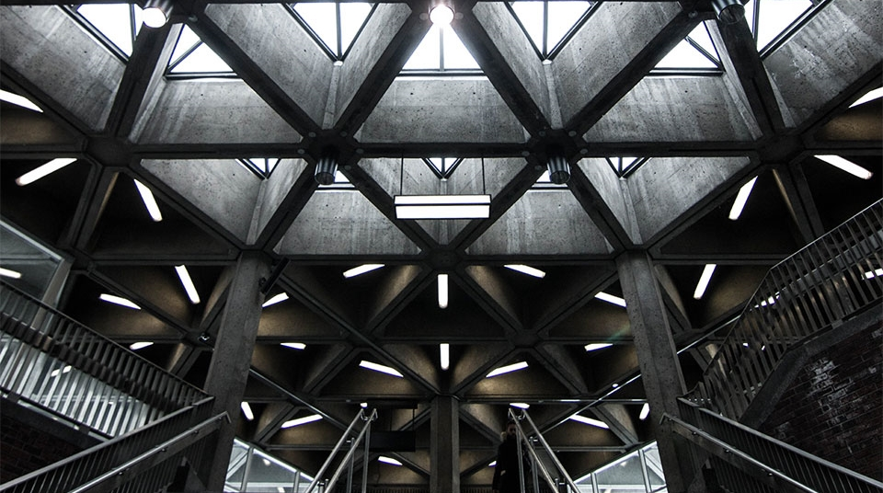
Respond of smart cities to pandemic Covid-19
Master Thesis
Mohammad Nawid Bayat
Supervisor: Prof. Ferhat Karaca
Co-Supervisor: Prof. Ali Turkyilmaz
External Examiner: Prof. Amin

Slide 2
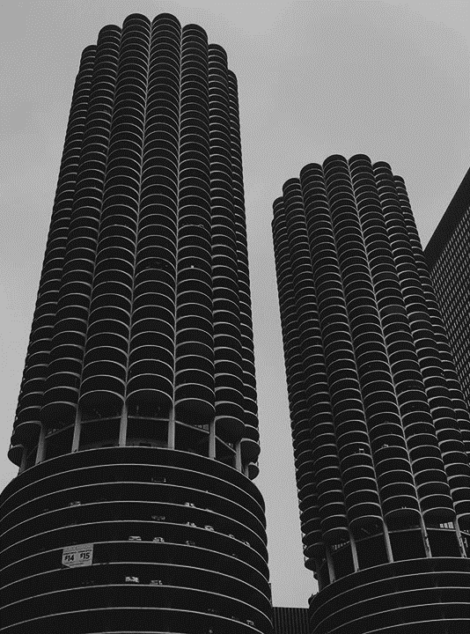
Agenda
Introduction
Objectives
ML Modeling
Results and Findings
Conclusion and Future scope

Slide 3

Introduction
Smart cities have a massive impact on the life of the citizens from different perspectives, particularly in the pandemic period
In this review, a systematic literature review addresses relevant articles on how smart cities can respond better to the pandemic .
Using ML approaches for the empirical analysis and finding out the correlation between Smartness pillars and COVID parameters and for prediction.
This includes the dimensions of 1) usability of smart technologies for better accessibility to medications (e,g, vaccines), 2) auto-detection of social distancing, facial mask, handshaking, and others, 3) and provision of education and work remotely.
Better decision making option for government

Slide 4
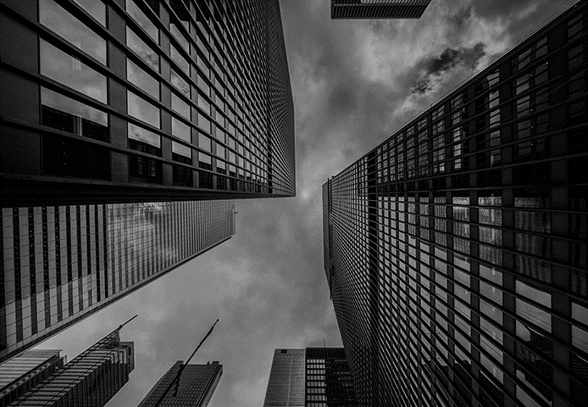

Objectives
Performing a comparative analysis on how the smartness of cities can be measured during the pandemic
Review the response of smart cities to (COVID-19)
Reviewing and analyzing smart city technologies that contribute to combating COVID-19
Using ML approaches MLP and others for the empirical analysis
They are often trained using backpropagation, a technique that adjusts the weights of the connections in order to minimize the error between the network's predictions and the actual outputs.

Slide 5
Results & Findings
No | Categories | Pandemic relevant factors
1 | Initiating smart city frameworks | Real-time data related to the infected cases provides the authorities with the accurate decision on when to take emergency actions (Quarantine time, treatments, and vaccinations) through Control Command Center and ICT features.
2 | Prediction and foresee | Through video surveillance and face recognition-based technologies, it can track the exact location of individuals without a facial mask, not maintain social distancing, identify every symptom of disease, and remind the authorities in a real-time automated system.
3 | Control and avoid the further transmission of the virus | Using ML and AI algorithms and technologies, it can predict the number of cases, casualties, lockdown periods, further actions that need to be taken to control the spread of the virus, and knowing pandemic risk factors
4 | Keep tracking the data and exact location of tainted people | Using Smart technologies and digitalized systems facilitates R&D sectors to come up with the ultimate solution for making drugs (vaccines) and treatment methods
5 | Medication (Vaccine) | Support well-being sectors for providing drugs (vaccines)
6 | Remote education accessibility, continuity of business and work | Smart Applications like Zoom, Meet, Slack, TradeX, Cypto, Binance, and others can be used for online education in schools and universities and continue trading, business, work, progression of R&D and education.
7 | Providing secure transition and transaction via digitalization and decentralization and Accelerating the cities' operations | Blockchain-based technology can provide secure and fast transactions via a P2P (peer-to-peer) system and avoid corruption using a decentralized system. Automat systems and networks via digital platforms and smart technologies, drones & robots where there is no need for individual physical contact, and there is no further spread of virus opportunities. Maintain industries and factory operations. Increase the accessibility of people to health services and treatments.
Smart Technologies
How to measure the smartness level of a city
6 pillars and 74 indicators for smartness
smart people, smart economy, smart technology, smart environment, smart administration, and smart living
Case studies of different cities
( China and Brazil)
ICT and CCC ( Control Command Center)
Digital platform, 5G, QR-code, Big data, Bluetooth, GPS, CCTV Cameras, Apps, Robots, Automated system, Smart Delivery System
Pedestrian Detection and social distancing monitoring using deep learning, IoT and AI
Information and Communication Technologies (ICT) for providing remotely education and work
Blockchian technology for providing secure transaction via p2p and transparent system through decentralization

Slide 6
ML Modeling
Multilayer Perceptron (MLP), ML
Lasso, Ridge, Random Forest Regression Models
MLPs are considered to be a fully connected multi-layer neural network, consisting of an input layer, one or more hidden layers, and an output layer
backpropagation
Each node in a MLP applies a nonlinear function to a weighted sum of its inputs, and the output of each node is passed on to the nodes in the next layer
They are often trained using backpropagation, a technique that adjusts the weights of the connections in order to minimize the error between the network's predictions and the actual outputs.
Unsupervised ML (Unlabeled data)
Classify the COVID data into 5 clusters and show why most countries have identical COVID-affected records and equivalent policies and measures intended to stop the pandemic spread.
K-means clustering algorithm
Elbow technique

Slide 7
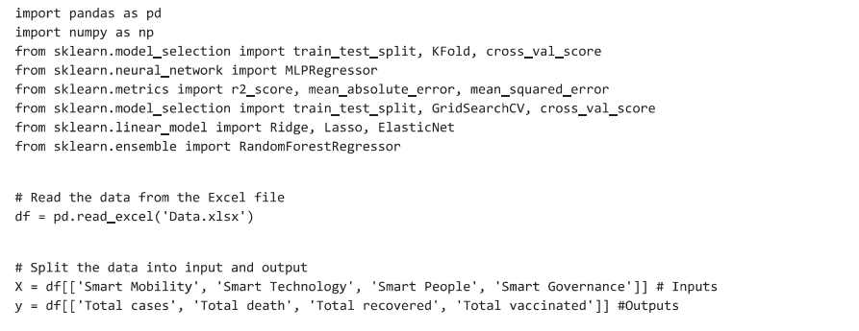
Conclusion
TIME FRAME FOR THE STUDY
SEPTEMBER 2021
Writing of the proposal
Literature review (SLR)
Methodology
analysis of the result
OCTOBER - DECEMBER 2021
Chapter 3
Designing and finalizing AIO 3 dimensional Smart city solution model
Case Studies of different cities
Chapter 4
JANUARY - APRIL 2022
Comparative Analyses of results and findings
Layout and discussion
Submission of Draft Thesis
To put it in a nutshell, based on the reviewed literature smart cities and their features do respond better to the COVID-19 pandemic than normal cities, it can provide the authorities to monitor individual’s behavior and minimize COVID-19 transmission and offer safe remote education, working and business continuity using smart technologies.

Slide 8
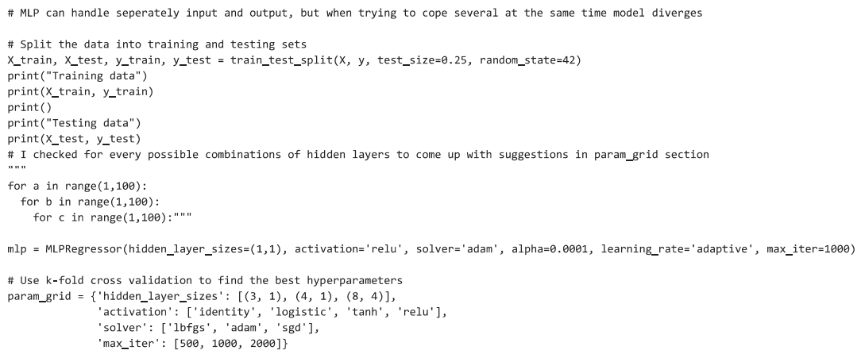
Conclusion
TIME FRAME FOR THE STUDY
SEPTEMBER 2021
Writing of the proposal
Literature review (SLR)
Methodology
analysis of the result
OCTOBER - DECEMBER 2021
Chapter 3
Designing and finalizing AIO 3 dimensional Smart city solution model
Case Studies of different cities
Chapter 4
JANUARY - APRIL 2022
Comparative Analyses of results and findings
Layout and discussion
Submission of Draft Thesis
To put it in a nutshell, based on the reviewed literature smart cities and their features do respond better to the COVID-19 pandemic than normal cities, it can provide the authorities to monitor individual’s behavior and minimize COVID-19 transmission and offer safe remote education, working and business continuity using smart technologies.

Slide 9
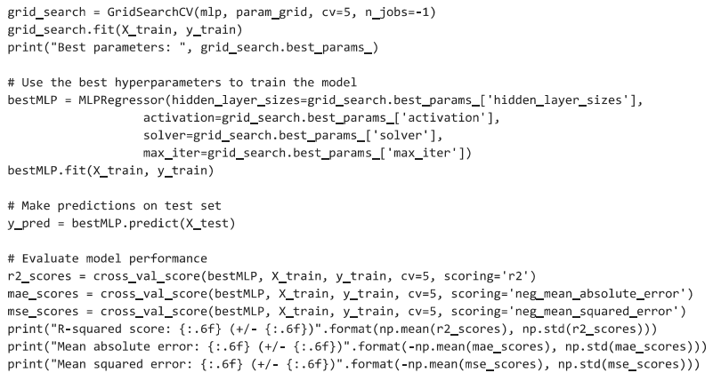
Conclusion
TIME FRAME FOR THE STUDY
SEPTEMBER 2021
Writing of the proposal
Literature review (SLR)
Methodology
analysis of the result
OCTOBER - DECEMBER 2021
Chapter 3
Designing and finalizing AIO 3 dimensional Smart city solution model
Case Studies of different cities
Chapter 4
JANUARY - APRIL 2022
Comparative Analyses of results and findings
Layout and discussion
Submission of Draft Thesis
To put it in a nutshell, based on the reviewed literature smart cities and their features do respond better to the COVID-19 pandemic than normal cities, it can provide the authorities to monitor individual’s behavior and minimize COVID-19 transmission and offer safe remote education, working and business continuity using smart technologies.

Slide 10
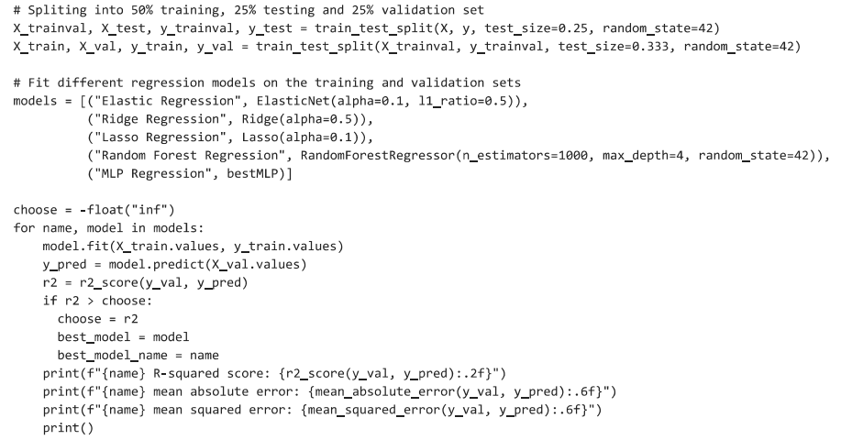

Slide 11
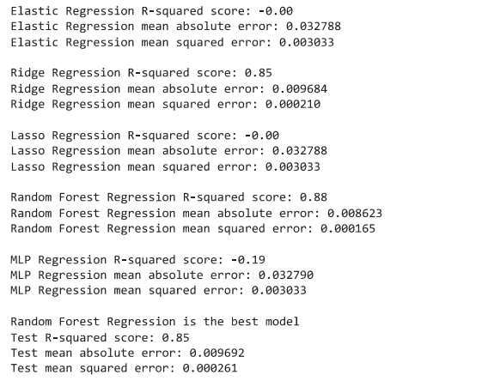

Slide 12
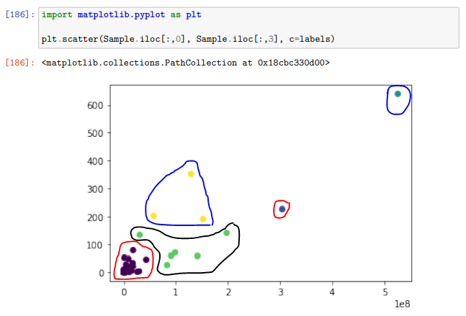
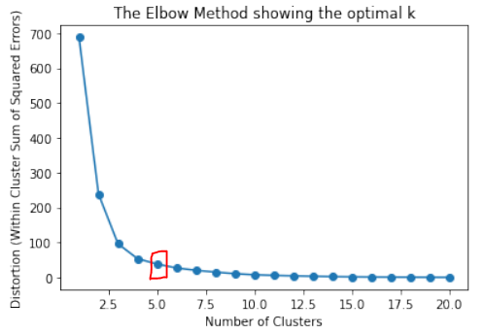
Smart City solution Model
UNSUPERVISED ML
ML fitting a model for Total cases
X = 3, 4, 8
Y = 1
Pearson Correlation = [290.20945203 11.93178272 4.01521691]
P-values = [1.14382848e-27 9.05659552e-04 4.86555069e-02]

Slide 13
ML Results
The prognostic accuracy of the Elastic Regression, Ridge Regression, Lasso Regression, Random Forest Regression, and MLP Regression models for the prediction of COVID-19 infection rates based on smart city characteristics will be assessed in this way. The Random Forest Model outperformed Ridge Regression after adjusting model parameters and hidden layers (R-squared score 0.88 and 0.85, respectively). The MAE and MSE scores obtained using the Random Forest Regression technique are 0.009692 and 0.000261, respectively.
However, The Elbow technique results in different records for each cluster, with the first cluster [0] including the most countries (171), the second and third clusters each comprising one country, the fourth cluster containing six countries, and the last cluster containing three countries. It explains why the majority of nations have comparable COVID-affected data and comparable pandemic prevention strategies and measures.

Slide 14
Results & Findings
Smart Technologies
How to measure the smartness level of a city
5 Smartness pillars
smart technology, smart environment, smart mobility, smart people, and smart governance
Smart City solutions and facilitation during the pandemic
ICT and CCC ( Control Command Center)
Digital platform, 5G, QR-code, Big data, Bluetooth, GPS, CCTV Cameras, Apps, Robots, Automated system, Smart Delivery System
Pedestrian Detection and social distancing monitoring using deep learning, IoT and AI
Information and Communication Technologies (ICT) for providing remotely education and work
Blockchian technology for providing secure transaction via p2p and transparent system through decentralization

Slide 15
Discussion
H1: smartness pillars impact the vaccination rate in all cities and provide better vaccination opportunities.
H2: COVID parameters can be impacted by Vaccination rates in terms of decreasing the number of cases and deaths and increasing recovery rates.
H3: Smartness pillars can influence COVID parameters indirectly by increasing immunization rates.
The higher the level of education and engagement of people, the higher the immunization rate will be.
According to this study, smartness pillars have an impact on vaccination rates, COVID outbreaks, fatalities, and recovery rates.
Based on findings and obtained results from models:
smart technology, smart people, smart mobility and smart governance significantly impact COVID parameters

Slide 16
Conclusion
To put it in a nutshell, based on the reviewed literature smart cities and their features do respond better to the COVID-19 pandemic than normal cities, it can provide the authorities to monitor individual’s behavior and minimize COVID-19 transmission and offer safe remote education, working and business continuity using smart technologies.
However, there are some limitations in the literature on the response of smart cities during pandemics. The associated specialist must dispatch one of their staff members to find the person and take appropriate action when they notice people in close physical contact who are not hiding their faces. It will take some time for the staff to show up because the infection spreads quickly between people. We suggest deploying robot and drone technology to detect people and take appropriate action since it will spread.

Slide 17
THANK YOU
Feel Free to ask Questions

