Slide 1
Performance Enhancements of LoRaWAN Using Machine Learning on the Edge
Author: Anuar Otynshin
Supervisor: Dimitrios Zorbas

Slide 2
Presentation Outline
Problem description
Objectives
General information
Proposed Solution
Results
Conclusion and future work
Questions

Slide 3
Problem Description
The number of IoT devices is growing
LoRaWAN is one of the most promising protocols for devices to transfer data
LoRaWAN performs poorly in saturated networks

Slide 4
Objectives
Evaluate and analyze existing literature
Identify gap in literature
Develop and implement an optimization technique
Optimize performance of LoRaWAN in saturated networks
Analyze the results and compare to the baseline approach

Slide 5

What is LoRaWAN?
Long Range Wireless Access Network (LoRaWAN)
  Low Power, Wide Area (LPWA) networking protocol for Internet of Things
How it works? (Class A LoRaWAN)
  Send a signal
  Wait for downlink transmission during 2 receiving windows
Confirmed traffic
  Wait for ACK signal
  If no gateway sends an ACK, retransmit data
  Max number of retransmissions can be configured

Slide 6
Why LoRaWAN?
Open source
Low power consumption
Up to several years of operation
Long range communication
Many kilometers wide communication
Security
Encrypted end-to-end communication

Slide 7
Literature Review
Research Focus
Methodology
Practical
Theoretical
Mathematical Model
Simulations
Real-world testing

Slide 8
Literature Review
Little research on optimizing the application layer parameters
Machine learning approach

Slide 9
Machine Learning Approach
Learn the network behavior
1
Identify any patterns of packet collision
2
Retransmit the packets taking the pattern into account
3

Slide 10
Reinforcement Learning and SARSA
Machine learning technique to increase reward
Requires no pre-trained models
Learn behavior by interacting with environment

Slide 11
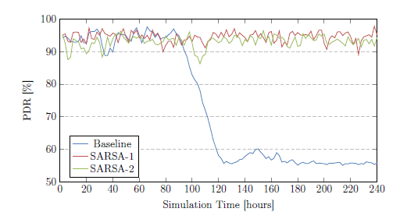
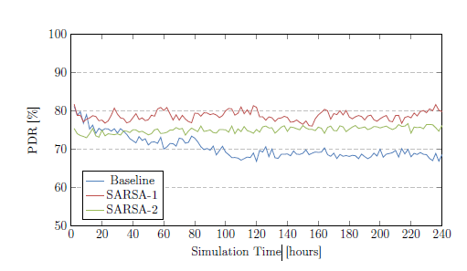
Results

Slide 12
Conclusion and Future work
SARSA-1 and SARSA-2 algorithms improve the performance of the network when compared to the typical LoRaWAN periodic application
Future work
  Influence of α, γ, ε
  Influence of unconfirmed traffic
  Mobile devices

Slide 13

Questions?

