Slide 1

University
Libraries:
Symbols of Innovation
Dr Loretta O’Donnell
Vice Provost, Academic Affairs
June, 2016

Slide 2

Trinity College Dublin Library

Slide 3

University of Zurich
Law Library

Slide 4

University of Berlin
Philological Library

Slide 5
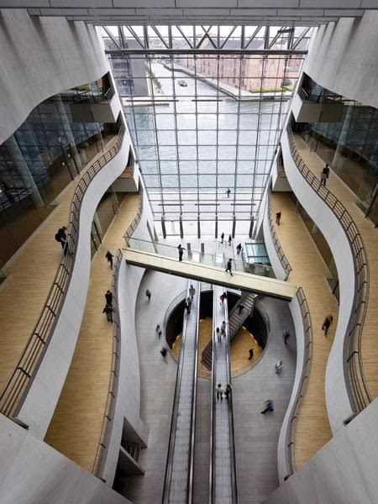
University of Copenhagen
Royal Library

Slide 6

University of Aberdeen
Sir Duncan Rice Library

Slide 7
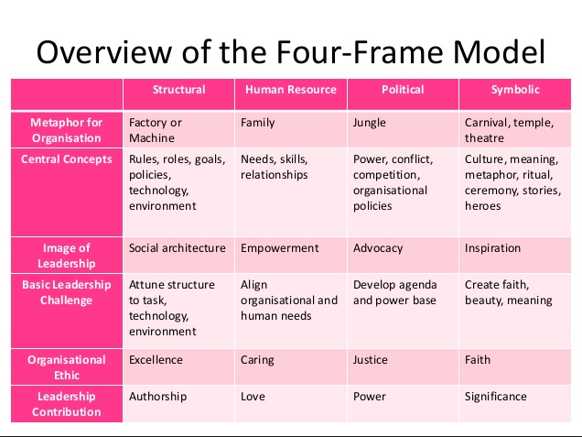
Bolman and Deal (1997)

Slide 8
Innovation
“…significant positive change”
Scott Berkun, cited in Bartlett (2016)

Slide 9
Your mission…
If libraries are symbols
Then they should create a culture of innovation
Bartlett (2016)
  Role models of creative thinking
  Entrepreneurship and experimentation are rewarded

Slide 10

Be the change…

Slide 11
References
https://www.timeshighereducation.com/five-of-the-most-striking-university-libraries-you-will-ever-see/2012248.article Accessed 23 May 2015
Bartlett, Jennifer A., "Just Give ‘Em Something New? How We Think about Innovation in Libraries" (2016). Library Faculty and Staff Publications. Paper 270. http://uknowledge.uky.edu/libraries_facpub/270
Bolman, L. G., & Deal, T. E. (1997). Reframing organizations: Artistry, choice and leadership (2nd edition). San Francisco: Jossey-Bass.
Evener, Julie. 2015. Innovation in the library: how to engage employees, cultivate creativity, and create buy-in for new ideas." College & Undergraduate Libraries 22, no. 3/4: 296-311

