Slide 1
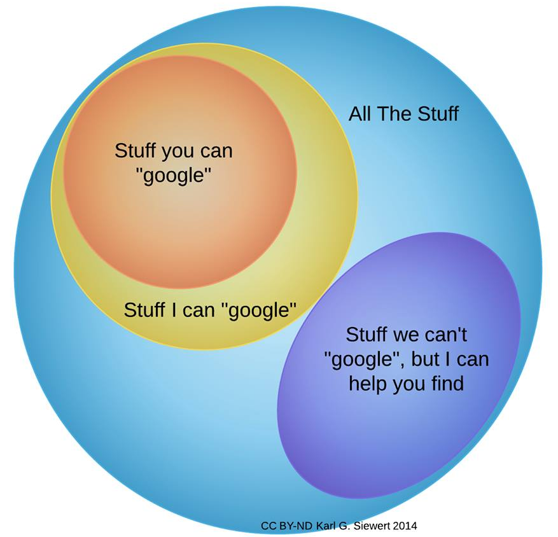
Reference Department
Kamilya Assylbekova
kamilya.assylbekova@nu.edu.kz
http://library.nu.edu.kz

Slide 2
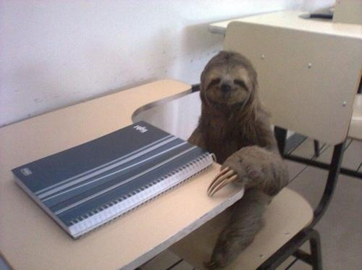
Library Sessions
The reference department offers sessions each semester for both students and faculty to support their research!

Slide 3
What Kinds of Sessions
Introduction to the Library
Citation Management Software
Advanced Google Searching
Evaluating Online Resources
Research Impact Metrics
Sessions on specific resources (ie. Web of Science)

Slide 4
When Are Sessions Offered?
September - December and February - April.
Afternoons, Monday-Thursday
3rd floor of the library, in English, can accommodate up to 8 people.
Weeks 1, 2, and 4 for students. Week 3 for faculty.

Slide 5
How Do the Sessions Work?
Faculty, staff, and students are emailed once a month, or more, to let them know about our session offerings.
Session calendar – listing staff and participants.
Revise based on staff discussions, as well as session numbers.
Lots of trial and error!

Slide 6
Trainings for local librarians
June Forum - Ref. Dept. staff has its practical sessions on the 2d day
School of Library Technologies (SLT)
Modern Trends in Cataloging
Innovative Tools of Reference Services
First training - October 20
Planned to have trainings every month
Upcoming trainings:
February 19-20 - SLT for cataloging
March 3-4 - SLT for medical librarians
March 18-19 - Joint conference with ENU

Slide 7
Periodicals
Newspapers, magazines, professional journals
Kazakh, English and Russian
Growing collection of more locally-based journals

Slide 8
Media
DVDs
  Faculty Requests
  Award Winners
CDs
  Titles recommended by the Music Library Association of America
Audiobooks
  Current print collection
  Bestsellers/starred reviews

Slide 9
Online Help
Ask-A-Librarian
  Questions accepted 24/7
  Checked each weekday morning, occasional Saturdays
Chat
  Questions accepted while a reference librarian is at the desk

Slide 10



Inter-Library Loan (ILL)

Slide 11
 | Delivered | CLS/NURIS | SHSS | SST | GSE
2013 | 229 | 86 | 10 | 98 | 3
2014 | 401 | 87 | 130 | 90 | 40
 | Cost Via ILL | Original Cost | Unavailable
Fall 2014 | 3702 | 7598 | 52

Slide 12
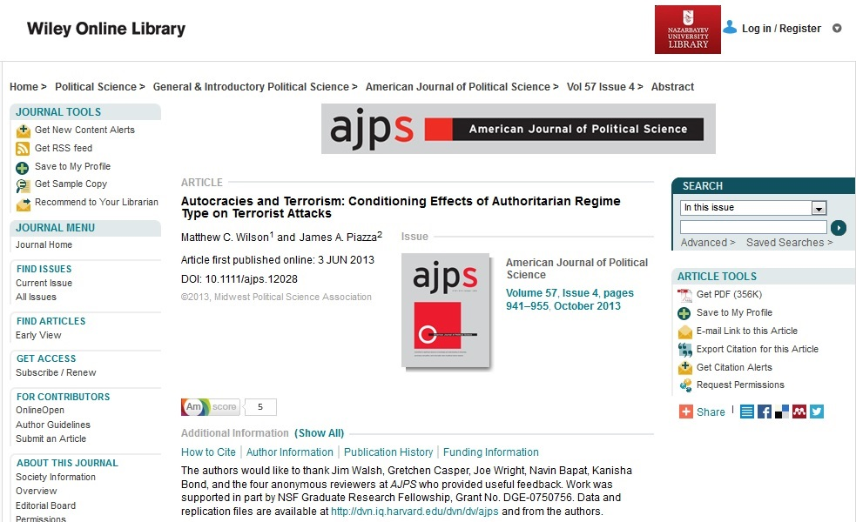

Slide 13
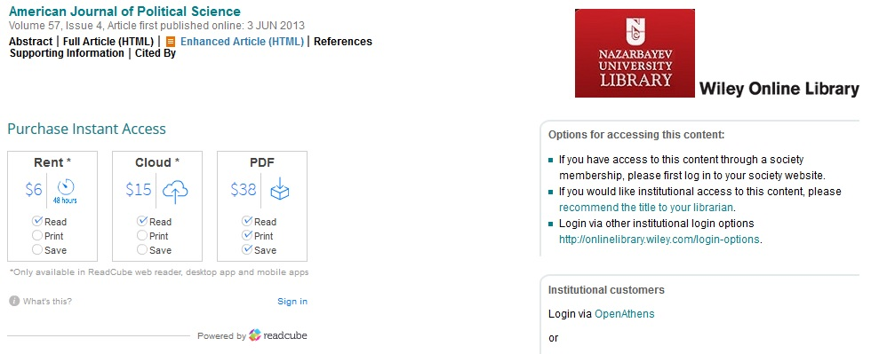

Slide 14
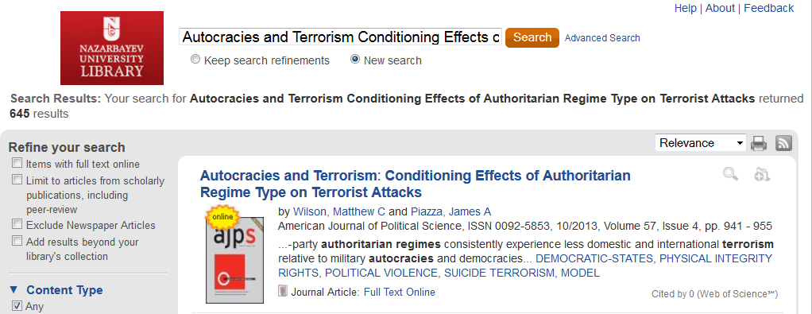

Slide 15
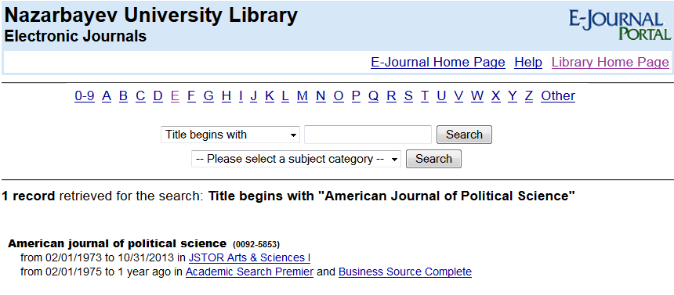

Slide 16
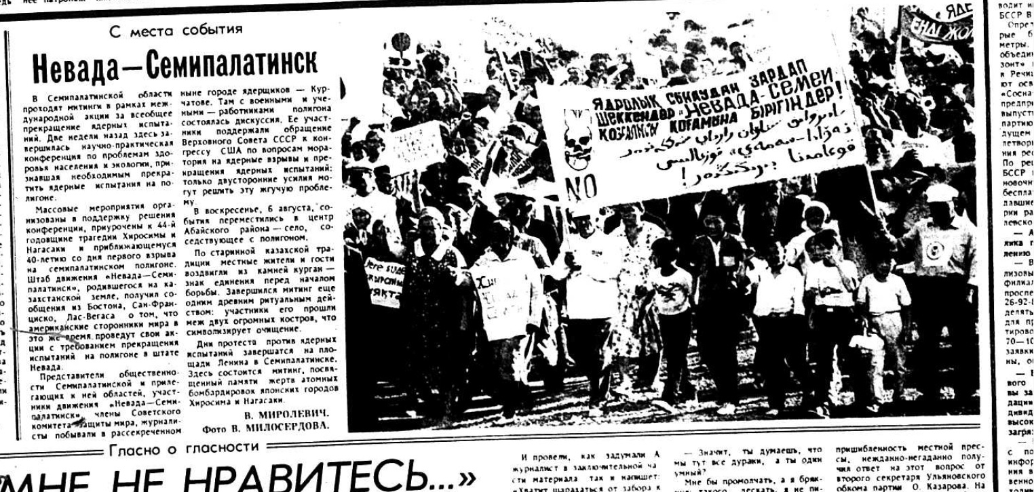

Slide 17
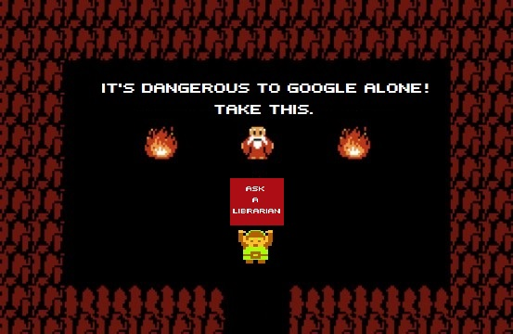

Slide 18
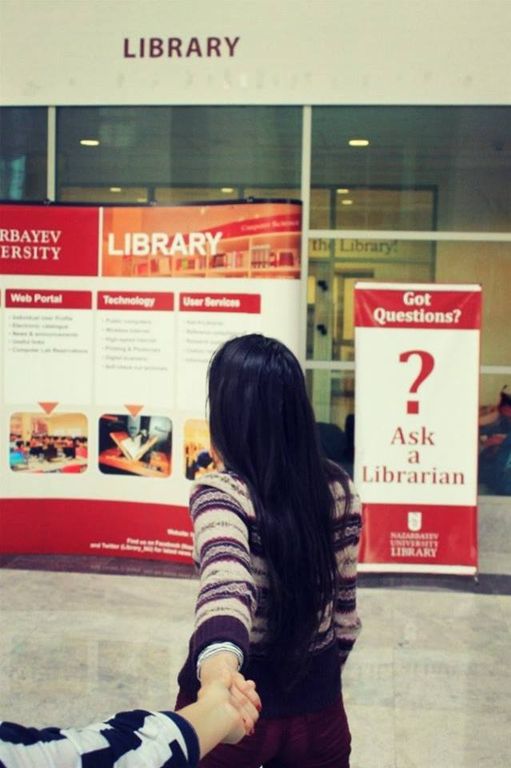


Outreach

Slide 19

What is the NU Institutional Repository?
An online open access archive of the research output of NU.
Open Access is the free access by any user worldwide to all documents available in the Repository.

Slide 20
Why Open Access?
Open Access benefits everyone by:
supporting the goals and values of universities to advance and share knowledge.
accelerating the pace of research.
opening up possibilities beyond the academic community.

Slide 21
How Open Access Benefits NU
NU is now among the 350 universities and research institutions worldwide that have joined the OA movement.
Studies show that broader access to publications leads to increased citations and impact.
Increased visibility of research and activities raises NU’s profile and international ranking.

Slide 22
Who Can Contribute to the Repository?
Faculty members and all employees of NU who have an academic degree of Master or higher can upload their scholarly publications to the Repository.
Scholarly Publications include: academic articles, reports, programs of lectures and courses, theses, books, conference proceedings, and any related digital and interactive multimedia materials.

Slide 23


E-resources coordination
Databases
E-books
E-journals
Tools and others

Slide 24

Manage requests
Organizing trial access
Review and analysis of usage statistics during trial
Overlap analysis
Price proposals

Slide 25
Decision
  “How much urgent and crucial is the resource”
  “How much financial resources library have”
Active interaction with Gulnar
Initiate purchase/subscription process

Slide 26

Once resource is subscribed...
Register resource
Check access on-campus/off campus
Add to Summon search (Update ClientCenter)
Translate and publish on the web-site and announce

Slide 27
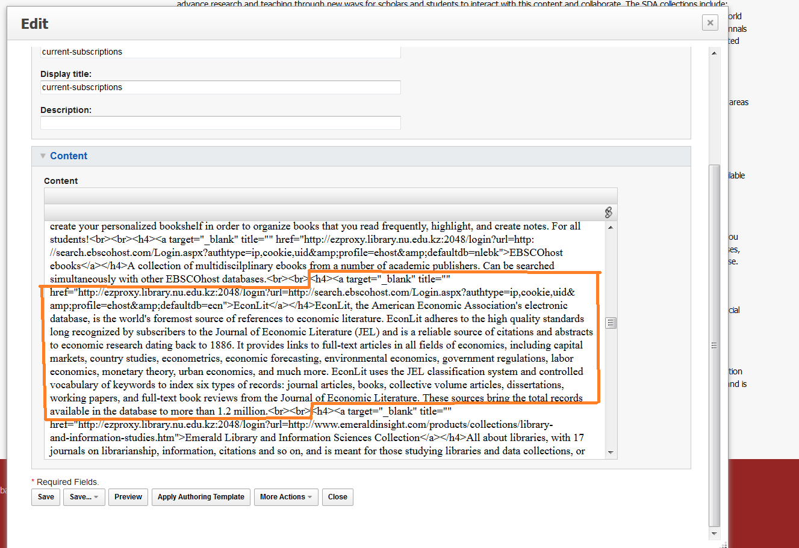

Slide 28
<h4><a target=”_blank” href=””>[RESOURCE NAME]</a></h4>
[RESOURCE DESCRIPTION]
<br><br>

Slide 29
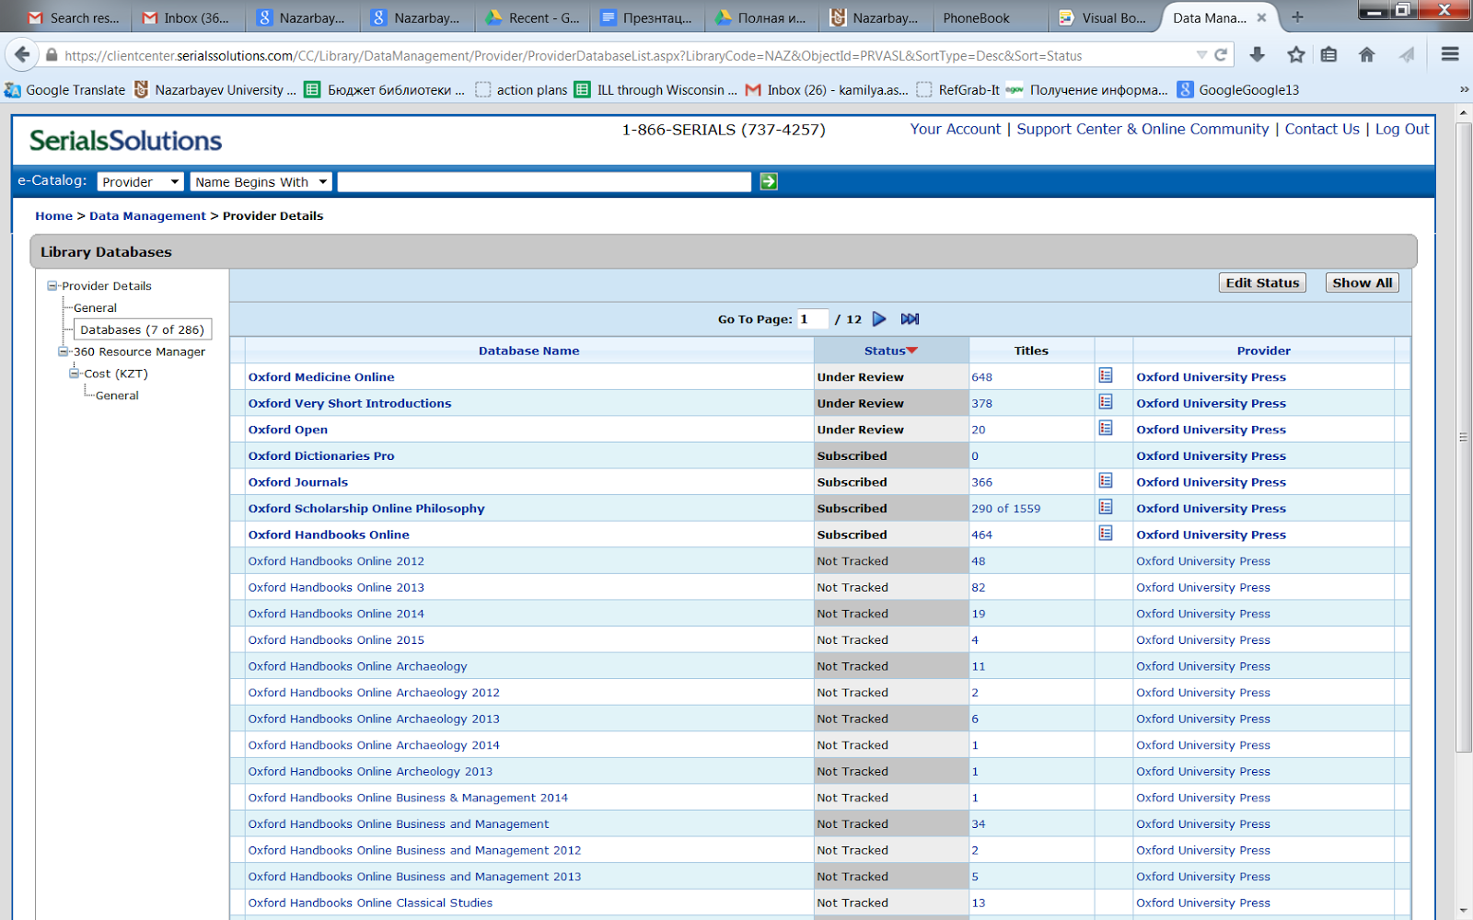

Slide 31
Usage statistics...
COUNTER standard
JR1 - BR2
Full-text download

Slide 32
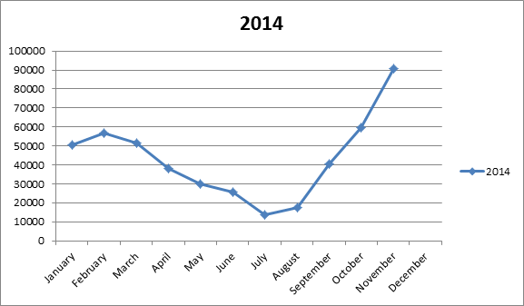

Slide 33
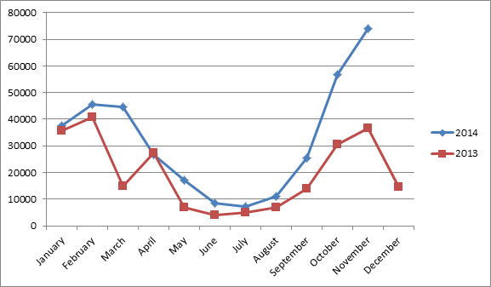

Slide 34
Vision in 5 years
Outstanding support of learning and teaching process in NU through all possible channels:
  online
  personal consultations
  trainings
Support of research (More active collaboration with Research offices, CLS, NURIS)
Professional education center for NU members and Kazakhstani librarians
High authority of library and librarians in academic community
Well identified Reference Desk

