Slide 1
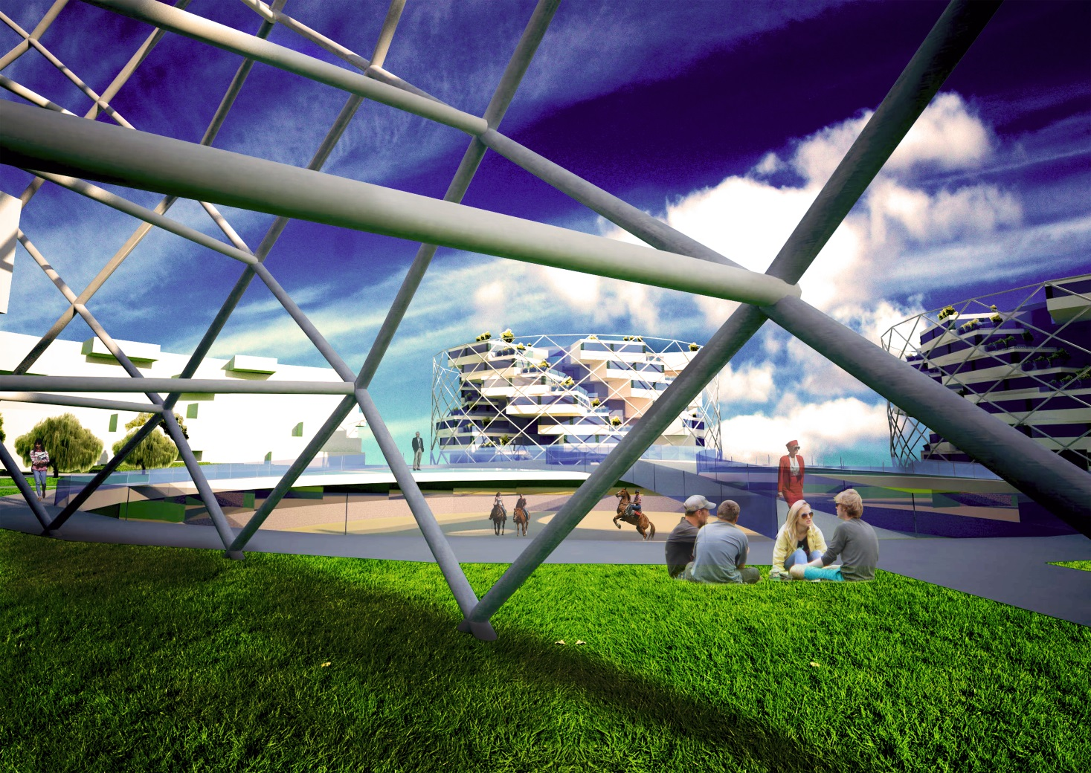

WHY YURT?

Slide 2
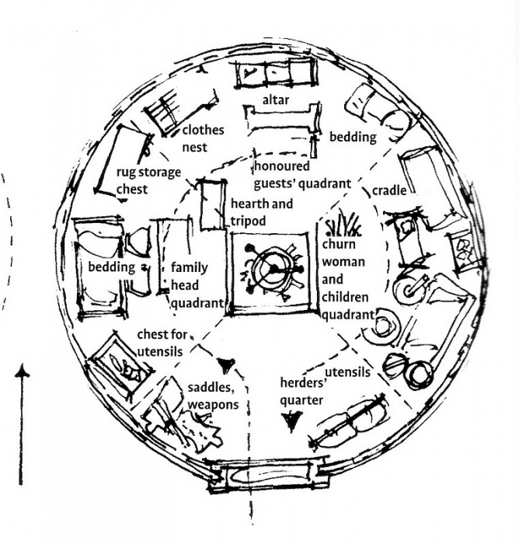
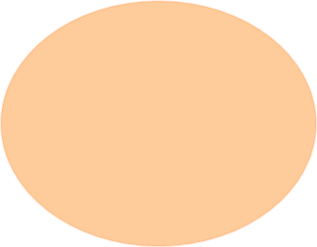
INSPIRATIONS – DAY LIFE IN YURT
The centre of social activities is in the middle of yurt – it´s „kitchen“
The area around this centre is used as living room and bedroom

Slide 3

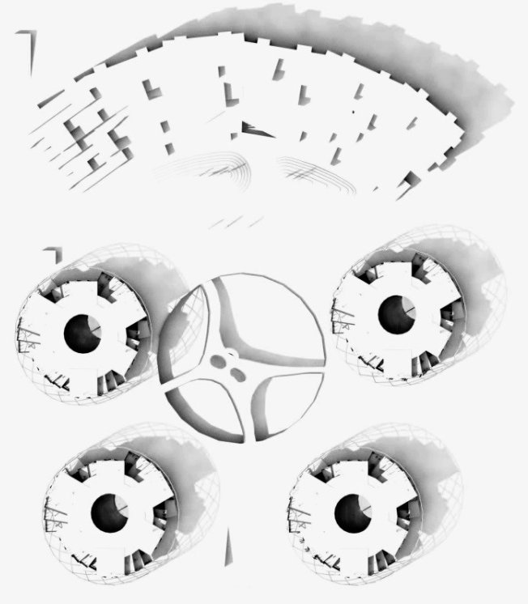
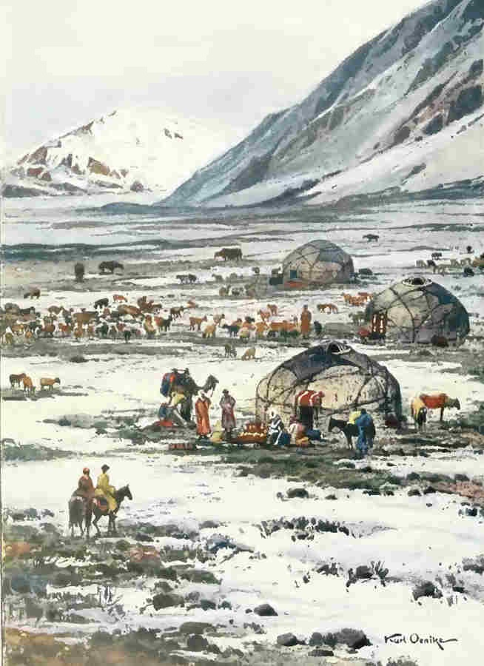


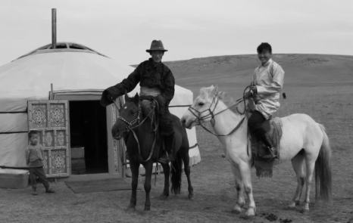
YURT IN URBAN DESIGN
Circle floorplan
Every day life with horses
Mountains as protection before cold wind

Slide 4
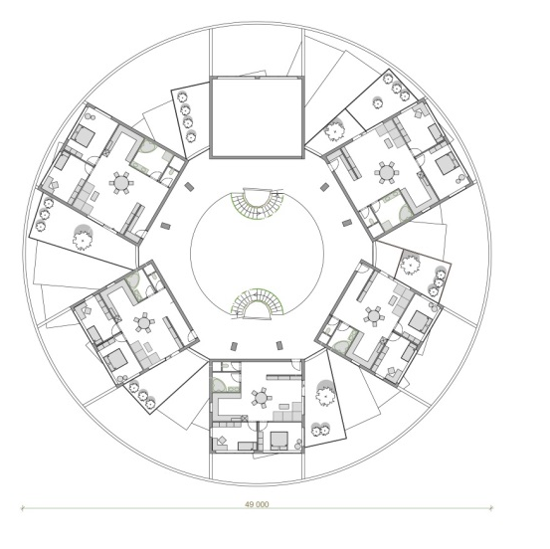
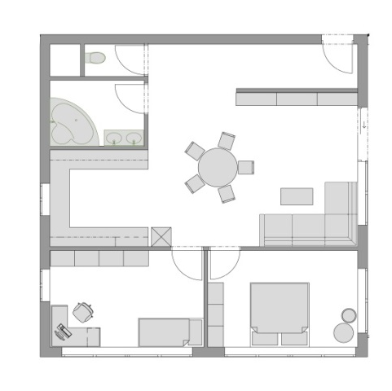
YURT IN FLOOR PLAN
Circle floorplan of all the building
Circle in floorplan of the flat

Slide 5
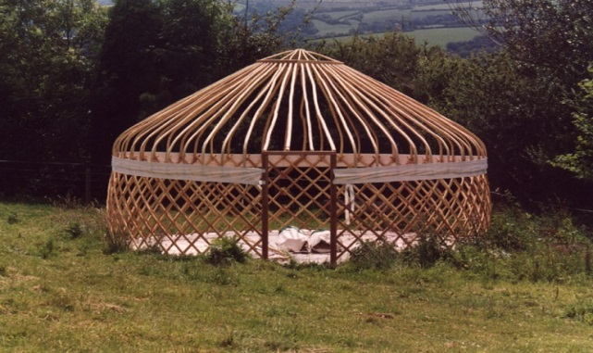
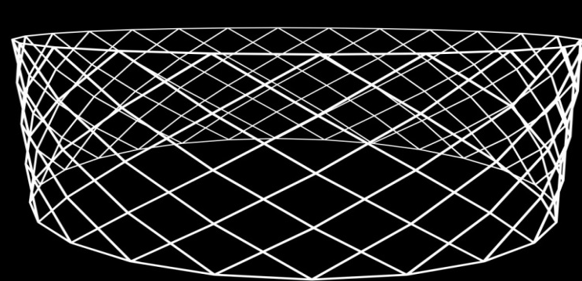
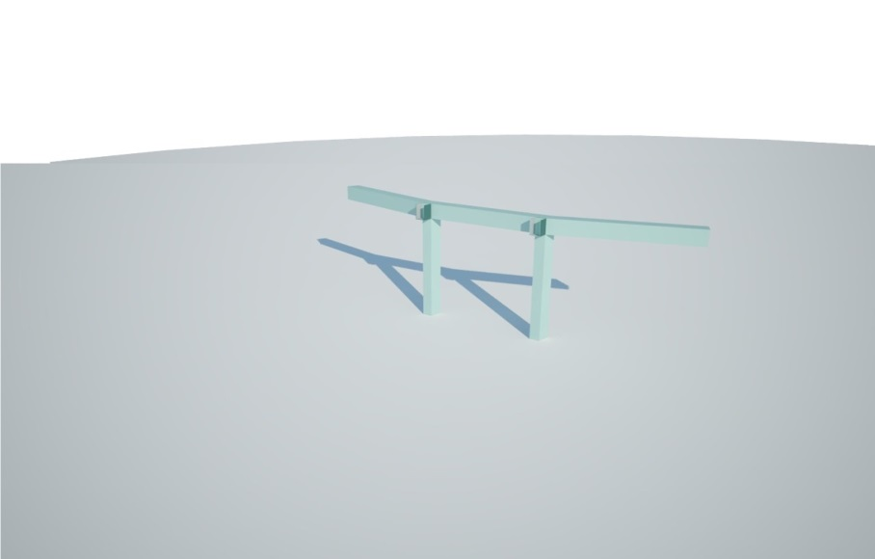
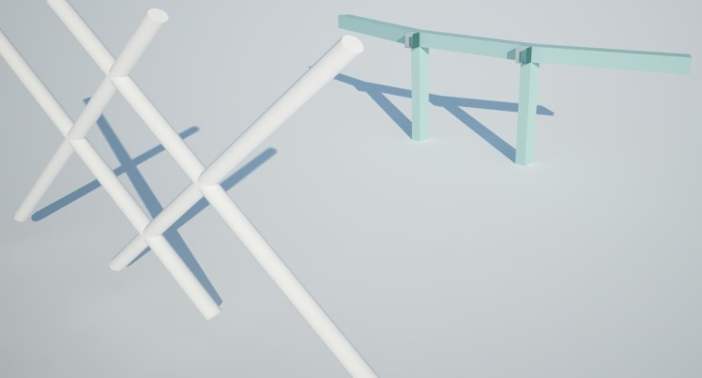
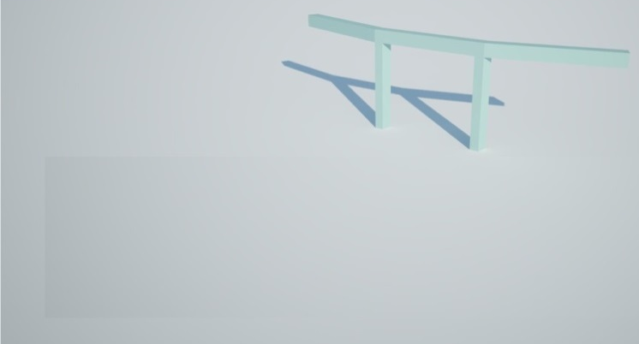
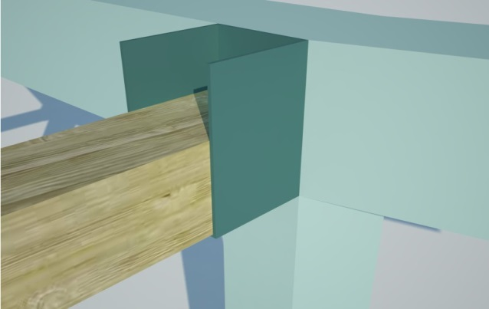
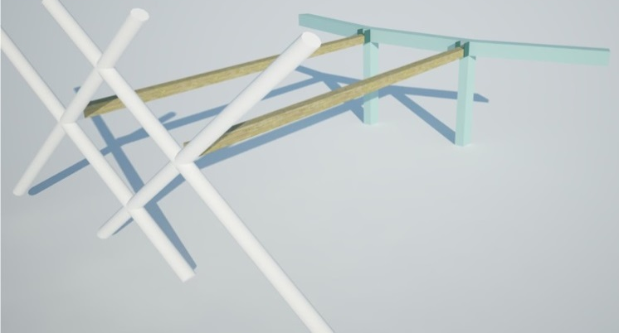
CONSTRUCTION SYSTEM
Indoor bearing construction
Link – beam to column
External „yurt“ construction
Wooden beam

Slide 6
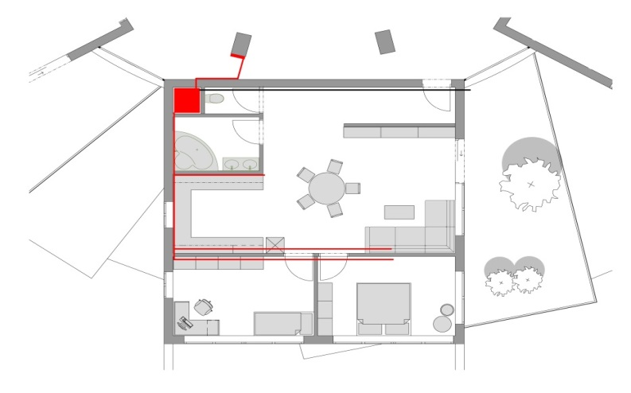
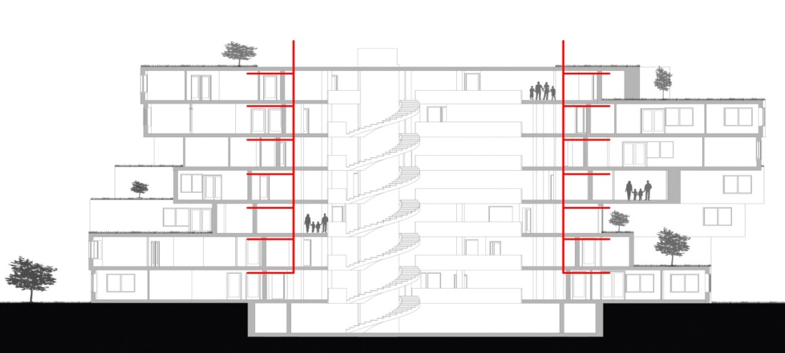
ECOLOGICAL CONCEPT
Recuperation and ventilation system - private recuperation unit in every flat
Absorption of fresh air
Hot fresh air is distributed to rooms
Conduct away polluted air

Slide 7
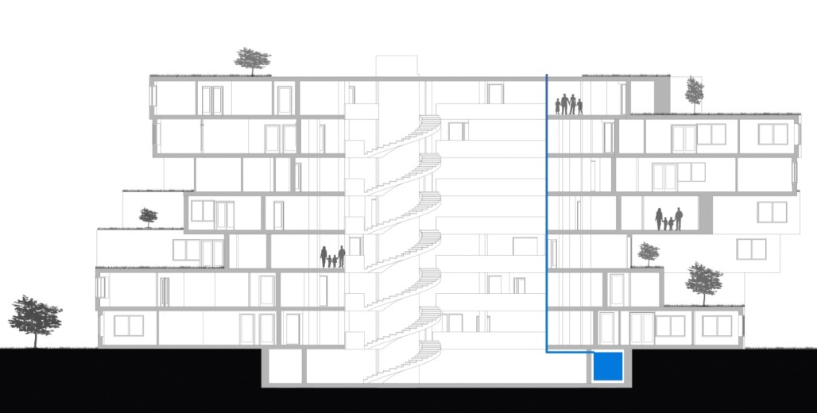
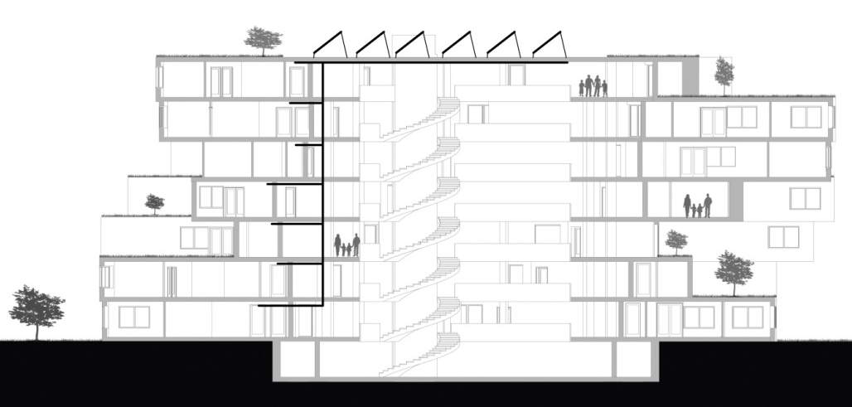
ECOLOGICAL CONCEPT
Photovoltaic panels on the top of building for heating and electricity
Accumulate of rain wather from roofs to barrels in the basement

Slide 8
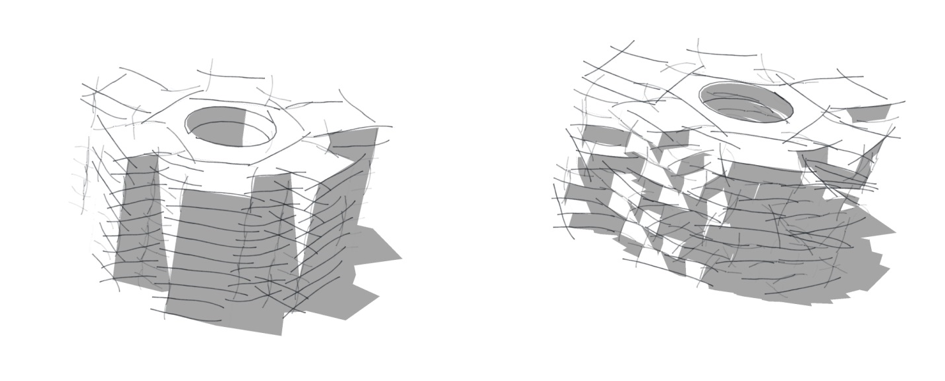
GREEN CONCEPT
Rotation of every floor, creates green teracce for every flat

Slide 9
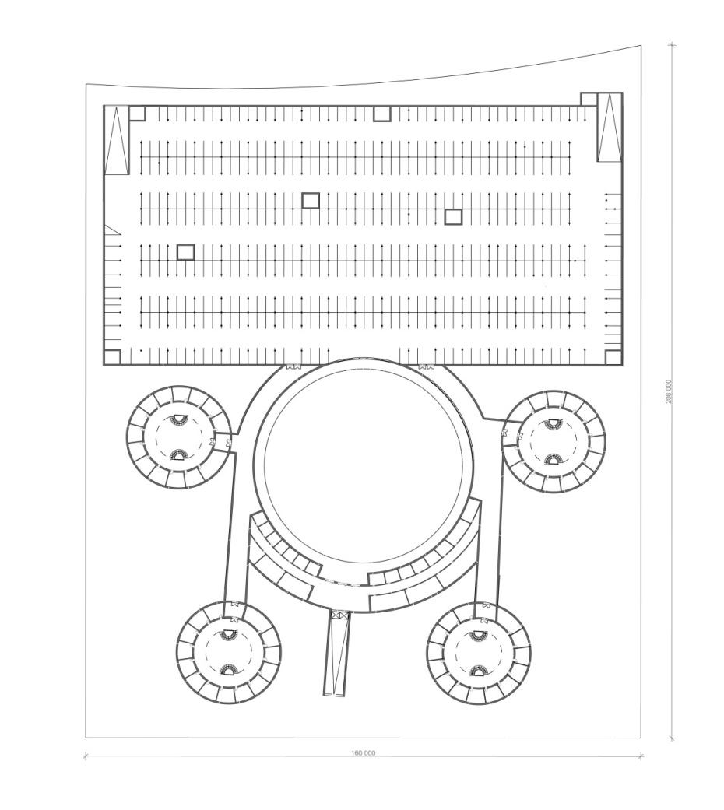
BASEMENT SYSTEM
The basement of „yurts“
Hippodrome and stables
The basement car parking

Slide 10
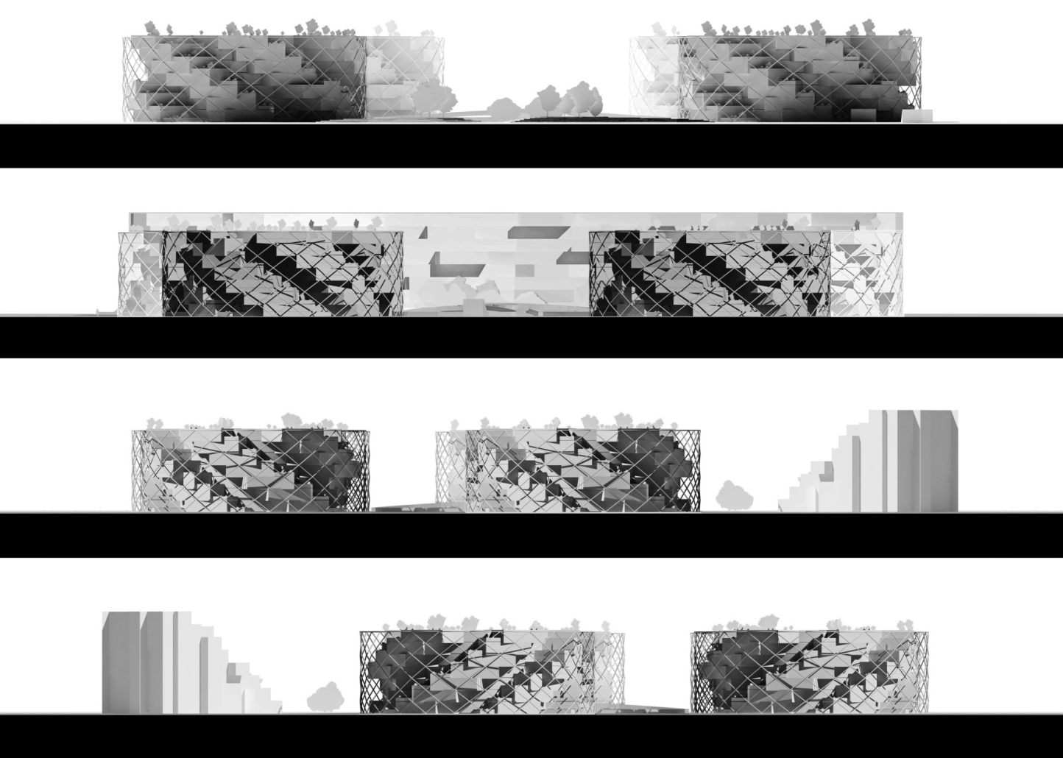
VIEWS

Slide 11
THANK YOU FOR YOUR ATTENTION!

