Slide 1
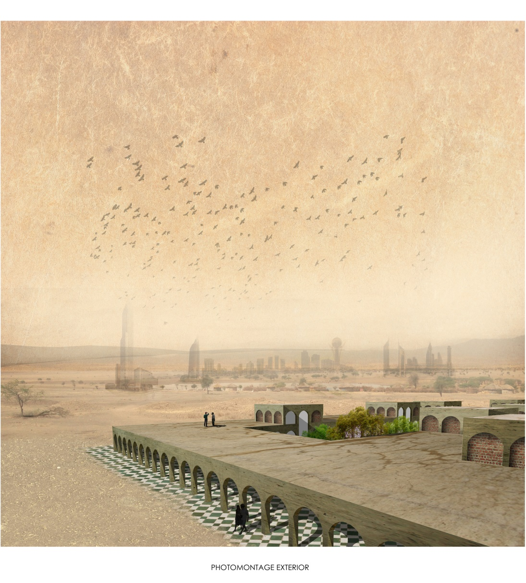

Belgium - 1st Prize _ University of Hasselt
Philippe Breels - Robbe De Geyndt - Nathalie Kavse

Slide 2
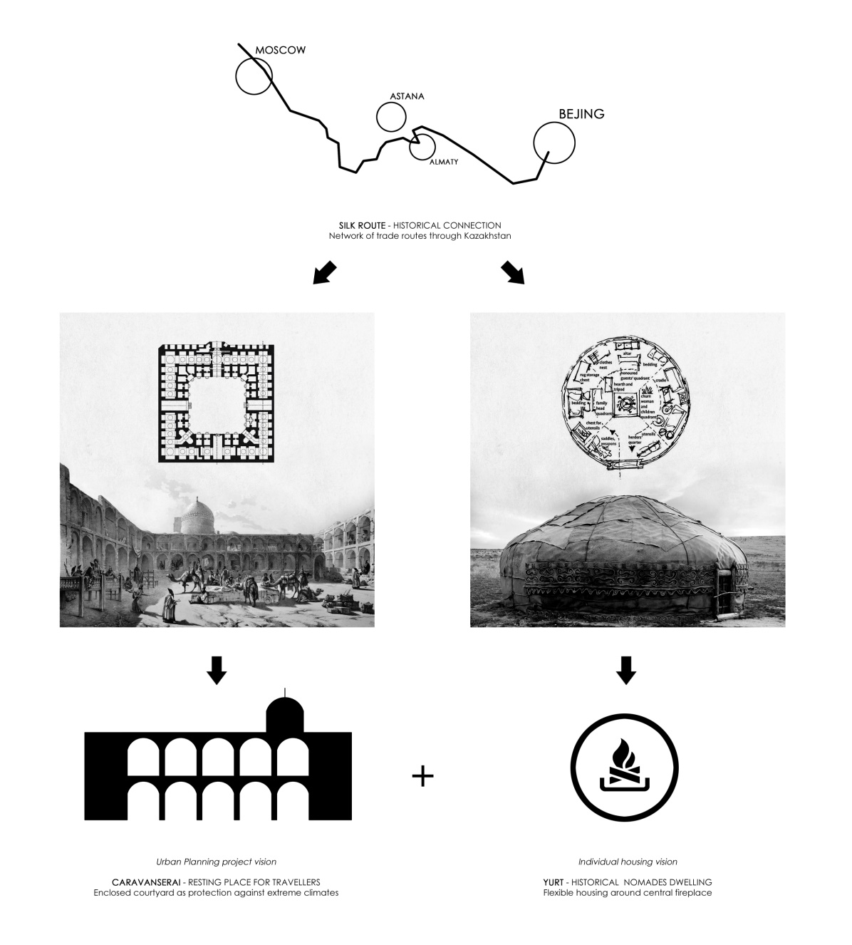
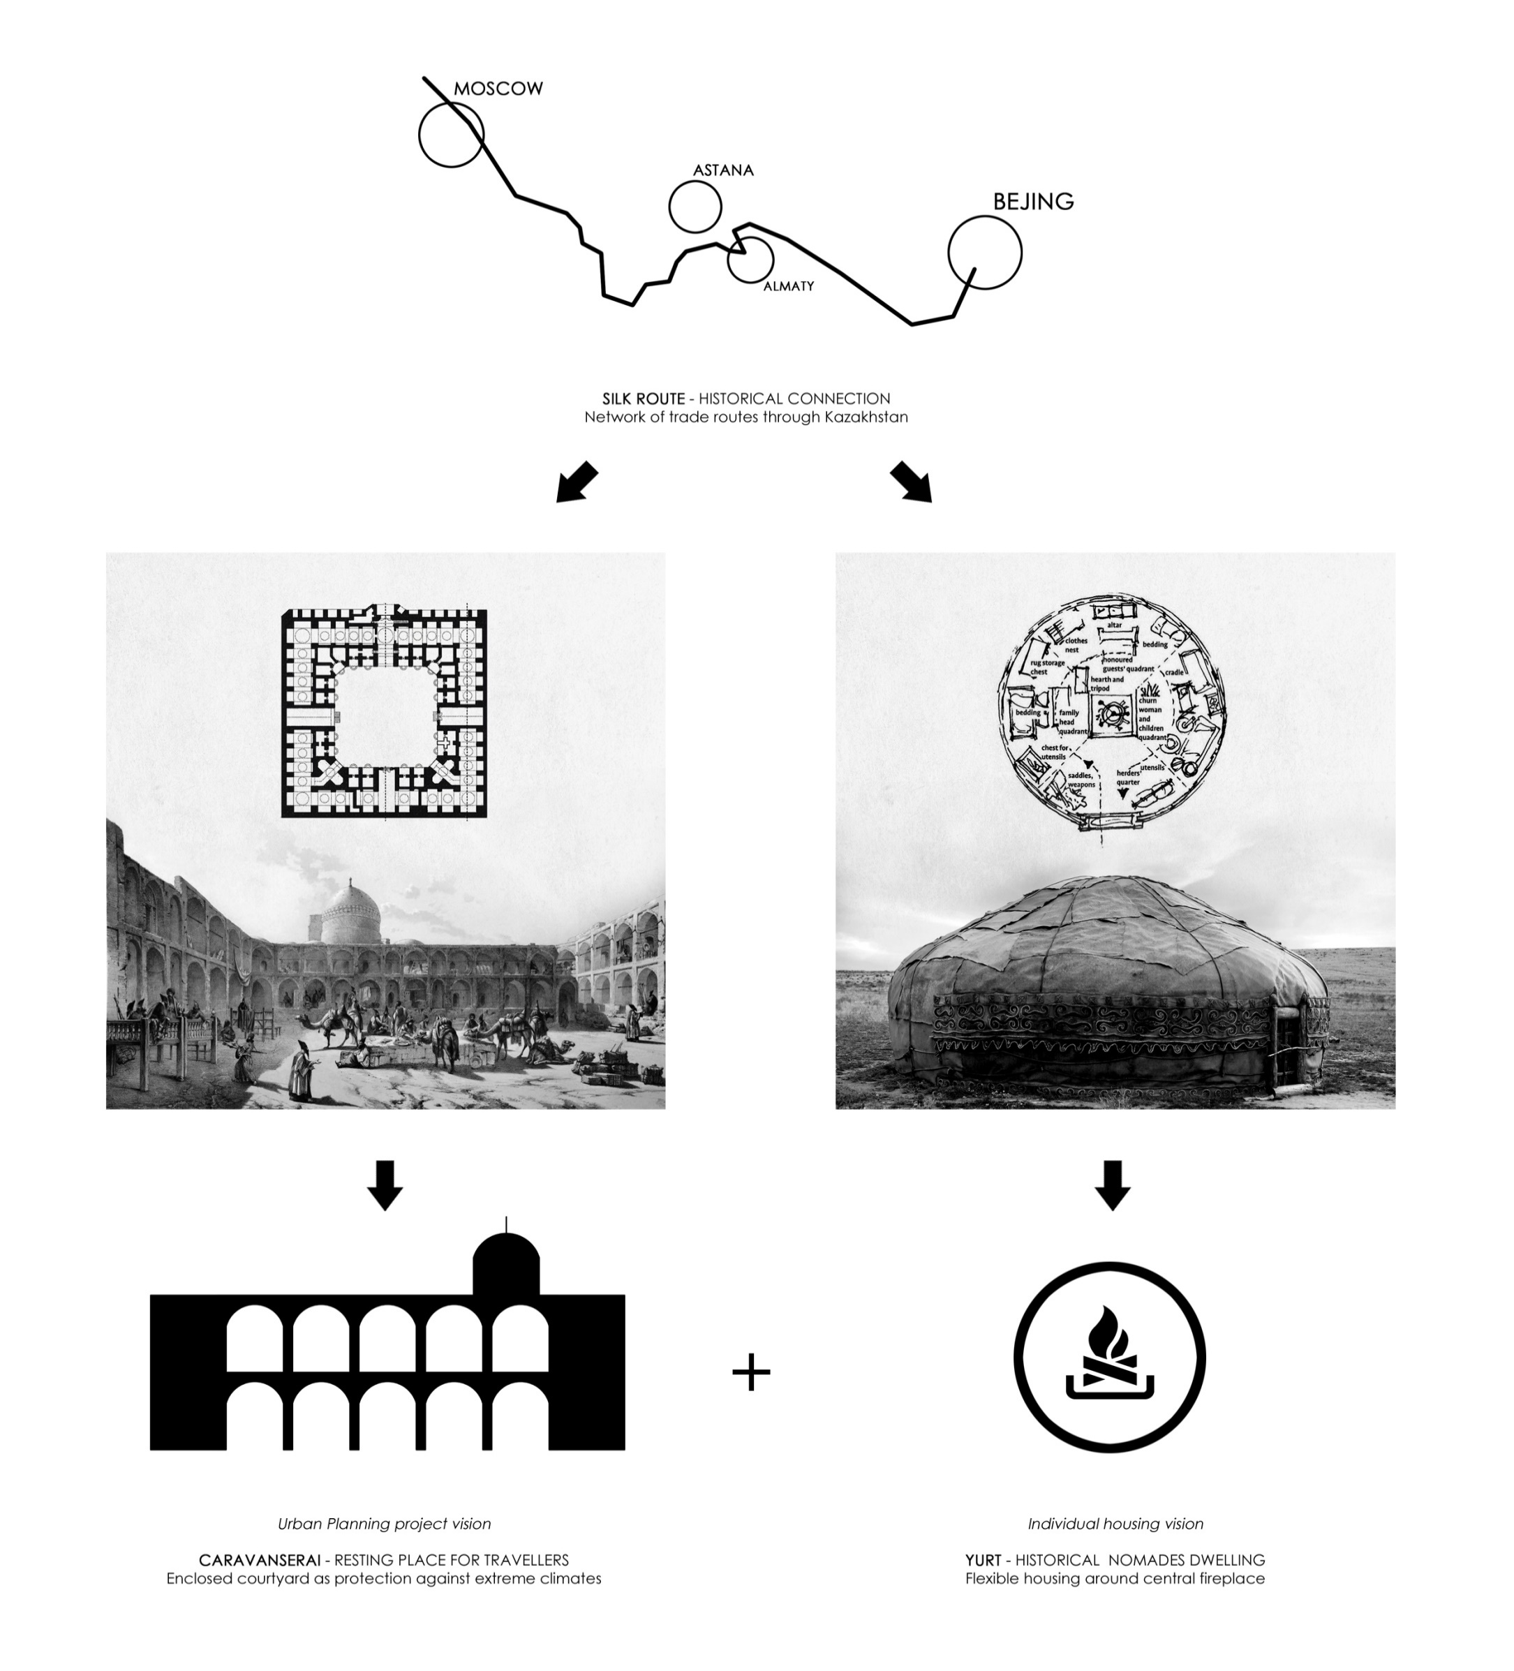


Slide 3
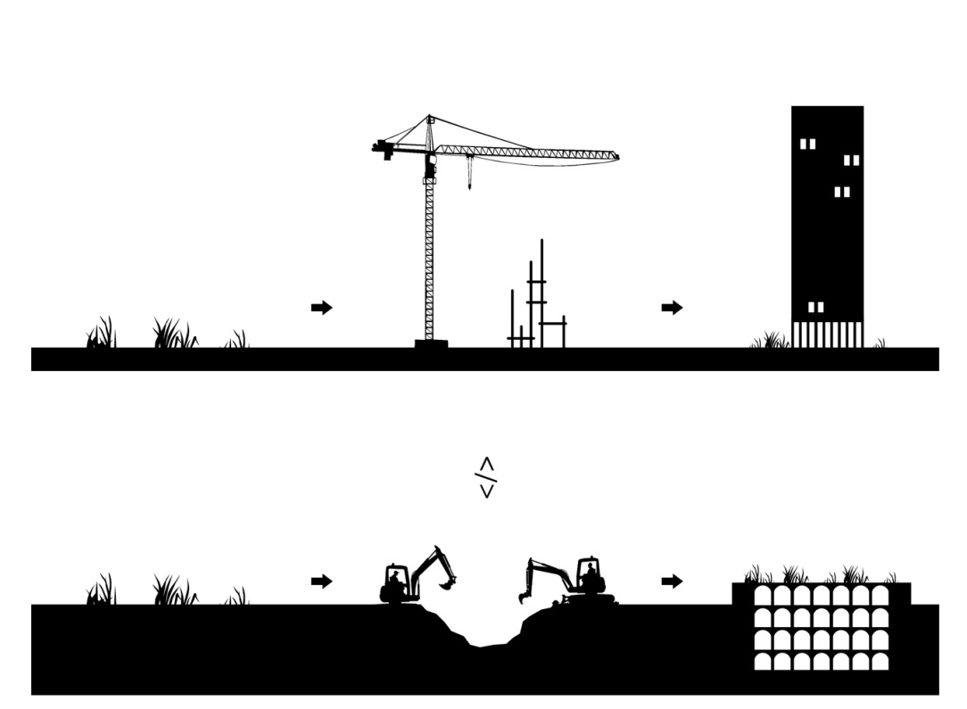


Slide 4



Slide 5
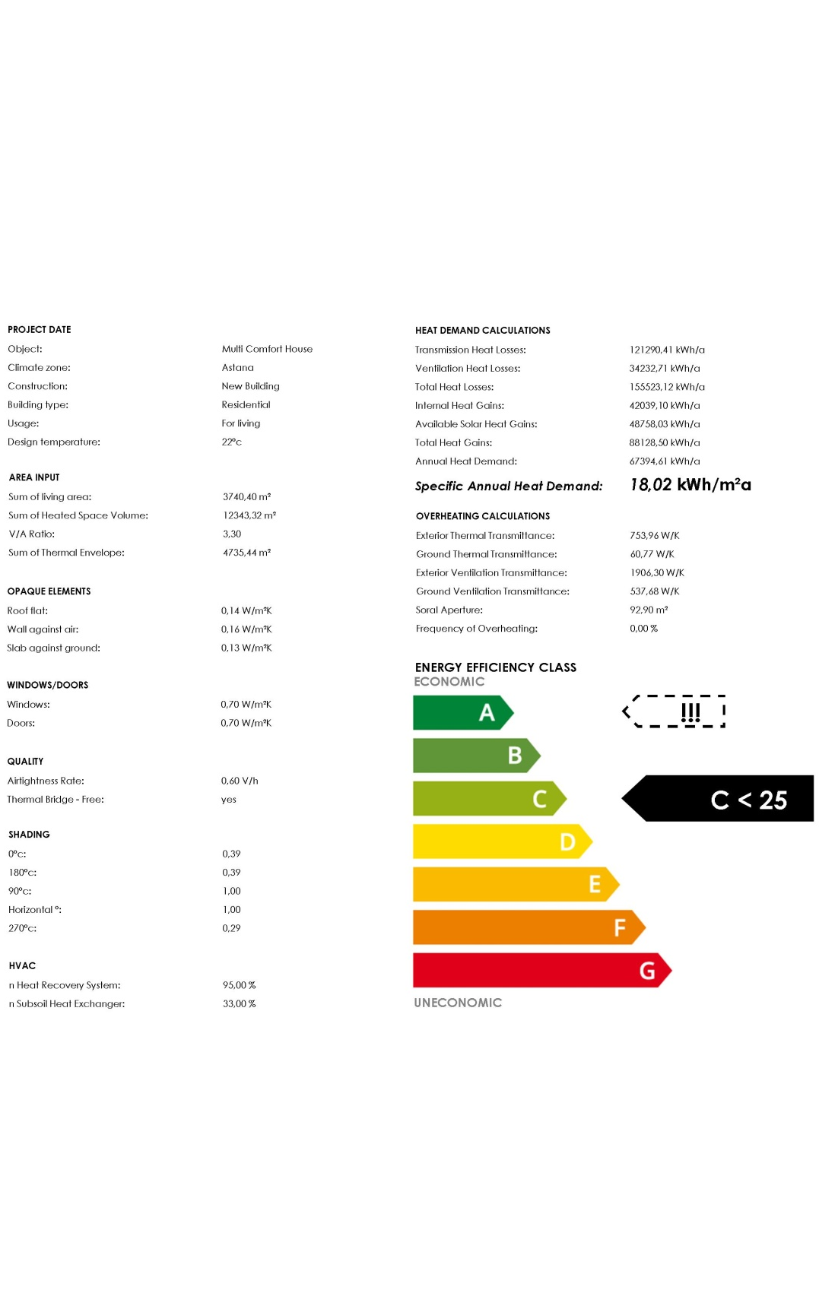
TYPE OF CONSTRUCTION _ TECHNICAL PARAMETERS

Slide 6
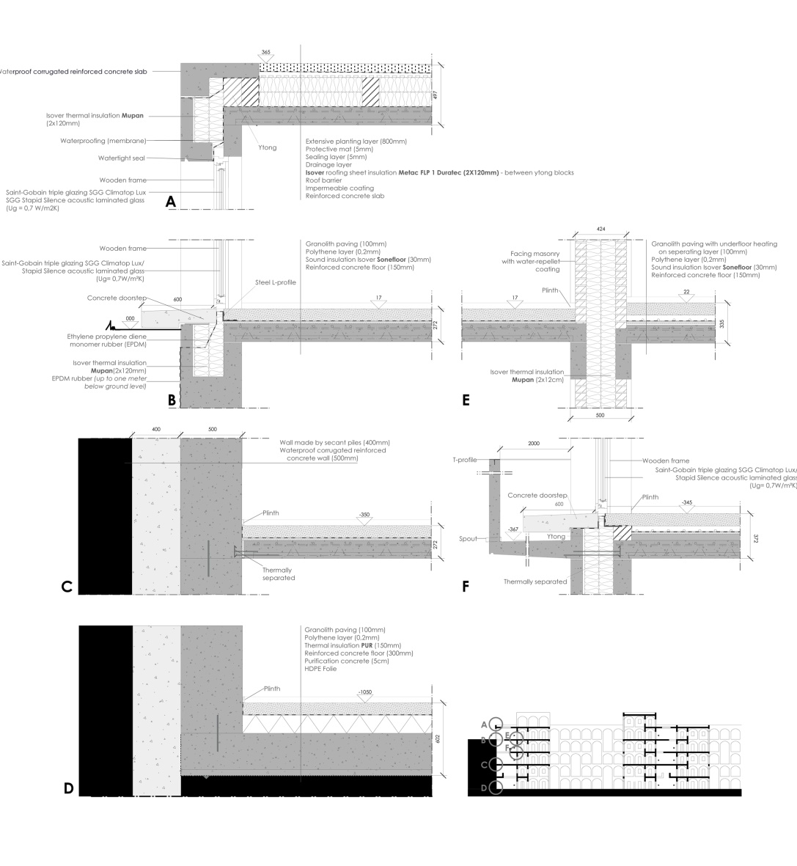
TECHNICAL DETAIL

Slide 7
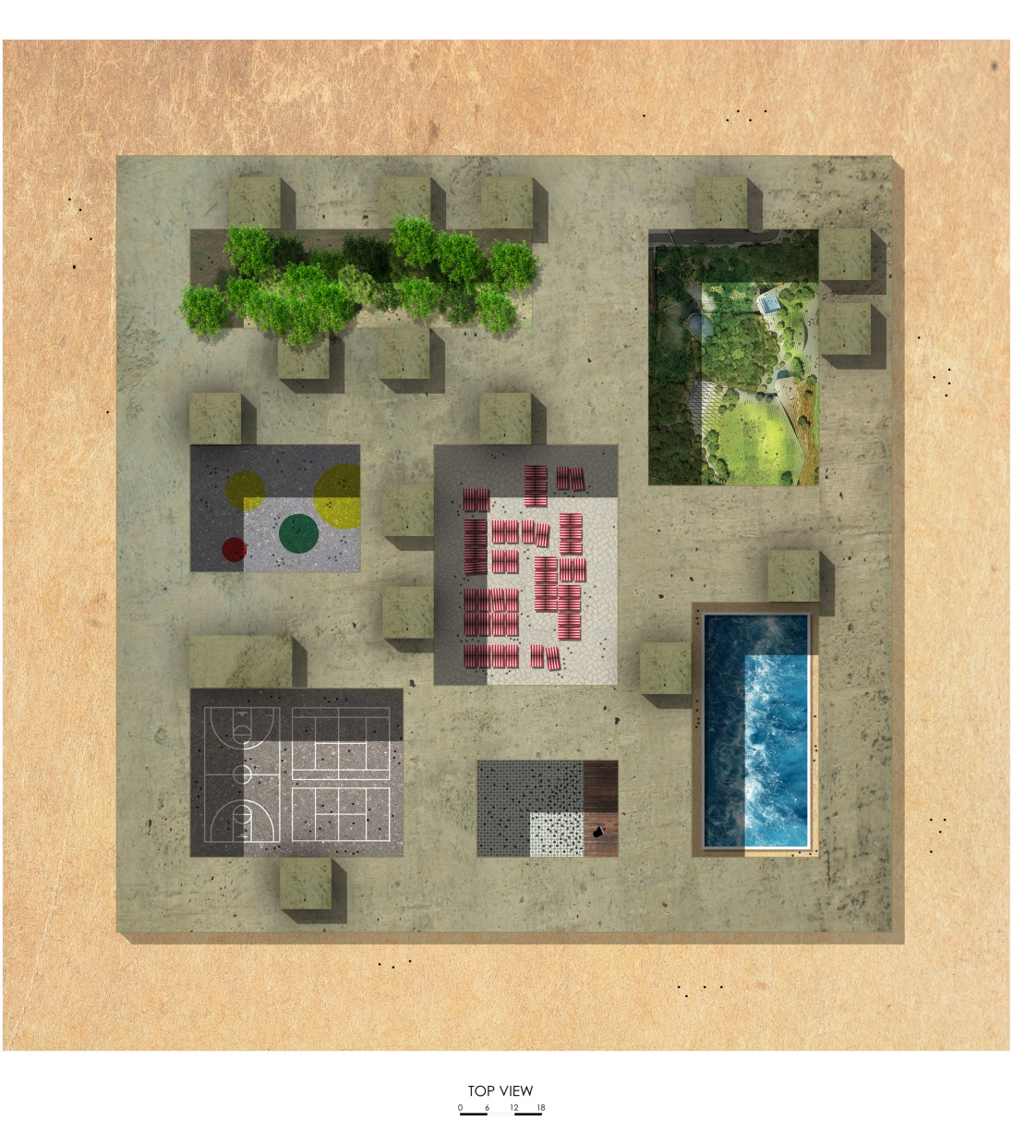

Slide 9
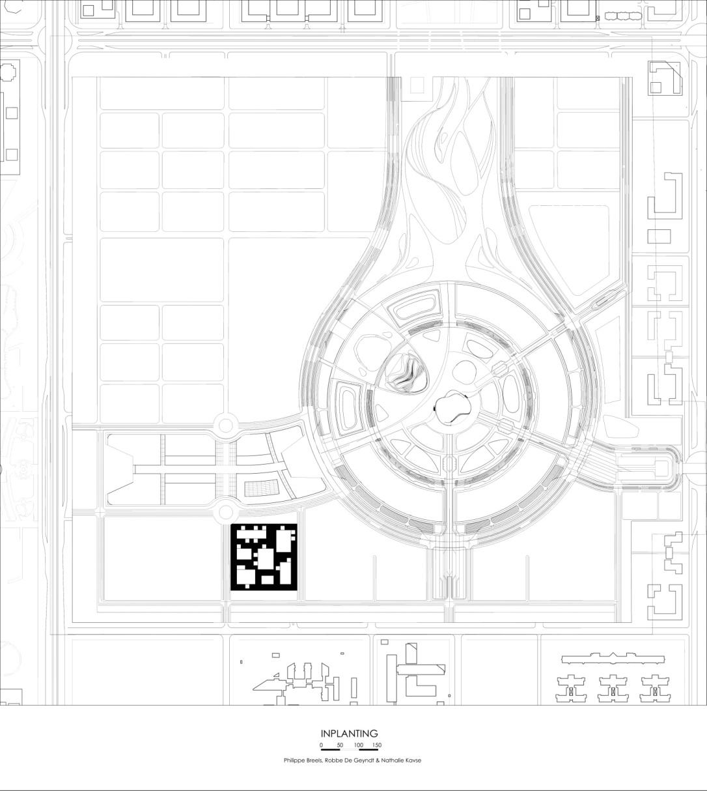

SITE PLAN

Slide 10
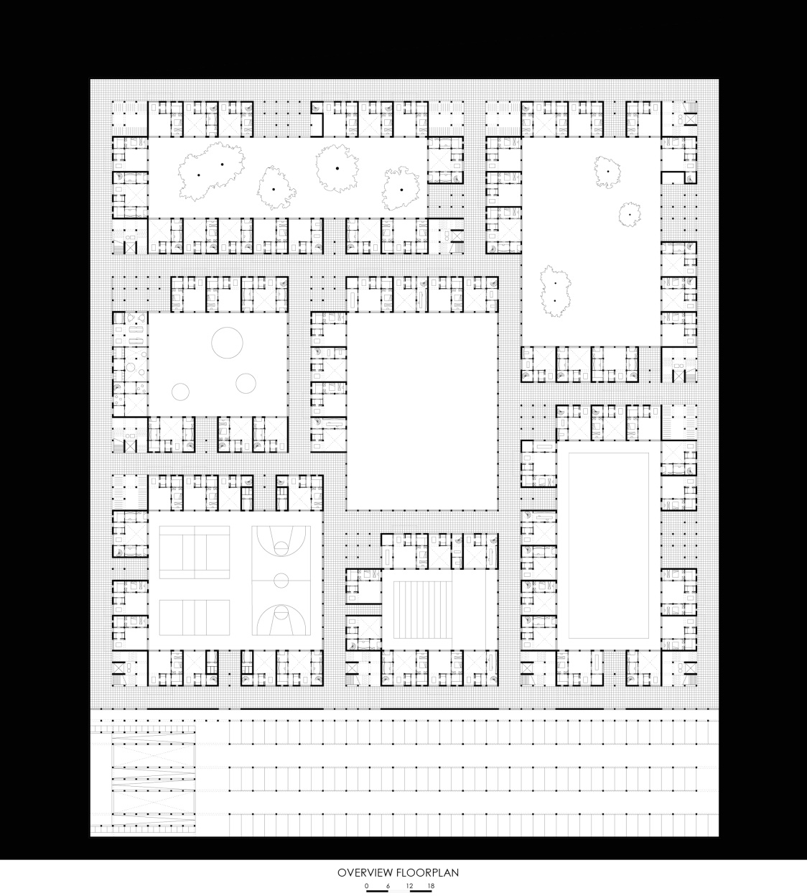

Slide 11
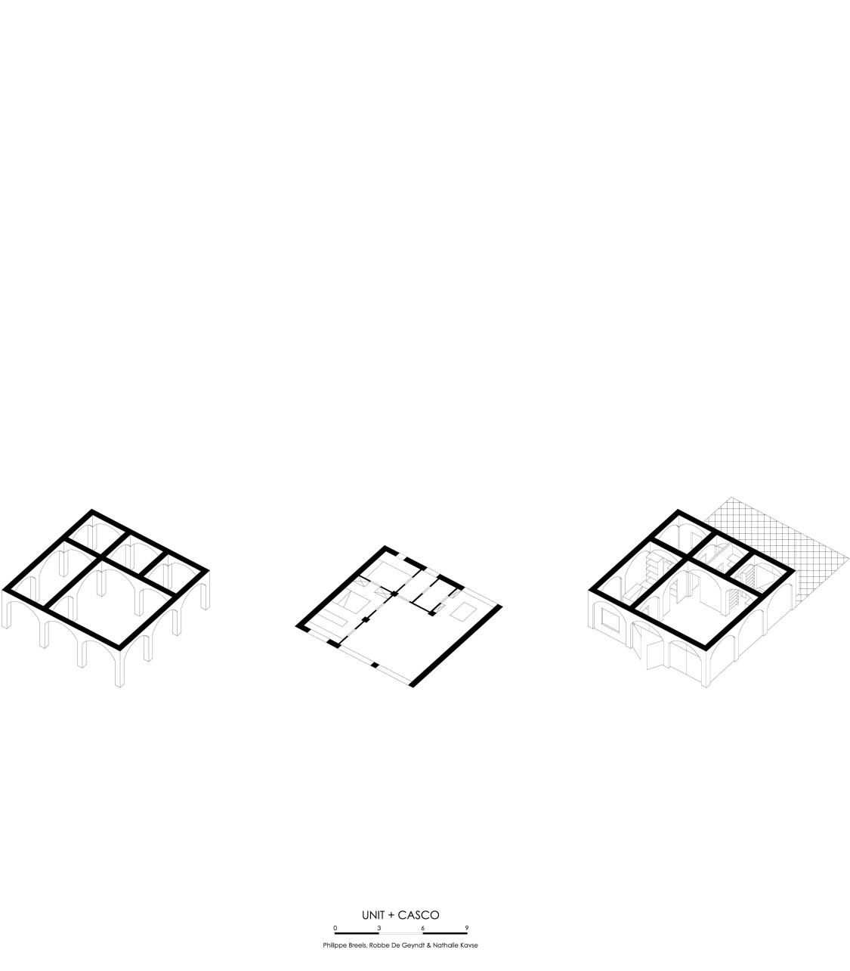

Slide 12
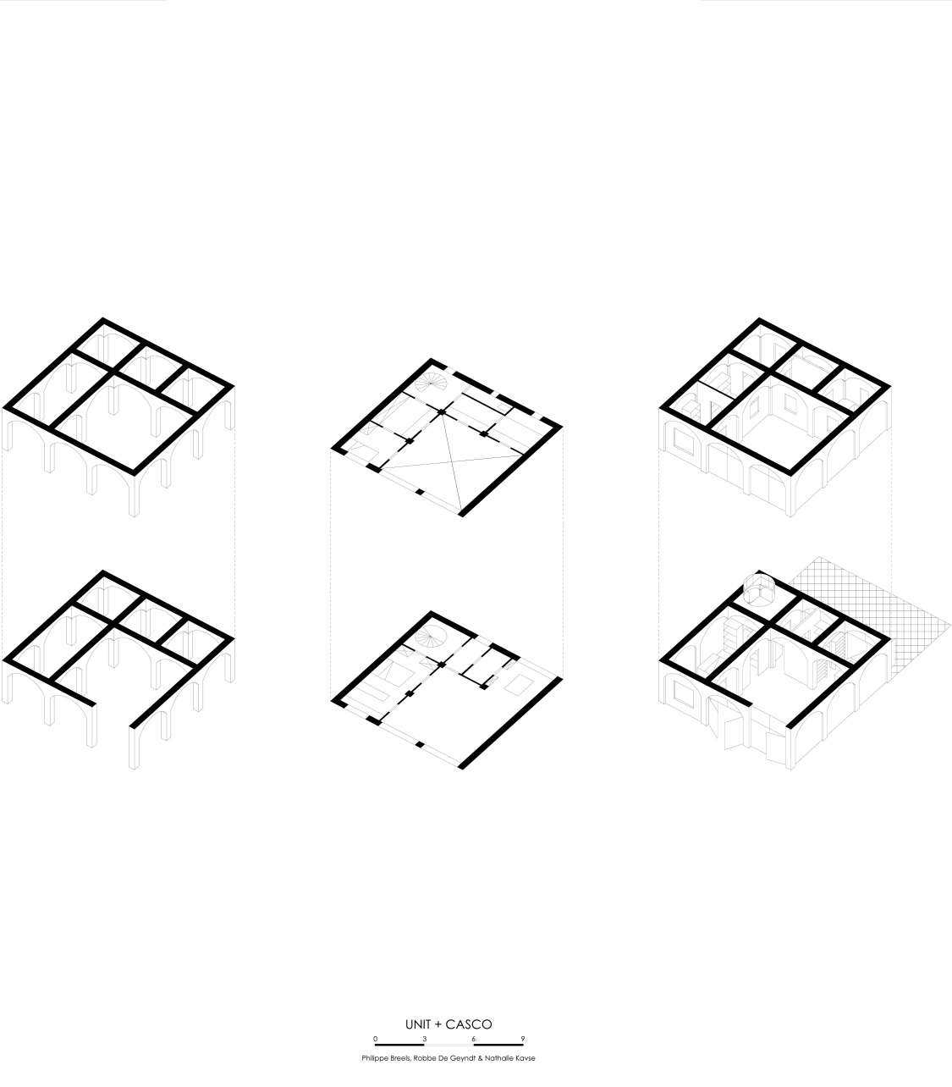

Slide 13
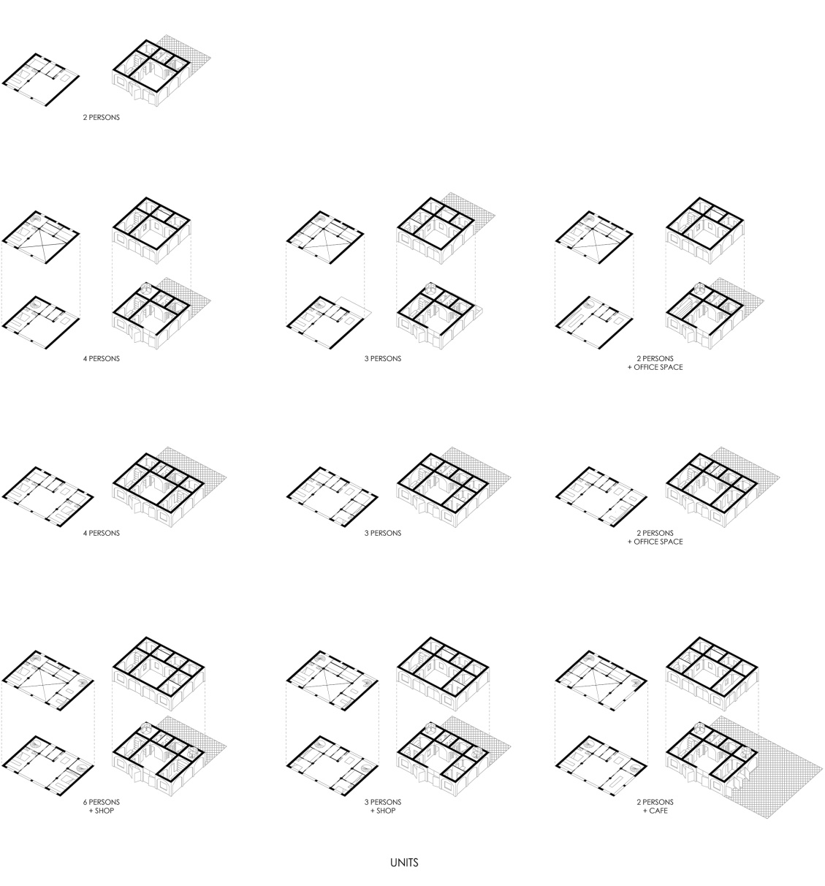

Slide 14
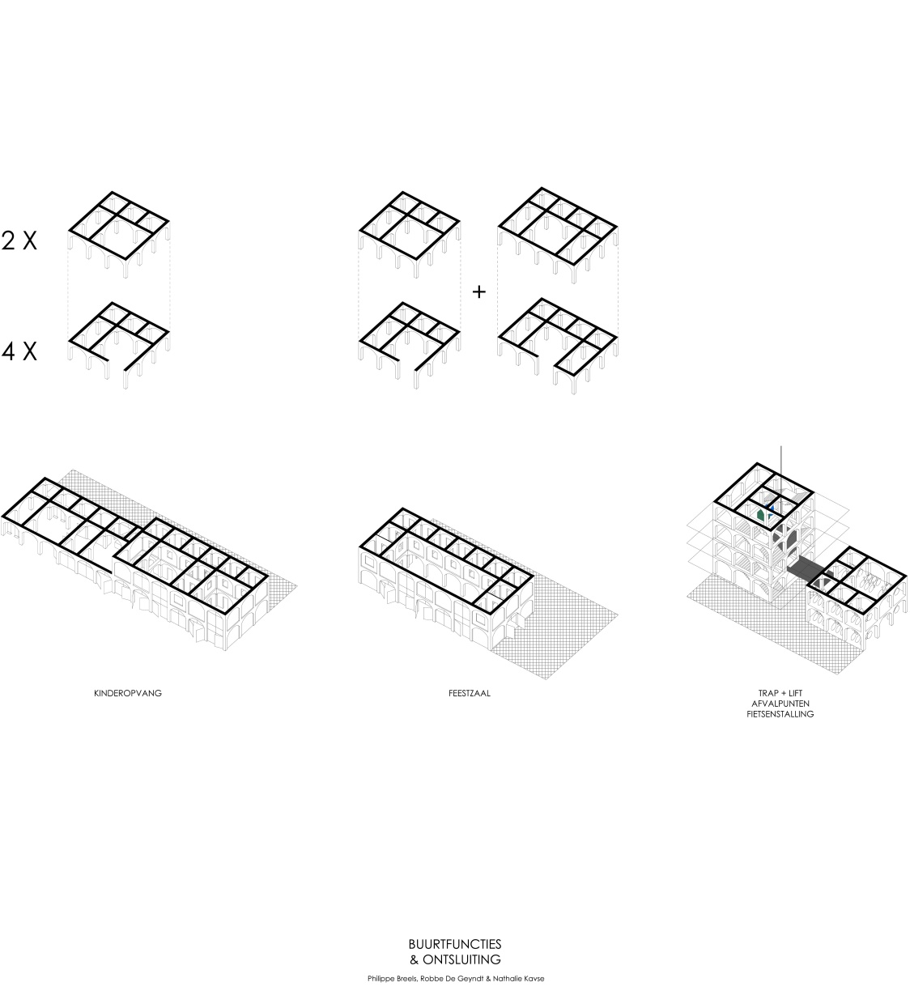
KINDERGARTEN
FUNCTION HALL
VERTICAL CIRCULATION (ELEVATOR + STAIRCASES)
WASTE COLLECTION POINTS
BICYCLE PARKING
NEIGHBOURHOOD FUNCTIONS

Slide 15
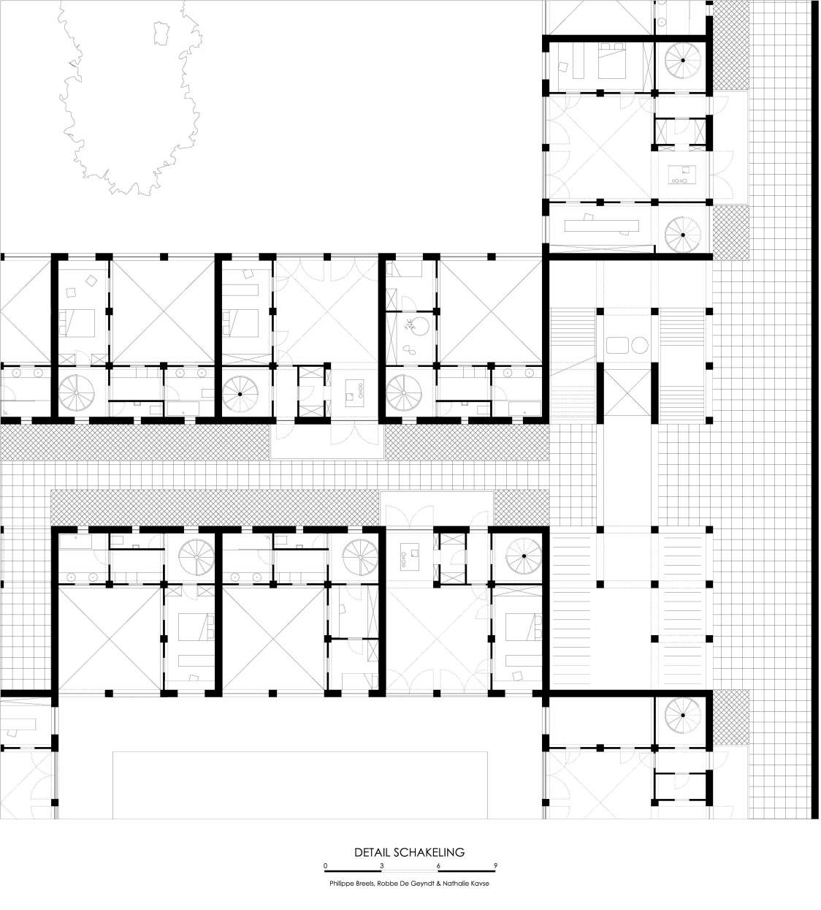

FLOORPLAN FRAGMENT

Slide 16
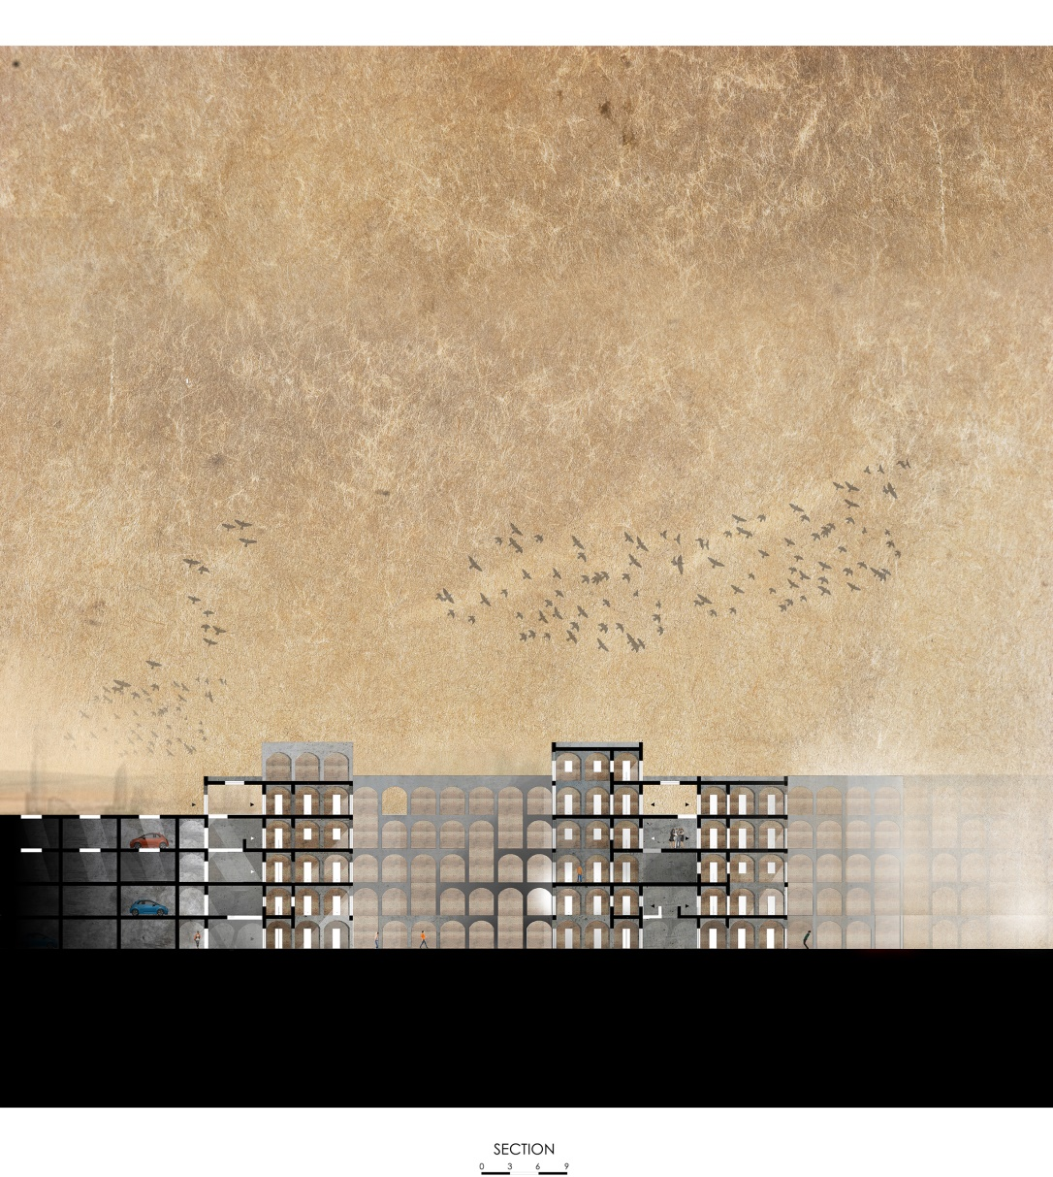

Slide 17
TECHNICAL DETAIL

Slide 18
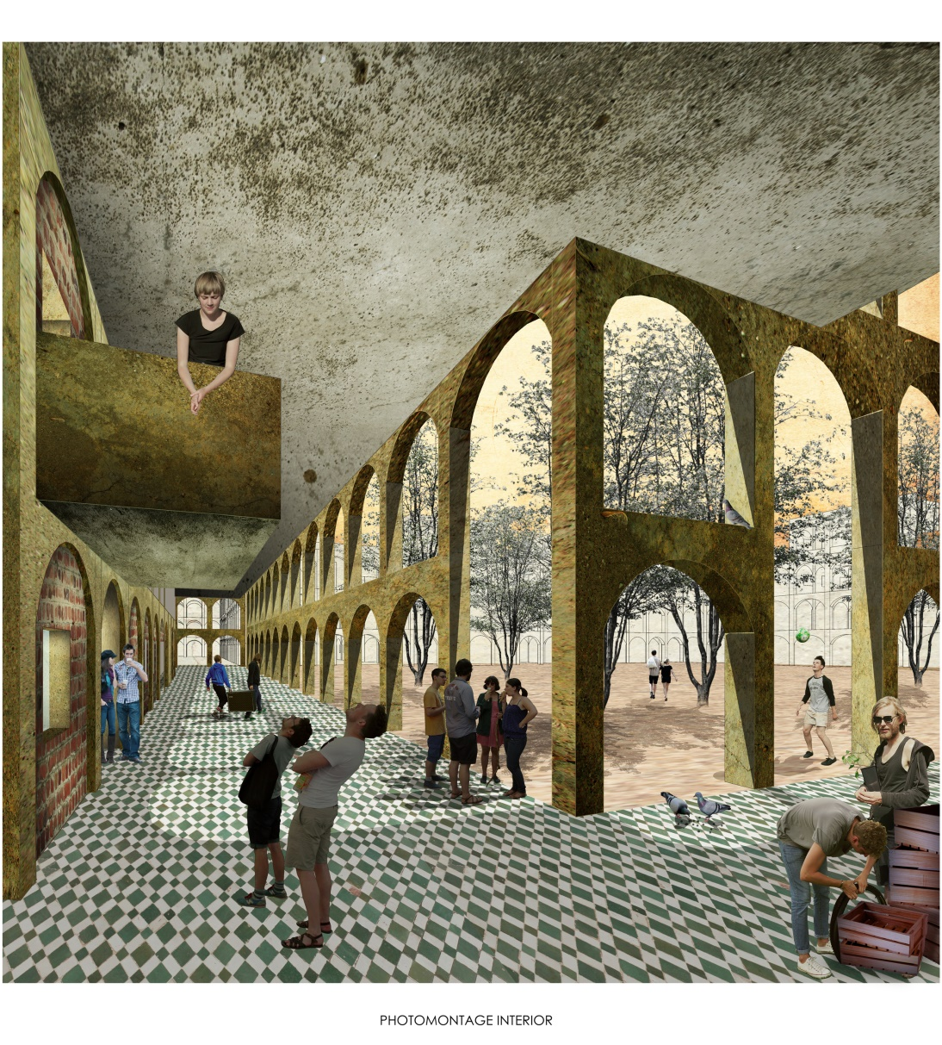

Slide 19
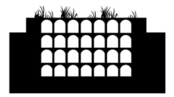
Спасибо за внимание
Belgium - 1st Prize
Philippe Breels - Robbe De Geyndt - Nathalie Kavse
University of Hasselt

