Slide 1
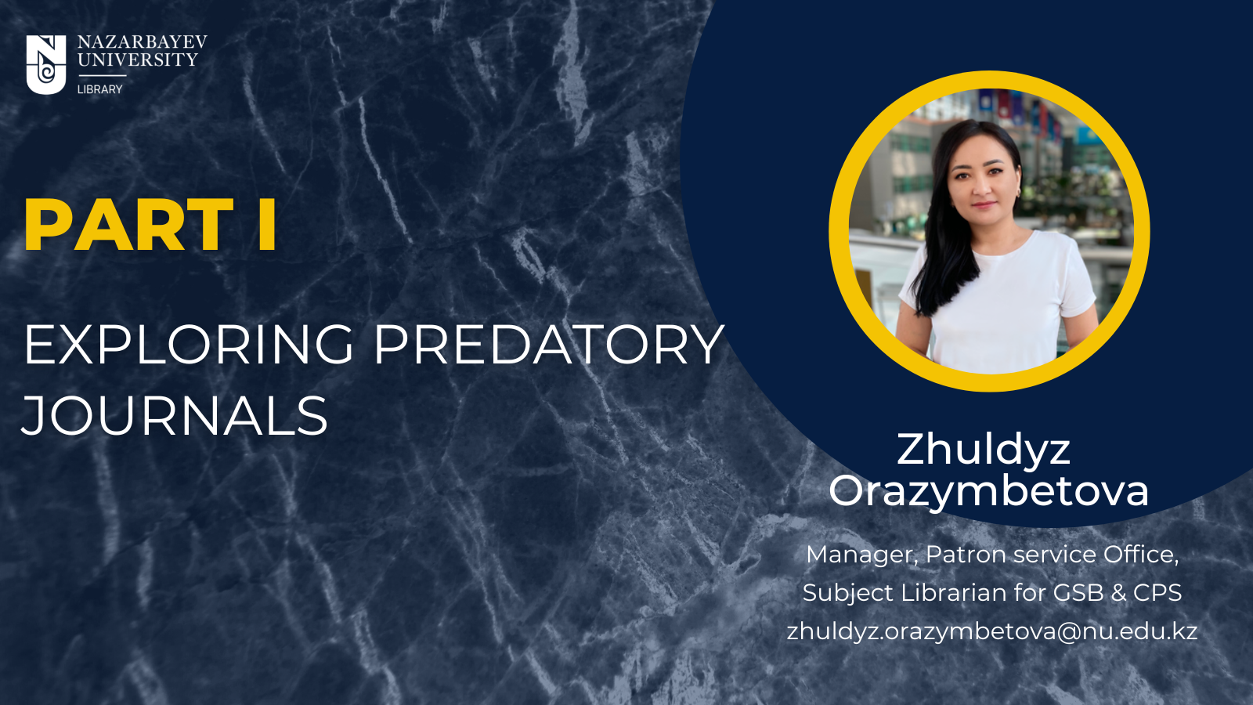

Slide 2

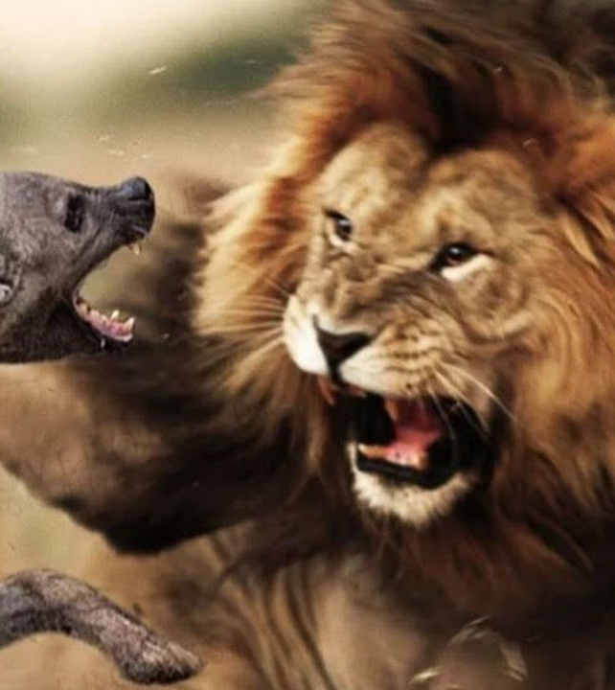
Zhuldyz Orazymbetova
07.09.2022
Predatory Journal
Predatory (Standalone) Journal is an exploitative academic publishing business model that involves charging publication fees to authors without checking articles for quality and legitimacy, and without providing editorial and publishing services that legitimate academic journals provide, whether open access or not.

Slide 3
Academic Journal Models
Zhuldyz Orazymbetova
07.09.2022
http://www.sherpa.ac.uk/romeo/index.php
Traditional Journal Model
Author submits the article
Review of the article
No Article Processing Charge
Paid access to the full text (institutions and individuals)
Open Access Journal Model
Author submits the article
Review of the article
Author or funder pays an Article Processing Charge (APC) (≈3000 €)
Free access to the full text
Hybrid Access Journal Model
Author submits the article
Review of the article
Author makes decision on access to the full text
Access to the full text depends on author
Predatory Open Access Journal (shouldn't exist)
Any article is published for money
and practically without a review)

Slide 4
Predatory Journals
Zhuldyz Orazymbetova
07.09.2022
Fake Journal
Non-existent journal
Clone of an existing journal
Not indexed in Abstract Databases
Payment for publishing
Invitation
Agents
Directory of Open Access Journal (DOAJ)
Predatory Journal
Existing Open access journal
Can be Indexed in Abstract Databases
Payment for publishing
Invitation
Agents
Directory of Open Access Journal (DOAJ)
American Hystorical Review
Wulfenia
WoS, Scopus …
WoS, Scopus …

Slide 5
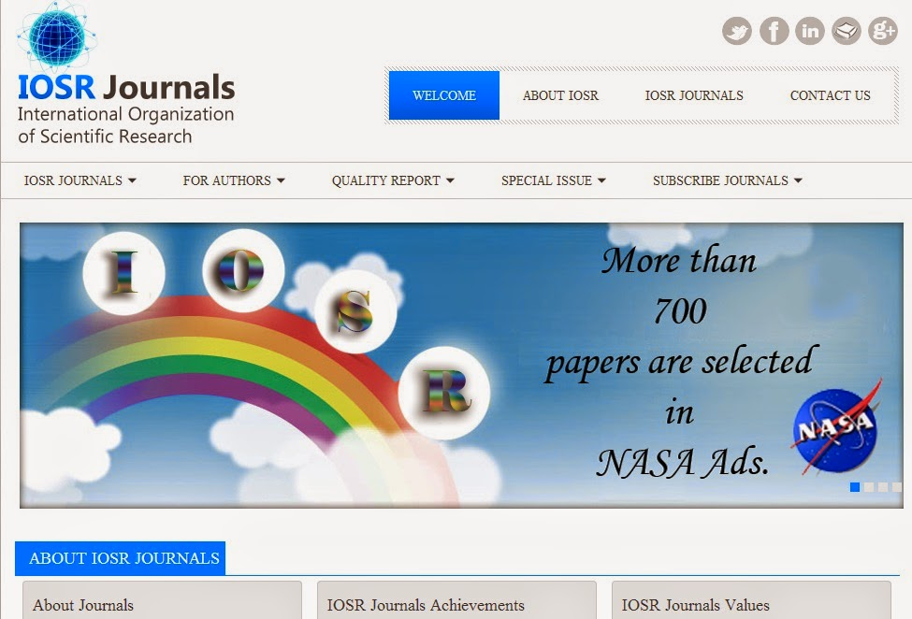
Fake Journals
Zhuldyz Orazymbetova
07.09.2022
Fake Journals created by a group from Ghaziabad, India
IOSR Journal of Computer Engineering (IOSR-JCE)
IOSR Journal of Electrical and Electronics Engineering (IOSR-JEEE)
IOSR Journal of Pharmacy and Biological Science (IOSR-JPBS)
IOSR Journal of Nursing and Health Science (IOSR-JNHS)
IOSR Journal of Mechanical and Civil Engineering (IOSR-JMCE)
IOSR Journal of Electronics and Communication Engineering(IOSR-JECE)
IOSR Journal of Dental and Medical Sciences (IOSR-JDMS)
IOSR Journal of Agriculture and Veterinary Science (IOSR-JAVS)
IOSR Journal of VLSI and Signal Processing (IOSR-JVSP)
IOSR Journal on Mobile Computing & Application (IOSR-JMCA)
IOSR Journal of Sports and Physical Education (IOSR-JSPE)
IOSR Journal of Polymer and Textile Engineering (IOSR-JPTE)IOSR Journal of Humanities and Social Science (IOSR-JHSS)
IOSR Journal of Research & Method in Education (IOSR-JRME)
IOSR Journal of Applied Geology and Geophysics (IOSR-JAGG)
IOSR Journal of Environmental Science, Toxicology and Food Technology
IOSR Journal of Mathematics (IOSR-JM)
IOSR Journal of Business and Management (IOSR-JBM)
IOSR Journal of Applied Physics (IOSR-JAP)
IOSR Journal of Applied Chemistry (IOSR-JAC)
IOSR Journal of Economics and Finance (IOSR-JEF)
IOSR Journal of Biotechnology and Biochemistry (IOSR-JBB)

Slide 6
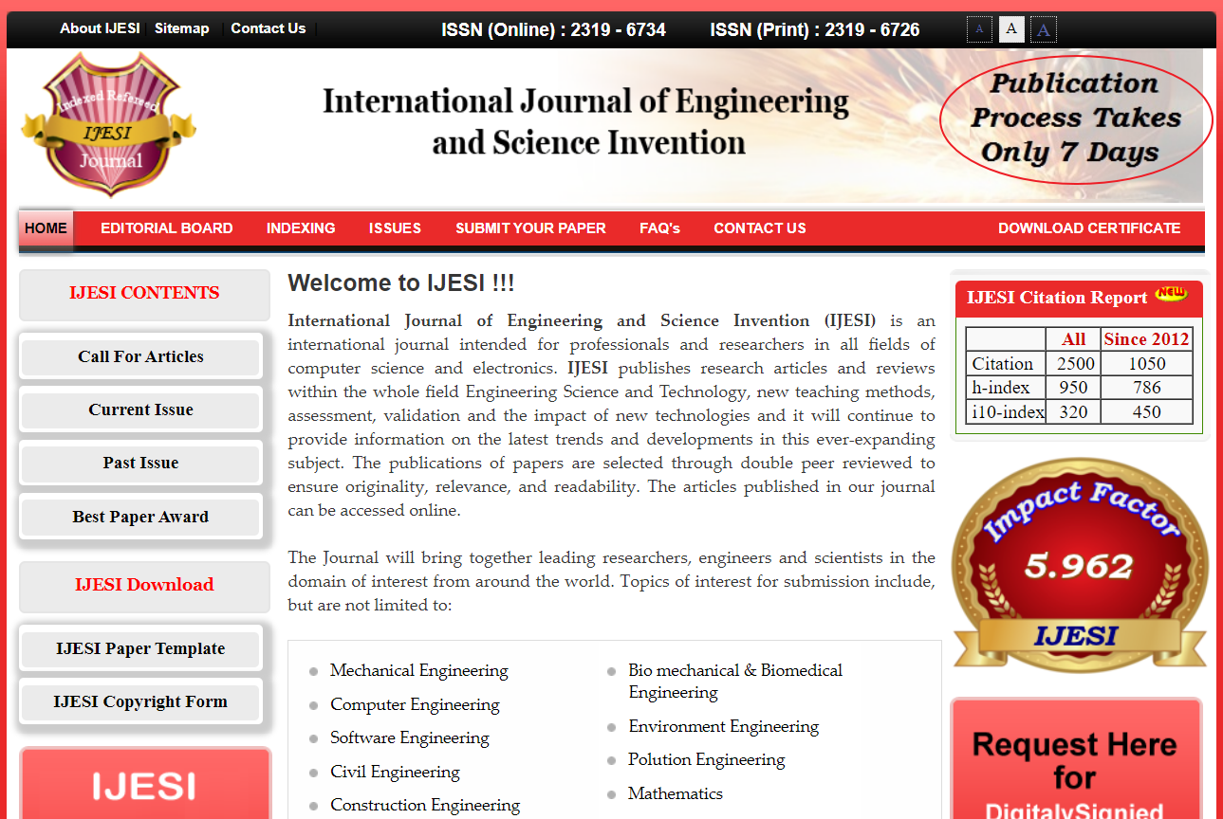
Fake Journals
Zhuldyz Orazymbetova
07.09.2022
Fake Journals Addresses
www.ijera.com
www.ijesi.org
www.theijes.com
www.ajer.org
www.ijpsi.org
www.aqcj.org
www.ijmer.com
www.ijceronline.com

Slide 7
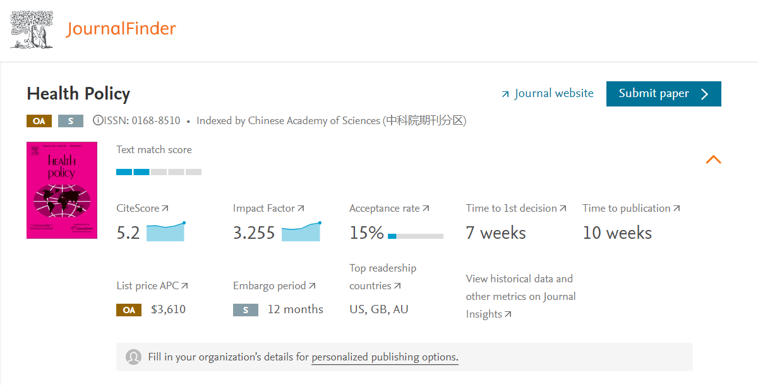
How to identify Predatory Journal?
Zhuldyz Orazymbetova
07.09.2022
Symbolic fee for publication in a journal (≈ 300-400 €)
Offer to pay first

Slide 8
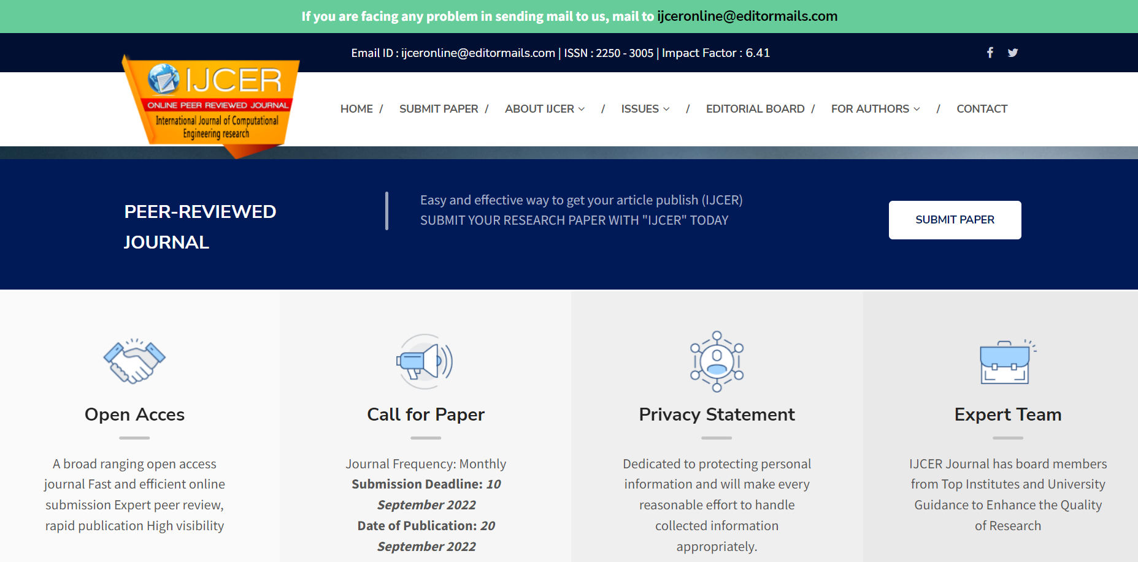
How to identify Predatory Journal?
Zhuldyz Orazymbetova
07.09.2022
No review procedure / Fast Peer-Review
Publication timing: only predatory journals promise fast publication

Slide 9
How to identify Predatory Journal?
Zhuldyz Orazymbetova
07.09.2022
Use predatory metrics:
Global Impact Factor
General Impact factor
World Trend Impact factor
International Impact Factor
Cosmos Impact Factor - Cosmos Foundation
Impact Factor - Cite Factor (Directory of International Research Journals)
IJESI Impact Factor etc.

Slide 10
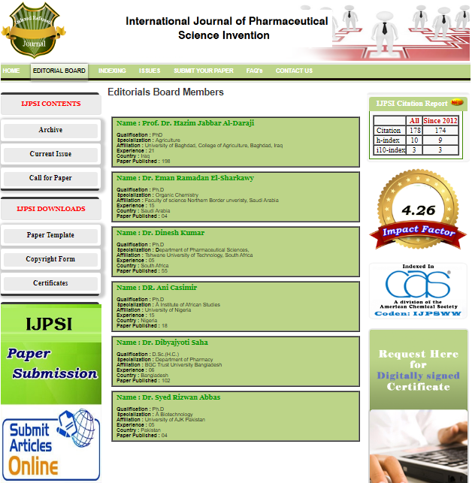
How to identify Predatory Journal?
Zhuldyz Orazymbetova
07.09.2022
The editorial board is not specified / One editorial board for different journals / Small geography)
Are the places of work and positions indicated, do you know the names of these people, can you find information about them?
It is impossible to see the location of the editorial board

Slide 11
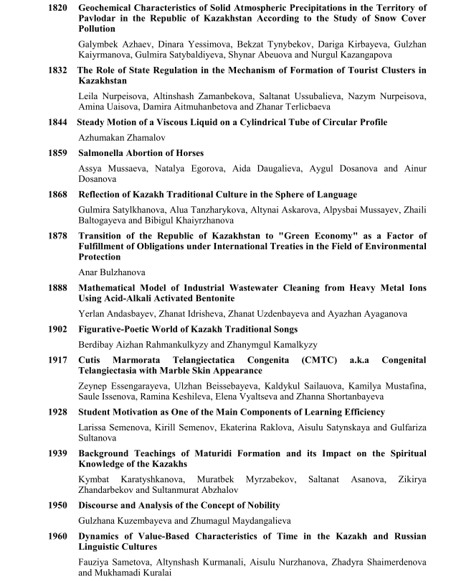
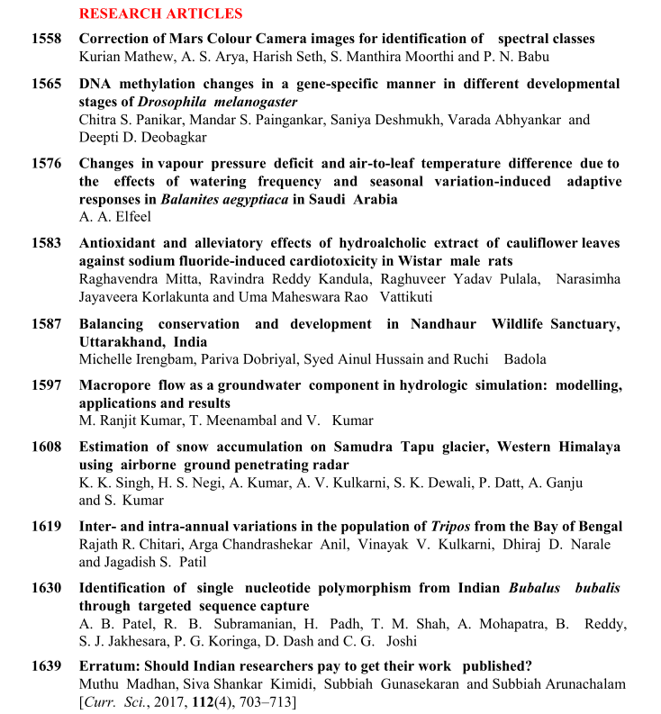
How to identify Predatory Journal?
Zhuldyz Orazymbetova
07.09.2022
Accepts articles in one journal in many related areas.

Slide 12


How to identify Predatory Journal?
Zhuldyz Orazymbetova
07.09.2022
The journal has a similar name with the famous journal in this subject, sometimes differing in prepositions OF or FOR

Slide 13
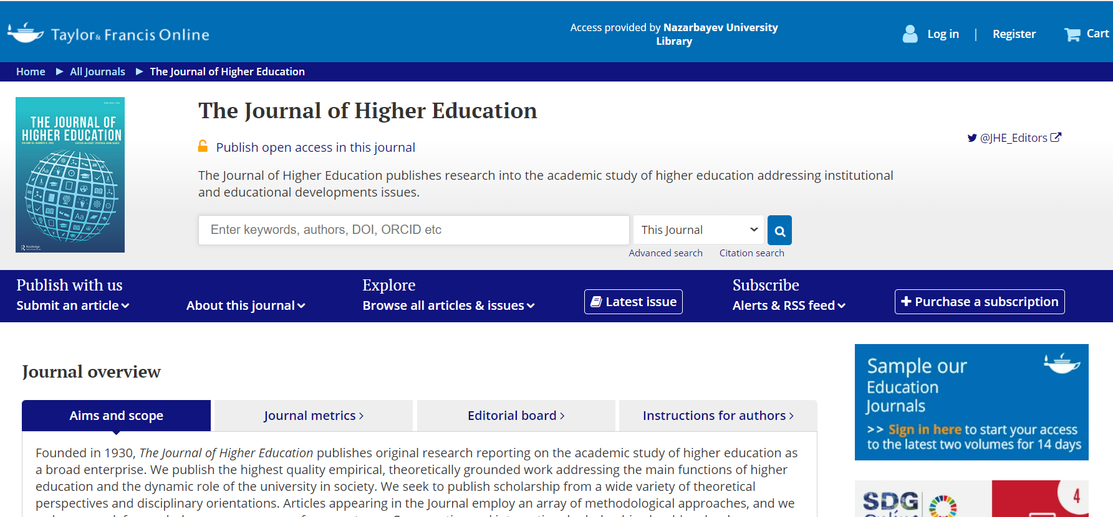
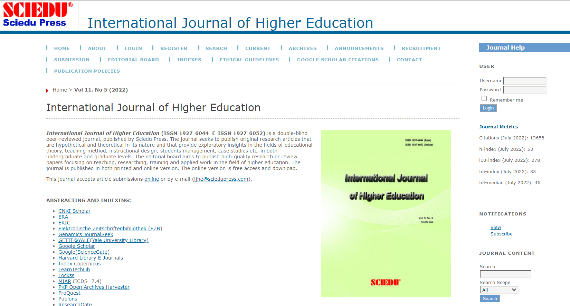
How to identify Predatory Journal?
Zhuldyz Orazymbetova
07.09.2022
Website design, presence of pop-up and blinking elements, grammatical errors

Slide 14
How to identify Predatory Journal?
Zhuldyz Orazymbetova
07.09.2022
Formatting guidelines for authors: most predatory journals do not have specific guidelines, including citation formats
Archive:
go to the proposed site of the journal, in the archive section
Find any article, preferably one of the latest
Check whether such an article is indexed, with such authors and title in Web of Science

Slide 15
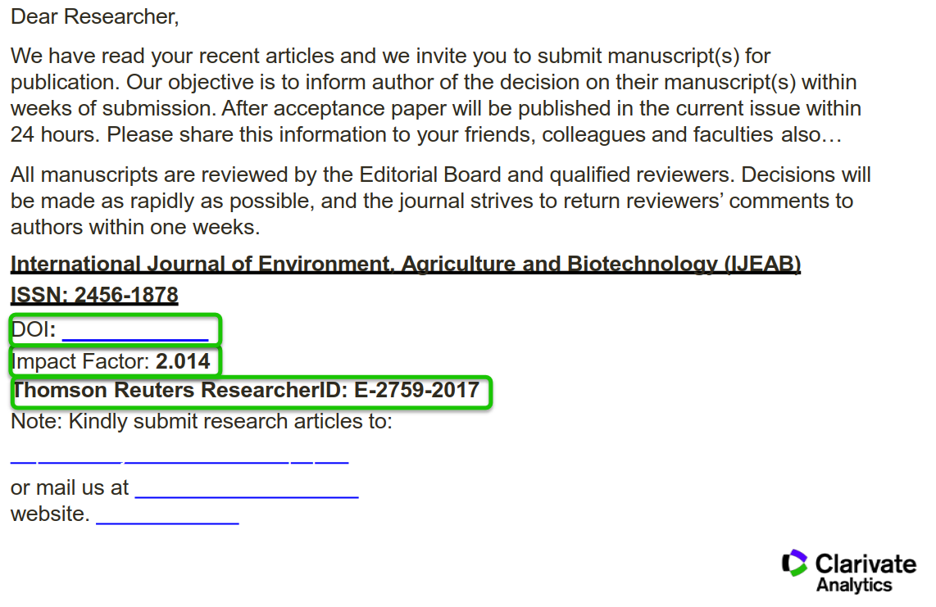
How to identify Predatory Journal?
Zhuldyz Orazymbetova
07.09.2022
Invitation / Suspicious mailing
Does the publisher keep spamming, or have you noticed intrusive marketing?

Slide 16
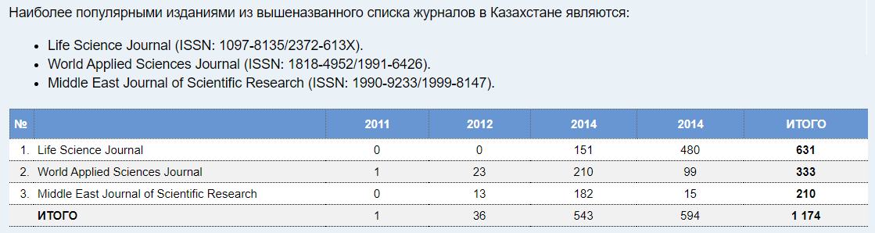
How to identify Predatory Journal?
Zhuldyz Orazymbetova
07.09.2022
по состоянию на 05.05.2015

Slide 17
Suggestions
Zhuldyz Orazymbetova
07.09.2022
Check with DOAJ whether the journal legitimate
Check the publishing model at https://v2.sherpa.ac.uk/romeo/
Check if the journal is indexed in Web of Science
Ignore predatory metrics
Remember, only predatory journals promise fast peer-review and publication
Use the checklist that will help you discover what you need to know when assessing whether or not a publisher is suitable for your research
Contact your Subject librarian for the help

Slide 18
Useful Links
Zhuldyz Orazymbetova
07.09.2022
(New) List of Predatory Journals – 2022
https://www.openacessjournal.com/blog/predatory-journals-list/
What Is Open Access? By Charles W. Bailey, Jr.
http://digital-scholarship.org/cwb/WhatIsOA.pdf
Open Science: Definitions and Description/ David Ball https://www.fosteropenscience.eu/sites/default/files/pdf/2236.pdf
Open Access Journal Quality Indicators
https://www.gvsu.edu/library/sc/open-access-journal-quality-indicators-5.htm
Is a title indexed in Scopus? A reminder to check before you publish
https://blog.scopus.com/posts/is-a-title-indexed-in-scopus-a-reminder-to-check-before-you-publish
Think. Check. Submit. https://thinkchecksubmit.org/

Slide 19
Zhuldyz Orazymbetova
07.09.2022
Thank you
for your attention!

