Slide 1
Совершенствование культуры научных исследований
Нейл Коллинз, профессор Школы гуманитарных и социальных наук Назарбаев Университета
Анна Кохен-Миллер, ассистент-профессор Школы образования Назарбаев Университета

Slide 2
СМИ и известность исследователя
Трехкомпонентная стратегия:
  Экспертная оценка
  Профессиональный аспект
  Социальный аспект
Измерение воздействия: 

Slide 3
СМИ и известность исследователя
Экспертная оценка:
  «Золотой стандарт», однако…
    Продвижение:
      Домашняя страница университета
      ResearchGate
      Academia.edu
Notes:
evaluation of scientific, academic, or professional work by others working in the same field. In academic publishing, the goal of peer review is to assess the quality of articles submitted for publication in a scholarly journal. Before an article is deemed appropriate to be published in a peer-reviewed journal, it must undergo the following process:
The author of the article must submit it to the journal editor who forwards the article to experts in the field. Because the reviewers specialize in the same scholarly area as the author, they are considered the author’s peers (hence “peer review”).
These impartial reviewers are charged with carefully evaluating the quality of the submitted manuscript.
The peer reviewers check the manuscript for accuracy and assess the validity of the research methodology and procedures.
If appropriate, they suggest revisions. If they find the article lacking in scholarly validity and rigor, they reject it.
· Because a peer-reviewed journal will not publish articles that fail to meet the standards established for a given discipline, peer-reviewed articles that are accepted for publication exemplify the best research practices in a field.

Slide 4
СМИ и известность исследователя
Экспертная оценка:
  Домашняя страница университета
    Самый важный актив маркетинга, однако…
      Непрофессиональная аудитория
      http://www.cam.ac.uk
  Собственная web-страница
        http://www.raw-rhodes.co.uk
Notes:
Research is fundamental to a university's reputation and ranking
Where is this research information to be found online?
University webpages that do publicise their institution's latest research are often uninviting or unimaginative in format, listing titles of research papers that have not been updated for months, or even years in some instances. Some universities fail to provide access to online information about their research at all.
The website is now arguably the most important piece of marketing collateral for any university, says Reader, citing a study conducted by the
Another challenge is to keep the style of writing and information consistent. "We aim to write for an educated lay audience. You have to remember that specialists in one field won't necessarily be familiar with other areas of academic research. It's important to keep these pages accessible and to have value for all without dumbing them down.”
Cambridge's social contribution through research in a way that people who are interested, but not from an academic background, can engage with and understand.”
http://www.raw-rhodes.co.uk

Slide 5
СМИ и известность исследователя
ResearchGate
    Сайт для установления деловых контактов в академической среде
      делиться результатами научных работ
      задавать/отвечать на вопросы
      поиск соавторов
Notes:
ResearchGate is a social networking site for scientists and researchers to share papers, ask and answer questions, and find collaborators.

Slide 6
Research Visibility and Social Media

Slide 7
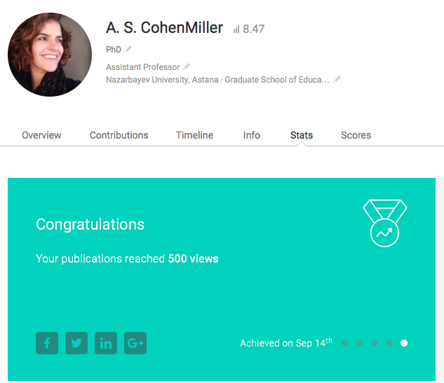

Slide 8
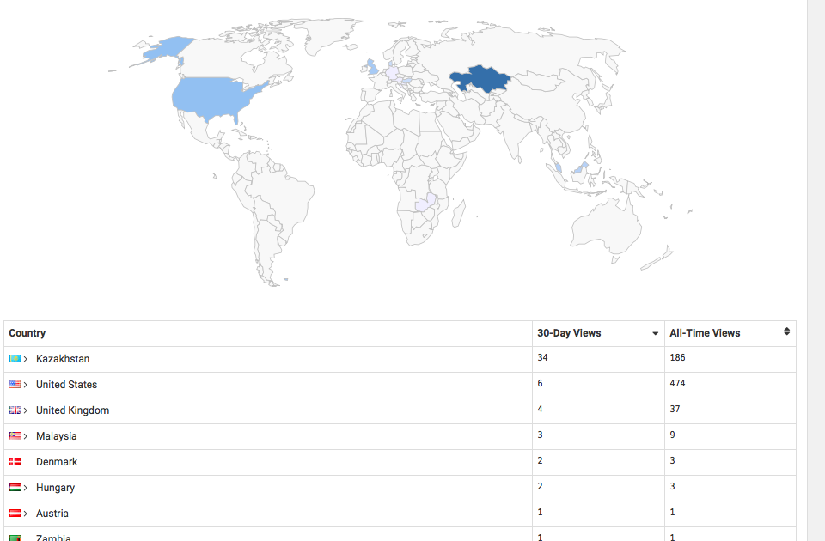

Slide 9
СМИ и известность исследователя
Экспертная оценка
  Academia.edu
    миллионы пользователей
      Философы + антропологи являются наиболее активными участниками
    больше просмотров профиля исследователя
      большинство зарегистрированных лиц - женского пола
      библиометрические измерения непоследовательны, однако
Notes:
Academic social network sites Academia.edu and ResearchGate, and reference sharing sites Mendeley, Bibsonomy, Zotero, and CiteULike, give scholars the ability to publicize their research outputs and connect with each other. With millions of users, these are a significant addition to the scholarly communication and academic information-seeking eco-structure. There is thus a need to understand the role that they play and the changes, if any, that they can make to the dynamics of academic careers. This article investigates attributes of philosophy scholars on Academia.edu, introducing a median-based, time-normalizing method to adjust for time delays in joining the site. In comparison to students, faculty tend to attract more profile views but female philosophers did not attract more profile views than did males, suggesting that academic capital drives philosophy uses of the site more than does friendship and networking. Secondary analyses of law, history, and computer science confirmed the faculty advantage (in terms of higher profile views) except for females in law and females in computer science. There was also a female advantage for both faculty and students in law and computer science as well as for history students. Hence, Academia.edu overall seems to reflect a hybrid of scholarly norms (the faculty advantage) and a female advantage that is suggestive of general social networking norms. Finally, traditional bibliometric measures did not correlate with any Academia.edu metrics for philosophers, perhaps because more senior academics use the site less extensively or because of the range informal scholarly activities that cannot be measured by bibliometric methods.

Slide 10
Research Visibility and Social Media

Slide 11
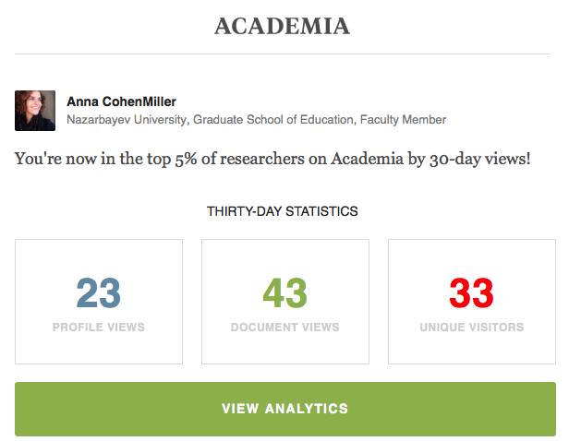

Slide 12
Research Visibility and Social Media

Slide 13
СМИ и известность исследователя
Профессиональный аспект
  Воздействие плюс …
    Установление деловых контактов
      Конференции
      Специализированные периодические издания
      Возможности для обучения должностных лиц

Slide 14
СМИ и известность исследователя
Социальный аспект (популярность)
  Блог, однако …
    Стандарты важны:
      The Conversation
      Television + radio
      Телевидение + радио
        Cправило комнаты отдыха
      Пресса: доступна, однако...
Notes:
а

Slide 15
СМИ и известность исследователя

Slide 16
Research Visibility and Social Media
Popular:
  blog but...
    Standards important:
      The Conversation
      Television + radio
        Common room rule
      Press: accessible but...

Slide 17
Research Visibility and Social Media
Popular:
  blog but...
    Standards important:
      The Conversation
      Television + radio
        Common room rule
      Press: accessible but...

Slide 18
СМИ и известность исследователя
Трехкомпонентная стратегия:
  Экспертная оценка; Профессиональный и Социальный аспекты
Для университета:
  Рейтинг
Для исследователя
  Карьера

Slide 19


ВЫВОДЫ
Что представляет собой Ваше виртуальное присутствие?
Какие ключевые понятия связаны с Вами?
Кто связан с Вами в виртуальном сообществе?

