Slide 1

OPEN ACCESS WEEK
Damel Mektepbayeva
Innovations Development Department
Block C2, 5112

Slide 2






Globalization

Slide 3

Singularity University

Slide 4
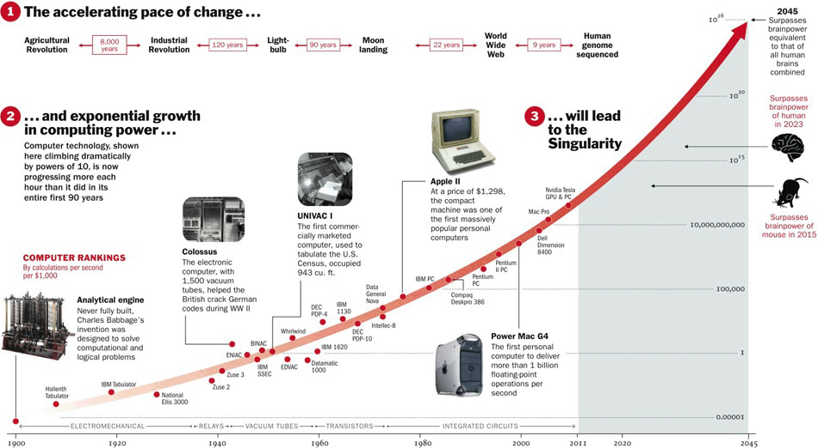
Moore’s law

Slide 5

Convergence
Artificial intelligence
IT
Apps
Big data
Biosensors
Robotics
Nanotech
Synthetic biology
Robotics
3D printing
Biotechnology
Computer Science

Slide 6
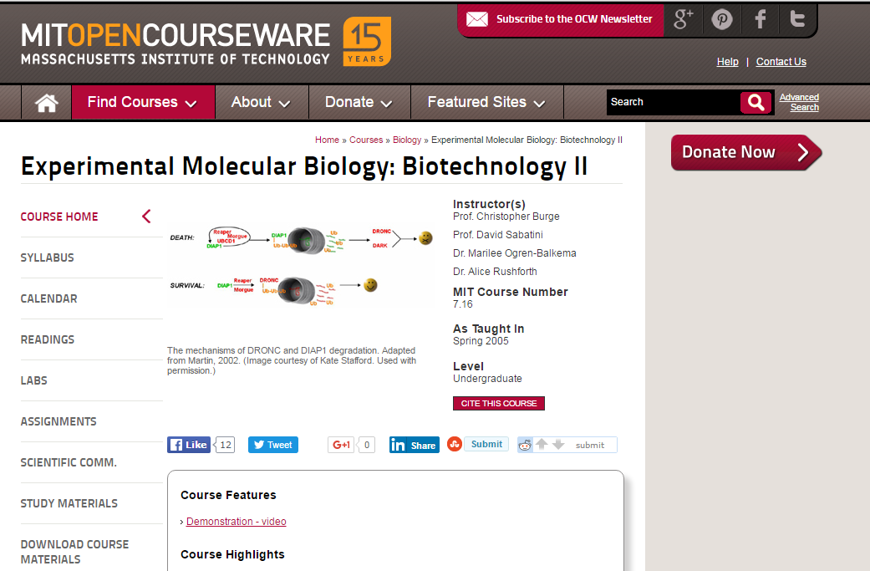
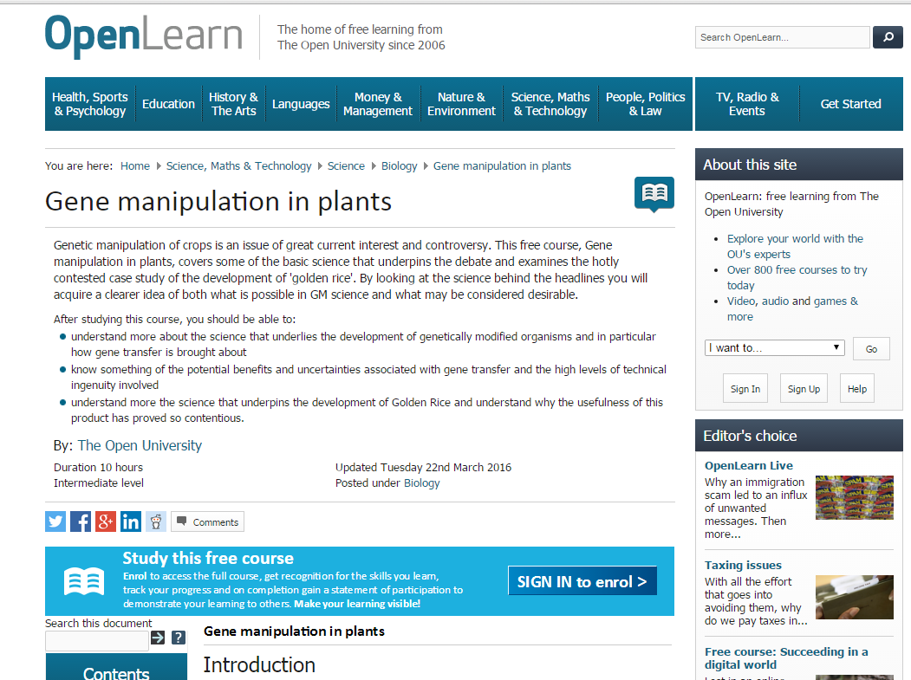
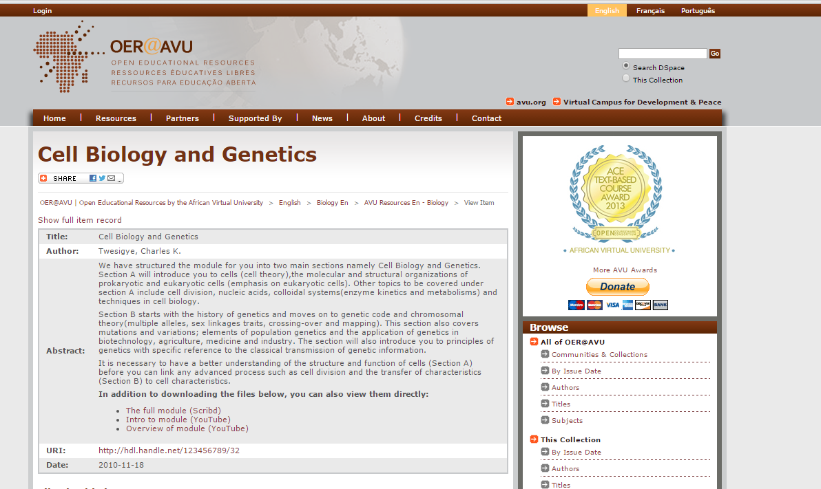

Free courses

Slide 7
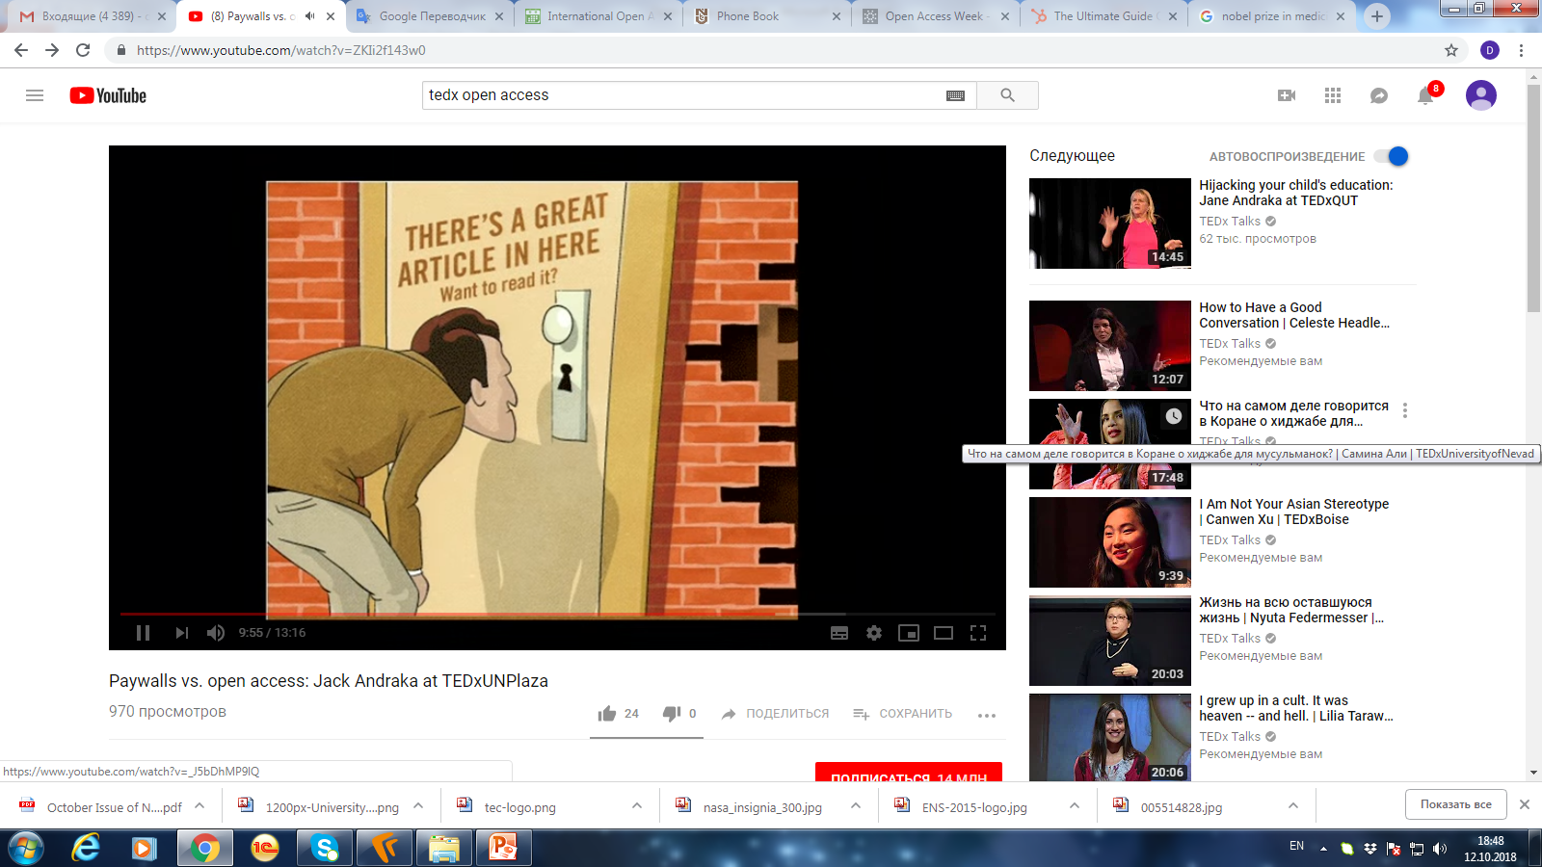
Paywalls
Based on who you are and where you work
90% of people has no access to knowledge

Slide 8
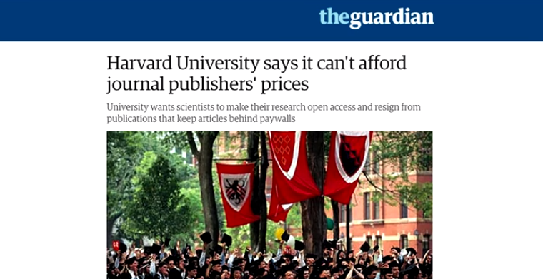
Disadvantages
Higher budget for universities
More time for publishing for researchers

Slide 9
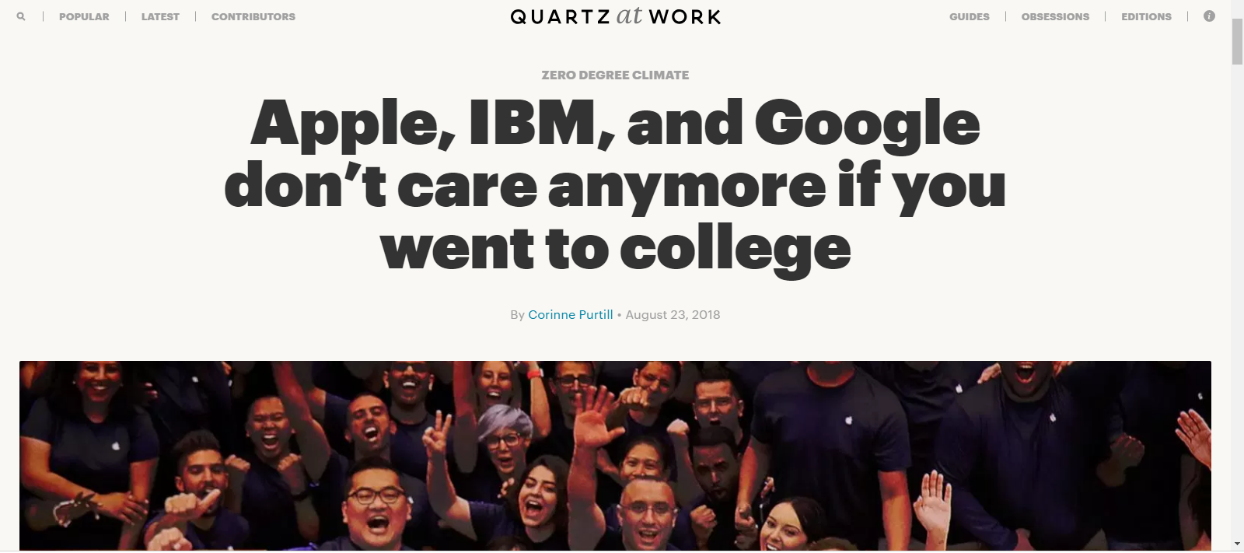
Knowledge democracy

Slide 10


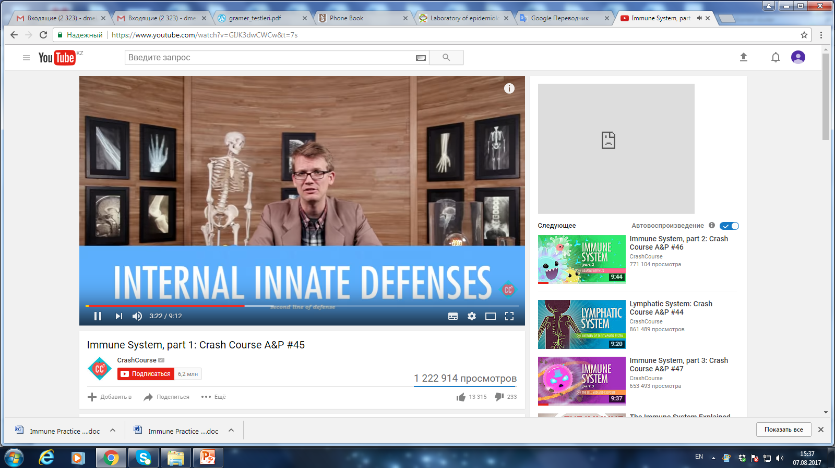
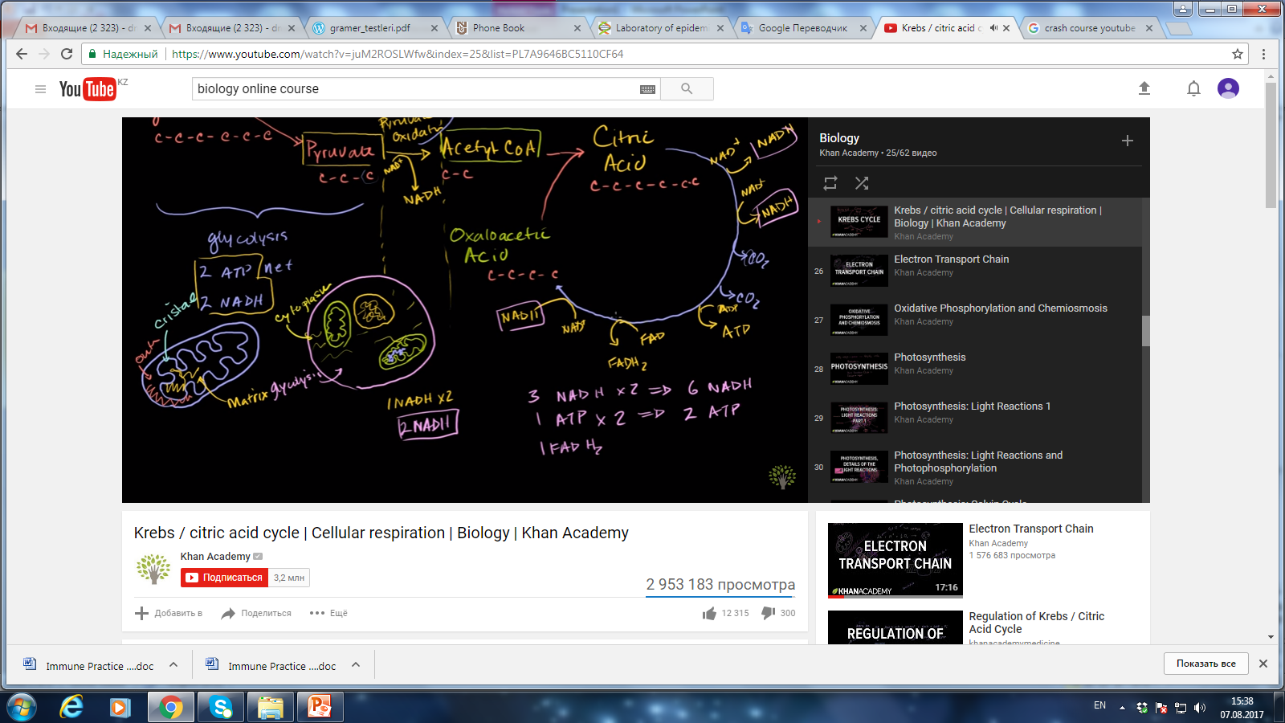


Open courses
6 229 326 followers
643 790 473 views
Registration date: May 19, 2006
3 261 704 followers
1 188 886 060 views
Registration date: November 16, 2006

Slide 11
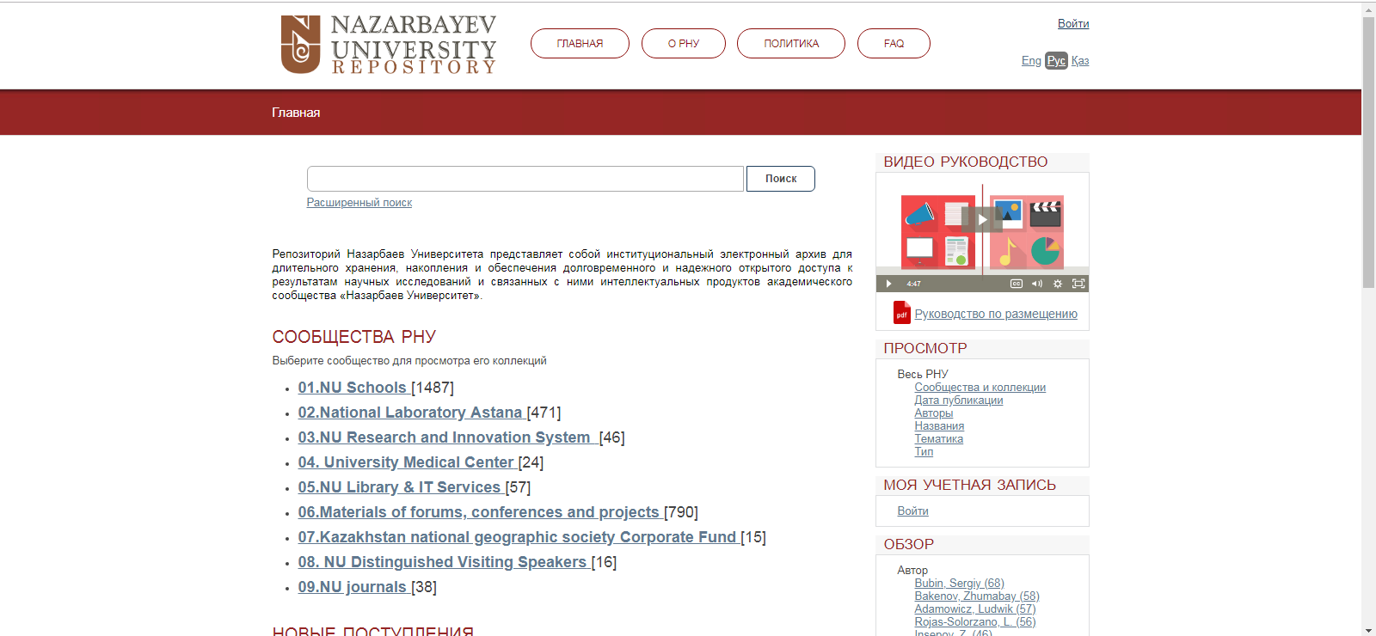
Why at NU

Slide 12
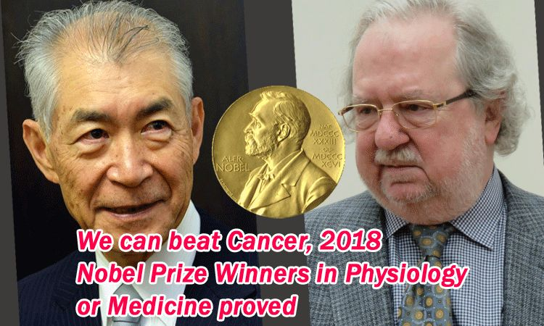

Slide 13
Knowledge is not a luxury
It should be a basic human right

