Slide 1


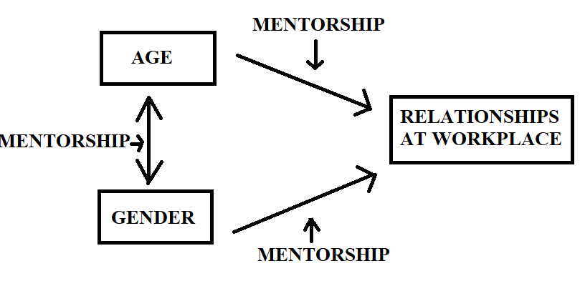
Factors that Affect Relationships at Workplace with Superiors: Perception of Young Female Faculty from Kazakhstan
REPLACE THIS BOX WITH YOUR ORGANIZATION’S
HIGH RESOLUTION LOGO
REPLACE THIS BOX WITH YOUR ORGANIZATION’S
HIGH RESOLUTION LOGO
Moldir Yelibay
Nazarbayev University Graduate School of Education; MSc. In Educational Leadership
Research Questions
It has also been revealed that mentorship can influence workplace relationships by building sense of friendship and collegiality, finding a work-life balance and career advancement opportunities for junior and female faculty (Schrodt, Cawyer& Sanders, 2003, Wilmott, 2009, Bynum, 2015)
Data collection procedures. Advertisement were sent via social networks to female faculty who were employed at universities, aged under thirty.
Data analysis: Transcribed interviews were printed and analyzed for differences or similarities by constant comparative method (Creswell, 2014, p.86). General categories were emerged, then grouped for themes. The last step was coding, where which build a story from data.
The goal of this study is to investigate into workplace relationships of young female faculty members and their superiors. In particular I focused on employee’s age and gender; and how mentorship moderates those relationships.
How are young female faculty treated by their superiors at the workplace?
How are young female faculty treated by their superiors at the workplace, if superior is a mentor?
Conceptual Framework
Findings
Findings pertaining RQ 1:
Young female faculties feel more comfortable if they have a female superior. They also perceive a societal pressure that she is expected to leave for a maternal leave, but then she becomes less skilled than male peers because missed from careers. Young men are considered as an ideal worker to the organization.
Findings pertaining RQ 2:
Interviewees receive guidance from their department chairs. Junior female faculties are navigated throughout the work process and receive assistance either from department chair or from a faculty member who is assigned by a department chair.
Literature review
Studies reveal that positive workplace relationships, particularly with superiors contribute for a better performance of an employer and one’s career advancement (Walthall, Dent, 2016; Colbert, Bono, Pirvanova, 2016).
However, it seems that age and gender bias affects how employers treat young females. For example in Denmark, young women in academia drop out from their career pursuits due to age and gender bias (Nielson, 2017). Another study from Taiwan on young females workers also revealed an unfair treatment at workplace: underestimation due to their young age and gender (Lien, 2005).
Methodology
Research design: Qualitative interview based study
Sample: Female faculty from Nur-Sultan, aged before 30, any discipline. Participants were found by snowball sampling.
Data collection methods: Semi-structured interviews
Contacts
References
Moldir Yelibay
Nazarbayev University
Email: mnurazkhan@nu.edu.kz
Phone: + 7 775 914 61 62
Bynum, Y. P. (2015). The power of informal mentoring. Education, 136(1), 69-73.
Colbert, A. E., Bono, J. E., &Purvanova, R. K. (2016). Flourishing via workplace relationships: Moving beyond instrumental support. Academy of Management Journal, 59(4), 1199-1223.
Lien, B. Y. H. (2005). Career development and the needs of young college-educated females in Taiwan. Journal of Career Development, 31(3), 209-223.
Nielsen, M. W. (2017). Reasons for leaving the academy: A case study on the ‘opt out’phenomenon among younger female researchers. Gender, Work & Organization, 24(2), 134-155.
Schrodt, P.,Cawyer, C. S., & Sanders, R. (2003). An examination of academic mentoring behaviors and new faculty members' satisfaction with socialization and tenure and promotion processes. Communication Education, 52(1), 17-29.
Walthall, M., & Dent, E. (2016). The leader-follower relationship and follower performance. Walthall, M., & Dent, EB (2016). The leader-follower relationship and follower performance. Journal of Applied Management and Entrepreneurship, 21(4), 5-30.
Willmott, K. E. (2013). Gender, Tenure and the Pursuit of Work-Life-Family Stability: An Exploration of Female Faculty Experiences at a" New Ivy" Research Institution (Doctoral dissertation, University of Rochester).

