Slide 1
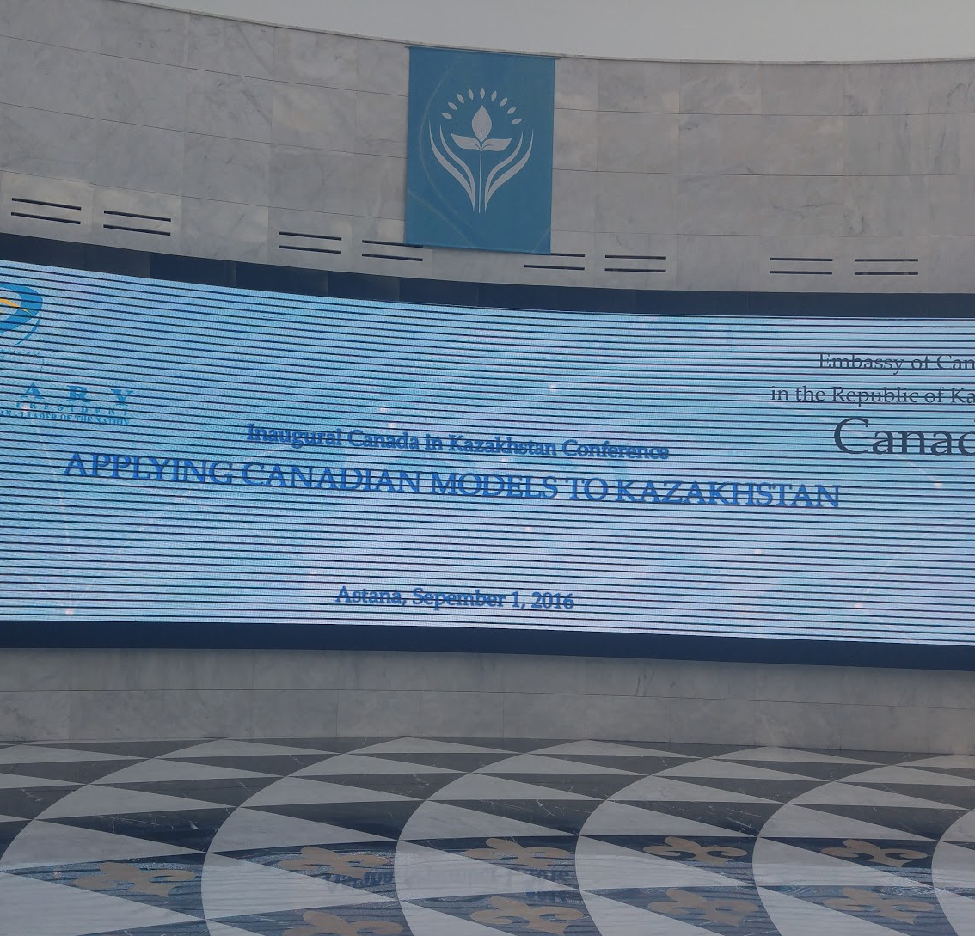
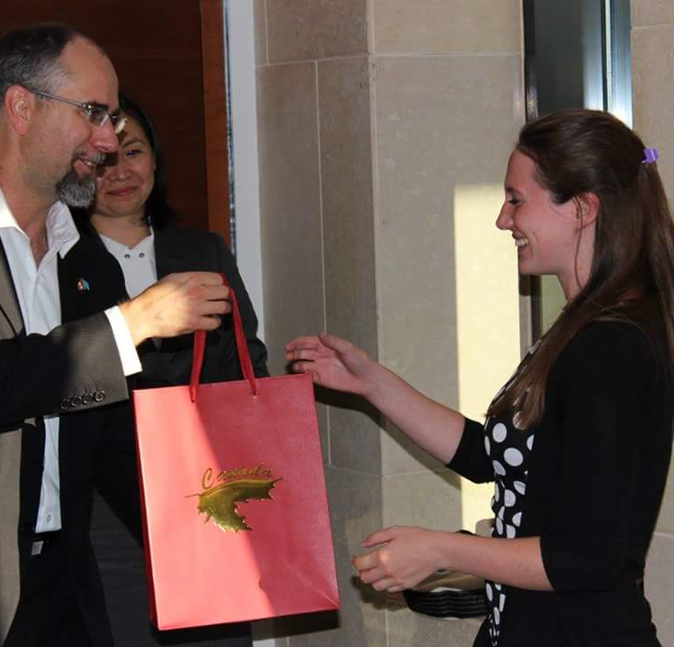
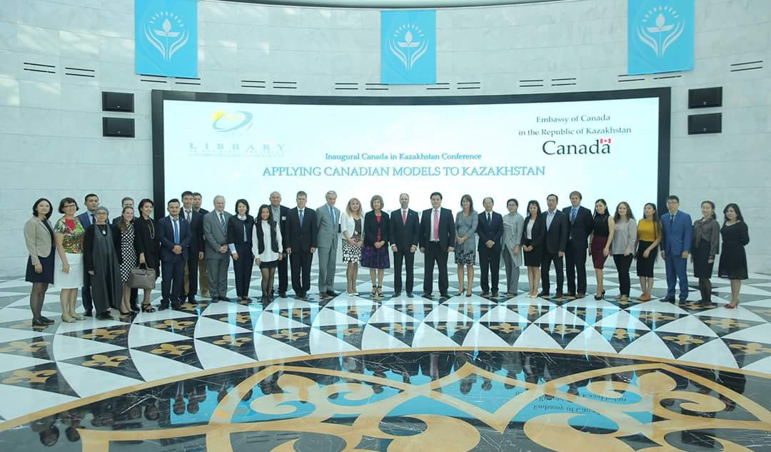

Conference Report from
Canada in Kazakhstan
The Conference
My Paper
Values of Librarianship
Canadian vs. Kazakh Laws
Canadian vs. Kazakh Libraries
Carlene Groen – Subject Librarian
Presentation for Library Staff
October 13, 2016

Slide 2
Canada in Kazakhstan Conference
Conference Themes
Public Service Institutions
Climate Change
Social Diversity as Strength
Recommendations
Government Transparency
Access to Information
Notes:
In July, there was a call for papers from the Canadian embassy for a conference on applying Canadian models to Kazakhstan. The invite was sent to the Faculty, but since Librarians are not included in the Faculty email list I heard about it on Facebook. So just think about all the information we are missing out on - it makes me angry! Considering Librarians weren’t invited to participate in this conference, my paper got 2nd place - it was better than GSPP and Engineering proffs. I’m telling you this, because Librarians deserve to be treated equal to Faculty, we publish and present at conferences, so we deserve to be included. We are equal!
The papers could discuss public service institutions, climate change, and social diversity. Every presentation had to have recommendations, and a theme emerged about the importance of having a transparent government and about open data/information.
Jay Saginbekov from Engineering discussed issues of Climate Change, but he has trouble in his research with getting GIS Data from the State. In Canada, that data would have to be made open access but in Kazakhstan weather data is considered a State secret.
My presentation discussed Kazakh laws that create a barrier to information access. I talked about censorship and State control. My recommendations also had themes of government transparency and access to information.
Any questions about the conference

Slide 3
Value of Librarianship One
Does the NU Library
Create educated and empowered citizens?
Provide equal and inclusive access to information?
Libraries create educated and empowered citizens by providing equal access to information
Notes:
I’m interested in social justice issues that relate to information access - think banned books, open access, digital divide, democratization of information, even the impact of poverty, environment, economics, and politics on the information landscape.
I became a Librarian because I want to help create educated and empowered citizens - which is a value of Librarianship.
Citizens gain knowledge from the information accessible through the library.
So what do you think?

Slide 4
Value of Librarianship Two
Does the NU community trust the Library to
Create educated and empowered citizens?
Provide equal and inclusive access to information?
Libraries act as a social bridge and bond within a
community for individual citizens to begin trusting each other regardless of their differences.
Notes:
For my Master’s degree I did a specialization called “community informatics”. Which is how to use technology for community development. But you can’t do any sort of community development work without trust.
Trust is reciprocal - we need to trust our community and the community needs to trust us. But even more than that, Libraries can build trust in the community.
I’m going to tell a story from my last job because it warms my heart. Georgetown is an academic library but we are open to the public. So every morning a Syrian refugee and one of our students started off their day by reading the newspaper. They started sitting as far apart as they possible could, but near the end they were sitting close together passing the different sections of the newspaper back and forth. The Library set the stage for that trust to be built.
What do you think?

Slide 5
Values of Librarianship
Three
Do NU Library activities support the advancement of a democratic society?
“Support the advancement of free and democratic society”
Notes:
An IFLA document manifesto on transparency, says “The information access provided by libraries and information services contribute to good governance by enlarging the knowledge of citizens and enriching their discussions and debates”. The discusses the Library role in developing citizen participation for democratic activities as being beneficial to guard against corruption and to ensure government transparency and accountability.
Just a show of hands. How many of you think Libraries have a role to play to preventing government corruption? What about the role of Libraries in government transparency? (maybe you aren’t sure?)
Do NU library activities support the advancement of a democratic society? Any examples?
Let’s give an example.
A student asks you what book they should read next. You can suggest Fifty shades of grey or if you suggest Henrietta Lacks, a story of race rights and medical ethics in America. How you answer can shape the students experience.
During banned books week, instead of showing books that were banned in the U.S we could have done a display of book covers from books banned in Kazakhstan. That would have supported the advancement of a free and democratic society.
Another example is leading by example. Making all our meeting minutes open to the University - that would show our transparency.
Those are some examples of how the role the Library has in supporting the democratic society.
Where does the quote “supporting the advancement of free and democratic society” come from?

Slide 6
Canada vs. Kazakh Laws - Libraries
Canadian Libraries Act
“Support the advancement of free and democratic society”
Kazakh Law on Culture
“Purpose to store and preserve collections”
Notes:
Supporting democracy isn’t just a value of Librarianship. In Canada, by law, Libraries are required to advance the free and democratic society.
Compare that to Kazakhstan. By law all we are required to do is store and preserve collections.
Until I read this, I really didn’t understand the obsession with the difference between open and closed access. If this is the purpose of Libraries you aren’t going to want people to use your collection - because they might get damaged - which goes against the law to preserve collections. The law doesn’t actually say you need to let people access the collections.
So for me, this law on culture that directs the purpose of Libraries goes against all 3 values of Librarianship that I hold.
Libraries create educated and empowered citizens by providing equal access to information
Reciprocal community trust
Advancement of the democratic society

Slide 7
Canadian laws support information access
Kazakh Laws do not support information access
Notes:
The argument explored this topic.
The Canadian Constitution, Copyright, and municipal regulations support Libraries providing access to information to citizens as compared to the implementation of the Kazakh Constitution, Copyright, and State regulations which restrict and conflict with the values of Librarianship and the practices to developing a community with a diversity of ideas.
So you ladies are probably much more familiar on the topic of Kazakh laws, but in terms of research publications with Libraries, there is a gap in the research. So my paper attempts to start the discussion of the impact of laws on information access in Kazakhstan.
Madina’s article feeds into this conversation too, because Kazakhstan has lots of strategic goals in science and education, that require educated and empowered citizens. But the laws of Kazakhstan are a barrier.

Slide 8
Store and Preserve
≠
Access and Knowledge Creation
Notes:
Let’s explore this law on culture a bit more. Store and preserve - Does not include providing access. We can store and preserve, but we don’t even have to provide access. Let that sink in. by law we don’t have to let people touch our books.
Part of why this is, is historic - so under the Soviet past Libraries were tools to collect one-sided political thoughts and ideas then to disseminate this political propaganda. Librarians restricted information to, “readers’ rank, connections, or social status”. This is not the equal access value of librarianship.
A modern example of this is the Library of the first President, this is where the conference was held. Its sole purpose is to store and preserve information about the President. They make it very difficult to access because when I went you had to go through 2 security check points and all of its resources are closed access. In order to visit, you have to fill out an application form and get accepted.
So as Librarians we have to work really hard to change the perception that libraries just store information. We provide not only access but that Libraries can also help our community create new knowledge. We can help with their papers, making videos, images, we can help communicate their ideas by helping with blogs, conferences, speeches.

Slide 9
London Public Library
Pushkin Library
“LPL Strengthens people and neighborhoods by creating connections that enrich lives, inspire discovery, and foster creativity, and expand possibilities”
“Store and preserve collections”
Notes:
Canadian Libraries policies are created at the municipal or city level. This is important because different communities have different needs. Which means each Library has the autonomy to create it’s own policies. Can you imagine the possibilities if we weren’t accountable to auditors - but to our community?! That would go a long way to creating trust.
Canadian libraries can respond to the needs of the local community. In London Ontario, that means providing programing like songwriting, beatles festival, local author and filmmaker workshops. They even have classes on breastfeeding and lego makerspaces. This is what is needed in their community.
Compare that to the Pushkin Library. There are trying to push beyond just storing information, because they used to have this 1 year program to develop IT job skills. So in the end 55 people got jobs, and 10 went on for higher education. But they could only do that with money from a U.S non profit. There was clearly a need in their community for IT skills, and yet instead of extending this program - the Library made the “our abai” database. That is the job of an archive - not a library. Libraries help people use information for the creation of new knowledge.
Kazakh Libraries are limited by the laws but we also limit ourselves.

Slide 10
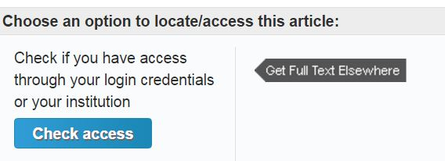



NU Library Information Access
Notes:
So how do we change the perception that Kazakh Libraries provide access and can help with knowledge creation, when we can’t even provide a basic level of information access. This is funding related of course. But I don’t know about you - but seeing all these lock symbols and recommend to your Librarian - they just ruin my day.
How can our community begin to trust us when we can’t even provide the basics of information access? It isn’t very often that I can tell a student Yes! We actually have that book or article.
If they don’t trust us to provide information how can we even begin to get them to trust us to help them in any other ways like data management, content creation like videos, images, maps.

Slide 11
Canada vs. Kazakh Law - Constitution
Canadian Constitution
“Freedom of religion, thought, expression, press, and peaceful assembly”
“The right to participate in political activities”
Kazakh Constitution
Can be overridden by law
Censorship is legal
No press freedom
Spying on citizens
Restricted assembly
Notes:
Limited by the Law on culture, we are limited by funding. And we limit ourselves, and we are limited by trust. But we are also limited by the laws that override the constitution.
In Canada, our Constitution provides us with the freedom of thought, expression, press freedoms, and can participate in political activities. All of these are important to information access and knowledge creation.
The Kazakh Constitution uses the word freedom a lot, but doesn’t define what that means there is also the fact that the constitution can override by laws. There are laws to make censorship legal, press freedom is void, spying on its citizens legal, restriction on ability to assemble or gather. I figure what hits the English news is only a little part of the whole story, so you ladies are probably hear more stories about when the internet is turned off, when protests are stopped, stories about bribery and corruption. All of this is important for you as Libraries to consider. They impact how you do you job, and they impact your community.
What this means is you voted for a president that makes it legal to censor information. You voted for a president who perpetuates the digital divide. You voted for a president that restricts your ability to access information. And because we live in the information age, therefore you voted for a President that limits your ability to compete in the global economy.
Because the President you voted for Librarians can’t provide basic levels of information access.

Slide 12
Bad Libraries Build Collections
Good Libraries Build Services
Great Libraries Build Communities
David Lanks. 2012
Notes:
In conclusion:
Because of Kazakh laws of censorship, and laws about the purpose of libraries to only preserve information- - we are limited to being a bad Library.
Building collections is all the State wants us to do. But our values as Libraries means we want to build services that provide access to information.
Values of Librarianship also require us to educate and empower, but because we don’t have the trust of people to provide collections and services we can’t become a great Library.

Slide 13
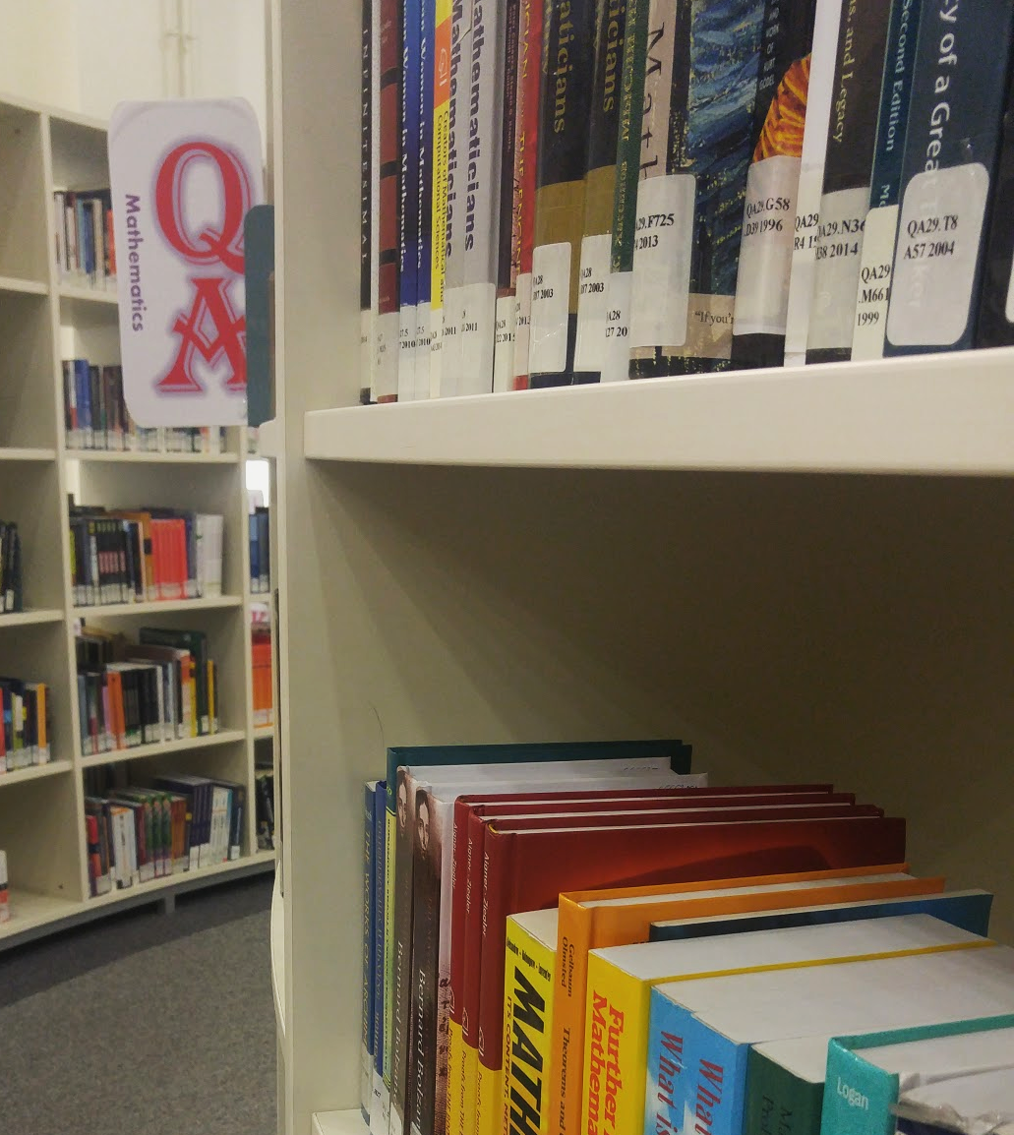
Contact
Carlene Groen
Subject Librarian for SST
Nazarbayev University Library
Block 5: Floor 3
carlene.groen@nu.edu.kz

