Slide 1
Indoor air quality assessment during lockdowns and improvement strategies for the residential houses in rural areas in Kazakhstan
Nurlan Otesh ID:201569201
Supervisor: Prof. Ferhat Karaca
Co-Supervisor: Prof. Mert Guney

Slide 2
Thesis Defense Outline
Introduction
Methodology
IAQ Benchmark
I/O air pollutants relationship
CO2 behavior at cooking process
Heating systems and Thermal comfort
Effect of heating system on CO2
Conclusion

Slide 3
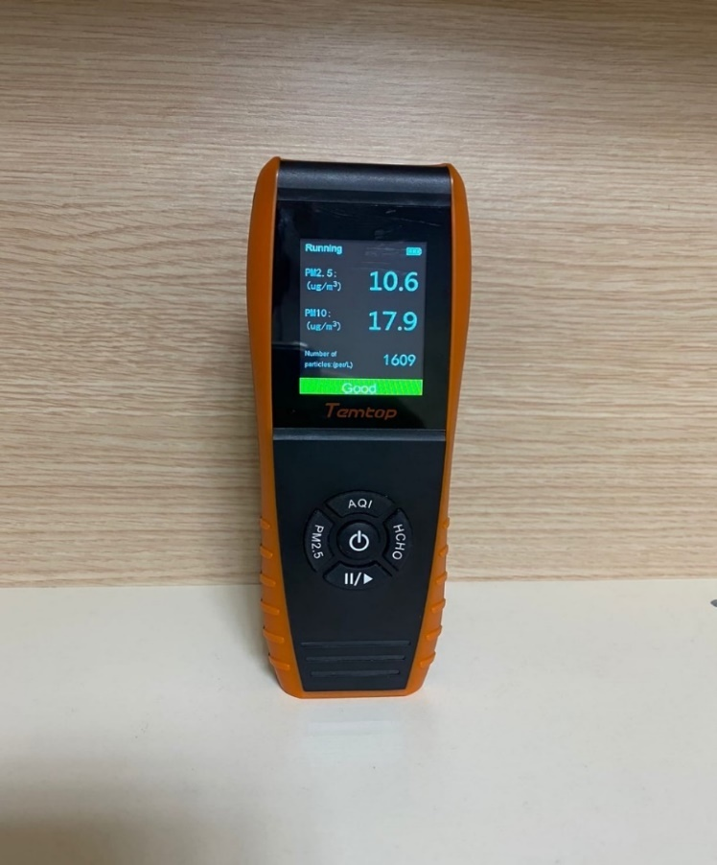
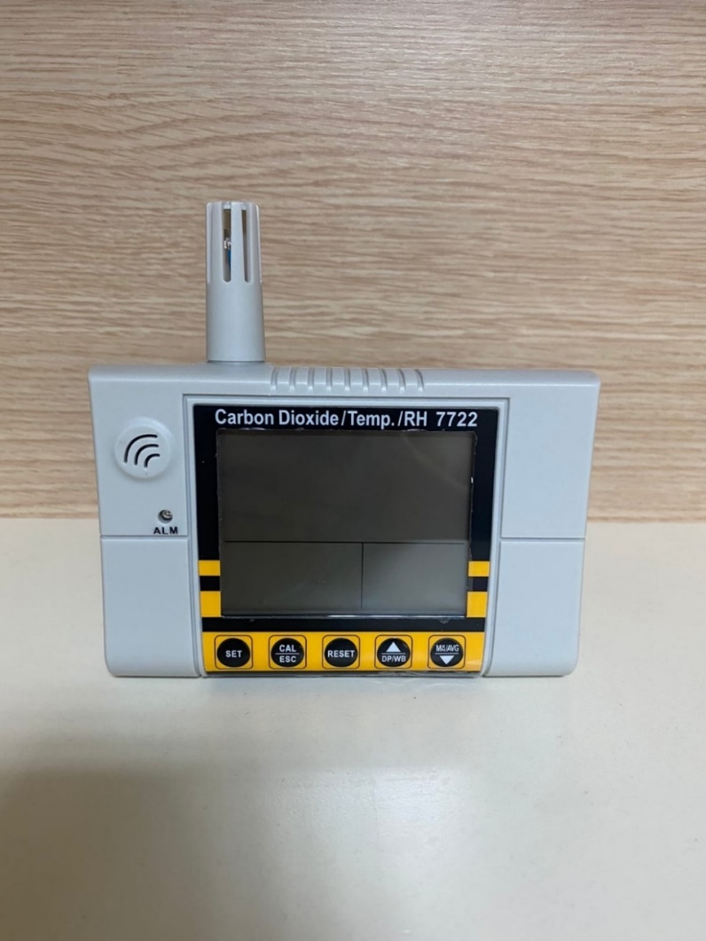
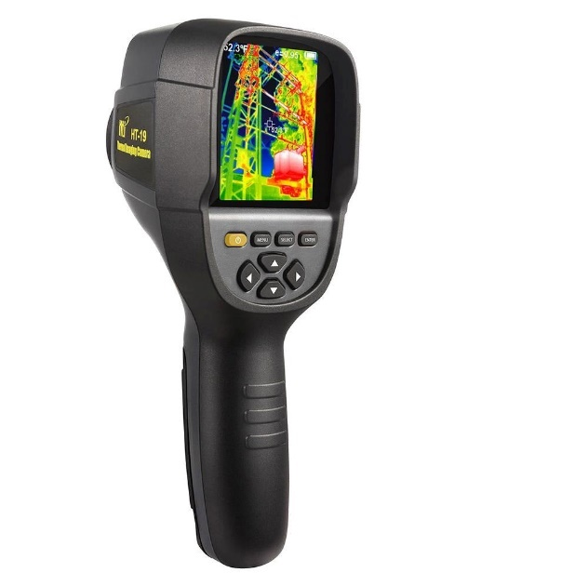
Sampling and Monitoring
Material Usage
Figure 1. PM meter, CO2 meter, Thermal camera

Slide 4
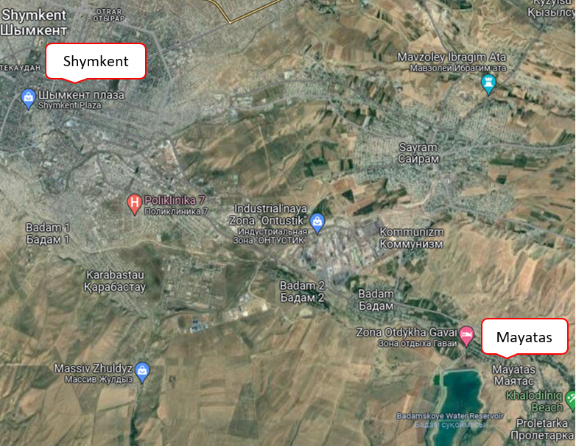
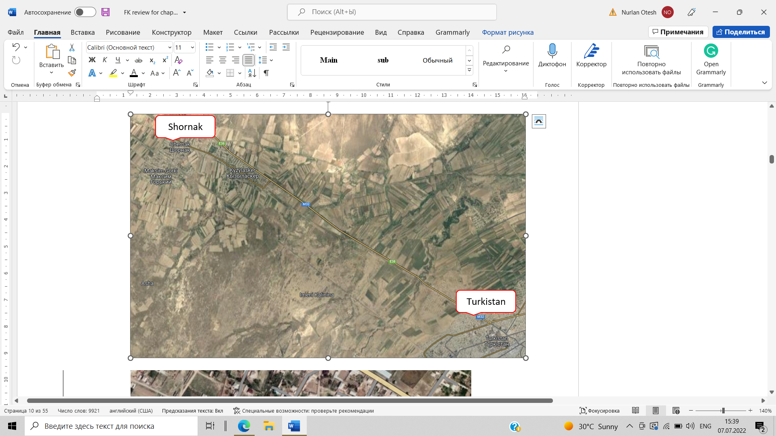
Sampling and Monitoring
Study Area
Mayatas (Toleby audany, 40km away from Shymkent) – 4 houses
Shornak (Turkestan audany, 30km away from Turkestan) – 3 houses
Figure 2. Geolocation of Mayatas and Shornak

Slide 5
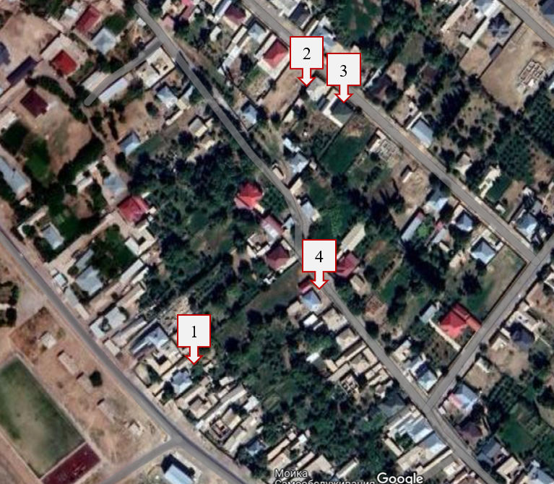
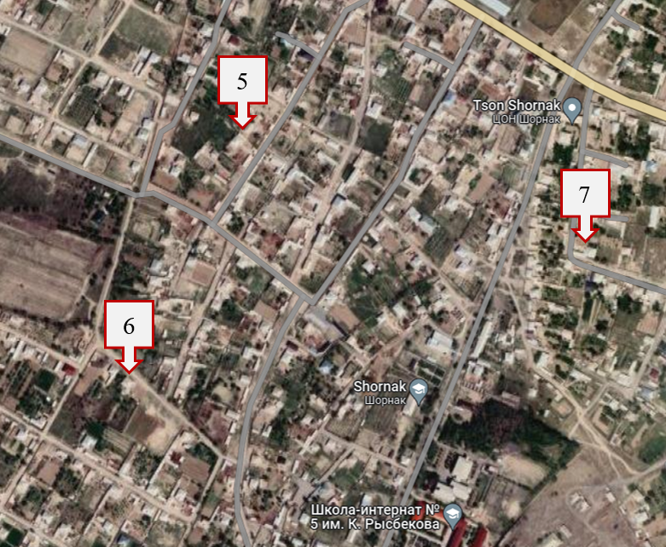
Sampling and Monitoring
Study Area
Figure 3. Geolocation of monitored houses in Mayatas and Shornak respectively

Slide 6
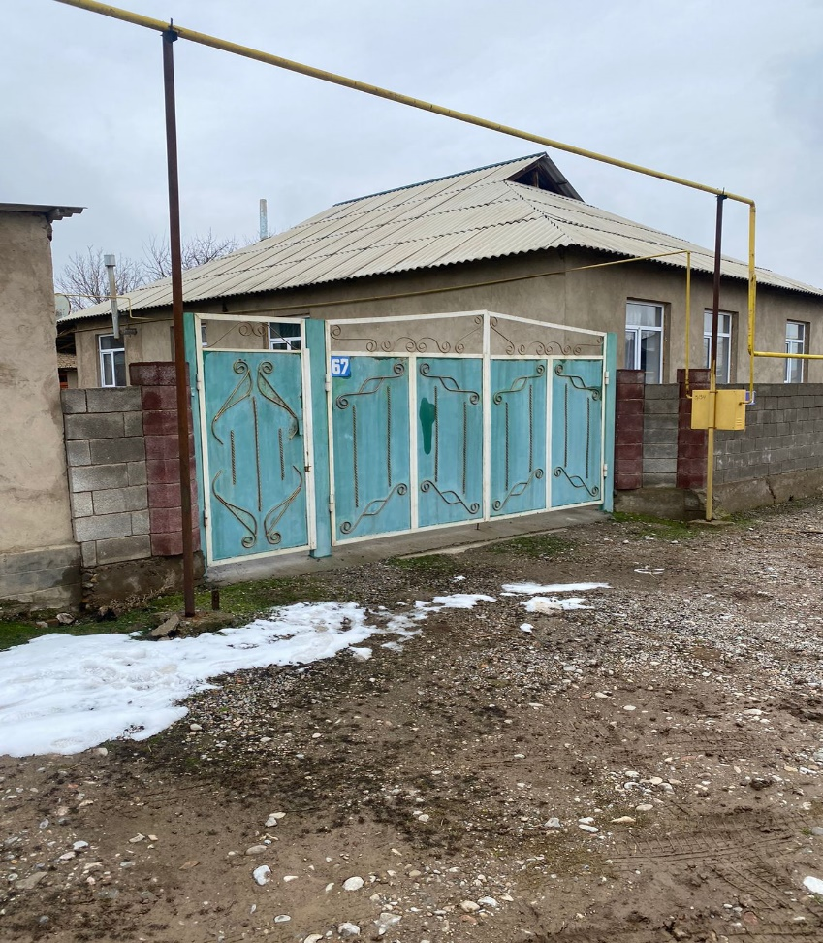
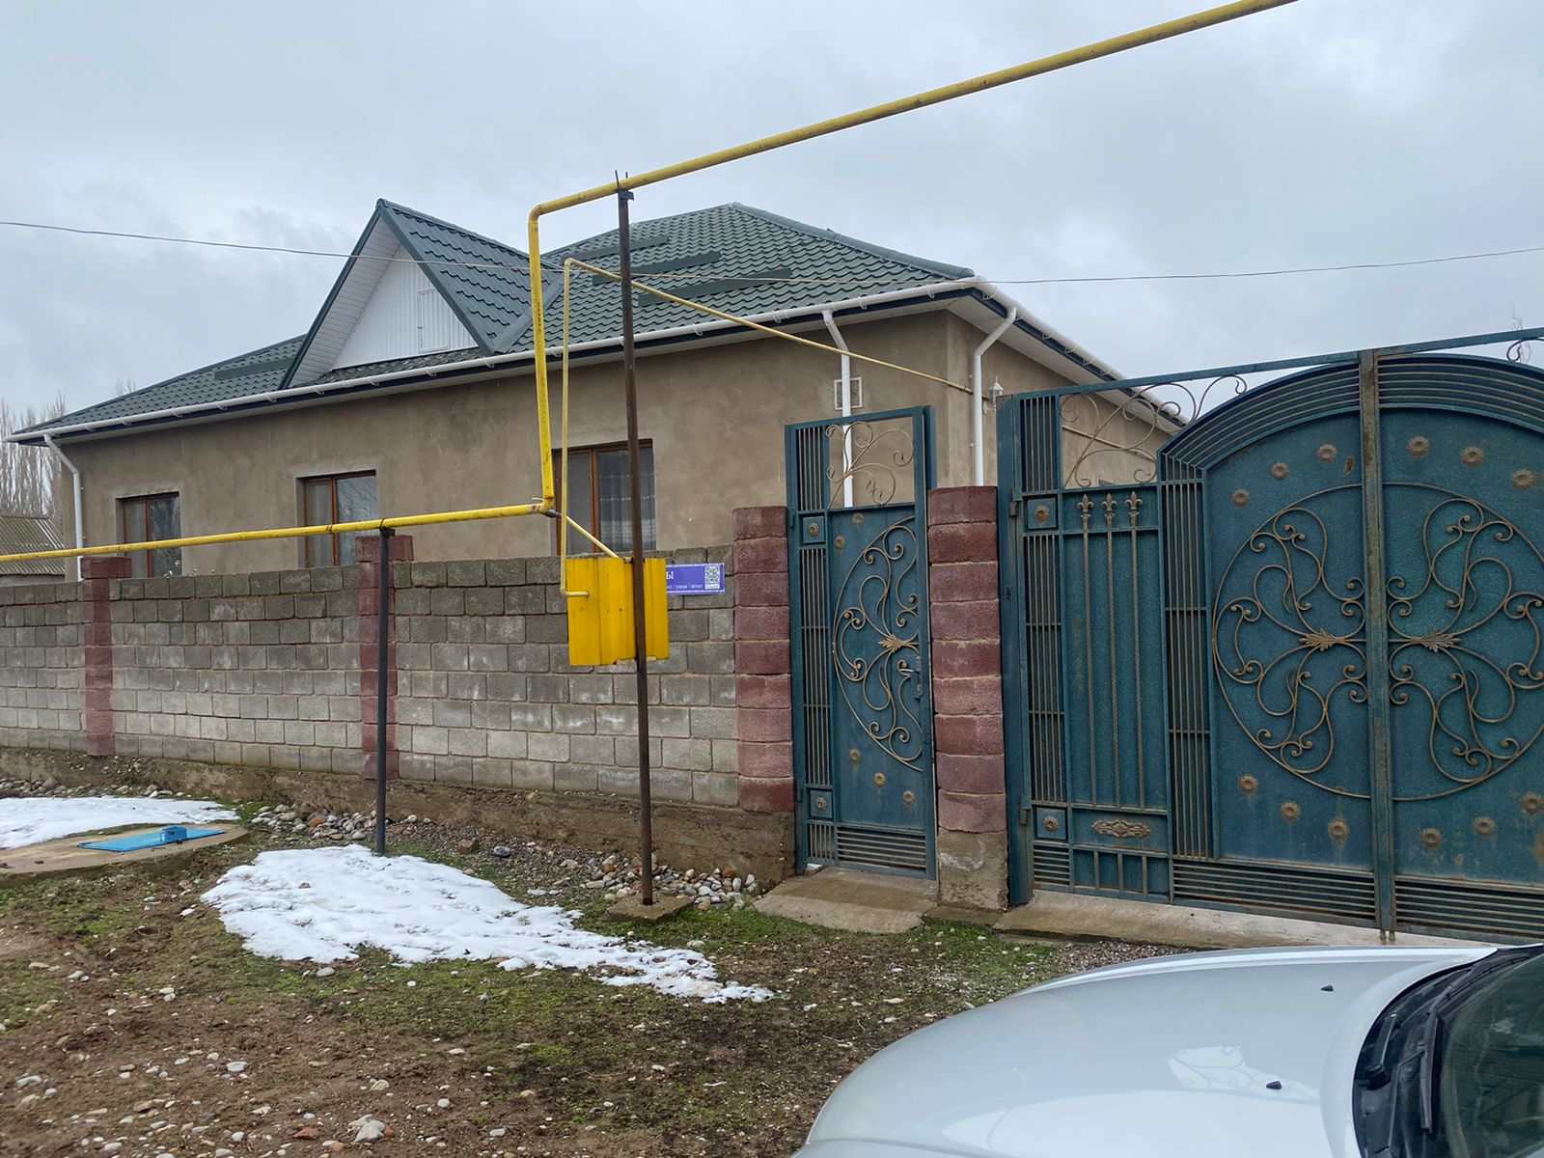
Sampling and Monitoring
Mayatas village
Figure 4. Monitored houses in Mayatas (House number 1 and 3)

Slide 7
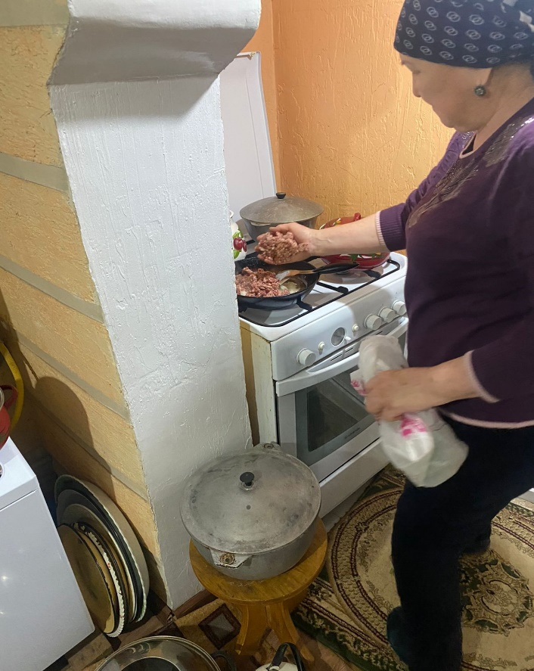

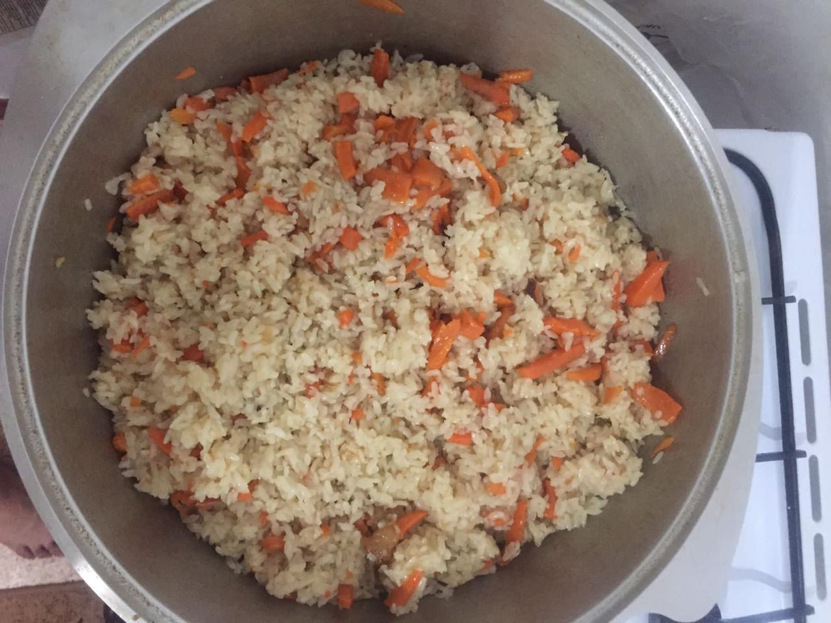
Sampling and Monitoring
Mayatas village
Figure 5. Cooking time photos in Mayatas

Slide 8
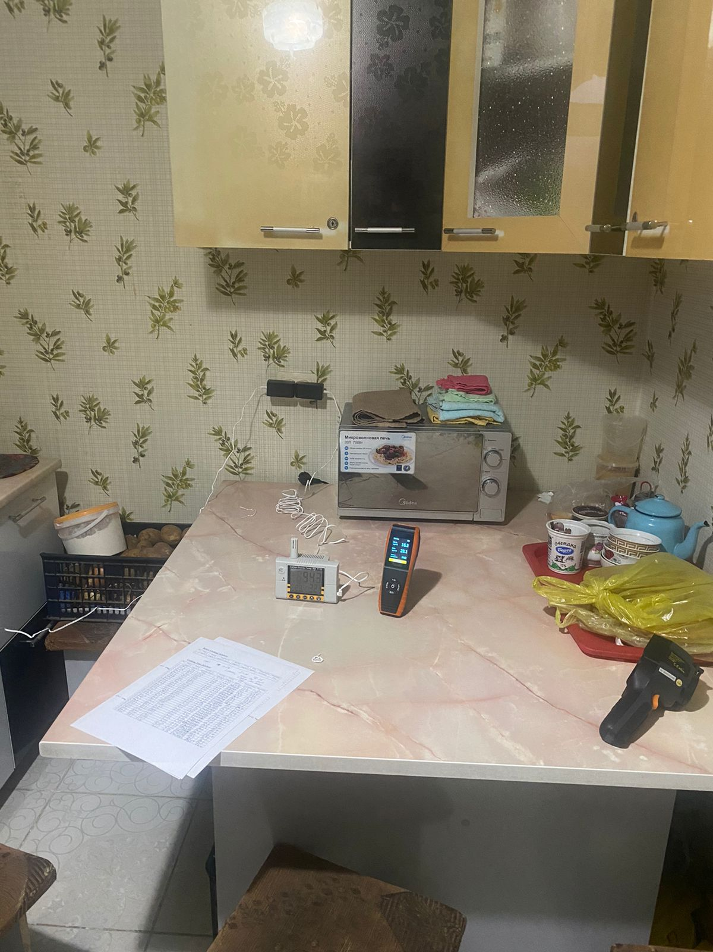
Sampling and Monitoring
Monitoring procedure
Attach the sensors properly
Prepare the room for monitoring
Fill out the questionnaire
5 min will stay at rest
Data recorded every 2 min
The duration of monitoring a 1 hour
Kitchen room and outdoor monitored
Figure 6. House – 5, Data collection process

Slide 9
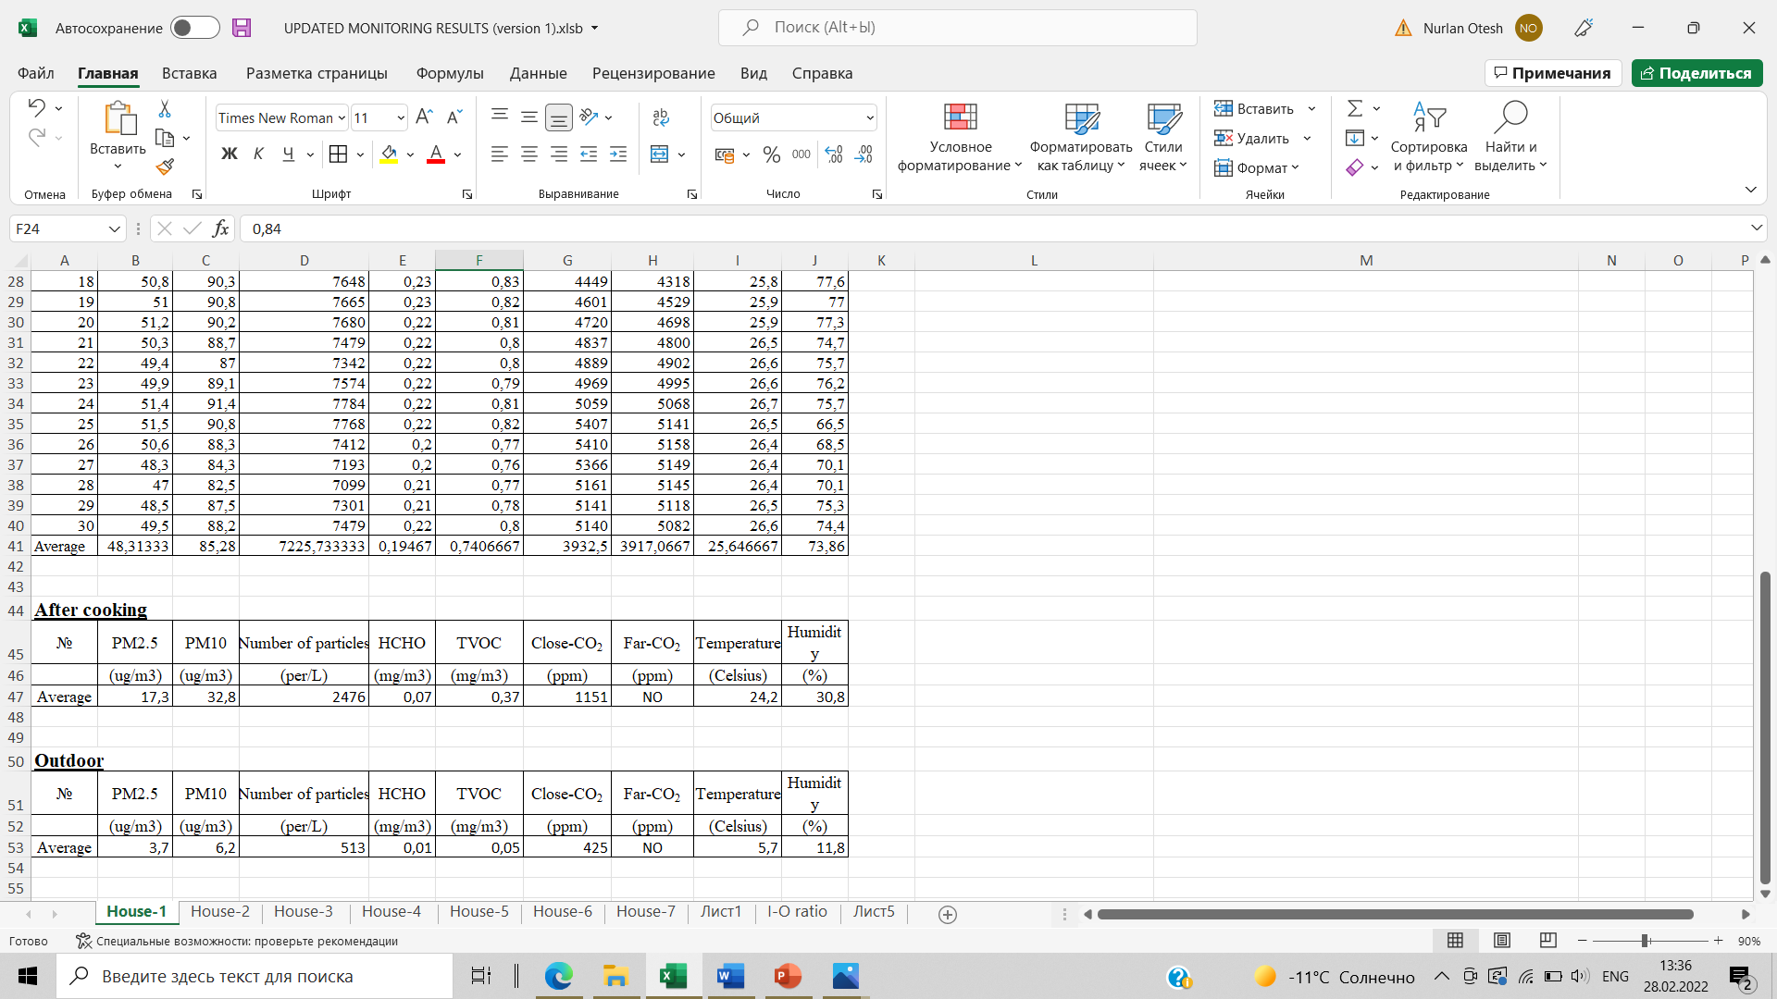
Sampling and Monitoring
Data collection
Pollutants | Allowable | Unacceptable
PM2.5 | 15 ppb
PM10 | 50 ppb
CO₂ | 1000 ppm | 5000 ppm
HCOH | 0.27 mg/m³ | -
Humidity | 20-50% | 50-100%
Temperature (Heating seasons) | 21.8 – 30 Celsius | Below 21.8 Celcius Higher 30 Celcius
Figure 7. Data recorded on Excel

Slide 10
Sampling and Monitoring
House | Wall structure material | Insulation material | Kitchen room connection
1 | Straw blocks | No | Direct connection with corridor
2 | Burnt bricks | Styrofoam | Isolated by a wooden door
3 | Burnt bricks | Styrofoam | Isolated by a wooden door
4 | Straw blocks | No | Direct connection with living room
5 | Cinder blocks | Styrofoam | Isolated by a wooden door
6 | Straw blocks | No | Direct connection with outdoor door
7 | Straw blocks | No | Isolated by a wooden door
Table 1. Wall materials and building characteristic

Slide 11
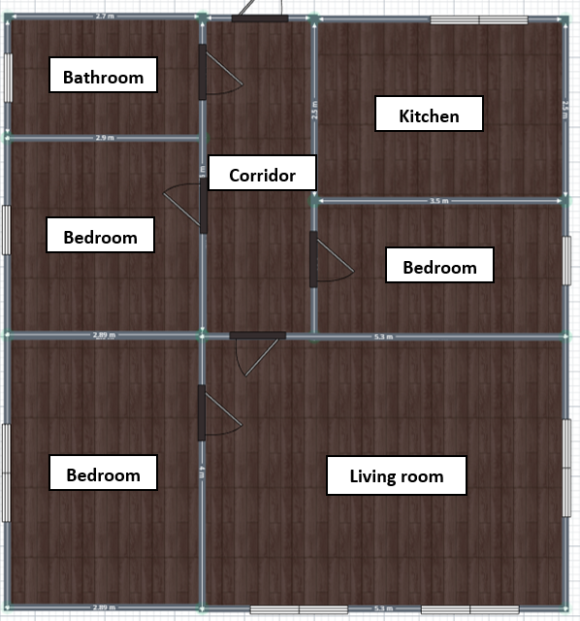
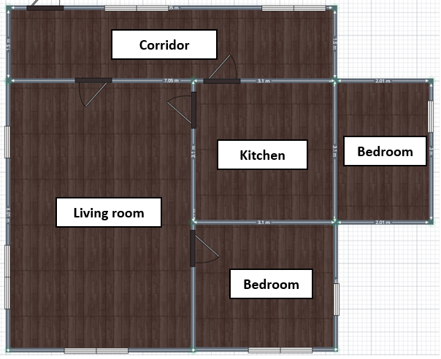
Sampling and Monitoring
The layout of rooms
Figure 8. The layout of Houses 1 and 2, respectively

Slide 12
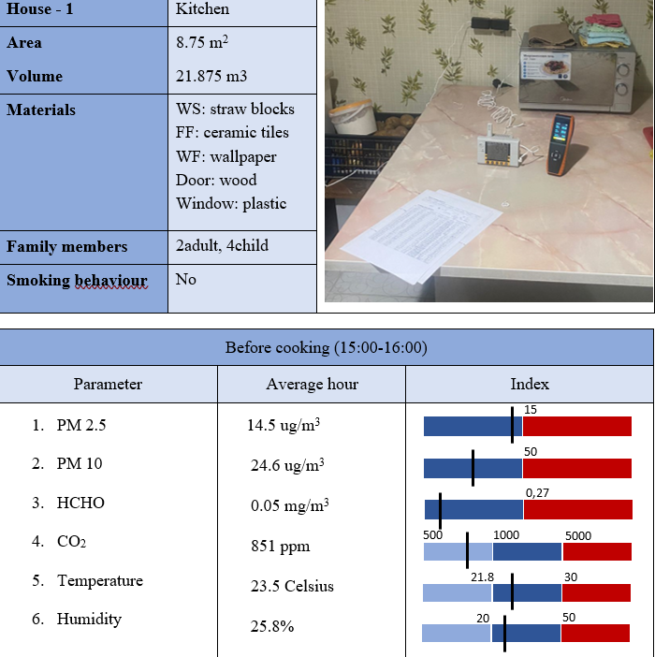
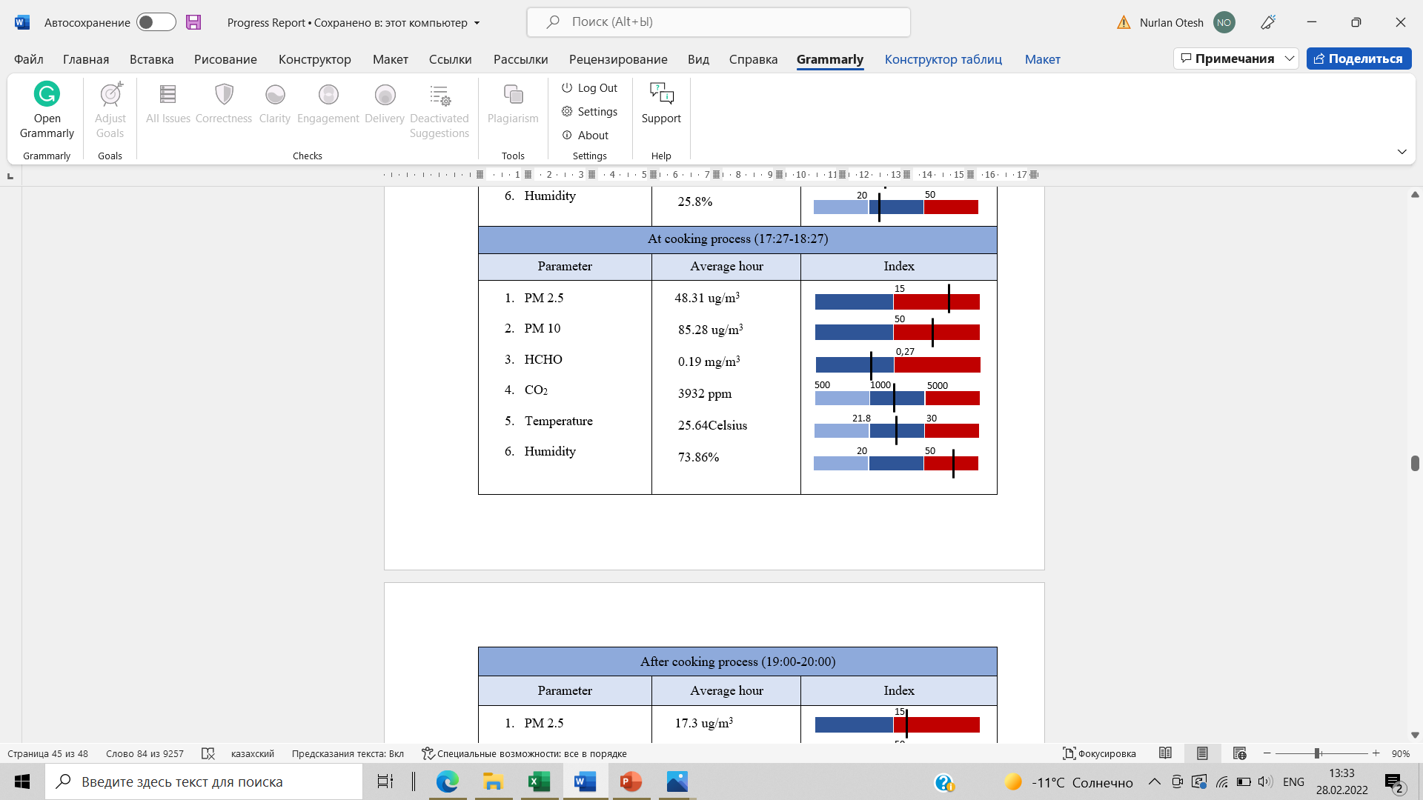
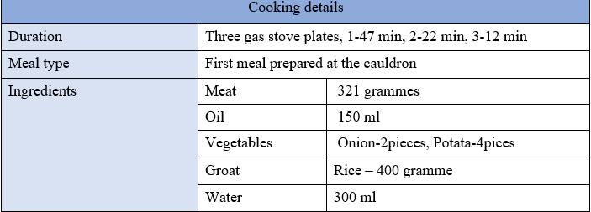
IAQ Benchmark
Figure 9. Collected data and IAQ Benchmark for house-1

Slide 13
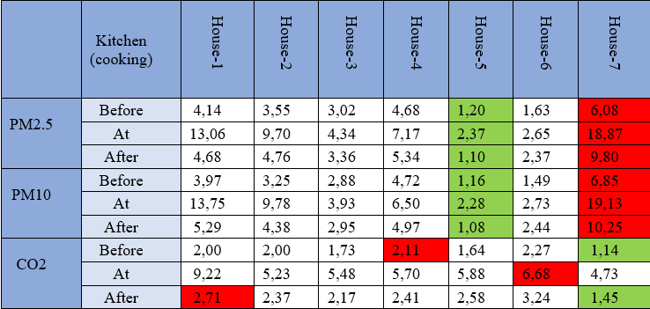
I/O ratio for air pollutants
Table 2. The I/O ratio value of air pollutants

Slide 14
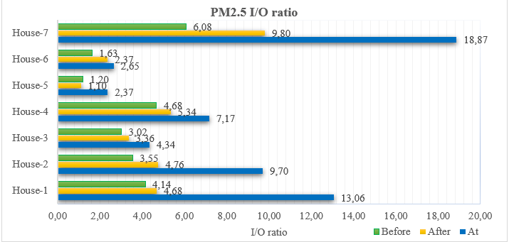
I/O ratio for air pollutants
Figure 10. PM2.5 I/O index in the kitchen room (before/during/after cooking)

Slide 15
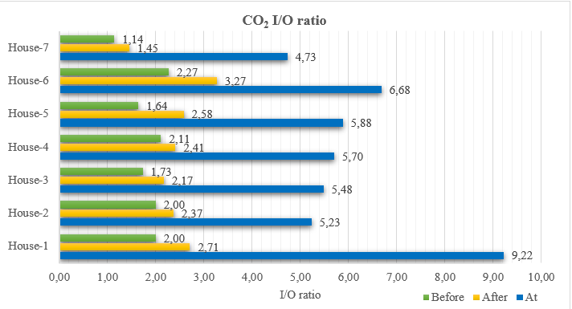
I/O ratio for air pollutants
Figure 11. CO₂ I/O index in the kitchen room (before/during/after cooking)

Slide 16
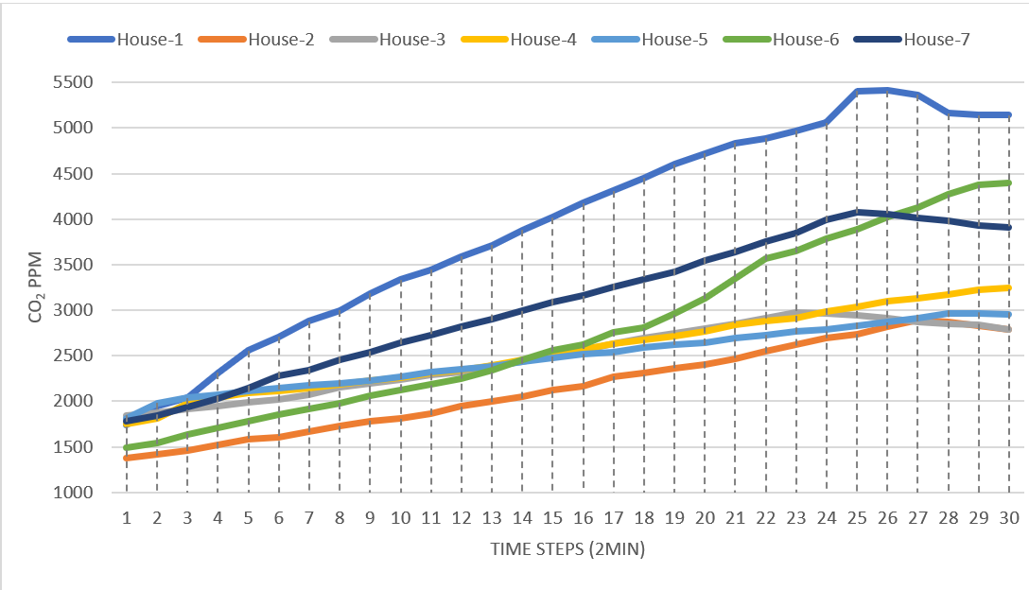
CO2 behavior at cooking process
Figure 12. CO2 trend at the cooking process

Slide 17
CO2 behavior at cooking process
House № | 1 | 2 | 3 | 4 | 5 | 6 | 7
CO₂ trend % | 604 | 350.36 | 379.82 | 344.16 | 425.36 | 371.78 | 548.45
Meal type | Main Course | Soup | Main course | Main course | Main course | Soup | Main course
Kitchen area (m²) | 8.75 | 9 | 12 | 18 | 15 | 10 | 6
Kitchen volume (m³) | 21.875 | 24.3 | 36 | 48.6 | 45 | 28 | 15
People in kitchen | 3 | 2 | 2 | 3 | 2 | 2 | 2
Duration | 47 | 40 | 48 | 60 | 54 | 60 | 35
2nd Stove duration | 22 | - | - | - | 33 | - | 24
3rd Stove duration | 12 | - | - | - | - | - | -
Tefal | - | - | - | 7 | - | - | 8
Cooking style | Firing in oil | Boiling the water | Firing in oil | Firing in oil | Firing in oil | Boiling the water | Heating and firing
Meat (gramm) | 321 | 232 | 344 | 327 | 176 | 251 | -
Oil | 150 | 30-50 | 50-80 | 150 | 150 | 80-100 | 100
Water | 300 | 1500 | 300 | 600 | 1750 | 750 | -
Condition of cap | Open | Closed | Closed | Closed | Open | Closed | Open
Table 3. CO₂ emission rate accordance to various parameters

Slide 18
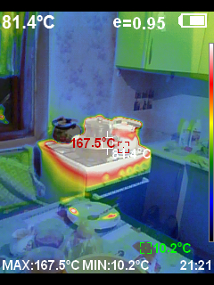
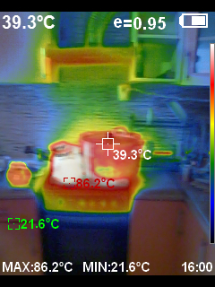
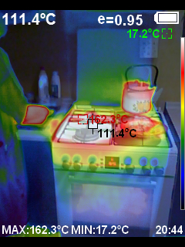
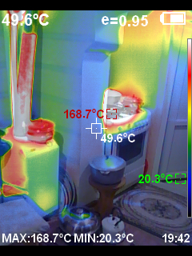
Thermal Photos
Figure 13. Thermal photos of the cooking process at the stove

Slide 19
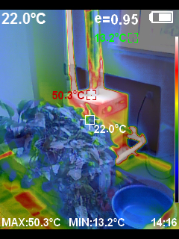
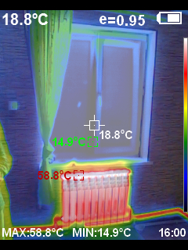
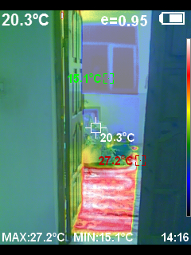
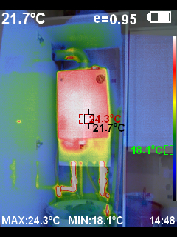
Thermal Photos
Figure 14. Thermal photos of heating systems

Slide 20
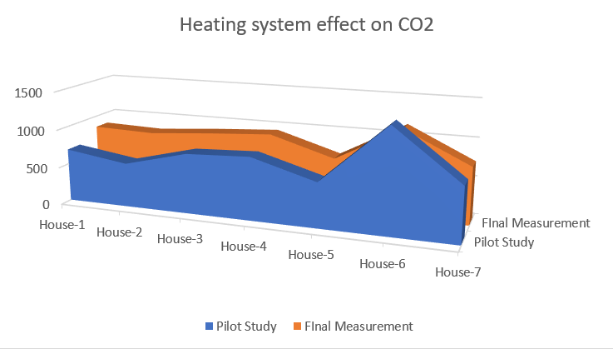
Heating system effect on CO2
 | House-1 | House-2 | House-3 | House-4 | House-5 | House-6 | House-7
Pilot Study (CO₂ ppm) | 694,4 | 576,8 | 783 | 821 | 583,6 | 1350,7 | 711,1
Final Study (CO₂ ppm) | 851 | 826 | 889,7 | 942 | 694 | 1148 | 743
Difference in % | 22,5% | 43,20% | 11,99% | 14,74% | 18,92% | -15,01% | 4,49%
Figure 15. Carbon Dioxide (ppm) level in the kitchen room for both studies

Slide 21
Conclusion
Living Style
Ventilation System
Heating system usage
Building design and materials
House-7

Slide 22
Reference List
Aiaj Pillariseti, Ellison Carter, et al. 2019. “Measuring personal exposure to fine particulate matter (PM_{2.5}) among rural Honduran women: A field evaluation of the Ultrasonic Personal Aerosol Sampler (UPAS)”. Environmental International 123 (2019) 50-53
Aiaj Pillariseti, Ellison Carter, et al. 2019. “Measuring personal exposure to fine particulate matter (PM_{2.5}) among rural Honduran women: A field evaluation of the Ultrasonic Personal Aerosol Sampler (UPAS)”. Environmental International 123 (2019) 50-53
Baumgartner, J., Clark, S., Carter, E., Lai, A., Zhang, Y., Shan, M., ... & Yang, X. (2019). Effectiveness of a household energy package in improving indoor air quality and reducing personal exposures in rural China. Environmental science & technology, 53(15), 9306-9316.
Begum, B. A., Paul, S. K., Hossain, M. D., Biswas, S. K., & Hopke, P. K. (2009). Indoor air pollution from particulate matter emissions in different households in rural areas of Bangladesh. Building and Environment, 44(5), 898-903.
Błaszczyk E. et al. Indoor air quality in urban and rural kindergartens: short-term studies in Silesia, Poland //Air Quality, Atmosphere & Health. – 2017. – Т. 10. – №. 10. – С. 1207-1220.
Błaszczyk E. et al. Indoor air quality in urban and rural kindergartens: short-term studies in Silesia, Poland //Air Quality, Atmosphere & Health. – 2017. – Т. 10. – №. 10. – С. 1207-1220.
Błaszczyk, E., Rogula-Kozłowska, W., Klejnowski, K., Kubiesa, P., Fulara, I., & Mielżyńska-Švach, D. (2017). Indoor air quality in urban and rural kindergartens: short-term studies in Silesia, Poland. Air Quality, Atmosphere & Health, 10(10), 1207-1220.
Branco, P. T. B. S., Alvim-Ferraz, M. C. M., Martins, F. G., & Sousa, S. I. V. (2014). Indoor air quality in urban nurseries at Porto city: Particulate matter assessment. Atmospheric environment, 84, 133-143.
Brown, S. K. (1997). Indoor air quality. Environment Australia.
Chen, B. H., Hong, C. J., Pandey, M. R., & Smith, K. R. (1990). Indoor air pollution in developing countries. World health statistics quarterly 1990; 43 (3): 127-138.
Cincinelli, A., & Martellini, T. (2017). Indoor air quality and health.
Colbeck, I., Nasir, Z. A., & Ali, Z. (2010). The state of indoor air quality in Pakistan—a review. Environmental Science and Pollution Research, 17(6), 1187-1196.
Daniela, D’Alessandro, Marco Gola, Appolloni Letizia, Dettori Marco, Gaetano Maria Fara, Andrea Rebecchi, Settimo Gaetano, and Stefano Capolongo. "COVID-19 and Living Spaces challenge. Well-being and Public Health recommendations for a healthy, safe, and sustainable housing." (2020): 1-15. https://re.public.polimi.it/retrieve/handle/11311/1142203/533524/2020_Covid19%20vs%20abitazioni.pdf
Daniela, D’Alessandro, Marco Gola, Appolloni Letizia, Dettori Marco, Gaetano Maria Fara, Andrea Rebecchi, Settimo Gaetano, and Stefano Capolongo. "COVID-19 and Living Spaces challenge. Well-being and Public Health recommendations for a healthy, safe, and sustainable housing." (2020): 1-15. https://re.public.polimi.it/retrieve/handle/11311/1142203/533524/2020_Covid19%20vs%20abitazioni.pdf
Dasgupta, S. (2004). Indoor air quality for poor families: new evidence from Bangladesh (Vol. 3393). World Bank Publications.
Dasgupta, S., Huq, M., Khaliquzzaman, M., & Wheeler, D. (2007). Improving indoor air quality for poor families: a controlled experiment in Bangladesh.
de la Sota, C., Lumbreras, J., Pérez, N., Ealo, M., Kane, M., Youm, I., & Viana, M. (2018). Indoor air pollution from biomass cookstoves in rural Senegal. Energy for Sustainable Development, 43, 224-234.
Fromme, H., Twardella, D., Dietrich, S., Heitmann, D., Schierl, R., Liebl, B., & Rüden, H. (2007). Particulate matter in the indoor air of classrooms—exploratory results from Munich and surrounding area. Atmospheric Environment, 41(4), 854-866.
Gautam, S. K., Suresh, R., Sharma, V. P., & Sehgal, M. (2013). Indoor air quality in the rural India. Management of Environmental Quality: An International Journal.
Hulin, M., Caillaud, D., & Annesi‐Maesano, I. (2010). Indoor air pollution and childhood asthma: variations between urban and rural areas. Indoor air, 20(6), 502-514.
John Volckness, Charles Henry, et al. 2016. “Development and Evaluation of an “Ultrasonic Personal Aerosol Sampler (UPAS)”. DOI: 10.1111/ina.12318
Kerimray et al (2020). Journal of the Air & Waste Management Association, https://doi.org/10.1080/10962247.2020.1813837
Kim, K. H., Pandey, S. K., Kabir, E., Susaya, J., & Brown, R. J. (2011). The modern paradox of unregulated cooking activities and indoor air quality. Journal of Hazardous materials, 195, 1-10.
Lee, S. C., & Chang, M. (2000). Indoor and outdoor air quality investigation at schools in Hong Kong. Chemosphere, 41(1-2), 109-113.
Masera, O., Edwards, R., Arnez, C. A., Berrueta, V., Johnson, M., Bracho, L. R., ... & Smith, K. R. (2007). Impact of Patsari improved cookstoves on indoor air quality in Michoacán, Mexico. Energy for Sustainable Development, 11(2), 45-56.
Mohd Nor Rawi, N. A., Jalaludin, J., & Chua, P. C. (2015). Indoor air quality and respiratory health among Malay preschool children in Selangor. BioMed research international, 2015.
Mukkannawar, U., Kumar, R., & Ojha, A. (2014). Indoor air quality in rural residential area-Pune case study. Int J Curr Microbiol App Sci, 3(11), 683-694.
Mulenga, D., & Siziya, S. (2019). Indoor air pollution related respiratory ill health, a sequel of biomass use. SciMedicine Journal, 1(1), 30-37.
Nazaroff, W. W. (2013). Exploring the consequences of climate change for indoor air quality. Environmental Research Letters, 8(1), 015022.
Nima Afshar-Mohajer, Rebecca Foos. 2020. “Field Evaluation of the Ultrasonic Personal Aerosol Sampler (UPAS) for Respirable Dust Exposure in a Taconite Mine”. DOI: 10.1093/annweh/wxaa094
Nima Afshar-Mohajer, Rebecca Foos. 2020. “Field Evaluation of the Ultrasonic Personal Aerosol Sampler (UPAS) for Respirable Dust Exposure in a Taconite Mine”. DOI: 10.1093/annweh/wxaa094
Oguntoke, O., Opeolu, B. O., & Babatunde, N. (2010). Indoor air pollution and health risks among rural dwellers in Odeda area, South-Western Nigeria. Ethiopian Journal of Environmental Studies and Management, 3(2).
Parajuli, I., Lee, H., & Shrestha, K. R. (2016). Indoor air quality and ventilation assessment of rural mountainous households of Nepal. International journal of sustainable built environment, 5(2), 301-311.
Pinheiro, Manuel Duarte, and Nuno Cardoso Luís. "“COVID-19 could leverage a sustainable built environment." .” Sustainability 12, no. 14 (2020): 5863. https://www.mdpi.com/2071-1050/12/14/5863/htm
Pinheiro, Manuel Duarte, and Nuno Cardoso Luís. "“COVID-19 could leverage a sustainable built environment." .” Sustainability 12, no. 14 (2020): 5863. https://www.mdpi.com/2071-1050/12/14/5863/htm
Saini J., Dutta M., Marques G. A comprehensive review on indoor air quality monitoring systems for enhanced public health //Sustainable Environment Research. – 2020. – Т. 30. – №. 1. – С. 1-12.
Saini J., Dutta M., Marques G. A comprehensive review on indoor air quality monitoring systems for enhanced public health //Sustainable Environment Research. – 2020. – Т. 30. – №. 1. – С. 1-12.
UNECE. 2019. “ENVIRONMENTAL PERFORMANCE REVIEWS - KAZAKHSTAN”. Third review.
Vanessa J, Ricardo Piedrahita, et al. 2019. “Comparison of next-generation portable pollution monitors to measure exposure to PM2.5 from household air pollution in Puno, Peru”. DOI: 10.1111/ina.12638
Vanessa J, Ricardo Piedrahita, et al. 2019. “Comparison of next-generation portable pollution monitors to measure exposure to PM2.5 from household air pollution in Puno, Peru”. DOI: 10.1111/ina.12638
Wagdi, D. (2015). Effect of building materials on indoor air quality in residential buildings in Egypt: A pre occupancy assessment.
Wang, Z., Xie, D., Tang, R., & Sheng, X. (2014). Investigation on indoor air quality at rural houses in winter in severe cold region. In Proceedings of the 8th International Symposium on Heating, Ventilation and Air Conditioning (pp. 69-75). Springer, Berlin, Heidelberg.
Xiang, R. B., Song, J. B., Zhu, Y., & Guang, W. (2016). Indoor air quality in kitchens in rural China. Environmental Engineering Science, 33(9), 699-704.
Zhang, X., Chen, B., & Fan, X. (2015). Different fuel types and heating approaches impact on the indoor air quality of rural houses in Northern China. Procedia Engineering, 121, 493-500.

Slide 23
THANK YOU FOR YOUR ATTENTION

