Slide 1
“Tips & Tricks on how to publish articles in international journals”
Gamze Keskin
g.keskin@elsevier.com
Customer Marketing Manager
Turkey, Iran, Middle East and Central Asia
© Reed Elsevier Group PLC
Notes:
The goal of this part of the presentation is to provide authors with background information on academic publishing including the origins and roles of key stakeholders.

Slide 2
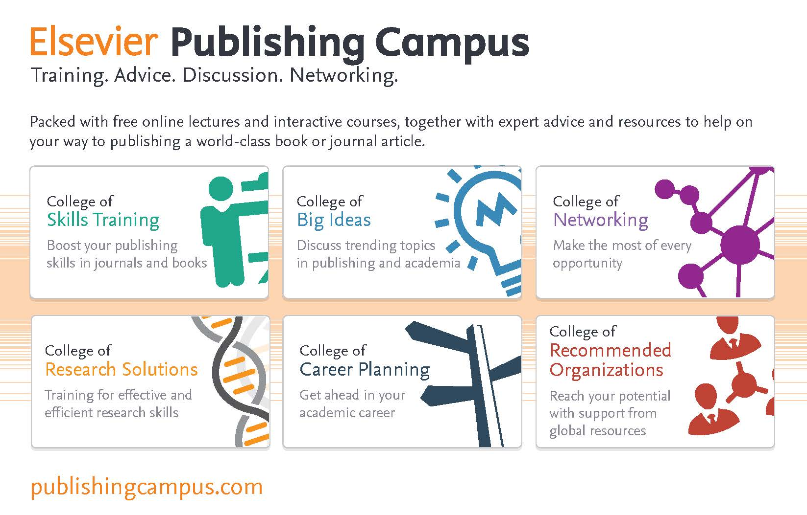
Notes:
The Elsevier Publishing Campus is an online platform offering free lectures, training and advice to support each stage of the researcher’s career. Whether you are interested in writing a journal article or book, learning how to conduct peer review for a high impact journal, understanding research and publishing ethics or preparing a successful grant application, the Campus has resources to assist.
Dedicated training takes time and effort and we believe successful researchers should be recognized for this. For each interactive training module or online seminar that you complete, your work will be recognized with an awarded certificate from Elsevier.

Slide 3

Scholarly publishing today
Scientific, technical and medical (STM) publishing
2,000 STM publishers
1.4 million
peer-reviewed
articles
20,000
peer-reviewed
journals
Notes:
The current system of Scientific, Technical and Medical (STM) publishing has evolved over hundreds of years and serves science and medical global communities.
The industry is highly competitive: some 2,000 publishing organizations annually publish 20,000 scholarly journals and 1.2-1.4 million articles from approximately 5.5 million researchers worldwide.

Slide 4




The publisher’s role
How do Publishers add value to the scientific and health community?
Registration
Certification
Dissemination
Preservation
Use
Notes:
If we take a modern look at publishers, they still fulfill the four roles set forth by Oldenburg as well as what could be considered a fifth, which is promoting and facilitating the “Use” of scholarly information. Scientific papers are not just ‘flat’ text, but are enriched in several ways in an online environment, for example through links connecting different papers. Or by incorporating multimedia tools within papers. Publishers also ensure papers can be found by search-engines and by inclusion in abstract databases.
Increasingly, publishers are investing in innovation and technology to find new methods to carry out these five roles.
Publishers coordinate the exchange of ideas between authors, editors, reviewers, and the wider STM audience of researchers, scientists, health professionals, students, and patients. They develop products and services by identifying and finding solutions for problems and improvements of the fundamental roles of publishing.

Slide 5
Research in Kazakhstan
SciVal Analysis, based on Scopus data

Slide 6
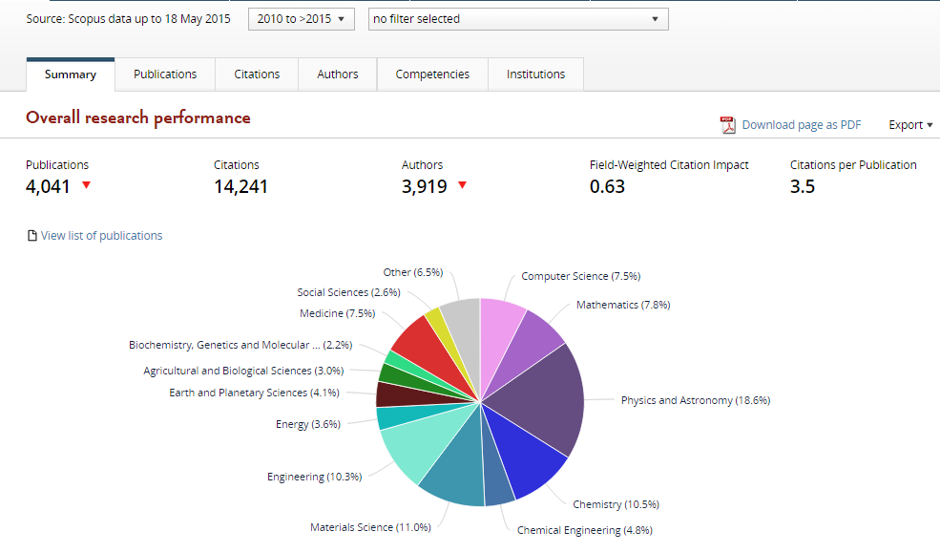
Research in Kazakhstan since 2010

Slide 7
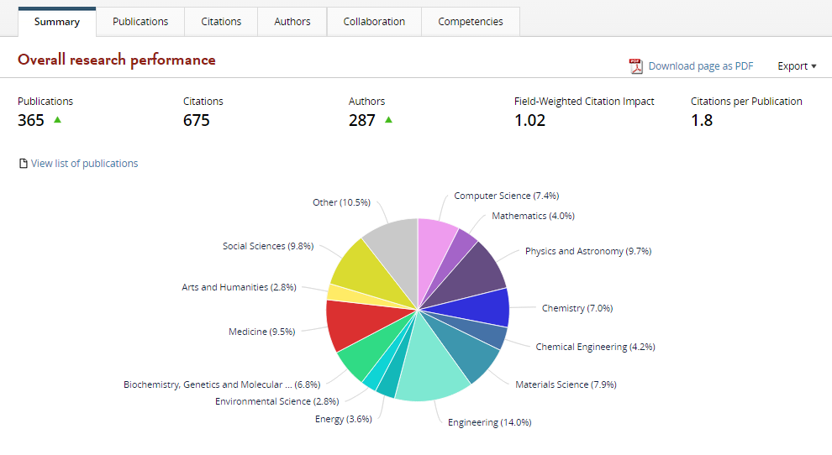
Research in Nazarbayev University since 2010

Slide 8
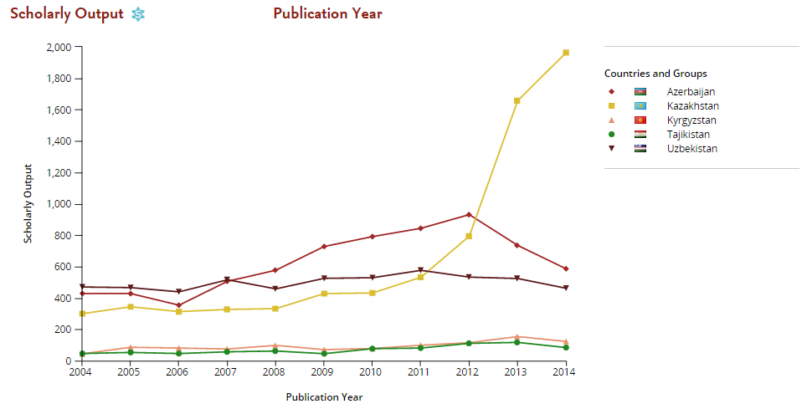
Comparison of Published Articles

Slide 9
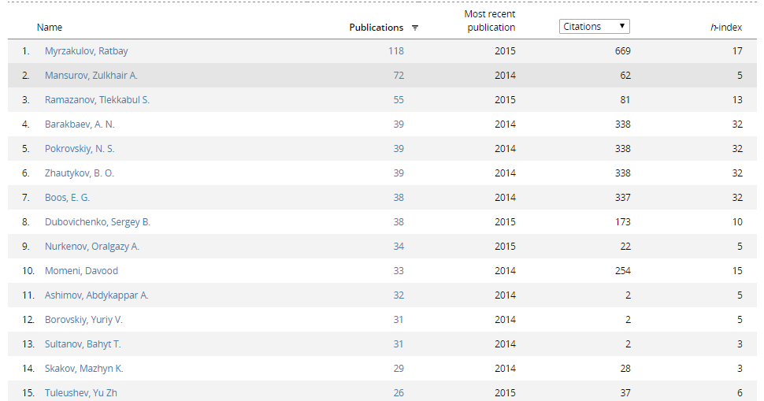
The most profilic Authors in terms of publishing

Slide 10
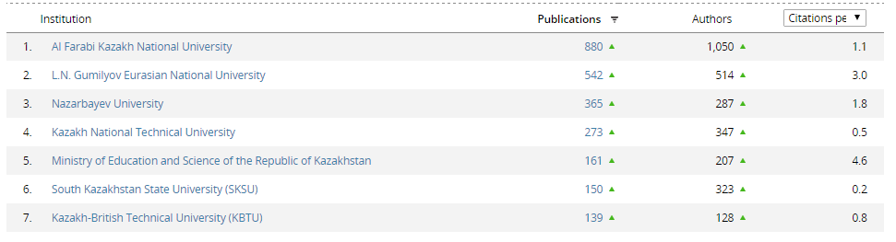
Biggest Universities in terms of publishing

Slide 11

Academic publishing
The publishing cycle
January 2015
30-60%
rejected by
> 13,000
editors
Solicit &
manage
submissions
>700 million
downloads by
>11 million
researchers in
>120 countries!
557,000+
reviewers
Publish &
Disseminate
Manage
Peer Review
12.6 million
articles available
365,000
articles
accepted
Production
Edit &
prepare
Notes:
(NOTE TO SPEAKER: VIEW IN SLIDESHOW AND USE ANIMATIONS FOR BEST EFFECT TO TELL THE STORY)
Let’s look at this illustration of the publishing cycle at one of the worlds’ leading STM publishers: Elsevier – and consider some staggering figures. Elsevier is a world-leading provider of information solutions that enhance the performance of science, health, and technology researchers, empowering them to make better decisions, deliver better care, and sometimes make groundbreaking discoveries, that advance the boundaries of knowledge and human progress. Elsevier provides web-based, digital solutions — among them ScienceDirect, Scopus, Elsevier Research Intelligence, and ClinicalKey — and publishes nearly 2,200 journals, including The Lancet and Cell, and over 25,000 book titles, including a number of iconic reference works.
12.6 million articles are currently archived in our system. Depending on the journal, on average 30-60% are rejected directly by one of the 13,000 editors they work with.
Those articles that are not rejected upfront will undergo peer review. Currently they work with around 560,000 reviewers to evaluate these articles. Of these, around half get accepted after minor or major revision.
Overall 365,000 articles are in the end accepted by the editors each year and “produced”, which means typeset, posted online, linked to the various external platforms like PubMed, promoted to the appropriate audience and of course archived for future use.
12.6 million articles are now available and have been downloaded over 700 million times, by 11 million researchers, across more than 120 countries.

Slide 12
Literature Review
Notes:
This module provides a overview of plagiarism and how to avoid it.

Slide 13

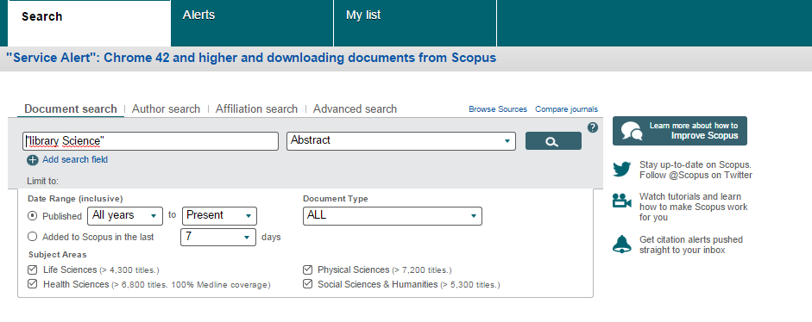
www.scopus.com
Scopus is the largest abstract and citation database of peer-reviewed literature: scientific journals, books and conference proceedings. Delivering a comprehensive overview of the world's research output in the fields of science, technology, medicine, social sciences, and arts and humanities, Scopus features smart tools to track, analyze and visualize research.

Slide 14

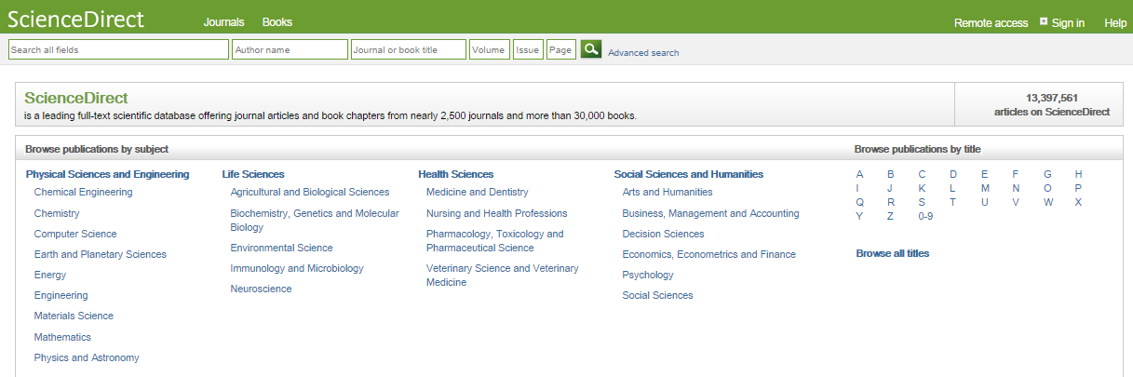
www.sciencedirect.com
ScienceDirect is Elsevier’s leading information solution for researchers, teachers, students, health care professionals and information professionals .

Slide 15

www.mendeley.com
Mendeley is a free reference manager and academic social network that can help you organize your research, collaborate with others online, and discover the latest research:
Automatically generate bibliographies
Collaborate easily with other researchers online
Easily import papers from other research software
Find relevant papers based on what you're reading
Access your papers from anywhere online
Read papers on the go, with our new iPhone app

Slide 16
Planning your article
Are you ready to publish?
Original results or methods
Outdated work
Duplication of published work
Significant enhancement of published work
Incorrect conclusions
Up-to-date review of a subject or field
Not ready
Work has no scientific interest
Ready
Work advances the field
Notes:
Are ready to publish? As a good rule of thumb:
You SHOULD NOT consider publishing yet if:
-The work is outdated,
-You would be duplicating previously published work, or if
-Your conclusions are incorrect or not acceptable
These points are good indicators that your report lacks scientific interest or does not substantially advance the field.
You SHOULD consider publishing your research if you have information that advances the understanding in a specific research field. This could take the form of:
-Presenting new, original results or methods,
-Rationalizing, refining, or reinterpreting published results, or
-Reviewing or summarizing a particular subject or field
Remember that a strong manuscript and message is crucial in order to present your contributions to the scientific community.
A strong manuscript and message is crucial in order to present your contributions to the scientific community.

Slide 17
Always keep in mind that…
…your published papers, are a permanent record of your research, are your passport to your community…

Slide 18
Your personal reasons for publishing?
Get funding?
Get promoted?
…???
PhD degree?
However, editors, reviewers, and the research community don’t consider these reasons when assessing your work.

Slide 19
Choosing the right journal
Best practices
Aim to reach the intended audience for your work
Choose only one journal, as simultaneous submissions are prohibited
Supervisor and colleagues can provide good suggestions
Shortlist a handful of candidate journals, and investigate them:
  Aims
  Scope
  Accepted types of articles
  Readership
  Current hot topics
Articles in your reference list will usually lead you directly to the right journals.
Notes:
It is really important to select an appropriate journal so that your work will reach the intended audience.
If your paper is outside the scope of a journal, it will likely be rejected immediately by the editors, not even because of the quality of the work, but because the topic doesn’t fit with the journal.
It is very important that you DO NOT gamble by submitting your manuscript to more than one journal at a time. International ethics standards prohibit multiple or simultaneous submissions, and the editors do find out!
Remember that your supervisor, who is often a co-author, has co-responsibility for your work, so ask them for help. Also, ask your colleagues when you’re deciding where to submit - they may be more familiar with the different journals that are relevant to your field.
Investigate all candidate journals to find out their Aims and Scope, Accepted types of articles, Readership and Current hot topics. Here's a tip: articles in your references will usually lead you directly to the right journals.

Slide 20
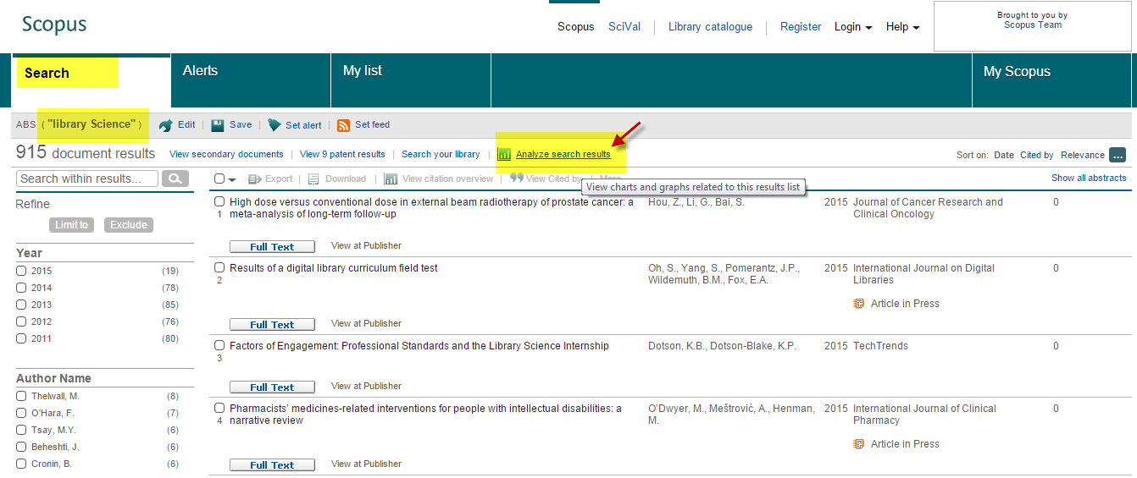
How to choose Journal By Using Scopus

Slide 21
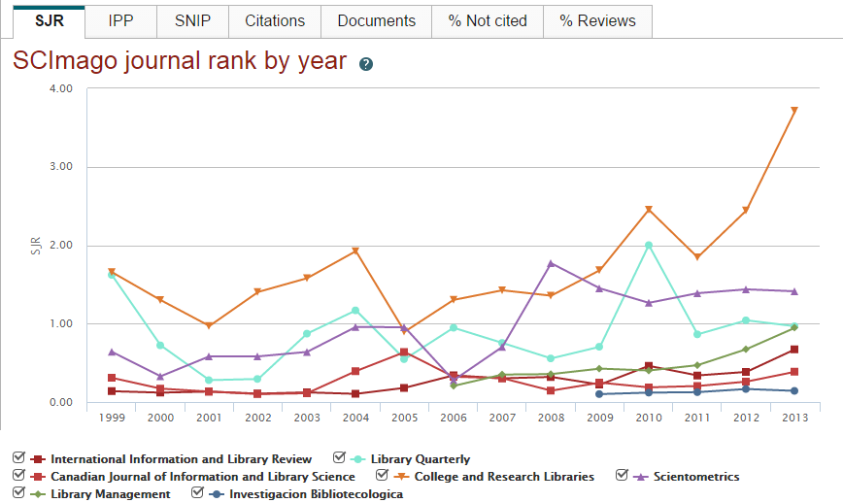
How to choose a Journal By Using Scopus

Slide 22
Bibliometric indicators
Impact
Factor
Eigenfactor
SNIP
SJR
H-Index
Notes:
We will briefly survey some of the key indicators of journal citation impact, from the familiar Impact Factor, to the less familiar, including the Eigenfactor and Article Influence, SJR and SNIP, to an alternative application for the author-based metric, H-Index.

Slide 23

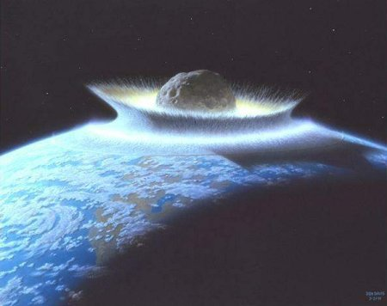
Impact Factor
Impact Factor
[the average annual number of citations per article published]
For example, the 2011 impact factor for a journal would be calculated as follows:
  A = the number of times articles published in 2009 and 2010 were cited in indexed journals during 2011
  B = the number of "citable items" (usually articles, reviews, proceedings or notes; not editorials and letters-to-the-Editor) published in 2009 and 2010
  2011 impact factor = A/B
  e.g. 600 citations = 2
  150 + 150 articles

Slide 24

SJR- SCImago Journal Rank
SCImago Journal Rank (SJR) , is a measure of the scientific prestige of scholarly sources: value of weighted citations per document. A source transfers its own 'prestige', or status, to another source through the act of citing it.
A citation from a source with a relatively high SJR is worth more than a citation from a source with a lower SJR.

Slide 25


Source Normalized Impact per Paper (SNIP)
Year 3
Year 2
Year 1
Citing Year
Freely available online via Scopus
Similar to Impact Factor, but considers 3 years
Measures contextual citation impact
Citations weighted by the likelihood of citation in the subject field of source
Devised at the University of Leiden, currently the most sophisticated journal performance indicator
Notes:
SNIP, Source Normalized Impact per Paper, was devised by Henk Moed while at the University of Leiden (Netherlands).
Unlike the Eigenfactor or SCimago Journal Rank, SNIP is based on an entirely novel methodology, which simultaneously accounts for database coverage of cited papers and for field-specific differences in citation rates based on local citation context rather than any top-down journal classification scheme.
Like the SCimago Journal Rank, it considers 3 years of publications and also gives a very up-to-date view of journal impact. This elegant metric is the most sophisticated journal performance indicator currently available and is freely available online.

Slide 26
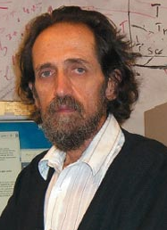
Determine the level of your achievements: h index
impact factor and the SJR: based on journal evaluation
h-index: accounts for a researcher’s body of work without the influence of other factors
Dr. Jorge E. Hirsch, University of San Diego
Notes:
Says something about the number of highly cited articles you have published as an author

Slide 27
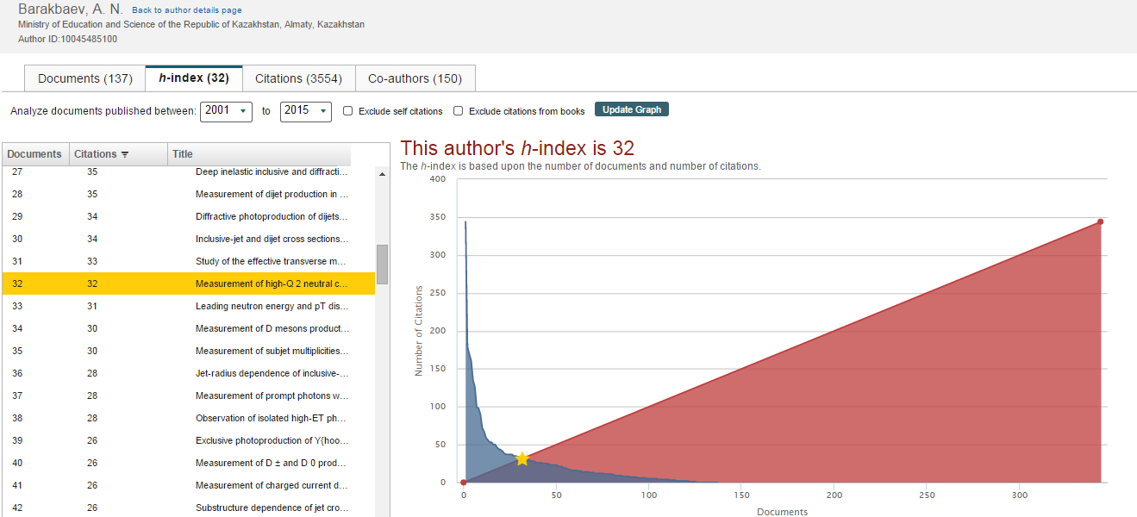
H-Index in Scopus

Slide 28
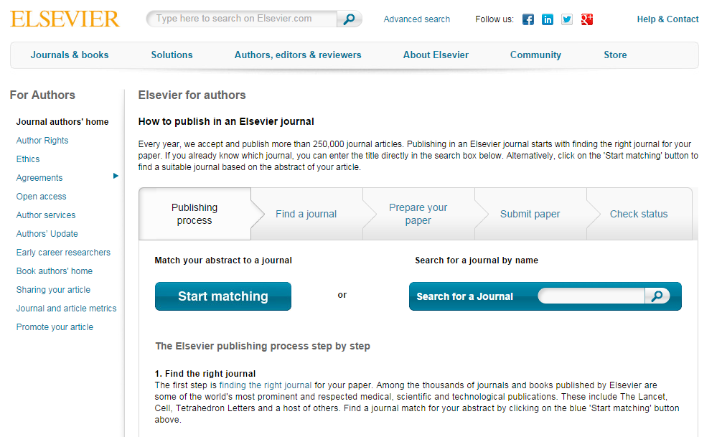
Choosing the right journal
Journal Finder Tool
Notes:
You can investigate journals by visiting their homepage on the publisher’s website (e.g. Elsevier.com, using Elsevier’s Journal Finder Tool), and by going through the abstracts of recent publications.

Slide 29
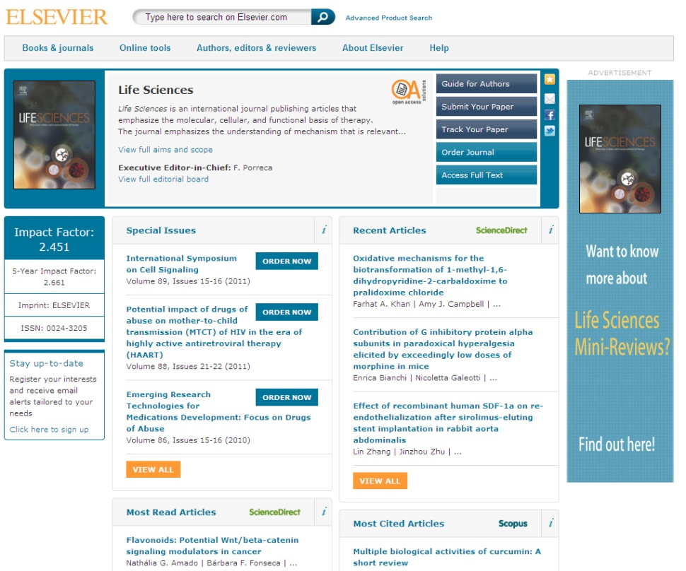
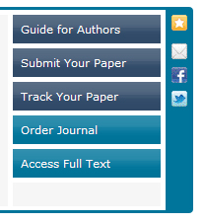
Guide for Authors
Find it on the journal homepage of the publisher, e.g. Elsevier.com
Keep to the Guide for Authors in your manuscript
It will save your time
Notes:
Editors (and reviewers) do not like wasting time on poorly prepared manuscripts. This is why each journal typically has a “Guide for Authors” with specific details for the preparation of your manuscript.
Apply the Guide for Authors to your manuscript, even to the first draft. It can help you with the text layout, reference style, nomenclature, figures and tables, and other important items.
This will save your time, along with the editor’s and reviewer’s.

Slide 30



Planning your article
Types of manuscripts
Full articles
Substantial, complete and comprehensive pieces of research
Is my message sufficient for a full article?
Letters or short communications
Quick and early communications
Are my results so thrilling that they should be shown as soon as possible?
Review papers
Summaries of recent developments on a specific top
Often submitted by invitation
Your supervisor or colleagues are also good sources for advice on manuscript types.
Notes:
There are various types of manuscripts that suit different purposes:
Full Articles are the most frequent type. These are often substantial, complete, and comprehensive pieces of research that are of significance.
Letters or Short Communications are quick and early communications of significant, original advances. These tend to be much more brief than full articles.
Review Papers summarize recent developments on a specific topic, highlighting important points that have been previously reported and introducing no new information. These are often submitted after invitation by an Editor.
Before selecting an article type for your manuscript, you should first self-evaluate your work. Ask yourself the following questions:
Is my message sufficient for a full article?
Are my results so thrilling that they should be shown as soon as possible in a short communication?
Your supervisor or colleagues are also good sources for advice on manuscript type – Sometimes outsiders can see the situation more clearly than you.

Slide 31

Planning Your Article
What makes a strong manuscript?
Clear and useful message
A logical manner
Readers grasp the research
Editors, reviewers and readers all want to receive well presented manuscripts that fit within the aims and scope of their journal.
Notes:
What makes a strong manuscript? Strong manuscripts have three key characteristics:
First: their scientific message is clear, useful and exciting.
Second: their message is presented and constructed in a logical manner. They enable the reader to arrive at the same conclusions as the author, and the format chosen best showcases the material.
Third: They enable readers, reviewers and editors to easily grasp the significance of the research.
The more effort you put into a manuscript upfront, the more likely it is to be accepted.
Editors, reviewers and readers all want to receive well presented manuscripts that fit within the aims and scope of their journal.

Slide 32
Publishing Ethics
Notes:
This module provides a overview of plagiarism and how to avoid it.

Slide 33
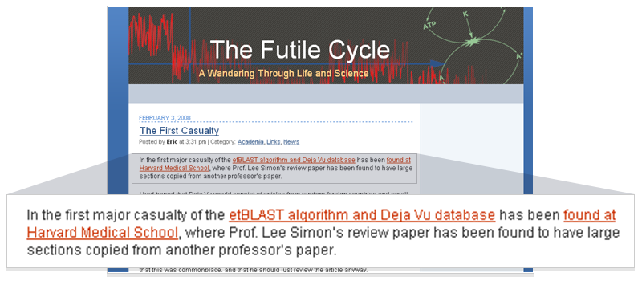
Why do we need originality and ethical conduct?
Unethical behavior by Researchers degrades the scientific record and the reputation of science and medicine in the broader community.
It can unfairly affect the reputation and academic record of individual researchers/authors.
A Massive Case Of Fraud
Chemical & Engineering News
February 18, 2008
Journal editors are left reeling as publishers move to rid their archives of scientist's falsified research
William G. Schulz
A CHEMIST IN INDIA has been found guilty of plagiarizing and/or falsifying more than 70 research papers published in a wide variety of Western scientific journals between 2004 and 2007, according to documents from his university, copies of which were obtained by C&EN. Some journal editors left reeling by the incident say it is one of the most spectacular and outrageous cases of scientific fraud they have ever seen. …
Notes:
Unethical behavior, if allowed to pass, would degrade the scientific record and would affect the reputation of the scientific community.
If left unchecked, the integrity, quality, and credibility of researchers would deteriorate.
Here are two examples of unethical conduct:
1. An article in Chemical & Engineering News reports on a chemist in India who plagiarized more than 70 papers over the past 4 years.
2. The blog on the right reports how recently developed plagiarism software, etBlast, has detected that a Harvard Med School professor copied large sections of a review paper from another professor’s work.
Detection is out there and the bottom line is that you will be caught. So let’s discuss more on how to plagariasm occuring in the ifrst place.

Slide 34

The most serious issues to avoid
These are the 3 most common forms of ethical misconduct that the research community is challenged with:
Fabrication
Making up research data
Falsification
Manipulation of existing research data
Plagiarism
Previous work taken and passed off as one’s own
Notes:
There are different ways that research cannot be considered original:
Fabrication is when the researcher makes up data.
Falsification is when the data collected is manipulated to fit certain trends.
Plagiarism is when work previously done or reports previously written are taken and passed off as one’s own work.
These three violations are the most common forms of ethical misconduct that the scientific and publishing communities are challenged with and trying to address.

Slide 35
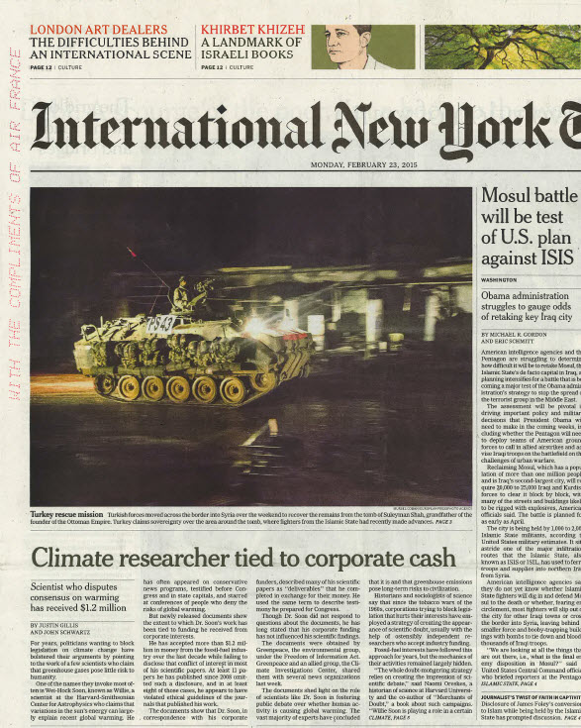
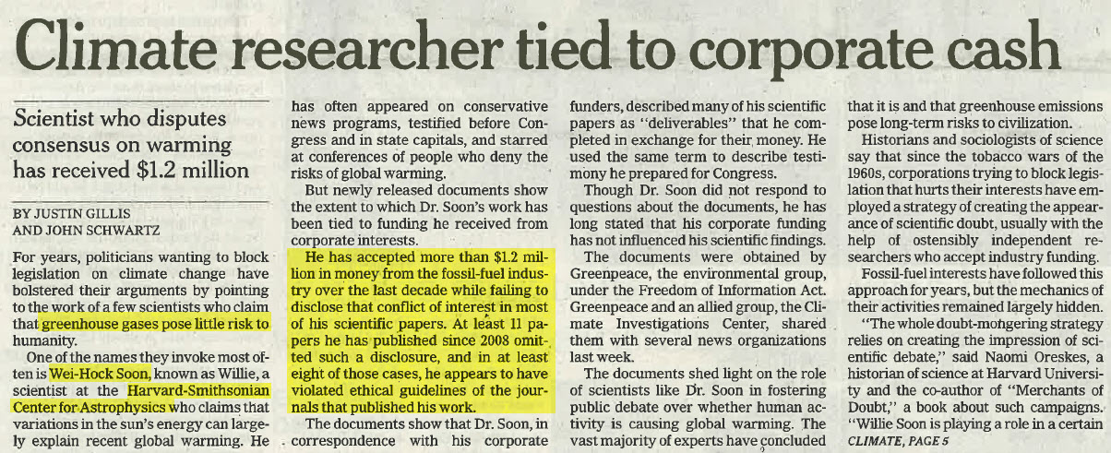
A recent example of what can happen

Slide 36

What does it mean to be an Author?
An “author” is generally considered to be someone who has made substantial intellectual contributions to a published study.
Being an author comes with credit but also with responsibility.
Decisions about who will be an author and the order of authors should be made before starting to write up the project.
Notes:
So what does it actually mean to be an ‘author’?
An “author” is generally considered to be someone who has made substantial intellectual contributions to a published study. Being an author comes with credit but also with responsibility and decisions about who will be an author and the order of authors should be made before starting to write up the research.

Slide 37


Authorship: Do’s and don’ts
General principles for who is listed first:
Abuses to be avoided:
First Author:
Conducts and/or supervises the data analysis and the proper presentation and interpretation of the results
Puts paper together and submits the paper to journal
Co-Author(s):
Makes intellectual contributions to the data analysis and contributes to data interpretation
Reviews each paper draft
Must be able to present the results, defend the implications and discuss study limitations
Ghost Authors:
Leaving out authors who should be included
Scientific Writers and Gift Authors:
Including authors when they did not contribute significantly
Notes:
Determining the order of authors on a paper can vary by discipline and culture, but the general rule is that the first author is the person who conducts or supervises the data collection, analysis, presentation and interpretation of the results, and also puts together the paper for submission. The corresponding author can be the first author, or sometimes is a senior author from the institution.
You should always avoid ghost authorship, which means excluding authors who participated in the work, and gift authorship, which means including authors who did not contribute to the work. Be consistent in how you write the authors names.

Slide 38


What is plagiarism?
“Plagiarism is the appropriation
of another person’s ideas, processes, results, or words without giving appropriate credit, including those obtained through confidential review of others’ research proposals and manuscripts.”
Federal Office of Science and
Technology Policy, 1999
“Presenting the data or interpretations of others without crediting them, and thereby gaining for yourself the rewards earned by others, is theft, and it eliminates the motivation of working scientists to generate new data and interpretations.”
Professor Bruce Railsback, Department of Geology, University of Georgia
Notes:
According to the Federal Office of Science and Technology Policy “Plagiarism is the appropriation of another person’s ideas, processes, results, or words without giving appropriate credit, including those obtained through confidential review of others’ research proposals and manuscripts.”
Professor Bruce Railsback, Department of Geology, University of Georgia suggest it is “Presenting the data or interpretations
of others without crediting them, and thereby gaining for yourself the rewards earned by others, is theft, and it eliminates the motivation of working scientists to generate new data and interpretations.”

Slide 39

What may be plagiarised?
Work that can be plagiarised includes…
Words (language)
Ideas
Findings
Writings
Graphic representations
Computer programs
Diagrams
Graphs
Illustrations
Information
Lectures
Printed material
Electronic material
Any other original work
Higher Education Academy, UK
Notes:
Work that can be plagiarised includes…
Words (Language)
Ideas
Findings
Writings
Graphic Representations
Computer Programs
Diagrams
Graphs
Illustrations
Information
Lectures
Printed Material
Electronic Material
Any Other Original Work

Slide 40

Correct citation is key
Crediting the work of others (including your advisor’s or your own previous work) by citation is important for at least three reasons:
To place your own work in context
To acknowledge the findings of others on which you have built your research
To maintain the credibility and accuracy of the scientific literature
Notes:
Correct citiation in your research paper is critical to avoiding any mistakes
Crediting the work of others (including your advisor’s or your own previous work) by citation is important for at least three reasons:
To place your own work in context
To acknowledge the findings of others on which you have built your research
To maintain the credibility and accuracy of the scientific literature

Slide 41
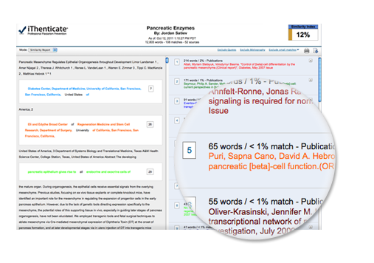

How can plagiarism be detected?
Huge database of 30+ million articles, from 50,000+ journals, from 400+ publishers
Software alerts Editors to any similarities between the article and this huge database of published articles
Many Elsevier journals now check every submitted article using CrossCheck
Notes:
CrossCheck is a huge database of 30+ million articles, from 50,000+ journals, from 400+ publishers. Software alerts Editors to any similarities between the article and this huge database of published articles. Many Elsevier journals now check every submitted
article using CrossCheck

Slide 42
Paraphrasing
Paraphrasing is restating someone else's ideas while not copying their actual words verbatim.
It is unacceptable:
Using exact phrases from the original source without enclosing them in quotation marks
Emulating sentence structure even when using different words
Emulating paragraph organization even when using different wording or sentence structure
– Statement on Plagiarism
Department of Biology, Davidson College.
www.bio.davidson.edu/dept/plagiarism.html
Notes:
Paraphrasing is restating someone else's ideas while not copying their actual words verbatim.
It is unacceptable to:
Using exact phrases from the original source without enclosing them in quotation marks
Emulating sentence structure even when using different words
Emulating paragraph organization even when using different wording or sentence structure

Slide 43
Can you plagiarise your own work? Text re-cycling/self-plagiarism
A grey area, but best to err on the side of caution: always cite/quote even your own previous work
For example
You publish a paper and in a later paper, copy your Introduction word-for word and perhaps a figure or two without citing the first paper
Editors may conclude that you intentionally exaggerated your output
Notes:
Can you plagiarise your own work?
Text re-cycling/Self-plagiarism is a grey area, but best to err on the side of caution: always cite/quote even your own previous work.
If you publish a paper and in a later paper, copy your Introduction word-for word and perhaps a figure or two without citing the first paper, Editors may conclude that you intentionally exaggerated your output.

Slide 44
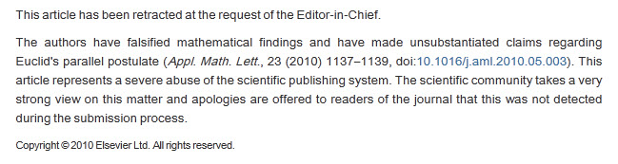
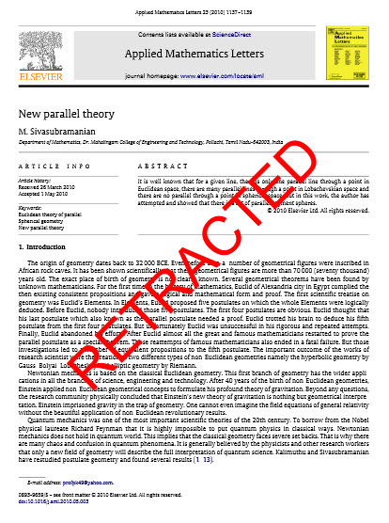
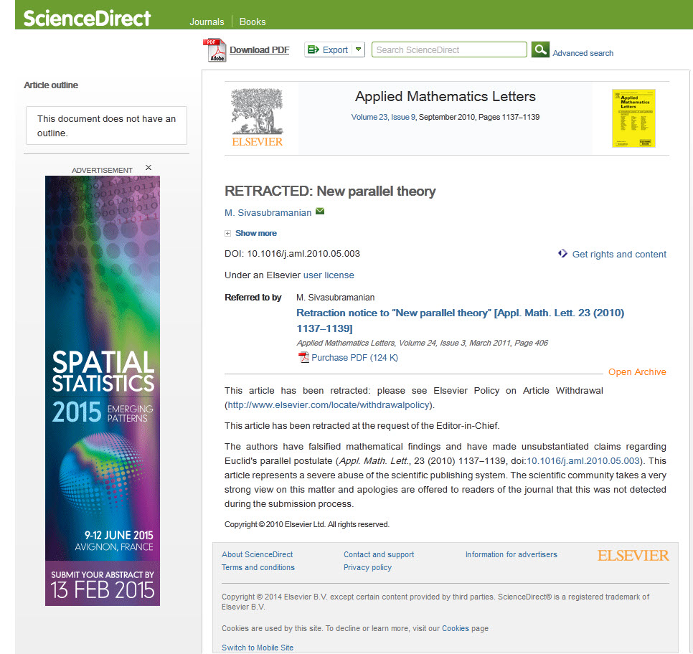
Article Retraction

Slide 45

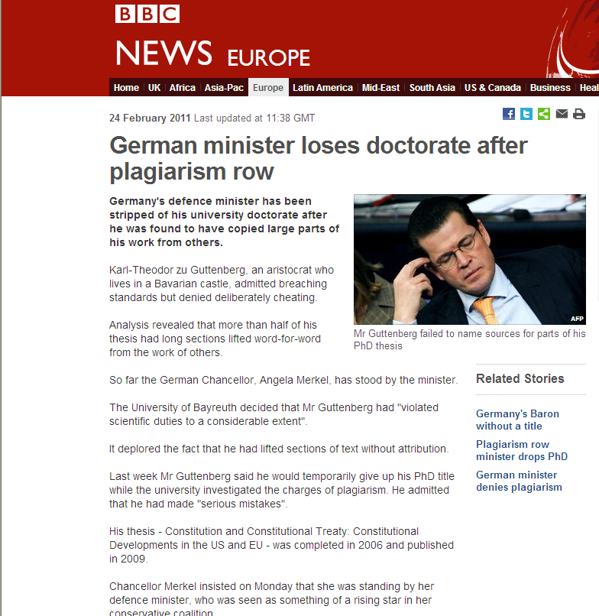
Publication ethics – How it can end

Slide 46




Who is really responsible for Ethics?
All Stakeholders
Authors
Institutions/Companies/Agencies/Funding Bodies
Publishers/Journal Editors
All Elsevier journals
are members of:
Notes:
But Authors are not the only ones who are responsible for ethics. A general division of responsibilities is as follows:
1. Authors – responsible to uphold ethics by learning of standards (such as through this presentation).
2. Institutions/companies/agencies/funding bodies – should set standards and communicate them; investigate and take action if unethical behavior is discovered
3. Publishers/journal editors – set standards for their journals and take editorial action if misconduct is discovered
In Elsevier’s case, we have listed all of our journals with the Committee on Publishing Ethics, a forum for editors to seek guidance on ethical issues.
And we have also established a Publishing Ethics Resource Kit (PERK) on our website for editors to use as a guide in making decisions on ethical issues with their journal.

Slide 47
How to get published
Using proper scientific language
Notes:
The goal of this presentation is to provide advice about the importance of using of proper scientific language in a manuscript.

Slide 48
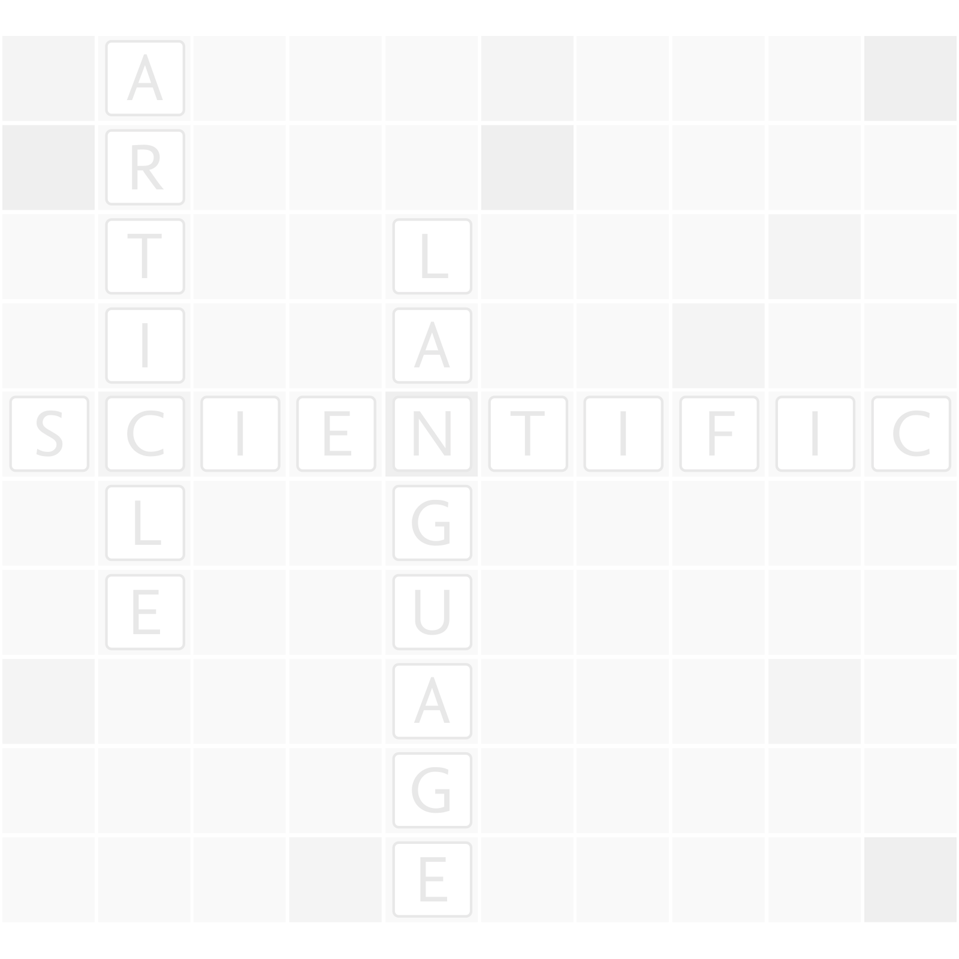
Why is language important?
Poor language quality can delay or block publication of work
Proper English should be used throughout the manuscript
Notes:
It’s important to take seriously the presentation of your manuscript, especially the language you use to communicate your results. Without clear and proper language, editors and reviewers will not grasp the full message or impact of your work. Even though the findings you report might be cutting edge, poor language quality, including errors in grammar, spelling, or language usage, could delay publication or could lead to outright rejection of the paper, preventing the research from getting the recognition it deserves.
Proper English should be used throughout the entire manuscript, including the captions and headings in figures, charts, graphs, and photos.

Slide 49
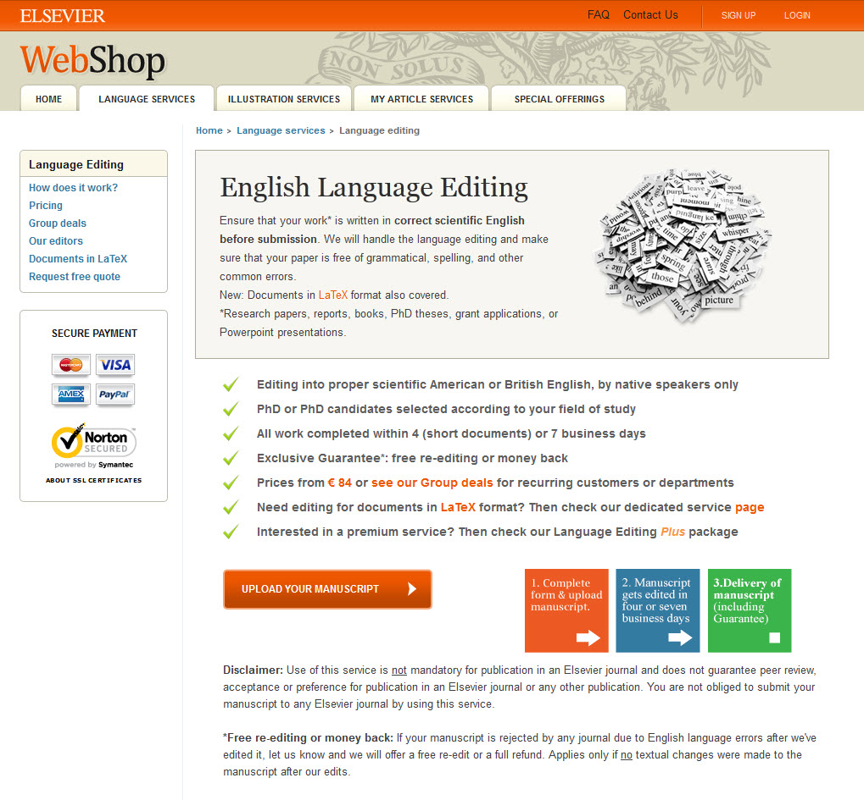
Do publishers correct language?
No!
It is the author’s
responsibility...
...but resources
are available
  Visit http://webshop.elsevier.com for translation and language editing services.
Notes:
Often, authors assume that the publisher will correct the language of their manuscript after it has been accepted, but this is not correct. It is actually the author’s responsibility to make sure a paper is in the best form possible.
Although publishers don’t correct language, they do often provide resources for authors who are less familiar with the conventions of international journals. Please check your publishers’ author website for more information. Some publishers may also perform technical screening prior to peer review, and if your paper’s language quality doesn’t meet a journal’s minimum standards, it could be returned to you for improvement.

Slide 50
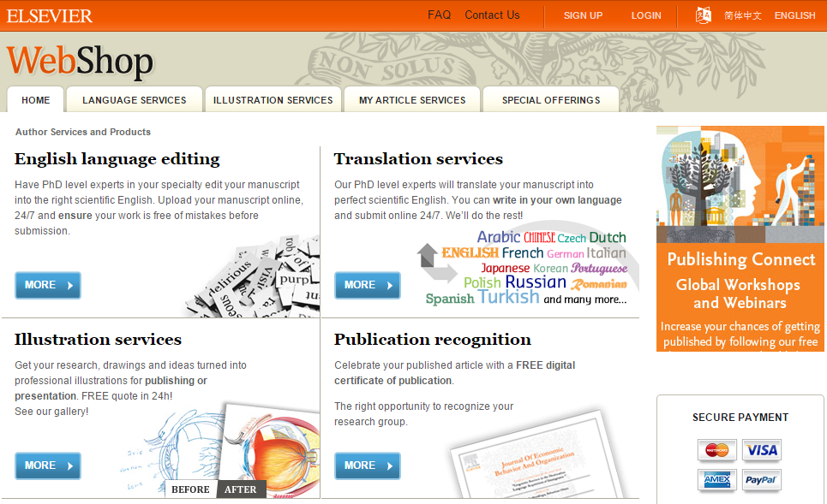
http://webshop.elsevier.com

Slide 51


The reviewing process
Notes:
The goal of this presentation is to provide researchers with background information on the peer review process, and outline the important steps they need to follow when reviewing a manuscript.
In this module, information has been combined from Elsevier and Sense About Science, a not-for-profit organization that equips researchers to make sense of scientific and medical claims in public.

Slide 52
January 2015
Peer review
Helps to determine the quality, validity, significance, and originality of research
Helps to improve the quality of papers
Publishers are outside the academic process and are not prone to prejudice or favour
Publishers facilitate the review process by investing in online review systems and providing tools to help Editors and Reviewers
© Reed Elsevier Group PLC
Notes:
After managing the submission of articles, the peer review process can begin. The quality and speed of reviews are important to both authors and readers.
Peer review has become the filter that is used to evaluate the quality, comment on validity, judge the significance and determine originality of research.
The process also helps to improve the quality of the paper. In a recent study by the publishing research consortium, over 90% of authors agreed that peer review improved the quality of their paper.
Publishers facilitate the review process by investing in developing, maintaining and upgrading the online review systems.

Slide 53
What is peer review?
Peer review places the reviewer, with the author, at the heart of scientific publishing
Reviewers make the editorial process work by examining and commenting on manuscripts
Without peer review there is no control in scientific communication
Reviewers are the backbone of the whole process
Notes:
Peer review is an established process that places the reviewer at the heart of scientific publishing. The process of peer review allows the academic community to improve the quality of scholarship, and to weed out poor quality, unsubstantiated, and false research. The Philosophical Transactions of the Royal Society was the first journal to formalize the peer review process in 1665. Since then, the process has been refined, formalized, and adapted for use in almost all scholarly publications. Peer review is now firmly at the centre of scientific publishing, because through peer review and the journal publishing process, whether open access or traditional publication, a researcher's work can be not only improved and validated, but also registered, disseminated, and preserved.
It is a testament to the impact of peer review that a scientific hypothesis or statement presented to the world without undergoing the peer review process is often ignored by the scholarly community. This is because without peer review, there is a strong argument to say that little to no quality control would exist in that scientific communication, leading to diminished trust in the research results presented.
The process of peer review relies upon researchers actively giving their time to review articles. Reviewers – who are also readers and authors – enable the process to work through critically examining and commenting on manuscripts in a fair and unbiased manner to ultimately improve the work before publication. Reviewers are the backbone of the peer review process.

Slide 54
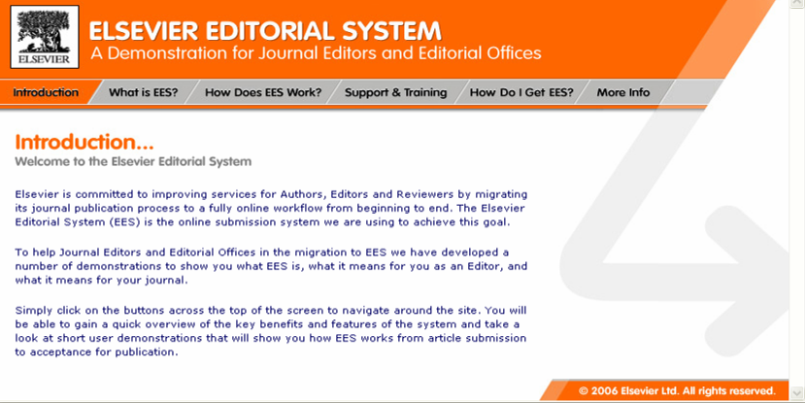
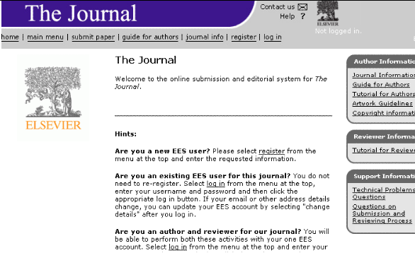
January 2015
Online peer review systems
Online peer review systems accept manuscript submissions and facilitate online peer review
Online systems can handle hundreds of thousands of submissions and reviews per year
© Reed Elsevier Group PLC
Notes:
These days, online submission systems facilitate the peer review process for manuscripts. In Elsevier’s case, this system is called Elsevier Editorial System or EES.
EES facilitates online submission, peer review, decision making and communication for authors, reviewers, and editors.
It handles over 1 million manuscript submissions and has 3.5 million active end users each year and since its development, the time taken to review has almost halved.
In addition to EES also has linked the manuscript’s references with abstracts in Scopus (Elsevier’s citation and abstracting database), allowing editors and reviewers to assess the quality of the paper and check the author’s claims. In general, online systems help editors reduce the amount of time it takes to review a paper, source appropriate reviewers, and facilitates communications between editors and reviewers from across the world. Editors also have access to an online tool to check if manuscripts are original or contain copied text.
Please note that not every manuscript submitted is peer reviewed. Editors and editorial offices filter out/reject on average around 25% of submissions on scope or poor quality or technical issues.

Slide 55
Michael Derntl. Basics of Research Paper Writing and Publishing. http://www.pri.univie.ac.at/~derntl/papers/meth-se.pdf
So how does it work?
Notes:
55
Do no hang on there too long. We will explain these three main points in the coming slides.

Slide 56
Example of a reviewer checklist for editor’s eyes only
Reviewer’s recommendation Accept / Minor Revision / Major Revision / Reject
Overall manuscript rating 1 →100 (poor → perfect)
1. Is the subject matter suitable for publication in JCR? Y/N
2. Is the paper acceptable in its present form? Y/N
3. Is the paper better suited for another journal? Y/N
If “Yes”, which other journal?
4. Does it contain material that might well be omitted? Y/N
5. Does it give adequate references to related work? Y/N
6 Is the English satisfactory? Y/N
7. Is the presentation of the work well organized? Y/N
8. Rate the paper using the following scale
(4 = Very good, 3 = Good, 2 = Marginal, 1 = Poor)
a. Originality 1 2 3 4
b. Scientific quality 1 2 3 4
c. Significance of findings 1 2 3 4
Notes:
Many journals ask reviewers to fill in a questionnaire, in addition to free text comments for journal Editors and for authors. Use of such a questionnaire can make the decision process of journal Editors more structured and objective.

Slide 57
Notes:
The Elsevier Publishing Campus is an online platform offering free lectures, training and advice to support each stage of the researcher’s career. Whether you are interested in writing a journal article or book, learning how to conduct peer review for a high impact journal, understanding research and publishing ethics or preparing a successful grant application, the Campus has resources to assist.
Dedicated training takes time and effort and we believe successful researchers should be recognized for this. For each interactive training module or online seminar that you complete, your work will be recognized with an awarded certificate from Elsevier.

Slide 58

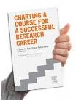
publishingcampus.com
elsevier.com/authors
elsevier.com/reviewers
elsevier.com/editors
Further reading at
Understanding the Publishing Process with Elsevier – complete guide
Publishing Ethics brochure – top reasons to publish ethically
Get Published – top tips on writing, reviewing and grant writing etc.
Get Noticed – new ways to promote your article and research
Open access – definitions and options
Career Planning Guide – download in 12 languages
Notes:
Useful collateral. We have shipped some to this event and they are at the back of this room for you to take home.

Slide 59


www.facebook.com/ElsevierCentralAsia
@ElsevierCAsia

Slide 60
Thank you
Elsevier Publishing Campus
www.publishingcampus.com
Information about publishing in journals
www.elsevier.com/authors
Notes:
Thank you for your attention.

