Slide 1


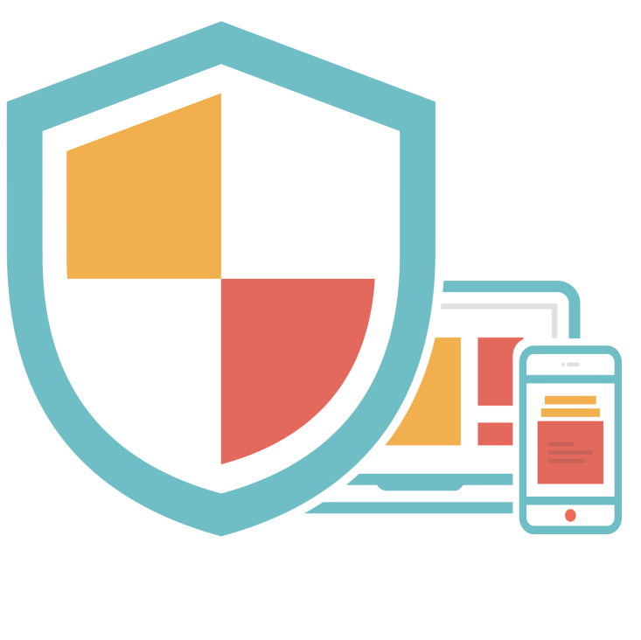





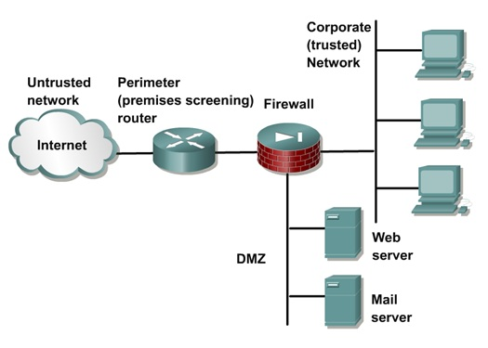

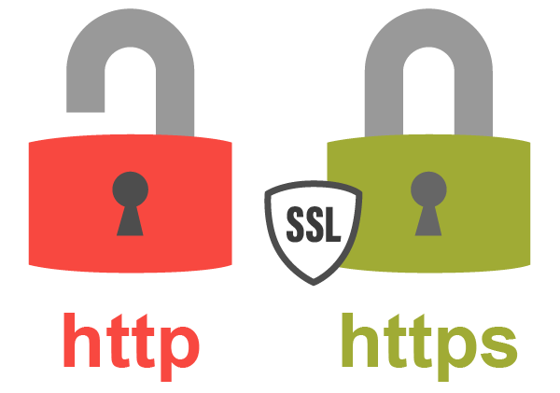


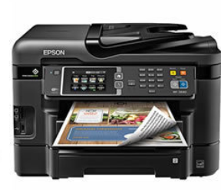
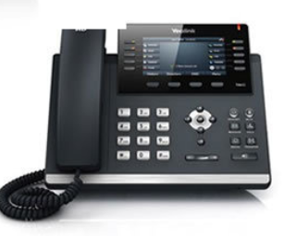


Digital hygiene
Сафин Руслан,
компания V-office

Slide 2
Personal information
‘S’ stands for Security
IIN, card numbers and other staff
You are responsible

Slide 3

GDPR
General Data Protection Regulation
When it started?
Why is it important?
How it affects on you?

Slide 4
Passwords
Usual requirements:
At least 8 characters
At least 1 uppercase letter
At least 1 lowercase letter
At least 1 number
At least 1 specified character
No more than 2 identical characters in a row
No name, last name, email address or name of company
Not matching commonly used passwords

Slide 5

Most commonly used passwords in 2018 by SplashData
1. 123456
2. password
3. 123456789
4. 12345678
5. 12345
6. 111111
7. 1234567
8. sunshine
9. qwerty
10. iloveyou

Slide 6
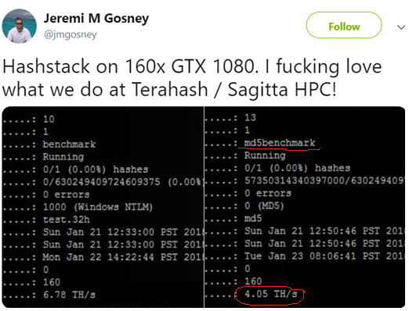
Passwords
8-digit password written with lower-case and upper-case letters and specified character could be cracked in 3 minutes
10-digit password written with lower-case and upper-case letters and specified character could be cracked in 10 days

Slide 7
Social engineering
Phone calls
Emails
Fake identities
Techniques

Slide 8
Phishing
Phishing is a type of social engineering
Why does it called phishing?
Intruder trying to masquerade as a trusted identity
What are the possible consequences?

Slide 9
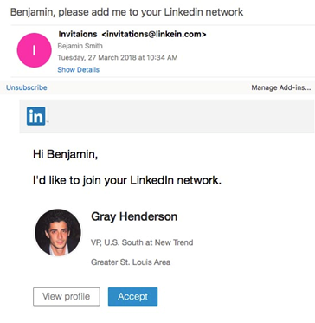
Example of phishing
Address
Interface
The name

Slide 10
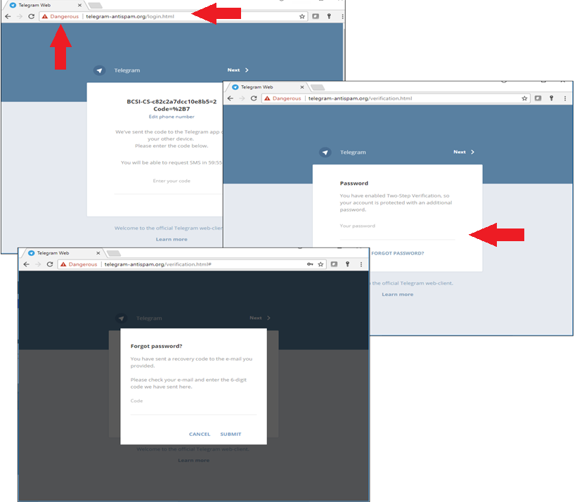

Slide 11
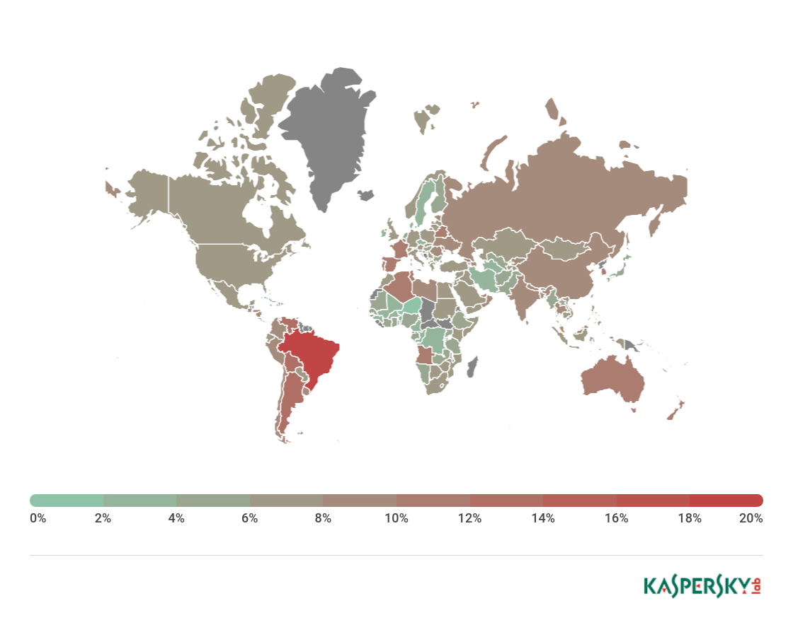
Geography of phishing
Countries | %
Brazil | 19,07
Argentina | 13,30
Venezuela | 12,90
Albania | 12,56
Bolivia | 12,32
Reunion | 11,88
Belarus | 11,62
Georgia | 11,56
France | 11,40
Portugal | 11,26

Slide 12
Pirated software
High Infection Rate – 1/3
Lost Time - 1.5 billion hours
Financial Cost - $464 billion USD worldwide

Slide 13
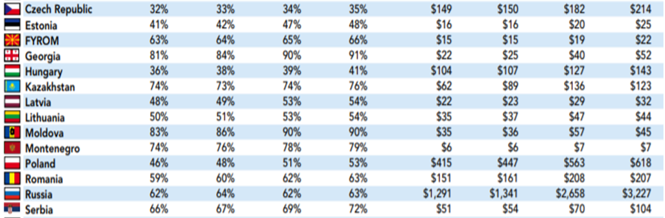
Pirated software in Central and Eastern European countries
RATES OF UNLICENSED SOFTWARE INSTALLATION COMMERCIAL VALUE OF UNLICENSED SOFTWARE ($M)
2017 2015 2013 2011 2017 2015 2013 2011

Slide 14
Antivirus is not a panacea
How does antivirus works?
Signature database
Heuristic analysis

Slide 15
Antivirus won’t help you
An advanced persistent threat (APT) is a prolonged and targeted cyberattack in which an intruder gains access to a network and remains undetected for an extended period of time
Zero-day attack - attacks that take advantage of a security vulnerability on the same day that the vulnerability becomes publicly known

Slide 16
Cell phones
Lock it with your secure password
Where is my phone?
iCloud.com/find
Google.com/android/find
Be able to erase, lock and find your cell phone

Slide 17
Apps on your cell phone
Always check the permissions you grant to any applications
Boosters, Cleaners, Antiviruses are mostly useless
Check rating and comments before actually installing an app

Slide 18
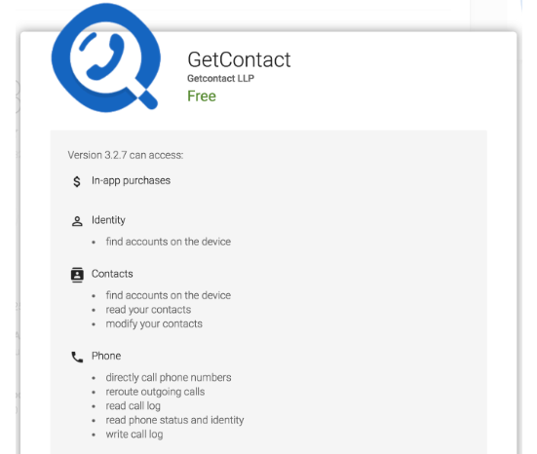
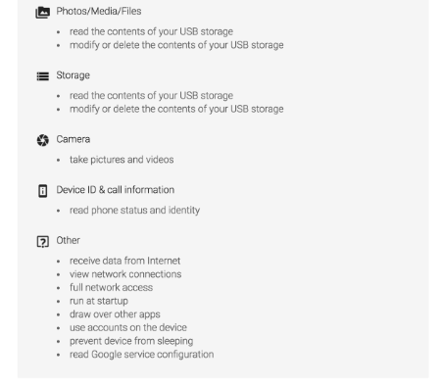
Permissions

Slide 19

Who is reading your email?
Third-party developers with the use of automated tools

Slide 20



Let’s suppose you are running a bussiness

Slide 21
Corporate network perimeter
Defensible boundary between the information and assets your organization needs to keep safe and those who could harm you

Slide 22
Common issues with network perimeter
Your internal users are connecting from external networks and using mobile devices to access internal resources.
Your data and applications housed data warehouses, cloud computing, and anything-as-a-service present access
Web services

Slide 23
Critical areas to focus on:
Strong authentication to allow controlled access to your information assets
Hardening of mobile and IoT devices that connect to your network
Embedding enhanced security services inside applications
Collecting security intelligence directly from applications and their hosts

Slide 24
IoT
‘S’ stands for security
Hackers once stole a casino's high-roller database through a thermometer in the lobby fish tank

Slide 25
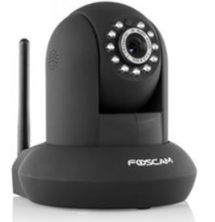
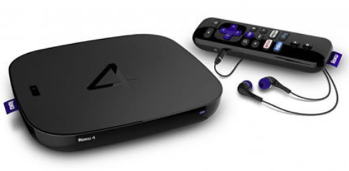
IoT
70% of all internet of things devices are vulnerable to cyber-attacks
There will be 26 billion individual Internet of Things devices in the world by the year 2020
In the year 2009, there were only about 9 million of these devices sold

Slide 26
Information Security systems components
PEOPLE
Staff training
Qualification
Competent Resources
PROCESS
Management Systems
Governance Frameworks
Best Practice
IT Audit
TECHNOLOGY
You can’t deploy technology without competent people, support processes and an overall plan

Slide 27
1. Predict
Predicting a cyber attack is not a simple task. There's no viable way for a single organization to intercept hackers communications and learn about the tools they're currently using, or where they plan to strike next.
Static application security testing (SAST)
Dynamic application security testing (DAST)

Slide 28
2. Prevent
Firewall - controls access to the network and monitors the flow of network traffic
Virtual Private Network (VPN) –
is a system that delivers enterprise-focused communication services on a shared public network infrastructure and provides customized operating characteristics uniformly and universally across an enterprise.

Slide 29

2. Prevent
Identity and access management (IAM) is the security discipline that enables the right individuals to access the right resources at the right times for the right reasons.
Intrusion Prevention System (IPS) - detect and block malicious network activity before damage occurs
The web application firewall (WAF) - to protect public and internal web applications

Slide 30
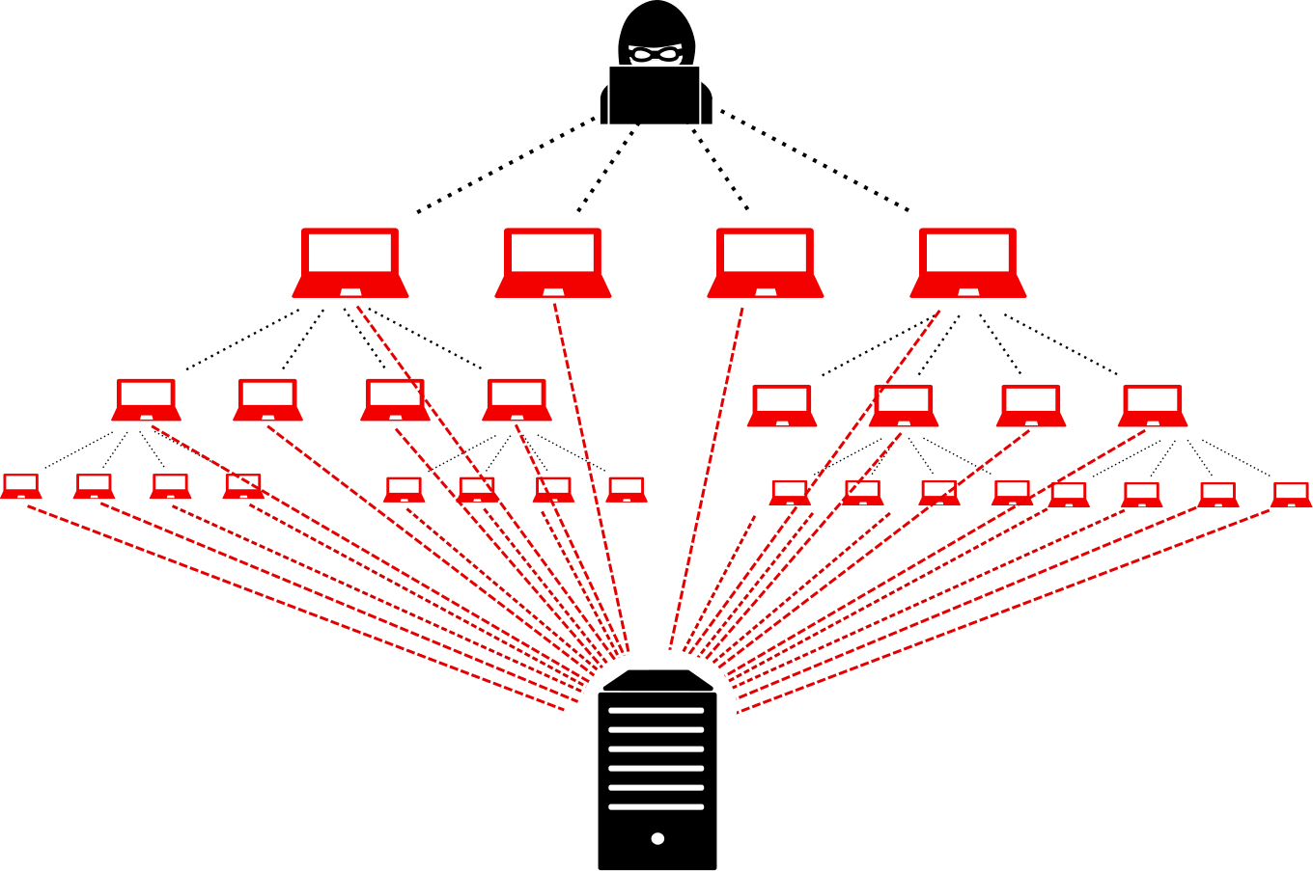
2. Prevent
Anti-DDoS - protect against one of the most common threats to server availability

Slide 31
3. Detect
Security information and event management (SIEM) - technology supports threat detection and security incident response through the real-time collection and historical analysis of security events from a wide variety of event and contextual data sources
Endpoint Protection is a solution deployed on endpoint devices to prevent file-based malware attacks, detect malicious activity, and provide the investigation and remediation capabilities needed to respond to dynamic security incidents and alerts

Slide 32
3. Detect
Data Loss Protection (DLP) describes a set of technologies and inspection techniques used to classify information content contained within an object
User and Entity Behavior Analytics (UEBA) technology protects organizations from insider threats by continuously monitoring users and endpoints with automated detection and response capabilities

