Slide 1

4th International Conference on Advances in Social Sciences
Global Research and Development Services
Kuala Lumpur, Malaysia
27-28 December, 2014
Madina Assangaliyeva
Katrina Griffiths
Jennifer Rempel
Sara Rizzo
Rebecca Slaven

Slide 2
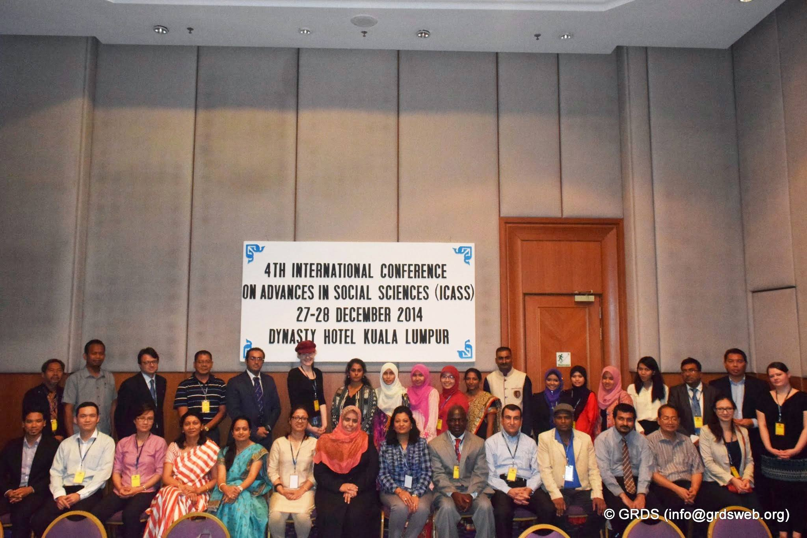

Background Information
The purpose of the 4th International Conference on Advances in Social Sciences is:
“to promote international dissemination of knowledge and development of cross-national academic fraternity”.

Slide 3
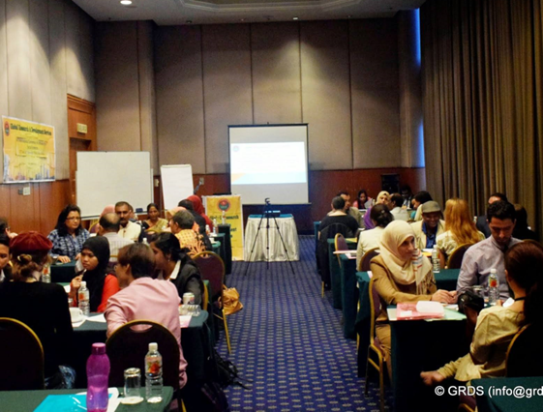
Knowledge Management
Dr. V.P Kallimani, Universiti Teknologi Petronas, Malaysia
KM systems typically preserve organizational knowledge by means of paper documents or computer files.
KM software programs can be of great value in collecting, storing, and distributing knowledge within an organization.

Slide 4
Knowledge Management at NU
The KM system at NUL could be streamlined.
Some paper documents could be eliminated and knowledge sharing incentivized by implementing an intranet system.

Slide 5
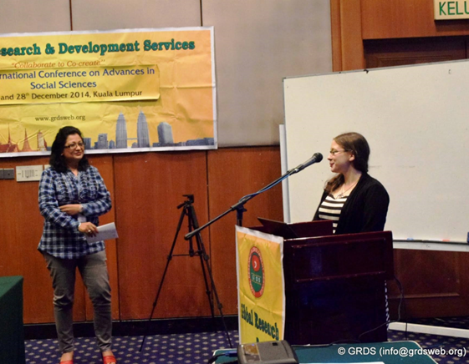
Intellectual Property Awareness
Siti Aisah Binti Sahlan, Universiti Teknologi Malaysia (Kuala Lumpur)
Students in the UK showed greater awareness of IP rights than Malaysian students, likely due to focus on IP rights in UK education.
Educators and librarians have a role to play in educating students on IP rights.

Slide 6
Intellectual Property Awareness at NU
SLs typically include discussion of IP rights in instruction sessions.
IP awareness messages can also be distributed among students via posters, videos, and social media.

Slide 7
Inquiry-Based Learning
Tze Jiun Lee, Centre for Pre-University Studies, Malaysia
Inquiry-based learning aims to engage students beyond typical classroom lectures.
This involves students being left more on their own to:
  solve problems
  formulate explanations
  design research procedures
  create their own research questions

Slide 8
Inquiry-Based Learning at NU
Studies about the effectiveness of IBL v. traditional lectures are inconclusive, likely because people have widely varying learning styles.
Many faculty at NU use a combination of both traditional lectures and IBL.
At the library, we could incorporate more problem-solving into our sessions.

Slide 9
Conclusion
The 4th International Conference on Advances in Social Sciences provided us with a great opportunity to discover how Social Sciences research can impact Libraries.
It was also a chance to meet professionals and researchers from all over the world!

Slide 10
Questions?

