Slide 1

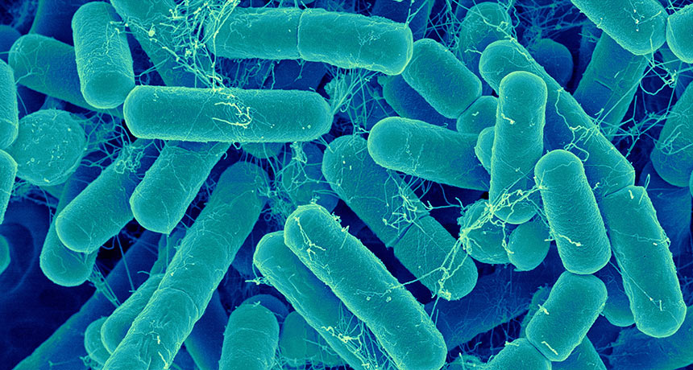
Simulation and modeling of microorganisms in Biofilm
Student: Gulzhahan BISSEMBAYEVA
Lead supervisor: ENRICO MARSILI,PhD
CO-SUPERVISOR: CARLO MOLARDI,PhD

Slide 2
OUTLINE:
INTRODUCTION
LITERATURE REVIEW
METHODOLOGY
NETLOGO
SCOPE AND CONSTRAINTS
RESULTS
DISCUSSION
CONCLUSION
REFERENCE LIST

Slide 3
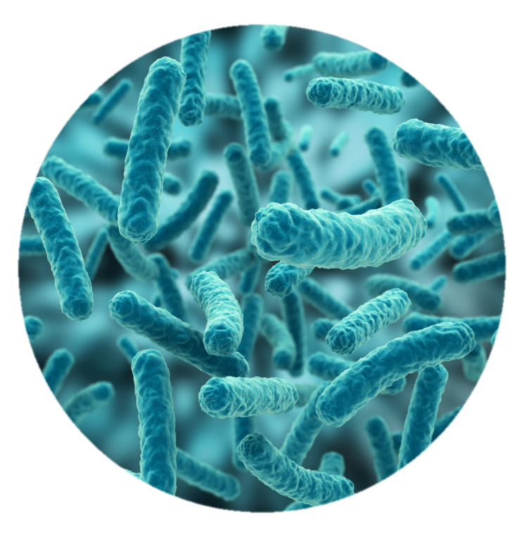
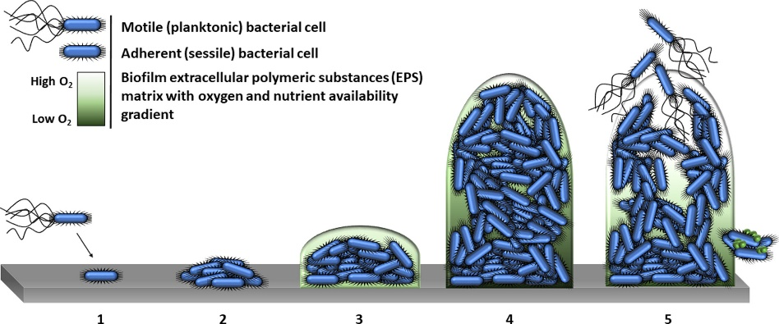
INTRODUCTION
Biofilm is the bacterial aggregation [1]
Biofilm-associated sessile communities represent the major bacterial lifestyle [2]
The biofilm is formed in three main stages: adherence, maturation and dispersal [3]
Figure 1. Steps a new bacterial species takes in forming a biofilm [4]

Slide 4
INTRODUCTION
Approximately 65% of the entire bacterial infections and 80% of chronic infections are related to bacterial biofilms [5,6]
Biofilms are responsible for the formation of 2% of bacterial infections on breast implants, 4% on mechanical heart valves and 40% on ventricular-assisted devices [6]

Slide 5
INTRODUCTION
Objectives:
Develop a simplified computational model for a single species bacterial biofilm attachment and dispersal
Understand the growth mechanism of biofilm
Provide general concepts of biofilms, their growth mechanism, a brief explanation of the coding tools adopted, and the limitations of the study
Thesis statement:
Computational simulations based on agent-based modelling (ABM) can help predicting the time for cells attachment and biofilm formation on biomedical devices. ABMs can reduce the need for preliminary laboratory experiments, thus saving time and resources

Slide 6
LITERATURE REVIEW: COMPUTATIONAL MODELS
Continuum models express the biofilm as a continuum material [7]
Microorganisms in the IbM models are considered as solid particles [7]
Agent-Based models are computational and mathematical models in which agents are autonomous and unique entities CA models rely on probability principles and set of simple rules [8,9]
Hybrid models combine discrete and continuous cell models [6]
Mathematical models
Continuum
Individual based (IbM)
Cellular automata (CA)
Hybrid models
Agent based (ABM)

Slide 7
LITERATURE REVIEW: AVAILABLE SOFTWARES
Simulation platforms:
CompuCell3D is a 3D C++ simulation software for solving biocomplexity problems and integrating a variety of mathematical models [10]
NetLogo is a software allowing to conduct multi-agent programmable modeling including system dynamics and participatory simulations [11]
Vcell is an open-source comprehensive platform for the simulation and modeling of cell systems [12]
BSim is an agent-based computational instrument for evaluating the behavior of microorganisms as a community [13]
Visual Studio code editor one of the most popular text editors used by developers [14]

Slide 8

LITERATURE REVIEW: NETLOGO
Multi-agent programming language capable of modeling sophisticated natural and social phenomena
Modeling substantial collections of agents evolving over time
Concurrent instructions to thousands of independent agents
Investigate the micro-level interactions between agents leading to macro-level behavior patterns [15]

Slide 9
SCOPE AND CONSTRAINTS
3D discrete agent-based modelling (ABM) approach
Full biofilm growth cycle
Single-specie
c-di-GMP and AHL-dependent mechanism of growth
No flow condition
No adhesion effects
Rectangular prism world

Slide 10
METHODOLOGY
Extensive literature review
Creation of ABM in Netlogo software
Checking the results
Editing the code in a weekly manner

Slide 11
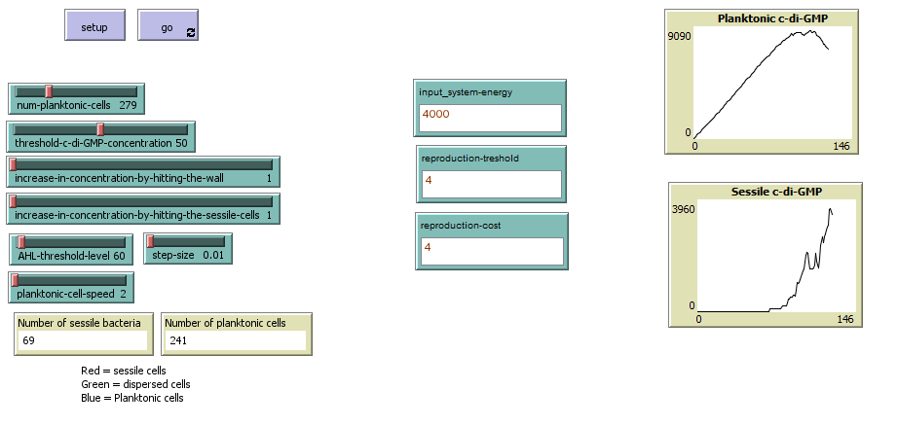
NETLOGO: INTERFACE
Interface elements: sliders, inputs, switches, outputs, graphs
Table 1. Interface elements
Interference elements | Names | Function
Slider | num-planktonic-cells | Initial number of planktonic cells in the model
Slider | threshold-c-di-GMP-concentration | The threshold c-di-GMP concentration, responsible for transforming planktonic cells to sessile cells
Slider | increase-in-concentration-by-hitting-the-wall | The level of c-di-GMP increase in planktonic cells resulted from each contact with the walls
Slider | increase-in-concentration-by-hitting-the-sessile-cells | The level of c-di-GMP increase in planktonic cells resulted from each contact with the sessile cells
Slider | AHL-threshold-level | The threshold AHL concentration in patches, responsible for sticking planktonic cells to certain zones of the world
Slider | planktonic-cell-speed | Speed of planktonic cells
Slider | step-size | Speed of sessile cells
Figure 2. NetLogo interface

Slide 12
Planktonic cells
Initial c-di-GMP level = 0
Reversible attachment
Elastic bouncing off the walls
Irreversible attachment
Reaching threshold c-di-GMP level
Sessile cells
Transformation into sessile cells
Dispersion
Creation of new planktonic cells
Energy level is between 1 and 10
Each hit increases c-di-GMP and AHL levels
Each movement takes energy
Eating nutrients provides energy
Reaching threshold AHL level
Sticking to the wall
Growing under certain conditions
Aggregation to microcolonies
Figure 3. NetLogo Biofilm growth cycle

Slide 13
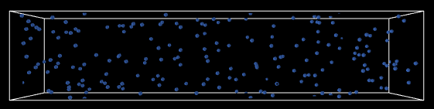
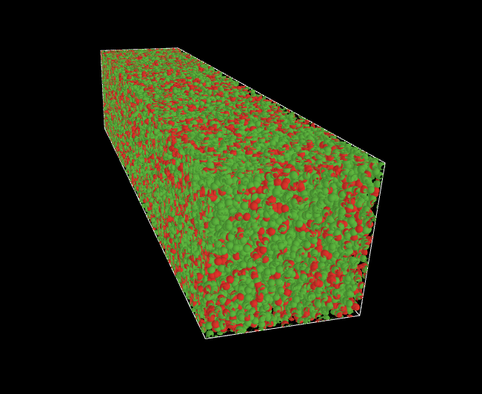
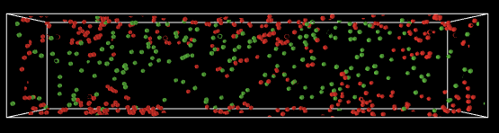
RESULTS
Figure 4. The agents in the model a) blue- planktonic cells b) red- sessile cells, green – newly-created planktonic cells c) simulation output

Slide 14
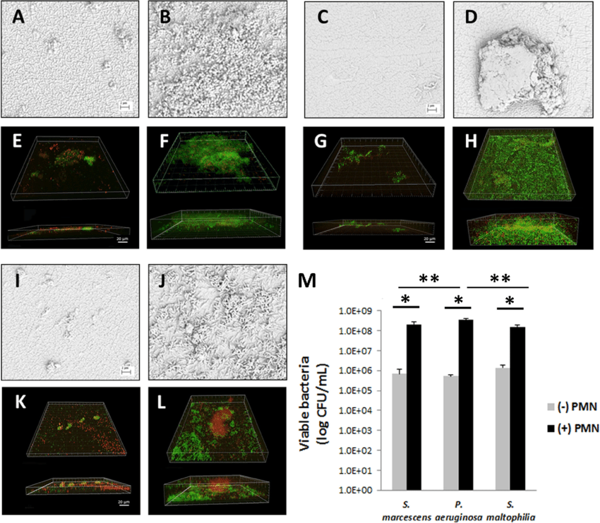
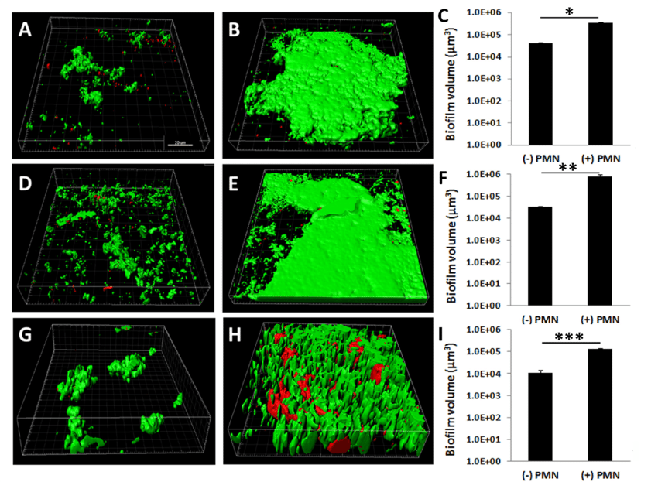
VISUAL COMPARISON
Figure 5. Patel et al. research. Laser scanning confocal microscopy and 3D modeling of Gram-negative biofilms using Imaris software [16]

Slide 15
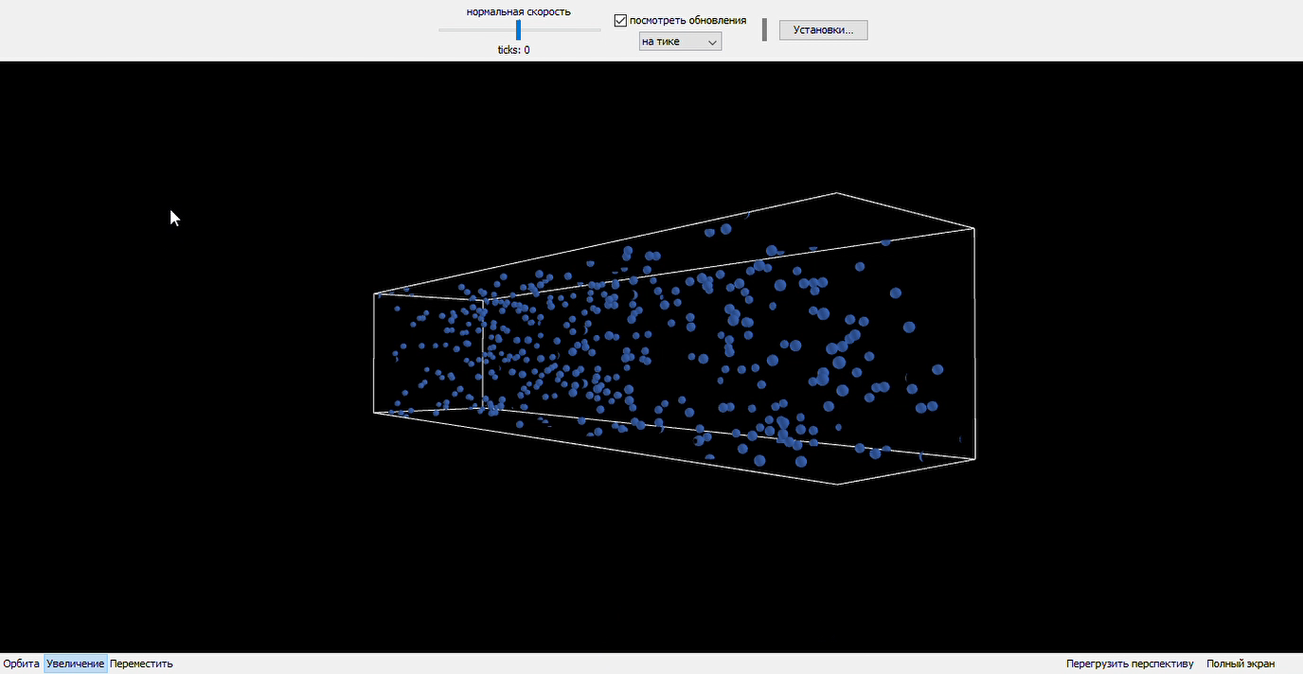
RESULTS
Initial number = 200
radius 6
100 neighboring sessile cells with energy <10
Figure 6. The agents in the model a) blue- planktonic cells b) red- sessile cells, green – newly-created planktonic cells

Slide 16
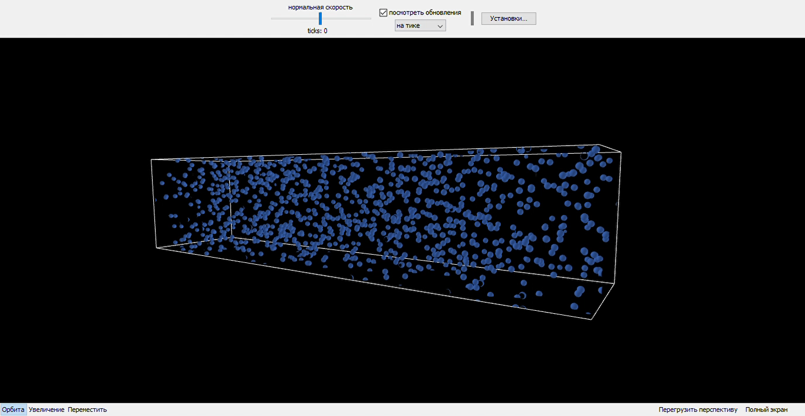
RESULTS
Initial number = 1000
radius 6
350 neighboring sessile cells with energy <10
Figure 7. The agents in the model a) blue- planktonic cells b) red- sessile cells, green – newly-created planktonic cells

Slide 17
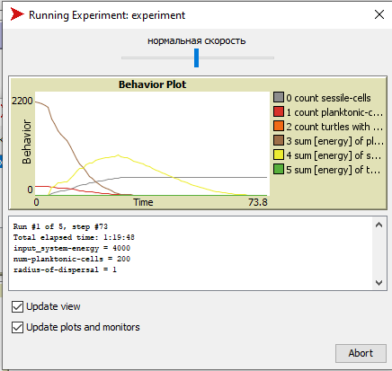
RESULTS: BehaviorSpace instrument
Running the simulation many times
Systematically altering the parameters of the model
Recording the data of each run
Explore multiple possible behaviors of the agents [17]
The number and total energy of planktonic, sessile and newly-created planktonic cells were assessed by varying the initial number of planktonic cells (10, 20, 50, 100, 200) and radius of dispersal (1-10 patches) parameters.
The BehaviorSpace tool was set to stop the simulation in two cases: when the time reaches 1000 ticks and when the total energies of sessile and planktonic cells equal to 0
Figure 8. Running the BehaviorSpace tool

Slide 18
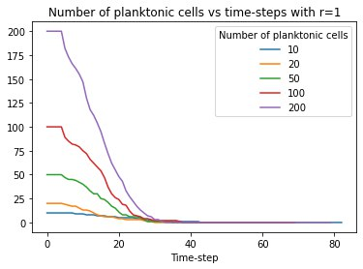
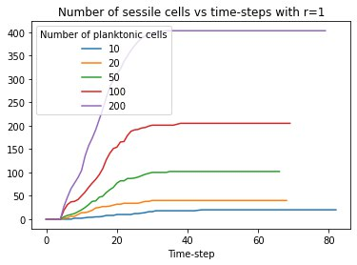
RESULTS
Figure 9. The results of the simulation (r=1)

Slide 19
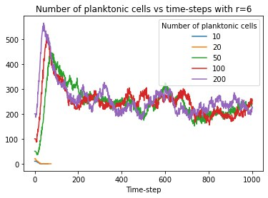
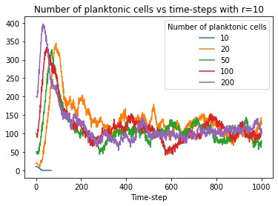
RESULTS
Figure 10. Comparing the results of simulation (r=6, r=10)

Slide 20
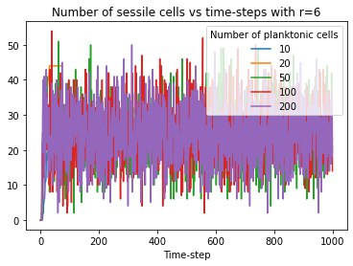
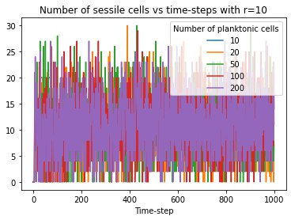
RESULTS
Figure 10. Comparing the results of simulation (r=6, r=10)

Slide 21
DISCUSSION
The initial number of planktonic cells plays a crucial role in triggering the biofilm formation and dispersal processes
Sessile cells have wider fluctuations in numbers and total energies compared to planktonic cells, due to their relatively low energy gain values and consistent transformations to planktonic cells, preventing their energy and number increases
Higher radius of dispersal is characterized by a higher number of sessile cells and a higher number of planktonic cells
The higher the threshold c-di-GMP level in planktonic cells, the slower sessile cells will disperse new planktonic cells

Slide 22
CONCLUSION
Despite the relative simplicity of this ABM model, it is one of the first 3D models in the research field serving to predict the behavior of microorganisms in the biofilm
This work has a great potential for further improvements and applications for research and analysis purposes
Limitations:
Experimental validation of the model was not accomplished in laboratory biofilm experiments due to the access limitations imposed by the COVID-19 pandemic.
Future work:
Netlogo model can be used further extended and then used as an example for generating a code in more complex programming languages
Run a complete version of the simulation on a faster machine, which will be available at high performance computing (HPC)-NU

Slide 23
REFERENCE LIST
[1] Cook, P. and Siraj, D., 2017. Bacterial Arthritis. Kelley and Firestein's Textbook of Rheumatology, pp.1876-1890.
[2] Jamal, M., Ahmad, W., Andleeb, S., Jalil, F., Imran, M., Nawaz, M., Hussain, T., Ali, M., Rafiq, M. and Kamil, M., 2018. Bacterial biofilm and associated infections. Journal of the Chinese Medical Association, 81(1), pp.7-11.
[3] Masters, B., 2015. Mandell, Douglas, and Bennett’s Principles and Practice of Infectious Diseases, Eighth Edition (2015) Eds: John E. Bennett, Raphael Dolin, Martin J. Blaser. ISBN: 13-978-1-4557-4801-3, Elsevier Saunders. Graefe's Archive for Clinical and Experimental Ophthalmology, 254(11), pp.2285-2287.
[4] LuTheryn, G., Glynne‐Jones, P., Webb, J., & Carugo, D. (2020). Ultrasound‐mediated therapies for the treatment of biofilms in chronic wounds: a review of present knowledge. Microbial Biotechnology, 13(3), 613-628. https://doi.org/10.1111/1751-7915.13471
[5] Banerjee, D., Shivapriya, P., Gautam, P., Misra, K., Sahoo, A., & Samanta, S. (2019). A Review on Basic Biology of Bacterial Biofilm Infections and Their Treatments by Nanotechnology-Based Approaches. Proceedings Of The National Academy Of Sciences, India Section B: Biological Sciences, 90(2), 243-259. https://doi.org/10.1007/s40011-018-01065-7
[6] Popławski, N., Shirinifard, A., Swat, M. and Glazier, J., 2008. Simulation of single-species bacterial-biofilm growth using the Glazier-Graner-Hogeweg model and the CompuCell3D modeling environment. Mathematical Biosciences and Engineering, 5(2), pp.355-388.

Slide 24
REFERENCE LIST
[7] Mattei, M. R., L. Frunzo, B. D’Acunto, Y. Pechaud, F. Pirozzi, and G. Esposito. 2017. "Continuum And Discrete Approach In Modeling Biofilm Development And Structure: A Review". Journal Of Mathematical Biology 76 (4): 945-1003. doi:10.1007/s00285-017-1165-y.
[8] Bodine, E., Panoff, R., Voit, E., & Weisstein, A. (2020). Agent-Based Modeling and Simulation in Mathematics and Biology Education. Bulletin Of Mathematical Biology, 82(8). doi: 10.1007/s11538-020-00778-z
[9] Scott, S., Middleton, C., & Bodine, E. (2019). An Agent-Based Model of the Spatial Distribution and Density of the Santa Cruz Island Fox. Handbook Of Statistics, 3-32. https://doi.org/10.1016/bs.host.2018.10.001
[10] Compucell3d. 2020. Frontpage - Compucell3d. [online] Available at: <https://compucell3d.org/> [Accessed 10 April 2020].
[11] NetLogo. 2020. Netlogo Home Page. [online] Available at: <https://ccl.northwestern.edu/netlogo/> [Accessed 10 April 2020].
[12] Krueger, S., 2020. Vcell- Modeling & Analysis Software – Virtual Cell Modeling & Analysis Software. [online] Vcell.org. Available at: <https://vcell.org/> [Accessed 10 April 2020]

Slide 25
REFERENCE LIST
[13] Gorochowski, Thomas E., Antoni Matyjaszkiewicz, Thomas Todd, Neeraj Oak, Kira Kowalska, Stephen Reid, Krasimira T. Tsaneva-Atanasova, Nigel J. Savery, Claire S. Grierson, and Mario di Bernardo. 2012. "Bsim: An Agent-Based Tool For Modeling Bacterial Populations In Systems And Synthetic Biology". Plos ONE 7 (8): e42790. doi:10.1371/journal.pone.0042790.
[14] Visual Code. 2020. "Visual Studio Code - Code Editing. Redefined". Code.Visualstudio.Com. https://code.visualstudio.com/
[15] Albiero F., Fitzek F.H.P., Katz M.D. (2007) Introduction to NetLogo. In: Fitzek F.H.P., Katz M.D. (eds) Cognitive Wireless Networks. Springer, Dordrecht. https://doi.org/10.1007/978-1-4020-5979-7_30.
[16] Patel, Naiya & Hinojosa, Jorge & Zhu, Meifang & Robertson, Danielle. (2018). Acceleration of the formation of biofilms on contact lens surfaces in the presence of neutrophil-derived cellular debris is conserved across multiple genera. Molecular Vision. 24. 94-104.
[17] NetLogo 6.2.0 User Manual: BehaviorSpace Guide. Ccl.northwestern.edu. (2021). Retrieved 10 March 2021, from https://ccl.northwestern.edu/netlogo/docs/behaviorspace.html#why-behaviorspace.

Slide 26


