Slide 2
Design and development of control
systems for UAVs
Alua Yermekova, MSc Student
School of Engineering and Digital Sciences Electrical and Computer Engineering Nazarbayev University
April 28, 2022

Slide 3
Table of Contents
Introduction
  1.1 UAV background dynamics
  1.2 Goals and Objectives
  Mathematical modelling of fixed-wing UAV
Closed-loop control of fixed-wing UAV using PID controller
Feed-forward compensation method for eliminating the non-minimum phase zeros
Conclusions

Slide 4
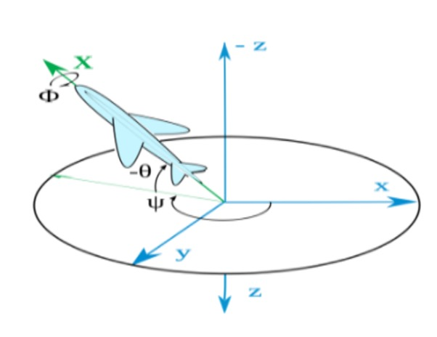
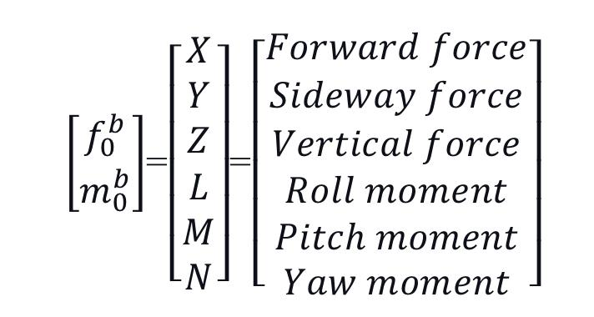
Fixed-wing UAV
(1)
Figure 1: NED and body frame of fixed-wing UAV[1-2]

Slide 5
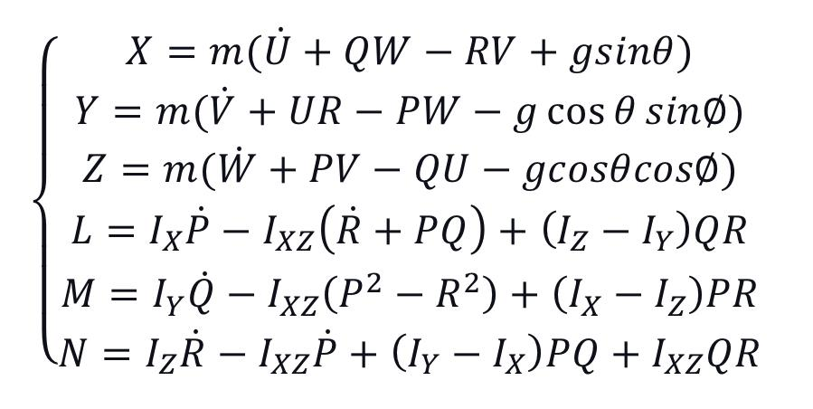
The equation of motion can be generalized in the following way:
(2)

Slide 6
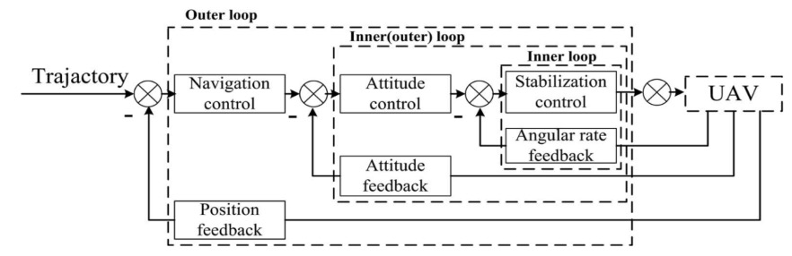
Figure 2: The basic control principal diagram [3]

Slide 7
Goals and objectives
To design the stability control system for UAVs under perturbed conditions
The following objectives were identified:
1. Mathematical modelling of fixed-wing UAV ->transfer functions
2. Simulation with MATLAB Simulink.
3. PID controller parameters by using the autotuning method
4. Robustness of the feedforward compensation (FFC) method

Slide 8
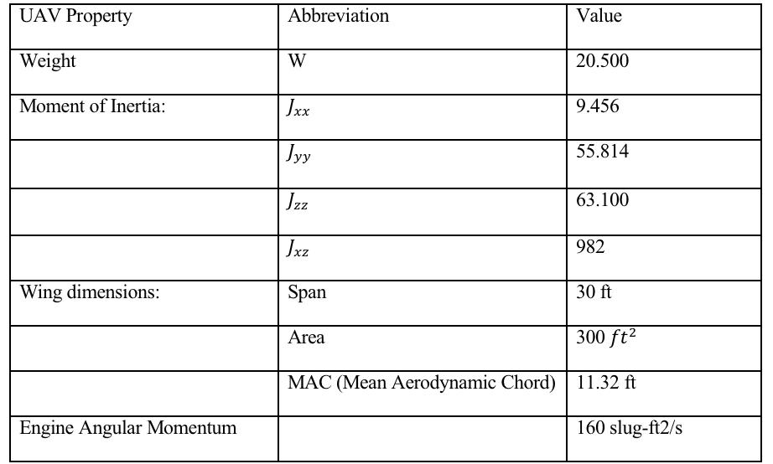
Table 1: The physical characteristics of F-16 model

Slide 9
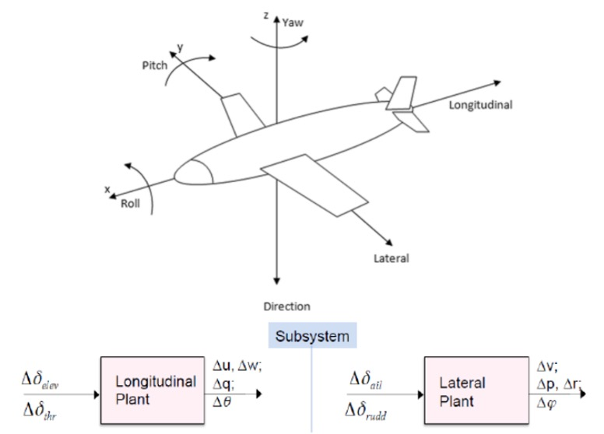
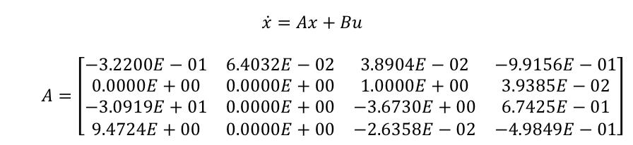
Figure 3: Longitudinal and later control of fixed-wing UAV [4]
After substitution the necessary values, the lateral subsystem matrixes can be identified in the following way:
(3)

Slide 10
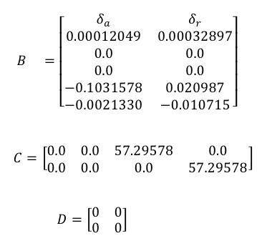
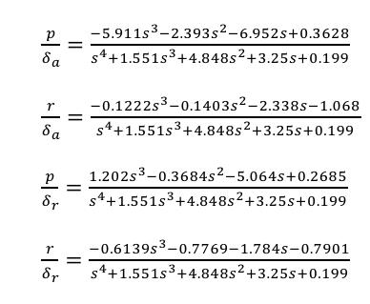
Dynamics of F-16 fixed-wing UAV
From the state matrices below, the transfer function of a fixed-wing UAV can be retrieved :
(4)
(5)

Slide 11
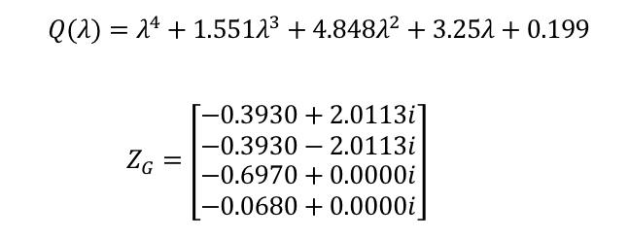
The system behavior is stable since the poles of the characteristic equation have a negative real part.
(6)

Slide 12
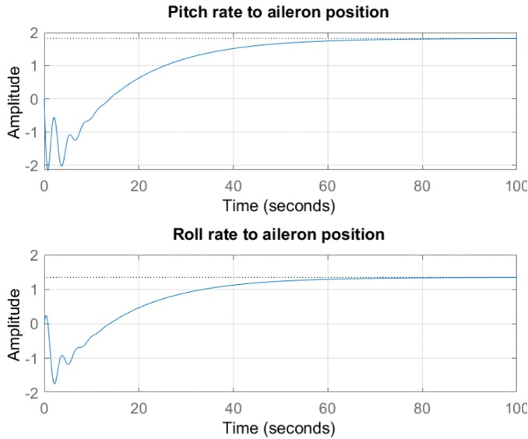
Figure 4: Step response of pitch and roll rates with respect
to the aileron position

Slide 13
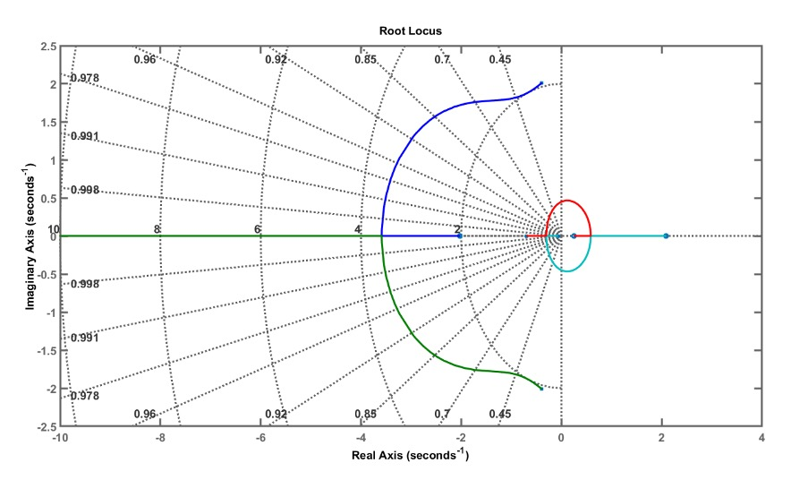
Figure 5: Root-locus of the open-loop system

Slide 14
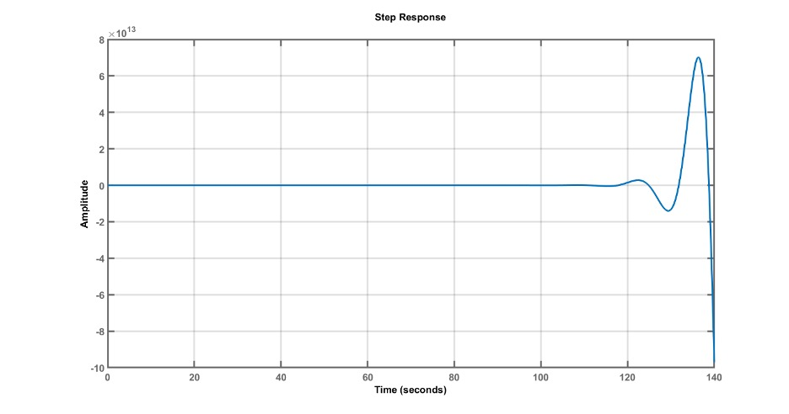
Figure 6: Step response of the closed-loop system without a controller

Slide 15
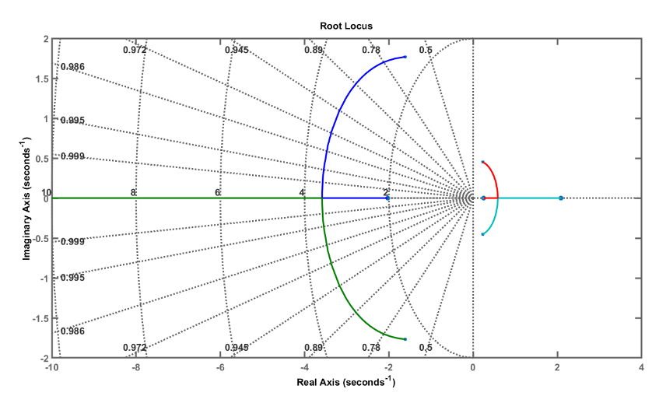
Figure 7: Root-locus plot of a closed-loop system without controller

Slide 16
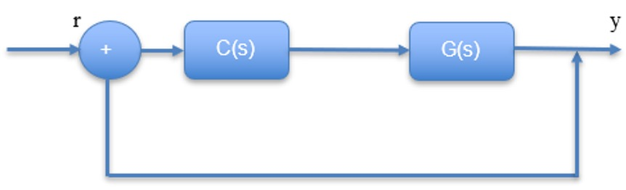
Designing the PID controllers with AutoTuner MATLAB
Figure 8: Block diagram of a closed-loop control of a roll angle transfer
function using PID controller

Slide 17
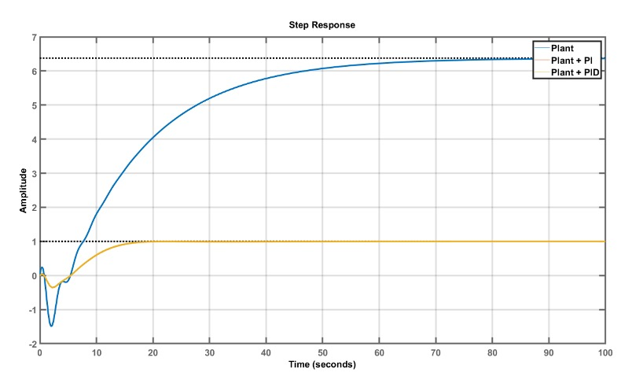
With auto-tuner method the parameters of PI controller:
K_p=0.223
K_i=0.0143.
Figure 9: Tuning PID controllers to stabilize the open-loop plant

Slide 18
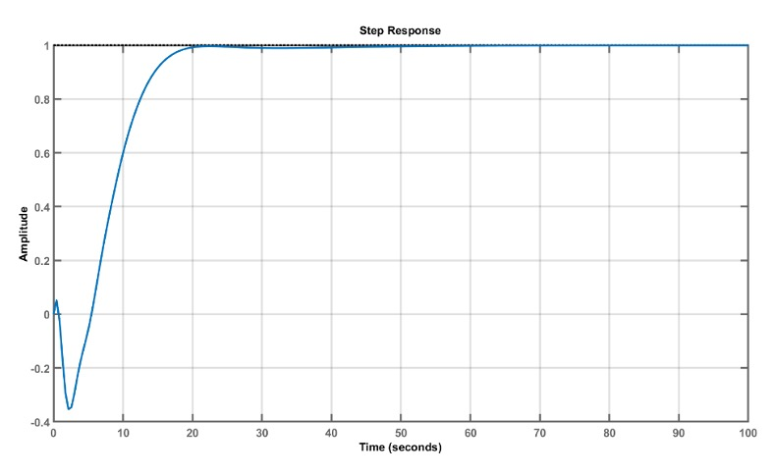
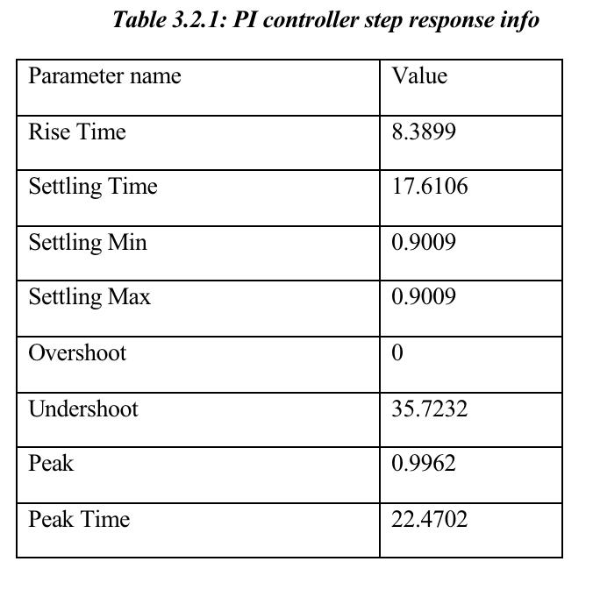
Table 2: PI controller step response info
Figure 10: PI controller response

Slide 19
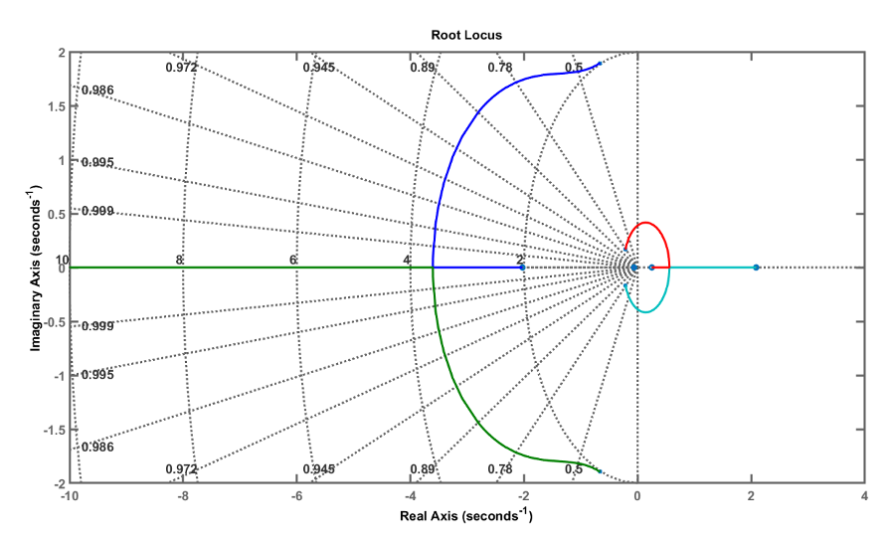
Figure 11: Root-locus plot of the closed-loop control system transfer function

Slide 20
Feed-forward compensation method for eliminating the non-minimum phase zeros
Following are the classical and novel approaches to eliminate the NMP(Non-minimum phase) systems:
• Pole-zero cancellation - Cannot handle with a complex conjugate poles and unstable system
• Feed-forward compensation method (FFC) - Can handle with both stable and unstable systems with complex conjugate poles

Slide 21
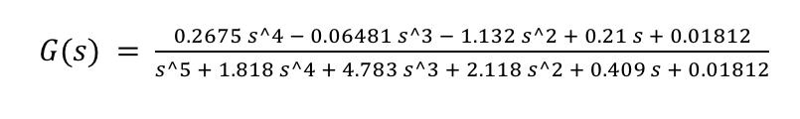
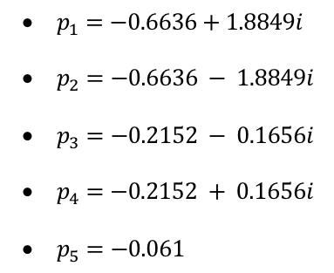
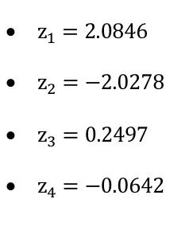
Pole-zero cancellation
Stable real and complex conjugate poles
Unstable real zeros

Slide 22
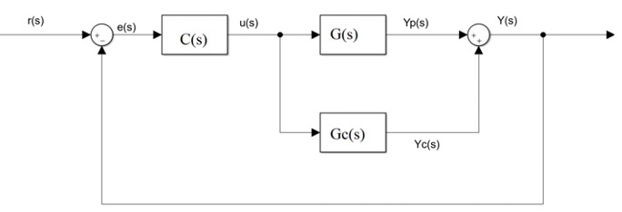
Feed-forward compensation method
Given G(s) – open-loop transfer function of the system with the following parts:
• R(s) – transfer function reference input signal. This can be a simple step signal, sine wave or even a complex one
• Y(s) – transfer function of the output signal
• E(s) – Transfer function of the error signal which can be calculated using the difference between the reference and output signal
• C(s) – Transfer function of the controller which is a simple PID feedback gain K here.
• Gc(s) – transfer function of the parallel compensator
• G(s) – transfer function of the plant
• Yp(s) – transfer function of the output plant
• Yc(s) – transfer function of the output of parallel compensator
Figure 12: Block diagram of a feed-forward compensator controller [5]

Slide 23
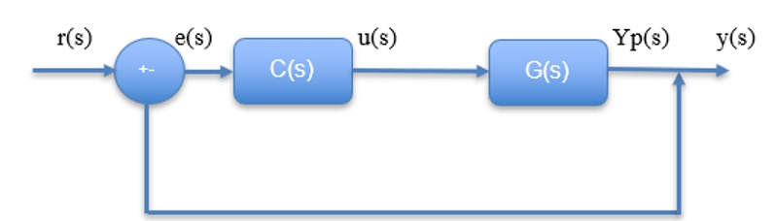
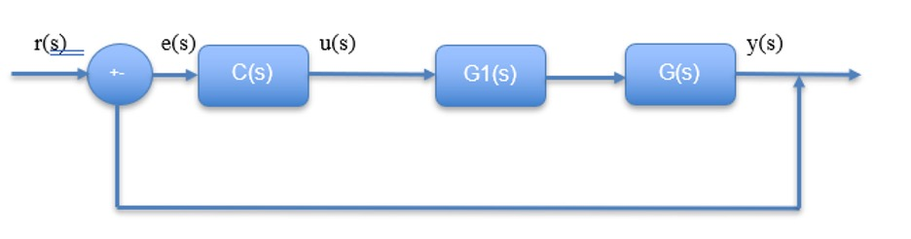
Therefore, the decomposition of the open-loop transfer function of the plant should be applied to the system shown below:
Figure 13: Block diagram of the cascaded control system
Figure 14: Simplified block diagram of decomposed control system
• G(s) = G1(s)*G2(s)
• G1(s) = MP (Minimum phase) and stable/unstable
• G2(s) = NMP (Non-minimum phase) and stable and unstable

Slide 24
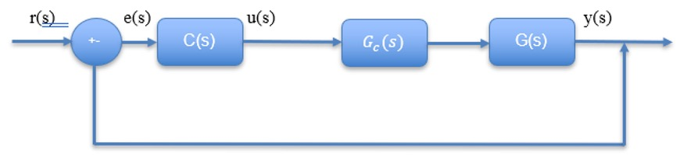
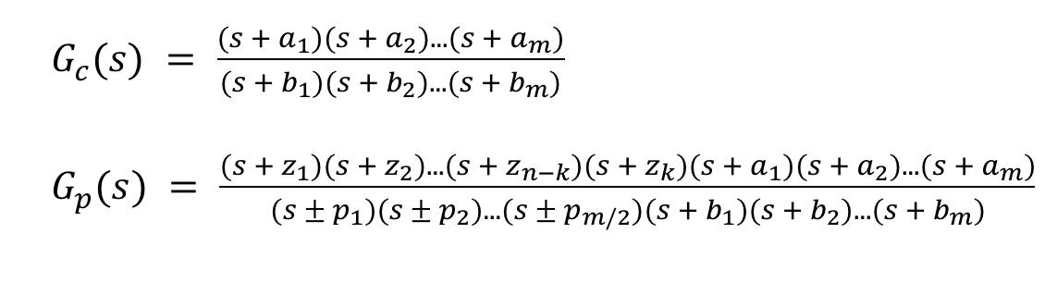
Figure 15: The block diagram of the cascaded pole-zero system

Slide 25
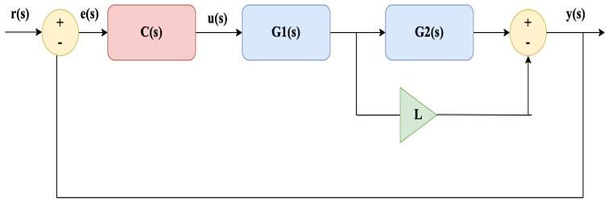
Tuning the parameters a,b and L
Figure 16: General block diagram of a feed-forward compensation method for a non-minimum phase stable system with complex conjugate pole pairs

Slide 26
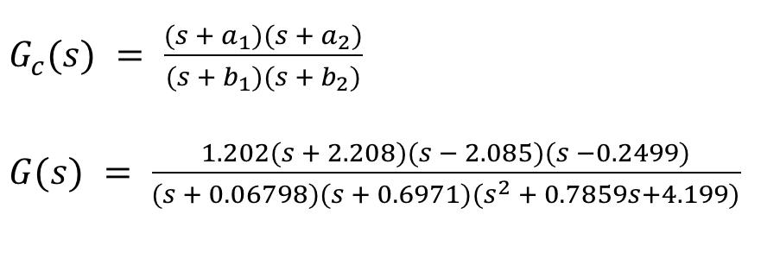
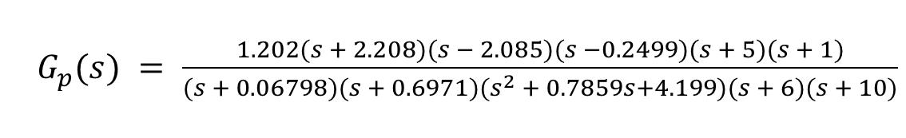
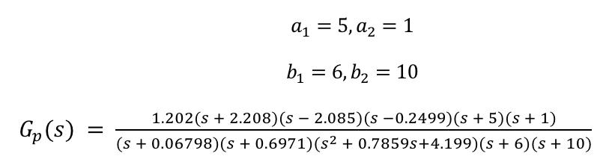
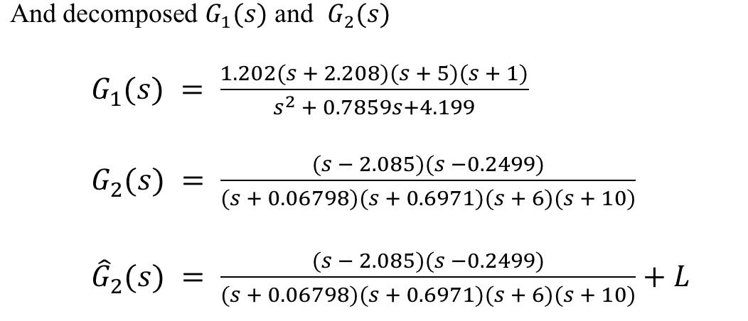
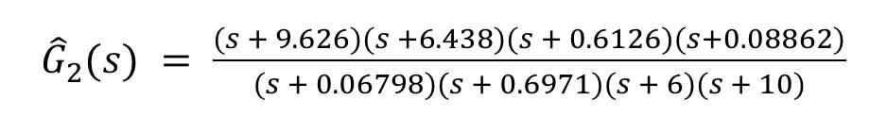
Choosing L is also an arbitrary selection depending on the purpose. Let’s for a moment take L = 1, which means that from unstable 2.085 and 0.2499 it can be shifted to -9.626, -6.438, -0.6126 and -0.08862

Slide 27
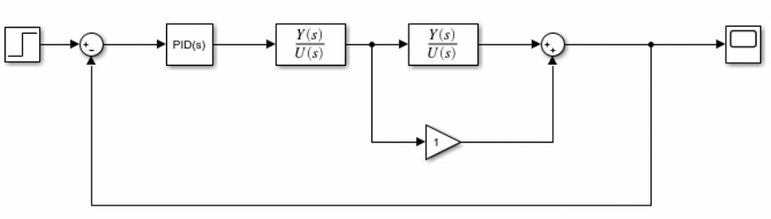
Figure 17: Simulink block diagram of a feed-forward compensation method for a non-minimum phase stable system with complex conjugate pole pairs

Slide 28
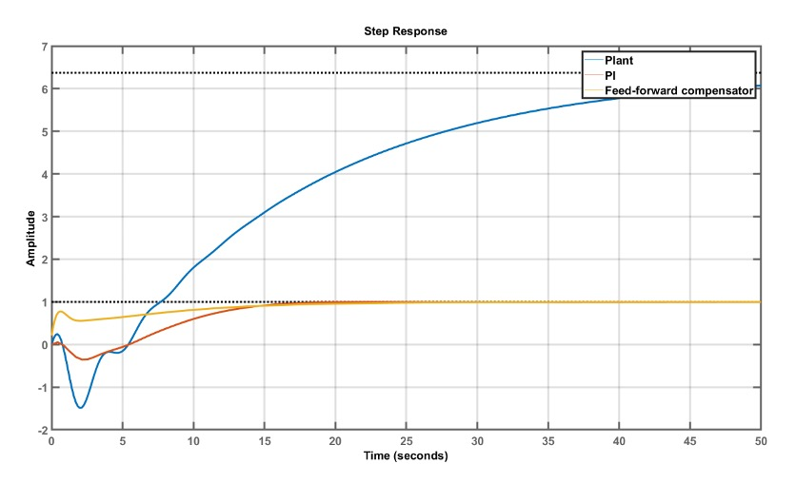
Figure 18: Feed-forward compensation method. Simple reference: step response with L = 1

Slide 29
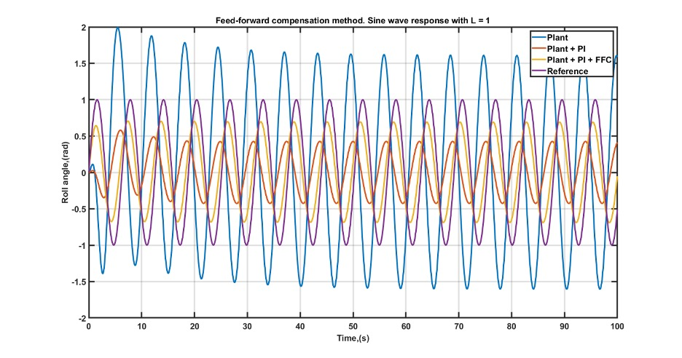
Figure 19: Feed-forward compensation method. Sine wave response with L = 1

Slide 30
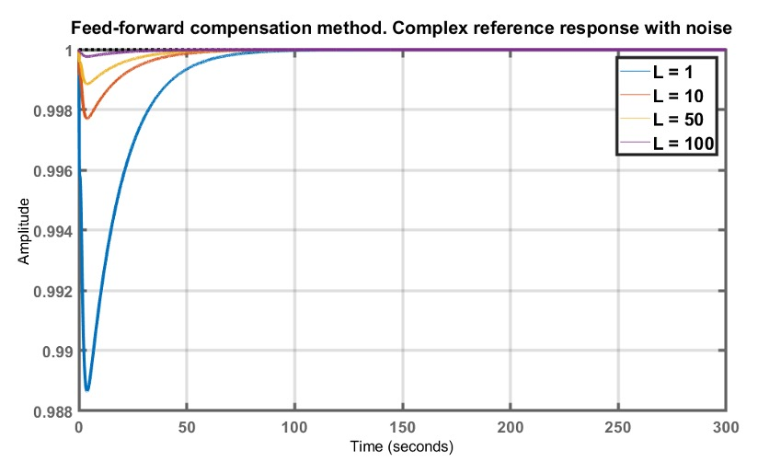
Figure 20: Feed-forward compensation method. Simple reference: Step response with 1≤L≤100, with step 5

Slide 31
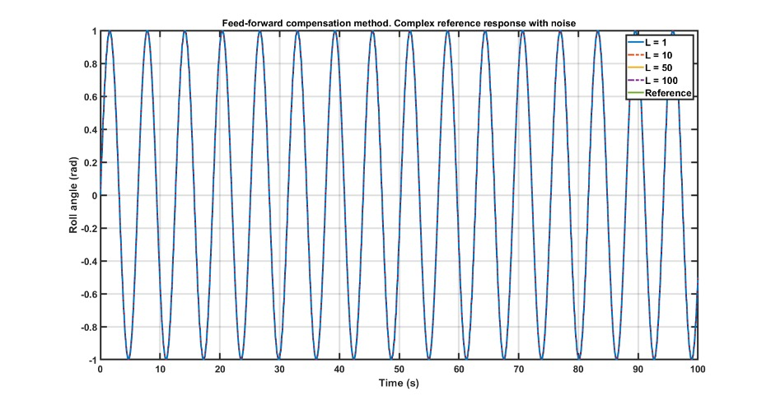
Figure 21: Feed-forward compensation method. Complex reference: Sine wave response with 1≤L≤100, with step 5

Slide 32
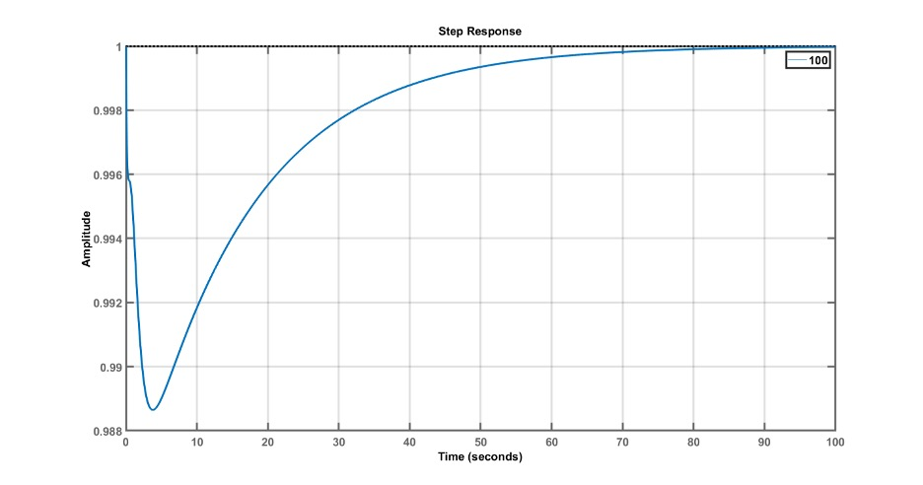
Figure 22: Feed-forward compensation method. Simple reference: Step response with L = 100

Slide 33
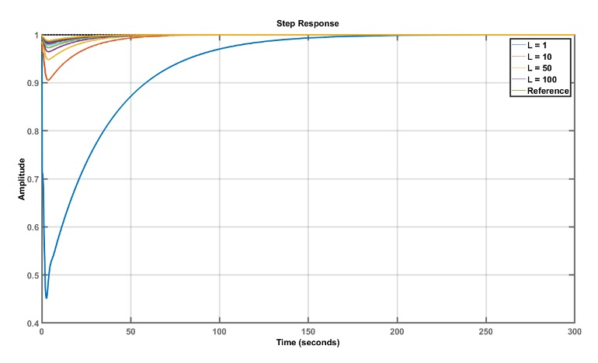
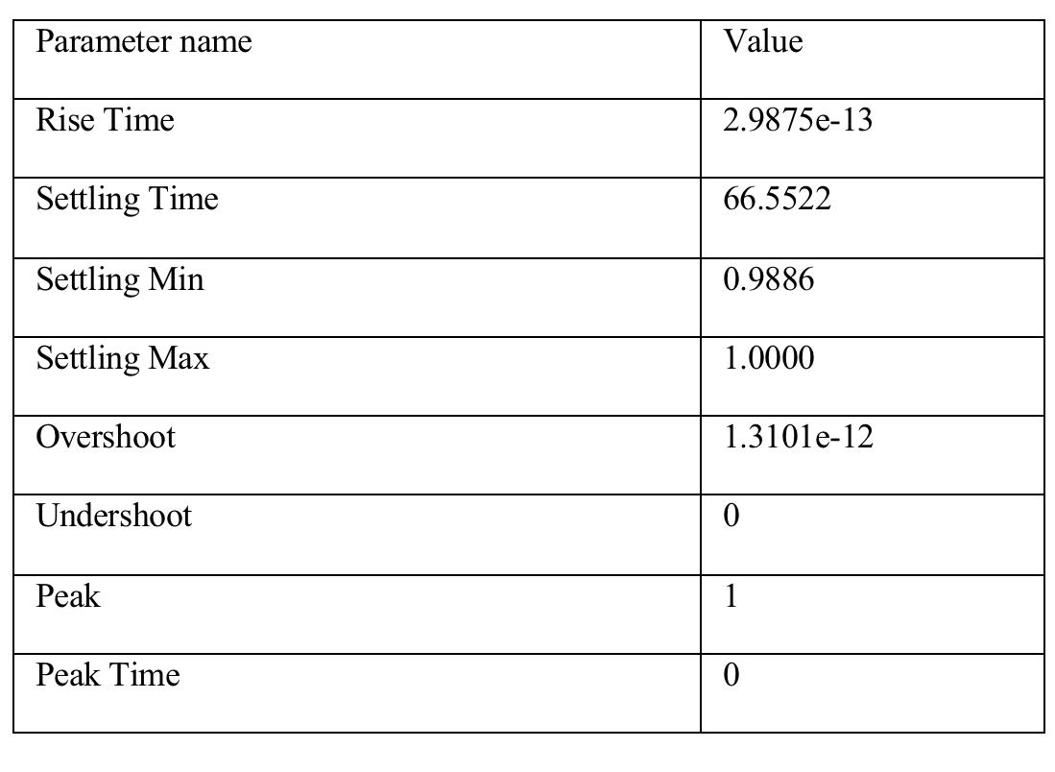
Table 3: FFC method applied step response info
Figure 23: PI+FFC controller response

Slide 34
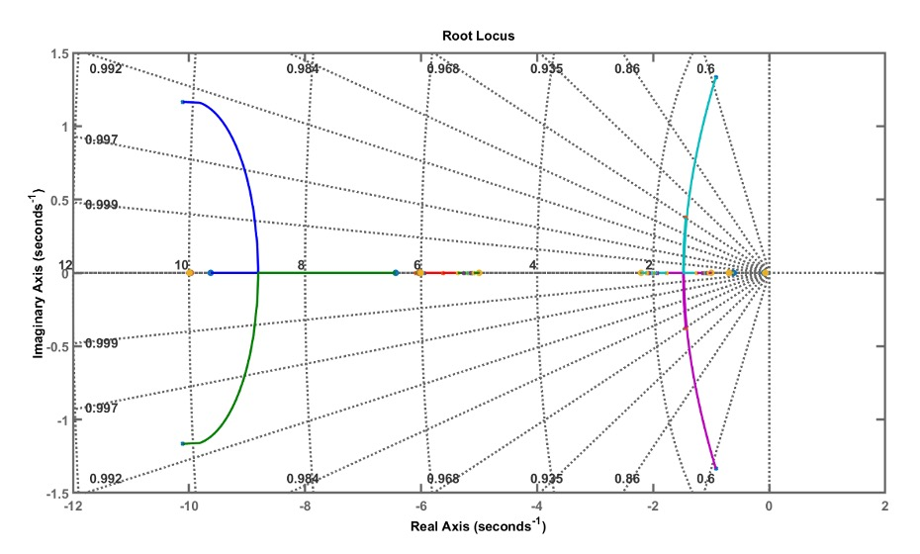
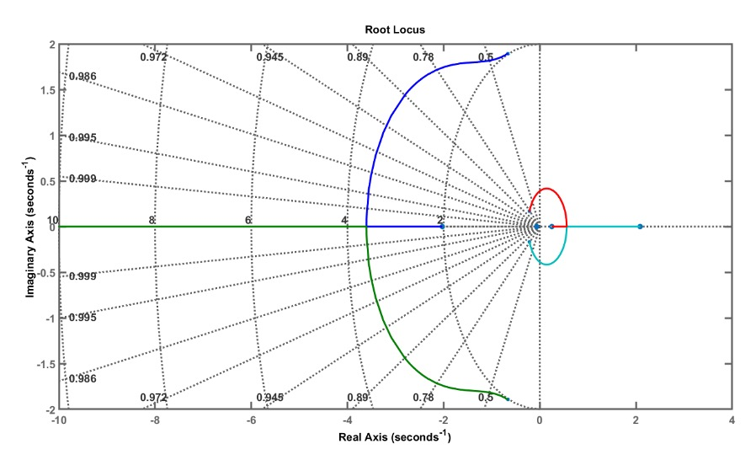
Comparison of a root locus plots
Root locus plot of a closed-loop control system using PI controller
Root locus plot of a closed-loop control system using PI and FFC controller
Figure 24: Comparison of a root locus plots

Slide 35
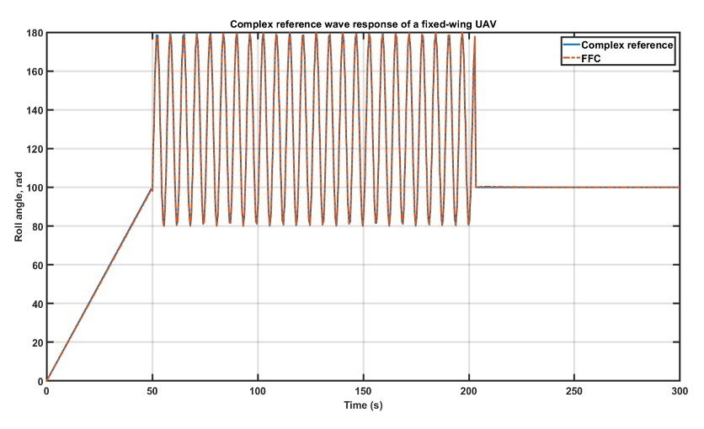
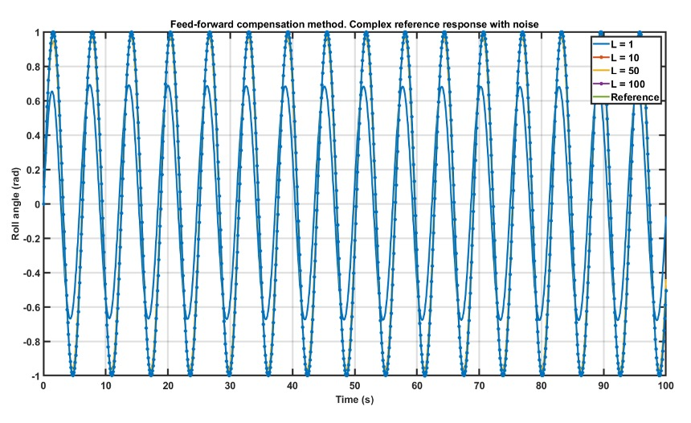
Figure 26: Feed-forward compensation method. Complex reference response with noise
Figure 25: PI+FFC controller response to the complex input

Slide 36
Robustness of a Feed-forward compensation method

Slide 37
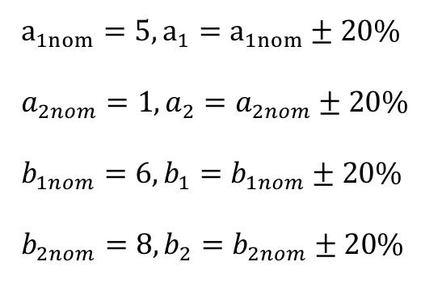
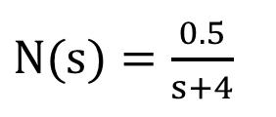
Robustness check methods
Monte-Carlo based approach. Tuning uncertainty parameters.
Testing the behavior for an external noise disturbance.
Assume the disturbance function in [31]

Slide 38
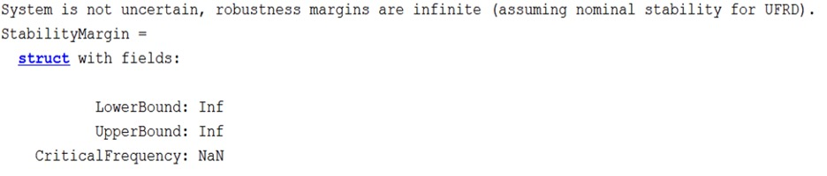
Tuning uncertainty parameters results

Slide 39
Testing for an external noise disturbance. Simple reference
Figure 26: Step response without noise
Figure 27: Step response with noise

Slide 40
Conclusions
Mathematical modelling of an open-loop fixed-wing UAV was derived
Open-loop and closed-loop system behavior was simulated
Closed-loop control using PID controller was designed
Non-minimum phase system was eliminated using a Feed-forward compensation method
Robustness of a method was established

Slide 41
Discussions and future research
Findings needs to be verified on other UAV components such as pitch and rudder angles
Needs to be verified experimentally by building the setup in the university laboratory
Artificial Intelligence and various nonlinear controllers can be designed to access the quality of an existing metrics
As a system is complex, the issue with a computation time may occur while number of decision variables will increase

Slide 42
References
[1]] Desa, H., Lumpur, K., Kamran, M., Universiti, J. (2013). Roll Angle Stabilization of Fixed-wing UAVs in occurrence of noises by using PID with EKF controller. 63(September), 189–200.
[2] Warsi, F. A., Hazry, D., Ahmed, S. F., Joyo, M. K., Tanveer, M. H., Kamarudin, H., Razlan, Z. M. (2014). Yaw, Pitch and Roll con- troller design for fixed-wing UAV under uncertainty and perturbed condition. Proceedings - 2014 IEEE 10th International Colloquium on Signal Processing and Its Applications, CSPA 2014, May, 151–156. https://doi.org/10.1109/CSPA.2014.6805738

Slide 43
References
[3] Zhai, R., Zhou, Z., Zhang, W., Sang, S., Li, P. (2014). Control and navigation system for a fixed-wing unmanned aerial vehicle. AIP Advances, 4(3). https://doi.org/10.1063/1.4866169
[4] Stevens, Brian L., et al. Aircraft Control and Simulation: Dynamics, Controls Design, and Autonomous Systems. 3rd ed., John Wiley & Sons, 2016.
[5] Dudiki, V. (2018). Feed-Forward Compensation of Non-Minimum Phase Systems FEED-FORWARD COMPENSATION OF NON-MINIMUM PHASE SYSTEMS A thesis submitted in partial fulfillment.

