Slide 1


56th Battery Conference Japan, Nagoya, Japan, 11-13th, November, 2015
Three-dimensional Zn/LiFePO₄ aqueous hybrid-ion battery for renewable energy integration into electrical grids.
Toru Hara 1,2,3,* Anton Antonov 1, Nurzhan Umirov 1,
Zhumabay Bakenov 1,2,3
1* Institute of Batteries LLC, Kabanbay Batyr Ave. 53, Astana, Kazakhstan, hara.toru@nu.edu.kz
2 Nazarbayev University Research and Innovation System, Kabanbay Batyr Ave. 53, Astana, Kazakhstan
3 Nazarbayev University, Kabanbay Batyr Ave. 53, Astana, Kazakhstan

Slide 2
Three-dimensional Zn anode
The merits are,
8-sec anode preparation -> 2.8 mAh/cm²,
Balanced anode/cathode capacity ratio,
Hopefully, short circuit failure suppression.

Slide 3




Introduction
Renewable energy integration into electrical grids is crucial for energy security, leading to the highly secured communication network, traffic control, industrial activities, etc.
Renewable energies are intermittent and cannot be easily directly integrated to electric grids without using batteries.
These batteries must be safe and inexpensive from the viewpoint of life-cycle cost.
Aqueous batteries are non-flammable that can be a great merit compared with traditional lithium-ion batteries that use flammable organic electrolyte solutions.

Slide 4
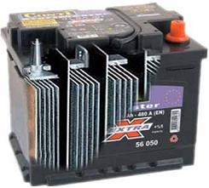

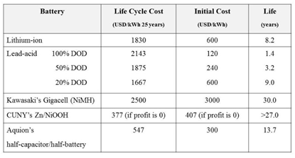
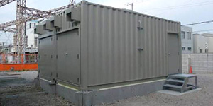
Conventional aqueous battery
Lead-acid battery:
toxic, life-cycle cost is not low
NiMH battery:
Gigacell costs $2500 kWh⁻¹ 25 years⁻¹
There are some new technologies that are currently under the field test.
Pb, PbO₂, H₂SO₄

Slide 5
Previous Work
Zn/LiFePO₄ system is a promising candidate.
No toxic materials.
Zn anode that delivers a higher gravimetric capacity (Zn, 818 mAh g⁻¹) than metal hydride (e.g., LaNi_{3.55}Co_{0.75}Mn_{0.4}Al_{0.3}, 300 mAh/g or less) and a comparable potential (-0.76 V vs. Standard Hydrogen Electrode, SHE) in aqueous media with metal hydride (e.g., LaNi_{3.55}Co_{0.75}Mn_{0.4}Al_{0.3}, -0.75 to -0.85 V vs. SHE).
Comparable cost with lead-acid battery when using Zn foil.
[N. Yesibolati, N. Umirov, A. Koishybay, M. Omarova, I. Kurmanbayeva, Y. Zhang, Y. Zhao, Z. Bakenov, Electrochimica Acta 152 (2015) 505-511.]

Slide 6
Challenging issue
The problem is zinc dendrite formation resulting in internal short circuit failure and how to balance anode/cathode capacities.
Counter measure
Facilitating long-range electronic conductivity through the inner core of zinc electrode,
Amplification of electrified interfaces to distribute current uniformly throughout the electrode structure,
Forming partially confined void volume elements within the interior of the porous zinc anode that expedite dissolution/deposition.
In short, POROUS, MONOLITHIC, THREE-DIMENSIONAL, and APERIODIC ARCHITECTURE.
[J. F. Parker, C. N. Chervin, E. S. Nelson, D. R. Rolison, J. W. Long, Energy Environ. Sci. 7 (2014) 1117-1124; J. F. Parker, E. S. Nelson, M. D. Wattendorf, C. N. Chervin, J. W. Long, D. R. Rolison, ACS Appl. Mater. Interfaces 6 (2014) 19471–19476.]

Slide 7
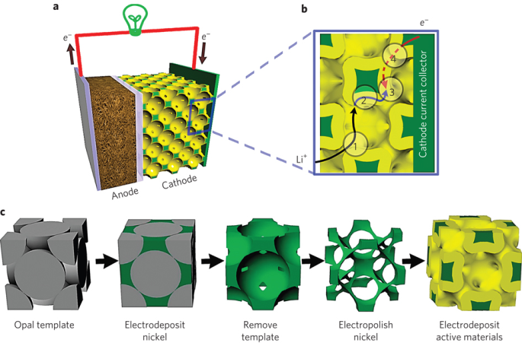
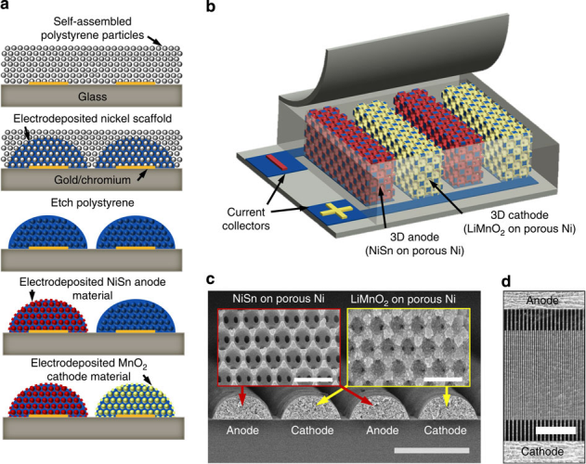
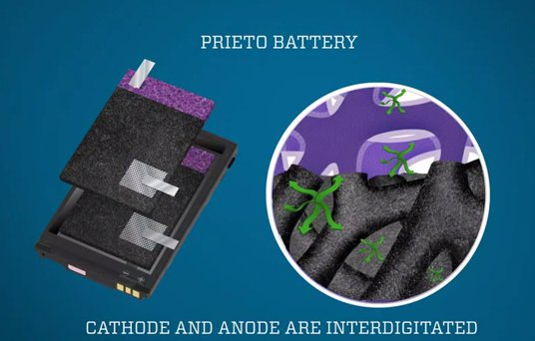
Counter measure
Our counter measure
Electrodeposited Zn
onto CFP
Parker’s counter measure
Sintered Zn
Porous
Monolithic
Three-dimensional aperiodic

Slide 8
Present work
Onto the current collector, carbon fiber paper (CFP), zinc was cathodically electroplated.
CFP
Zn @ CFP

Slide 9
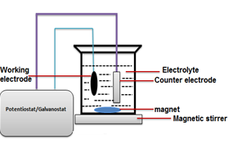
Present work
Constant current density of 500 mA cm⁻².
Deposition time of 8 sec.
→Zn 3.4 mg cm⁻², 2.8 mAh cm⁻²
Electrolyte solution:
0.52 mol L⁻¹ ZnSO₄·7H₂O,
0.15 mol L⁻¹ (NH₄)₂SO₄,
0.7 g L⁻¹ polyacrylamide (PAA, MW=200,000),
0.05 g L⁻¹ thiourea,
40 g L⁻¹ H₃BO₃ (pH = 4)
2/98 vol.% ethanol/water with 0.1 g L⁻¹ sodium dodecyl sulfate (SDS) (ethanol and SDS were added as wetting agents).
0.13-mm-thick graphite backing-plate is attached to a CFP beforehand by using carbon paint adhesive [PELCO® high temperature carbon paste (silicate)].

Slide 10
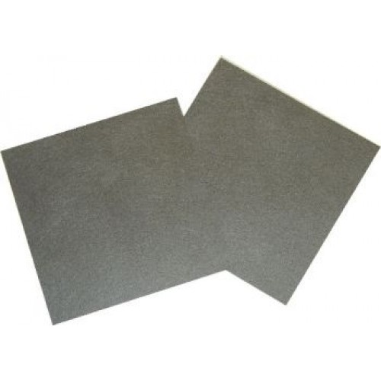
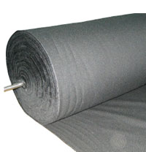
Future plan
Cost reduction
[TGP-H-060 (190-μm-thick) or TGP-H-120 (370-μm-thick), Toray Industry Inc.]
Carbon fiber felt (cheap)

Slide 11









Thank you ☺

