Slide 1
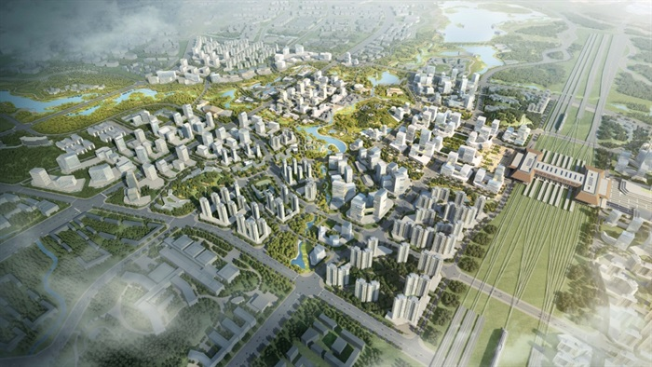
zone infrastructures:
China’s new urban paradigm and export product
Tim Oakes

Slide 2
outline
introduction
BRI and the China model of development
infrastructure
zone infrastructure
case: Gui’an New Area, China
concluding points

Slide 3
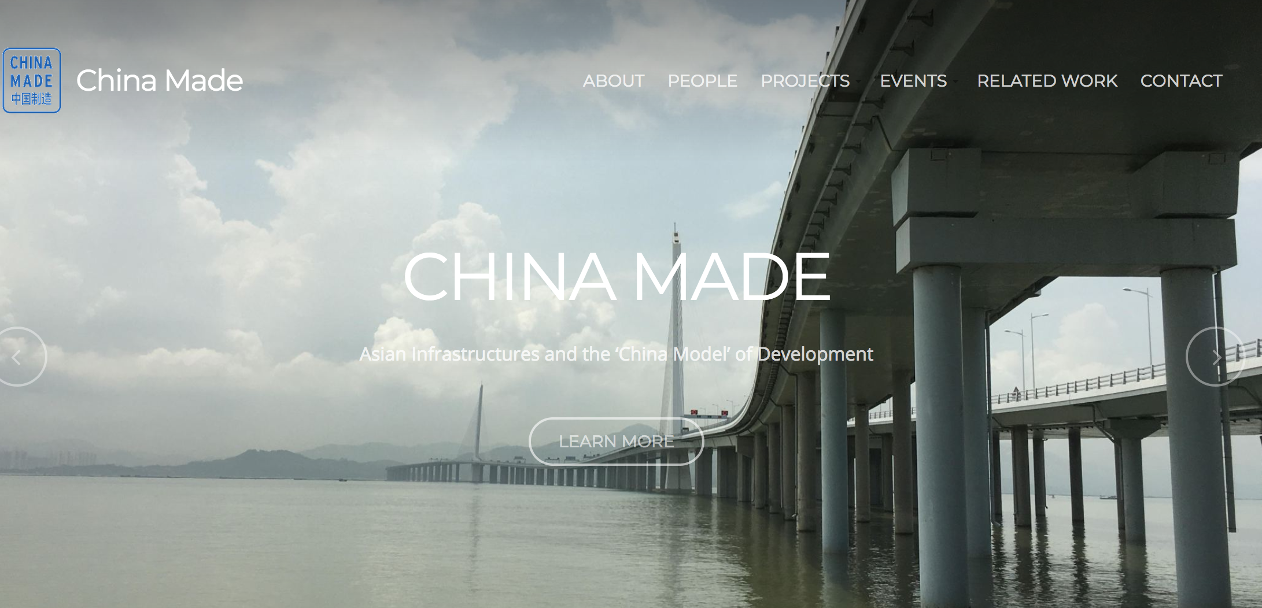

Slide 4
outline
introduction
BRI and the China model of development
infrastructure
zone infrastructure
case: Gui’an New Area, China
concluding points

Slide 5
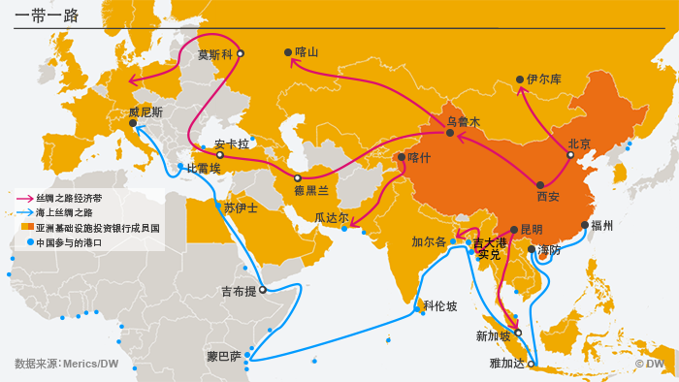
BRI and the China model of development
the ‘China model’
  developmental idealism vs. developmental pragmatism

Slide 6
BRI and the China model of development
the ‘China model’
  developmental idealism vs. developmental pragmatism
    south – south friendship
    mutual benefit (win-win scenarios)
    policy non-intervention (‘no strings attached’)

Slide 7
BRI and the China model of development
the ‘China model’
  developmental idealism vs. developmental pragmatism
    south – south friendship
    mutual benefit (win-win scenarios)
    policy non-intervention (‘no strings attached’)
  “a striking departure in Chinese policy” (Fukuyama)
    “For the first time, China is seeking to export its development model to other countries.”

Slide 8
BRI and the China model of development
the ‘China model’
  developmental idealism vs. developmental pragmatism
    south – south friendship
    mutual benefit (win-win scenarios)
    policy non-intervention (‘no strings attached’)
  “a striking departure in Chinese policy” (Fukuyama)
    “For the first time, China is seeking to export its development model to other countries.”
    “China’s development model is different from the one currently fashionable in the West. It is based on massive state-led investments in infrastructure—roads, ports, electricity, railways and airports—that facilitate industrial development.”

Slide 9
BRI and the China model of development
the ‘China model’
  developmental idealism vs. developmental pragmatism
    south – south friendship
    mutual benefit (win-win scenarios)
    policy non-intervention (‘no strings attached’)
  “a striking departure in Chinese policy” (Fukuyama)
    “For the first time, China is seeking to export its development model to other countries.”
    “China’s development model is different from the one currently fashionable in the West. It is based on massive state-led investments in infrastructure—roads, ports, electricity, railways and airports—that facilitate industrial development.”
  Is it really a ”striking departure”?

Slide 10
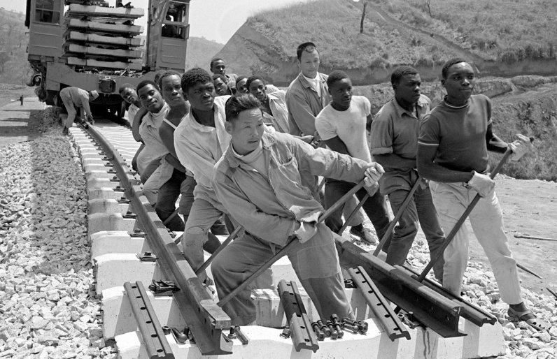
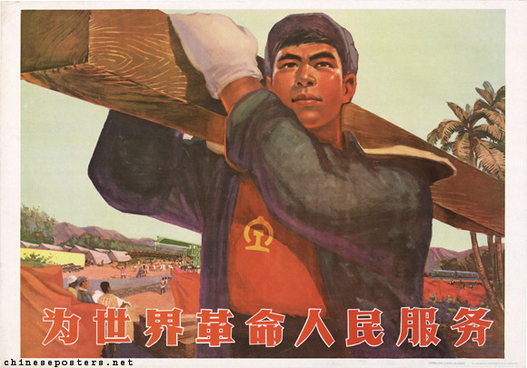
BRI and the China model of development
the ‘China model’
Mao-era socialist model

Slide 11
BRI and the China model of development
the ‘China model’
Mao-era socialist model
an ambiguous model today
  not centralized and only loosely directed by Beijing

Slide 12
BRI and the China model of development
Belt & Road Initiative 一带一路

Slide 13
BRI and the China model of development
Belt & Road Initiative 一带一路
  more the elevation of existing policy to national level than new policy content

Slide 14
BRI and the China model of development
Belt & Road Initiative 一带一路
  more the elevation of existing policy to national level than new policy content
  BRI is abstract and metaphorical

Slide 15
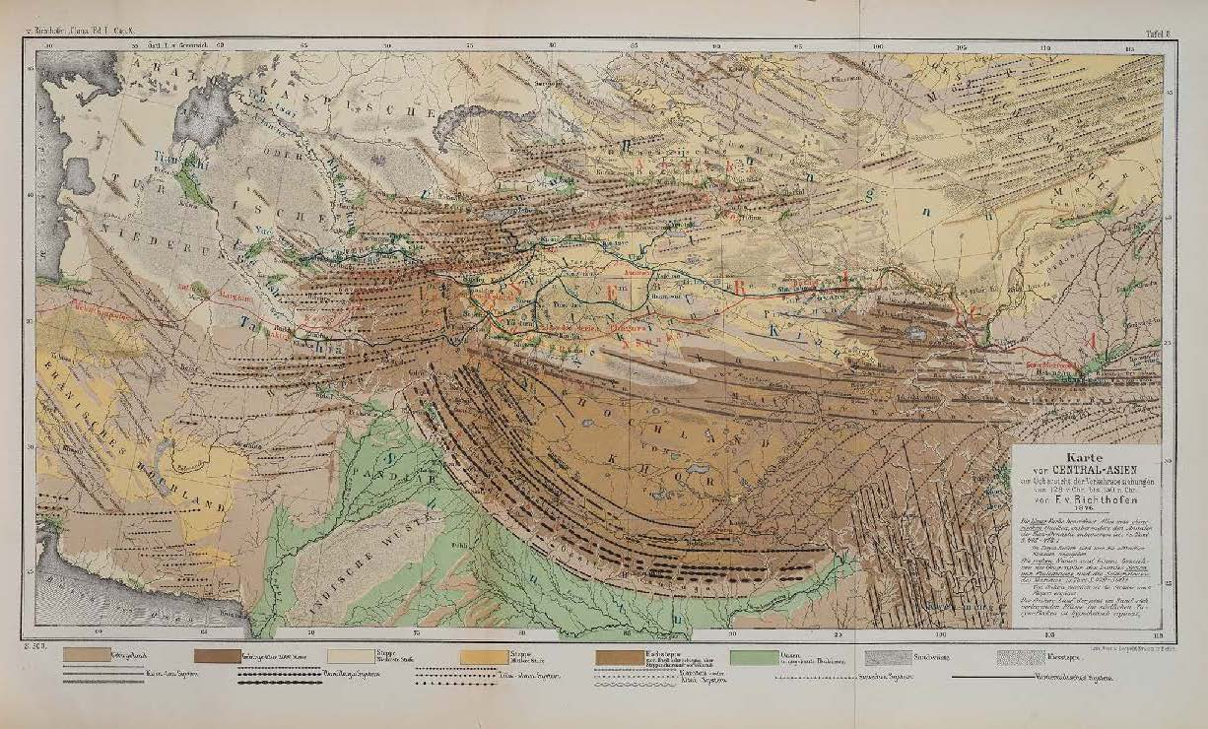

Slide 16
“That that the idea of a Silk Road(s) contains a history closely entangled with European imperialism is skirted around in the contemporary reworking of the concept into OBOR narratives.”
~ Sidaway & Woon (2018)

Slide 17
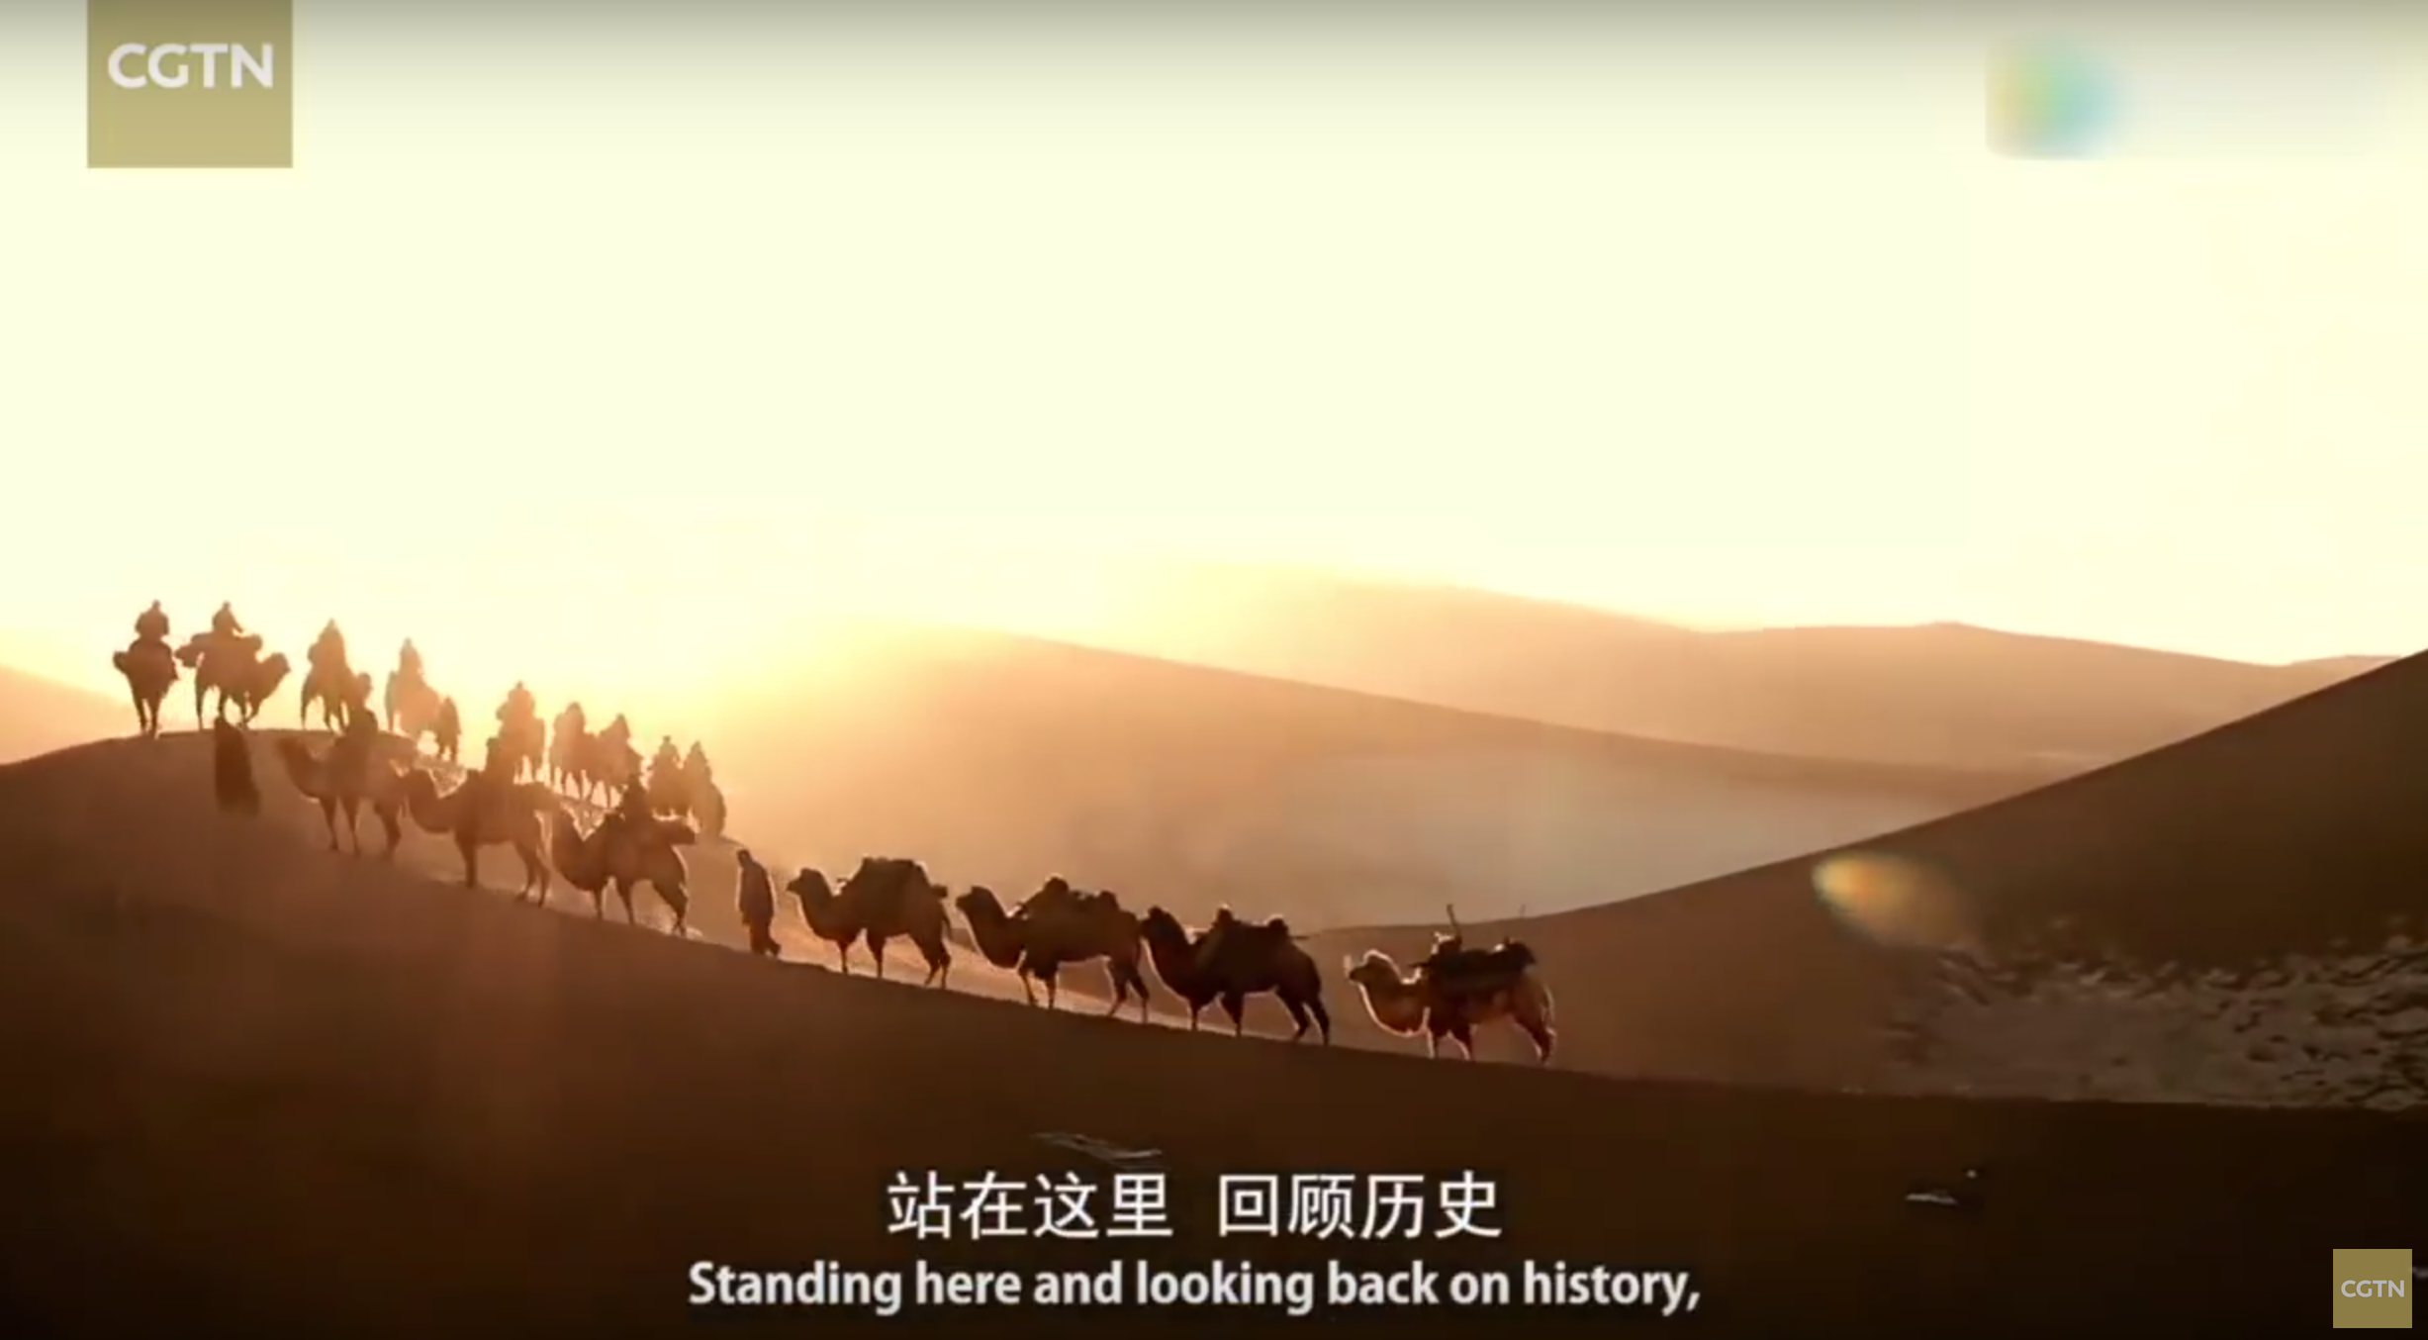

Slide 18
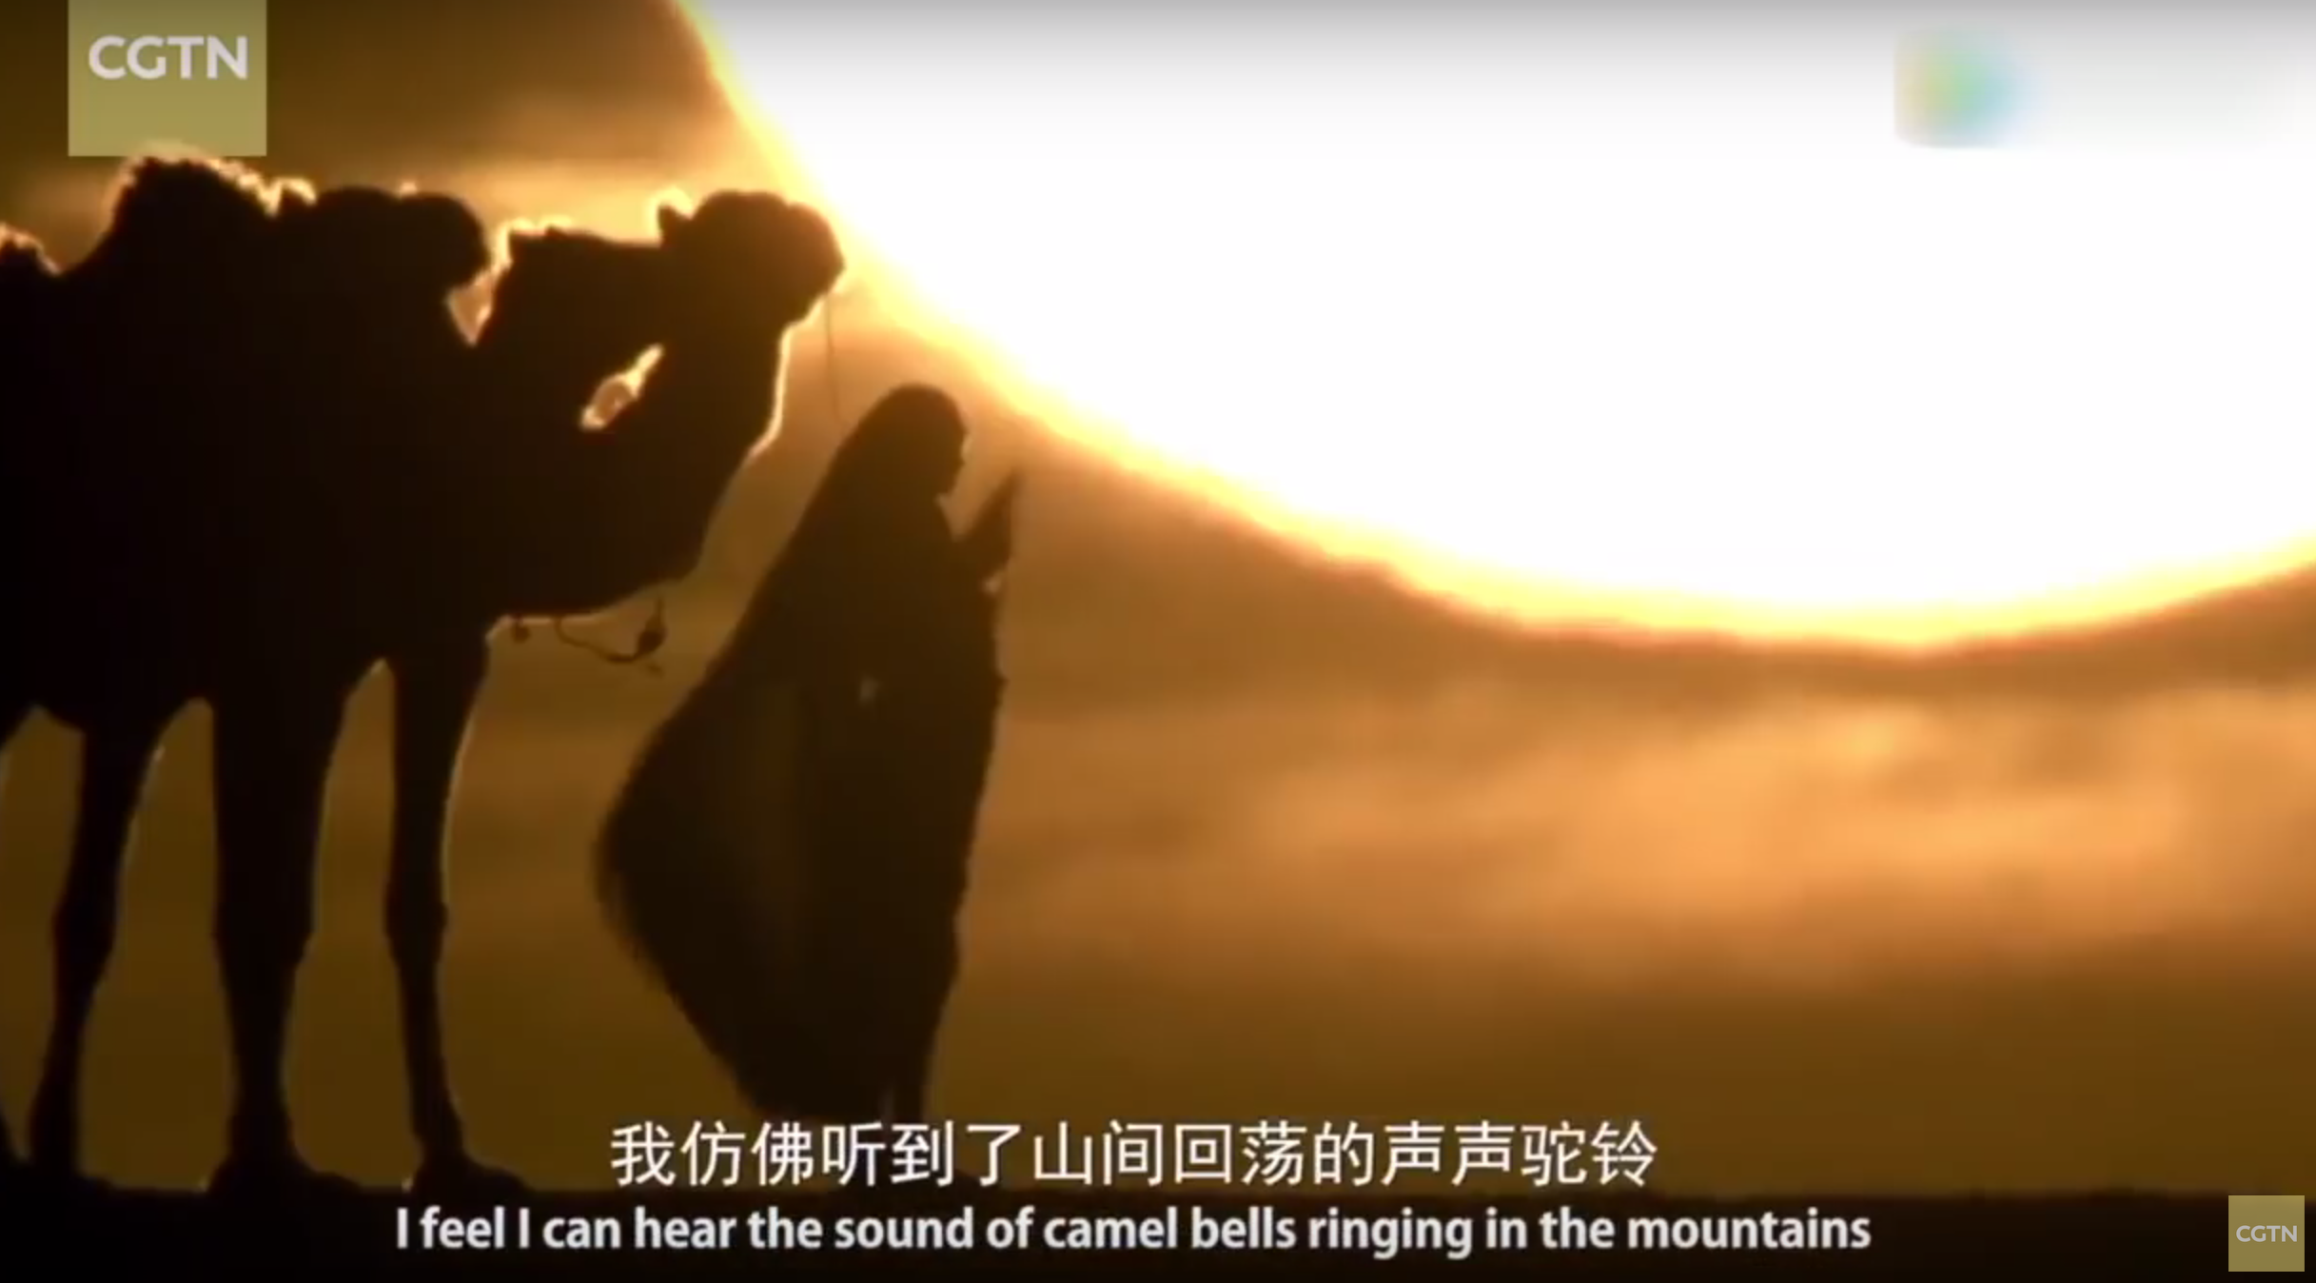

Slide 19
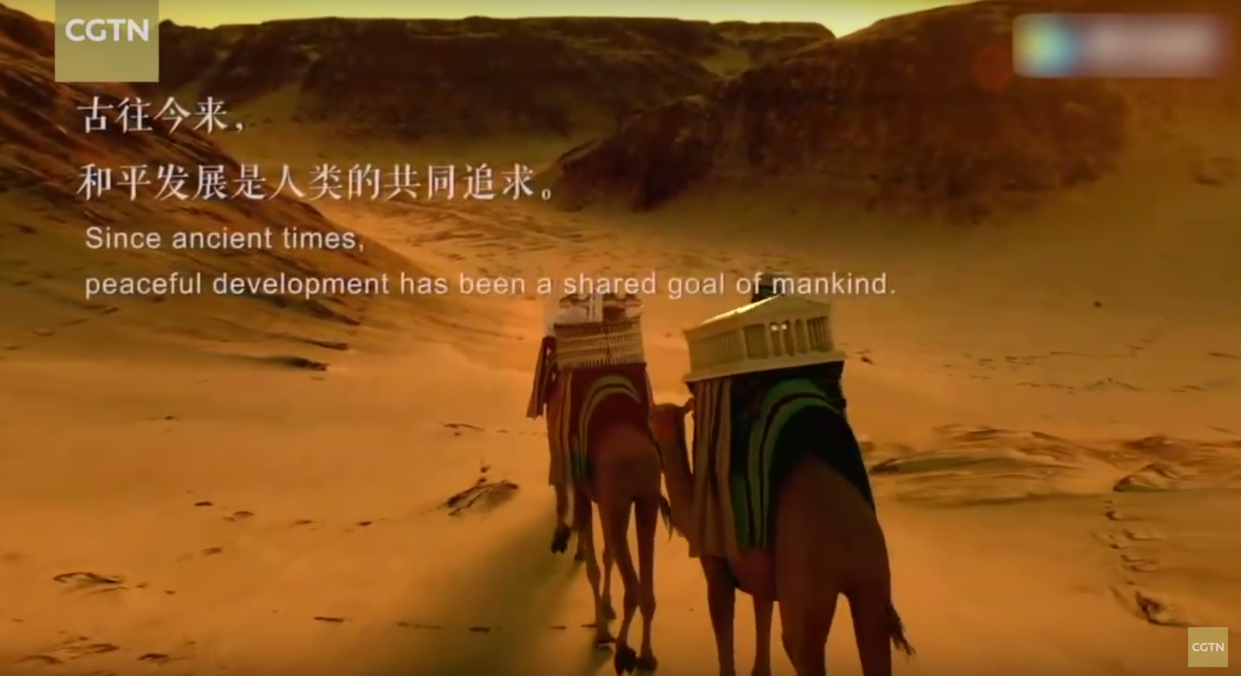

Slide 20
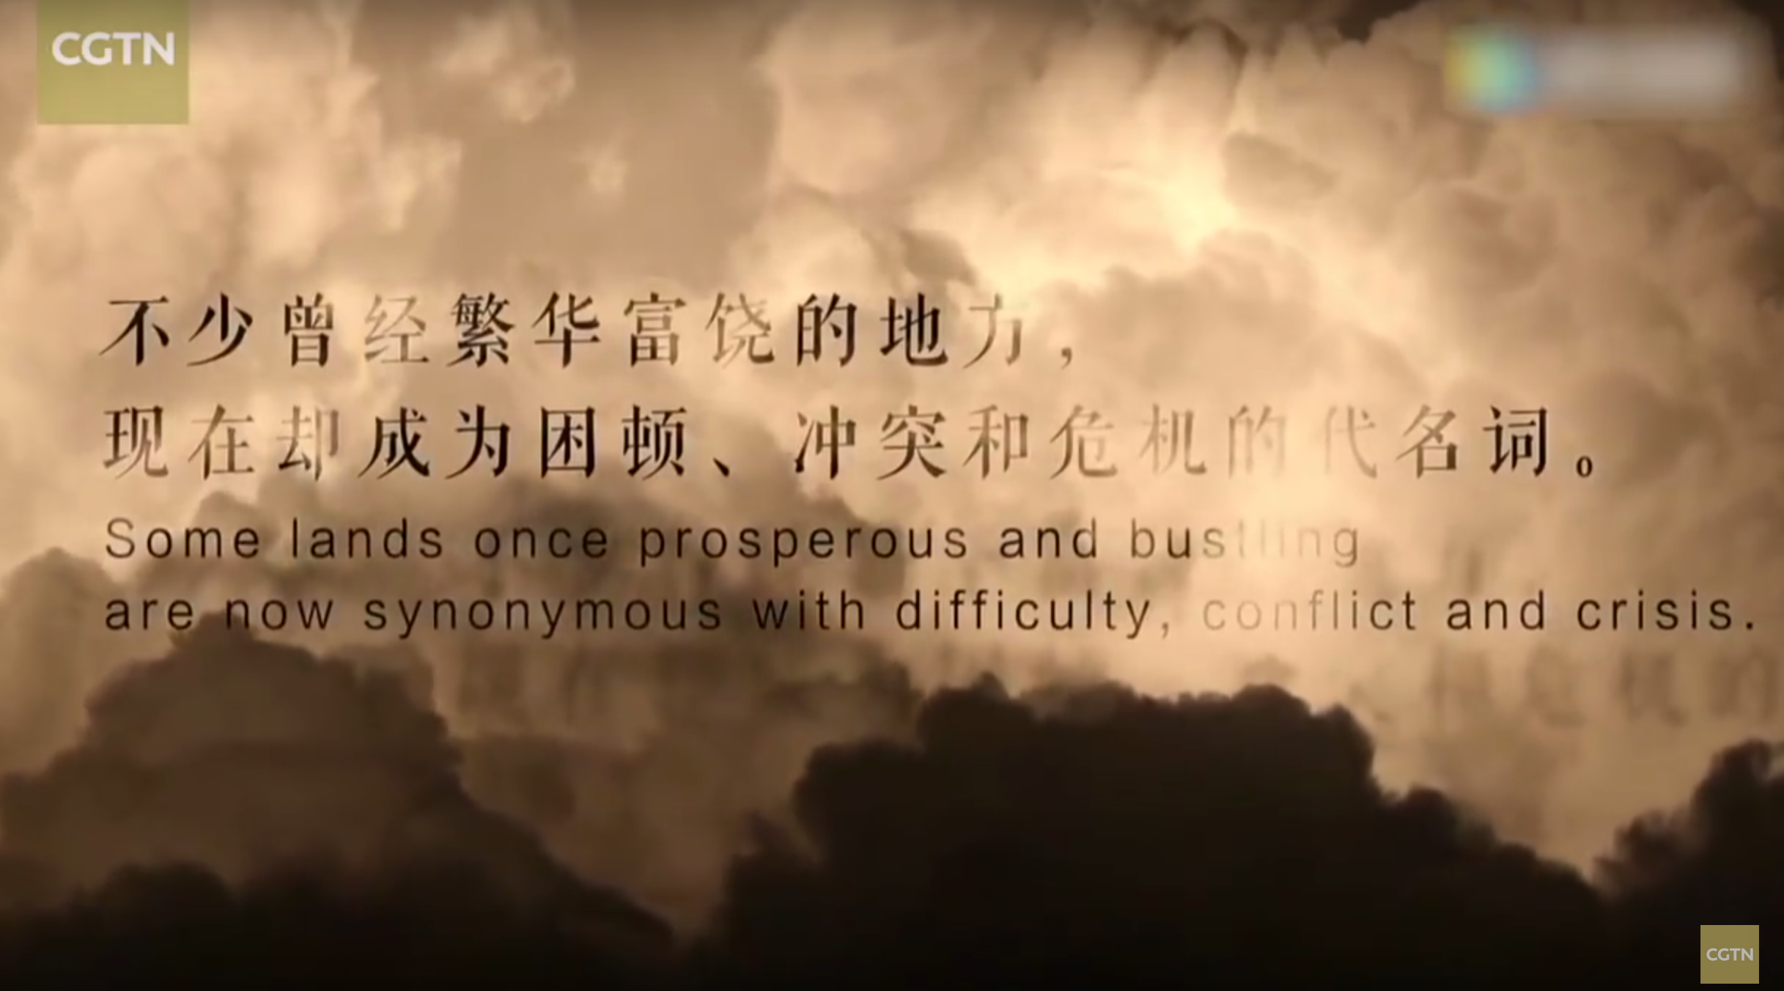

Slide 21
BRI and the China model of development
Belt & Road Initiative 一带一路
  more the elevation of existing policy to national level than new policy content
  BRI is abstract and metaphorical
  practical goals: internationalize the yuan, absorb excess labor capacity, export overcapacity, turn border regions into trade zones, investment channel for foreign exchange reserves

Slide 22
BRI and the China model of development
Belt & Road Initiative 一带一路
  more the elevation of existing policy to national level than new policy content
  BRI is abstract and metaphorical
  practical goals: internationalize the yuan, absorb excess labor capacity, export overcapacity, turn border regions into trade zones, investment channel for foreign exchange reserves
  more a ‘spatial fix’ than a geopolitical strategy

Slide 23
BRI and the China model of development
Belt & Road Initiative 一带一路
  more the elevation of existing policy to national level than new policy content
  BRI is abstract and metaphorical
  practical goals: internationalize the yuan, absorb excess labor capacity, export overcapacity, turn border regions into trade zones, investment channel for foreign exchange reserves
  more a ‘spatial fix’ than a geopolitical strategy
  unintended outcomes

Slide 24
BRI and the China model of development
Belt & Road Initiative 一带一路
  more the elevation of existing policy to national level than new policy content
  BRI is abstract and metaphorical
  practical goals: internationalize the yuan, absorb excess labor capacity, export overcapacity, turn border regions into trade zones, investment channel for foreign exchange reserves
  more a ‘spatial fix’ than a geopolitical strategy
  unintended outcomes
  disconnect between aspiration and reality?
    “…results suggest that project activity on the ground is not adhering to China’s grand vision. For five of the six corridors, there appears to be no significant relationship between corridor participation and project activity” ~ Hillman et al 2018

Slide 25
BRI and the China model of development
Belt & Road Initiative 一带一路
  more the elevation of existing policy to national level than new policy content
  BRI is abstract and metaphorical
  practical goals: internationalize the yuan, absorb excess labor capacity, export overcapacity, turn border regions into trade zones, investment channel for foreign exchange reserves
  more a ‘spatial fix’ than a geopolitical strategy
  unintended outcomes
  disconnect between aspiration and reality?
    “We find that Chinese development projects in general, and Chinese transportation projects in particular, reduce economic inequality within and between regions. These results suggest that Chinese investments in ‘connective infrastructure’ produce positive economic spillovers that flatten the spatial distribution of economic activity.” (Bluhm et al 2018, 30)

Slide 26
BRI and the China model of development
the ‘China model’
  developmental idealism vs. developmental pragmatism
    BRI is both idealistic and pragmatic
    it is not so much a policy departure as a policy extension

Slide 27
outline
introduction
BRI and the China model of development
infrastructure
zone infrastructure
case: Gui’an New Area, China
concluding points

Slide 28
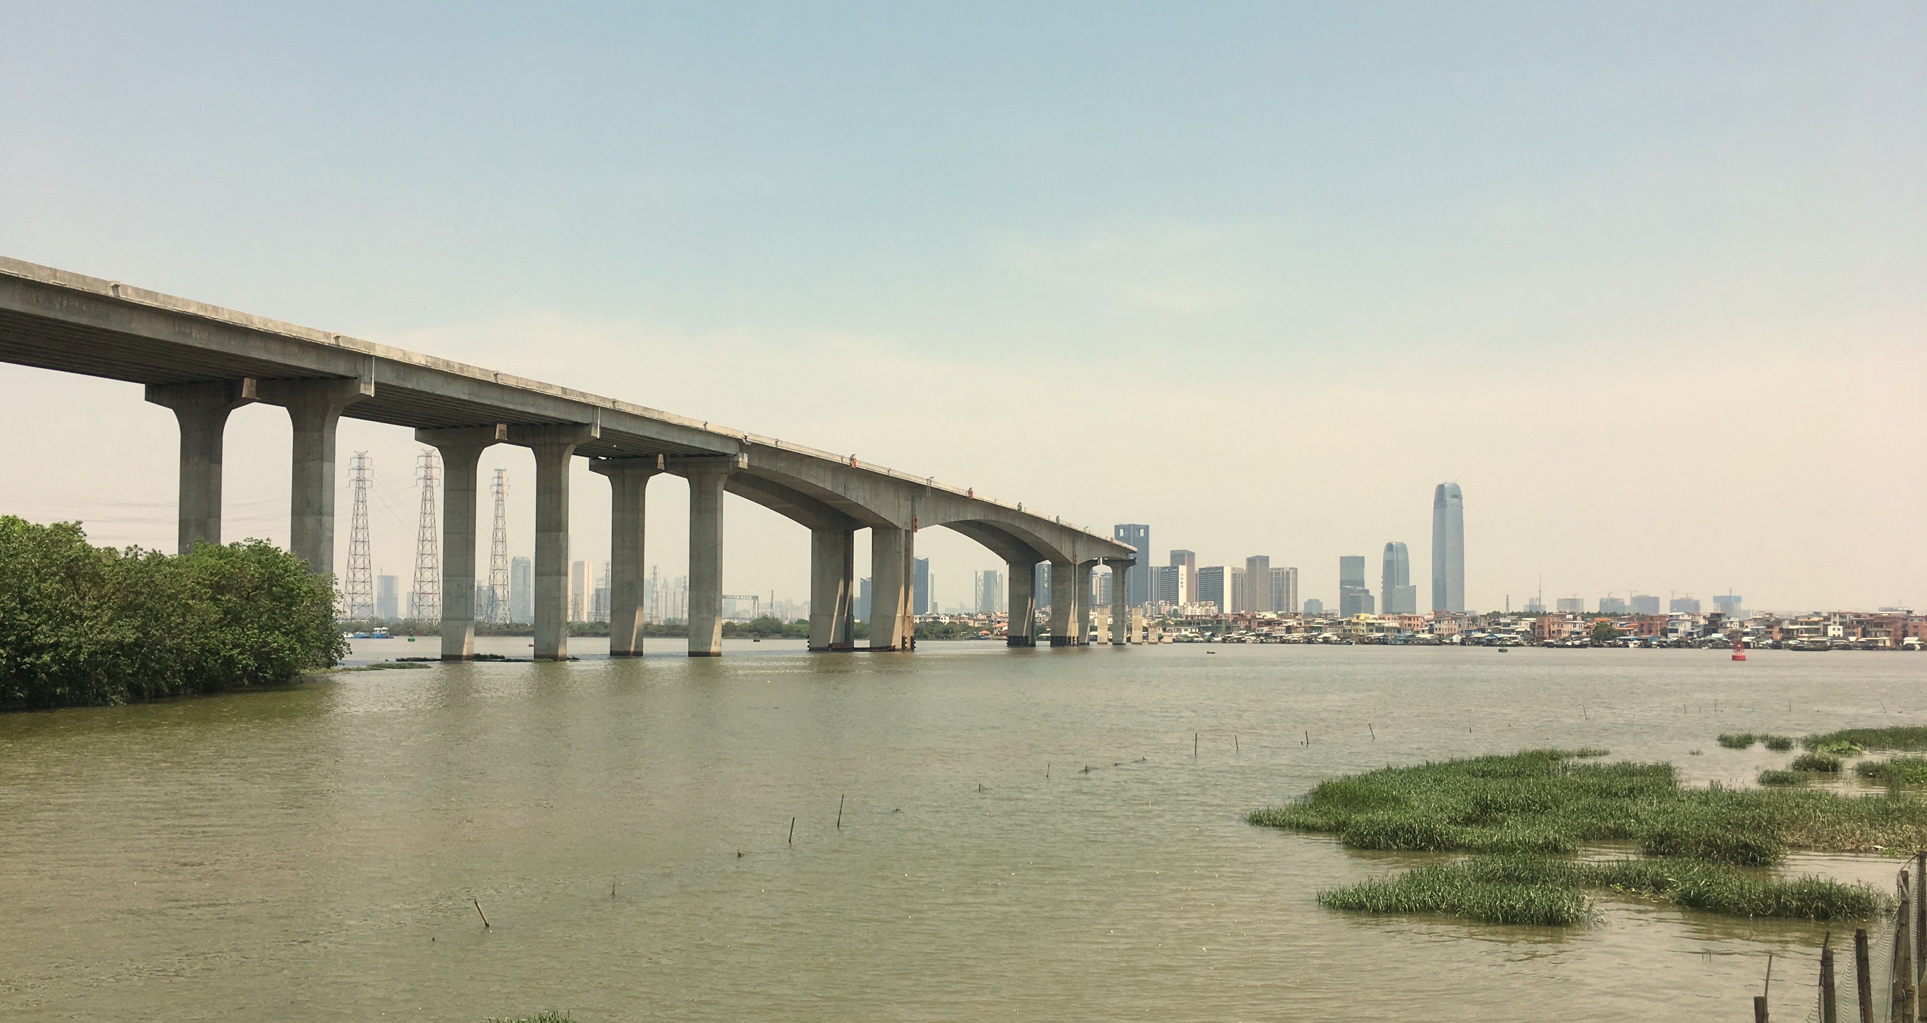
infrastructure

Slide 29
infrastructure
“the totality of both technical and cultural systems that create institutionalized structures whereby goods of all sorts circulate, connecting and binding people into collectivities.”

Slide 30
infrastructure
“the totality of both technical and cultural systems that create institutionalized structures whereby goods of all sorts circulate, connecting and binding people into collectivities.”
Asia = $8 trillion infrastructure deficit (CSIS)
China is the paradigmatic infrastructure state
infrastructures involve both on-the-ground materialities and powerful imaginaries
Infrastructures are both top-down state-making instruments
and subject to bottom-up forces of everyday life

Slide 31
outline
introduction
BRI and the China model of development
infrastructure
zone infrastructure
case: Gui’an New Area, China
concluding points

Slide 32
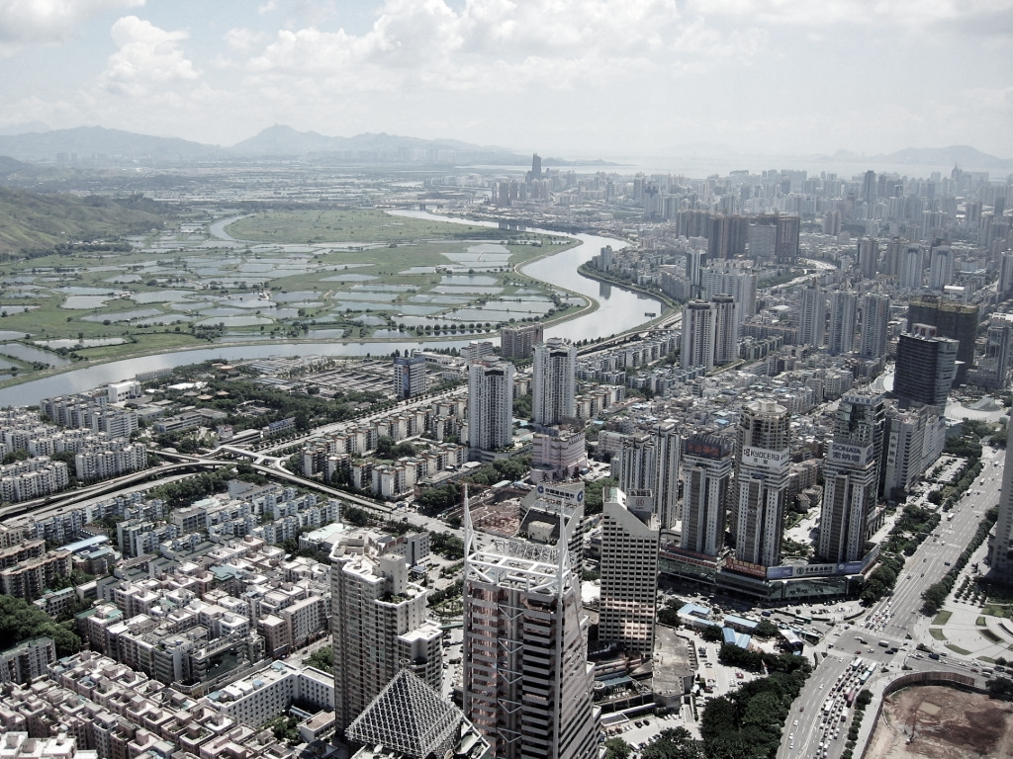
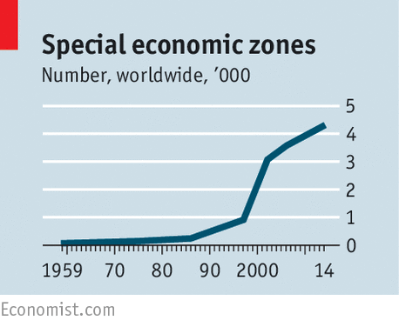
zone infrastructure
infrastructure space
the zone – manufacturing enclave → world city template

Slide 33
zone infrastructure
infrastructure space
the zone – manufacturing enclave → world city template
a parallel infrastructure to the state
space of exception

Slide 34
zone infrastructure
infrastructure space
the zone – manufacturing enclave → world city template
a parallel infrastructure to the state
space of exception
SEZs & SLNAs

Slide 35
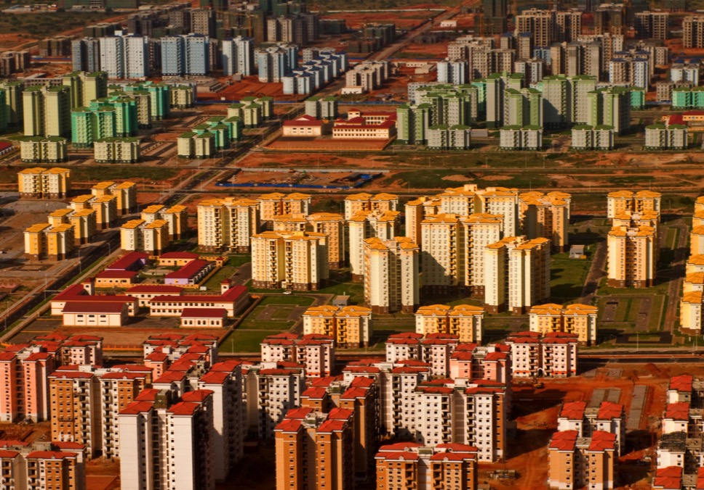

Slide 36
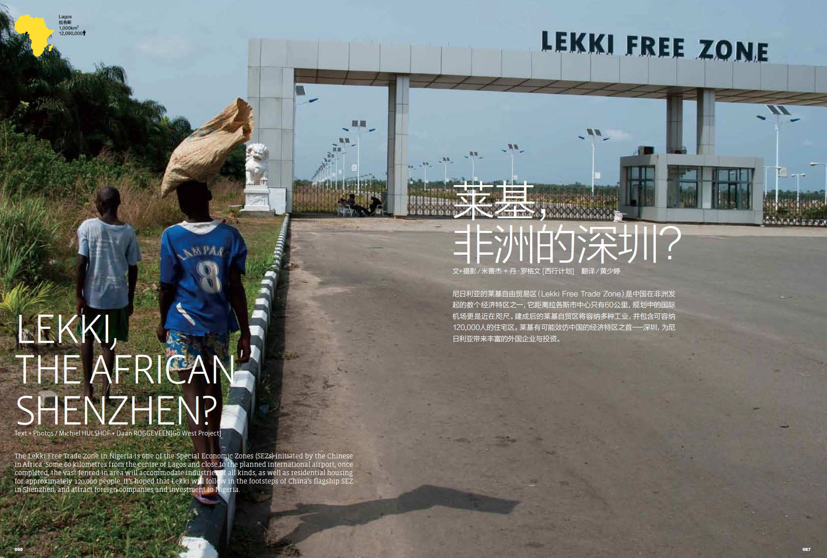

Slide 37
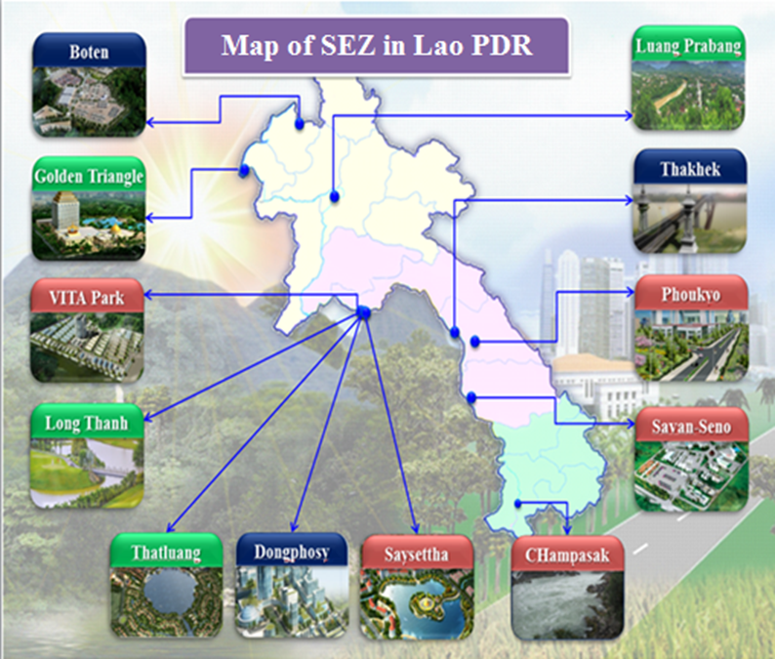

Slide 38
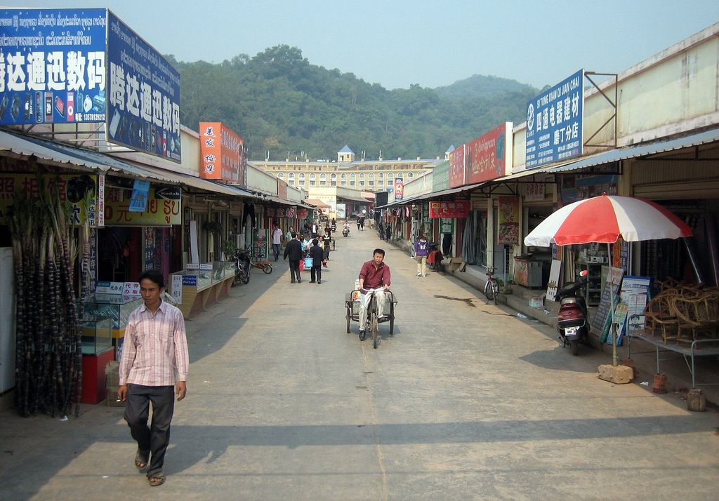

Slide 39
“The currency in use was the Chinese yuan, locally consumed products were imported from China, Chinese writing dominated the scene, and even the time zone was set according to China. Pornographic items, banned in Laos, could be found in Boten, as well as cabaret shows performed by Thai kathoey (male-to-female transgender persons). Most of the casino's clients were professional Chinese gamblers. equipped with headsets on which they could receive instructions from their China -based bosses, who were following the action on the Internet.” (Tan 2017, 145)

Slide 40
“The currency in use was the Chinese yuan, locally consumed products were imported from China, Chinese writing dominated the scene, and even the time zone was set according to China. Pornographic items, banned in Laos, could be found in Boten, as well as cabaret shows performed by Thai kathoey (male-to-female transgender persons). Most of the casino's clients were professional Chinese gamblers. equipped with headsets on which they could receive instructions from their China -based bosses, who were following the action on the Internet.” (Tan 2017, 145)
“…contrary to China’s Shenzhen model, the Lao SEZs have witnessed a retreat of the state’s role in the process of zone development; full planning and regulatory authority is granted to zone developers. As a result, most zones, especially those operated by Chinese investors, have become single firm zones that are badly designed and misplaced” (Laungaramsri 2017)

Slide 41
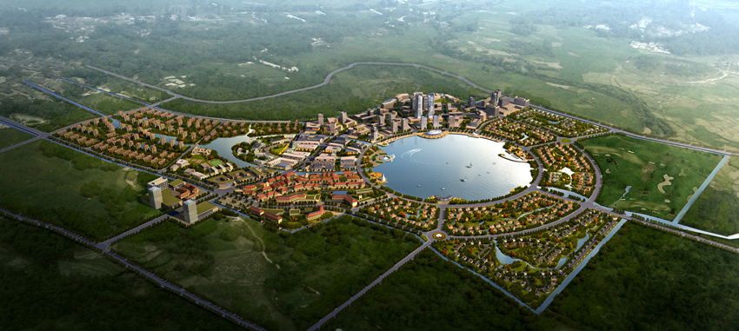
That Luang Marsh Project

Slide 42
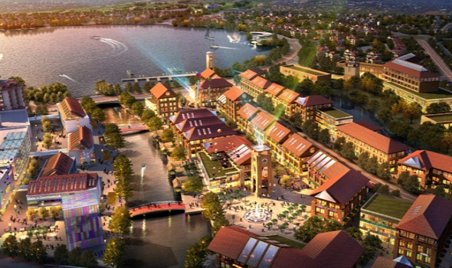

Slide 43
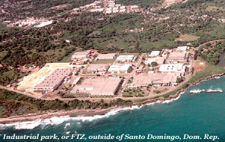
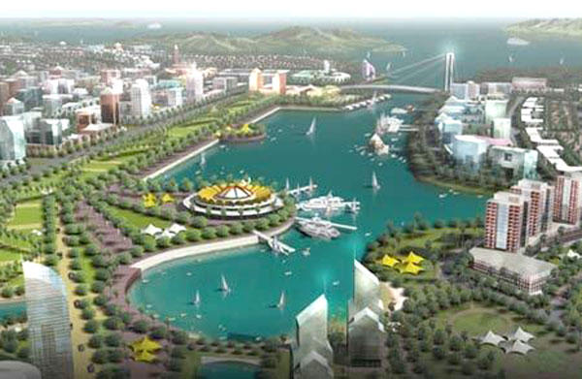
A spectrum of zone spaces:
“Modular Zones”
“Ex-Cities”

Slide 44
outline
introduction
BRI and the China model of development
infrastructure
zone infrastructure
case: Gui’an New Area, China
concluding points

Slide 45
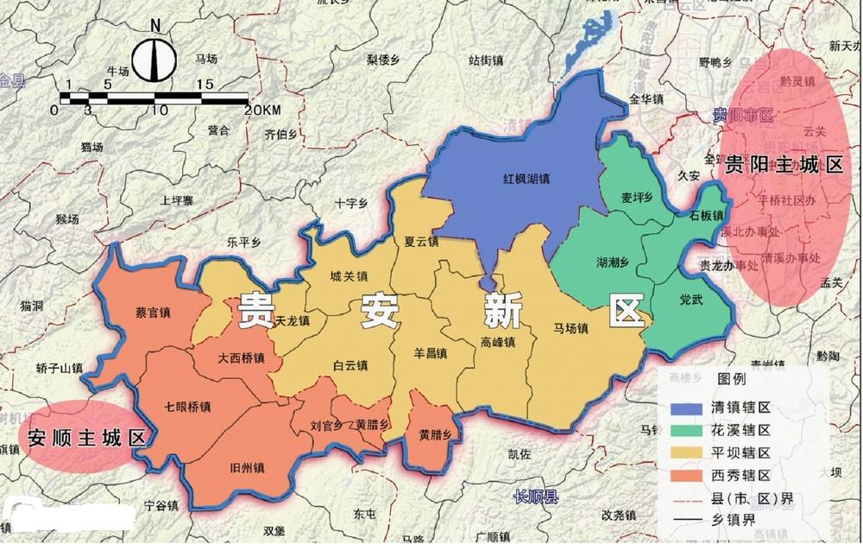
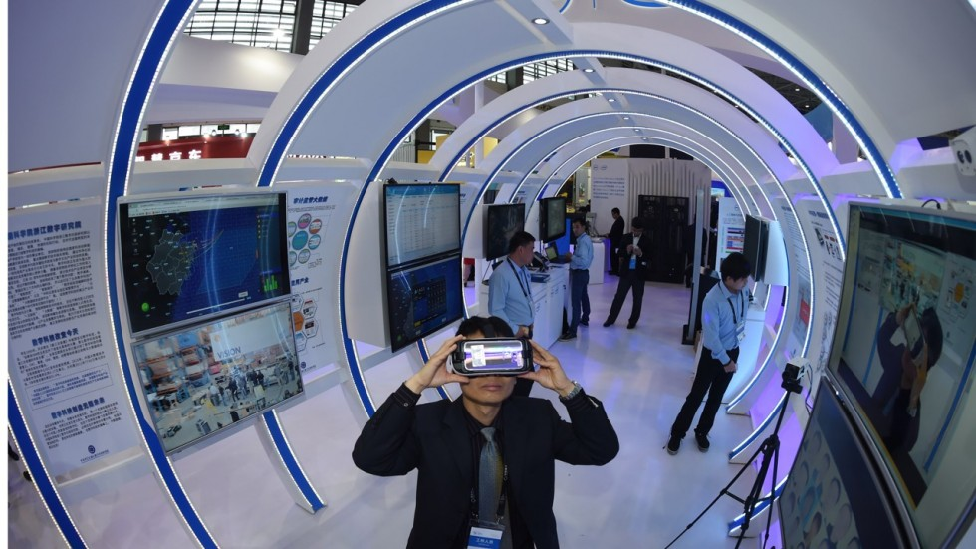
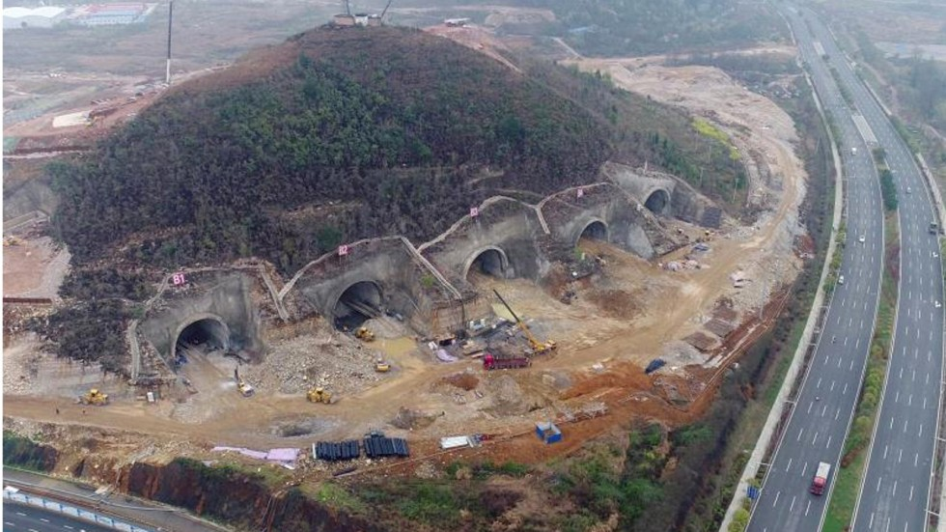
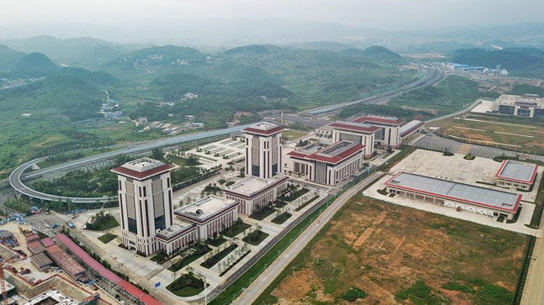
Gui’an New Area

Slide 46
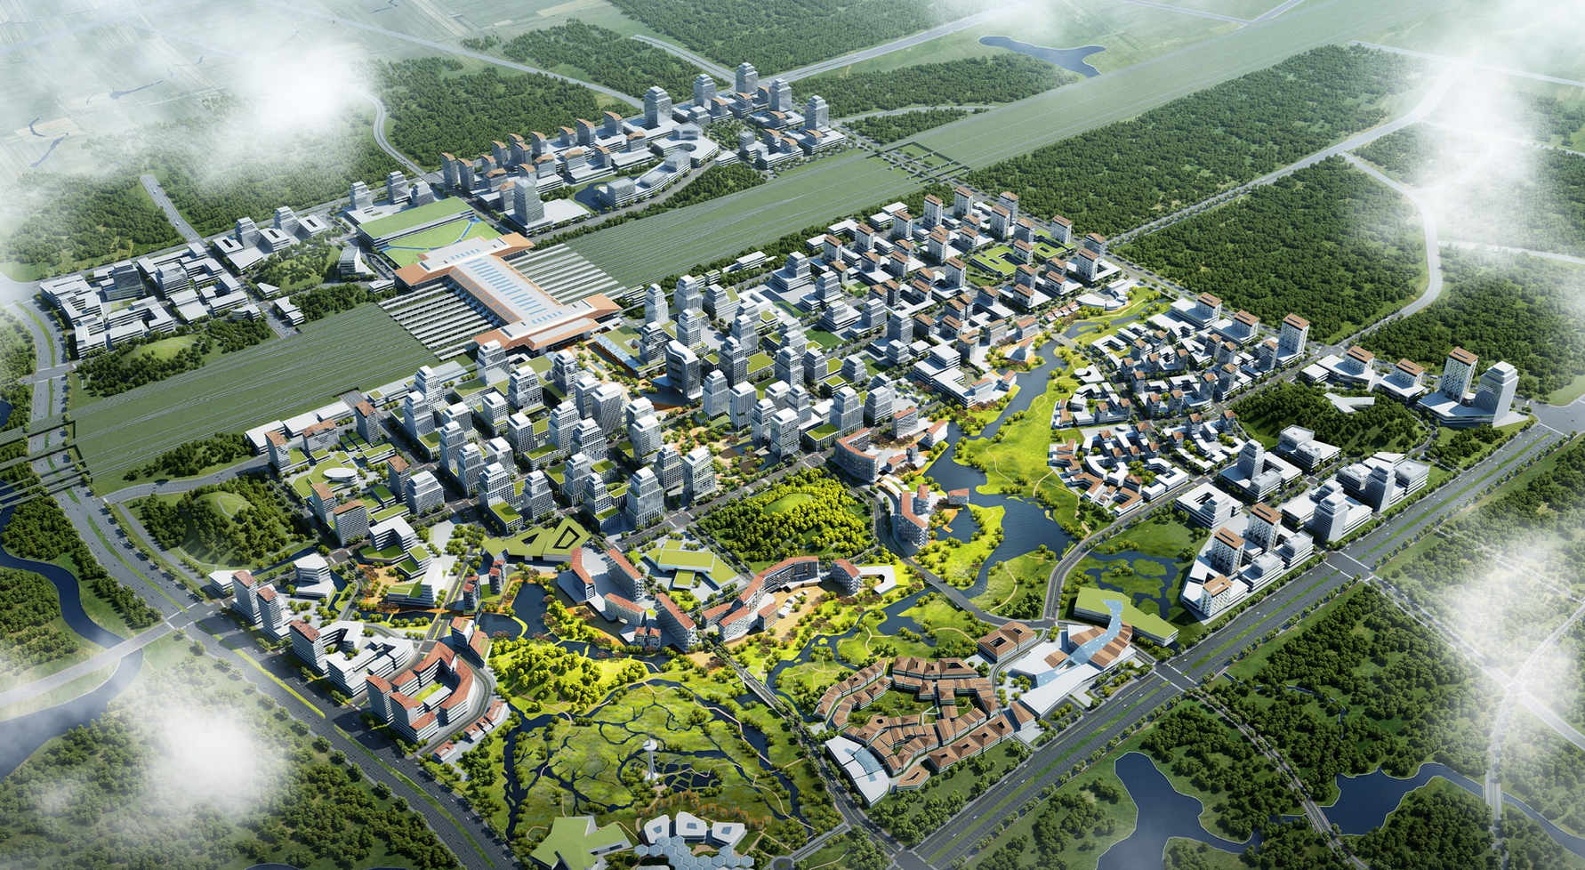
zone as creation city

Slide 47
zone as creation city
“In most Chinese cities today, the HSR station is usually far away out on the periphery of the city. Typically it takes longer to get from your house to the HSR station than it does to get to wherever you’re going on the HSR! The HSR exists in a completely different space-time than most of the cities in China. GuiAn will be different, because our HSR station will be right in the middle of the city, and we’ll build the CBD up around that. Except that it won’t be a CBD. It will be an RBD, a ‘recreation business district’, focusing on ecology, leisure, and a good lifestyle, rather than on commerce “

Slide 48
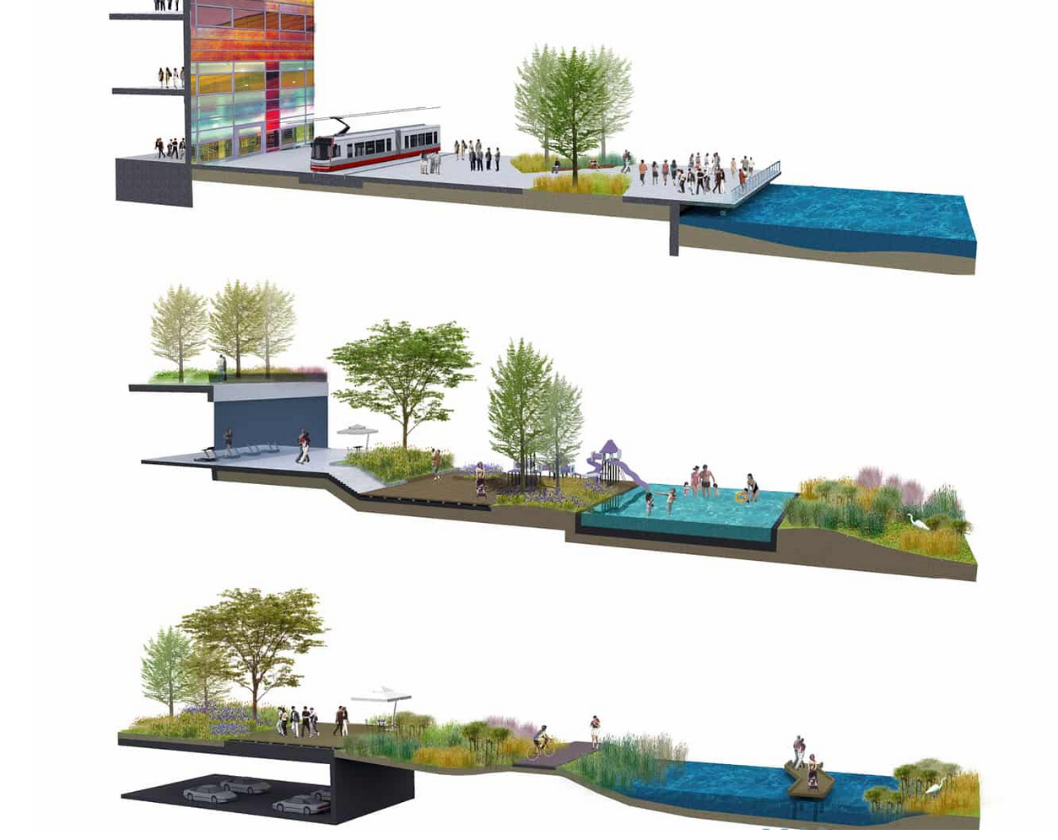
“Beijing, Shanghai, cities like that, they’re already built; you can’t just add the eco-infrastructures to them later, you have to do it first. So, here in GuiAn, we haven’t built the city yet. We start with the infrastructure under the ground (the sponge city infrastructure) then the roads. Then we build the city on top of that. It will be an important demonstration of how to fix the problems of urban sickness (城市病).”

Slide 49
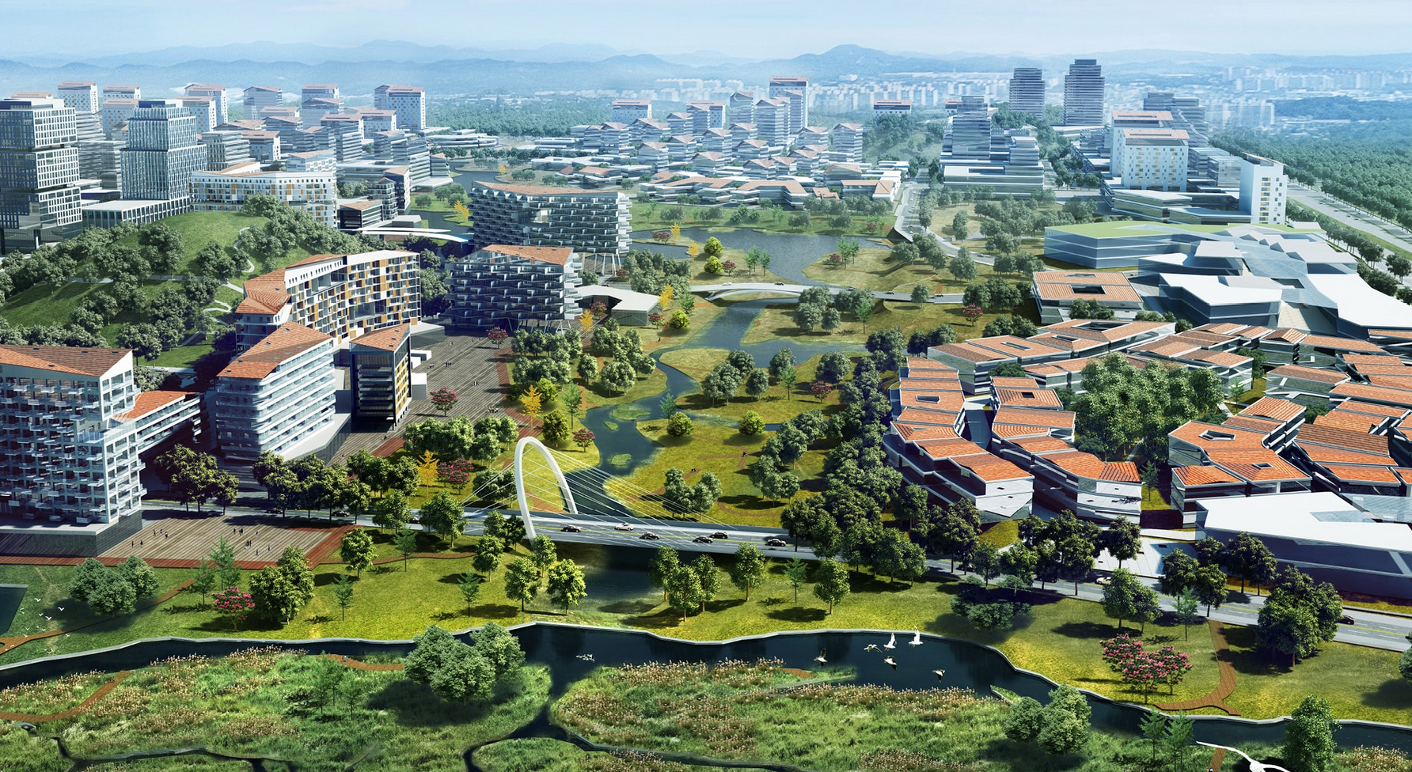

Slide 50
“GuiAn can be a model for export, an example of how the problems of ‘city 2.0’ can be resolved, for other parts of the world. GuiAn is unique in the world. It represents a model of post-urbanization (后城镇化). The current moment is similar to that moment, in the 1970s, when postmodernism was initiated, the demolition of public housing.

Slide 51
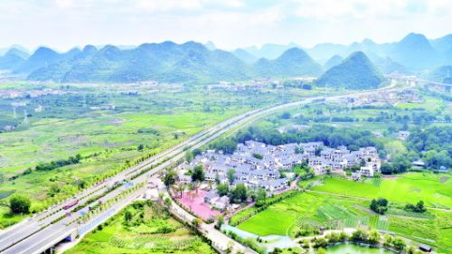
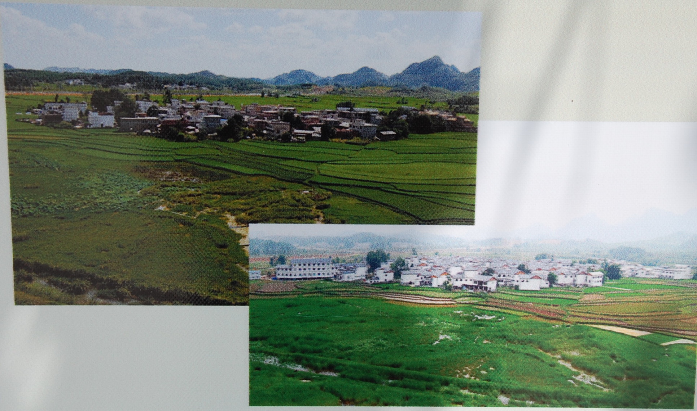
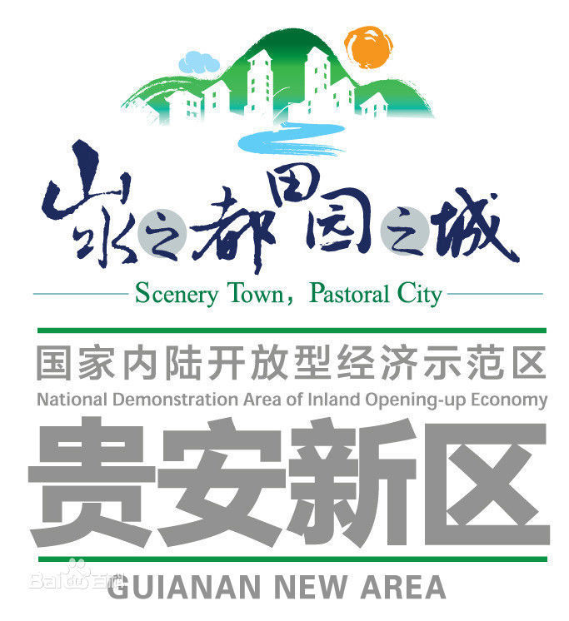
zone as aesthetic infrastructure

Slide 52
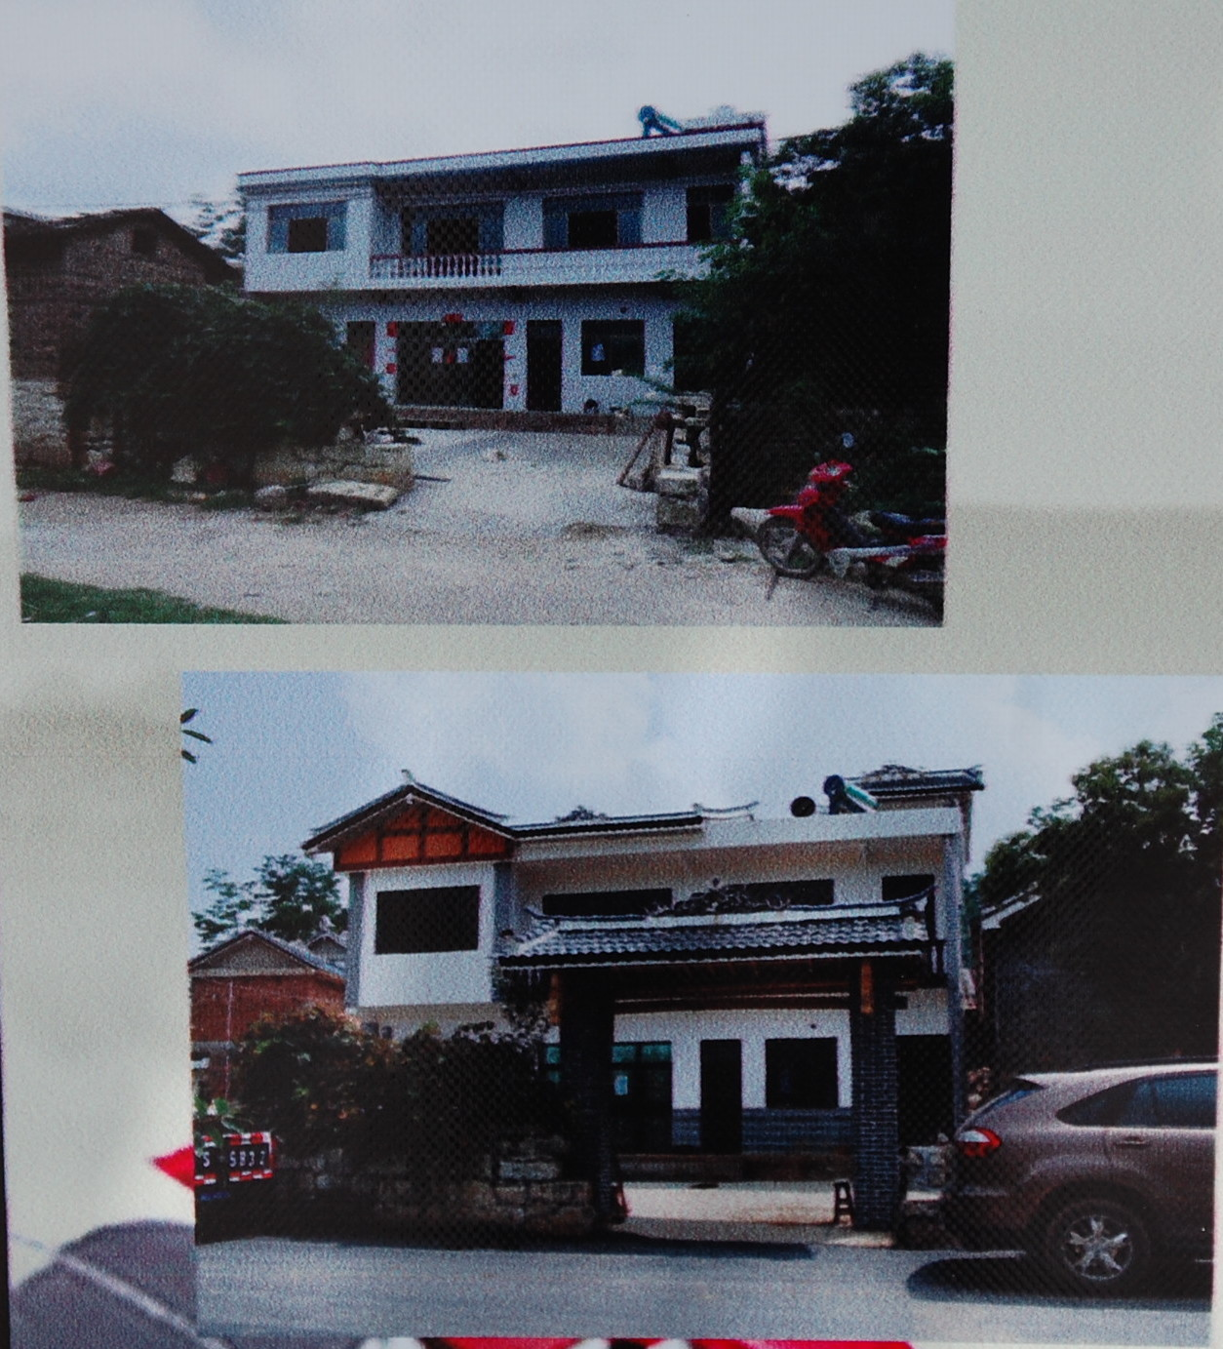

Slide 54
尊重历史，留住乡愁 – “Respected history asks nostalgia to stay the night”

Slide 55
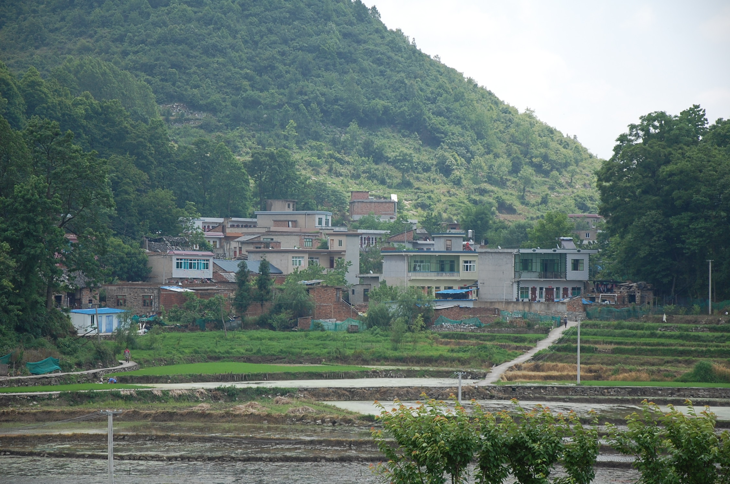

Slide 56
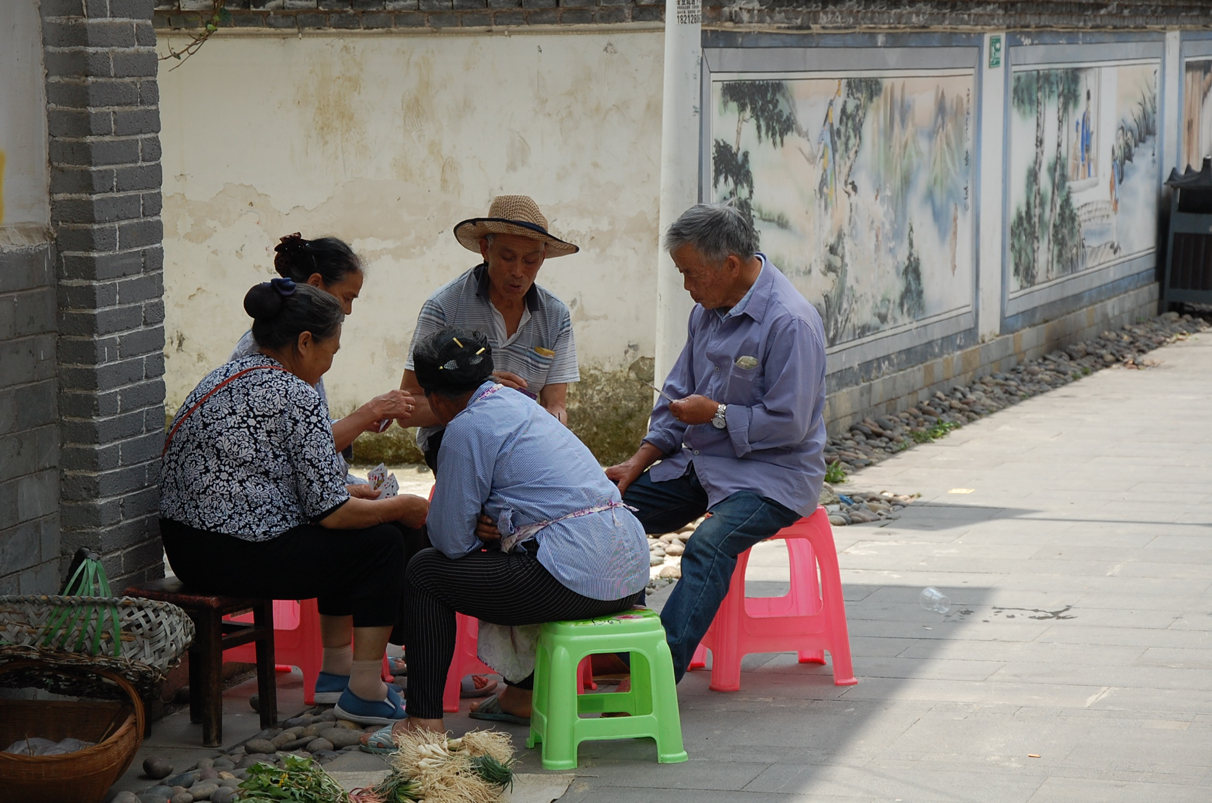

Slide 57
outline
introduction
BRI and the China model of development
infrastructure
zone infrastructure
case: Gui’an New Area, China
concluding points

Slide 58
Gui’an as infrastructure space
“…a new kind of ‘operating system’ for shaping a new kind of city. Infrastructure has become the urban structure itself – the very parameters of global urbanism” (Easterling 2014)

Slide 59
Gui’an as infrastructure space
“…a new kind of ‘operating system’ for shaping a new kind of city. Infrastructure has become the urban structure itself – the very parameters of global urbanism” (Easterling 2014)
…a “medium” that says one thing but does another. The infrastructure is doing something despite what it says.

Slide 60
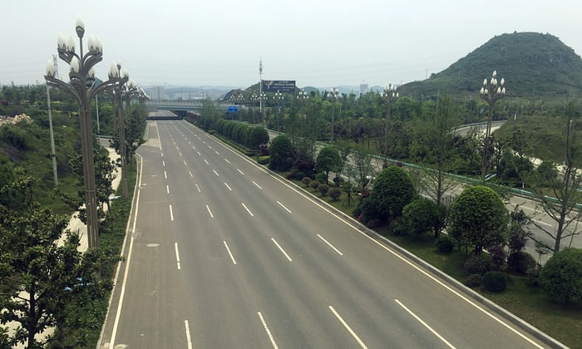
Gui’an as infrastructure space
“…a new kind of ‘operating system’ for shaping a new kind of city. Infrastructure has become the urban structure itself – the very parameters of global urbanism” (Easterling 2014)
…a “medium” that says one thing but does another. The infrastructure is doing something despite what it says.

Slide 61
Gui’an as infrastructure space
“…a new kind of ‘operating system’ for shaping a new kind of city. Infrastructure has become the urban structure itself – the very parameters of global urbanism” (Easterling 2014)
…a “medium” that says one thing but does another. The infrastructure is doing something despite what it says.

