Slide 1

ILL InterLibrary Loan
Madina Assangaliyeva
Manager, Reference and E-resources Department at Nazarbayev University Library
madina.assangaliyeva@nu.edu.kz
http://library.nu.edu.kz

Slide 2
Definition
Policies
Management Systems
Policies Examples
NU Library ILL

Slide 3
Definition
Interlibrary loan is the process by which a library requests material from, or supplies material to, another library

Slide 4
Policies
ALA Interlibrary Loan Code for the United States, 2008 revision - http://www.ala.org/rusa/resources/guidelines/interlibrary
ALA Interlibrary Loan Code for the United States, Explanatory Supplement - www.ala.org/rusa/resources/guidelines/interlibraryloancode
Indiana Resource Sharing Manual - http://www.in.gov/library/3288.htm
Academic Libraries of Indiana Resource Sharing Code - http://ali.bsu.edu/Programs/ResourceSharing/20110214_ALI-RSC_RESOURCE-SHARING-CODE_Approved%2002-14-11.pdf

Slide 5
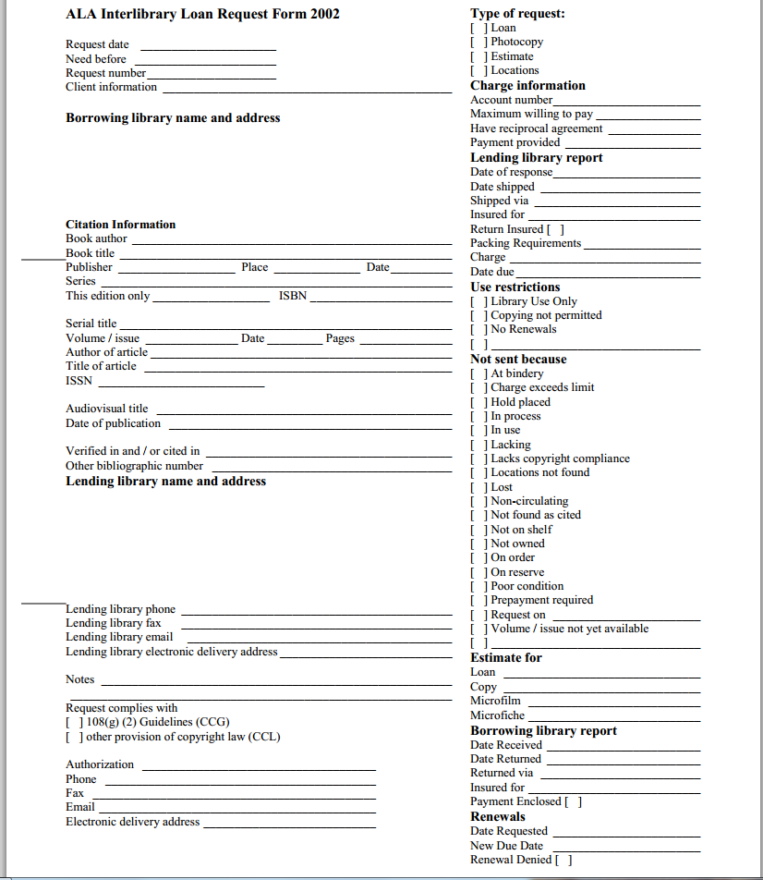
ILL Sample Request form

Slide 6
ILL Management Systems
Article Requesting Services
DOCLINE - http://www.docline.gov
RapidILL - http://www.rapidill.org/
Management Systems
Clio - http://cliosoftware.com/products/cliosystem.htm
OCLC ILLiad - http://www.oclc.org/illiad/
OCLC WorldCat Resource Sharing - http://www.oclc.org/support/documentation/resourcesharing/using/userguide/wcrs_overview/wcrs_overview.htm
Relais International - http://www.relais-intl.com/relais/home/index.htm
VDX - http://www.oclc.org/uk/en/vdx/about/default.htm

Slide 7
ILL lending policies samples
https://library.nd.edu/ill/lending_policy.shtml Lending Web Page Example - Academic Library,small
Lending Web Page Example - Academic Library, Medium https://ill.ulib.iupui.edu/ILLiad/IUP/Lending/LendingLogon.html
Lending Web Page Example - Academic Library, Large http://libguides.lib.msu.edu/c.php?g=96605&p=626666
http://www.imcpl.org/using/ill/other/ Lending Web Page Example - public Library, Large
LibGuides http://libguides.lib.msu.edu/c.php?g=96605&p=626666
Special library http://www.newberry.org/interlibrary-loan

Slide 8




Inter-Library Loan (ILL) at NU Library

Slide 9
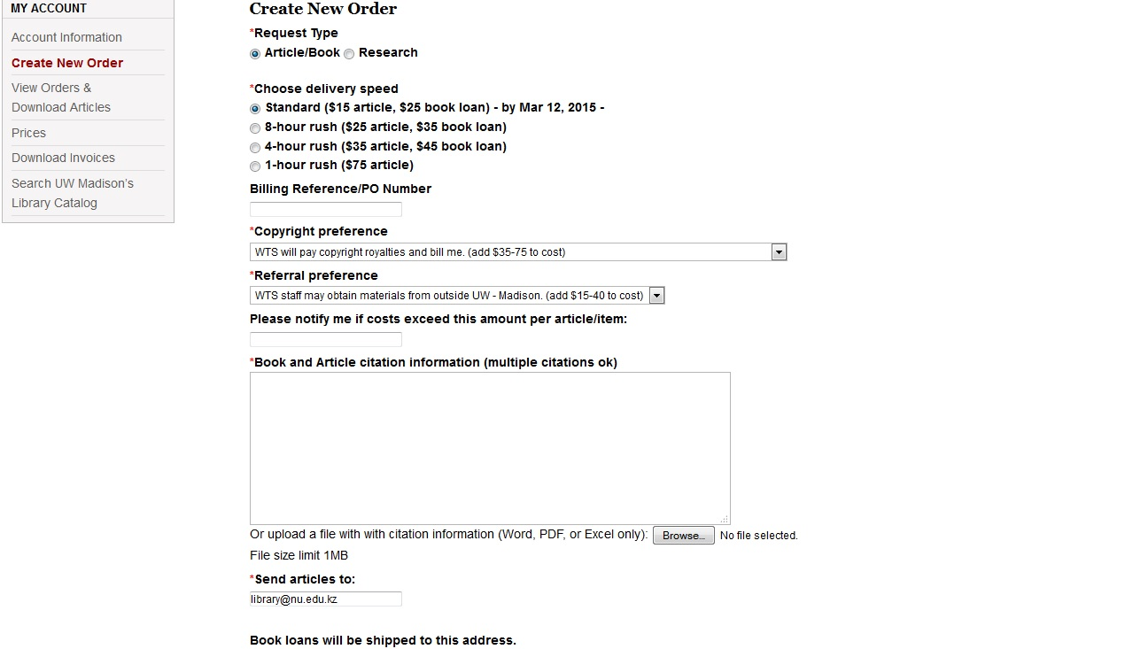
UWM Article Delivery Service WTS

Slide 10
NU ILL Stats
 | Delivered | CLS/NURIS | SHSS | SST | GSE
2013 | 229 | 86 | 10 | 98 | 3
2014 | 401 | 87 | 130 | 90 | 40
 | Cost Via ILL | Original Cost | Unavailable
Fall 2014 | 3702 | 7598 | 52

Slide 11
School of Medicine ILL
Only NUSOM faculty and students
Partner University of Pittsburgh Medical Library
Managed by Anar and Jeniffer

Slide 12
Questions????

