Slide 1
Green Librarianship: Achieving Sustainable Development
April 12, 2018
Carlene Groen
Subject Librarian for School of Science and Technology

Slide 2
Objectives
To define “Sustainable Development”
Become familiar with Green Library projects
Identify opportunities for NU Library and NU University

Slide 3
Sustainable Development:
Sustainable development is development that meets the needs of the present without compromising the ability of future generations to meet their own needs.
Brundtland Report (1987)

Slide 4
Sustainable Development - Balance
Economics
Social
Environment
Money
Personal Finances
GDP
NAFTA
Wage gap
History
Culture
Religion
Ethics
Education
Health
Politics
Traditional Knowledge
Pesticides
Irrigation
Biodiversity
Poaching/hunting
Clean water
Logging/mining
Urban Design

Slide 5
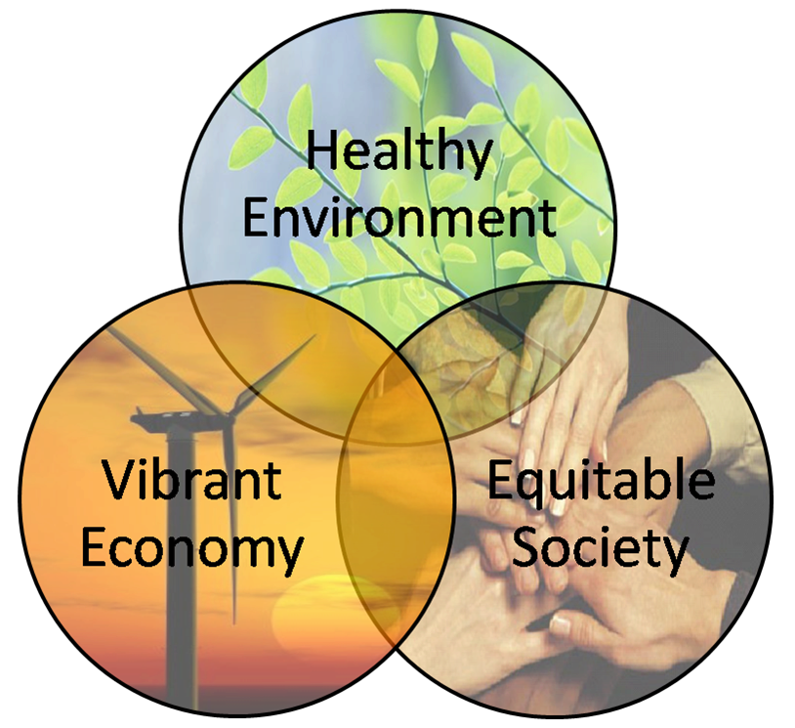
Why do you think Sustainable Development is important?

Slide 6
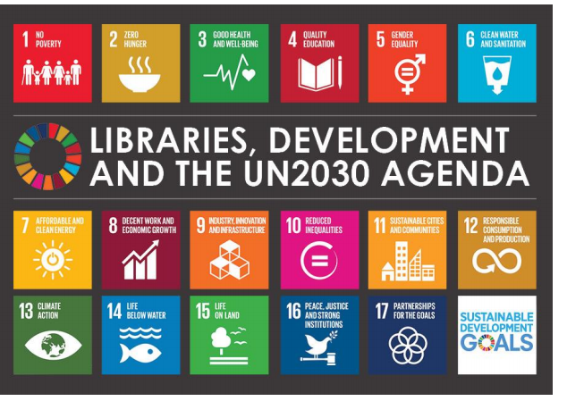

Slide 7
Green (Sustainable) Librarianship

Slide 8
The Building and Operations
Location
water/energy conservation
Building Materials
Air and noise pollution
Services/Programming
Community Projects
Environmental (green information) Literacy

Slide 9
Collection Management
Format
Weeding and Archive
Digitizing
Consortium
Alternative collections

Slide 10
Duke Kunshan University
Rainwater - treatment plant - irrigation and grey water
Air filters - on campus and all transportations system
Optimizes sunlight and and shading
Mostly Car free campus
Wetlands into a nature park which uses traditional knowledge on flood control

Slide 11
West Vancouver Library
Green Policy and Strategic Plan
purchasing, housekeeping, solid waste management, integrated pest management, erosion control, landscape management, and plumbing
2006-2010
68% reduction in water usage
34% reduction in power usage
42% reduction in gas usage
30% less solid waste pick-up

Slide 12
What opportunities exist to incorporate
“Sustainable Development” Librarianship at NU?

