Slide 1



ISOVER Multi-Comfort House Students Contest Edition 2015
Residential function in cold climate – Astana, Kazakhstan
Kazakhstan, KAZGASA, 1st Prize, Ruslan Abildinov, Valeriya Sidorenko, Iwan Schröder

Slide 2

CONCEPT

Slide 3
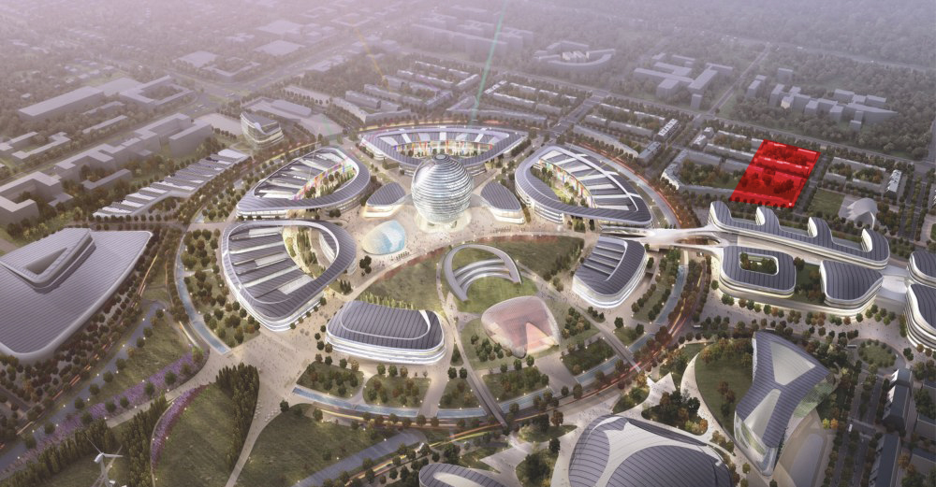
LOCATION OF PROJECT

Slide 4
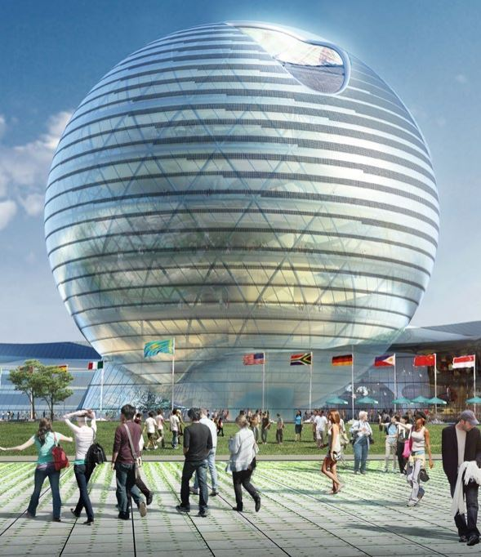


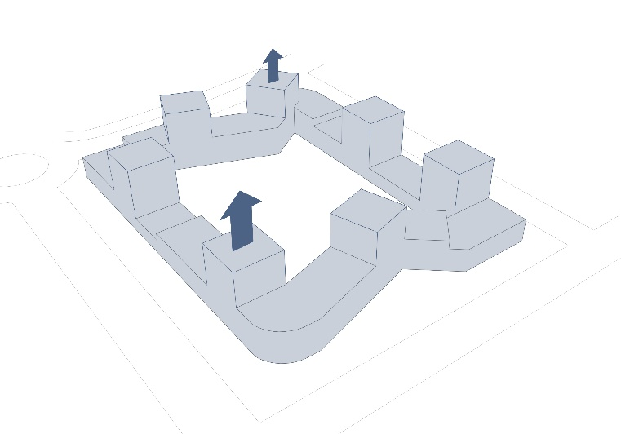
CLARITY , HARMONY , SUSTAINABILITY

Slide 5
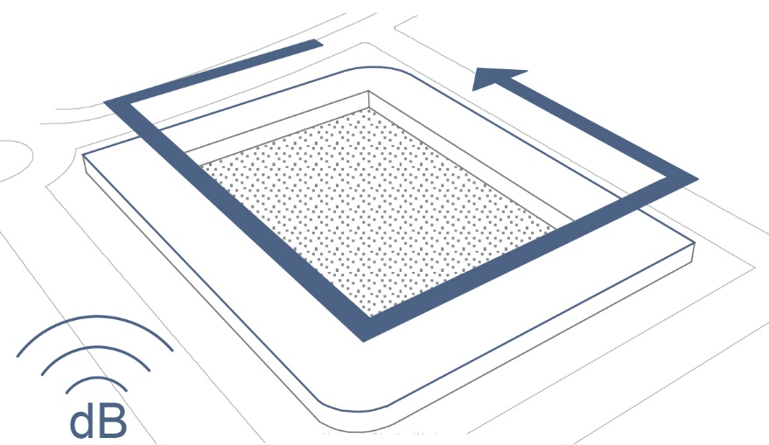
Noise isolation and solitude of the internal space of the residential complex

Slide 6
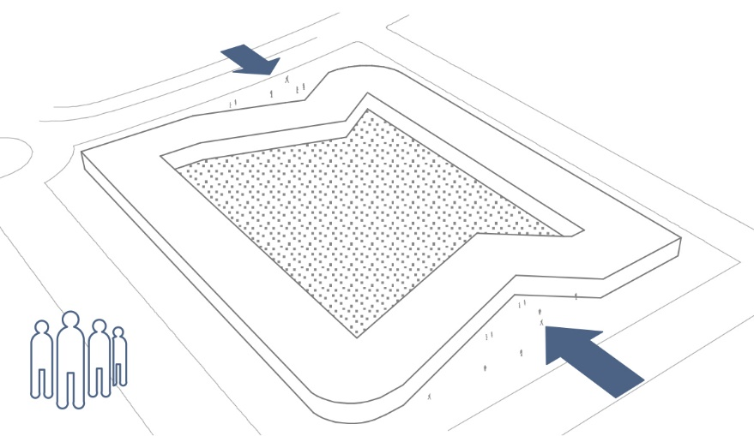
Creation of public and recreational spaces

Slide 7
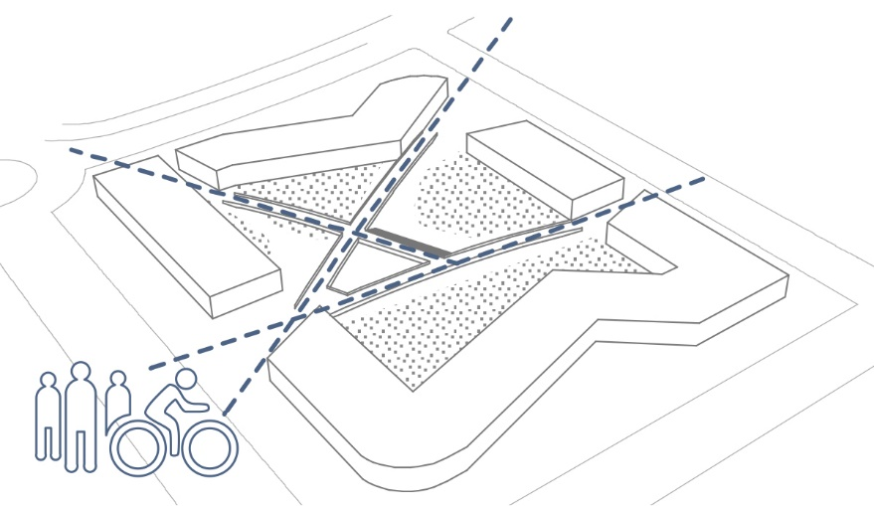
Connection of the residential complex with the surrounding infrastructure

Slide 8
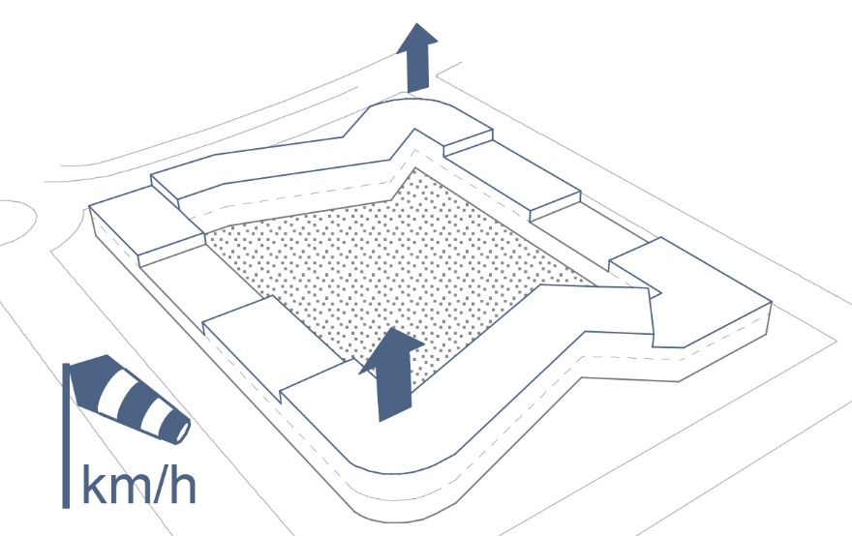
Protection from wind due to increasing the level of high-altitude platforms

Slide 9
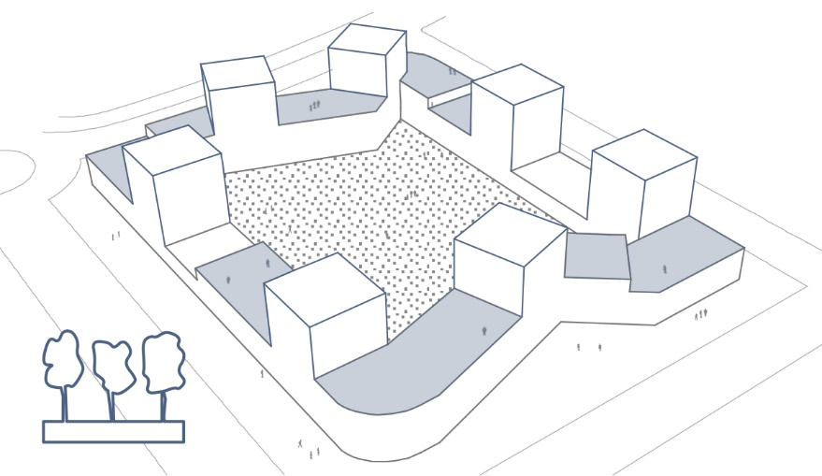
Location of houses and green terraces in accordance with the insolation

Slide 10
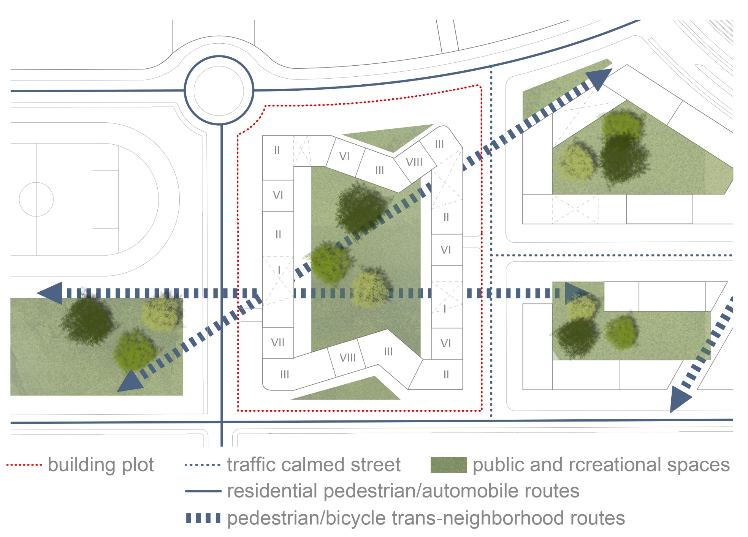
SITE PLAN

Slide 11
ARCHITECTURAL DECISION

Slide 12
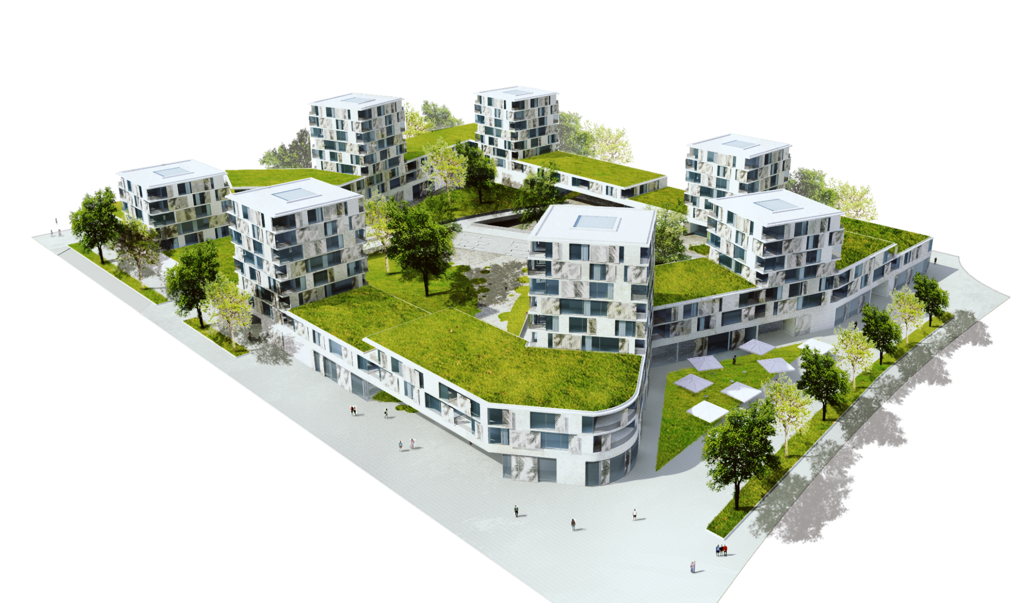
PROJECT OVERVIEW

Slide 13
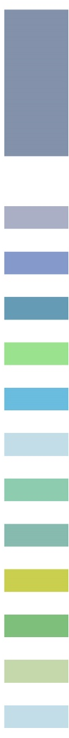
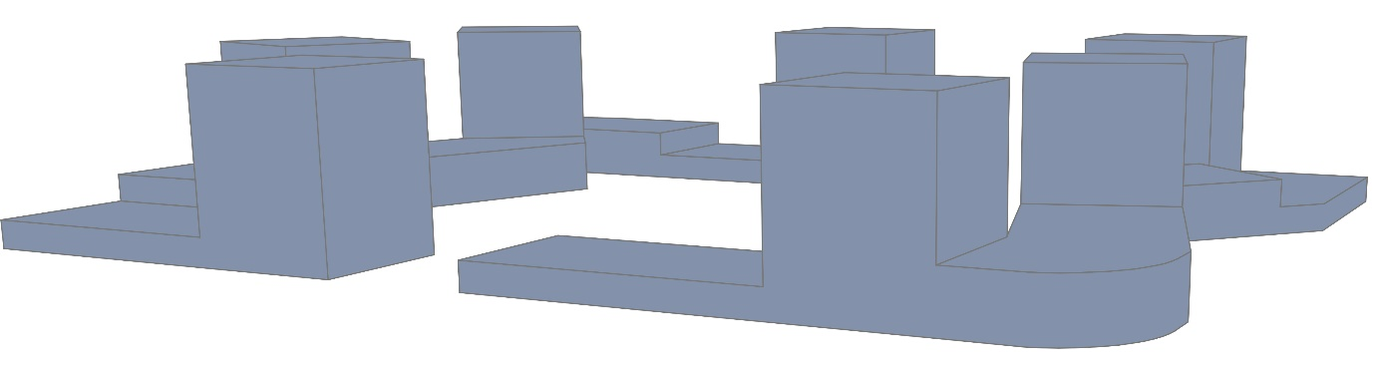
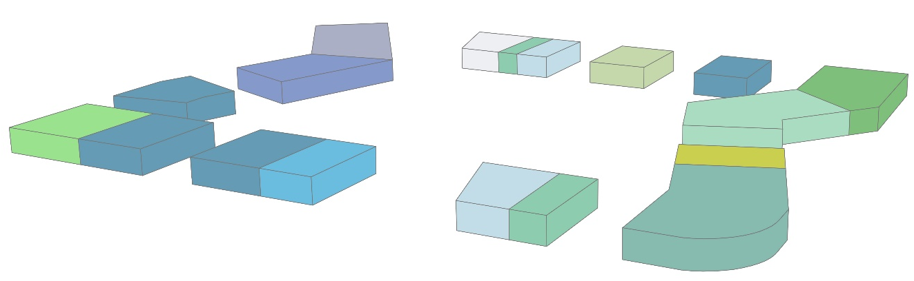

living area = 26 000 m²
offices = 515 m²
restaurant = 558 m²
shop = 1406 m²
beauty shop massage = 363 m²
bakery = 197 m²
parking entrance/exit
garbage room = 294 m²
market = 786 m²
pharmacy = 217 m²
fitness studio = 647 m²
kindergarten = 698 m²
repair shop = 272 m²
bicycle shop = 242 m²

Slide 14
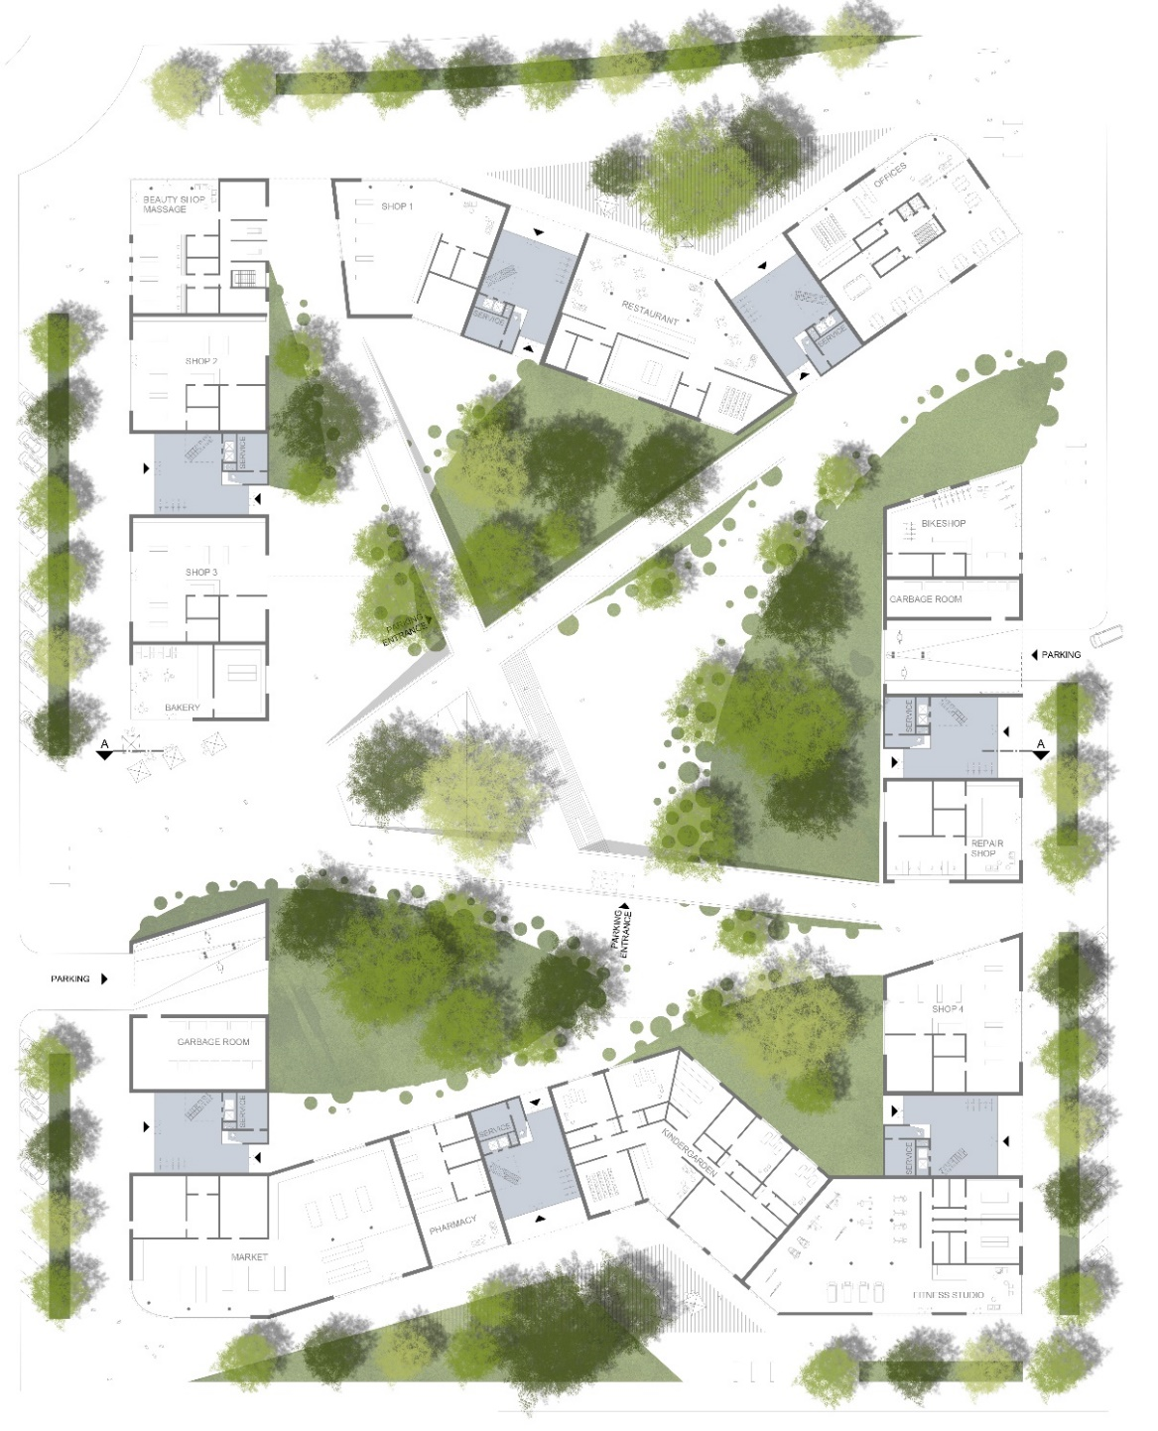
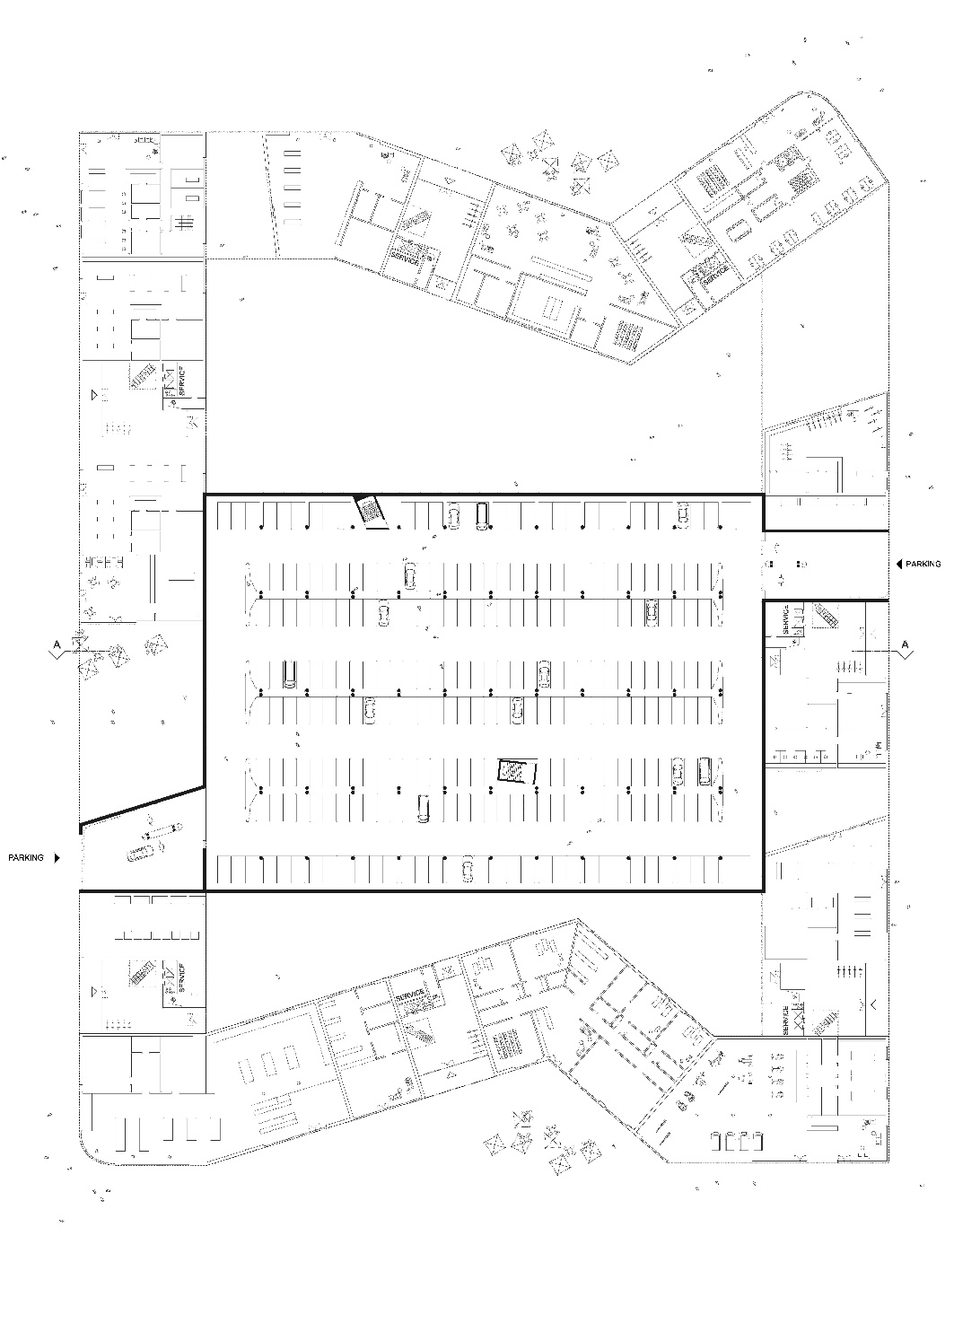
PARKING PLACES CA. 300
PARKING PLACES CA. 50 AROUND RESIDENTIAL COMPLEX
GROUNDFLOOR PLAN WITH LANDSCAPE DESIGN

Slide 15
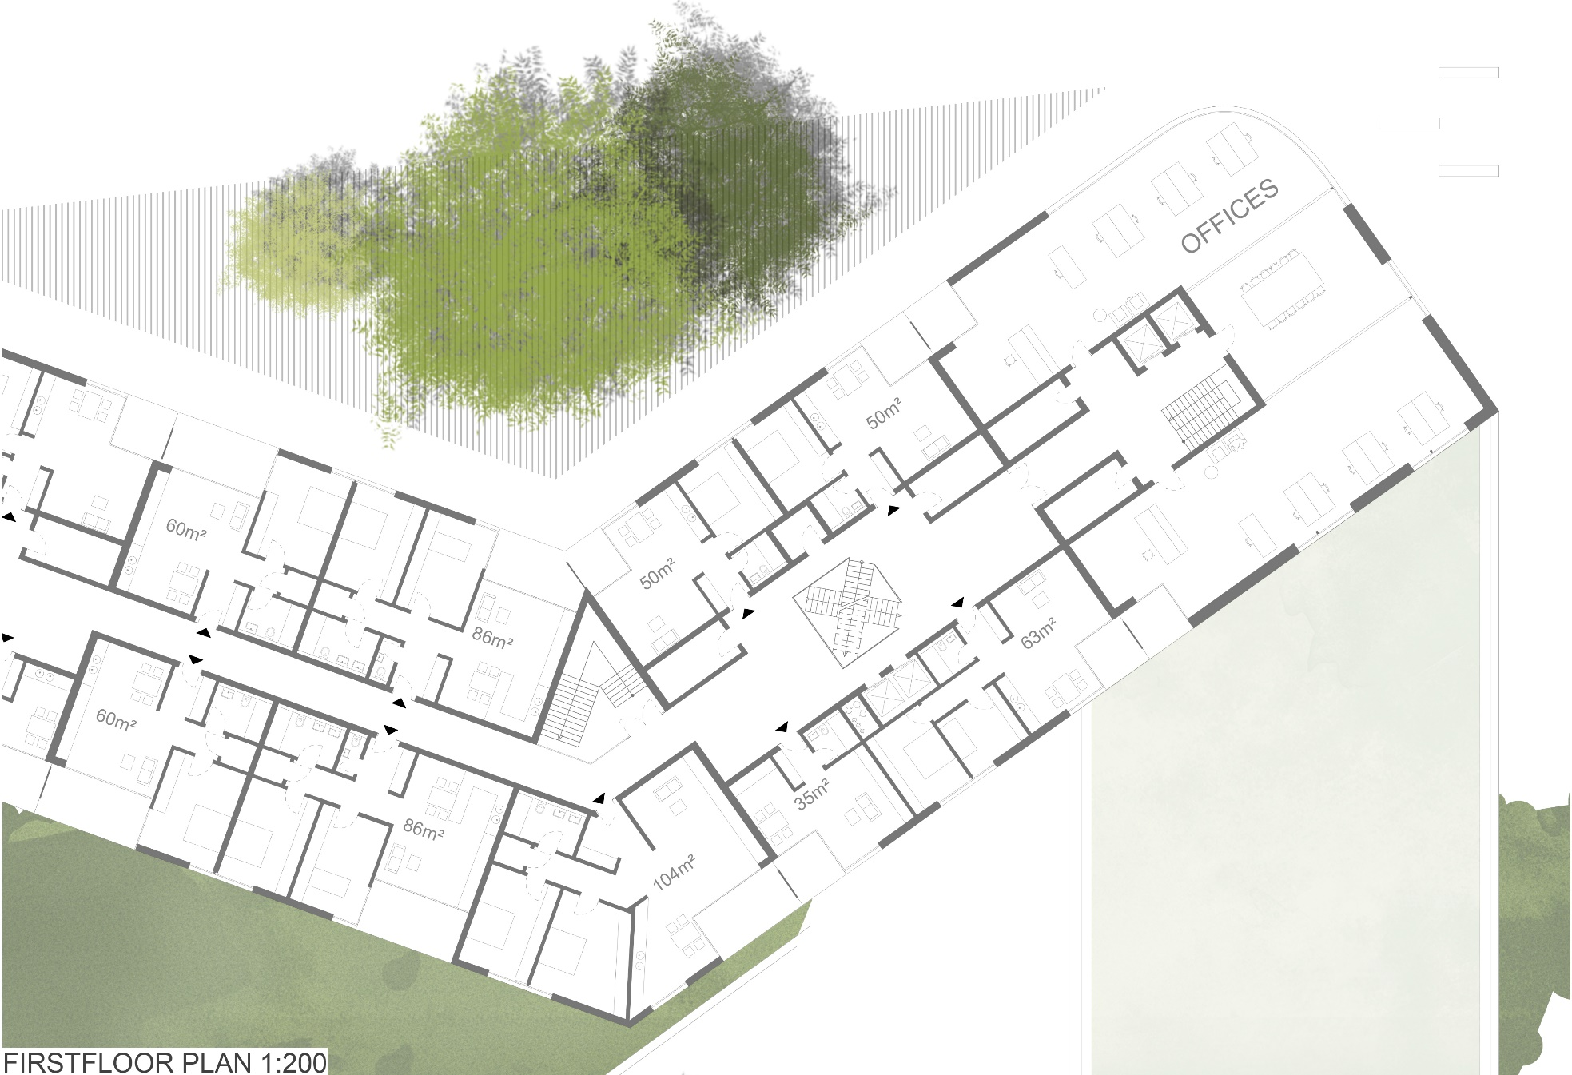
FIRSTFLOOR PLAN

Slide 16
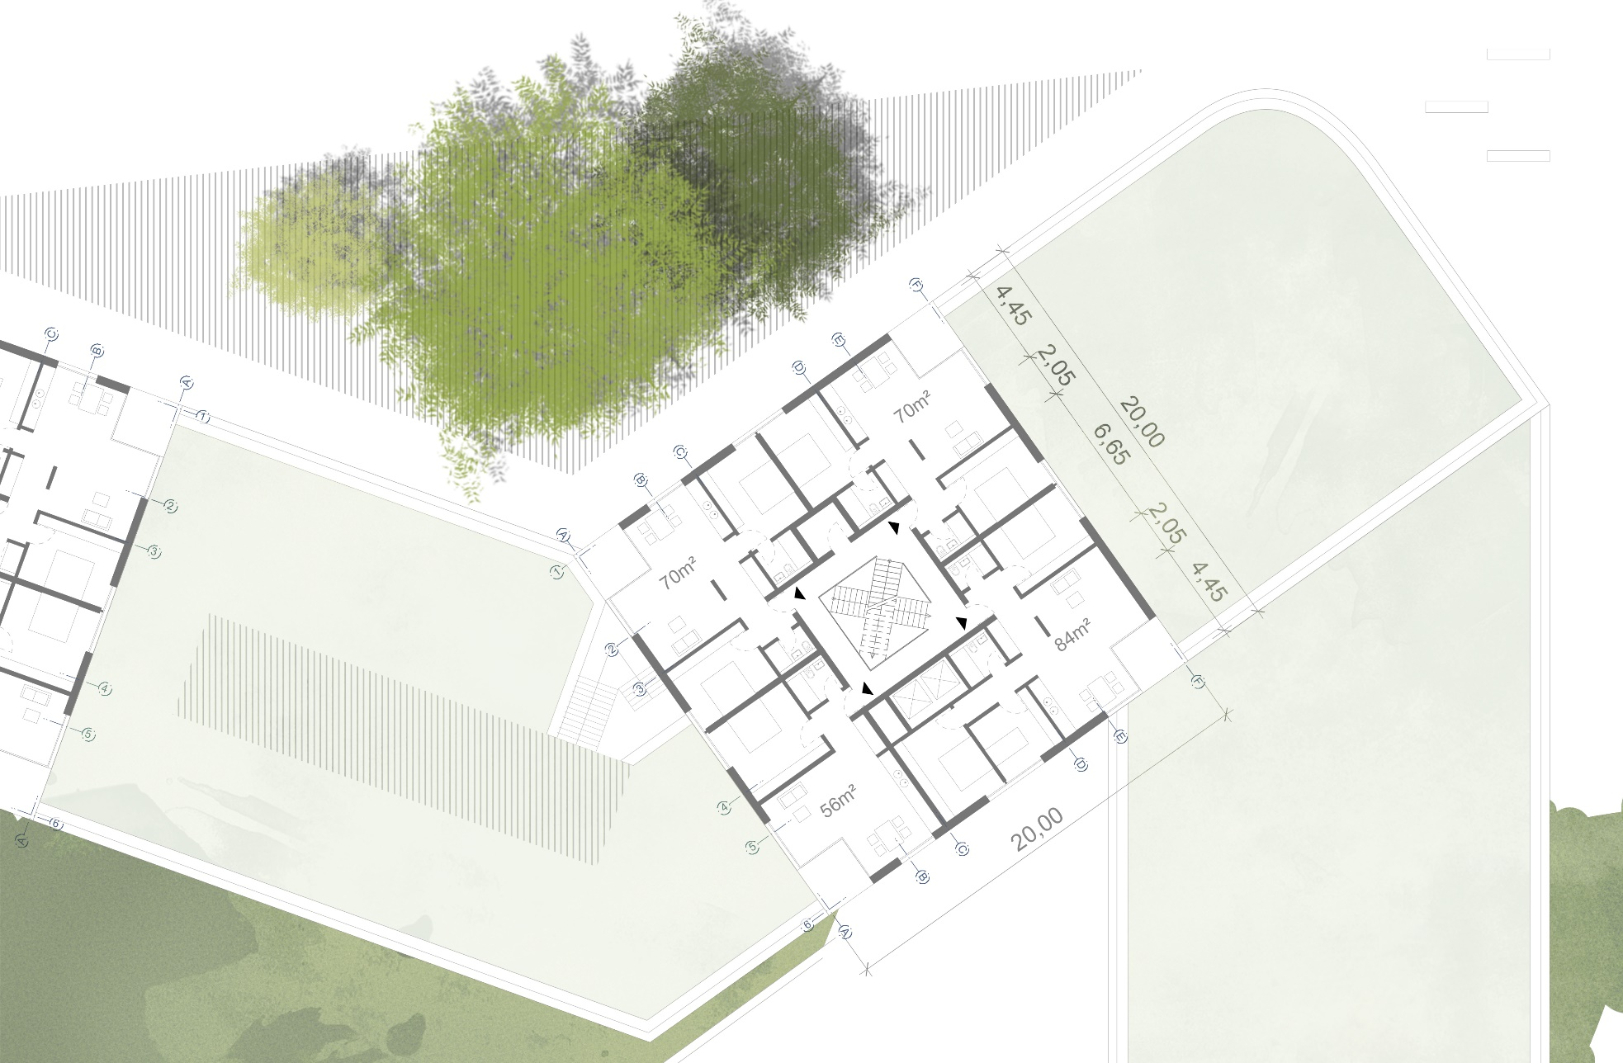
SECONDFLOOR PLAN

Slide 17
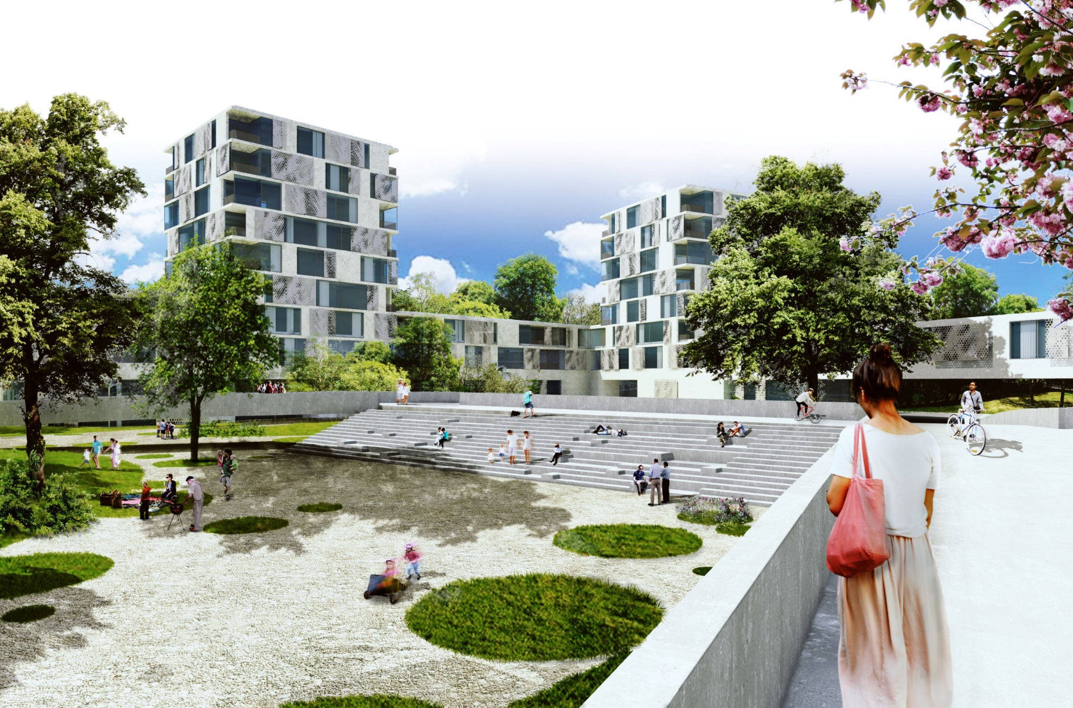
VIEW COURTYARD PARK

Slide 18
TECHNICAL ASPECTS

Slide 19
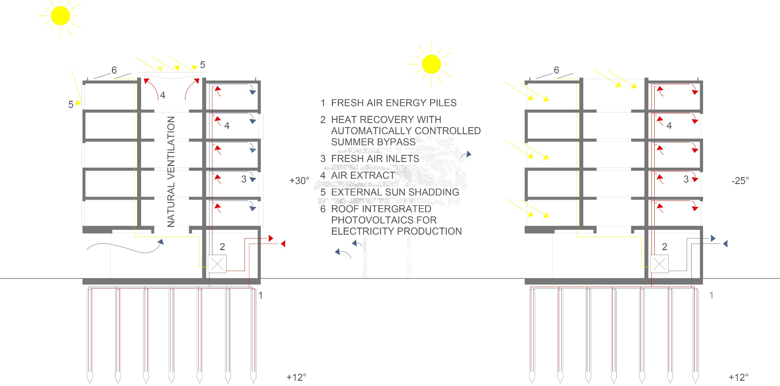
SUMMER VENTILATION/ COOLING
WINTER PASSIVE HEAT GAINS

Slide 20
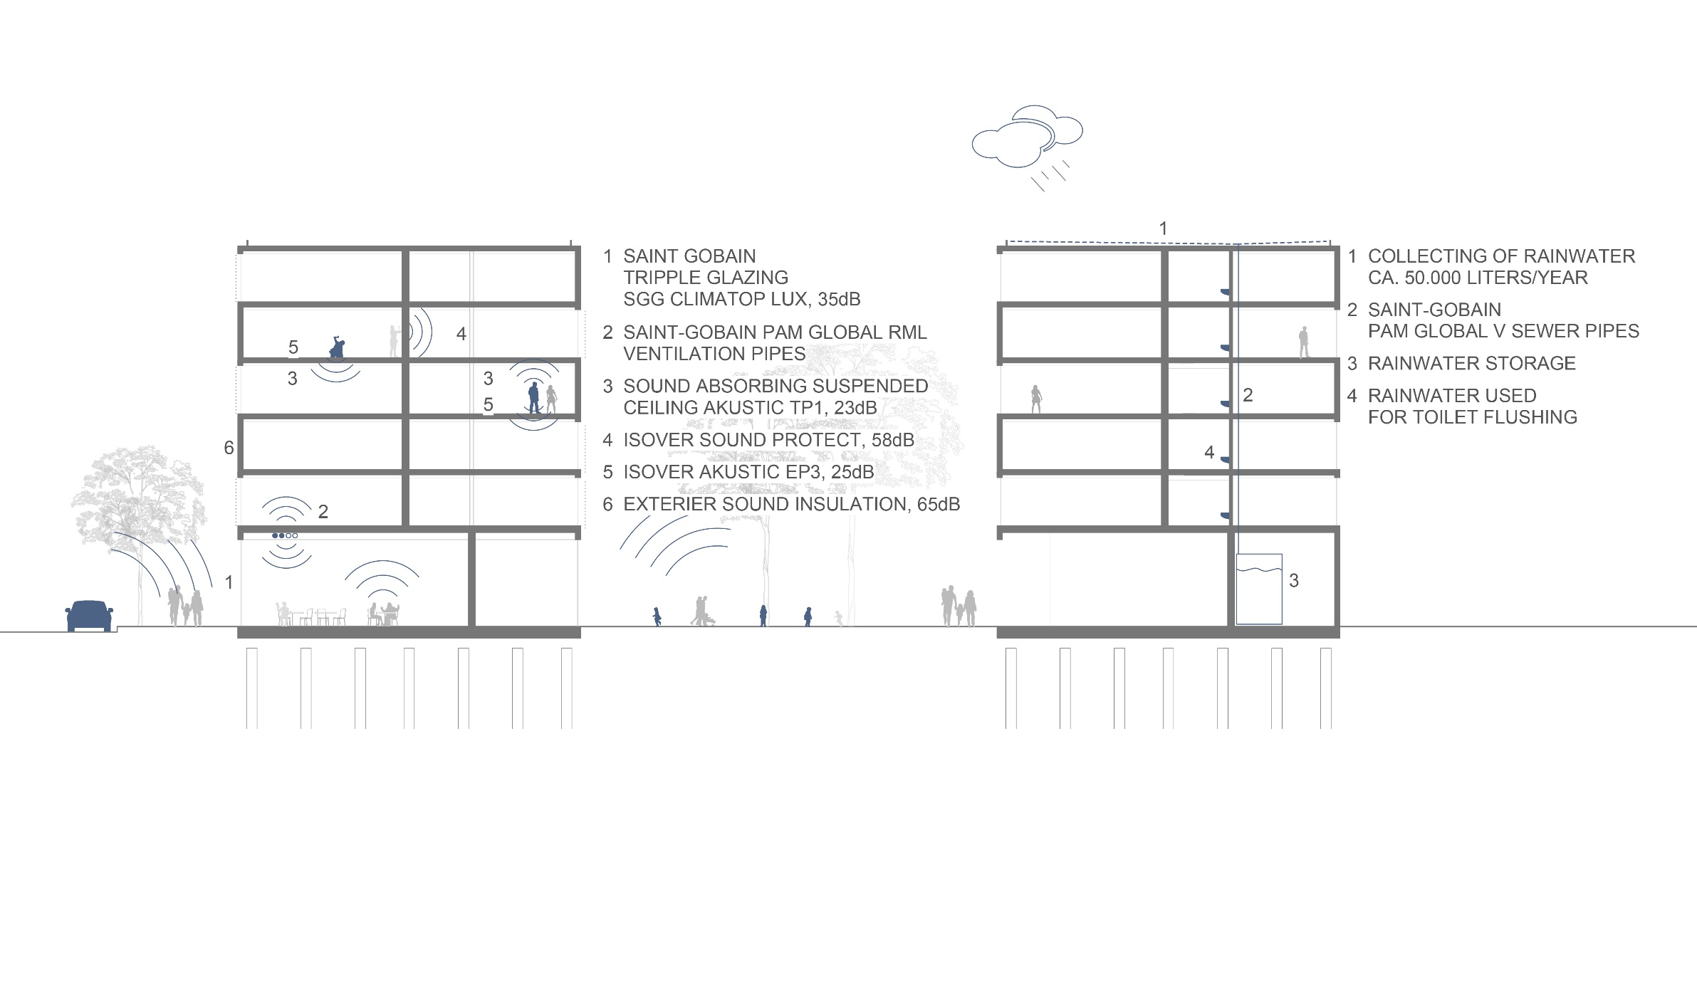
ACOUSTICS

Slide 21
RE-USE OF RAIN WATER

Slide 22
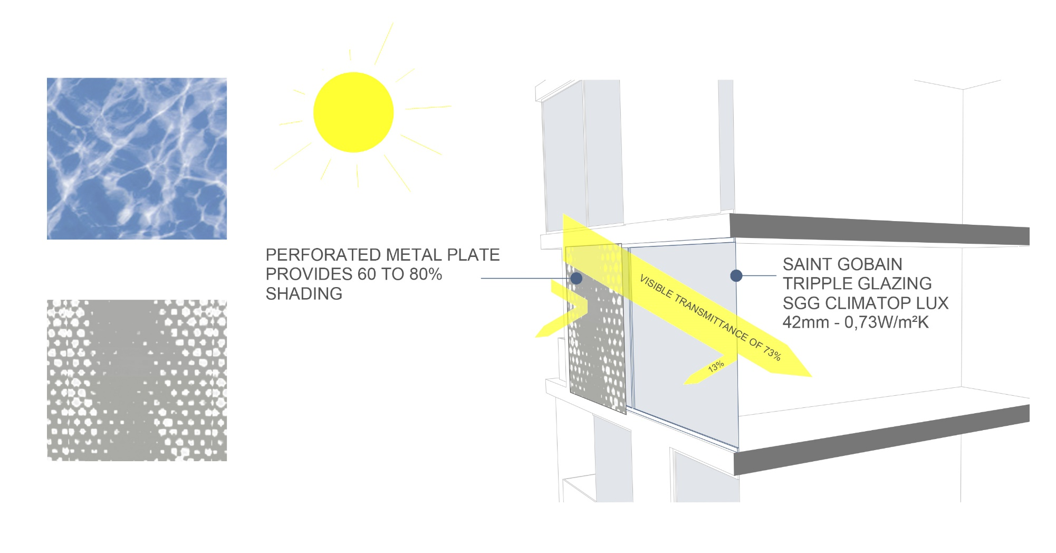
WAVE SURFACE USED AS PATTERNS FOR PERFORATION ON SHELF

Slide 23
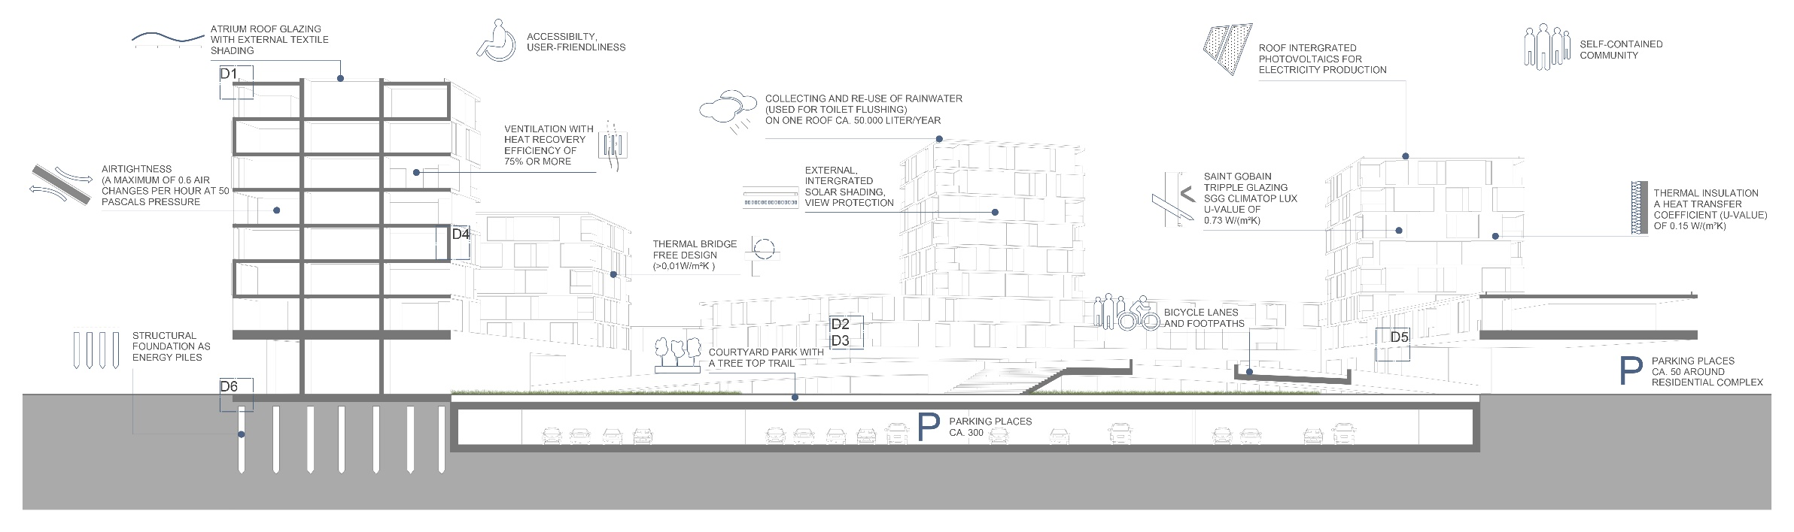
GROSS FLOOR AREA 31753 m²
DENSITY OF HOUSING 8807 m²/ha
TOTAL NUMBER OF APARTMENTS ca. 330
SECTION A-A WITHOUT SCALE

Slide 24

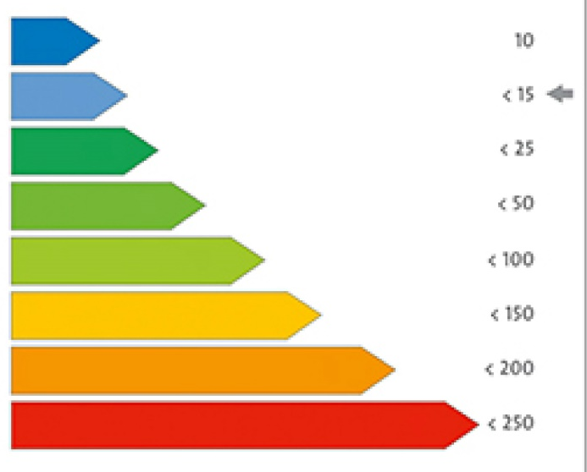
MULTI-COMFORT DESIGNER:
CALCULATION FOR A TOWER WITH 8 FLOORS - OVERVIEW PALETTE
A.PROJECT DATA
Object: Residential Complex
Climate zone: Astana
Construction: New Building
Building Type: Residential
Usage: For living
Design Temperature: 22.00°C
E. QUALITY
Airtightness rate: 0.60
Thermal Bridge Free: Yes
F. MEAN SHADING FACTORS
North 0°: 0.47
South 180°: 0.70
West 270°: 0.70
East 90°: 0.70
OVERHEATING PARAMETERS
Kind of Construction: Massive
Max. admitted interior temperature: 25
SUMMER VENTILATION STRATEGY
Summer Air Exchange Rate
Natural Ventilation Losses 0.2
Mechanical Ventilation Losses 0.4
G. HVAC
Heat Recovery System: 90.00 %
Subsoil Heat Exchanger
Efficiency: 33.00 %
Length: 80 m
H.CALCULATIONS
Transmission Heat Losses: 122782.89 kWh/a
Ventilation Heat Losses: 36370.72 kWh/a
Total Heat Losses: 159153.60 kWh/a
Internal Heat Gains: 35965.44 kWh/a
Available Solar Heat Gains: 103632.60 kWh/a
Total Heat Gains: 123246.58 kWh/a
Annual Heat Demand: 35907.02 kWh/a
Specific Annual Heat Demand:11.22 kWh/(m²a)
B. AREA INPUT
Sum of living area: 3200.00 m²
Sum of Heated Space Volume: 9422.16 m²
V/A Ratio: 2.94
Sum of Thermal Envelope: 2392.00 m²
C. ENVELOPE- OPAQUE ELEMENTS
(Average U-Values)
Flat Roof: 0.11
Wall against air: 0.08
Wall against ground: 0.17
Slab against ground: 0.10
D.ENVELOPE- WINDOWS AND DOORS
(Average U-Values)
Windows: 0.73
Doors: 0.80

Slide 25
MULTI-COMFORT DESIGNER:
ORIGIN RESIDENTIAL COMPLEX SIMULATION – OVERVIEW PALETTE
A.PROJECT DATA
Object: Residential Complex
Climate zone: Astana
Construction: New Building
Building Type: Residential
Usage: For living
Design Temperature: 22.00°C
E. QUALITY
Airtightness rate: 0.60
Thermal Bridge Free: Yes
F. MEAN SHADING FACTORS
North 0°: 0.47
South 180°: 0.70
West 270°: 0.70
East 90°: 0.70
OVERHEATING PARAMETERS
Kind of Construction: Massive
Max. admitted interior temperature: 25
SUMMER VENTILATION STRATEGY
Summer Air Exchange Rate
Natural Ventilation Losses 0.2
Mechanical Ventilation Losses 0.4
G. HVAC
Heat Recovery System: 90.00 %
Subsoil Heat Exchanger
Efficiency: 33.00 %
Length: 80 m
H.CALCULATIONS
Transmission Heat Losses: 1430980.88 kWh/a
Ventilation Heat Losses: 401265.12 kWh/a
Total Heat Losses: 1832246.01 kWh/a
Internal Heat Gains: 396793.83 kWh/a
Available Solar Heat Gains: 918164.04 kWh/a
Total Heat Gains: 1233091.15 kWh/a
Annual Heat Demand: 599154.85 kWh/a
Specific Annual Heat Demand:16.97 kWh/(m²a)
B. AREA INPUT
Sum of living area: 31753 m²
Sum of Heated Space Volume: 73126.88 m³
V/A Ratio: 2.07
Sum of Thermal Envelope: 44598.30 m²
C. ENVELOPE- OPAQUE ELEMENTS
(Average U-Values)
Flat Roof: 0.11
Wall against air: 0.08
Wall against ground: 0.17
Slab against ground: 0.10
D.ENVELOPE- WINDOWS AND DOORS
(Average U-Values)
Windows: 0.73
Doors: 0.80

Slide 26
CONSTRUCTION DETAILS

Slide 27
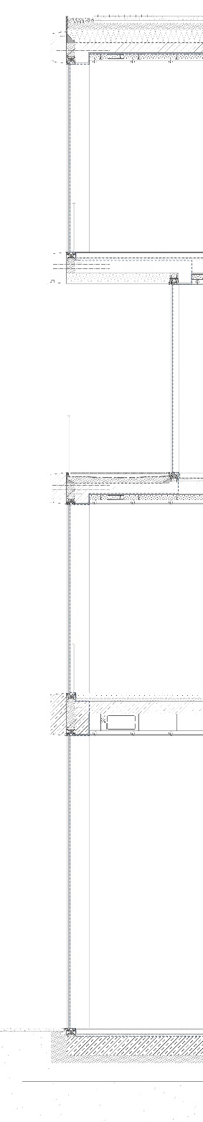
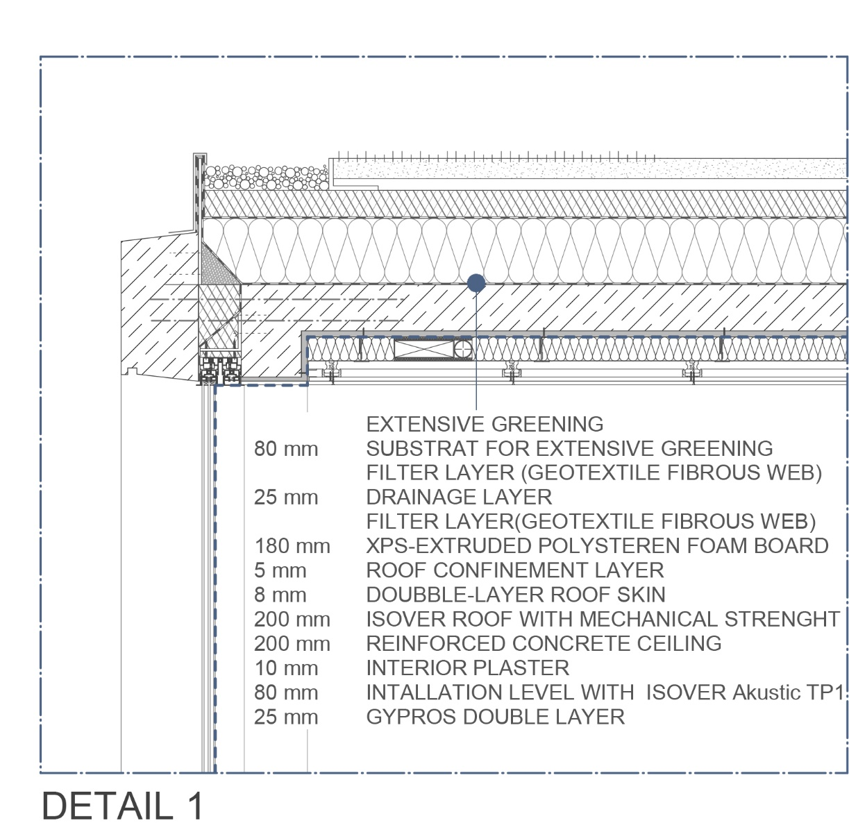

Slide 28
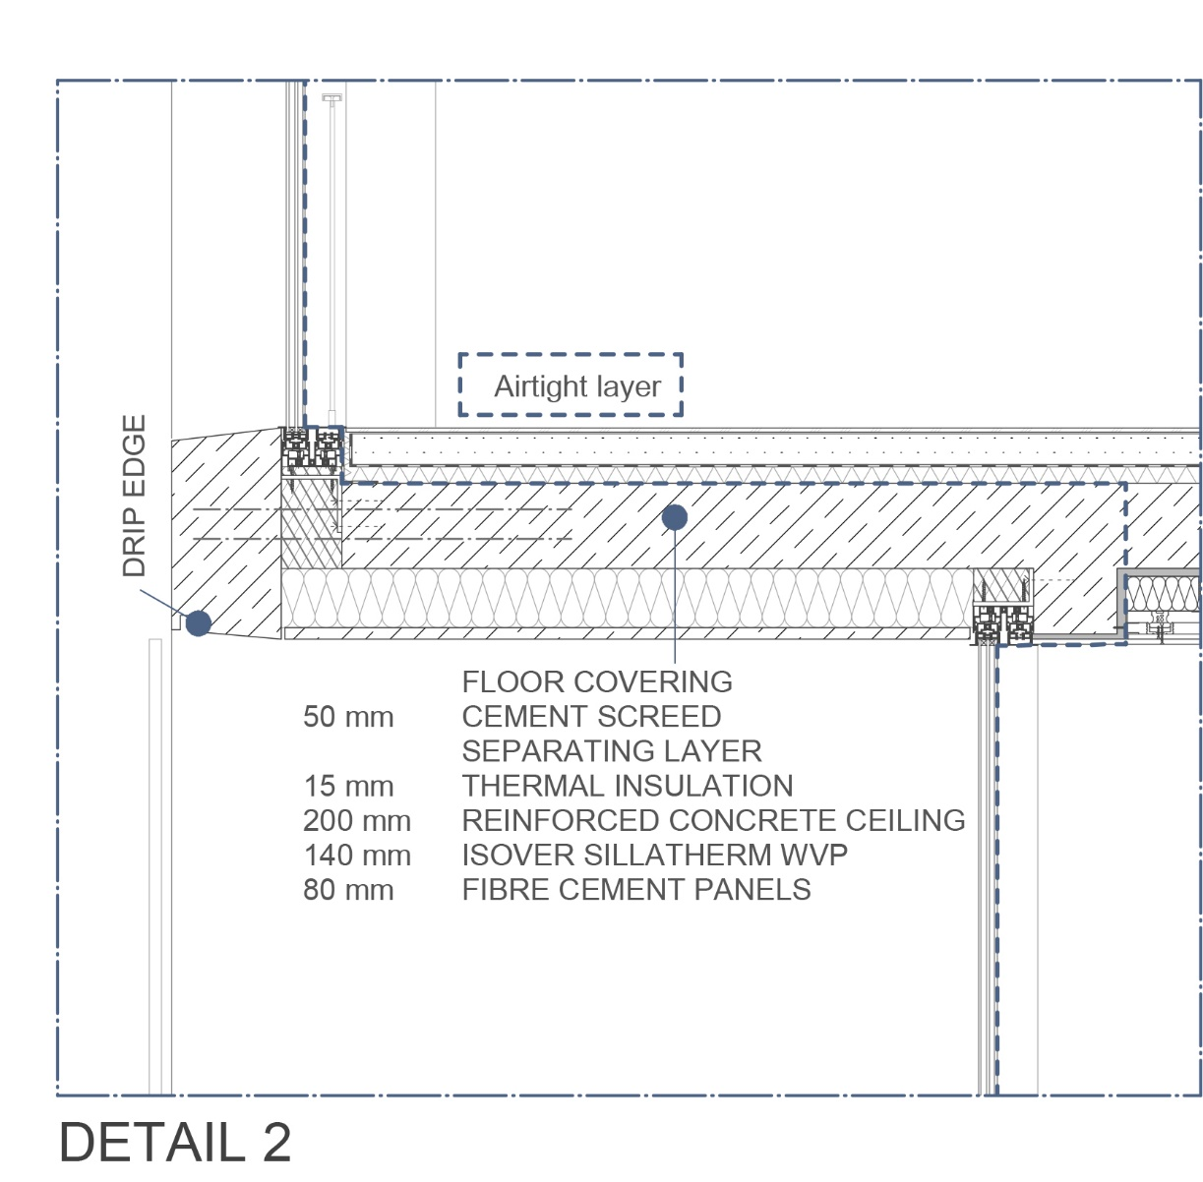

Slide 29
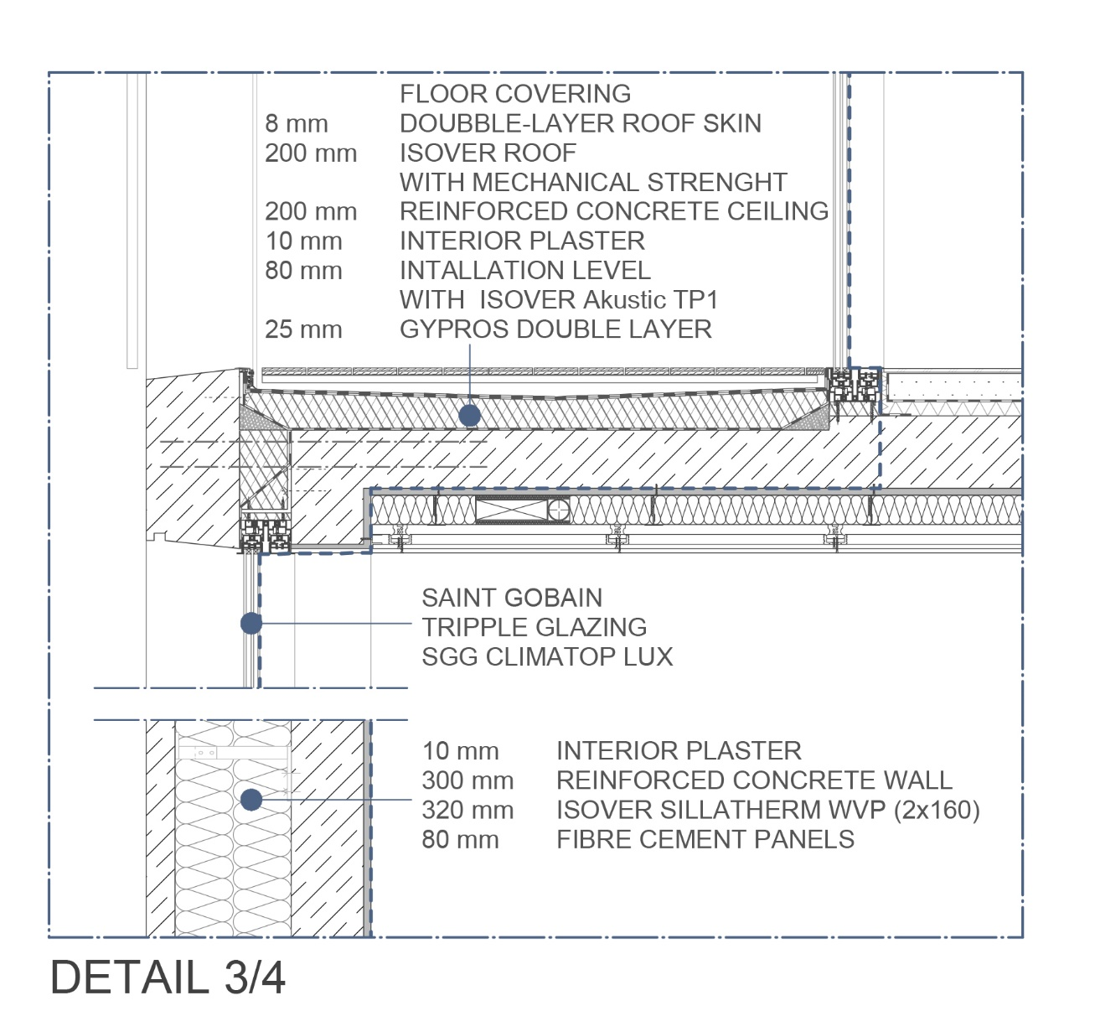

Slide 30
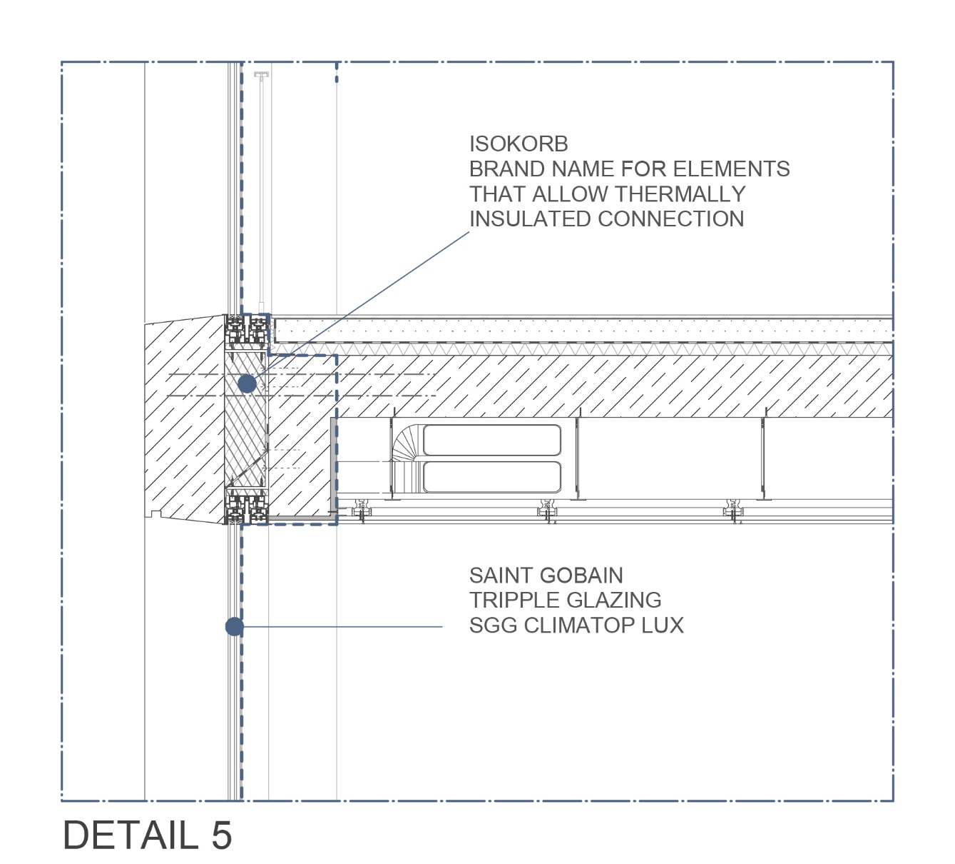

Slide 31
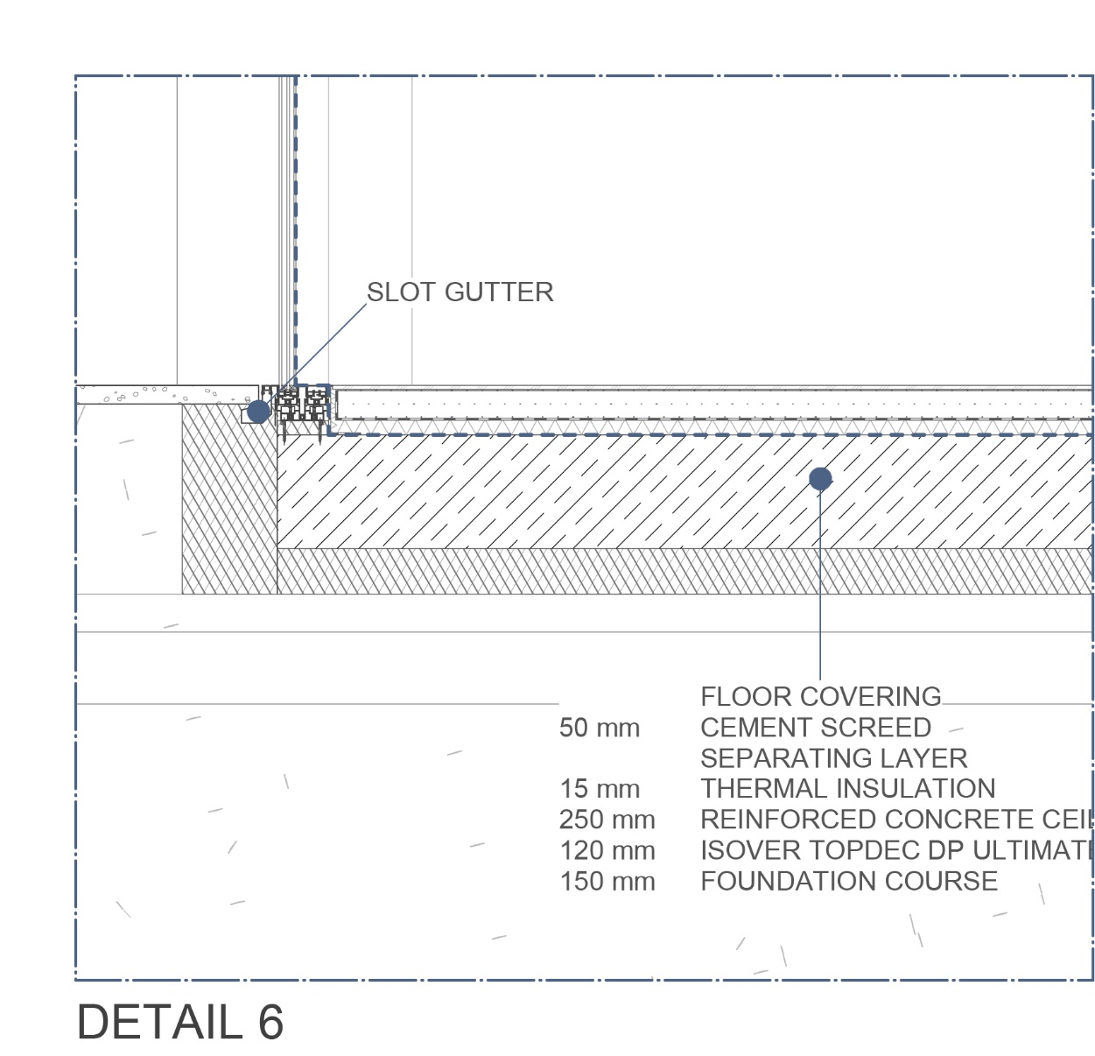

Slide 32
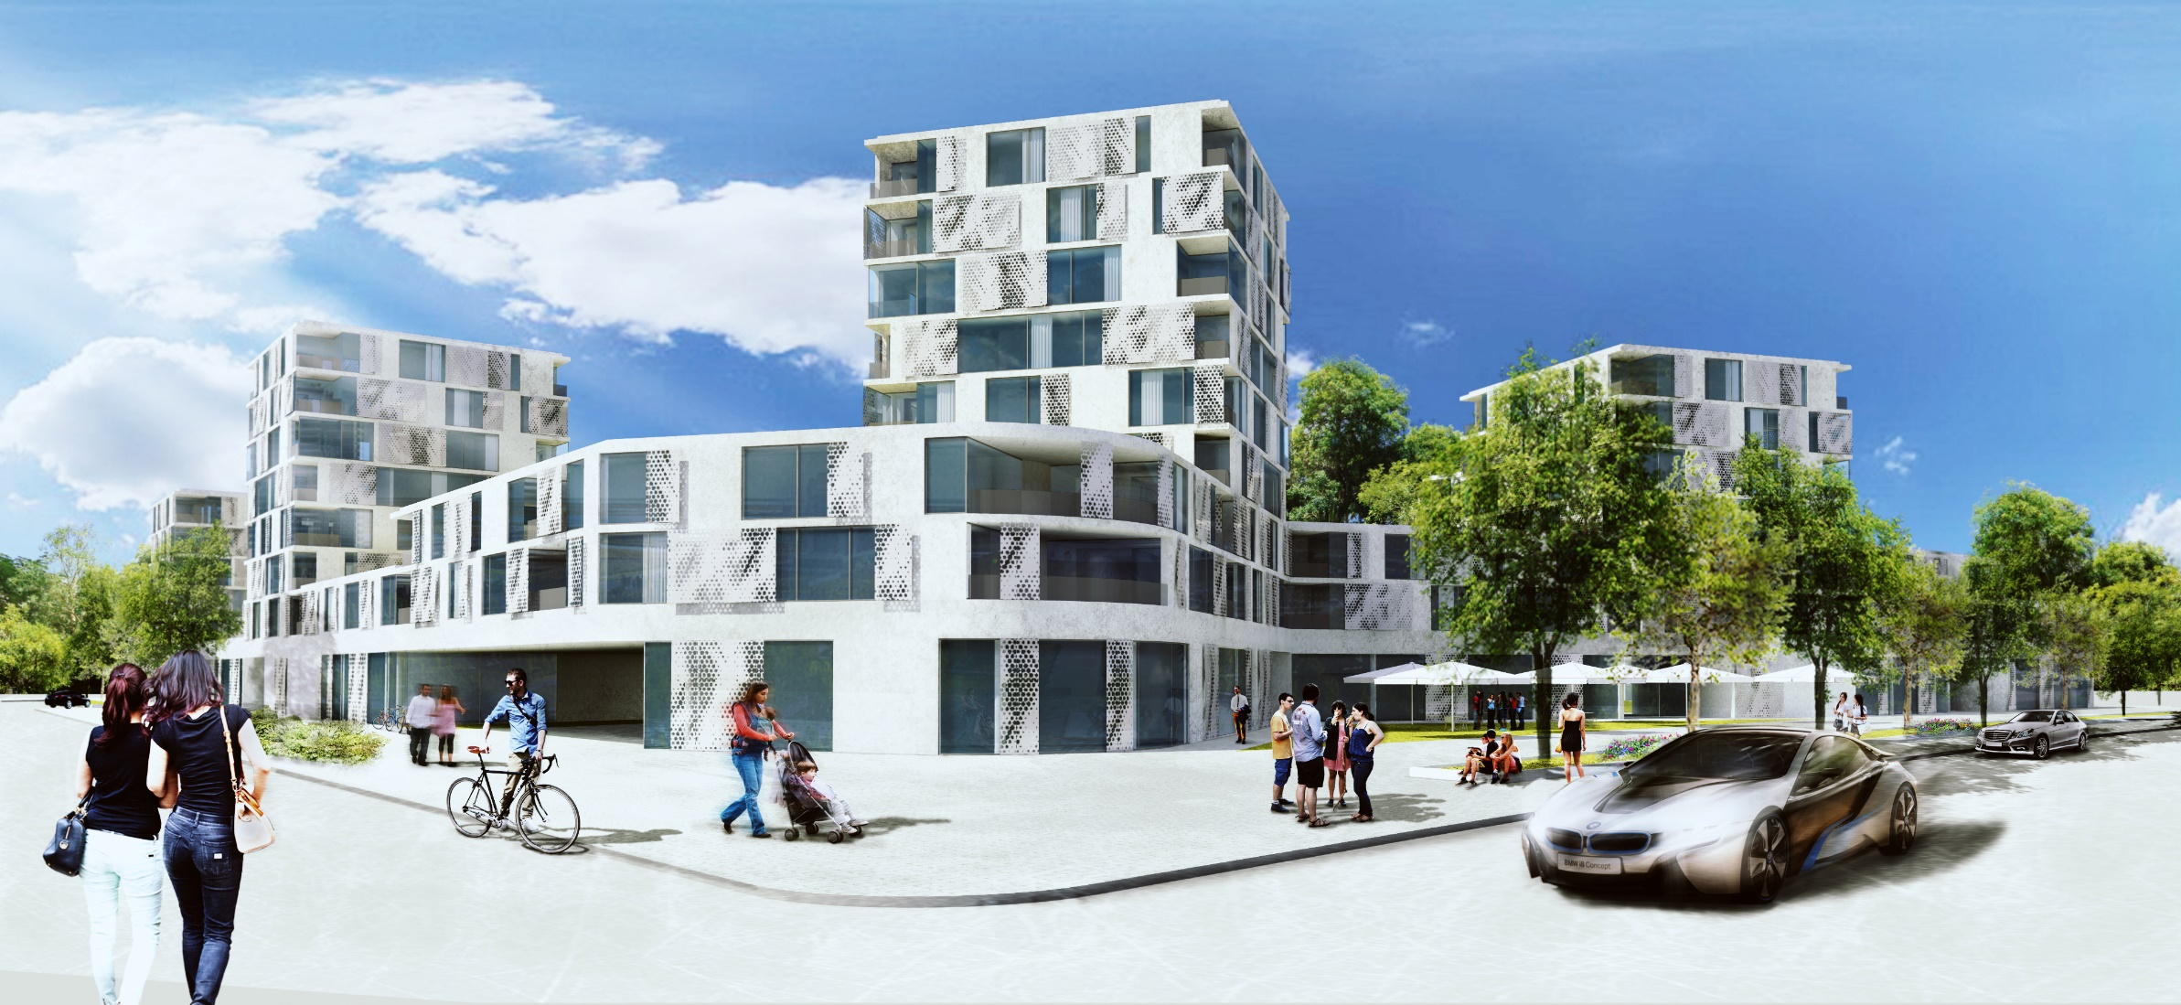
SIMPLICITY IS EFFICIENCY

