Slide 1


International Advocacy Plan and libraries
If you want to go fast: walk alone
If you want to walk far: walk together
Ingrid Bon
Manager Development Programmes

Slide 2

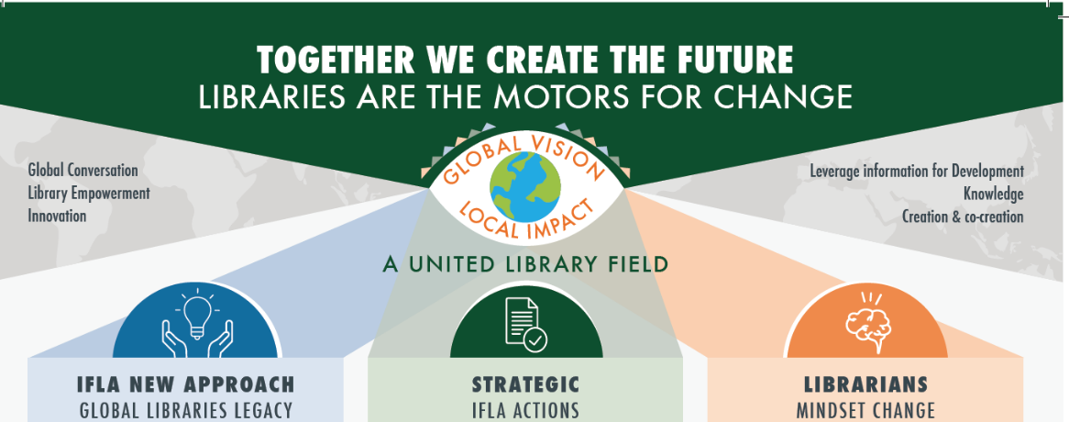
Notes:
IFLA is working hard on its own transformation looking ahead towards a united library field.
Along with Gloria, Gerald Leitner is a secretary general since 2016.
Team has changed a lot, kept on building what was already there in the past years + introduces novelties!
What has also changed? Major: IFLA has become one of the Global Libraries legacy partners, which means that they received almost 30 mil $ for the next 10 years to continue with strategic projects.
What are those projects?

Slide 3
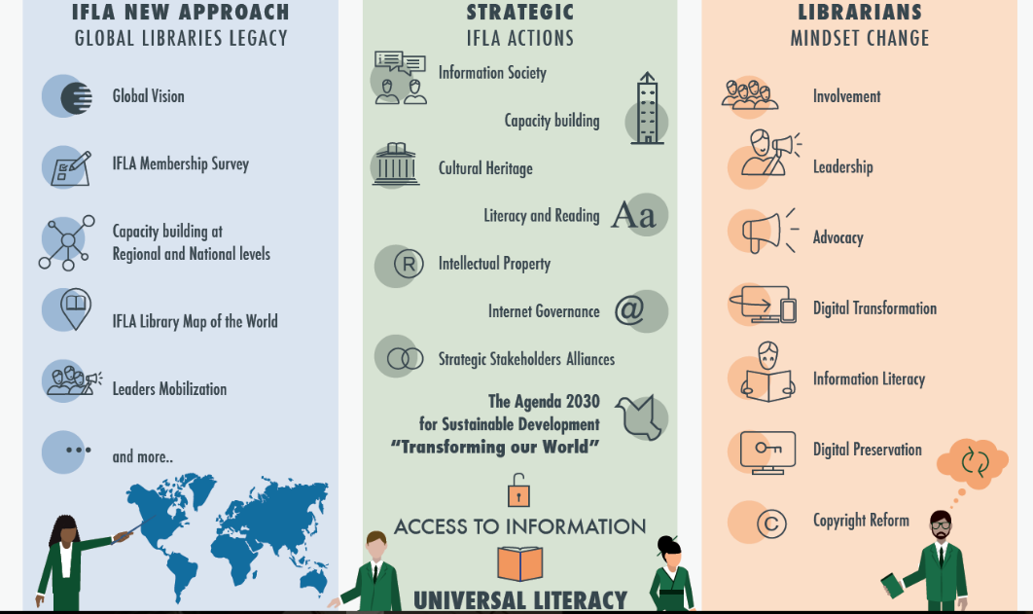
Notes:
Well, the future is uncertain, but here are some directions.
GV – by 2019 actions!
LMW – stats, compare for benchmarking, stories!
LEADERS. Among top 5.

Slide 4
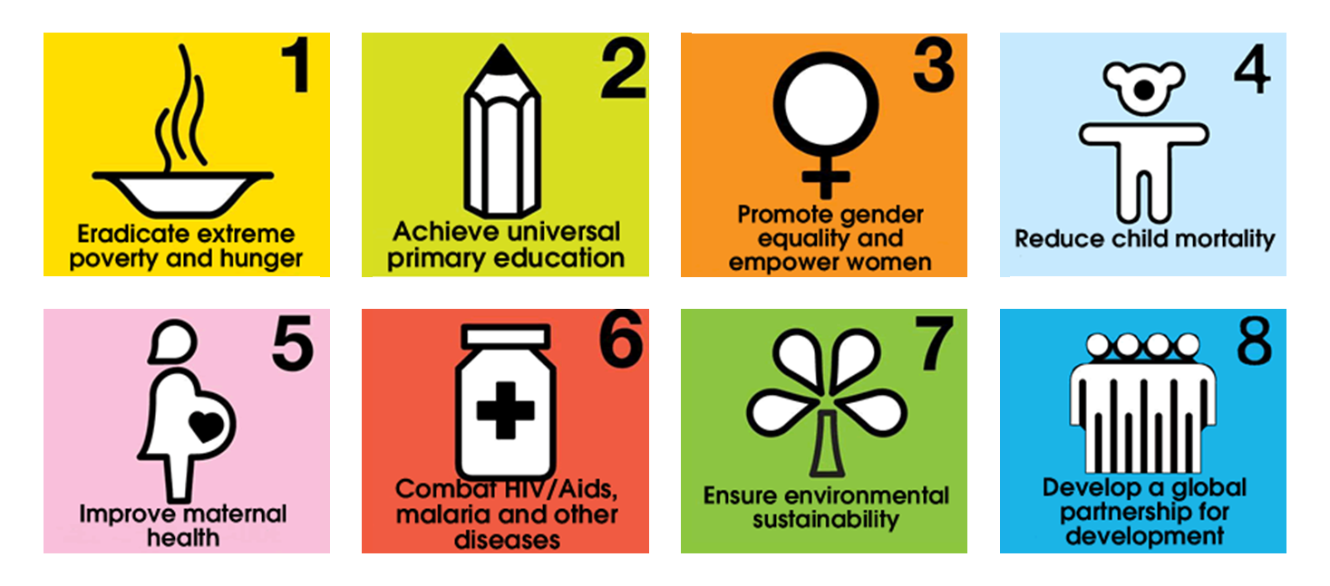
UN MILLENNIUM DEVELOMENT GOALS (2000)
Sustainable Development

Slide 5
Timeline UN
Rio+20 UN Conference on Sustainable Development (2012)
Open Working Group on Sustainable Development Goals (2014)
UN Secretary General’s High Level Panel (2013)
Inter-Governmental Negotiations (2015)
Post-2015 Development Summit (2015)
UN General Assembly (2014)
SDGs begin (Jan 1, 2016)
Outcome:
‘The Future We Want’ (June)
Outcome: Report inc. ‘The Data Revolution’ (May)
Outcome: Draft SDGs (September)
Outcome: Secretary General’s Synthesis Report (December)
Outcome: Zero Draft Post-2015 Framework Document (June)
Outcome:
2030 Agenda for Sustainable Development: Declaration, SDGs, Means of Implementation, Monitoring and Accountability (September)
Outcome: First Voluntary National Reviews at High Level Political Forum(July)
Sustainable Development

Slide 6
WHY INCLUDE ACCESS TO INFORMATION
IN THE 2030 AGENDA?
Information is fundamental for development – and libraries support this
Information promotes better decision-making, helps people learn new skills
Information helps people exercise their rights
Information promotes accountability
Advocating for access to information can create policy space for libraries to move into and become development partners
Sustainable Development

Slide 7

THE LYON DECLARATION ON ACCESS TO INFORMATION AND DEVELOPMENT (2014)
www.lyondeclaration.org
Sustainable Development

Slide 8
































































600 SIGNATORY
ORGANISATIONS & INSTITUTIONS
Sustainable Development

Slide 9
What did/does the Lyon Declaration ask for?
6. We call on Member States of the United Nations to acknowledge that access to information, and the skills to use it effectively, are required for sustainable development, and ensure that this is recognized in the post-2015 development agenda by:
  Acknowledging the public's right to access information and data, while respecting the right to individual privacy.
  Recognizing the important role of local authorities, information intermediaries and infrastructure such as ICTs and an open Internet as a means of implementation.
  Adopting policy, standards and legislation to ensure the continued funding, integrity, preservation and provision of information by governments, and access by people.
  Developing targets and indicators that enable measurement of the impact of access to information and data and reporting on progress during each year of the goals in a Development and Access to Information (DA2I) report.
Sustainable Development

Slide 10
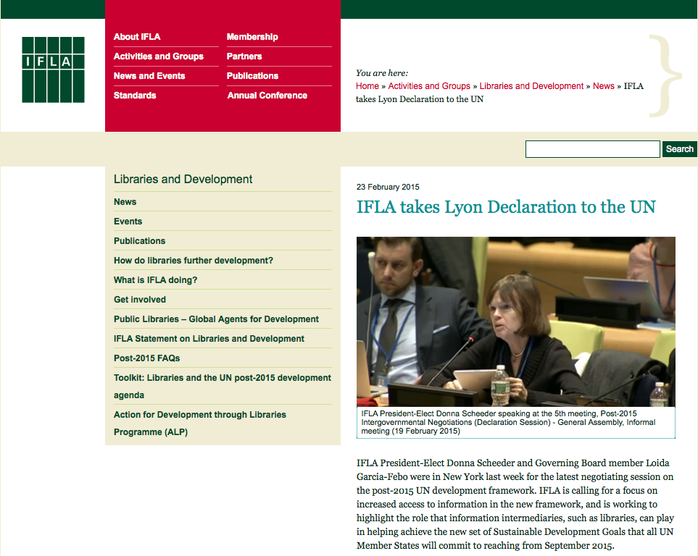
Sustainable Development

Slide 11
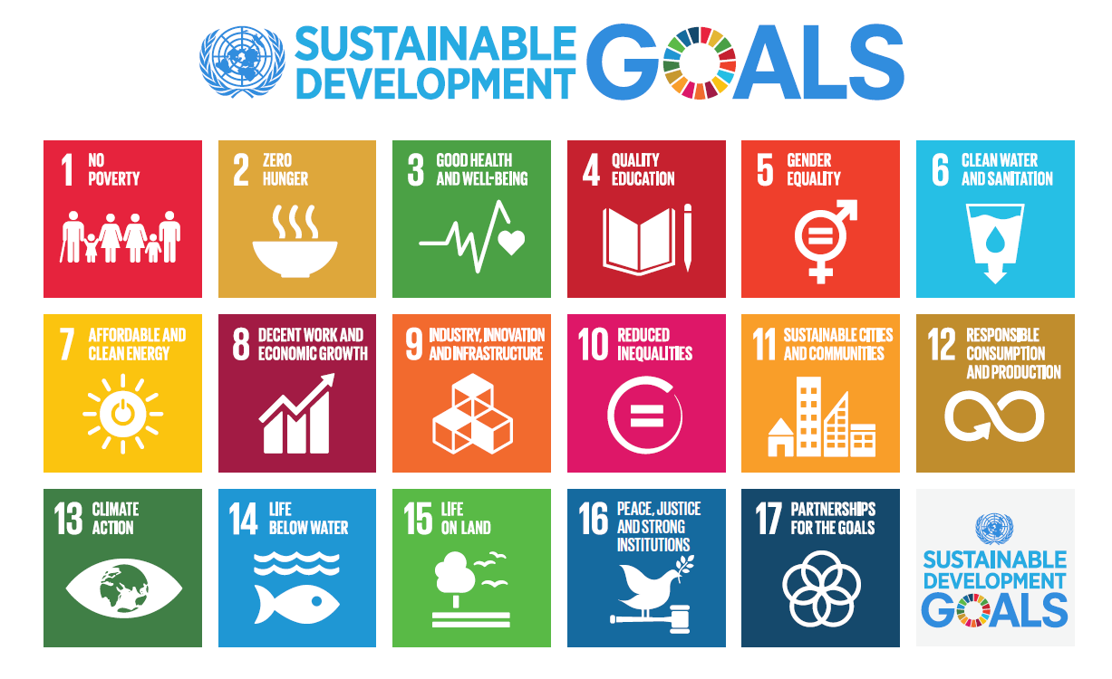

Slide 12
Examples of Goals and Targets
Goal 2: End hunger, achieve food security and improved nutrition, and promote sustainable agriculture
  Target 2.3 by 2030 double the agricultural productivity and the incomes of small-scale food producers, particularly women, indigenous peoples, family farmers, pastoralists and fishers, including through secure and equal access to land, other productive resources and inputs, knowledge, financial services, markets, and opportunities for value addition and non-farm employment
Goal 3: Ensure healthy lives and promote well-being for all at all ages.
  3.1 by 2030 reduce the global maternal mortality ratio to less than 70 per 100,000 live births
Goal 4: Ensure inclusive and equitable quality education and promote life-long learning opportunities for all.
  4.6 by 2030 ensure that all youth and at least x% of adults, both men and women, achieve literacy and numeracy
Goal 5: Achieve gender equality and empower all women and girls
  5b. enhance the use of enabling technologies, in particular ICT, to promote women’s empowerment
Goal 11: Make cities and human settlements inclusive, safe, resilient and sustainable
  11.4 strengthen efforts to protect and safeguard the world’s cultural and natural heritage
Sustainable Development

Slide 13
Goal 16: PROMOTE PEACEFUL AND INCLUSIVE SOCIETIES FOR SUSTAINABLE DEVELOPMENT, PROVIDE ACCESS TO JUSTICE FOR ALL AND BUILD EFFECTIVE, ACCOUNTABLE AND INCLUSIVE INSTITUTIONS AT ALL LEVELS
  Target 16.10:
  “Ensure public access to information and protect fundamental freedoms, in accordance with national legislation and international agreements”
Sustainable Development

Slide 14
UNESCO
  Goal 4: Quality Education;
  Ensure inclusive and equitable quality education and promote lifelong learning opportunities for all
  Target 4.1:
“By 2030, ensure that all girls and boys complete free, equitable and quality primary and secondary education leading to relevant and effective learning outcomes”.
Activities and programmes
Lifelong learning
Create a nation of readers
Sustainable Development

Slide 15
Access to information?
But what if you cannot read?
Illiteracy
Blind or bad vision
Information literacy
It starts with:
Learn to Read
Read to Learn
Sustainable Development

Slide 16




Policies:
IFLA/UNESCO Public Library Manifesto (1994)
IFLA/UNESCO School Library Manifesto (1998)
IFLA Position on Internet Governance (2013)
IFLA Statement on Libraries and Development (2013)
The Lyon Declaration on Access to Information and Development (2014)
IFLA Internet Manifesto (2014)
Joint Statement of Principles of Public Access in Libraries (2016)
IFLA Position on Internet Neutrality and Zero Rating (2016)
Public Interest: There must be favorable conditions to allow equal access to information and protect the public interest
Sample issues:
Development
Libraries
Public Access to ICTs
Net Neutrality
Zero Rating
Provenance
Media Plurality
Commodification of Information
Public Domain
Trade Negotiations
External Positions:
Manila Principles on Intermediary Liability (2015)
Brussels Declaration on Trade and the Internet (2016)
Cape Town Declaration (2015)
SDG Targets:
1.4, 4c, 8.5, 16.6, 16.10
Sustainable Development

Slide 17
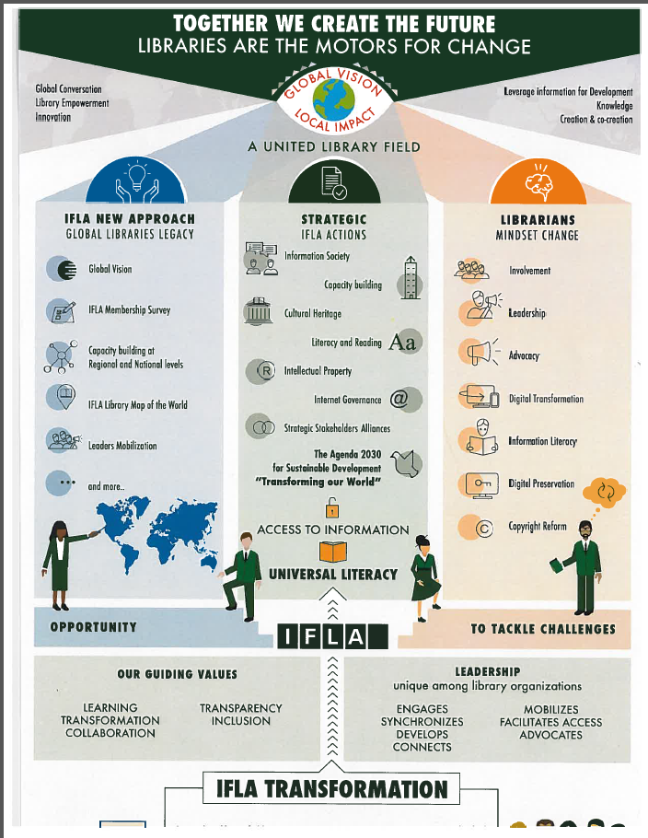
Sustainable Development

Slide 18
IFLA APPROACH
OUTPUTS
DIRECT OUTCOMES IFLA members
LONG-TERM IMPACT on community and users
Build a highly engaged network of library leaders
Ensure perception that libraries are critical community assets
Better employed
Ensure libraries have necessary virtual and physical assets
Better engaged through high quality information
Provide training and skill development for librarians to increase their user/community impact
More healthy
Ensure relevant services
Better connected
Enable field to advance agenda, including advocacy for sustainable funding
Better educated
Ensure librarians have best trained staff
Arm field with cutting edge, actionable research
More engaged in community
Knowledge sharing
Partnerships
Metrics: # users, quality of user experience
Libraries as engines of development/Key community assets
5

Slide 19
Timeline IAP
International Advocacy Plan (2016)
Regional workshops Singapore;
Pretoria, Montevideo, Den Haag (2016)
Call for IAP proposals January and August 2017
Train the Trainer workshop (2016)
Workshops Jamaica and Doha (2017)
Continues follow up by participants
115 And 75 proposals
Outcome:
Plan in action
Outcome:
13 Core Trainers
Outcome:
80 participants from 40 countries
Outcome: Call published IFLA webpages and social media
Outcome: 40 participants from 20 countries
Outcome:
Booklet published, social media, support from Advocacy Communications Officer and Manager Development Programmes
Outcome:
10 and 14 proposals accepted
Sustainable Development

Slide 20

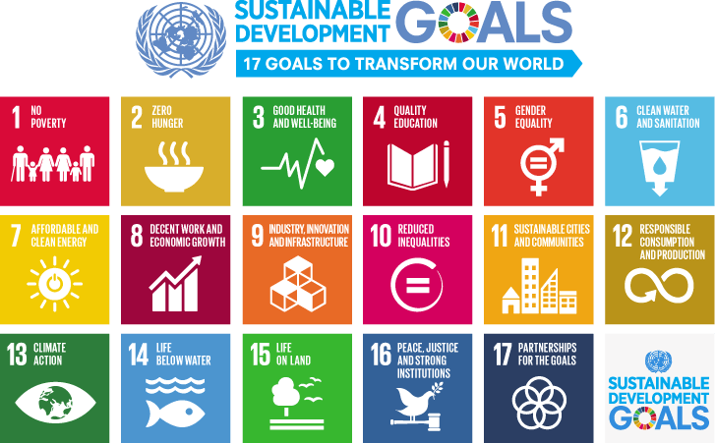

INTERNATIONAL ADVOCACY PROGRAMME
LIBRARIES, DEVELOPMENT,
AND THE UN 2030 AGENDA

Slide 21
… how to get onto the Agenda …
… how to get a seat at the table …
… how to be viewed with credibility and integrity…
… how to be part of the discourse…
… how to join the conversation that you need to be in …
Sustainable Development

Slide 22
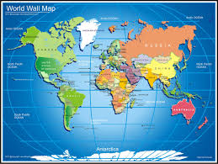
Six regions of the world
10 countries at each regional workshop
participants from 73 countries
  Representing library associations AND library community
120+ participants
Partnering with: BMGF, PL2020, EBLIDA, IFLA regional offices and translation centres
Sustainable Development

Slide 23
Golden opportunity to put libraries in 2030 National Plan
Information about Agenda 2030 and SDG’s
Awareness of activities libraries ARE already performing and how they are connected and support the SDG’s
Focus on public libraries
Develop an ADVOCACY plan based on the needs of ones specific country
What gift do you have as library field to your government?
What is the library field already doing to support the SDG’s?
Sustainable Development

Slide 24
Advocacy Cycle
Step 1
Identify and analyse the issue
Step 2
Set the goals and the objectives
Step 3
Identify the decision makers
Step 4
Define the message and the ‘ask’
Step 5
Set your timeline
Step 6
Assess resources, choose tactics & implement
Step 7
Monitor, evaluate, and share
What problem do you want to solve?
Adapted from Open Society Foundations
https://www.opensocietyfoundations.org
How will you measure success?
What do you want to achieve?
Whom do you need to influence?
How will you do it?
What needs to happen to address the problem?
When should you say it?
Sustainable Development

Slide 25
Lessons learned
Get the right message
Make it short and comprehensible
Network
Lack of DATA management
Need for National Reading Strategies and Media Information Literacy
Celebrate success
Stop modesty
Make libraries visible in society
Sustainable Development

Slide 26
Follow up workshops
Signed agreements:
awareness raising activities
Advocacy activities
Two Calls for IAP proposals
115 and 75 received
10 and 14 selected
Communications via: Slack, Flickr, IFLA Lib4Dev
Sustainable Development

Slide 27
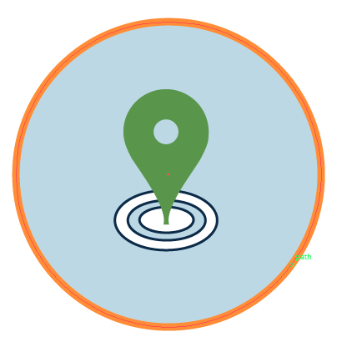
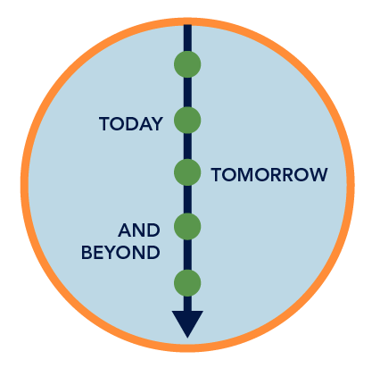


Partnering with libraries is good for development
Locally based
Publicly funded
and sustainable
Trusted by the communities they serve
Staffed by professionals
Sustainable Development
http://www.ifla.org/libraries-development

Slide 28
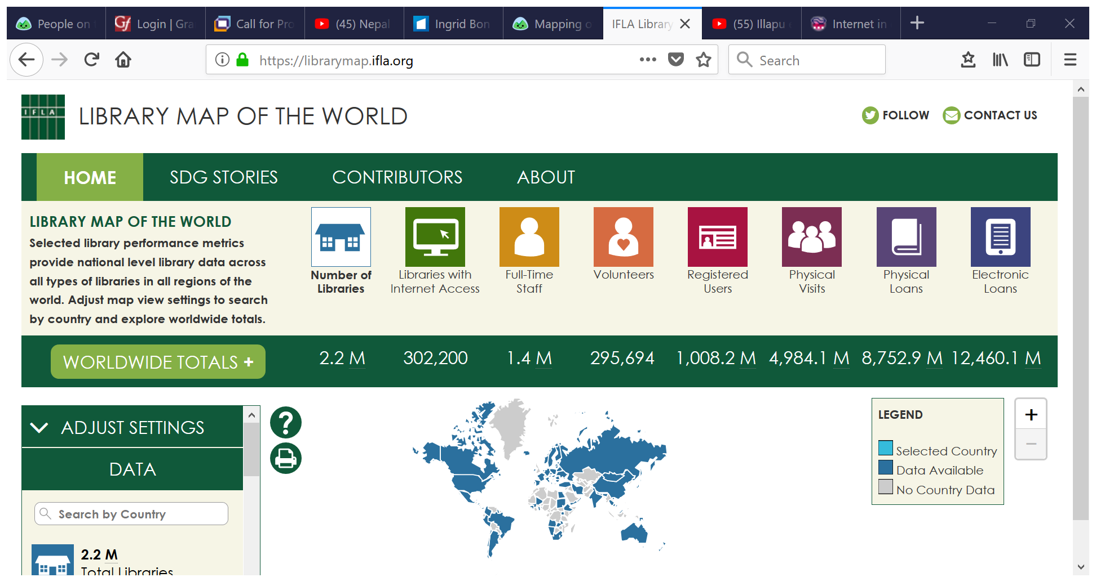

Slide 29
IFLA focus/ambition
International Advocacy Programme
DA2I (Development and Access to Information)
Media and Information Literacy
Fake News
Toolkit Literacy
Global Vision
Library Map of the World
Sustainable Development

Slide 30
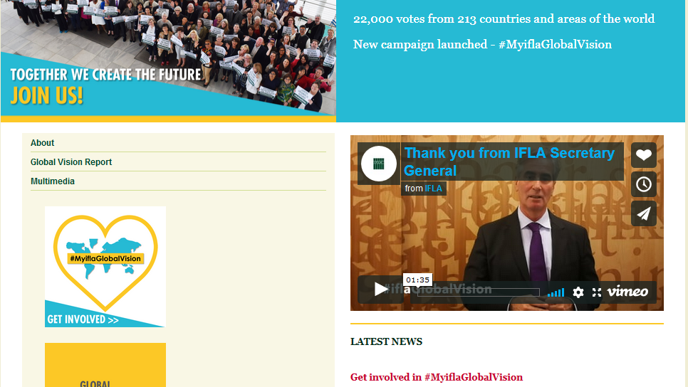

Slide 31
APRIL 2017
MAY-AUGUST 2017
AUGUST 2017
SEPTEMBER - OCTOBER 2017
OCTOBER 2017 -
MARCH 2018
CREATE A GLOBAL VISION
GLOBAL VISION ACTION PLANS DEVELOPMENT

Slide 32
What is your ambition?
IFLA
A United Library Field With Big Ambitions!
Do you want to be part of this?
Will you join us?
Become IFLA Member!
Sustainable Development

Slide 33
Thank you!
Spaziba! Kvala!
Dank u wel! Merci beaucoup!
Vielen Dank! Takk se mucke! Chokran!
Chamsahamnida!
Ingrid.bon@ifla.org
@Cholitarubia
Sustainable Development

