Slide 1
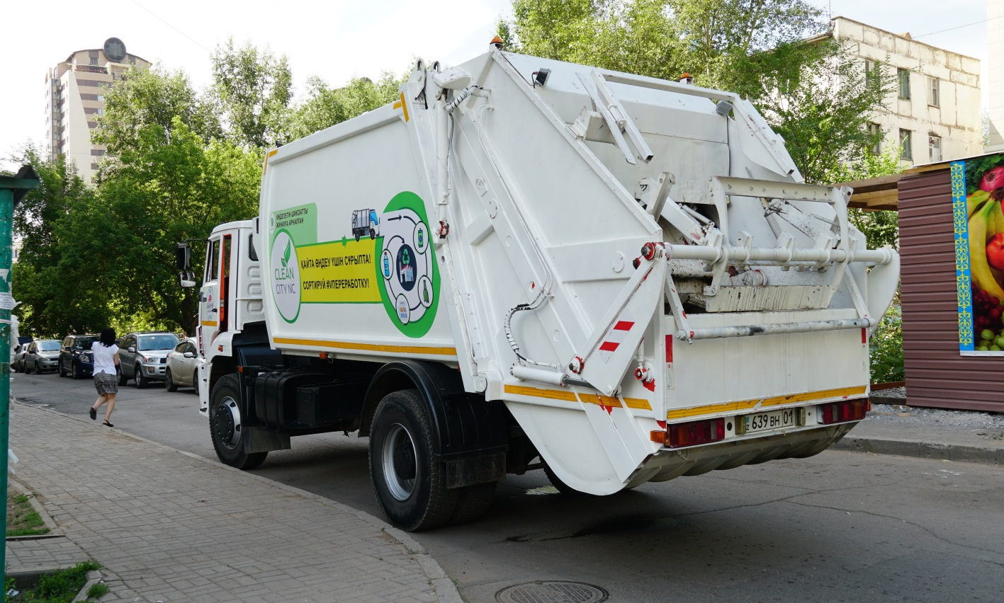
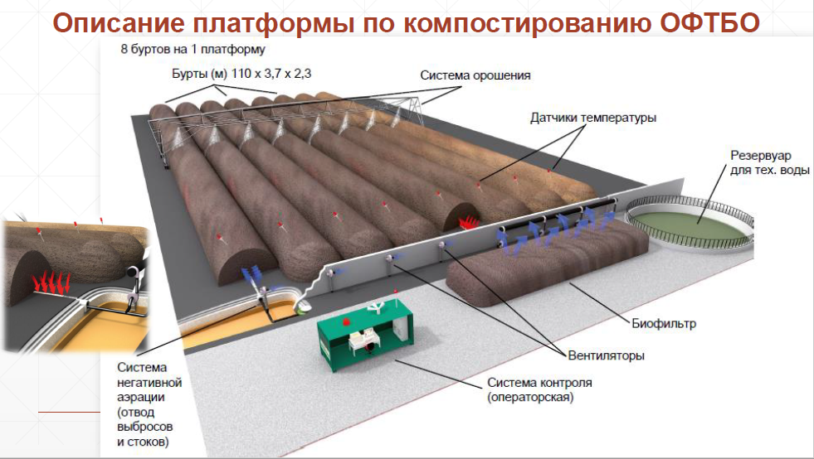
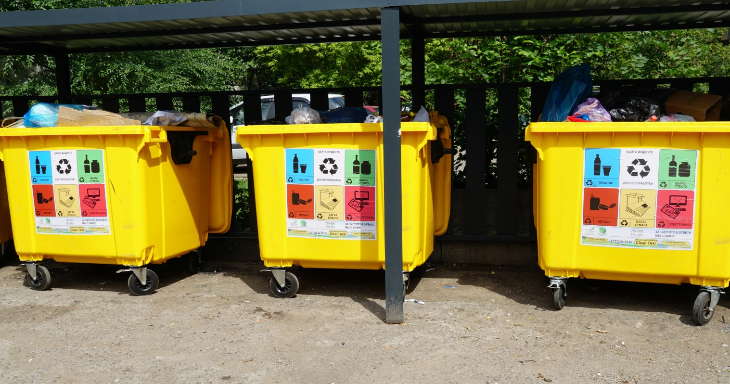
Municipal solid waste prospects in Astana Yurcha, Sergey

Slide 2
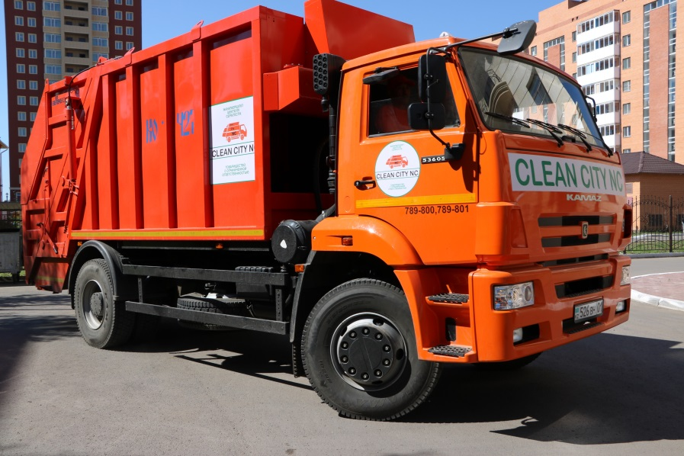
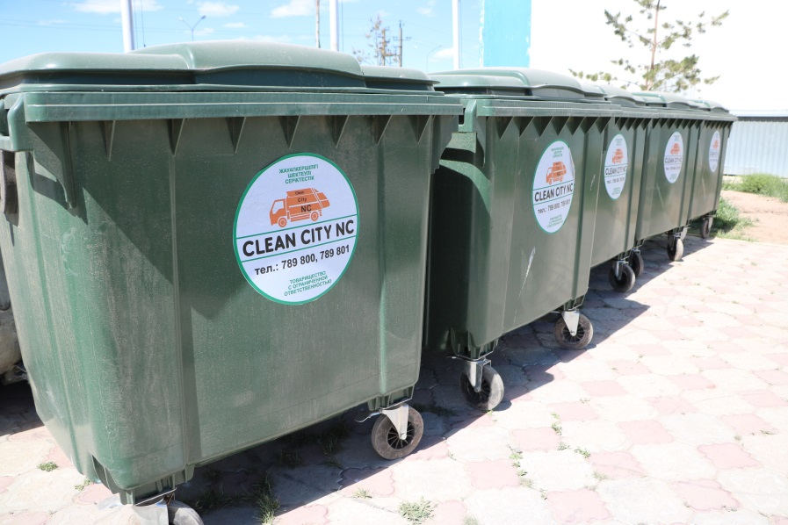
Information about MSW collection
Quantity of MSW collection area– 2565
Quantity of containers for mixed MSW - 9030
Quantity of removal trucks- 60
Amount of MSW collected from January till August 2018 is about 146 480 tons

Slide 3
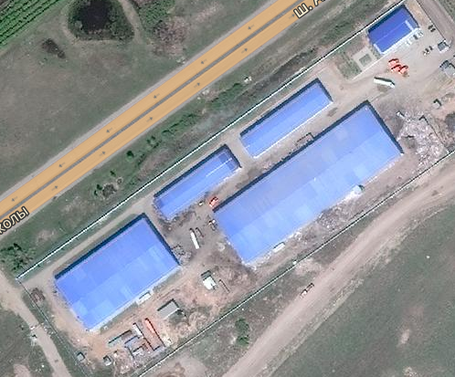
MSW treatment facility in Astana city
Sorting lines - 250 000 tons per year
Pyrolysis facility - 20 000 tons per year
PET recycling facility- 2500 tons per year
PE recycling facility - 1500 tons per year
WEEE treatment facility - 250 tons per year
5
1
2
3
4

Slide 4
Information of current situation on MSW treatment facility in Astana
1. | The volume of MSW accepted from January to August 2018 is 173 790 tons (21700 tons on an average per month) MSW incoming capacity increased from the begging of the year from 570 till 792 tons per day , and in August increased till 922 tons per day.
2. | Amount of collected recyclables increased up to 10 tons per day
4. | Since 2018 started the facility of WEEE recycling where people with disabilities are attracted
5. | The amounts of gross recycling: PET – 1 124 tons; PE – 1 043 tons; WEEE – 250 tons
6. | At the moment the % of collected recyclables from incoming MSW goes up to 13%

Slide 5
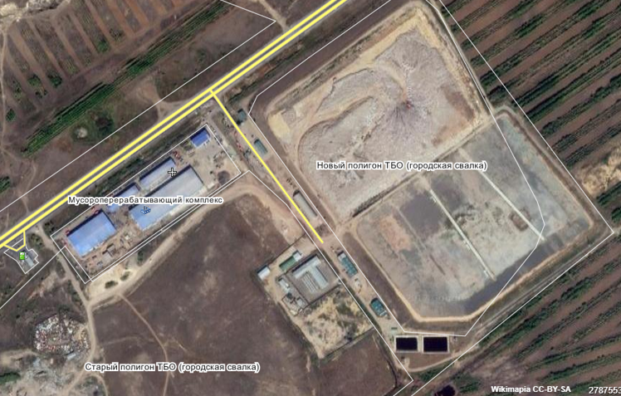
General characteristics of the landfill
The landfill has 3 sites:
1 site – 1 cell of the landfill. The project capacity was 2,8 million tons. At the moment places around 4 million tons of MSW. The area is 12 Ga. It was operated from August 2006
2 site – 2 cell of the site MSW. The project capacity is 2 million tons. The area is 12 Ga. It is operated from May 2018.
3 site – the site is for the reception and placement of industrial and construction waste. The area is 6,7 Ga.

Slide 6
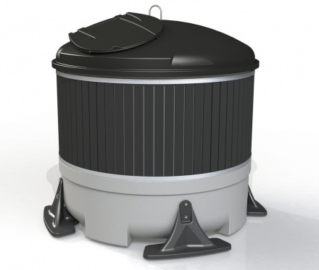
Implementation of underground Containers in Astana city
Currently collecting organization of Astana city (Clean City NC) Serviced Following Types of Containers:
12 units = 5 m³
100 units = 3 m³
Total 112 Containers, optimized for 408 м³ of Waste.

Slide 7
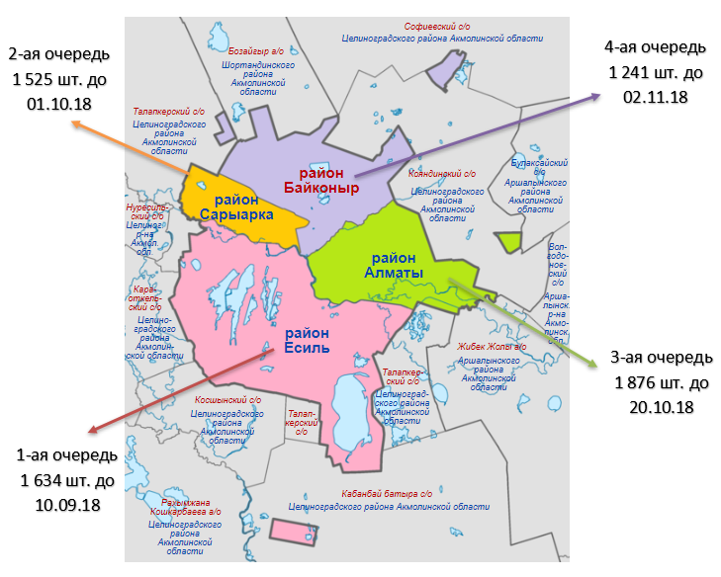
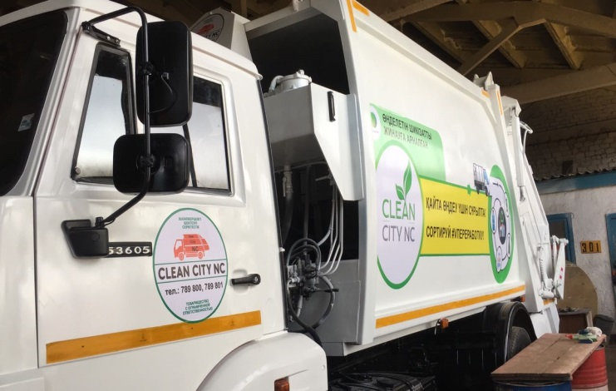
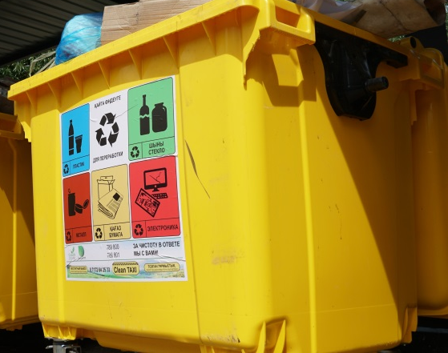
Implementation of separate collection of MSW in Astana
Saryarka area = 51 Address
Almaty area 204 containers = 41 Address
Esil and Baikonyr areas 203 Containers = 49 Addresses
Collected amount of waste:
In July 2018 from Almaty –Baikonyr areas = 265,38 tons
In August, 2018 from Almaty-Baikonyr areas = 89,02 tons
Saryarka area = 102,2 tons
delivery and arrangement of containers goes according to graphics

Slide 8
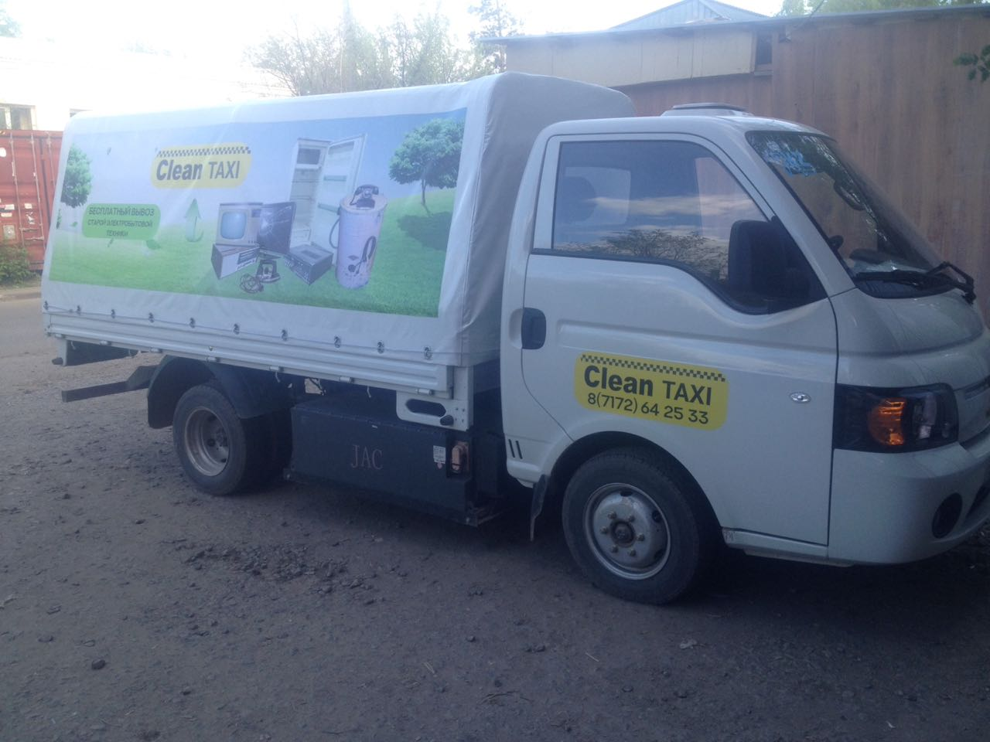
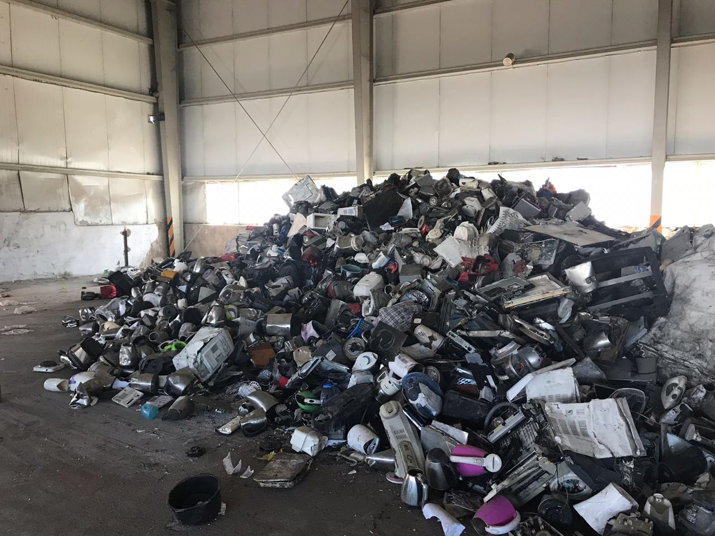
CLEAN TAXI
Clean Taxi – New ecological project which serfs as service for free WEEE collection in Astana city.
A special service is provided for Astana citizens to facilitate WEEE collection and disposal
Service is provided free of charge
Electric vehicles are used for WEEE collection
Anyone can get its WEEE removed just by leaving a message on website cleantaxi.kz or at call-center +7 (717)2 64 2533

Slide 9
Implementation of organic fraction of MSW treatment
Technology selection:
- By the recommendations of France agency Syctom has been selected the technology of the Compost Systems GmbH, which projects are implemented around the world
Organic Fraction of MSW will be treated be means of aerobic decomposition with the use of specialized equipment for aeration of waste;
Capacity of the object is 170 thousands tons per year (considering with the population growth and corresponding increases the volume of MSW generation);

Slide 10
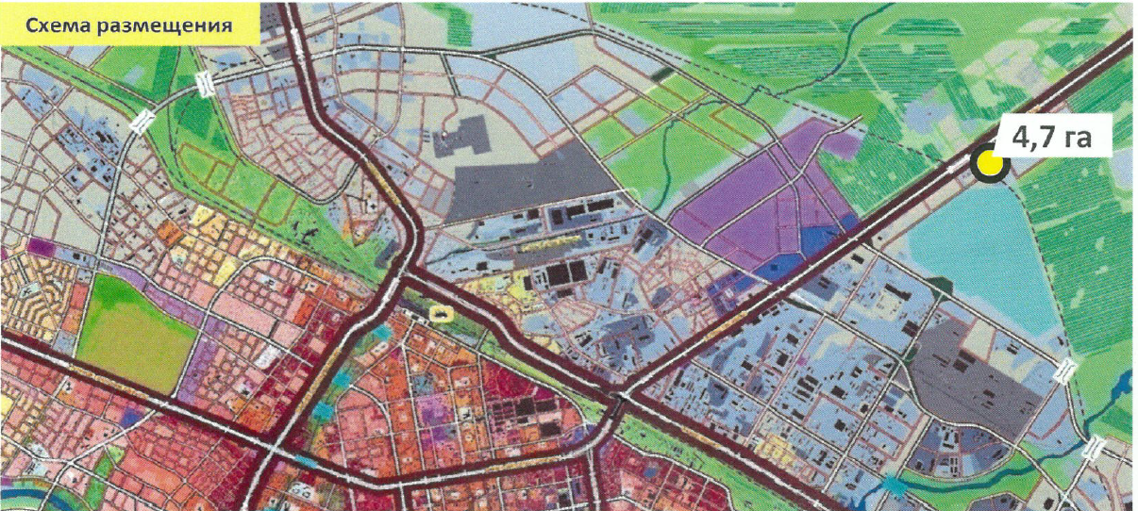
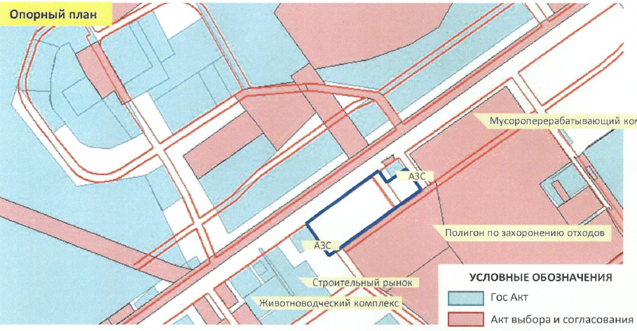
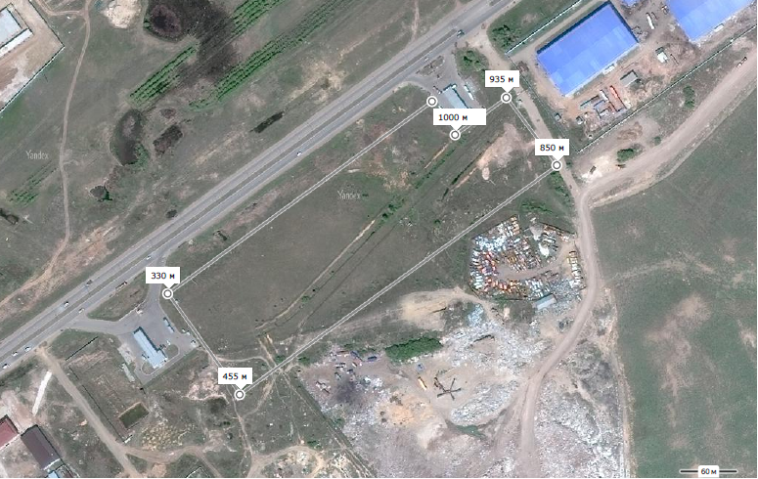
Object location

Slide 11
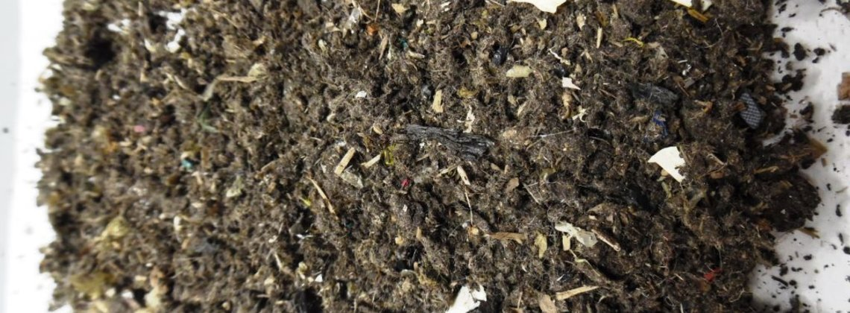
Technical specifications of Compost
Applications of technical compost:
Recultivation of landfills, quarries, disturbed landscapes;
component of the insulating layer for landfills;
as a part of fertilizers.
Metal | Permissible content, mg/kg of dry matter (СВ)
As | 18
Cd | 3
Cr | 120
Hg | 2
Ni | 60
Pb | 180
Se | 12
Cu | 300
Zn | 600
Inerts | Limit values in dry matter
Film and Styrofoam size, 5 mm | < 0,3 %
Other Plastics size 5 mm | < 0,8 %
Glass + Metals size, 2 mm | < 2,0 %
Indicators of pathogenic content
Viable worms eggs | Absence in 1,5 g
Salmonella | Absence in 1 g

Slide 12
Target indicators to be achieved in 2019-2023
№ | Target Indicator | Target Indicator
 |  | 2019 | 2020 | 2021 | 2022 | 2023
1. | Coverage of the city by separate collection of MSW | 100% | 100% | 100% | 100% | 100%
2. | Amount of collected MSW, tons | 362 083 | 367 695 | 373 395 | 379 182 | 385 060
3. | % of collected recyclables from incoming MSW at MSW treatment plant | 12% | 17% | 20% | 23% | 25%
4. | Amount of treated organic fraction of MSW, tons | 42 500 | 170 000 | 170 000 | 170 000 | 170 000

Slide 13
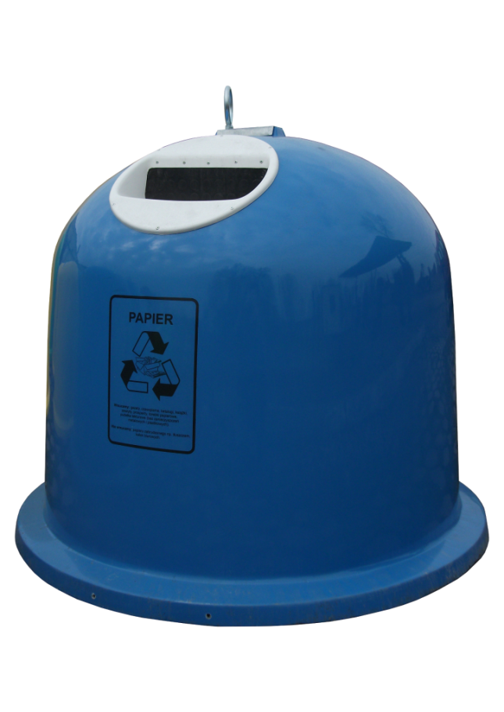
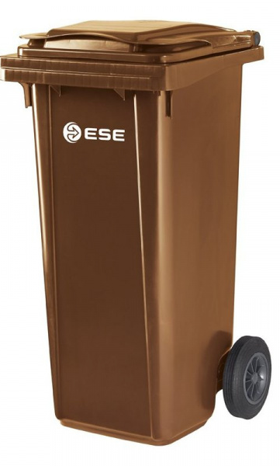
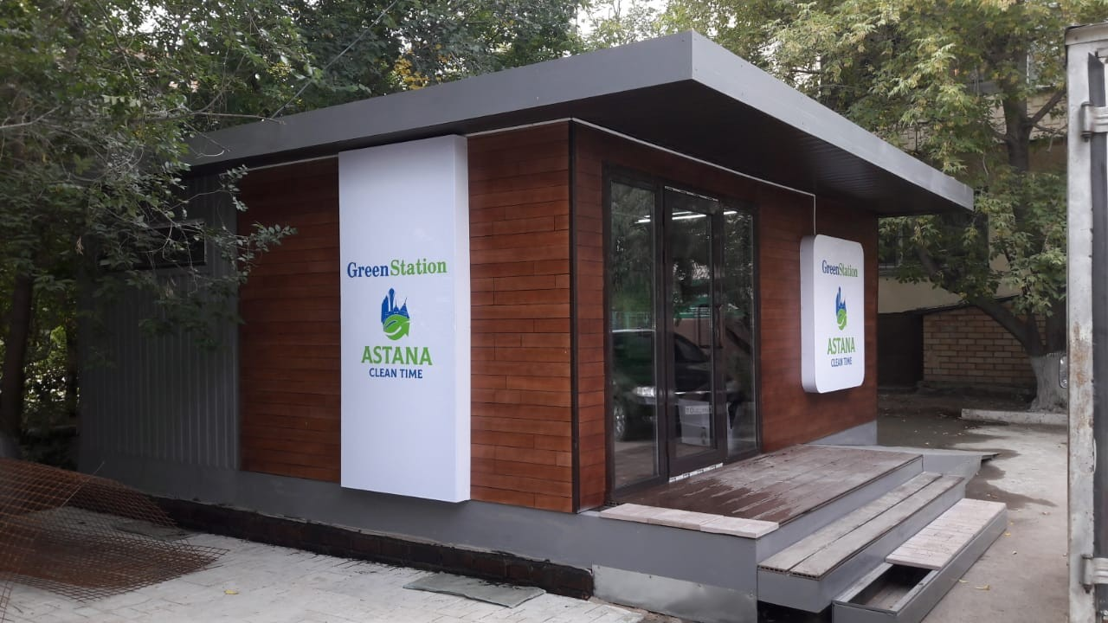


MSW collecting prospects
Bell shaped container for collecting glass packs
Separate Collection of Organic Waste in Private Sector and public catering enterprises
Implementation of municipal collection points (in 2018 will be placed 22 civic amenity sites)

Slide 14
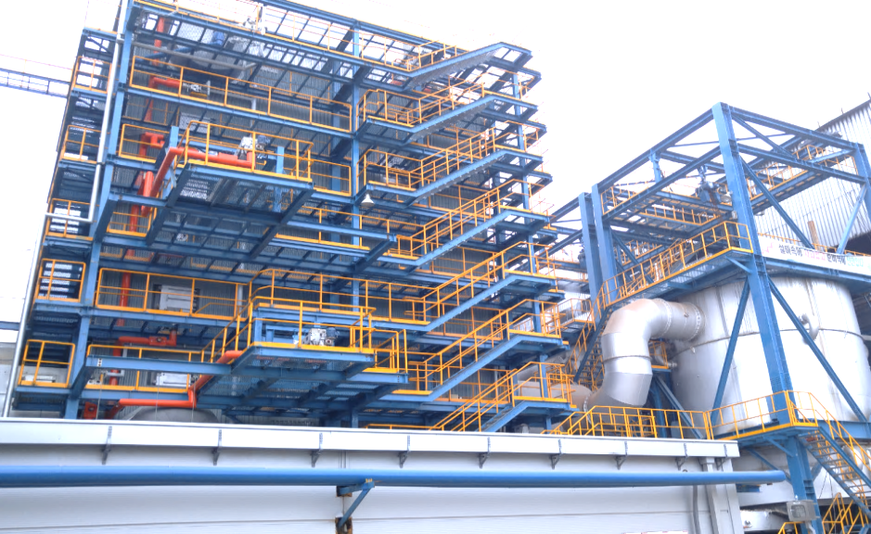
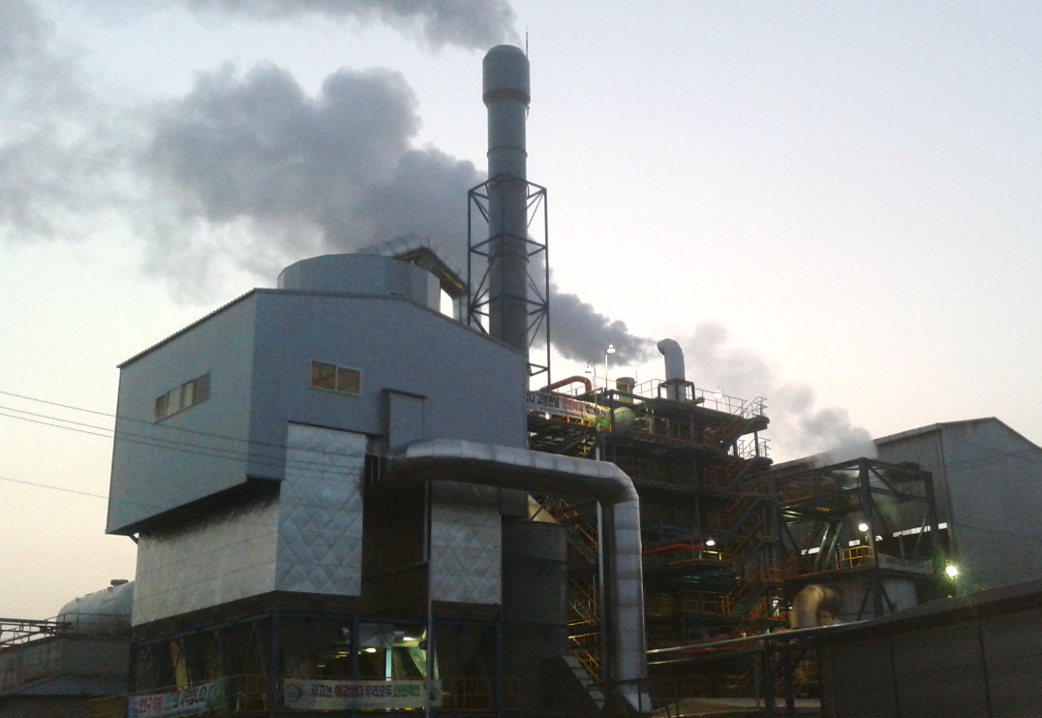
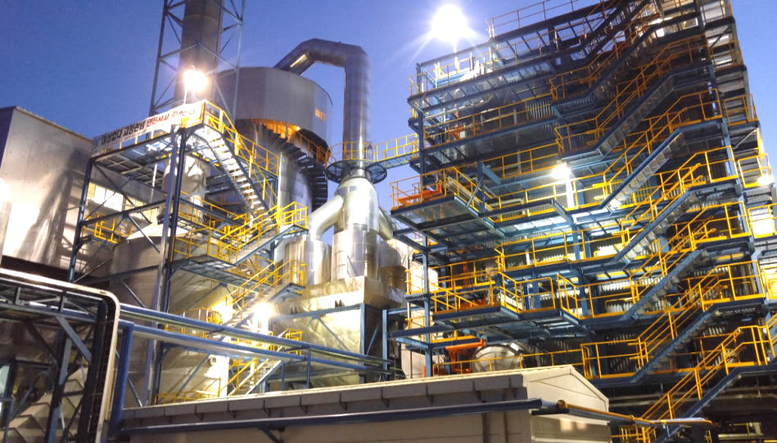
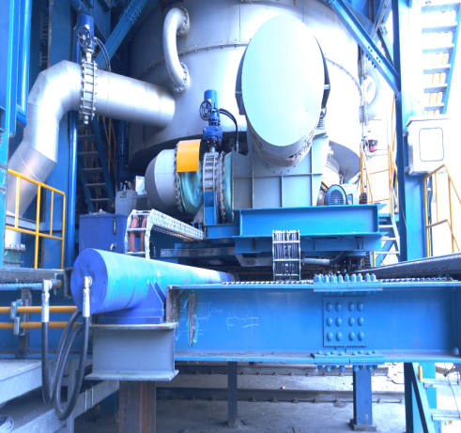
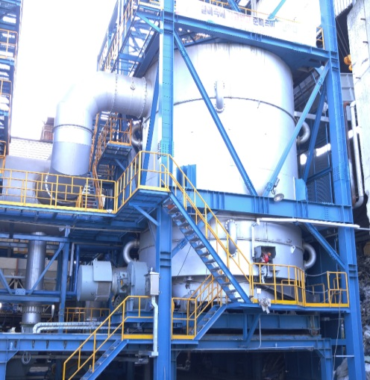
Prospect of MSW treatment
Implementation of MSW incineration facility with capacity of 100 thousands tons of MSW per year
Getting up to 3-4 MWt of energy per year
Астана

