Slide 1
IMPACT ASSESSMENT OF COMBINED HEAT AND POWER PLANTS (CHPs) IN ALMATY: PM2.5 SIMULATIONS OVER THE CITY USING WRF-AERMOD MODELLING AND IT’S VERIFICATION WITH GROUND LEVEL MEASUREMENTS
Presented by: Theophilus Bright Ogbuabia
Lead Supervisor: Prof. Ferhat Karaca
Co-Supervisors: Prof. Mert Guney, Prof. Nassiba

Slide 2
Table of Content
Introduction
Purpose of Research
Research Methodology
Results
Conclusion
1
2
3
4
6

Slide 3
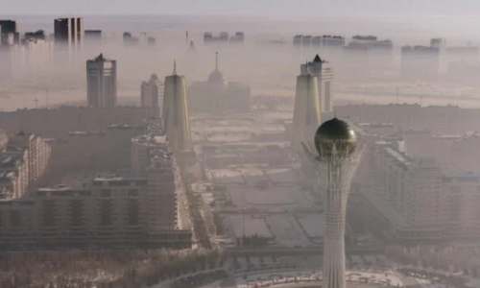
1
INTRODUCTION
Air Pollution in Kazakhstan
Sources of Air Pollution In Kazakhstan
Effects of Industrialization on Air Quality
Power Generation and Distribution in Kazakhstan
Combined Heat and Power Plants in Almaty
Figure 1 : Nur-Sultan’s City

Slide 4
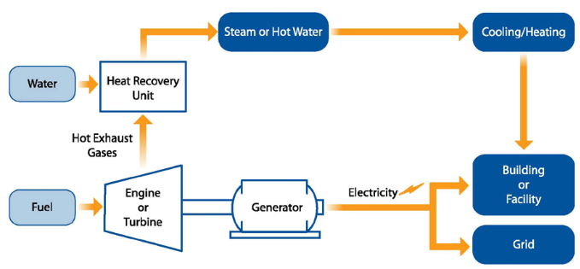
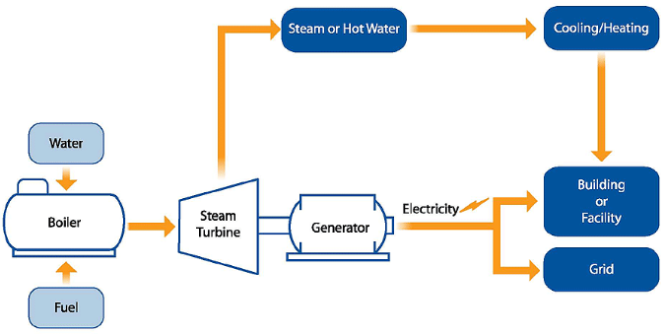
1
INTRODUCTION CTD.
Figure 2(A) : Combustion Turbine with Heat Recovery Unit
Figure 2(B) : Steam Boiler with Steam Turbine

Slide 5
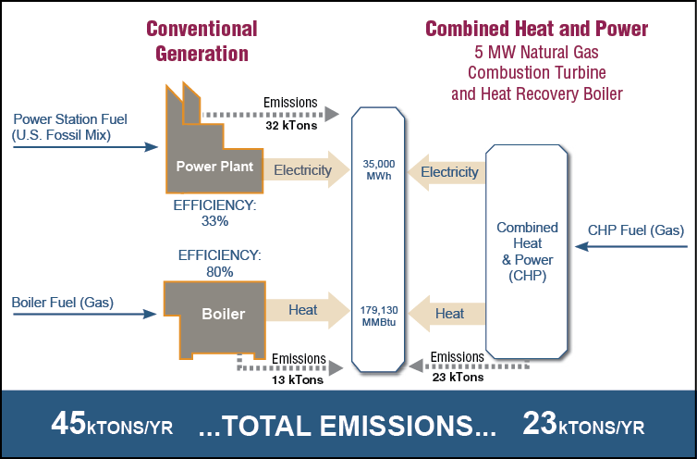
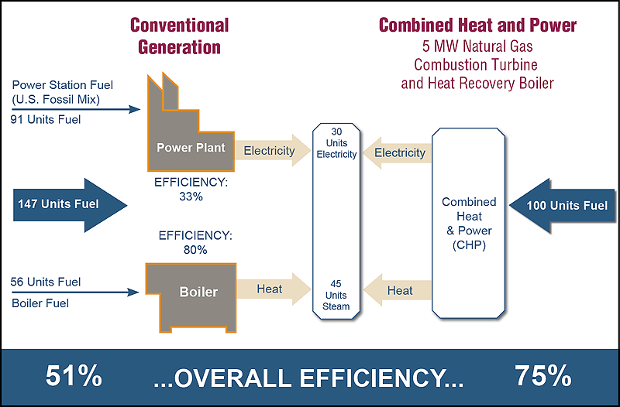
1
INTRODUCTION CTD.
Comparisons between Conventional Energy Generation and CHPs
Figure 3(A): comparison between the total emissions of conventional generation and CHPs
Figure 3(B): comparison between the total emissions of conventional generation and CHPs

Slide 6
Purpose of Research/Hypothesis
2
Combined Heat and Power Systems Emissions is a major contributor of Air Pollution in Almaty and in Kazakhstan at large:
Estimate the concentration of Particulate Matter (PM2.5) in the Emissions of CHPPs with the use of WRF-AERMOD.
Compare the emissions of CHPPs and the observed data to assess the contribution of CHPPs to the air quality in Almaty

Slide 7
Research Justification
WHO records
The results of this Project can be utilized by the relevant stakeholders to monitor the activities of Power Plants in the City.
This research can be employed for the whole of Kazakhstan.
The research methodology employed in this research can be used for other sources of PM2.5

Slide 8
3
Research Methodology
The Coupled Models: WRF-AERMOD
WRF – Weather Research and Forecasting Model
AERMOD – Air Dispersion Model

Slide 9
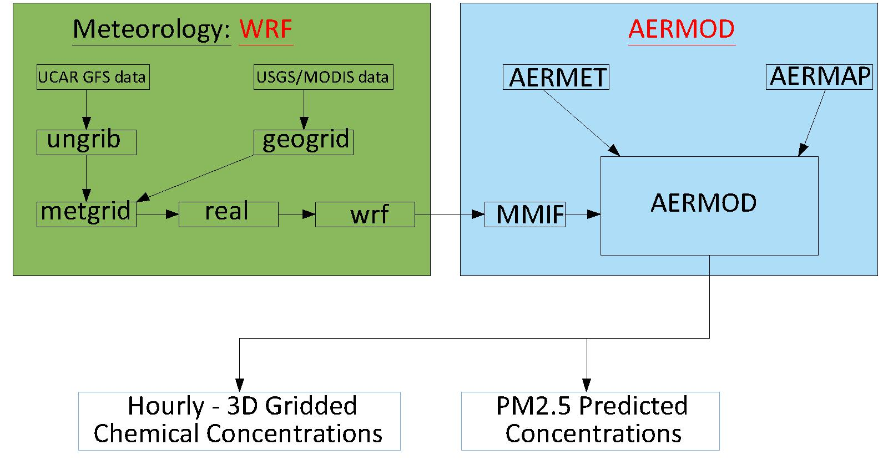
3
Research Methodology CTD.
Data Collection:
The Initial Meteorological Data
The Geographical Data and
The Emission Data
Figure 4: Flow of data from WRF and Emission Center to the CMAQ Model

Slide 10
Time Period For Simulation
Figure 5: Showing Cummulative Monthly Concentration of PM2.5 in Almaty, Source of Data: United States Embassy’s Website

Slide 11
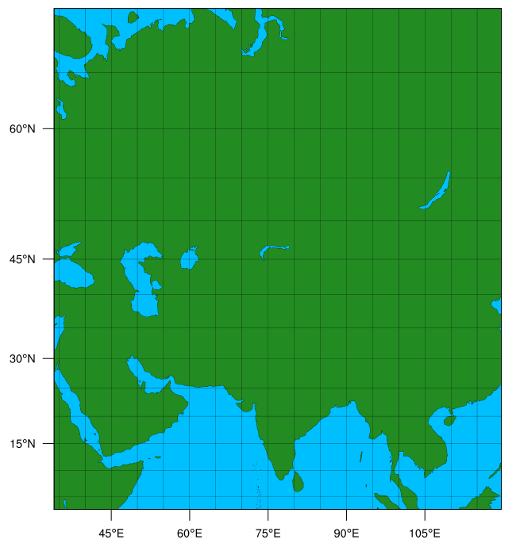
Location of CHPP-1, 2, 3
WPS Domain Configuration

Slide 12
Calculation for Estimating the Emission of Power Plants
General Equation for estimating the emission
E = A * Ef * (1 – ER/100) ----------- (1)
Where:
E = emissions
A = Activity rate
Ef = Emission Factor
ER = Overall emission reduction efficiency (%)
Where ER is not known, the emission is estimated as:
E = Ef * A ------------ (2)
The value of Ef can be obtained from Table 1.1-7 of AP-142

Slide 13
4
Results - Controlled Emission
Table 1: Showing daily maximum PM_{2.5} concentration from simulation using WRF-AERMOD and Observed data obtained from the US Embassy website for 1st to 14th of January 2021 (Controlled)
Day | % Contribution
1 | 0.07
2 | 0.17
3 | 0.01
4 | 0.18
5 | 0.12
6 | 0.53
7 | 1.03
8 | 0.49
9 | 0.07
10 | 1.33
11 | 86.23
12 | 0.09
13 | 0.02
14 | 1.51

Slide 14
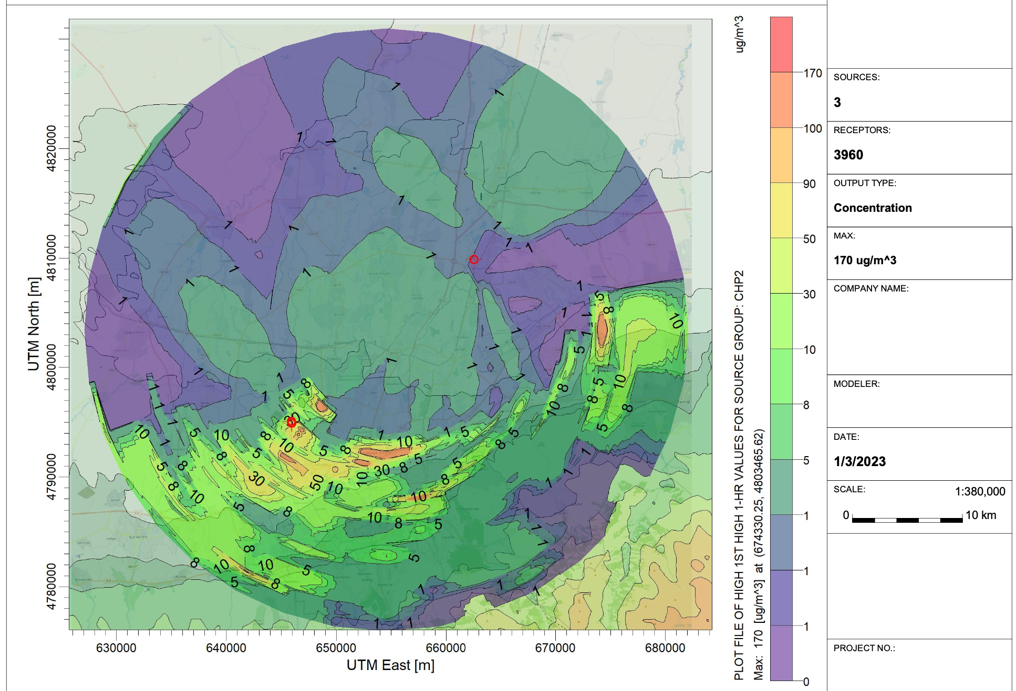
Figure 6: Showing dispersion results for CHPP-2 – controlled emission

Slide 15
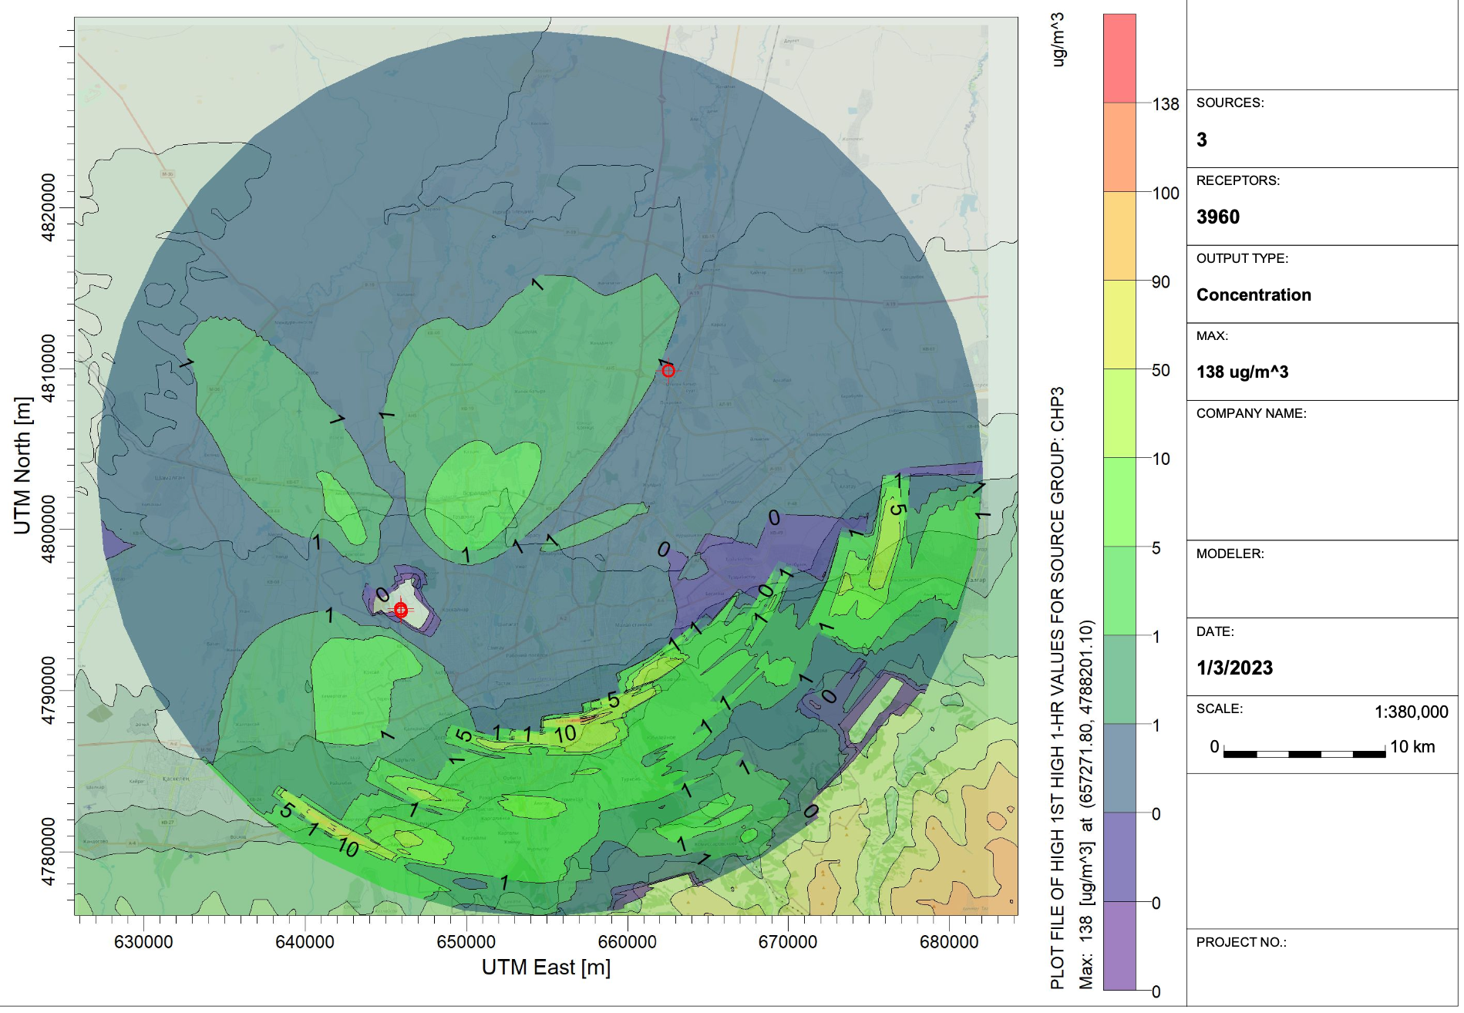
Figure 7: Showing dispersion results for CHPP-3 – controlled emission

Slide 16
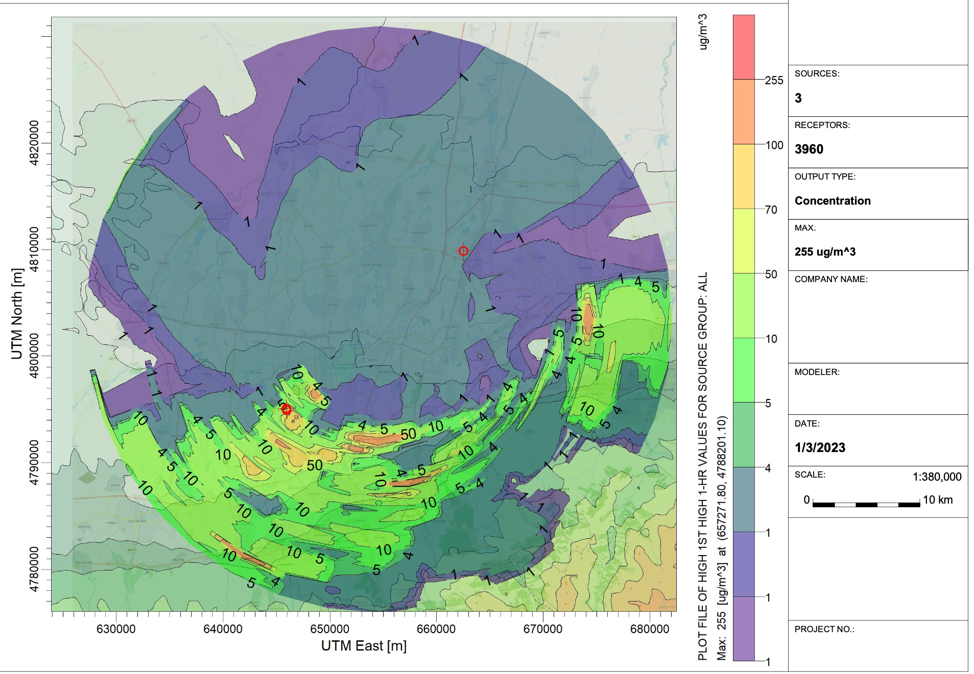
Figure 8: Showing dispersion results for CHPP-2 &CHPP-3 – controlled emission

Slide 17
Results - Uncontrolled Emission
Table 2: Showing daily maximum PM_{2.5} concentration from simulation using WRF-AERMOD and Observed data obtained from the US Embassy website for 1st to 14th of January 2021 (Controlled)
Day | % Contribution
1 | 5.27
2 | 12.32
3 | 0.46
4 | 12.58
5 | 8.23
6 | 37.98
7 | 73.50
8 | 35.27
9 | 5.03
10 | 94.78
12 | 6.32
13 | 1.34
14 | 107.37

Slide 18
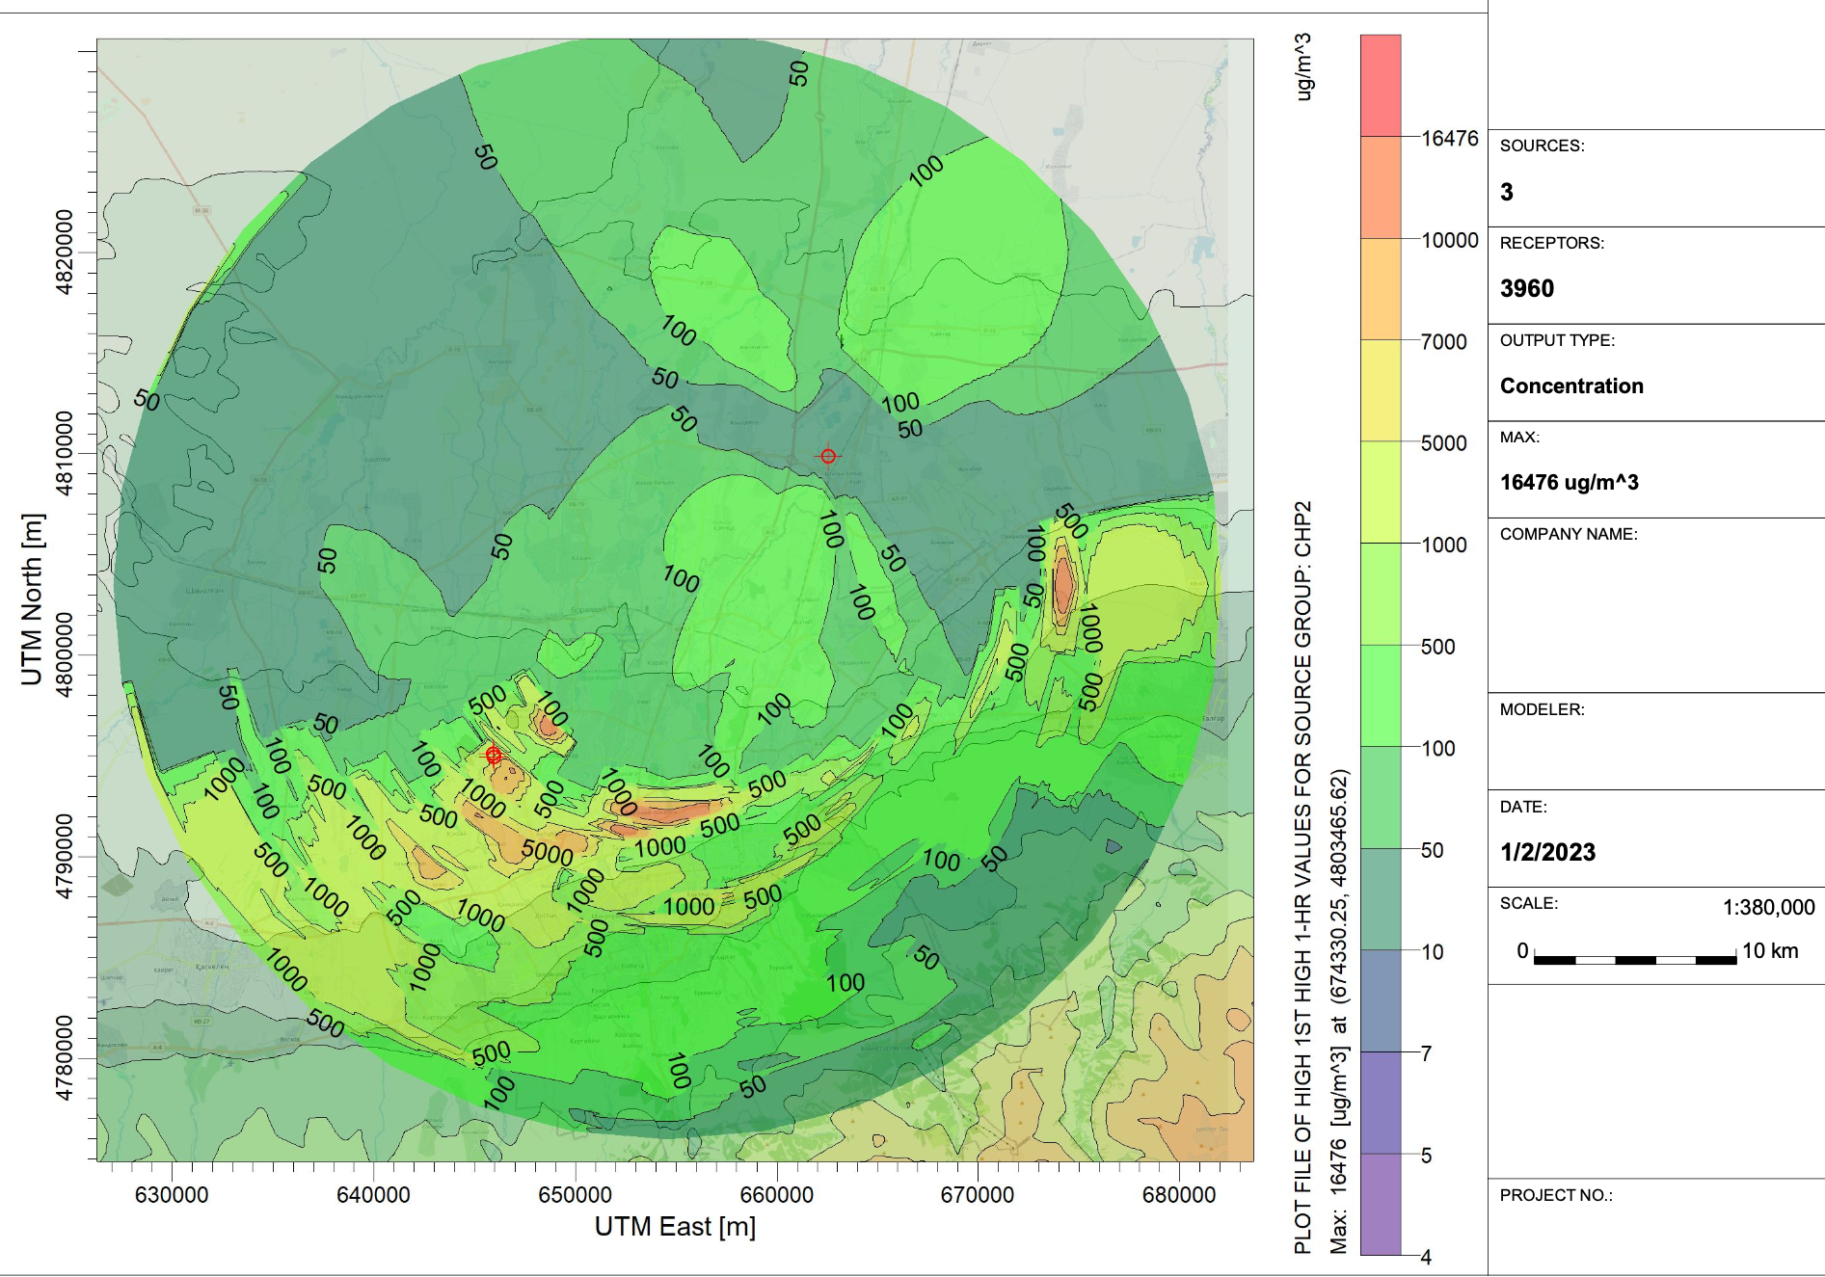
Results - Uncontrolled Emission
Figure 9: Showing dispersion results for CHPP-2 – Uncontrolled emission

Slide 19
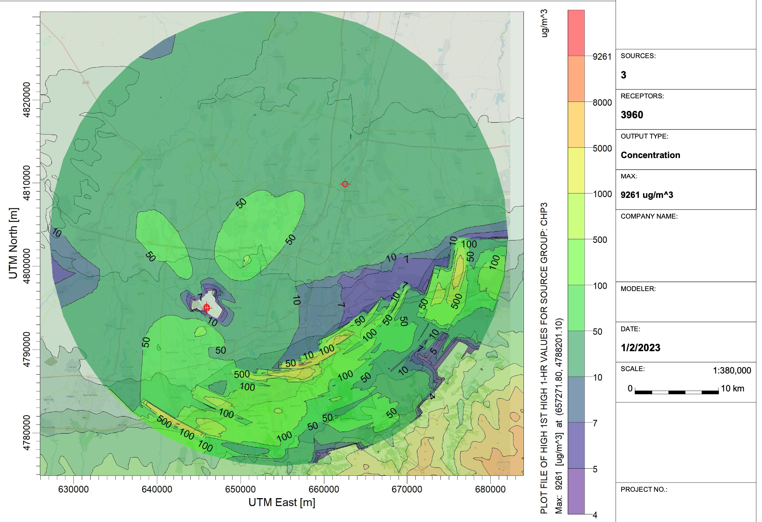
Results - Uncontrolled Emission
Figure 10: Showing dispersion results for CHPP-3 Uncontrolled emission

Slide 20
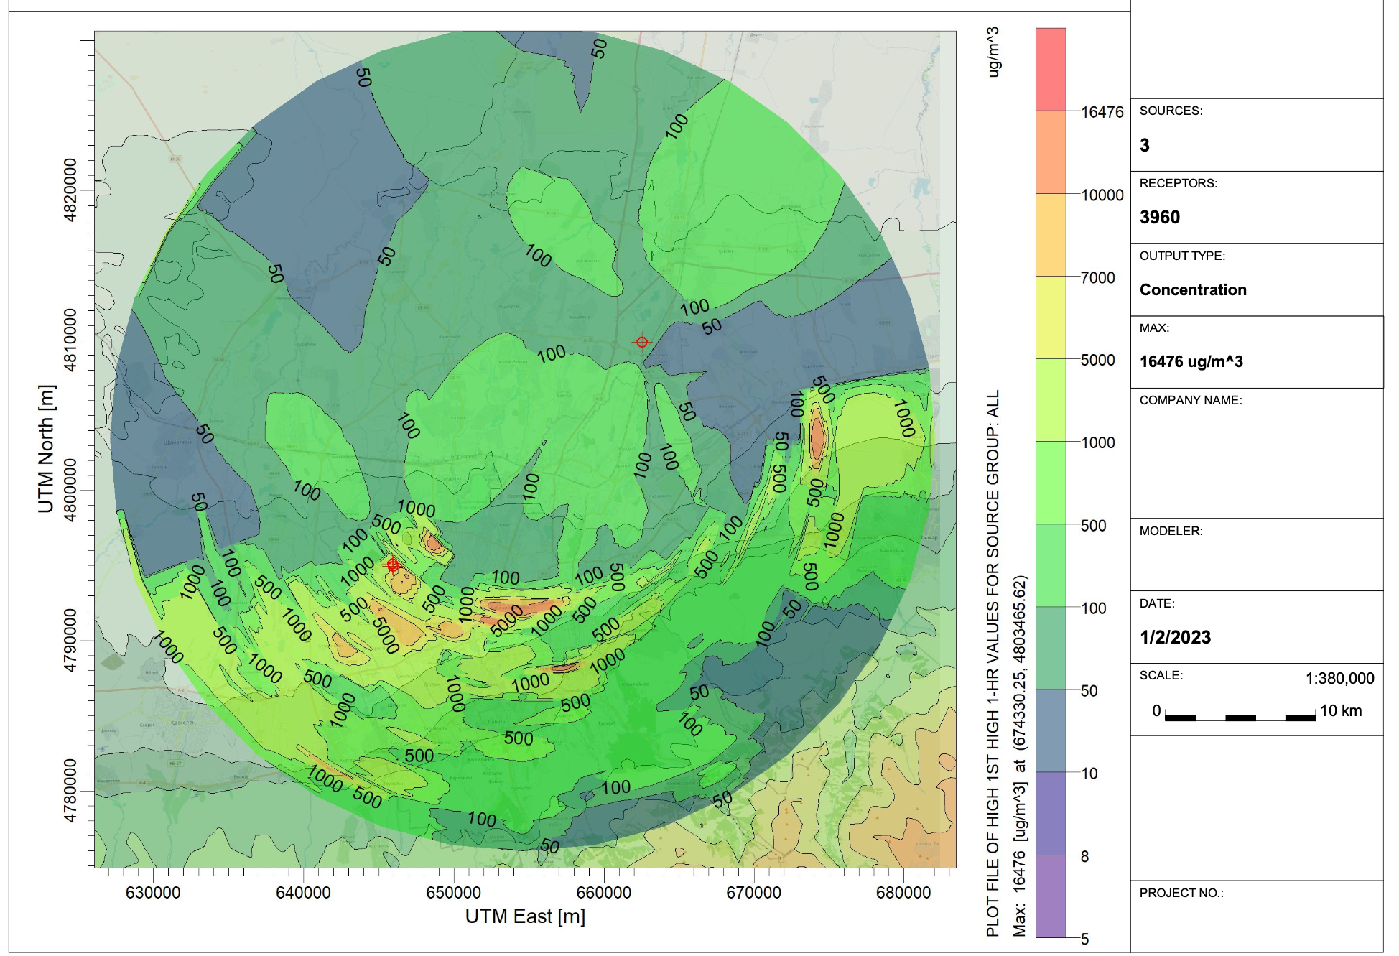
Results - Uncontrolled Emission
Figure 11: Showing dispersion results for CHPP-2 &CHPP-3 – Uncontrolled emission

Slide 21
6
Conclusion
An analysis of the emission from CHPs in Almaty was carried out in other to formulate a logical and scientific basis for emission control in Almaty.
A verification of the simulation results was done using ground level measurements of the US Embassy in Almaty to ascertain the correctness of the results
From the analysis of the results, the emission coming from CHPs must be controlled to reduce the effect on the quality of air in Almaty as the air quality index at the time of this report is way lower than the value set by WHO

Slide 22
Research Limitation
Data Availability
Power Plants
Ground Level Stations

Slide 23
5
References
Ahn, H., Rim, D. and Freihaut, J., 2018. Performance assessment of hybrid chiller systems for combined cooling, heating, and power production. Applied Energy, 225, pp.501-512.
Assembayeva, M., Egerer, J., Mendelevitch, R. and Zhakiyev, N., 2018. A spatial electricity market model for the power system: The Kazakhstan case study. Energy, 149, pp.762-778.
Benchrif, A., Wheida, A., Tahri, M., Shubbar, R. and Biswas, B., 2021. Air quality during three covid-19 lockdown phases: AQI, PM2.5 and NO2 assessment in cities with more than 1 million inhabitants. Sustainable Cities and Society, 74, p.103170.
Choi, Lee, Woo, Kim and Lee, 2019. Comparison of PM2.5 Chemical Components over East Asia Simulated by the WRF- Chem and WRF/CMAQ Models: On the Models’ Prediction Inconsistency. Atmosphere, 10(10), p.618.
Duan, W., Wang, X., Cheng, S., Wang, R. and Zhu, J., 2021. Influencing factors of PM2.5 and O3 from 2016 to 2020 based on DLNM and WRF-CMAQ. Environmental Pollution, 285, p.117512

Slide 24

Thank You for Your Attention

