Slide 1
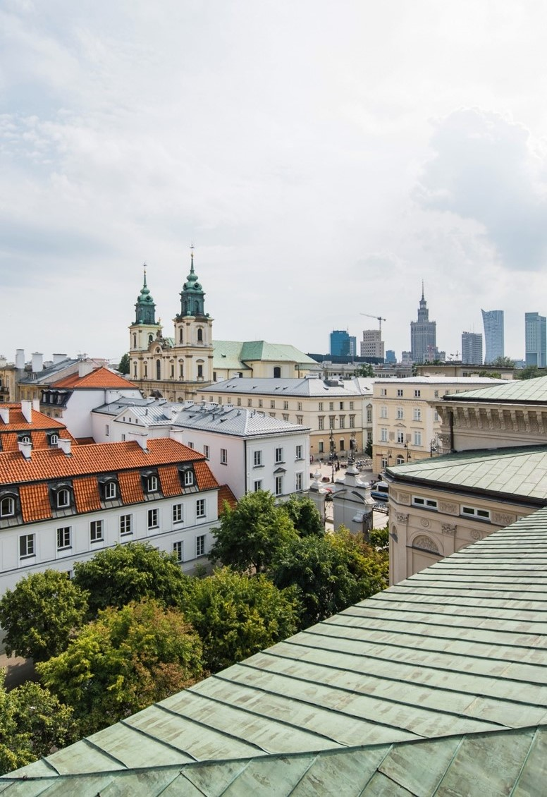

Transition from
autoritarian regime
to democracy:
role of local self-government.
The case of Poland.

Slide 2
Structure
Concept of decentralization
Local government restoration and reform in Poland, the degree of local autonomy for the territorial units
Practical aspects of local government’s functioning -tensions between recentralization and local autonomy
The main argument of the paper: by restoration of local self-government in Poland it was possible to build and strengthen democratic regime on all – local, regional and national – levels.

Slide 3
Decentralization
Understanding as the right (and ability) of local communities to govern themselves (bottom-up approach)
Local government is an emanation of the interests of these citizens - a public law corporation, that is, a public administration entity equipped with administrative authority
Obligation to perform the delegated functions and the exclusive fulfilment of this obligation
Additional guarantees by legal provisions that, apart from the designated scope of supervision, the state can not interfere with its activities

Slide 4
Restoration and reform of Polish local government
The restoration of Polish local self-government in 1990 (and the deepening of decentralization in 1998) after 40 years of non-existence
Move from centralization of socialist regime to decentralization and distribution of powers in democracy
Restitution of self-governing local government was one of the necessary conditions for restoring the democratic system in Poland and building a civil society
Poland as a „champion of decentralization” in CEE – other countries rather superficial changes (Nordic countries as role models)

Slide 5
Local government units
Structure of local government:
  communes (gmina) – 2478
  counties (powiat) – 380
  voivodships/regions (województwo) – 16
  Note: Poland is approximately 312,685 sq km, while Kazakhstan is approximately 2,724,900 sq km
  (1/9 the size of Kazakhstan)

Slide 6
Poland – administrative division

Slide 7
Constitutional framework of Polish local government
Constitution of April 2, 1997 devotes to the local government the whole Chapter VII (Articles 163-172)
Fundamental articles 15 and 16,
  principle of decentralization of public authority, taking into account social, economic or cultural ties in territorial division,
  creating ex lege of the local government community by the population of the territorial units.
  Local government participates in the exercise of public authority, and performs public tasks on its own behalf and on its own responsibility (financial, legal and decision-making autonomy)

Slide 8
Features of Polish local government
Part of a broader state-building strategy, with purposeful division of powers between central and local government
Democratic mandate from popular vote
Legal identity and autonomy protected by the Constitution
Independent budget and own sources of income (local taxes and share in income taxes)
Property rights (communal property)
Control over personnel (local government officials)
Substantive competences in the field of public services
Strong one-man leadership of commune heads/mayors/city presidents

Slide 9
The practice of Polish local government functioning
The functioning of local government can be considered one of the greatest successes of the Polish transformation
Local government as the heart of functioning democracy – issues of trust, shared responsibilities, civic participation
Majority of public services and public affairs are local government’s responsibility
Accountability to local citizens (elections, referenda)
Narrow government’s supervision (only legal)

Slide 10
Problems of Polish local government
The practice of government administration indicates an instrumental approach to local governments - decentralization often means transferring tasks and problems without accompanying financial resources
Central administration has lost a large part of its competences and impact on current public affairs - tensions between the national and local government
Problems of local government’s competences and actions in imperious and non-imperious sphere (legal basis of LG’s actions)
Recentralization tendencies, growing after 2015

Slide 11
Conclusions
Polish local government is the main functional component of a broad system of public administration, responsible for the vast majority of day-to-day public services
Decentralization served both as a tool for dismantling the communist state and as the foundation of broader state-building strategy
Local government proved to be one of the main factors in establishing a functioning democracy and radically changed the system of the state
LG remains a strong democratizing factor, despite growing recentralization tendencies
New challenges: leadership vs. communityship, stronger empowerment of local communities (evaluating the actions of LG), functional subregional level, fostering vertical and horizontal coperation

Slide 12

UNIWERSYTET WARSZAWSKI
Krakowskie Przedmieście 26/28
Warszawa 00-927
www.uw.edu.pl

