Slide 1
MSc Thesis Title:
SMART HEATING OF RESIDENTIAL SECTOR USING HEATING PANELS
Zhanar Rakhimbayeva
2nd year MSc student
zhanar.rakhimbayeva@nu.edu.kz

Slide 2

Contents
Introduction
Background
Research Objectives
Literature Review
Space heating systems
Numerical Study
Overview
Model Configuration
Results and Discussion
Conclusions
Mesh Verification
Temperature and Velocity distribution
Experimental Study
Methodology
Computational Thermal Manikin (CTM)
Model Validation
Numerical Study
Geometry of the CFD domain
Boundary Settings
Case study & Boundary Conditions
Energy consumption
Thermal comfort: PMV & PPD

Slide 3
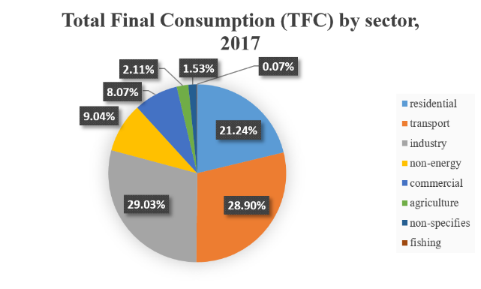
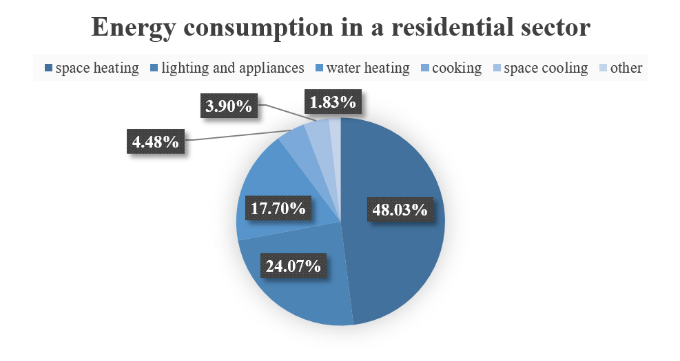
Introduction
Background
Total Final Consumption (TFC) by sector, 2017
Energy consumption in a residential sector
Energy Consumption
Fossil Fuels
Global Warming
Figure 1: The breakdown of energy consumption: a) general sector; b) residential sector [1]

Slide 4
Introduction
Research Aims & Objectives
PROBLEM STATEMENT
Is it possible to reduce the heat output of space heating in residential sector so that less energy is consumed while maintaining an acceptable level of comfort? What are the different space heating strategies?

Slide 5
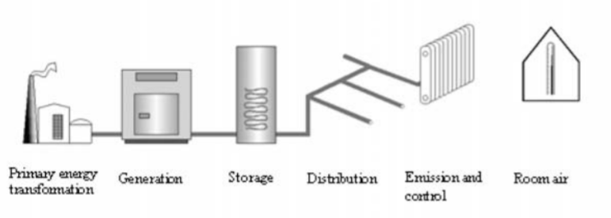
Literature Review
Space Heating Systems
RHC systems
Embedded
tubing in ↓
Electrically heated radiant systems ↓
Ceilings
Walls
Floors
Electric ceiling panels
Electric wall
heating
Electric floor heating
Hydronic ceiling panels
The most optimal Heating, ventilation and air conditioning (HVAC) system
District heating and cooling (DHC)
Figure 1: Schematic diagram of district heating system [2]
Radiant heating and cooling (RHC) – more than 50% radiant heat transfer [3]
      Preferable thermal comfort due to lower difference of air temperature
Figure 2: The most common used RHC systems [3]

Slide 6
Literature Review
Experimental Study
First experimental study was conducted by Olsen [4], referred as a benchmark case
It includes nine different heating systems with double-glazed window and wall insulation
It is recommended to place heating radiator panel on the exposed wall to the outdoor environment
Numerical Study
Development and advancement in computer technology
Accessibility of commercial software
Computational Fluid Dynamics (CFD), experimentally studied by [5]
HVAC simulations
Less time consuming
Cost effective
Research works by Raczkowski et al. [6], Risberg et al. [7] and Teodosiu [8] proved the capability of using CFD method for evaluating HVAC systems in buildings

Slide 7
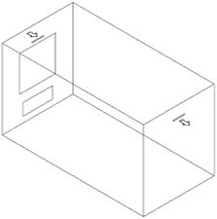
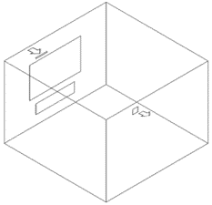
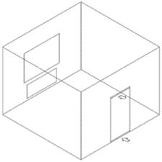
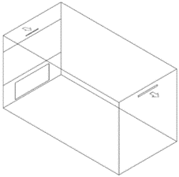
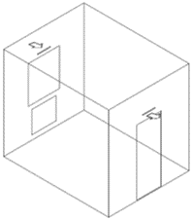
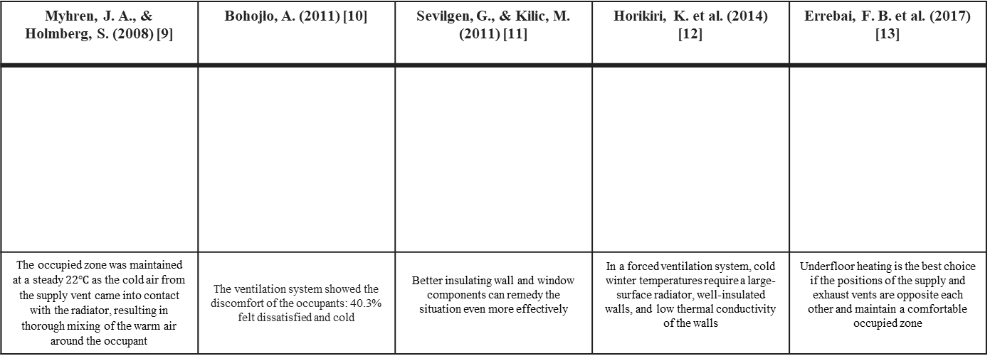
Literature Review
Numerical Study
Table 1: Major findings on space heating in research studies [9-18]
Myhren, J. A., & Holmberg, S. (2008) [9] | Bohojło, A. (2011) [10] | Sevilgen, G., & Kilic, M. (2011) [11] | Horikiri, K. et al. (2014) [12] | Errebai, F. B. et al. (2017) [13]
The occupied zone was maintained at a steady $22℃$ as the cold air from the supply vent came into contact with the radiator, resulting in thorough mixing of the warm air around the occupant | The ventilation system showed the discomfort of the occupants: 40.3% felt dissatisfied and cold | Better insulating wall and window components can remedy the situation even more effectively | In a forced ventilation system, cold winter temperatures require a large-surface radiator, well-insulated walls, and low thermal conductivity of the walls | Underfloor heating is the best choice if the positions of the supply and exhaust vents are opposite each other and maintain a comfortable occupied zone

Slide 8
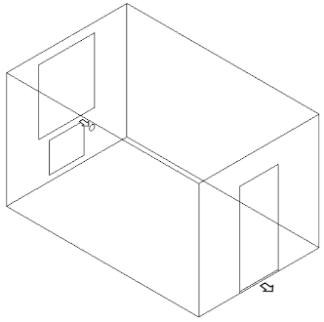
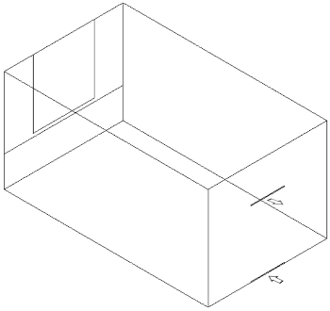
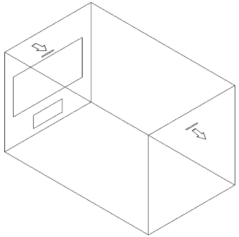
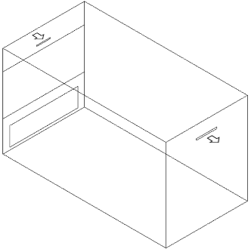
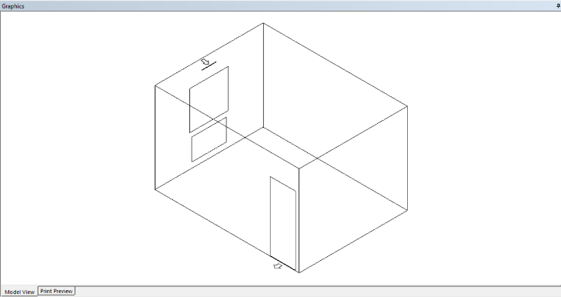
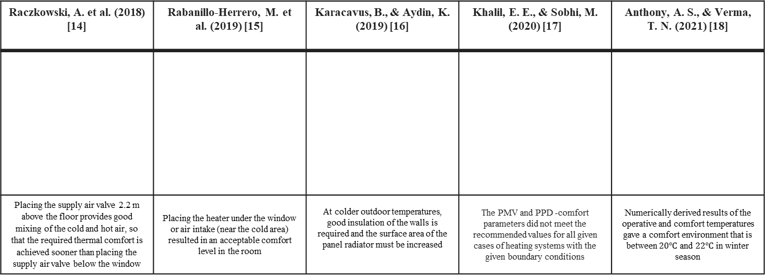
Literature Review
Numerical Study
Table 1: Major findings on space heating in research studies [9-18]
Raczkowski, A. et al. (2018) [14] | Rabanillo-Herrero, M. et al. (2019) [15] | Karacavus, B., & Aydin, K. (2019) [16] | Khalil, E. E., & Sobhi, M. (2020) [17] | Anthony, A. S., & Verma, T. N. (2021) [18]
Placing the supply air valve 2.2 m above the floor provides good mixing of the cold and hot air, so that the required thermal comfort is achieved sooner than placing the supply air valve below the window | Placing the heater under the window or air intake (near the cold area) resulted in an acceptable comfort level in the room | At colder outdoor temperatures, good insulation of the walls is required and the surface area of the panel radiator must be increased | The PMV and PPD -comfort parameters did not meet the recommended values for all given cases of heating systems with the given boundary conditions | Numerically derived results of the operative and comfort temperatures gave a comfort environment that is between $20℃$ and $22℃$ in winter season

Slide 9
Introduction
HYPOTHESIS
Focused heating (heating directly an occupant) may be a more economical strategy to provide comfortable heating to occupants under the same conditions as conventional heating
Research Aims & Objectives

Slide 10
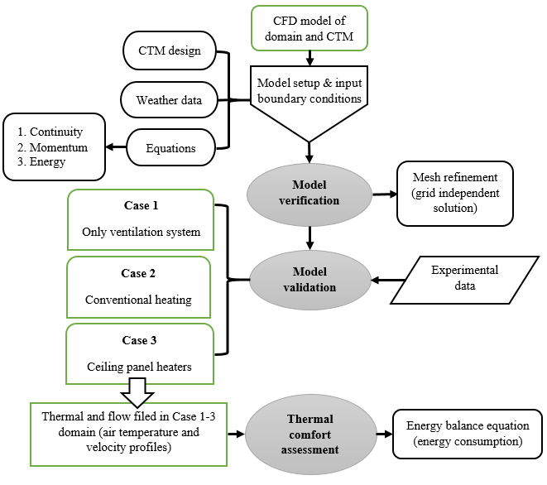


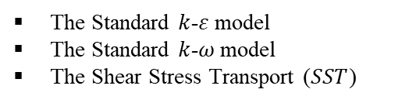
Methodology
Overview
The governing equations
Turbulence models:
The Standard $k$-$ε$model
The Standard $k$-$ω$model
The Shear Stress Transport ($SST$)
Radiation models:
Discrete Transfer
Monte Carlo
Thermal Comfort:
ISO 7730 International Standard
ASHRAE Standard 55-2017
PMV & PPD
PMV: $−0.5<X<0.5$
Acceptable range for thermal comfort
PPD: $X<10\%$
Figure 5: Methodology of the present CFD numerical analysis [5, 19]

Slide 11
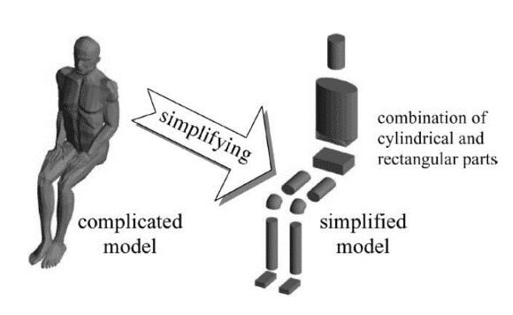
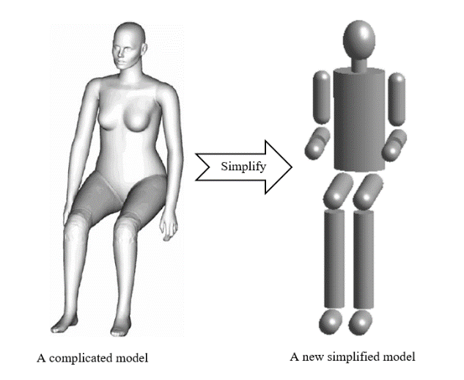
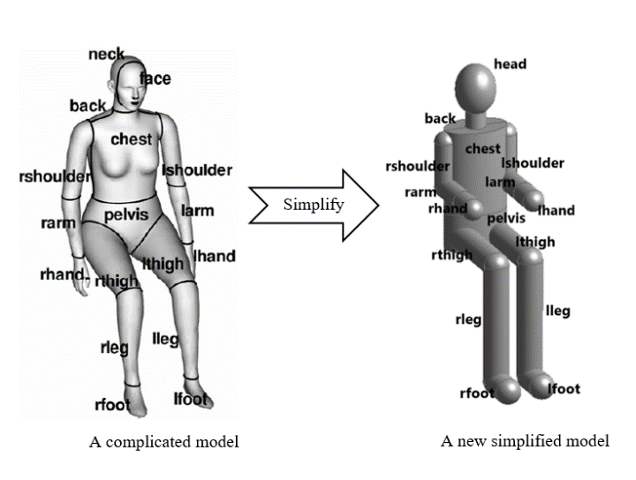
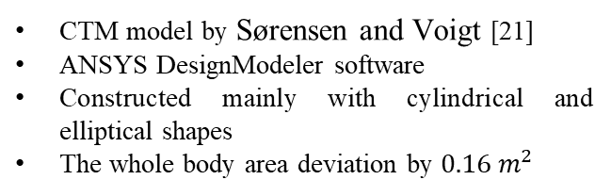
Methodology
Computational Thermal Manikin (CTM)
Computational Thermal Manikin (CTM) – a real human body model:
to analyze heat loss
to assess the thermal comfort
Miyanaga et al. [20] conducted a comprehensive study on a simplified CTM
validation of the geometry with experimental data
Figure 3: The simplification of complicated model with same dimensions [20]
CTM model by Sørensen and Voigt [21]
ANSYS DesignModeler software
Constructed mainly with cylindrical and elliptical shapes
The whole body area deviation by $0.16 m^{2}$
a)
b)
Figure 6: A geometry of CTM: a) simplified model; b) body parts [21]

Slide 12
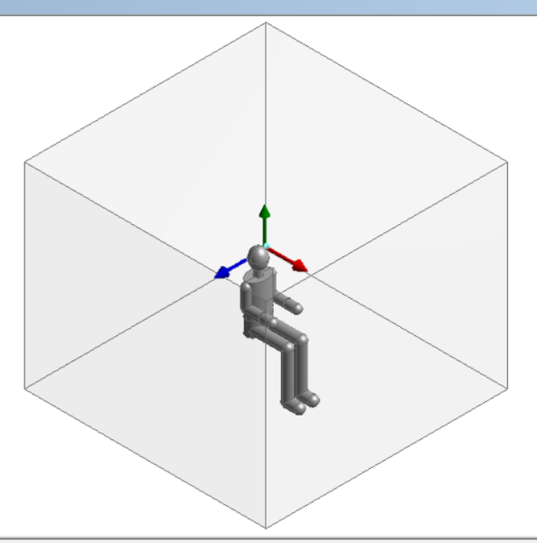
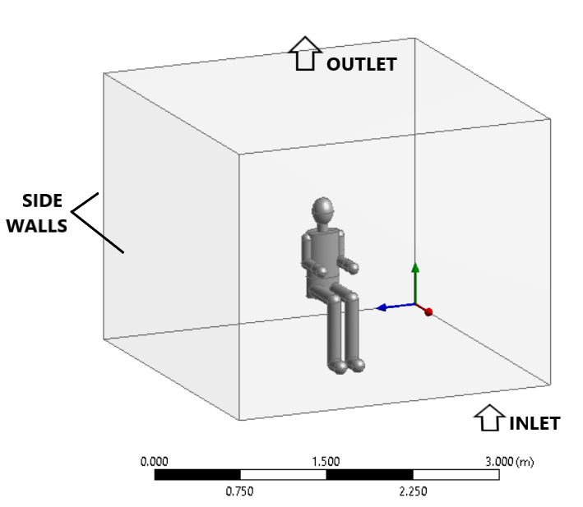
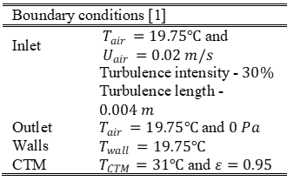
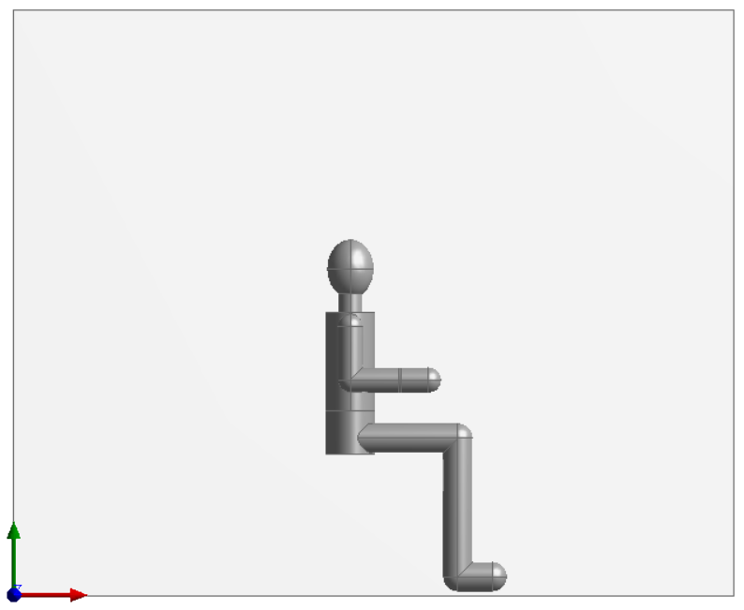
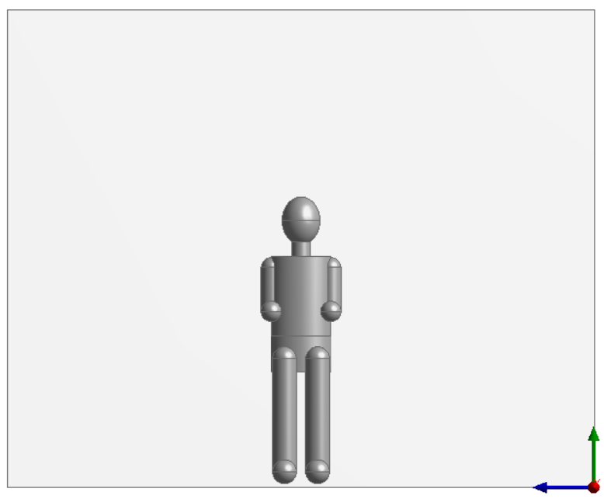
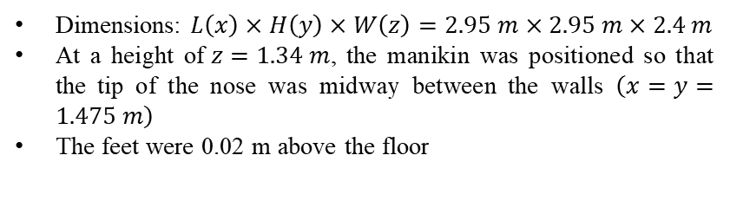
Methodology
Geometry of the CFD domain
Table 3: Boundary conditions [21]
a) Isometric view
b) Side view
c) Front view
Figure 8: Inlet and outlet locations
Dimensions: $L\left(x\right)×H\left(y\right)×W\left(z\right)=2.95 m×2.95 m×2.4 m$
At a height of$z=1.34 m$, the manikin was positioned so that the tip of the nose was midway between the walls$\left(x=y=1.475 m\right)$
The feet were 0.02 m above the floor
Figure 7: A redesigned CTM in a seated position in an enclosed space with a modified and simplified geometry scheme

Slide 13
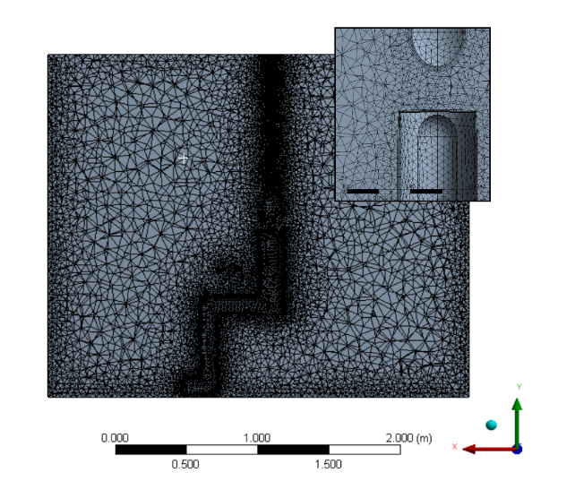
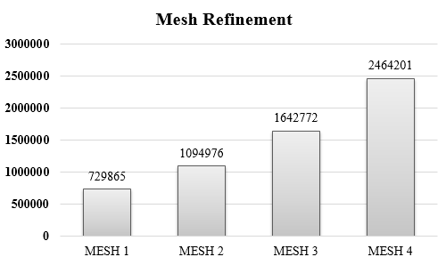
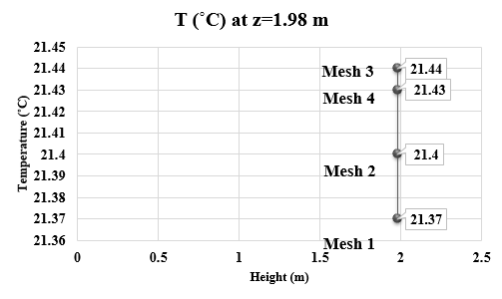
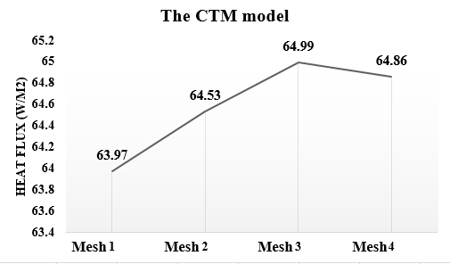
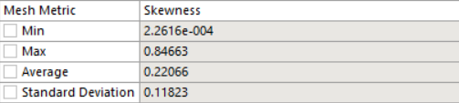
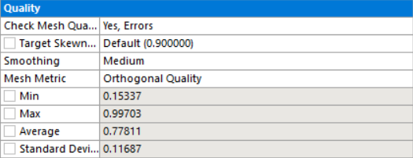
Model Configuration
Mesh Verification
a) inflation method
Figure 10: Mesh verification graphs
Refining the previous mesh by 50%, and Mesh 3 selected as the final mesh with 3 243 468 nodes
Table 4: Estimation of error between mesh refinements
b) skewness quality
c) orthogonal quality
Figure 9: Refinement of the final mesh

Slide 14
Model Configuration
Model Validation
Table 5: The comparison between simulated and experimental results
Table 6: Mesh validation compared with three turbulence models and radiation models
SST turbulence model – k-ɛ and k-ω turbulence models as a blending function [22]
The Monte Carlo – accurate and robust performance of the radiative heat transfer [23-24]
< 2%

Slide 15
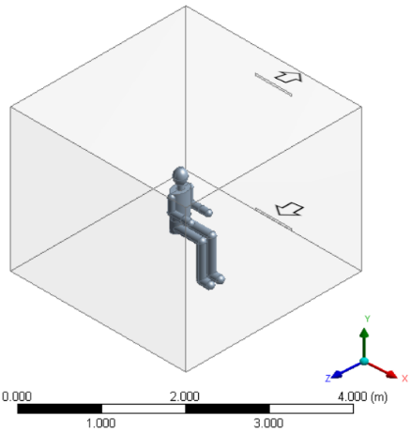
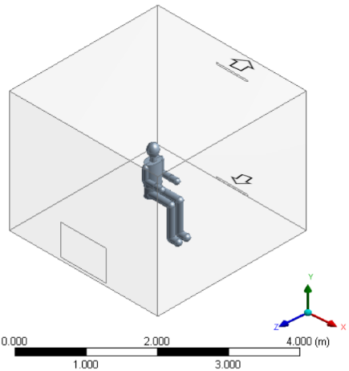
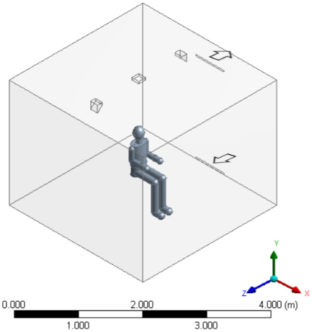
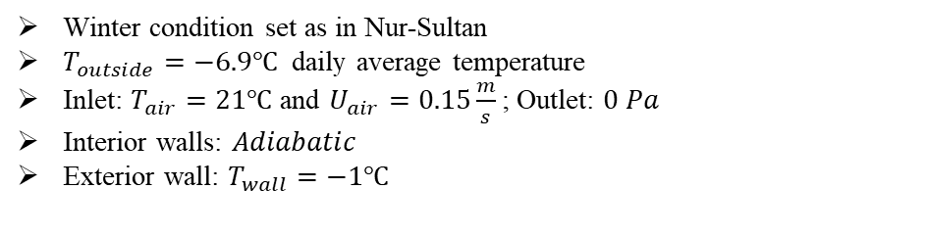
Model Configuration
Case Study & Boundary Conditions
a)
b)
c)
Figure 11: Geometry of case studies: a) forced heat convection; b) and c) forced heat convection and heat radiation
Winter condition set as in Nur-Sultan
$T_{outside}=−6.9℃$ daily average temperature
Inlet: $T_{air}=21℃$ and $U_{air}=0.15\frac{m}{s}$; Outlet: $0 Pa$
Interior walls: $Adiabatic$
Exterior wall: $T_{wall}=−1℃$
Boundary Conditions

Slide 16
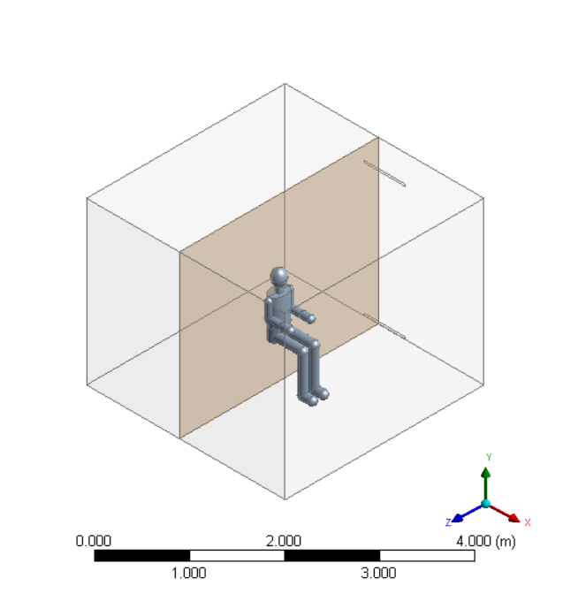
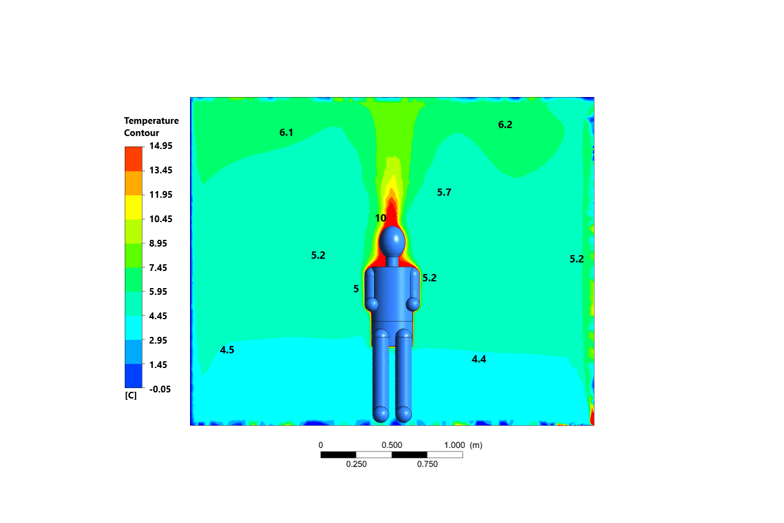
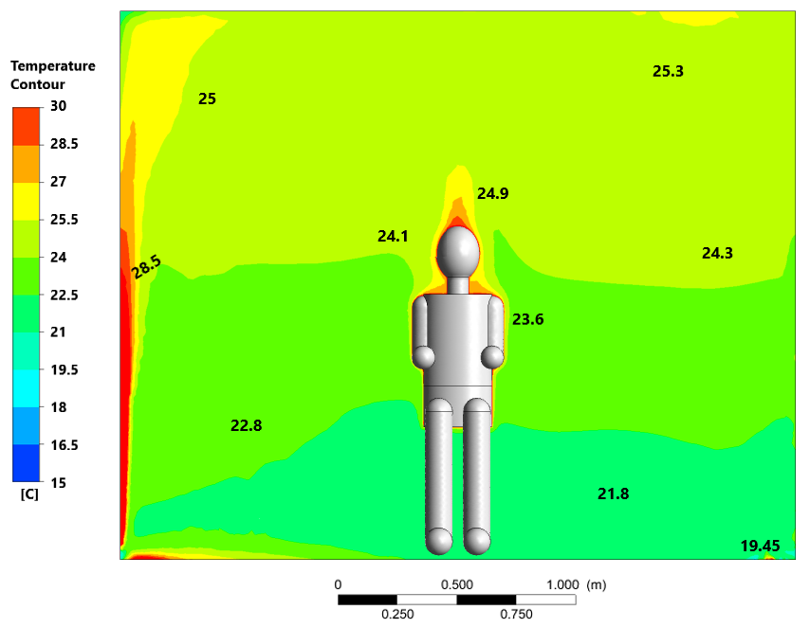
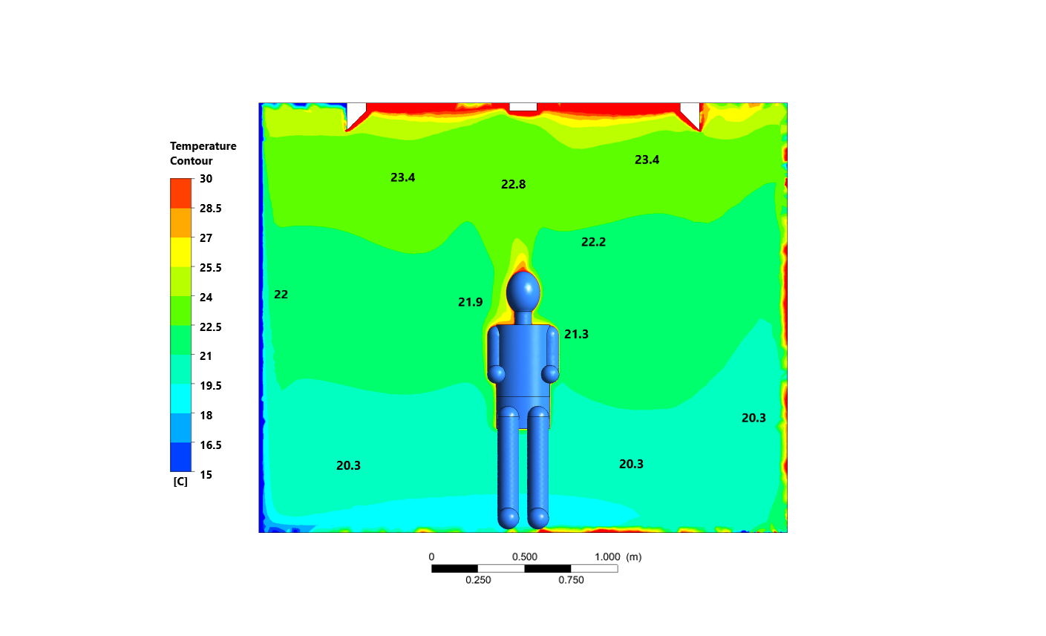
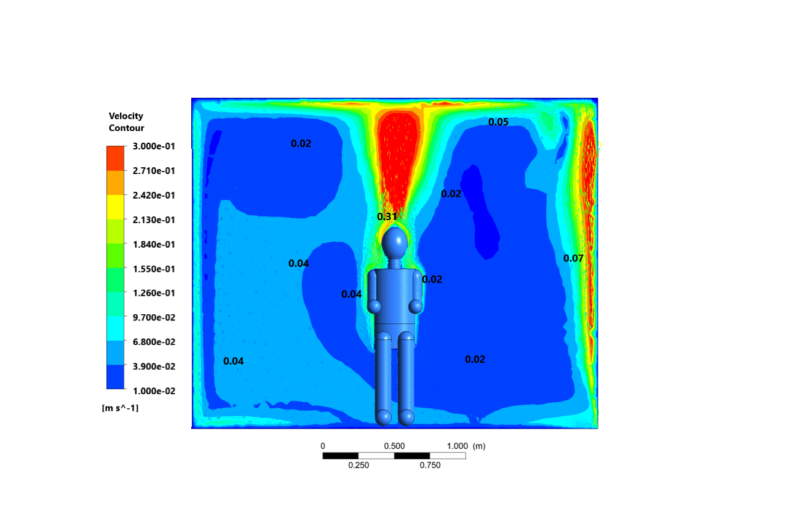
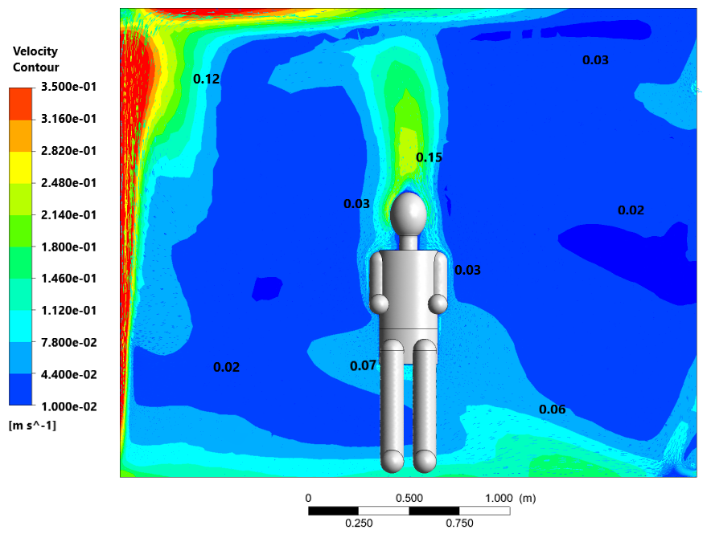
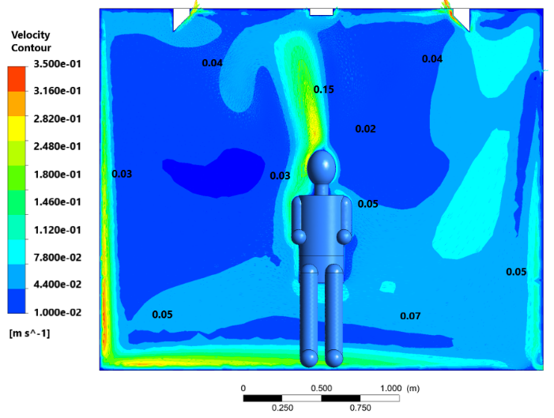



Results and Discussion
Temperature and Velocity distribution
a)
$$T_{avg}=5.7℃$$
b)
$$T_{avg}=23.7℃$$
c)
$$T_{avg}=22.7℃$$
Figure 12: Air temperature distribution along the x=1.38 m: a) Case 1; b) Case 2; c) Case 3
a)
b)
c)
Figure 13: Air velocity distribution along the z=1.38 m: a) Case 1; b) Case 2; c) Case 3

Slide 17
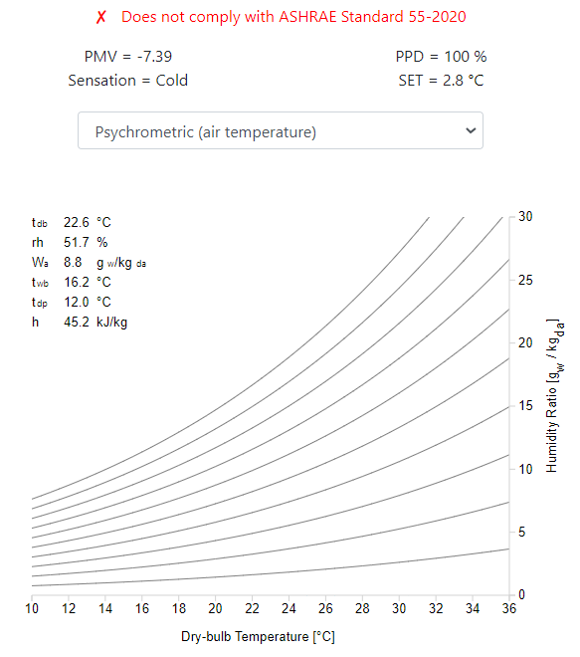
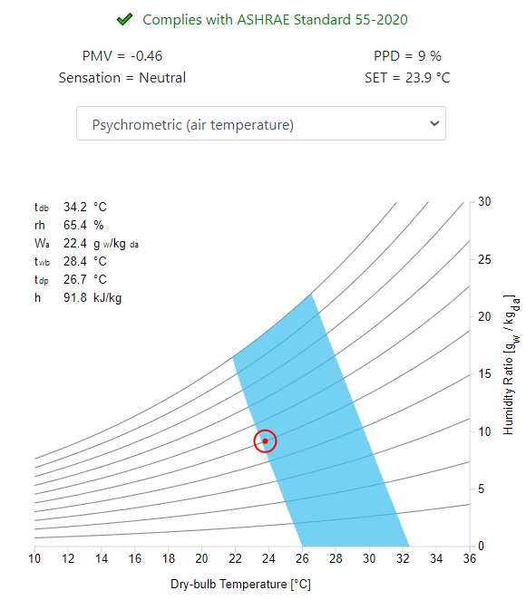
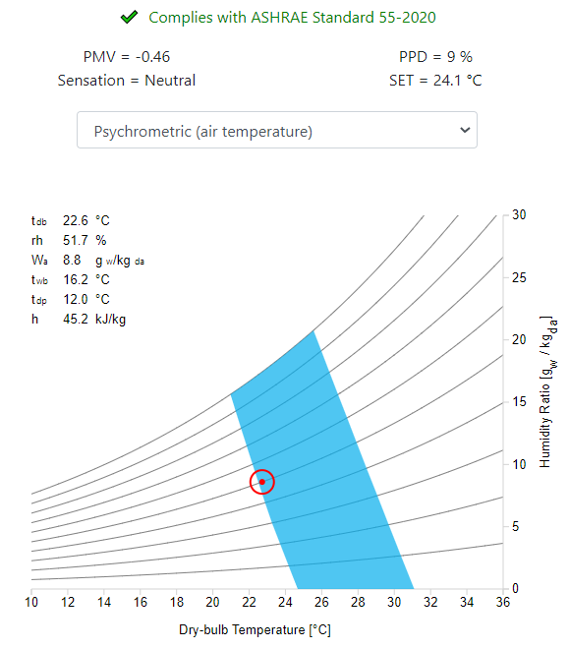
Results and Discussion
Thermal Comfort
CBE Thermal Comfort tool – online PMV and PPD evaluation tool
Parameters:
  Relative humidity – 50%
  Metabolic rate – 1 met
  Clothing level – 0.61 clo
a)
b)
c)
Figure 15: PMV and PPD values using CBE thermal comfort tool: a) Case 1; b) Case 2; c) Case 3

Slide 18
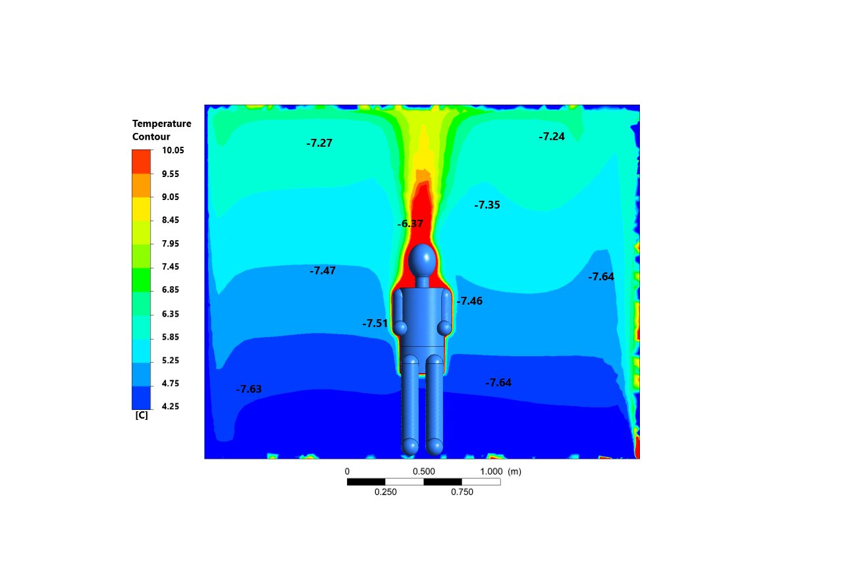
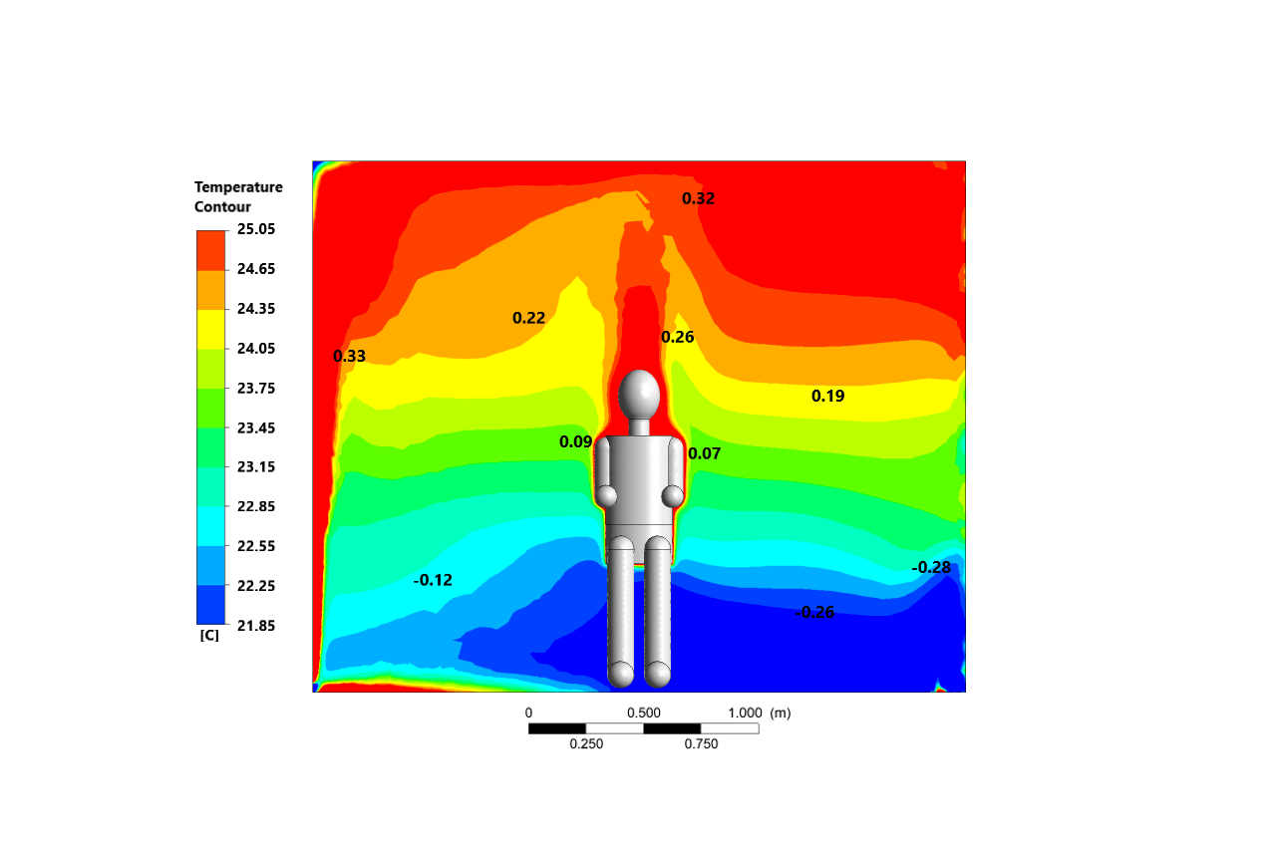
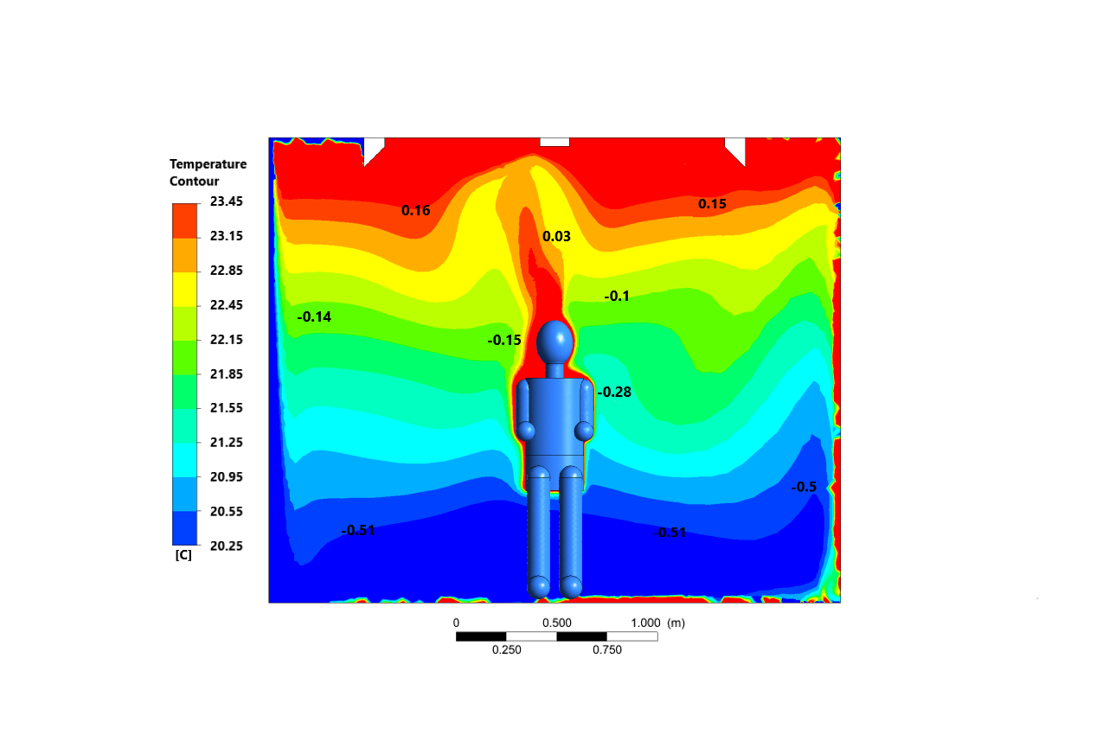



Results and Discussion
PMV and PPD
a)
b)
c)
Figure 16: PMV comfort parameter along the plane at x=1.38m illustrated on air temperature profile: a) Case 1; b) Case 2; c) Case 3
a)
b)
c)
Figure 17: PPD comfort parameter along the plane at x=1.38m illustrated on air temperature profile: a) Case 1; b) Case 2; c) Case 3

Slide 19
Results and Discussion
Energy Consumption
where ${\dot{m}}_{i}$ is the mass flow at the inlet; ${\dot{m}}_{o}$ is the mass flow at the outlet; ${\dot{h}}_{i}$ is the static enthalpy at the inlet; ${\dot{h}}_{o}$is the static enthalpy at the outlet; ${\dot{Q}}_{R}$ is the heat flux of radiator panel.
Case 2
$$\dot{Q}=1 351+ \left|8.7×{10}^{−6}× \left(−3973\right)\right|−\left|\left(−4.14×{10}^{−5}\right) ×\left(−68.6 \right)\right|=1 351 [W]$$
𝑄 ̇=1 351+ |8.7×〖10〗^(−6)× (−3973)|−|(−4.14×〖10〗^(−5) ) ×(−68.6 )|=1 351 [𝑊]
Case 3
$$\dot{Q}=574.5+232.9+641+ \left|1.4×{10}^{−5}× \left(−3948\right)\right|−\left|−4.13×{10}^{−5} ×\left(−2214 \right)\right|=574.5+232.9+641+0.06−0.09=1 448 \left[W\right]$$
𝑄 ̇=574.5+232.9+641+ |1.4×〖10〗^(−5)× (−3948)|−|−4.13×〖10〗^(−5) ×(−2214 )|=574.5+232.9+641+0.06−0.09=1 448 [𝑊]
$$\dot{Q}= 1 351 \left[W\right]≈1.35 kW$$
𝑄 ̇= 1 351 [𝑊]≈𝟏.𝟑𝟓 𝒌𝑾
$$\dot{Q}= 1 448 \left[W\right]≈1.45 kW$$
𝑄 ̇= 1 448 [𝑊]≈𝟏.𝟒𝟓 𝒌𝑾

Slide 20

Conclusions
A primary case with pure ventilation system, was also analyzed as benchmarking condition for both cases with combined forced convection and radiation. The results showed:
In case 1 (benchmark case), the PMV value was -7.43 and PPD was 100%;
In case 2, the performance of the traditional ventilation (at 21$°$C) with a side radiator heating systems showed PMV and PPD values of -0.46 and 9%, respectively;
In case 3, the ceiling’s small, focused heating panels – PMV and PPD values: -0.46 and 9%, respectively
The proposed idea can still be modified and optimized, the forced heat convection works best with the side radiator
CFD method is a practical and valid tool suitable for heat transfer analysis in HVAC systems and PMV & PPD thermal factors

Slide 21
References
[1] The International Energy Agency (IEA), https://www.iea.org/
[2] Yildiz, A., & Güngör, A. (2009). Energy and exergy analyses of space heating in buildings. Applied Energy, 86(10), 1939-1948. (10), 1939-1948.
[3] ASHRAE (2016), HVAC Systems and Equipment. ASHRAE, Atlanta.
[4] Olesen, B. W., & BW, O. (1980). Thermal comfort in a room heated by different methods.
[5] Dixit, A., & Gade, U. (2015). A case study on human bio-heat transfer and thermal comfort within CFD. Building and Environment, 94, 122-130.
[6] Raczkowski, A., Suchorab, Z., & Brzyski, P. (2019). Computational fluid dynamics simulation of thermal comfort in naturally ventilated room. In MATEC Web of Conferences (Vol. 252, p. 04007). EDP Sciences.
[7] Risberg, D., Westerlund, L., & Hellström, G. J. (2017). Computational fluid dynamics simulation of indoor climate in low energy buildings: Computational set up. Thermal Science, 21(5), 1985-1998.
[8] Teodosiu, C., Kuznik, F., & Teodosiu, R. (2014). CFD modeling of buoyancy driven cavities with internal heat source—Application to heated rooms. Energy and Buildings, 68, 403-411.
[9] Myhren, J. A., & Holmberg, S. (2008). Flow patterns and thermal comfort in a room with panel, floor and wall heating. Energy and buildings, 40(4), 524-536.
[10] Bohojło, A. (2011). Numerical Analysis of Thermal Comfort Parameters in Living Quarters. acta mechanica et automatica, 5, 5-10.
[11] Sevilgen, G., & Kilic, M. (2011). Numerical analysis of air flow, heat transfer, moisture transport and thermal comfort in a room heated by two-panel radiators. Energy and buildings, 43(1), 137-146.
[12] Horikiri, K., Yao, Y., & Yao, J. (2014). Modelling conjugate flow and heat transfer in a ventilated room for indoor thermal comfort assessment. Building and Environment, 77, 135-147.
[13] Errebai, F. B., Derradji, L., & Amara, M. (2017). Thermal behaviour of a dwelling heated by different heating systems. Energy Procedia, 107, 144-149.
[14] Raczkowski, A., Suchorab, Z., Połednik, B., Zarzeka-Raczkowska, E., & Życzyńska, A. (2018, July). Computational fluid dynamics simulation of thermal comfort in naturally ventilated room by the fresh air valve installed in an external wall. In AIP Conference Proceedings (Vol. 1988, No. 1, p. 020041). AIP Publishing LLC.
[15] Rabanillo-Herrero, M., Padilla-Marcos, M. Á., Feijó-Muñoz, J., & Meiss, A. (2019). Effects of the radiant heating system location on both the airflow and ventilation efficiency in a room. Indoor and Built Environment, 28(3), 372-383.
[16] Karacavus, B., & Aydin, K. (2019). Numerical investigation of general and local thermal comfort of an office equipped with radiant panels. Indoor and Built Environment, 28(6), 806-824.
[17] Khalil, E. E., & Sobhi, M. (2020). Air Flow Patterns and Thermal Comfort in a Room with Diverse Heating Systems. In AIAA Scitech 2020 Forum (p. 1221).
[18] Anthony, A. S., & Verma, T. N. (2021). NUMERICAL ANALYSIS OF NATURAL CONVECTION IN A HEATED ROOM AND ITS IMPLICATION ON THERMAL COMFORT. Journal of Thermal Engineering, 7(1), 37-53.
[19] Hajdukiewicz, M., Geron, M., & Keane, M. M. (2013). Calibrated CFD simulation to evaluate thermal comfort in a highly-glazed naturally ventilated room. Building and Environment, 70, 73-89.
[20] Miyanaga, T., Urabe, W., & Nakano, Y. (2001). Simplified human body model for evaluating thermal radiant environment in a radiant cooled space. Building and Environment, 36(7), 801-808.
[21] Sørensen, D. N., & Voigt, L. K. (2003). Modelling flow and heat transfer around a seated human body by computational fluid dynamics. Building and environment, 38(6), 753-762.
[22] Stamou, A., & Katsiris, I. (2006). Verification of a CFD model for indoor airflow and heat transfer. Building and Environment, 41(9), 1171-1181.
[23] Malalasekera, W., Versteeg, H. K., Henson, J. C., & Jones, J. C. (2002). Calculation of radiative heat transfer in combustion systems. Clean Air, 3(1), 113-143.
[44] Parthasarathy, G., Patankar, S. V., Chai, J. C., & Lee, H. S. (1995). Monte Carlo solutions for radiative heat transfer in irregular two-dimensional geometries. Journal of heat transfer, 117(3), 792-794.

Slide 22
THANK YOU FOR YOUR ATTENTION!

