Slide 1

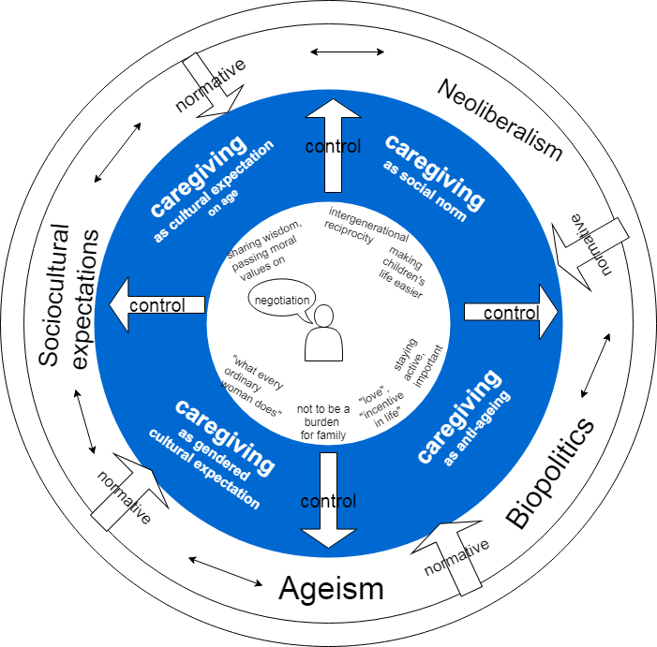
Negotiation of caregiving practices is a strategy to successfully deal with multiple and contradictory discourses around ageing and old age for aged women.
Neither Allowed To Get Old, Nor Allowed To Stay Young: Urban Kazakhstani Aged Women Negotiate Ageing
Adel Kosherbayeva
MA in Eurasian Studies
Categories | themes
Discourses of ageism | “Othering”: negative stereotypes about old age, ageing, distinguishing, accepting (Altzheimer disease, etc.)
Anti-ageing | Prioritizing self-representation rather than deteriorated health
 | Stressing one’s responsibility to “fight” old age , unpleasant to “quit” to old age
 | Continuity (forever young soul, “I am the same”), normative (must do)
gender based anti-ageing | Caregiving rather than care-recieving
 | Continuing performing femininity, beauty practices, dressing
 | Even more efforts to perform femininity, beauty practices, dressing
age based Sociocultural expectations | Ageing must be accepted (change, limit herself), moral example
age and Gender based Sociocultural expectations | Pursuit of youthfulness is unpleasant (molodit’sya)
 | Caregiving is more important than beauty, grandmothering
 | Moral example for everyone even more than men
INTRO
The worldwide increase of the life span affects the social construction of the old age and being old. This research addresses the ways aged woman in Kazakhstan construct ageing qualitatively and with regard to the social expectations imposed on them based on gender and age.
METHOD
Discourse analysis of ten qualitative in-depth interviews with urban
aged women (59-69 y.o.)
DISCUSSION
Multiple discourses that influence construction of
ageing and are
reproduced by aged
women-participants in
different contexts of
talking.
Ageism
Anti-ageing
Sociocultural expecta
tions based on gender
and age
The core theme of
caregiving often
“reconciles” the
discourses without a
danger to be socially sanctioned.
Category | Themes
Caregiving as sociocultural expectation for women | everyday caregiving: cooking, cleaning, grandmothering
 | teaching gender-based values and practices (for granddaughters)
 | supporting harmony in family
Caregiving as sociocultural expectation for aged women | more important than beauty
 | passing wisdom, experience, moral values
 | grandmothering is a joy of later life, love, affection
Caregiving as a social norm | helping, making others’ lives easier
 | saving the failure of state to provide a child care
 | compensating the failure of state to provide stability
 | intergenerational support
Caregiving as anti-ageing | continuing to be needed
 | continuing to do meaningful, fruitful practices
 | staying active physically
Caregiving as ageism | distinguishing from old ones who are a burden for their families

