Slide 1
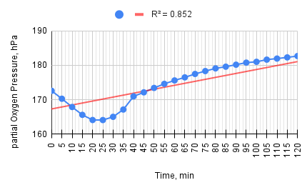
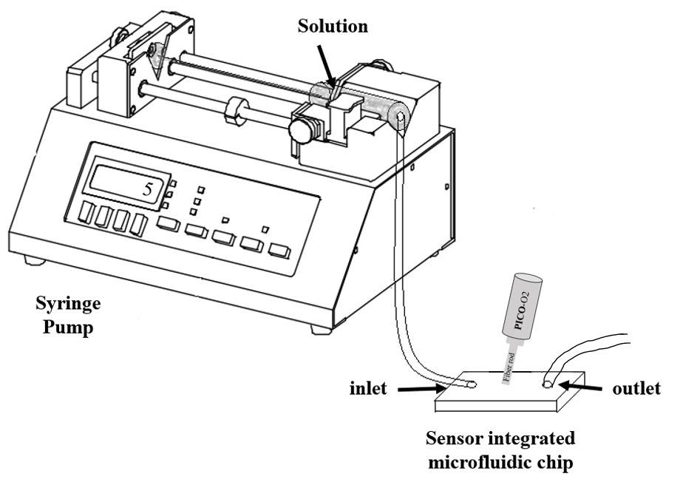
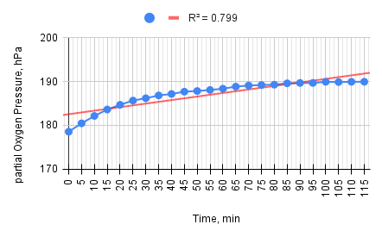
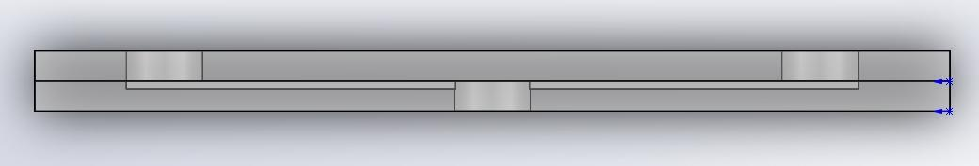
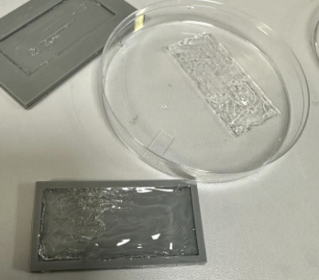


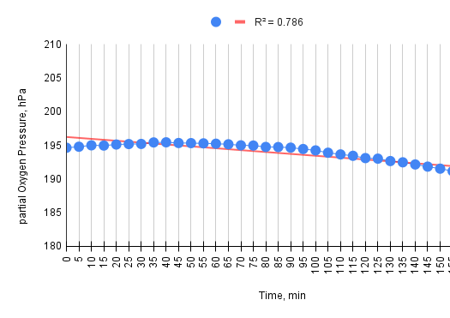
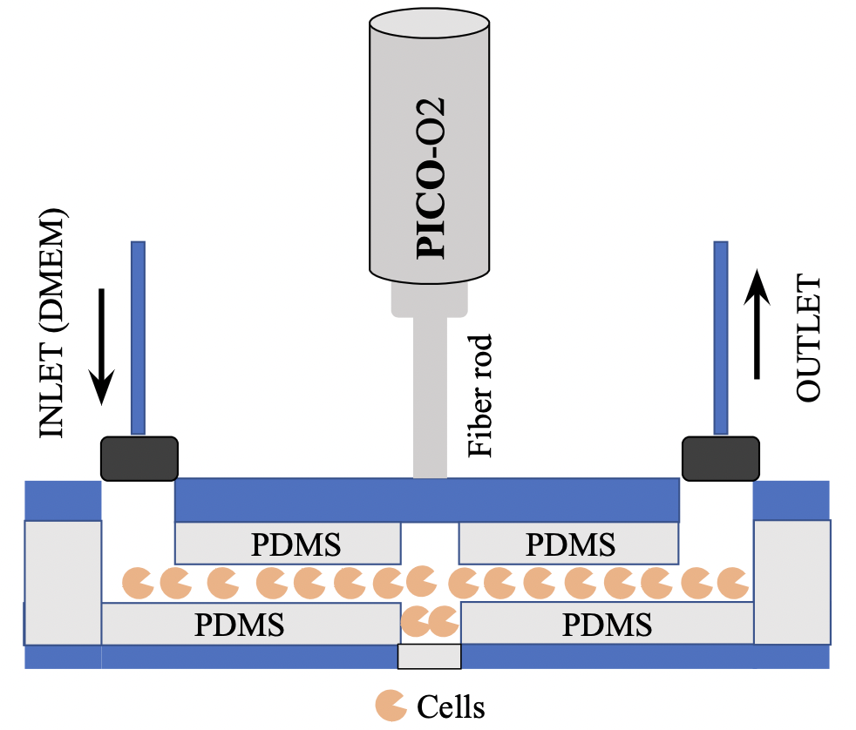
Development of an oxygen sensor integrated microfluidics and its online monitoring system
Yuriy Tsoy
Introduction
Organ-on-a-chip refers to a microfluidic device that replicates the structure and function of tissues on a miniature scale.
The fiber-optic oxygen meter intended for measuring oxygen (O2) levels. These sensors use optical fibers to detect and quantify the concentration of oxygen in a given environment.
The microfluidic chip for continuous flow consists of input and output for an environment with cells, and also the spot for fiber optic sensor. The main purpose of experiments is to develop a method and platform for accurately measuring the respiration and acidification rates of mammalian cells at the microscope using thermoplastic microfluidic devices.
OXYGEN MEASUREMENT
The oxygen sensor, PICO-O2 developed by PyroScience GmbH, was calibrated within an incubator environment and regulated to human body temperature (37℃).
The continuous flow experiments were conducted using the configuration depicted in Figure 3. This setup features an Aladdin Single-Syringe pump, a PICO-O2 oxygen meter, and an organ-on-a-chip (OoC) device integrated with a bonded PDMS chip. The syringe within the pump contained a blend of Dulbecco's Modified Eagle Medium (DMEM, Sigma, USA) and distilled water. The flow rate was established at 10μL per minute.
Methods
MICROFLUIDIC DEVICE
The design of organ-on-chip (OoC) was drafted in 3D CAD software, SOLIDWORKS, complete with detailed dimensions, and subsequently printed.The microfluidic device, measuring 55mm by 25mm, is composed of two distinct parts crafted from cyclic olefin copolymer (ChipShop, Germany). The lower section of the chip includes a microchannel that is 45 mm long, 1 mm wide, and 1 mm deep. The upper part features a smooth surface with holes designed for the inlet and outlet, complementing the bottom part.
Fig.6 - Partial oxygen pressure vs time values of continuous flow experiment №2.
Fig.4 - The setup.
Fig.1 - The side view of OoC - 3D MODEL .
ANALYTICS
The experiment is conducted using the specialized software Pyro Workbench, which is designed for the oxygen sensor PICO-O2. This software generates all the necessary graphs to visualize the data. However, for more precise data collection, the experimental data are transferred to Excel. In Excel, the data are used to construct detailed scatter plots, allowing for close observation of the results. Additionally, the use of microscopy enables a more detailed examination of cellular activity, providing insights into the cellular dynamics after the experiment.
Fig.7 - Partial oxygen pressure vs time values of continuous flow experiment №3.
The poly dimethyl sulfoxide chip (PDMS) (see Fig.2) was fabricated by mixture of SYLGARD 184 Silicone Elastomer Base and SYLGARD 184 Silicone Curing Agent (DOW, US) in a ratio of 1 to 10, respectively. The molds with exact properties of OoC chip was filled by mixture, and finally PDMS was thermally fabricated under 100℃.
MICROSCOPY
Results
The data collected from the integrated sensors were analyzed using Pyroscience software and Excel, focusing on identifying patterns in oxygen consumption by cells within the microfluidic chips.
DATA OVERVIEW
The data was collected using the PyroScience Workbench with an oxygen sensor calibrated under specific conditions, maintaining a temperature of 37°C and a pressure of 1013 mbar throughout the experiment.
The data points cover a continuous recording, marking oxygen levels in hectopascals (hPa) at roughly 5-minute intervals.
Fig.8 - The living cells.
Fig.9 - The dead cells.
Fig.2 - The Poly Dimethyl Sulfoxide Chip (PDMS) .
Green fluorescent (Fig.8) dye might be used to assess live cells or certain live cell functions, while a red dye (Fig.9) might be used to either stain dead cells.
Overlaying these figures could provide information on the health status of the cells after the experiment.
The fabrication process requires the adhesion of two PDMS components. These elements must be joined to form the initial structure. Subsequently, the lower segment of the OoC must be fused to the corresponding PDMS base through the application of a plasma treatment, ensuring a secure bond. The upper section of the chip is then secured in place using a specialized fixture designed for this purpose (see Fig.3).
Conclusion
In conclusion, the experiment not only demonstrates the capability of microfluidic systems to support and monitor cellular activities but also highlights the critical need for precision in system design and data interpretation to use the full potential of these technologies in engineering field.
References:
  Sanzhar Shakarim, Daniele Tosi, and Gulsim Kulsharova. “Integration of fiber optic sen- sors in organ-on-a-chip devices towards label-free cell viability assays”. In: (2022), pp. 1– 6. doi: https://10.1109/SAS54819.2022.9881355.
Fig.3 - The side view of OoC with integrated oxygen sensor PICO-O2.
Fig.5 - Partial oxygen pressure vs time values of continuous flow experiment №1.
Gulsim Kulsharova

