Slide 1
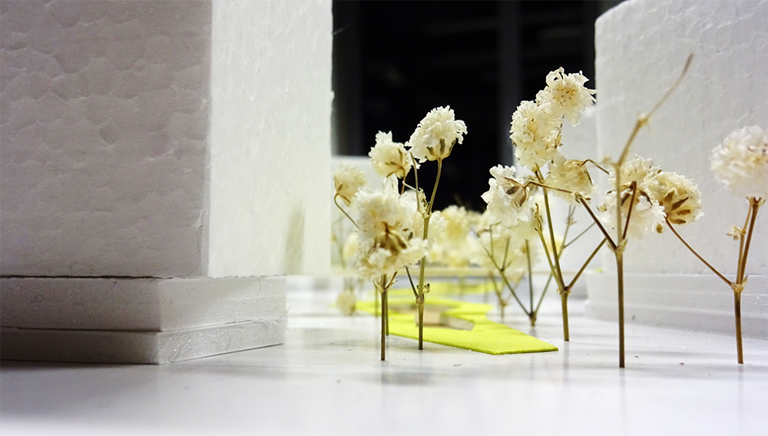


THE 5 ELEMENTS
TEAM LATVIA
Krista Krancina I Janis Pomerancevs I Elina Skudra

Slide 2




THE 5 ELEMENTS
TEAM LATVIA
Krista Krancina I Janis Pomerancevs I Elina Skudra

Slide 3

THE 5 ELEMENTS
TEAM LATVIA
Krista Krancina I Janis Pomerancevs I Elina Skudra

Slide 4
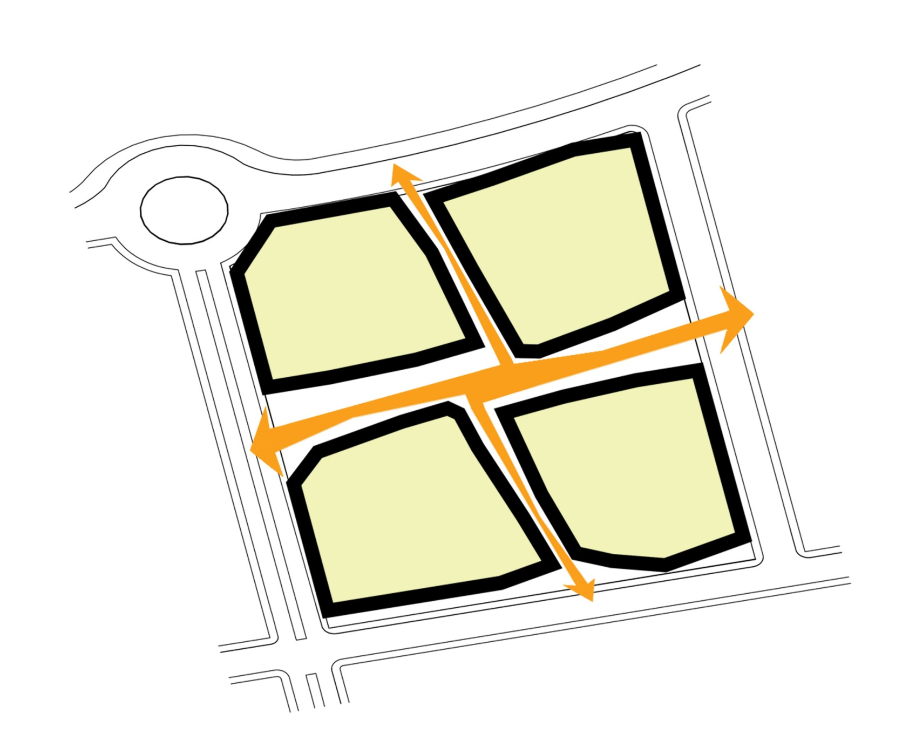
MAIN AXES WITH 4 ELEMENTS
THE 5 ELEMENTS
TEAM LATVIA
Krista Krancina I Janis Pomerancevs I Elina Skudra

Slide 5
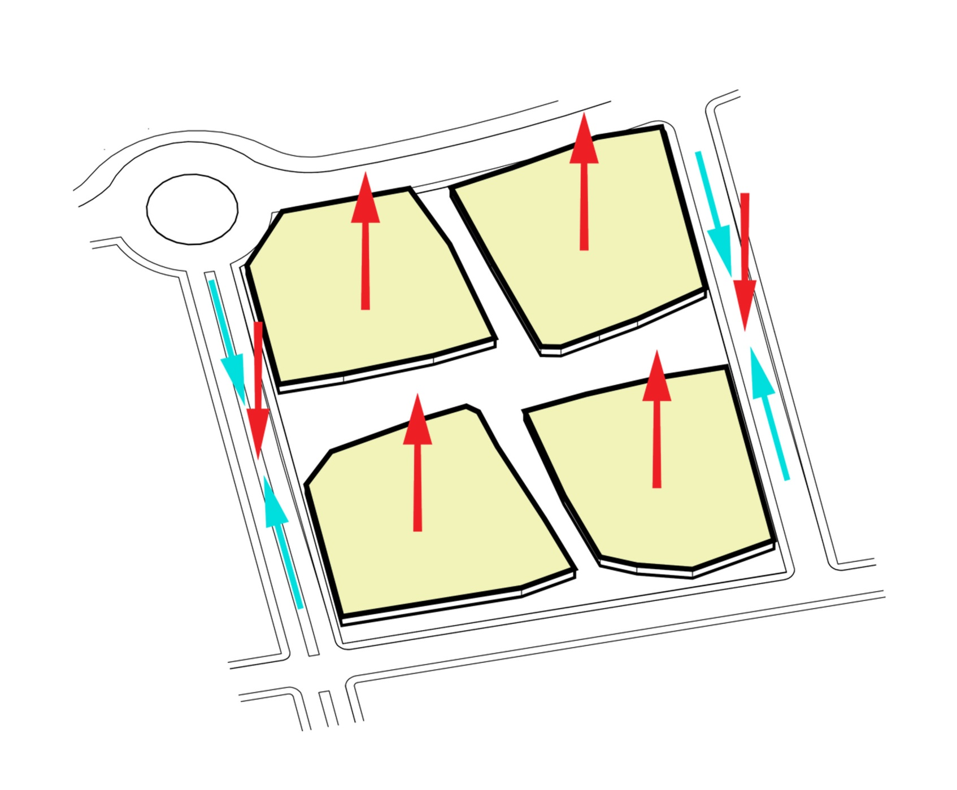
THE LEVELS
THE 5 ELEMENTS
TEAM LATVIA
Krista Krancina I Janis Pomerancevs I Elina Skudra

Slide 6
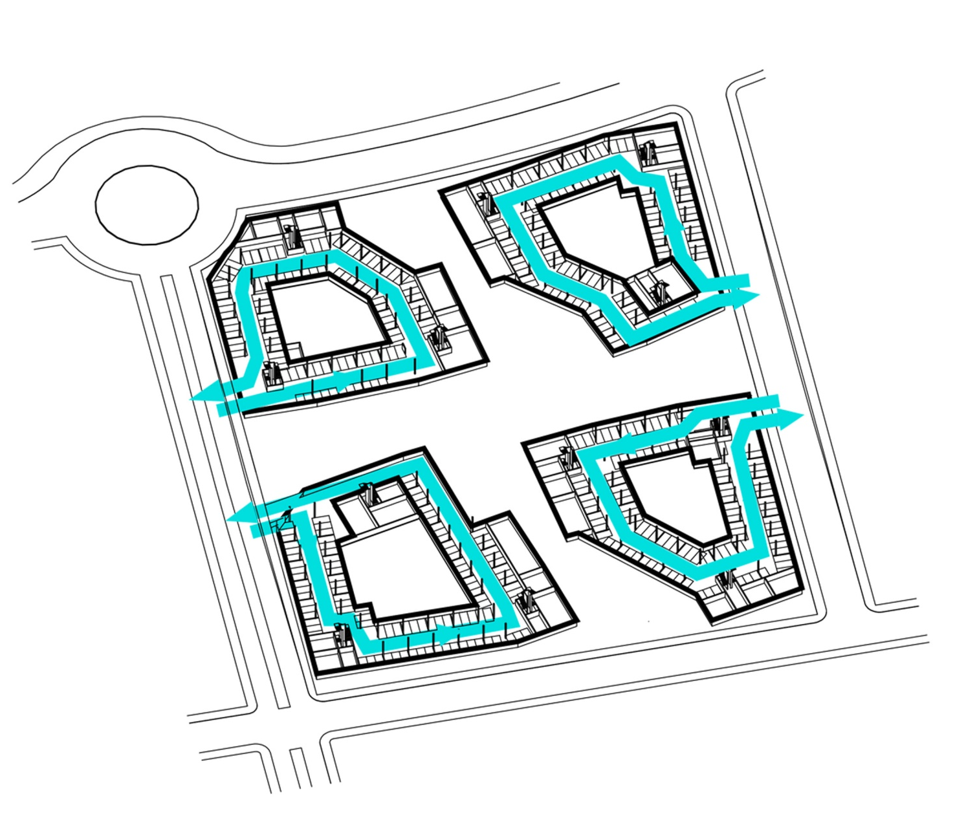
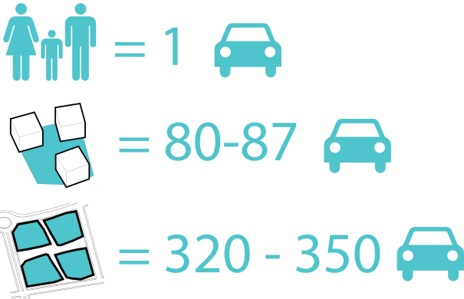
UNDERGROUND PARKING LOOPS
THE 5 ELEMENTS
TEAM LATVIA
Krista Krancina I Janis Pomerancevs I Elina Skudra

Slide 7
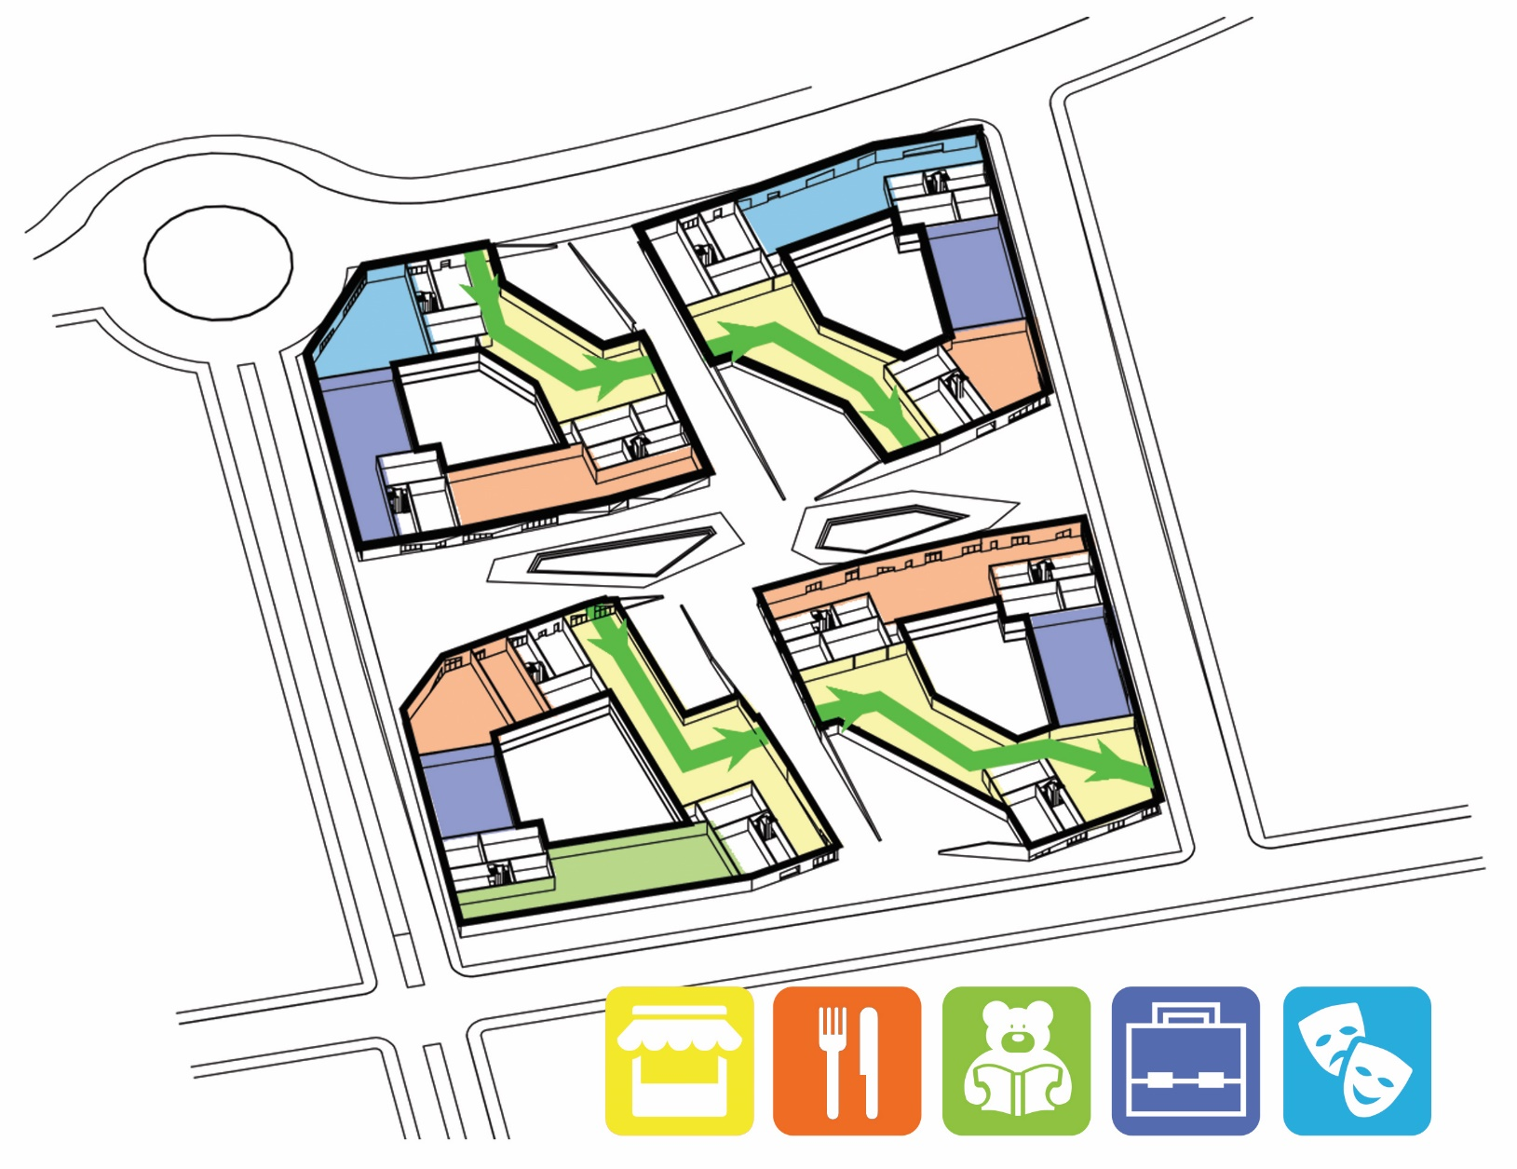
MULTIPLE COMMUNITY FUNCTIONS
THE 5 ELEMENTS
TEAM LATVIA
Krista Krancina I Janis Pomerancevs I Elina Skudra

Slide 8
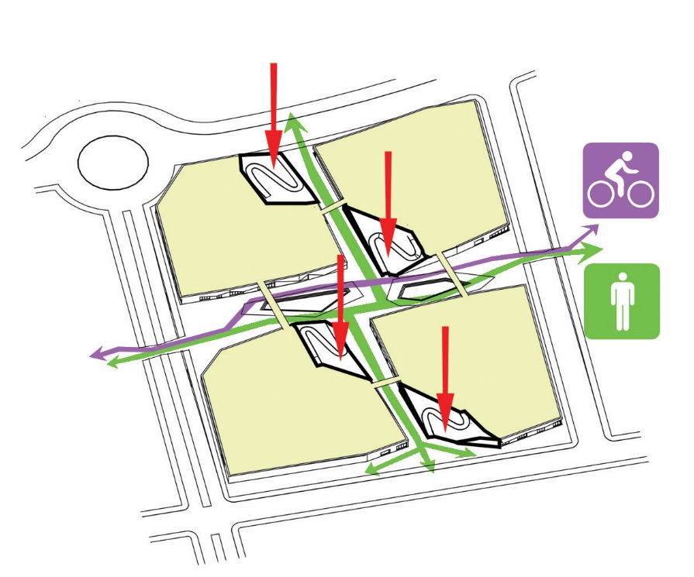
ACCESSIBILITY AND CONNECTIONS
THE 5 ELEMENTS
TEAM LATVIA
Krista Krancina I Janis Pomerancevs I Elina Skudra

Slide 9
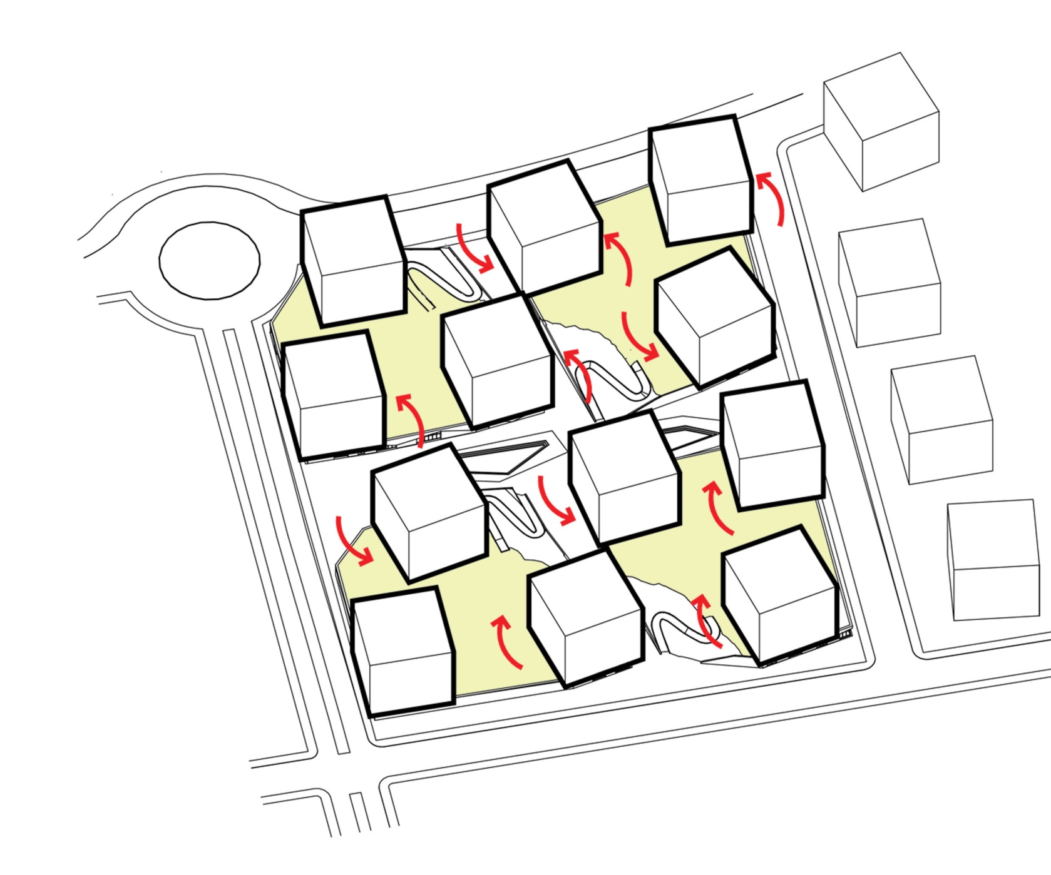
OPTIMAL ROTATION OF THE BUILDING BLOCKS
THE 5 ELEMENTS
TEAM LATVIA
Krista Krancina I Janis Pomerancevs I Elina Skudra

Slide 10
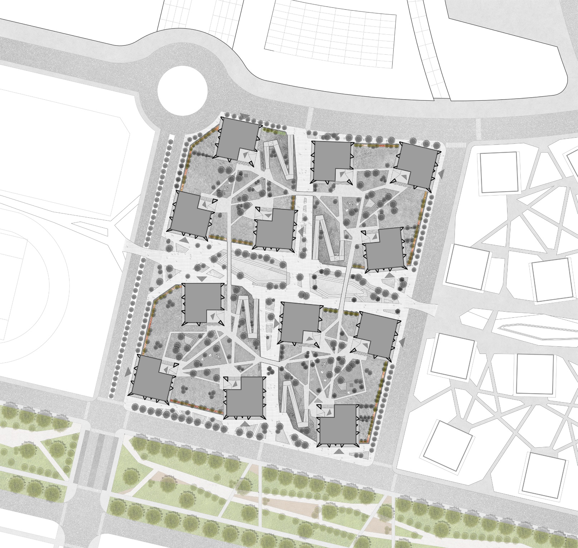

THE WINDSHIELD
THE 5 ELEMENTS
TEAM LATVIA
Krista Krancina I Janis Pomerancevs I Elina Skudra

Slide 11
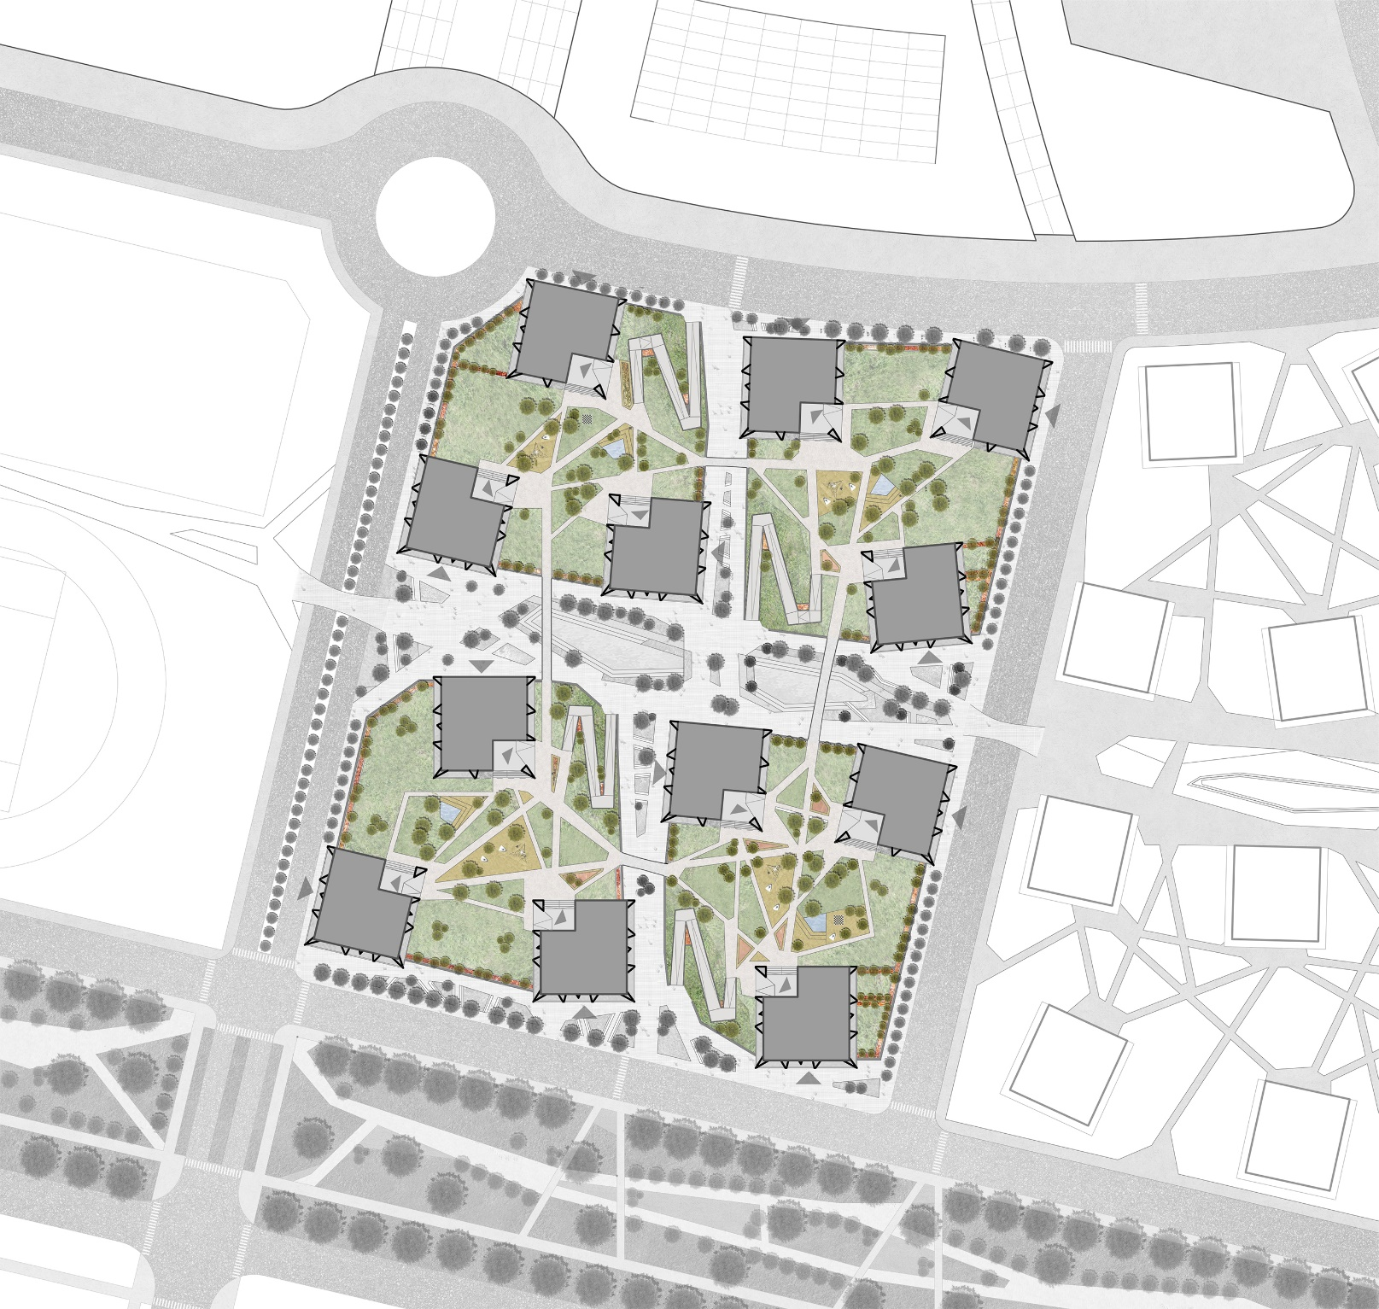

THE GREEN ZONE
THE 5 ELEMENTS
TEAM LATVIA
Krista Krancina I Janis Pomerancevs I Elina Skudra

Slide 12
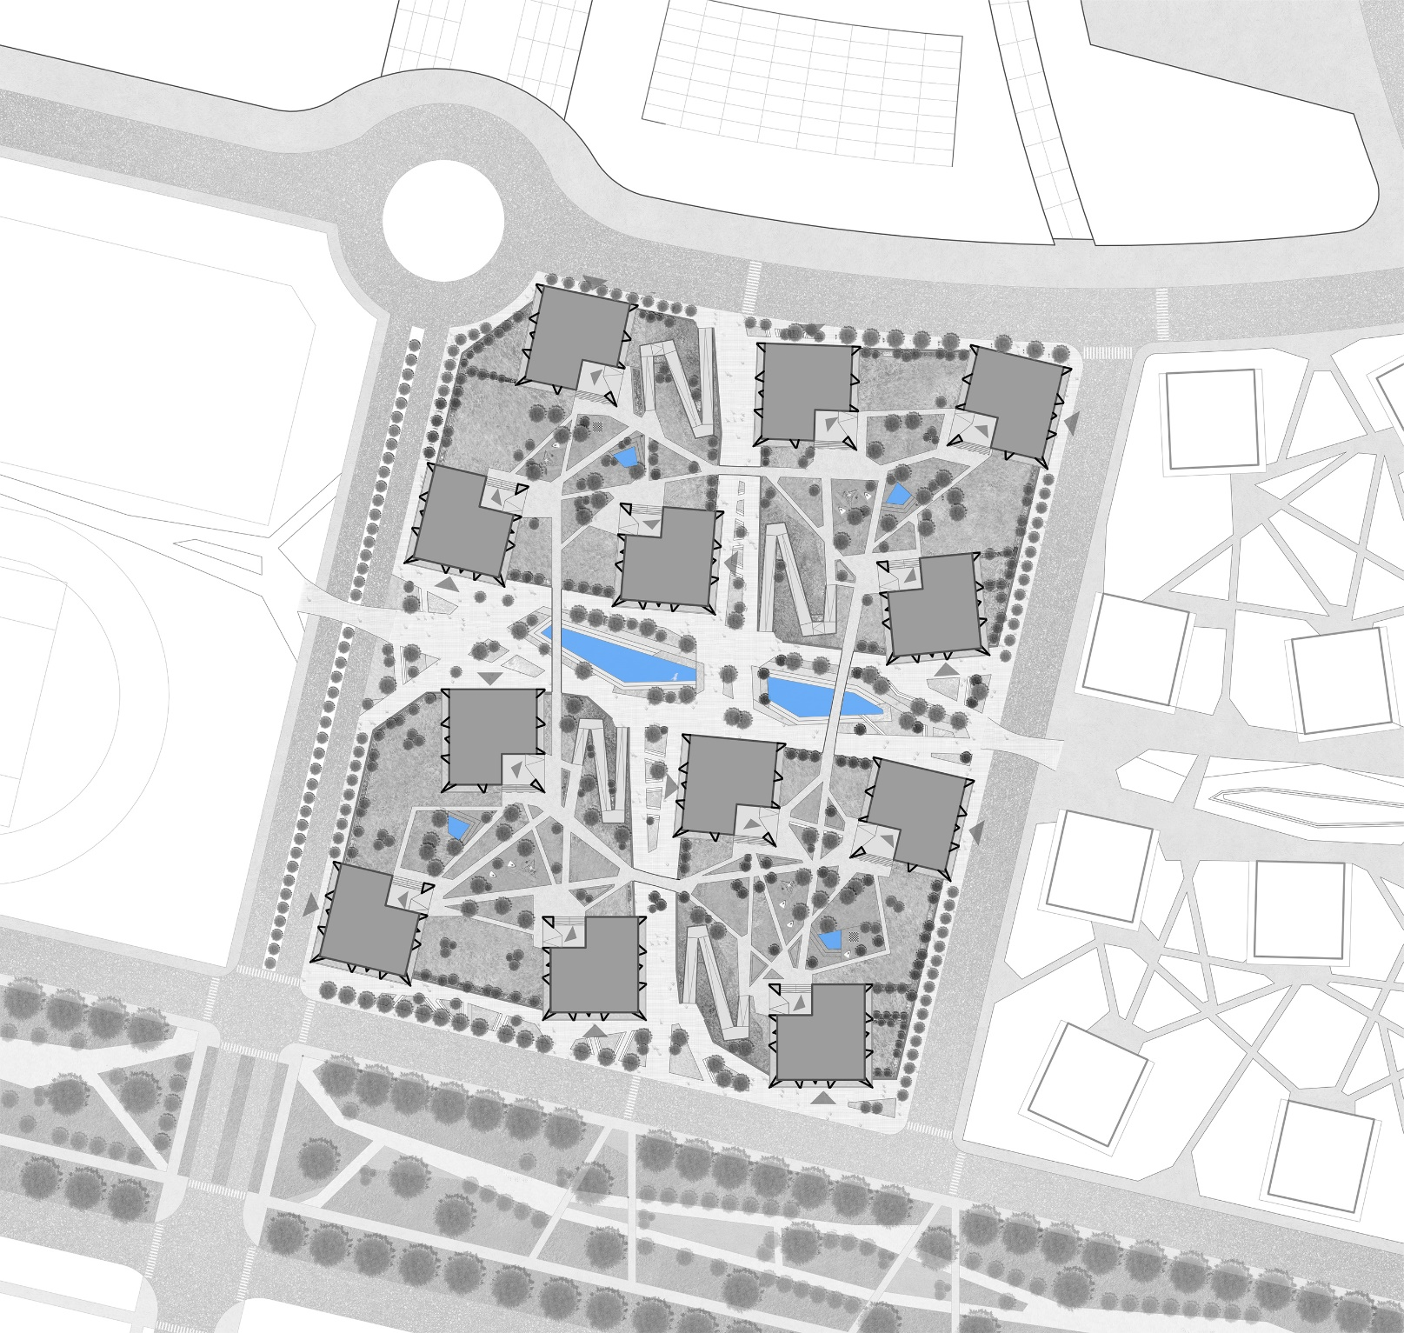

THE WATER PLACES
THE 5 ELEMENTS
TEAM LATVIA
Krista Krancina I Janis Pomerancevs I Elina Skudra

Slide 13
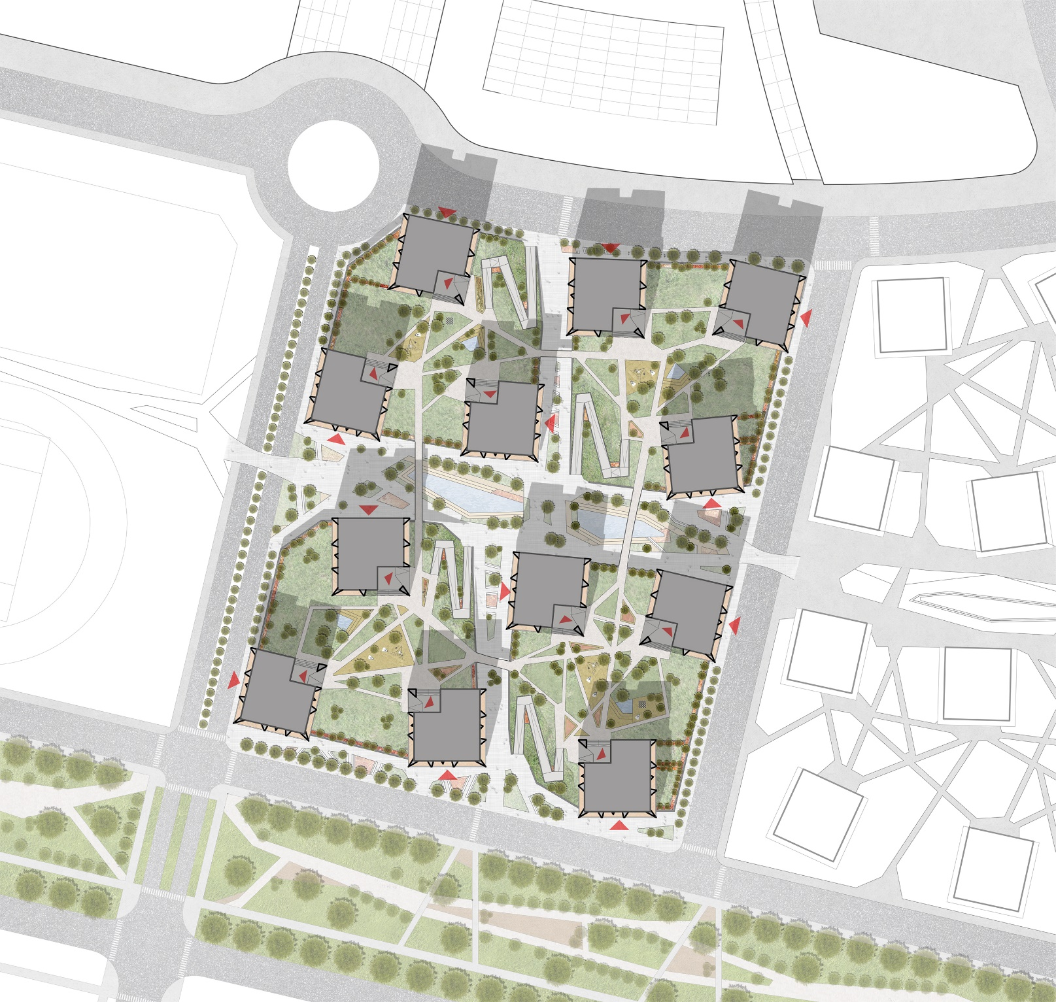

SHELTER FROM THE BURNING SUN
THE 5 ELEMENTS
TEAM LATVIA
Krista Krancina I Janis Pomerancevs I Elina Skudra

Slide 14
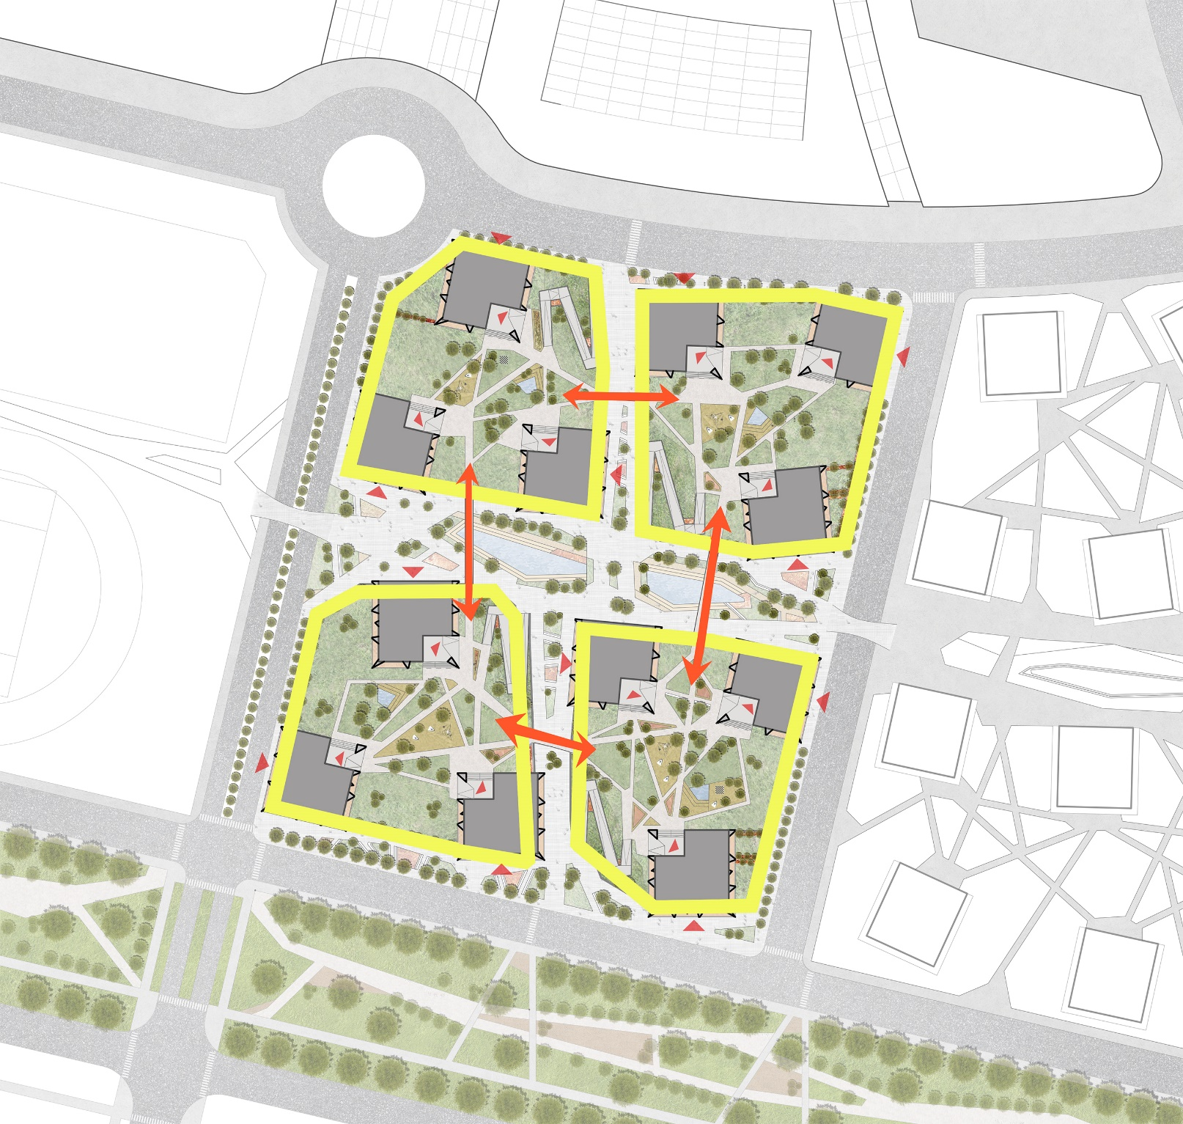
THE 5 LINKED ELEMENTS
THE 5 ELEMENTS
TEAM LATVIA
Krista Krancina I Janis Pomerancevs I Elina Skudra

Slide 15
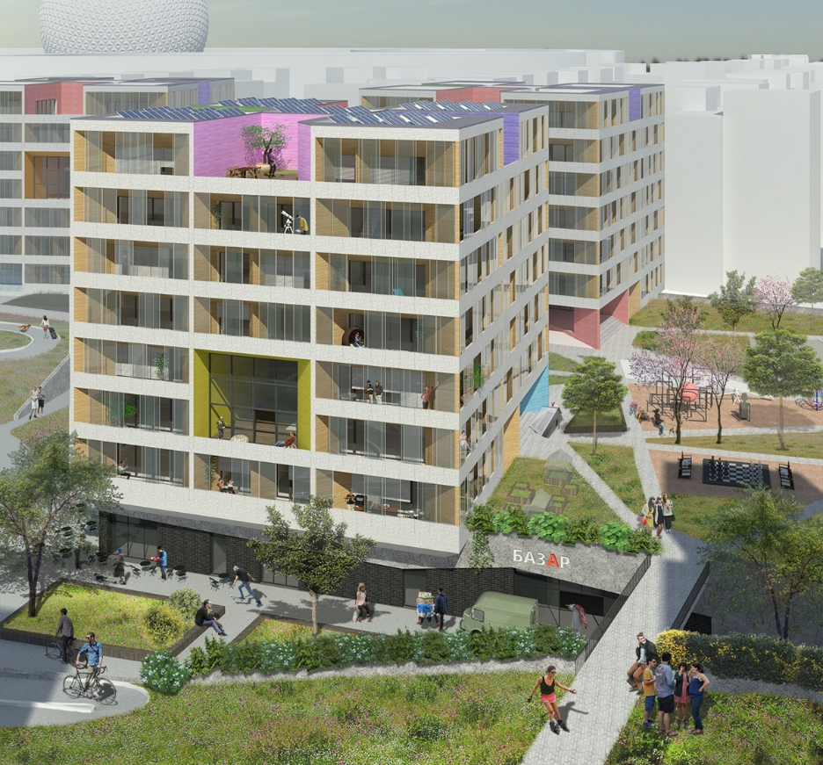
THE 5 ELEMENTS
TEAM LATVIA
Krista Krancina I Janis Pomerancevs I Elina Skudra

Slide 16
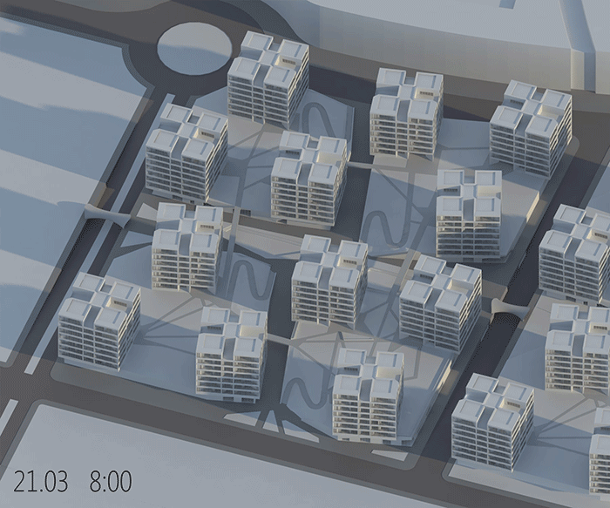
THE 5 ELEMENTS
TEAM LATVIA
Krista Krancina I Janis Pomerancevs I Elina Skudra

Slide 17
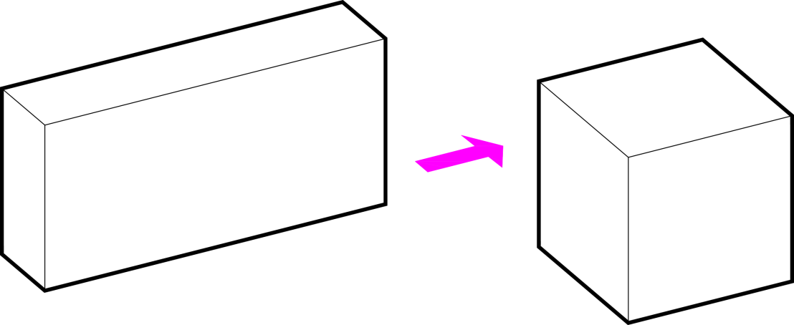
V=15600 m³
S=4450 m²
V=15600 m³
S=3750 m²
15% REDUCED BUILDING ENVELOPE
THE 5 ELEMENTS
TEAM LATVIA
Krista Krancina I Janis Pomerancevs I Elina Skudra

Slide 18
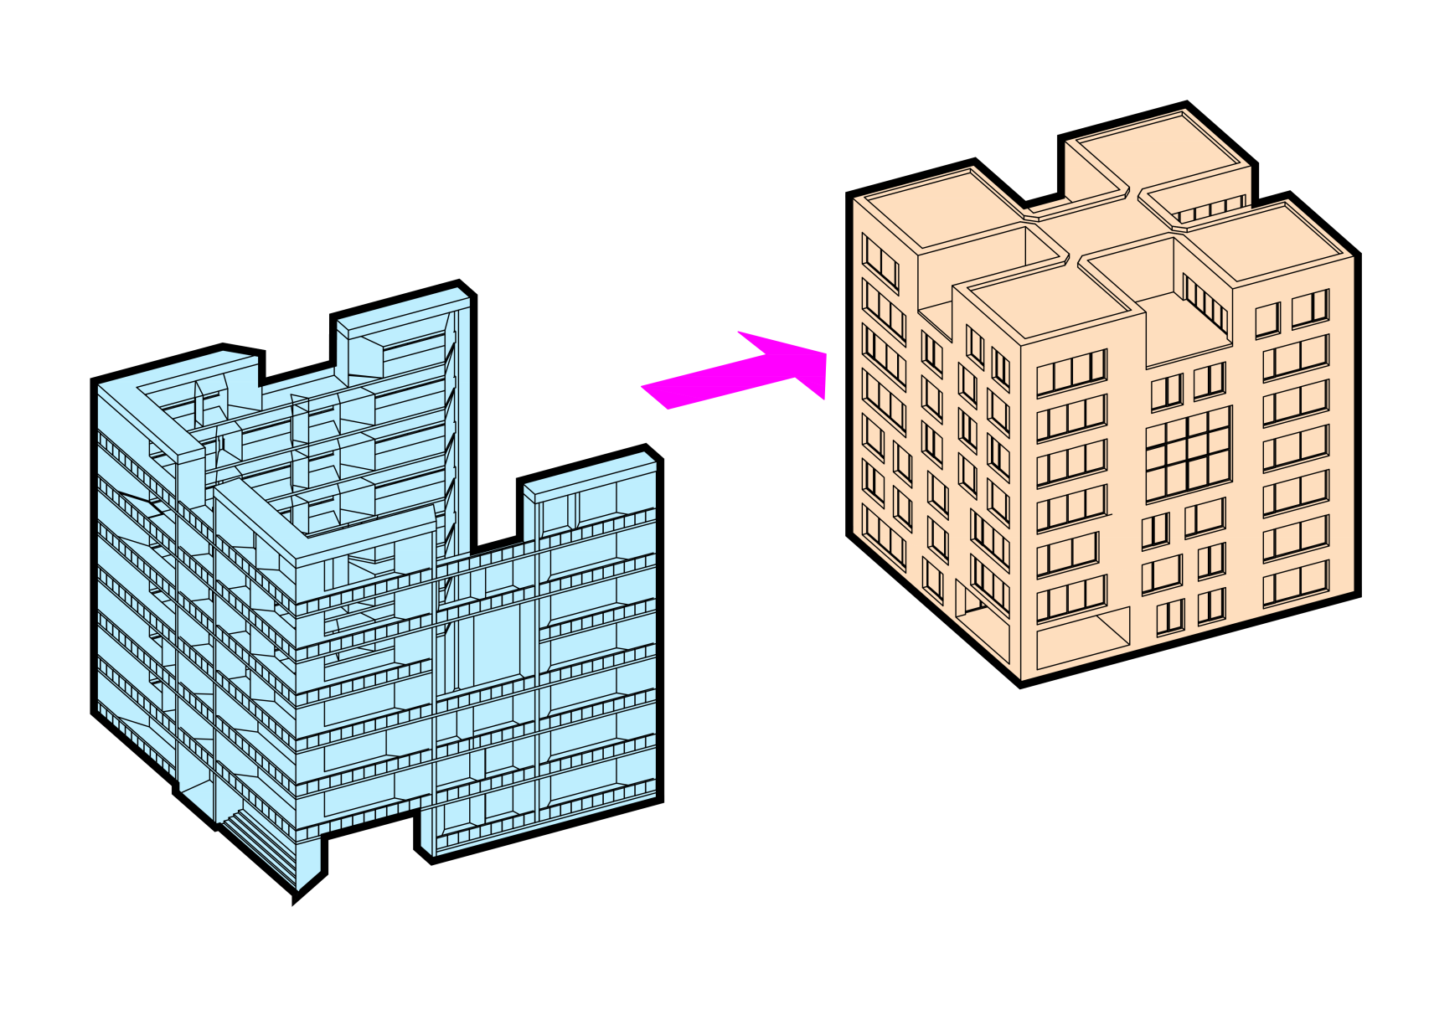
Unheated shell
Heated core
PROTECTED BUILDING VOLUME
THE 5 ELEMENTS
TEAM LATVIA
Krista Krancina I Janis Pomerancevs I Elina Skudra

Slide 19
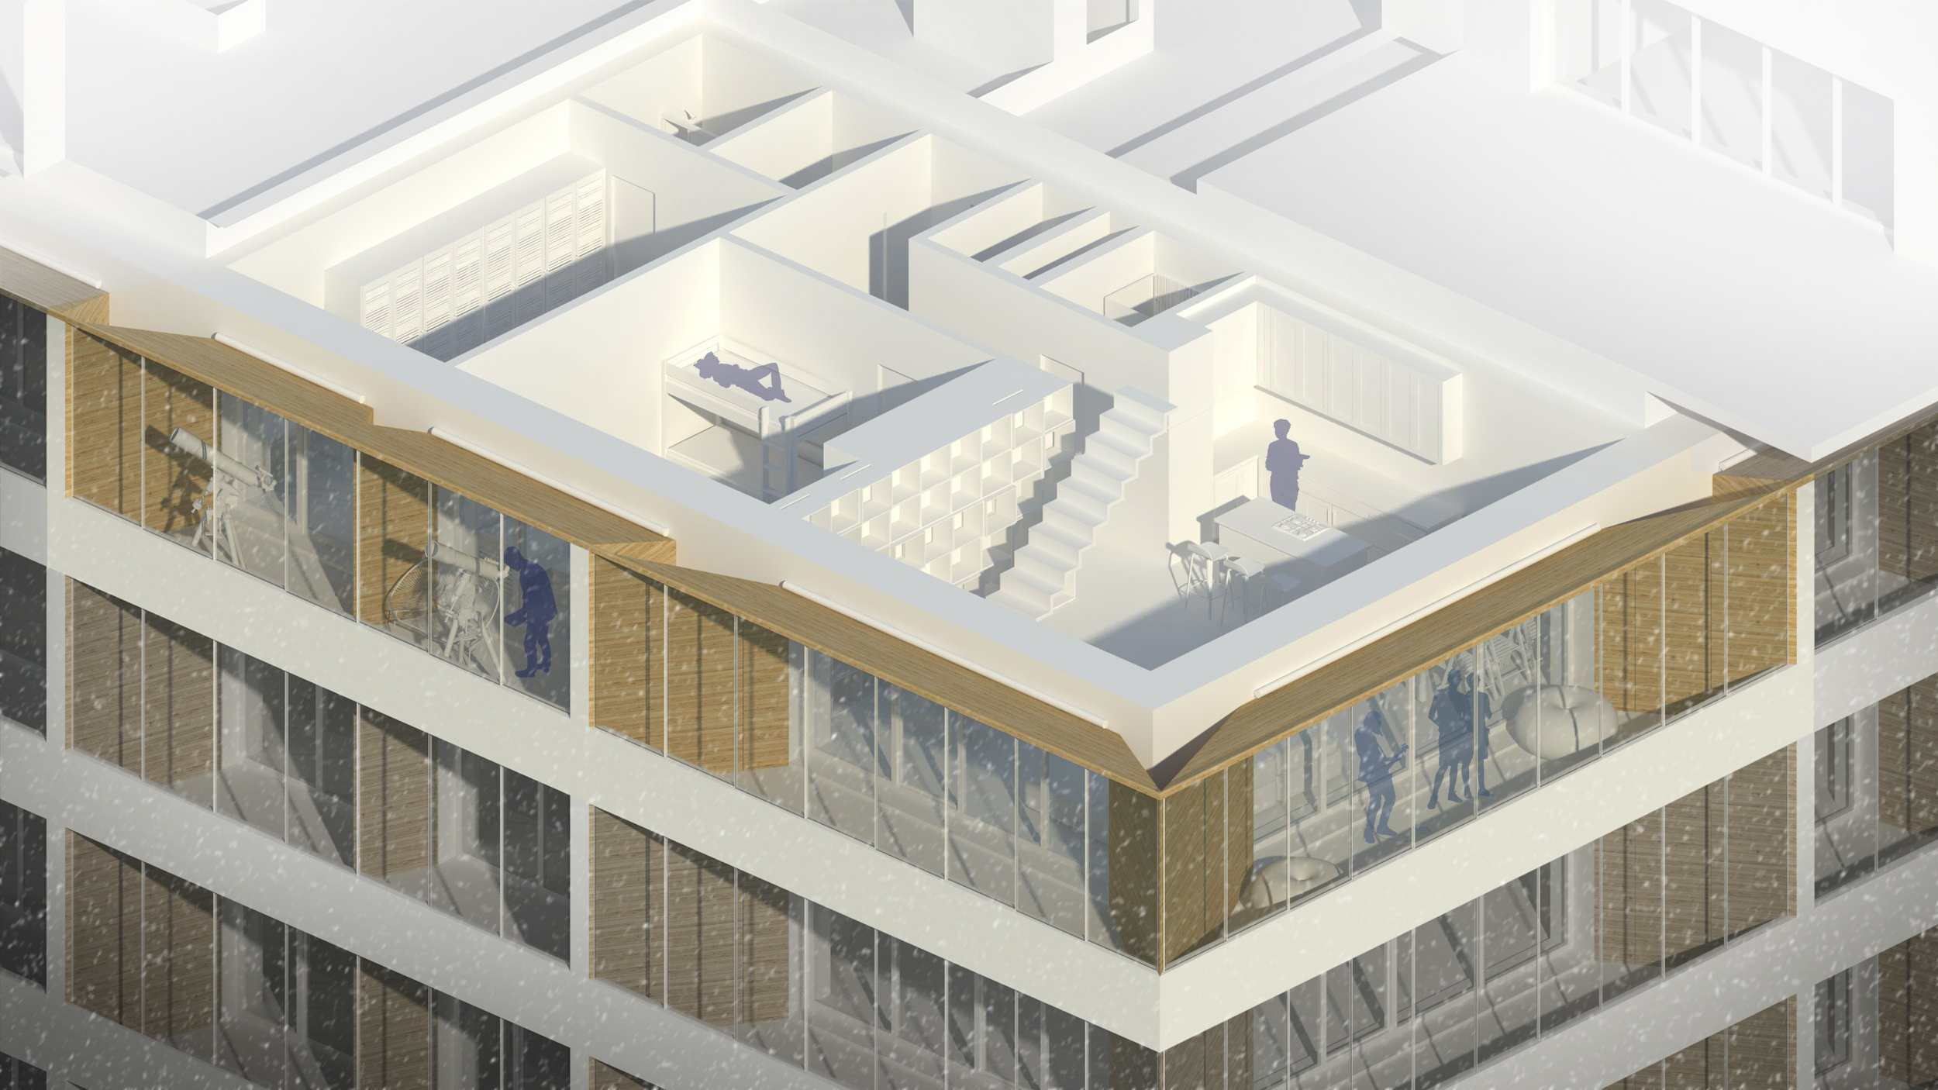
THE 5 ELEMENTS
TEAM LATVIA
Krista Krancina I Janis Pomerancevs I Elina Skudra

Slide 20
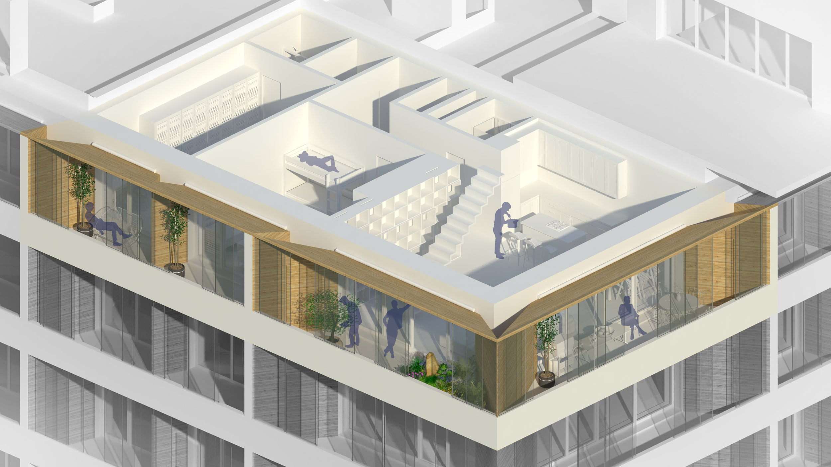
THE 5 ELEMENTS
TEAM LATVIA
Krista Krancina I Janis Pomerancevs I Elina Skudra

Slide 21
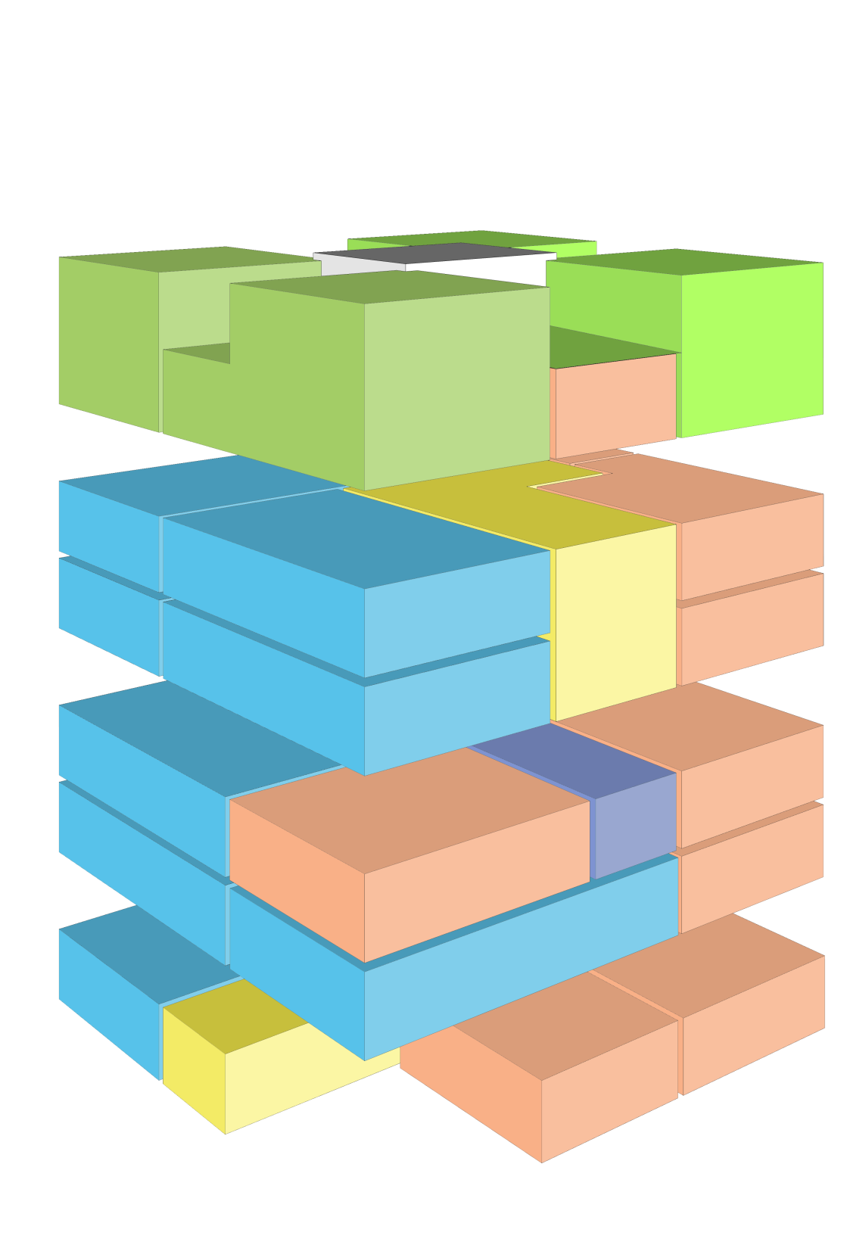
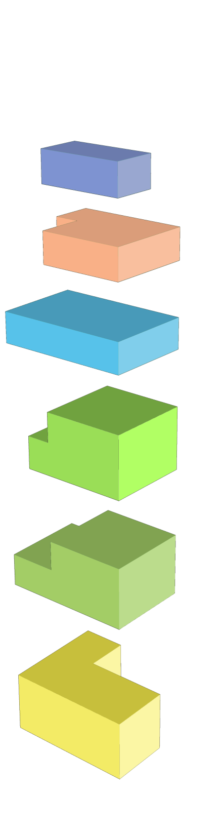
Studio apartment
2 room apartment
3 room apartment
2 storey 3 room apartment
2 storey 4 room apartment
Indoor public space
ARRANGEMENT OF APARTMENTS
THE 5 ELEMENTS
TEAM LATVIA
Krista Krancina I Janis Pomerancevs I Elina Skudra

Slide 22
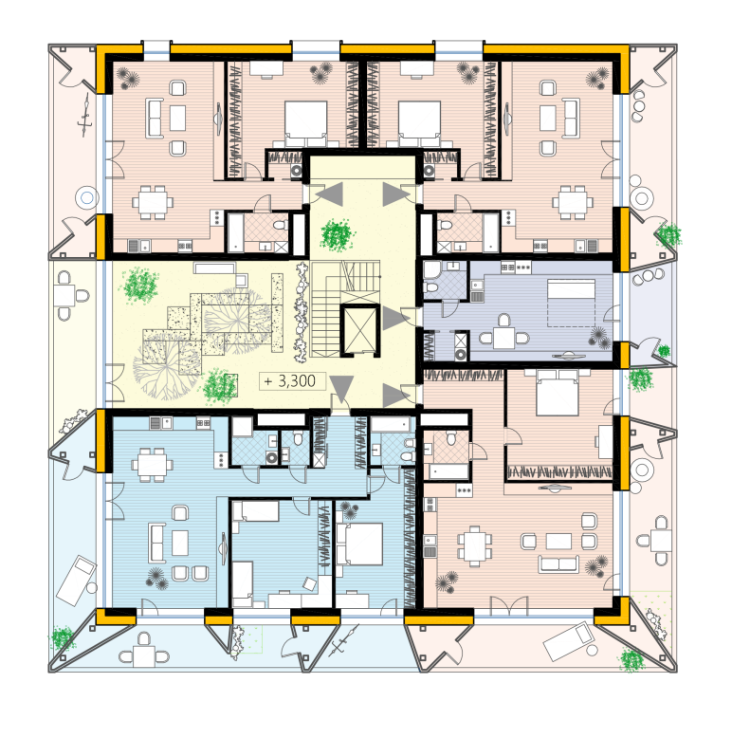
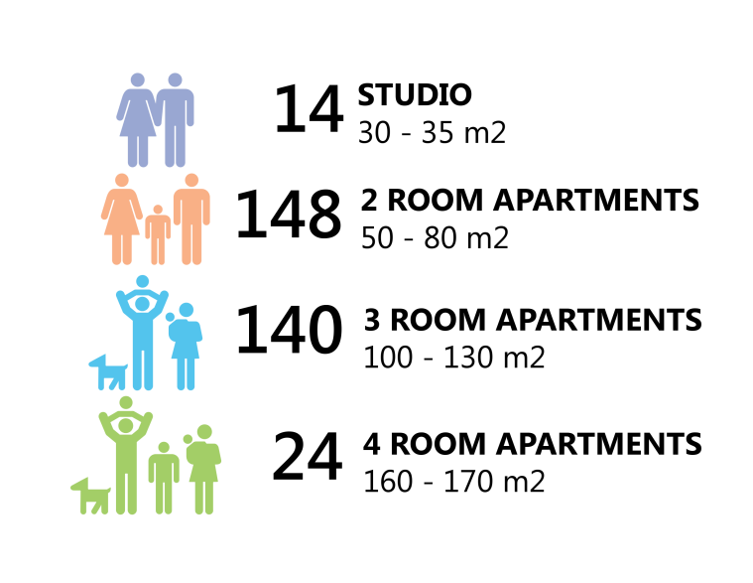

TYPICAL FLOOR PLAN
THE 5 ELEMENTS
TEAM LATVIA
Krista Krancina I Janis Pomerancevs I Elina Skudra

Slide 23
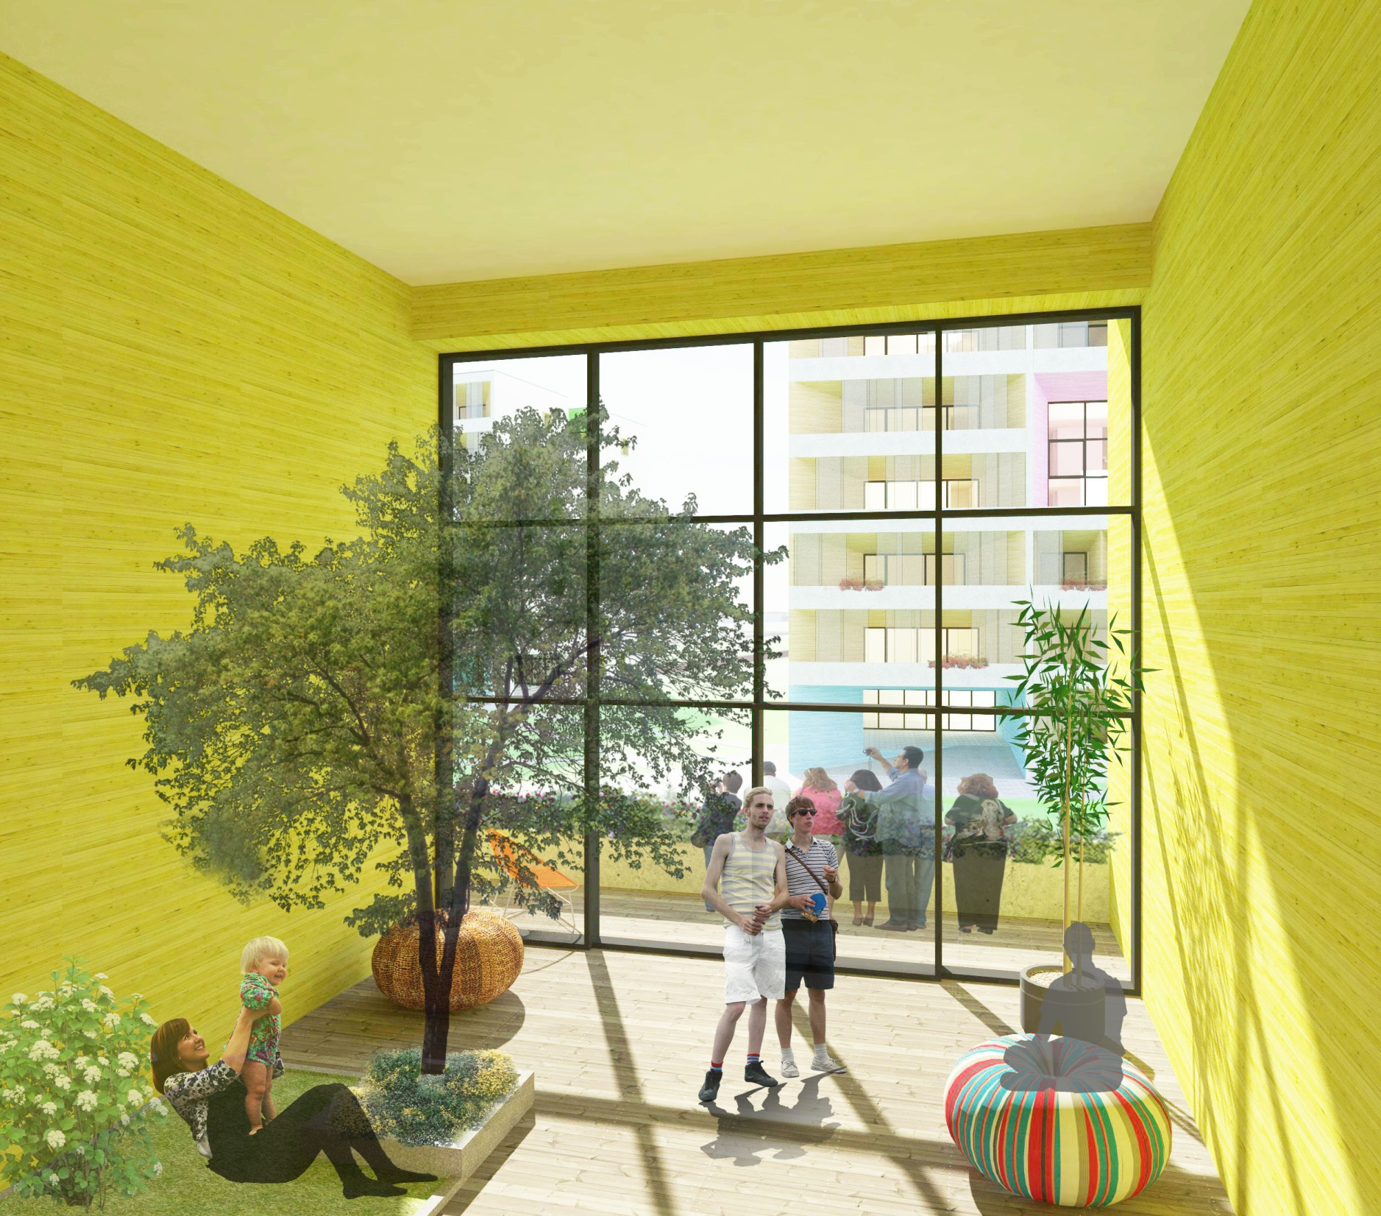
THE 5 ELEMENTS
TEAM LATVIA
Krista Krancina I Janis Pomerancevs I Elina Skudra

Slide 24
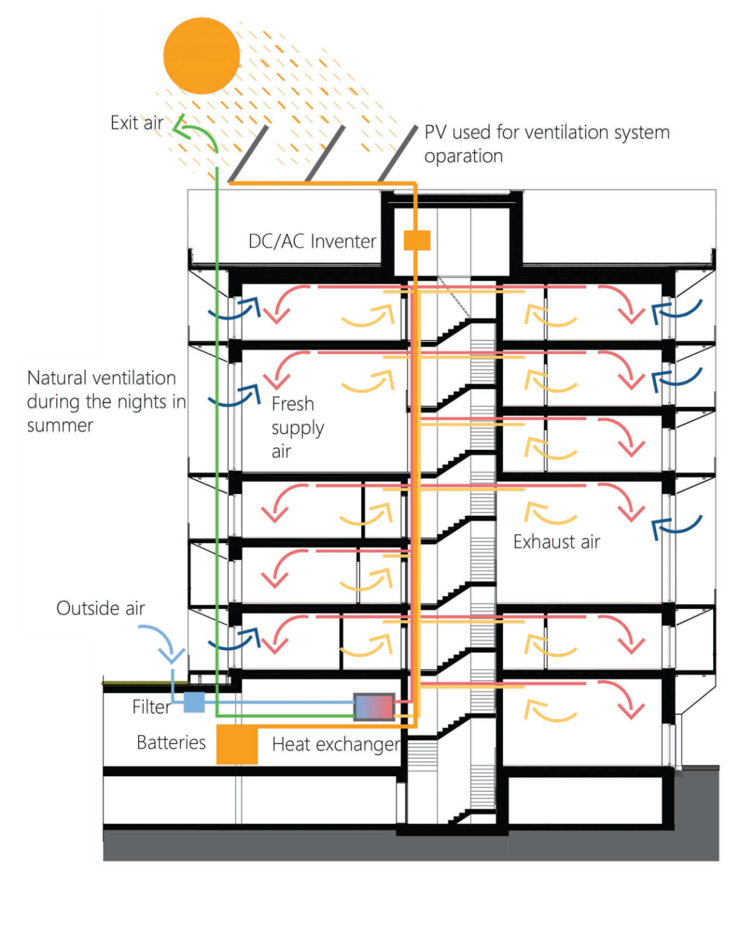

VENTILATION CONCEPT
THE 5 ELEMENTS
TEAM LATVIA
Krista Krancina I Janis Pomerancevs I Elina Skudra

Slide 25
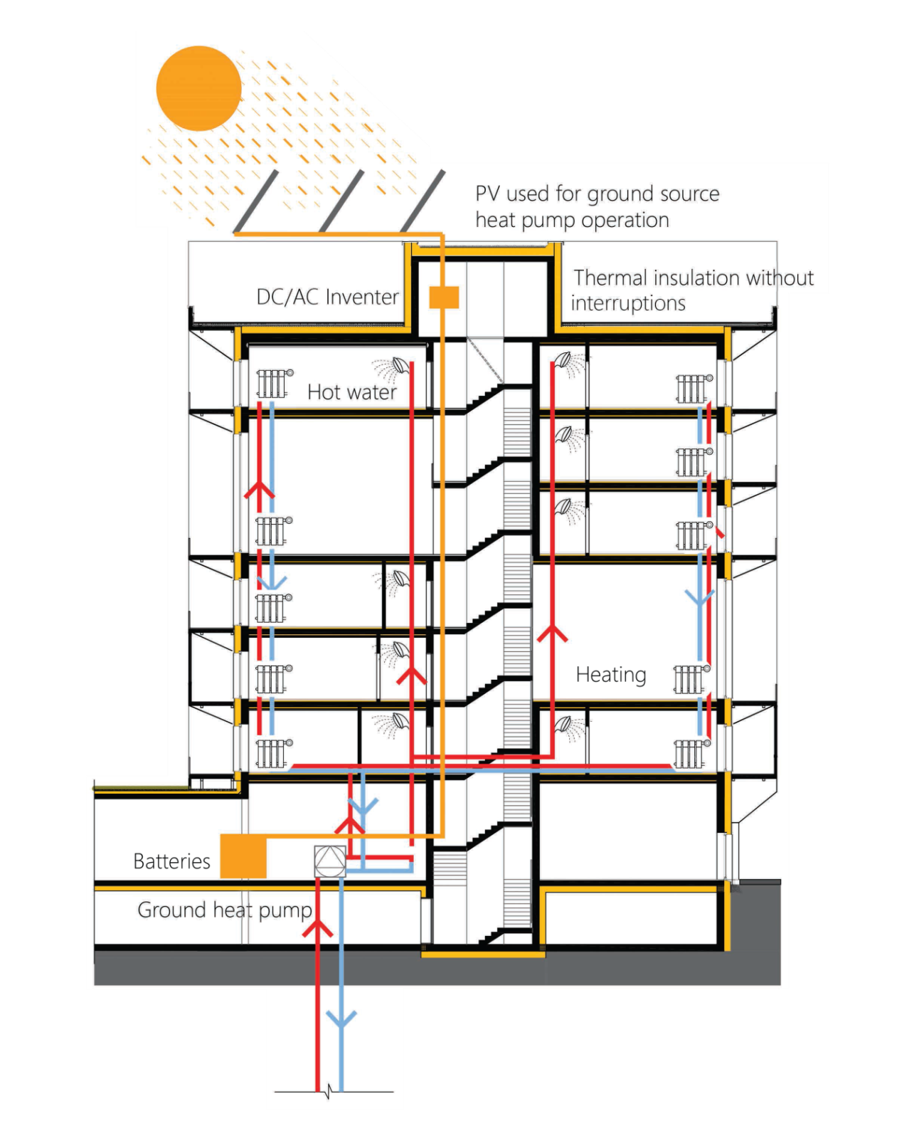

ENERGY CONCEPT
THE 5 ELEMENTS
TEAM LATVIA
Krista Krancina I Janis Pomerancevs I Elina Skudra

Slide 26
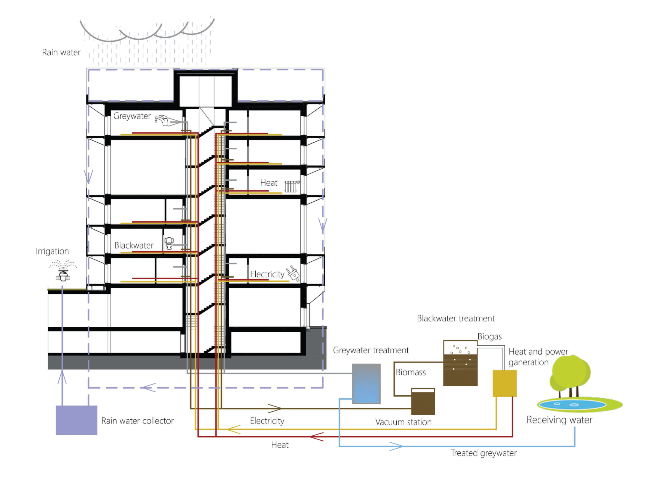

WATER CYCLE CONCEPT
THE 5 ELEMENTS
TEAM LATVIA
Krista Krancina I Janis Pomerancevs I Elina Skudra

Slide 27
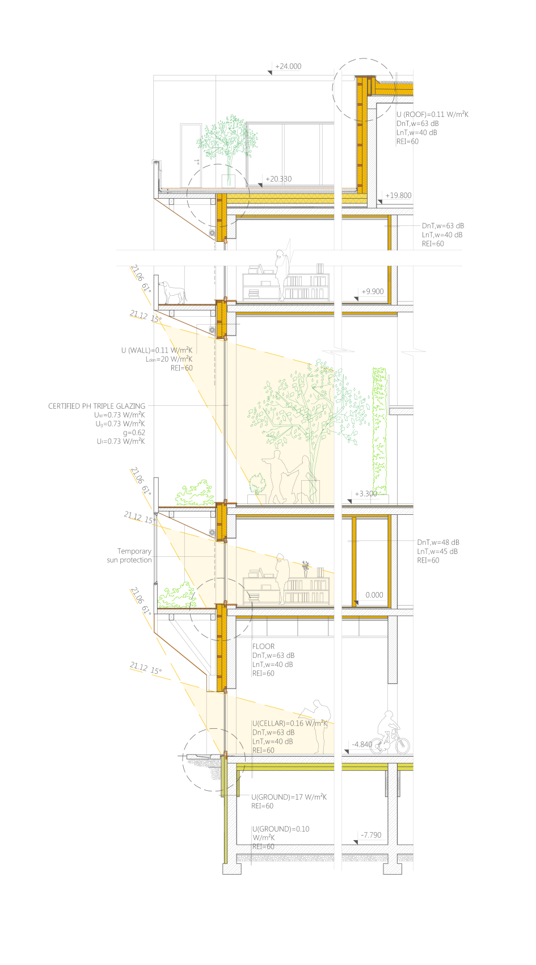
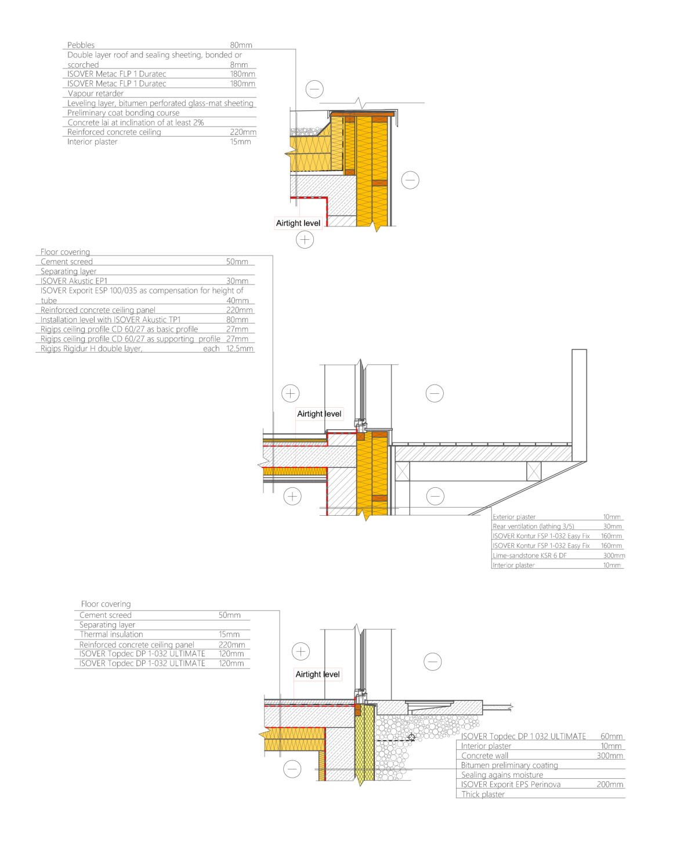
DESIGN DETAILS
THE 5 ELEMENTS
TEAM LATVIA
Krista Krancina I Janis Pomerancevs I Elina Skudra

Slide 28
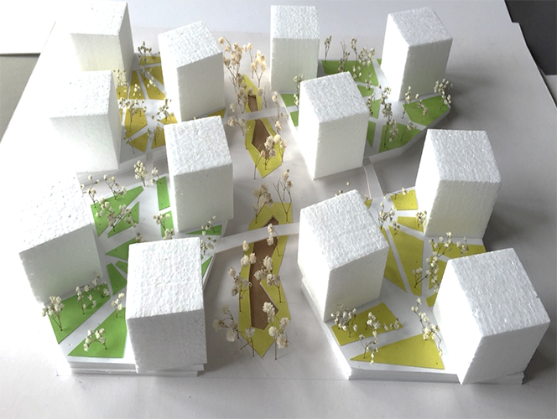
THE 5 ELEMENTS
TEAM LATVIA
Krista Krancina I Janis Pomerancevs I Elina Skudra

