Slide 1




IX Eurasian Academic Libraries Conference “Alive to Changes: Engage. Embrace. Ensure”
30 September - 2 October | 2020
KEYNOTE SPEECH
The Modern Academic Library
changing times, evolving roles
Jayshree Mamtora
Co-Convenor, IFLA Regional Standing Committee for Asia and Oceania
Information Coordinator, IFLA Academic and Research Libraries
Scholarly Communications Librarian,
James Cook University,
Townsville, Australia
jayshree.mamtora@jcu.edu.au
Notes:
Good morning
Zdrasvuyte, Dobroe utro
Thank you so much for the invitation to present at this Conference – I am very pleased to be able to join you today.
In recent years, there have been significant changes in the role of the academic library that has had an impact on the teaching, learning and research of the university. The library has become engaged in new and innovative areas leading to a repositioning of its role and function.
So in this presentation I am going to highlight some of the trends that are impacting our libraries and the way we work, and would like you to consider how these trends fit in with you are at in the workplace – are you already using some of these technologies? Do you already have some of these services in place? How has this impacted on your students and your staff and their successes? If you haven’t, then can you see where you could make changes with what you offer now? Can you reflect on what the long-term impact might be?

Slide 2
Reports consulted
NMC Horizon Report: 2017 Library Edition – North America & Europe
SCONUL: Mapping the future of academic libraries (2017) – UK
ACRL Academic library impact – improving practice and essential areas to research (2017) – USA
IFLA Trends Report (2017) – Global (but solely about academic libraries)
  Riding the waves or caught in the tide: navigating the evolving information environment
Notes:
In preparing this presentation, I have drawn inspiration from a number of library reports: the Horizon Library reports, the SCONUL report from the UK, ACRL in the USA and the IFLA Trends report.
These are listed in the slide [and I also have a list of references that you can download, to look at later].

Slide 3
Trends
Libraries as gatekeepers
Connectivity
Technology
User focus
Complex research environment
Notes:
When we look at the trends identified in each of the four reports, a pattern emerges:
Libraries are acting as gatekeepers, or facilitators
We have rich content collections
Libraries are regarded safe places, with the Librarian as trusted partner
There is Connectivity
Between people and institutions; and
Between the physical and digital – with the latter being the big disrupter
Technology
Ever since the first dial-up modem and bibliographic database, libraries have been both developers and adopters of technology; and this process has only accelerated; but
Technology can be both empowering, and disempowering
There is far more focus on users
Ever since the books were unchained, we’ve always believed that users come first, but now user perspectives and user needs are front and centre of all new innovations and strategies
There is the Emergence of a far more intricate, complex research environment (we also have)
The simple relationship between the researcher who writes a paper and has it published has been disrupted;
Now the researcher/writer can be the publisher, and must provide access to the research as well as the original data [NEXT SLIDE]

Slide 4
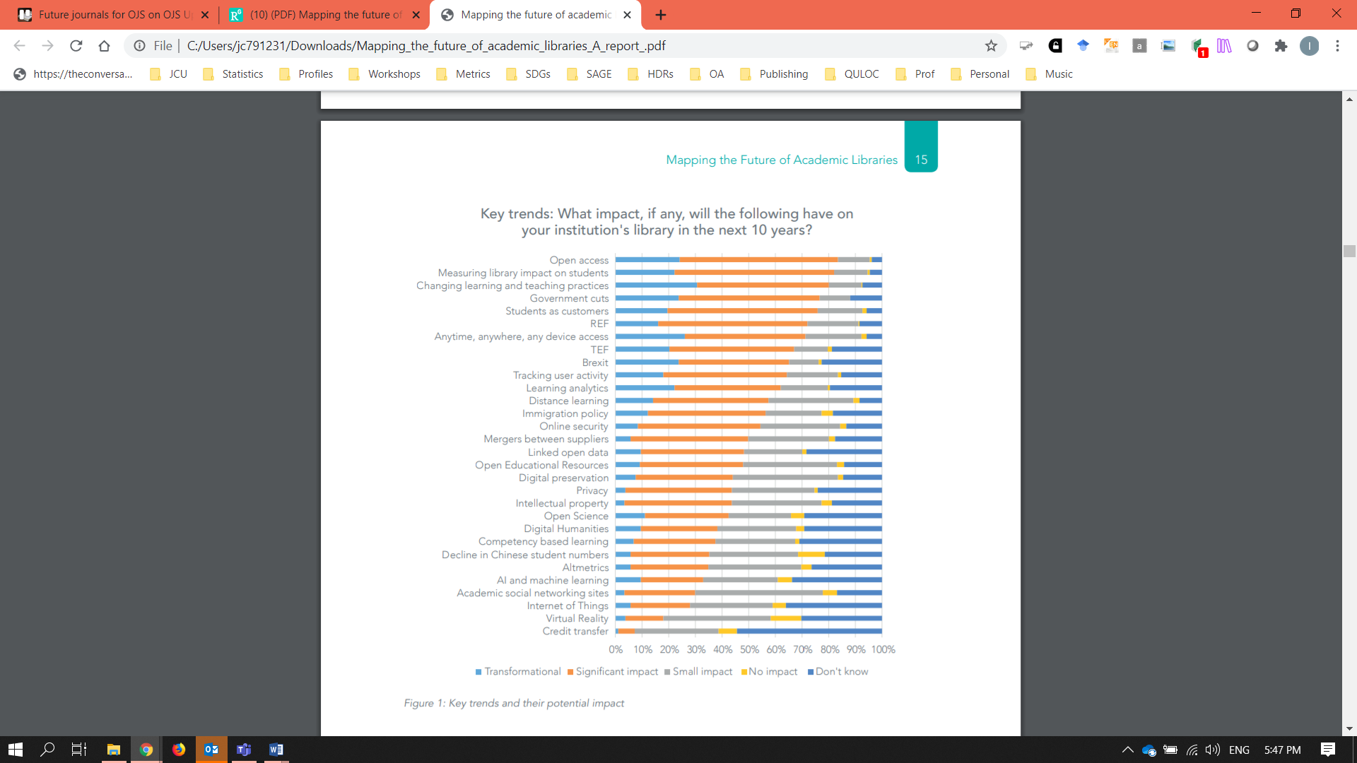
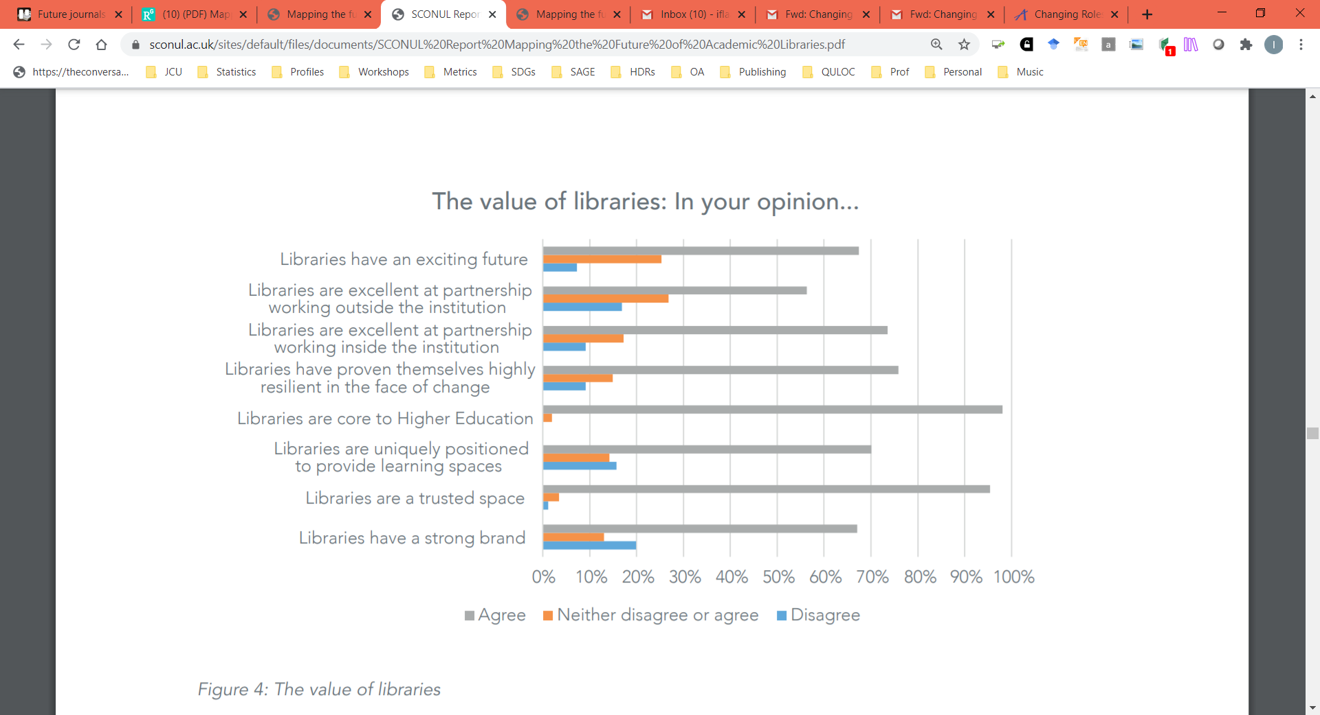
Key Trends
SCONUL, 2017
Notes:
The SCONUL 2017 (Society of College, National and University Libraries) Report, Mapping the Future of Academic Libraries, outlined 30 trends that would impact libraries in the next 10 years based on a national survey of academic librarians UK. They identified the top three key trends as being
Open access
Measuring library impact on students, which has to do with user experience; and
Changing learning and teaching practices
The survey respondents also believed that:
Libraries are core to higher education
Libraries are a trusted space
And libraries have proven themselves highly resilient in the face of change. And change is what they are facing in a significant way right now.
I have chosen just six trends or opportunities, to explore:
Open Access, and Open Scholarship
In terms of the users, the UX Experience, Learning Spaces and Digital Fluency
And in terms of the technology, Artificial Intelligence and Blockchain Technology.
So let’s begin, shall we [NEXT SLIDE]

Slide 5
#1 Open Access
Notes:
As academic librarians, we are all familiar with the open access movement, and the significant role that open access plays in providing unrestricted access to scholarly research. I’m aware tomorrow’s session will focus on open access, and I am very much looking forward to it.
It is 18 years since a group of scholars came together to set up the Budapest Open Access Initiative in 2002, calling for all authors to make their work freely available, rather than allow a publisher to lock it away behind a pay wall.
The group established open access as a concept for the first time, and ten years later at BOAI12, they urged researchers to set the DEFAULT TO OPEN, make OPEN the default for research and scholarship.
The Horizon Library reports identified open access as a trend in their 2014 and 2015 reports; and both the latest 2017 SCONUL and Horizon reports continued to highlight it as a trend in a time of financial hardships. [NEXT SLIDE]

Slide 6
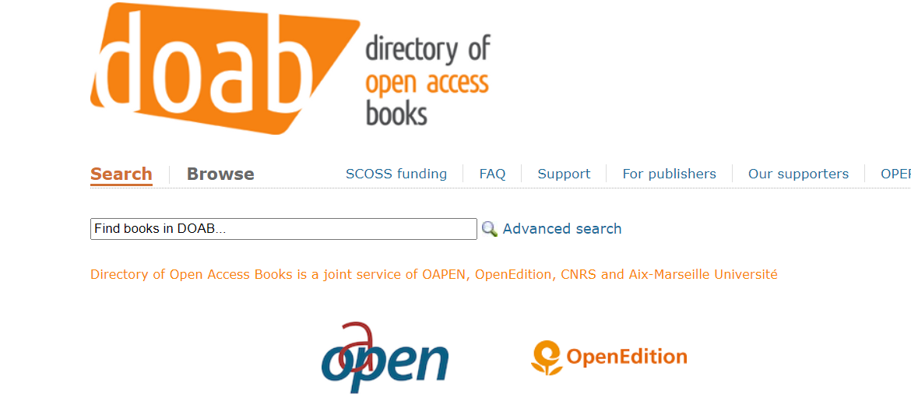
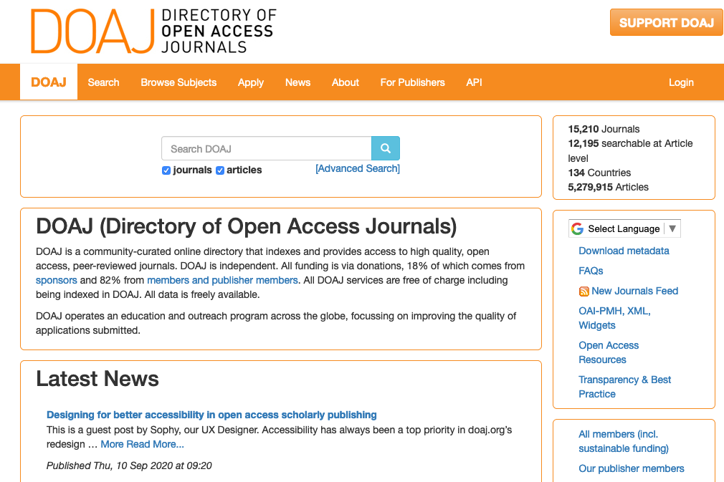
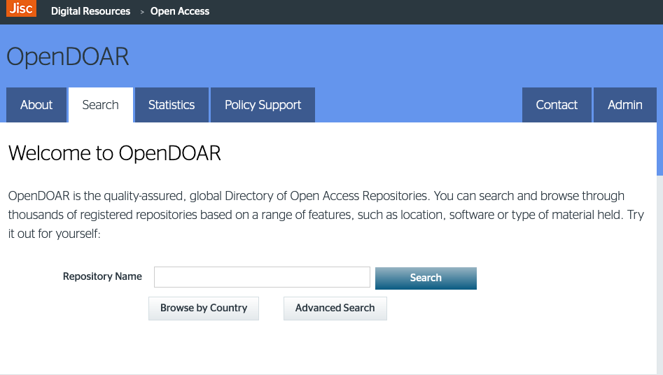
Open Access
Notes:
University libraries have been collaborating with researchers to help make their work freely accessible by setting up open access repositories, and introducing open access policies. Open Access Week is marked every year globally, and Funding bodies have followed suit by mandating open access of any research that they fund.
OA has grown exponentially with the Directory of Open Access Journals (DOAJ) currently lists 5 million articles in over 15,000 peer-reviewed journals from over 130 countries (DOAJ, 2020). We also have the Directory of Open Books with 31,401 from more than 400 publishers.
Of particular note In 2019, the University of California Libraries, the largest public university system in the US, cancelled its US$11 million subscription to Elsevier journals after failure to reach agreement on an OA deal. UC publishes nearly 10% of all research papers in the US with 18% published in Elsevier journals.
More recently we have seen the important role OA is playing during these Covid times

Slide 7
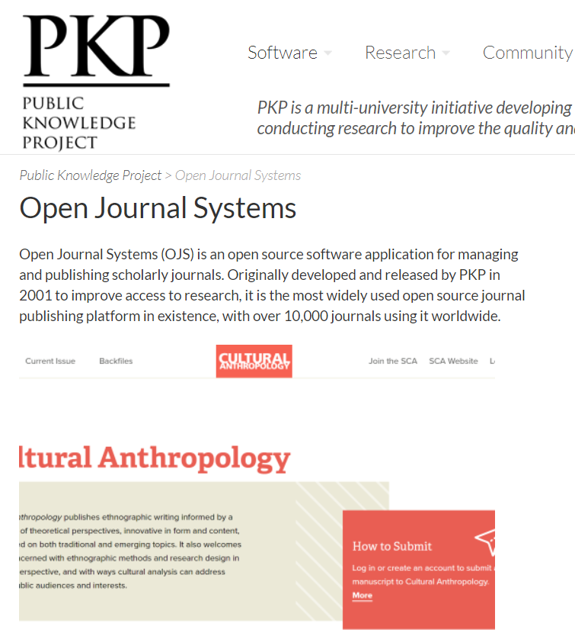
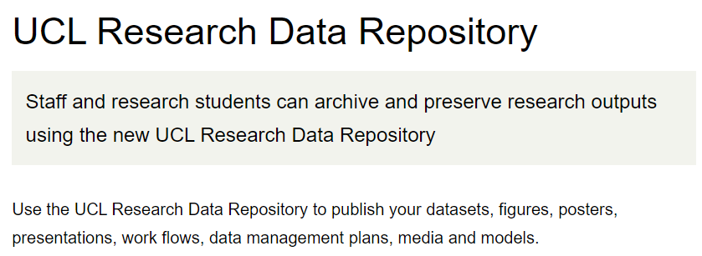
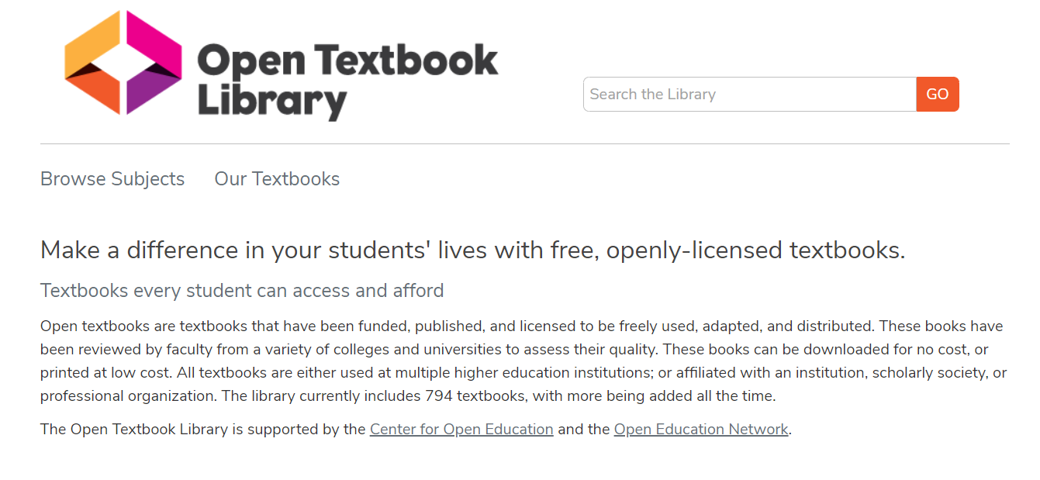
Open scholarship
Notes:
Open access has broadened to Open scholarship with the inclusion of open data, and the emergence of Open educational resources and open source software.
There are now requirements to make the data underpinning the research to be made freely available, and Journals are introducing policies for the data from the research that they publish, to bemade available from a repository.
OERs are now available - Free and openly licensed educational materials that can be used for teaching, learning and research. OERs can be downloaded, embedded, re-used or adapted to suit particular teaching or learning activities, depending on the licence. Examples include the OER Commons and Open Textbook Library. There are a tremendous number of resources available worldwide, from primary through to post-graduate materials.
The Availability of Open source software such as Open Journals Systems which facilitate the publishing of open access journals.

Slide 8
#2 The UX Experience
Notes:
Designing for user experience requires identifying all the individual steps or ‘touchpoints’ by which a user accesses a service or resource – this interaction is known as ‘user experience’, abbreviated as is the way these days as ‘UX’.
UX is a mixture of both the physical and the digital. But the move to digital services and products, has pushed UX to the forefront.
Putting users first is actually what we as librarians do. Any assessment of UX, is an assessment by users.

Slide 9
UX
Trend
Definition:
  Effectiveness – how good is the result?
  Efficiency – how fast or cheap is it?
  Emotional satisfaction – how good does it feel?
  Quality of relationship with the entity that created the product or service?
Notes:
According to Kuniavsky (2010), cited by Walton (2015), user perceptions include:
Effectiveness – how good is the result?
Efficiency – how fast or cheap is it?
Emotional satisfaction – how good does it feel?
What is the Quality of the relationship with the entity that created the product or service?
Academic libraries are now increasingly using ethnographic methodologies when exploring the UX experience, according to Walton (2015).
Walton says “the main pressure to adapt UX in academic libraries has been the dramatic move to digital services and digital information”. The term ‘ethnography’ has developed to mean virtually any qualitative research project.

Slide 10
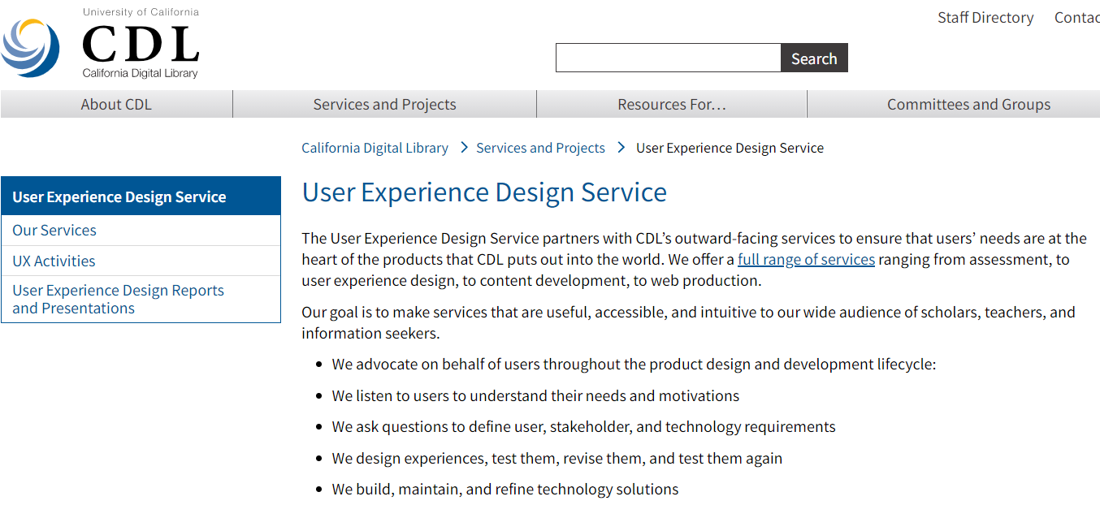
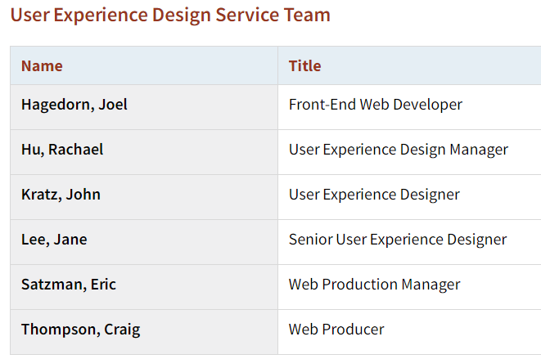
Notes:
At the University of California, the value and importance of UX is seen in the creation of the User Experience Design Service, to support the California Digital Library.
Their mission is more than just about the library catalogue, CDL continues “to explore how services such as digital curation, scholarly publishing, archiving and preservation support research throughout the information lifecycle“

Slide 11
Google can bring you back a hundred thousand answers. A librarian can bring you back the right one
Neil Gaiman, fantasy writer & Honorary Chair of National Library Week in the US
Notes:
Well, remember, academic libraries are having to compete with search engines like Google, that seemingly has everything one would wish at their fingertips.
So the academic library is not the only place to go.
Therefore, the user experience has to be paramount in the design of digital services and products in the academic library, both to differentiate itself from equally easy options, such as Google, and to ensure that the staff and students are best supported in their learning and research.

Slide 12
#3 Learning Spaces
Notes:
Leading on from an improved UX, is the trend of the re-envisioning of library spaces into learning spaces.
Pedagogic changes in higher education, have led to academic librarians rethinking the design of library spaces in order to improve the student experience – we now have “active learning classrooms, media production studios, makerspaces, and other areas conducive to collaborative and hands on work”.
Further, Mehtonen (2016) saw libraries being seen as “hybrid environments – a fusion of physical, social, and digital spaces and services”. The social space dimension fosters face-to-face interactions; and the digital space dimension, facilitates greater responsiveness to patrons’ mobile devices” (Horizon Report, 2017)..

Slide 13
Learning spaces
The Verge, Geelong Waterfront Campus Library, Deakin University
Notes:
And what is noticeable about this trend, apart from the whole ‘user experience’ is that it is inevitable the library partners with other departments in the university.
For example, Deakin University Library in Australia, undertook a joint research project with their School of Architecture and Building, to establish a setting for the evaluation of academic library spaces, built upon a set of Criteria of Quality (CoQ) and Quality Indicators (QI) .
This has proved of value in planning and evaluating library building projects at Deakin (Horn, Lingham & Owen 2014).
One of the lessons learned has been the need for continuous improvement of the framework, particularly given rapid technological change and a highly dynamic higher education environment.

Slide 14
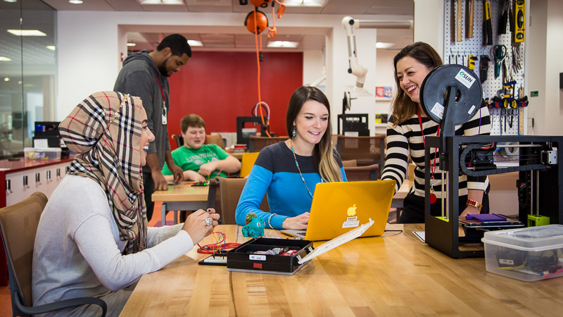
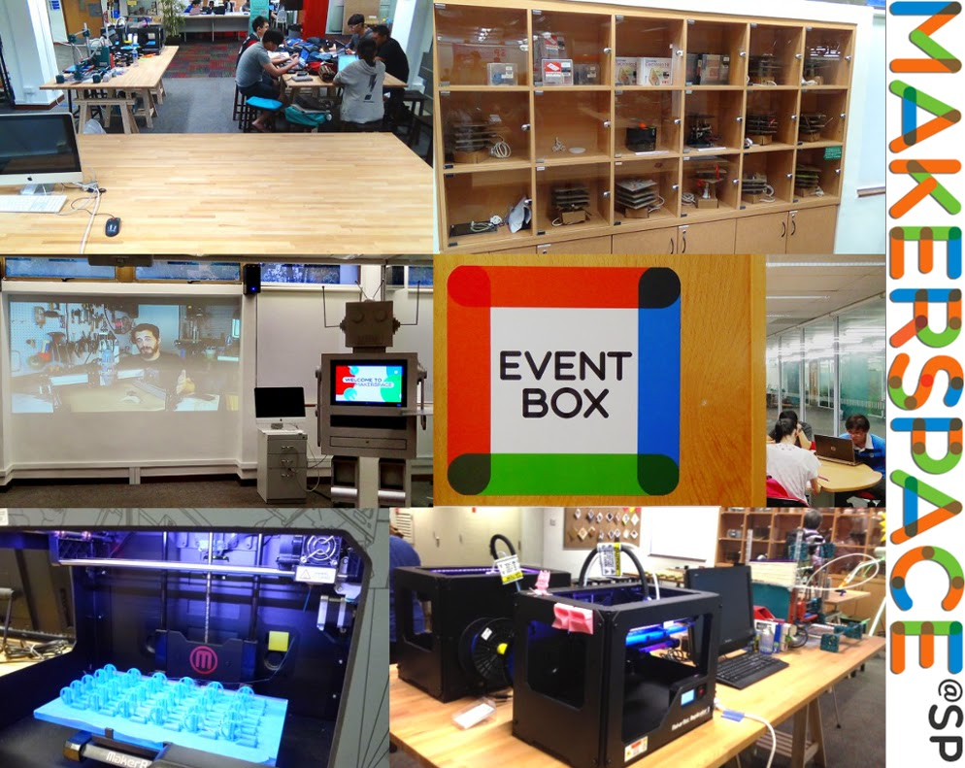
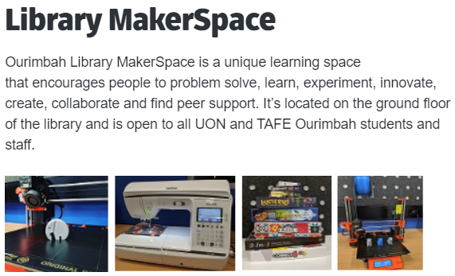
MakerSpaces
Notes:
And what has emerged here is the development of the library makerspace, also named Hackerspace or Hacklab, which offers users an opportunity to create intellectual and physical materials using resources such as computers, 3-D printers, audio and video capture and editing tools, and traditional arts and crafts supplies (Wikipedia).

Slide 15
MakerSpaces
Jon Burke (2015), justified an Academic Library Makerspace:
  It can provide opportunity for hands on learning
  It allows students to work collaboratively with peers – group participation and collaboration
  It allows for self-directed learning
  It allows students to prototype and problem solve
  It allows for tinkering and exploring how things work and delve into troubleshooting
  It can add to a library’s mission by adding making activities that are a reasonable extension of the library’s goals
  It can provide access to services and needs that may not be easy to get at otherwise
Notes:
Jon Burke, in his article, “Making Sense: Can makerspaces work in Academic Libraries,” (2015),
justifies an Academic Library Makerspace in the following way:
AS ABOVE
http://www.ala.org/acrl/sites/ala.org.acrl/files/content/conferences/confsandpreconfs/2015/Burke.pdf)

Slide 16
#4 Digital Fluency
Notes:
Digital fluency was highlighted as one of 10 responsibilities of academic and research libraries over a five-year period, in the 2017 Horizon Library report :
“Spreading digital fluency is a core responsibility [for academic and research libraries]. Libraries are well-positioned to lead efforts that develop patrons’ digital citizenship, ensuring mastery of responsible and creative technology use, including online identity, communication etiquette, and rights and responsibilities” (p. 9).
So what exactly is ‘digital fluency’?
In their paper from 2012, Wang, Myers & Sundaram, defined digital fluency as “the ability to reformulate knowledge and produce information to express oneself creatively and appropriately, in a digital environment”. It’s the digital environment that matters.

Slide 17
Digital fluency
Trend
Definitions
  Digital literacy
  Digital fluency
Notes:
In 2018, Jennifer Sparrow asked, “How is digital fluency different from digital literacy? I
n learning a foreign language, a literate person can read, speak, and listen for understanding in the new language. A fluent person can create something in the language: a story, a poem, a play, or a conversation.
Similarly, digital literacy is an understanding of how to use the tools; digital fluency is the ability to create something new with those tools. Digital fluency can be viewed as an evolving collection of fluencies including, but not limited to, curiosity fluency, communication fluency, creation fluency, data fluency, and innovation fluency” (Sparrow, 2018)
In relation to the UN’s Sustainable Development Goals, Digital Fluency addresses:
SDG4 Ensure inclusive and equitable quality education and promote lifelong opportunities for all
And SDG10 – reduce inequality within and among countries

Slide 18
CAUL Digital Dexterity Project
Resources:
  A position statement on digital dexterity outlining principles and goals
  A Digital Dexterity Framework for library professional setting out the capabilities which make up digital dexterity
  A champions network which include a champion within each member university library who can work within a community of practice to develop skills, share resources and provide feedback to other champions
  An Advocacy Toolkit that provides a structured way to approach advocating for and engaging with conversations about digital dexterity at an institution
  A Digital Dexterity Community of Practice
Notes:
In Australia in 2019, the Council of Australian University Librarians (CAUL), took the concept of digital fluency one step further, and released a position statement on ‘digital dexterity’.
CAUL says that “Digital dexterity is a fundamental aspect of the mission of university libraries, now and for the foreseeable future”; and that it is more than digital literacy, and that it enables “active participation in all aspects of work and life in a digital world”. Again, this is the digital environment we are talking about.
So how does CAUL propose to advance digital dexterity? CAUL has developed a range of resources to encourage digital dexterity at Australian academic institutions:
Released A position statement
A national champions network
An advocacy toolkit
A community of practice
One of the examples CAUL provides, is work being undertaken at La Trobe University in Melbourne, Australia [NEXT SLIDE]

Slide 19
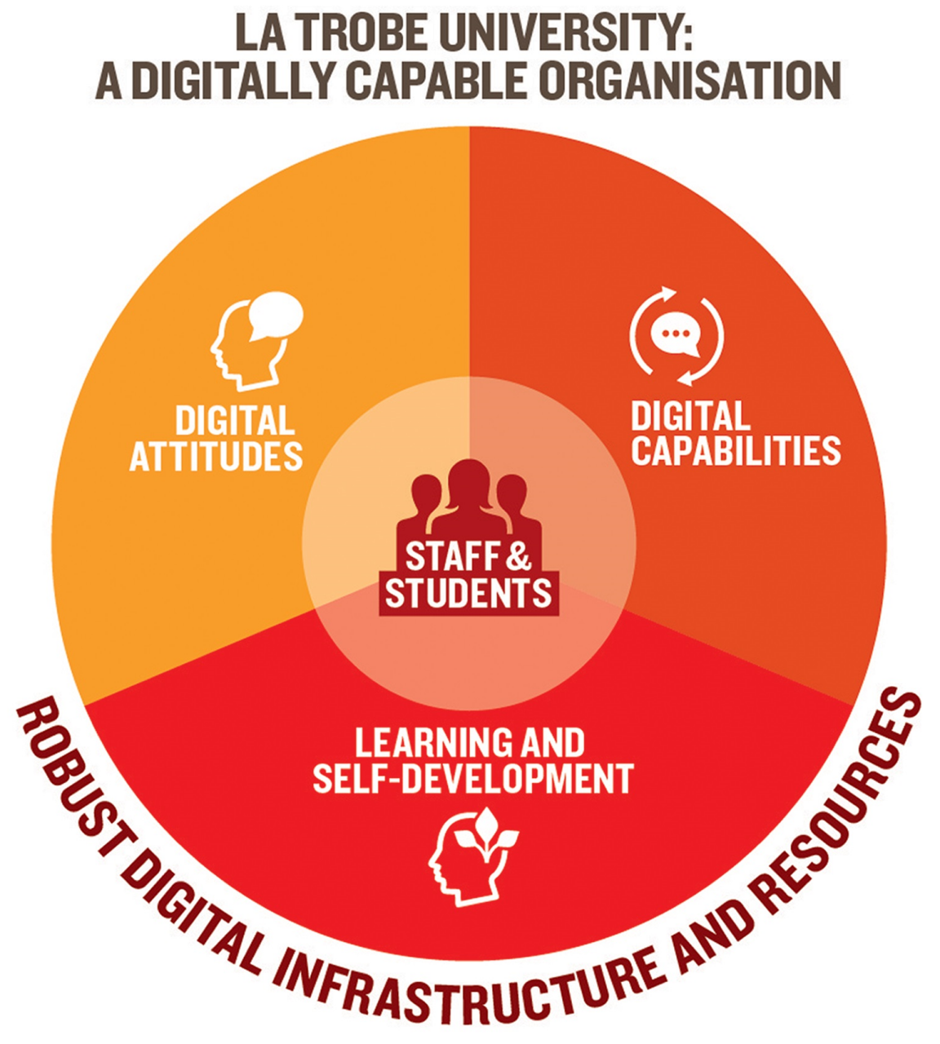
Digital fluency @La Trobe Uni
Notes:
The La Trobe University (LTU) Digital Literacies Framework, supports its strategic focus on digital capabilities by outlining the attitudes and skills that its staff and students need in a digitally connected world.
The Framework provides the basis for a coordinated and collaborative approach to:
building staff capacity for digital practice and scholarship
building digital knowledge and capabilities into the student learning and research experience
engaging staff, students and other stakeholders in scholarly conversations about digital issues.
The University vision is for a digitally capable organisation which supports digital innovation and prepares students for an increasingly digital future. In this environment, staff and students can develop the know-how and skills to enable them to be confident and competent digital agents, operating fearlessly in a digital world.
It is well worth downloading this Framework, and seeing to what extent it meets your current and future needs.

Slide 20
#5 Artificial Intelligence
Notes:
When we consider the application of artificial intelligence, or AI, in libraries, do we think of robots in libraries?

Slide 21
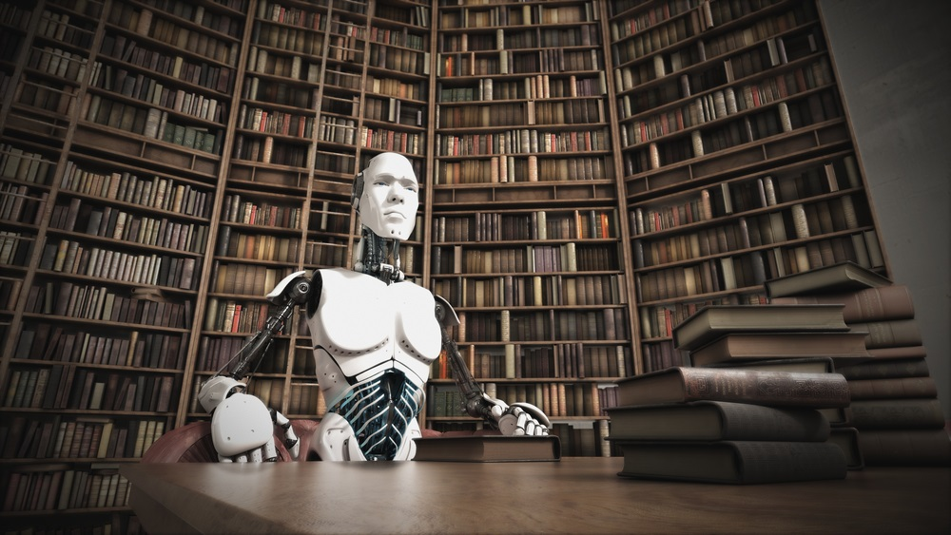
Artificial intelligence
http://relentlesswriters.blogspot.com/2015/10/curious-robot-visits-library.html
Notes:
Are robots in libraries just a gimmick? Or can they contribute something special?
If we step back a little, we can appreciate that AI could be a major innovation for academic libraries. The 2017 Library Horizon Report, stated that “these emerging technologies can personalise the library experience for patrons, connecting them more efficiently to resources that best align with their goals”.
[NEXT SLIDE]

Slide 22
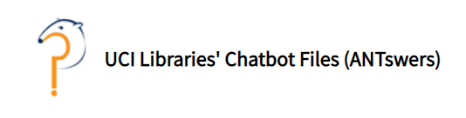
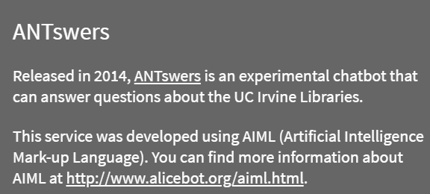
Artificial intelligence
Application of AI in libraries:
  Augmented reference services – a 24/7, 365-day reference service
Notes:
At the University of California at Irvine, the University’s mascot, Peter the Anteater, has been adopted by the library to deliver ANTswers, an augmented reference service. Of the 12,000 questions that have been asked of the ANTswers library chatbot, to date, 63% have been library related, and 80% of them have been answered correctly (Zalaznick 2019).
Also, the impersonal nature of a robot or chatbot can sometimes be an advantage. Tim Smith, the library’s head of web service, says that “the people least likely to ask questions in person, are the ones most likely to drop out. One of our main goals was providing those students an avenue to ask questions where they wouldn’t before” (Zalaznick 2019). Who knew librarians were so scary?
Of course, the library chatbot is only as good as the algorithm upon which it is based. And algorithms are written by humans.
In 2018, at the University of Rhode Island, the library opened the first AI Lab in any US university library. This addressed the twin aims of introducing the technology, as well as affording a neutral venue where the impacts of AI could be discussed (Zalaznick 2019). [NEXT SLIDE]

Slide 23
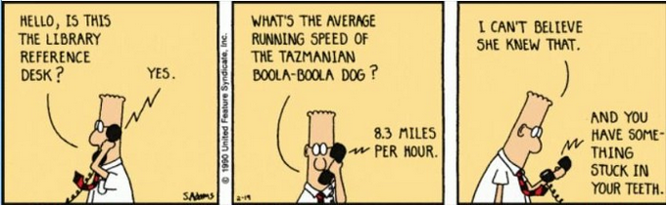
https://medium.com/@NormanJacknis/the-ai-enhanced-library-a34d96fffdfe

Slide 24
Artificial intelligence
Application of AI in libraries:
  Augmented reference services – a 24/7, 365-day reference service
  Enhanced knowledge discovery
    Sorting the wheat from the chaff
Notes:
The use of AI in academic libraries as a tool to facilitate access to collections, is an obvious choice.
The US Library of Congress has developed a program to use AI to enable users to access over 1.5 million photos in over 16 million newspaper pages (Macaulay 2020).
The name of the AI tool, Newspaper Navigator, uses an ‘object detection tool’ trained to find photos, illustrations, maps, cartoons, comics, headlines & adverts. The tool then uses OCR – optical character recognition – just as you would use to find text in a PDF, in order to link the image with the corresponding article.
[NEXT SLIDE]

Slide 25
Artificial intelligence
Robots in libraries? Robots as librarians?
Application of AI in libraries:
  Augmented reference services – a 24/7, 365-day reference service
  Enhanced knowledge discovery
    Sorting the wheat from the chaff
    Transcription / Interpretation / Connections
Notes:
At the 2nd International Conference on AI for Libraries, Archives, and Museums, held at Stanford University in December 2019, delegates discussed how applications of AI can unlock our past for the benefit of the future (Coleman 2020). And one of the key steps is to demystify and democratise AI.
Attention was given to Finland and its attempt to ensure that 1% of the population have a basic knowledge of how AI works and can be used. Now, Finland has a small population (5.5m), just 29% of Kazakhstan (in a landmass of just 12%), but ensuring that 55,000 citizens know about AI and its use, is a pretty good start.
Opening up access to historic collections, such as manuscripts, is an ideal, if difficult task for machine learning.
An example is the In Codice Ratio research project in Italy, which is using AI to capture handwritten documents comprising over 85 kilometres of shelving
held in the Vatican Secret Archive, (referenced in Coleman 2020). [NEXT SLIDE]
I’d now like to turn to the next and last trend … [NEXT SLIDE]

Slide 26
#6 Blockchain Technology
Notes:
A blockchain is, a growing list of records, i.e. blocks. Crucially, each block is imprinted with a cryptographic hash of the previous block, a timestamp, and transaction data. By design, a blockchain cannot be modified.
Fundamental to blockchain is that it addresses the issue of ‘trust’. Owing to the fact that blockchains are open and transparent, it is possible to have trust in the blockchains. And by being decentralised, it reduces the likelihood of being open to capture.
[NEXT SLIDE]

Slide 27
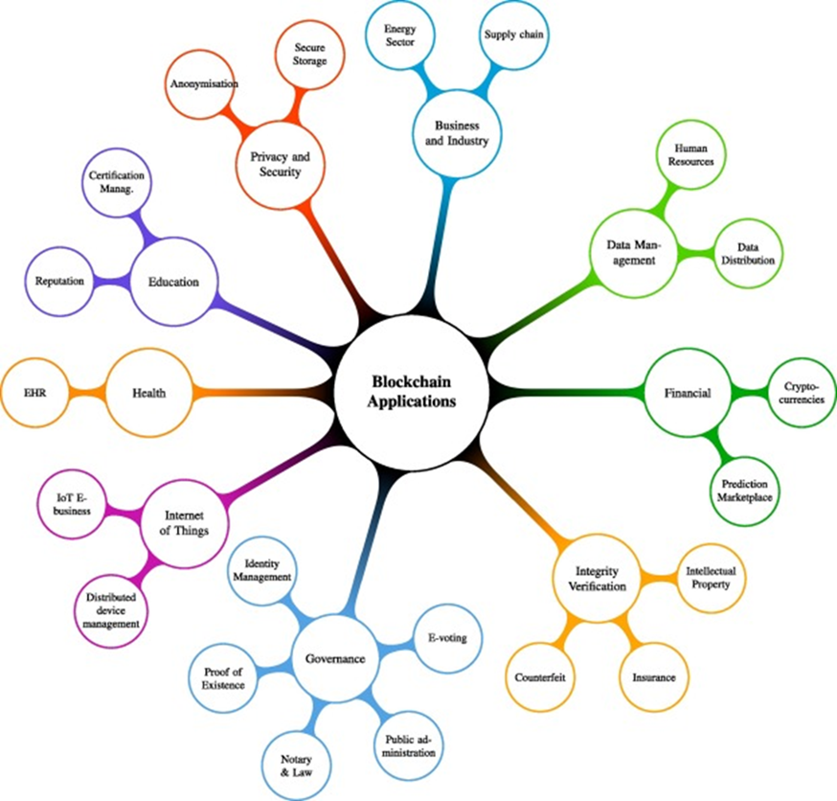
Blockchain Applications
Uses of blockchain:
  Privacy and security
  Business and industry
  Integrity verification
  The Internet of Things
  Health
  Education
  Governance
  Data Management
Casino, Dasaklis and Patsakis, 2018
Notes:
These features are what has led to blockchain being most associated with cryptocurrencies, like Bitcoin, where trust, traceability and authenticity, are paramount.
In this mage, a Mindmap abstraction of the different types of blockchain applications, (from a paper by Casino, .Dasaklis and Patsakis, 2018), we can see the different areas in which blockchain technology can be applied.
Of interest as librarians, are the areas to do with integrity verification (IP), governance (proof of identity), and data management

Slide 28
Blockchain in Libraries
Use in academic libraries
  Archives & special collections
  Digital preservation & general data
  Rights & royalty payments
Notes:
In academic libraries, there are many potential uses of blockchains. I will focus on 3:
In archives & special collections, including records management, where provenance & authenticity are essential
For verifying digital assets, such as in digital preservation & general data deposit
To manage rights & royalty payments, where there is a need to assign proof of ownership of a digital asset; and also ensure that any rights’ payments are conveyed to the rights’ holder.
Blockchain is just one of a number of new technologies, together with AI and the Internet of Things, that we will see utilised increasingly in academic libraries. Whether we understand it or not, blockchain will be part of the future.
In a presentation to the CILIP Blockchain Briefing in London earlier this year, Hamilton suggested that “blockchain offers the potential to revolutionise our processes – research papers could be linked automatically to grants, equipment, personnel, research data and software. And perhaps more importantly – citations, attempts to reproduce experimental results, retractions and updates. Taking this to its logical conclusion, blockchain could provide the global research community with programmable digital infrastructure”.
[NEXT SLIDE]

Slide 29
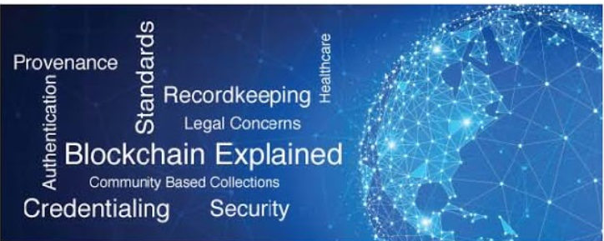
Notes:
In 2018, researchers from San Jose State University in the US, predicted that blockchain technology was “ a trend on the brink of revolutionizing the public and private sectors…”, “but librarians have not been evidenced in these mainstream discussions. However, the use of blockchain technology in libraries is on the radar of many information professionals who are curious about or understand its disruptive potential”.
Since then the University received a grant to study this in more detail for a better understanding of blockchain technology in libraries.
Just last month, the University reported back that it used the grant for to host a national forum, deliver a virtual conference, sponsored a MOOC on blockchain (https://ischool.sjsu.edu/blockchain-mooc), and published a book outlining opportunities and challenges for blockchains in libraries.

Slide 30
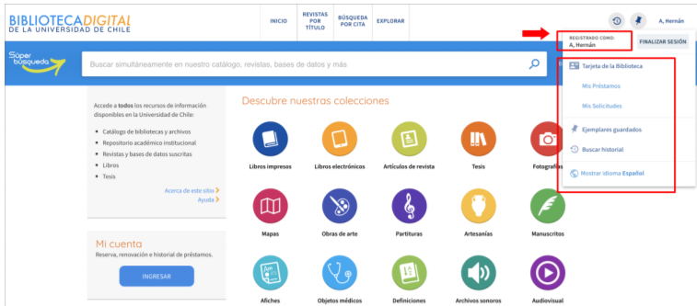
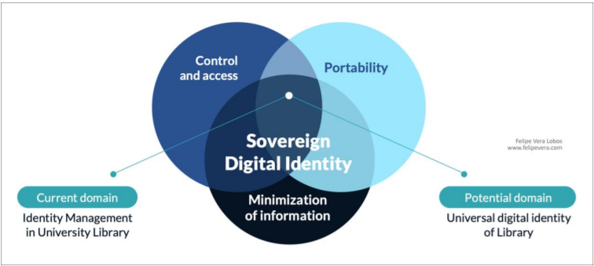
Lobos and Lagos, 2019
Notes:
At the University of Chile Library in South America, blockchain technology is being trialled for use in a decentralised inter library loans system. Each participating institution, regardless of the library management system they are using, whether it be commercial software, open source technologies, or custom-developed systems, can collaborate, using blockchain technology to verify the authenticity of each individual borrower.
Its early days yet, so keep an eye on these developments.

Slide 31
Conclusion
Notes:
In this presentation, I have only been able to highlight a few trends – and challenges – that academic librarians face. What is clear is that the future is very much in our own hands.
So what have we learnt?
We have seen how the open movement has facilitated an explosion in the quantity of publications, of the availability of information and data, encouraging greater knowledge and enquiry in support of research and learning;
We have seen ways in which technology is being used to better exploit our collections, to authenticate the data, and facilitate deeper access;
We have seen how important is the need for staff and students to be digitally fluent, to better manipulate the digital resources and services;
And we have revisited the need to be user-centric in the design of our products and services, and the design of our library spaces, both physical & digital.
Having seen all this, we are now best placed to meet the challenges of both the present time, and the future [NEXT SLIDE]

Slide 32
Concluding thoughts
Adaptability – academic librarians must be prepared to acquire new skills, new knowledge, new perspectives
Interconnectedness – products and services are connected on multiple levels, to do with skills, technology, UX, access, policies
Connectedness – partnerships are paramount to achieving meaningful change
The future is OPEN – open access, open scholarship, open data
Notes:
So what would lead to our success in this venture?
Adaptability – as librarians, we need to become much more adaptable, and much more open to new ideas, new services, and new ways of doing things. I think we’ve shown that we can do this. We have to ensure that we continuously update our skills and those of our staff to keep up with a changing world.
Interconnectedness – if we introduce, for example, new digital products and services, then we also have to address issues associated with them, e.g. to do with technology skills, user experience, access, digital fluency, policies – they’re all interconnected. We need to be on the same wave length as the institutions that we work for so that we keep up with the changes in the institution and the higher education sector. Not just for the sake of it, rather for improving the way we do things, bettering our services and contributing to the success of our students and staff.
Connectedness –We’ve seen in the examples I’ve given that a library partnering with other departments and colleges in a university, as well as other institutions can deliver benefits beyond what a single academic library can hope to achieve on its own. For this reason, partnerships are key.
We already know this, the future is open – if we are to advance research in our institutions, facilitate access to information and knowledge, enhance teaching and learning, strengthen connectedness – then the only way is through open initiatives.
THE FUTURE IS OURS to LEAD AND TO BELIEVE IN
A final word …

Slide 33
A final word about IFLA
IFLA
  Explore the ten ways you can engage with IFLA
IFLA Regional Standing Committee for Asia and Oceania
  Committee member: Irina Shubina, KAZGUU University
  Webinar: Academic Libraries in the Post-COVID World, 16 October
    Speakers include Mr Piotr Lapo, Nazarbayev University Library
IFLA Academic and Research Libraries
  Regular webinars and blog posts
Notes:
Explore the 10 ways YOU can engage with IFLA.
IFLA’s own mission is to inspire, engage, enable and connect the field.
Member countries: https://www.ifla.org/node/9511

Slide 34
IX Eurasian Academic Libraries Conference “Alive to Changes: Engage. Embrace. Ensure”
30 September - 2 October | 2020
THANK YOU FOR LISTENING!
Jayshree Mamtora
Co-Convenor, IFLA Regional Standing Committee for Asia and Oceania
Information Coordinator, IFLA Academic and Research Libraries
Scholarly Communications Librarian,
James Cook University,
Townsville, Australia
jayshree.mamtora@jcu.edu.au
Notes:
Spasibo bolshoe!
Dosvidaniya!
Thank you very much!

