Slide 1
Practical BCI speller based on user-specific feature representation and Convolutional Neural Network
Author:
Thesis Advisor:
Thesis Co-Advisor:
Accepted by:
Madina Kudaibergenova, MS in CS
Min-Ho Lee, Assistant Professor
Berdakh Abibullaev, Assistant Professor
Vassilios D. Tourassis, Dean

Slide 2

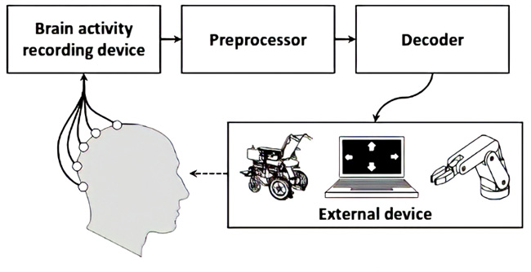
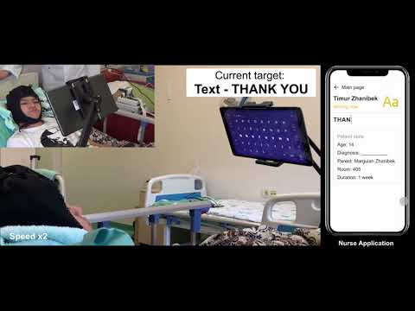
Introduction
Brain-Computer Interface (BCI) - system enables users (with disabilities) to interact with a computer by brain-activity measured via electroencephalogram (EEG) [1].
EEG - test to detect electrical activity in brain using small metal discs (electrodes) attached to scalp. EEG-based devices consist of: EEG cap/headset, electrodes, EEG recorder (amplifier, power), visual feedback (e.g. computer monitor) [2].
BCI implementations: ERP BCI speller -> detects EEG signal to identify the expected character. BCI-spelling application allows the users to communicate with environment using a GUI: displaying letters, numbers, and special symbols[3].
General BCI system
Demo video of practical BCI system

Slide 3
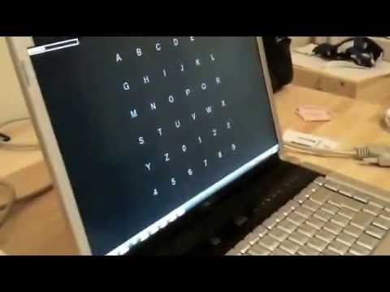
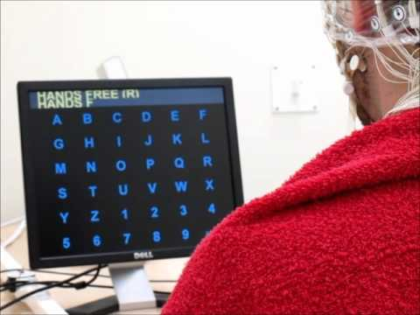
Previous works - Monitor-sized BCI spellers
Standard BCI spellers are implemented in 20-22-inch screen with 2-3 cm character size and 5 cm distance b/w them [4-6].
BCI speller system implemented on laptop monitor.
Authors: Armagan Amcalar and Mujdat Cetin, Sabanci University, Turkey.
BCI speller using brain waves to spell words.
Authors: Neuronal oscillations and cognition group, Dept. Integrative Neurophysiology, CNCR, VU University Amsterdam.

Slide 4
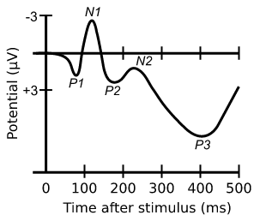
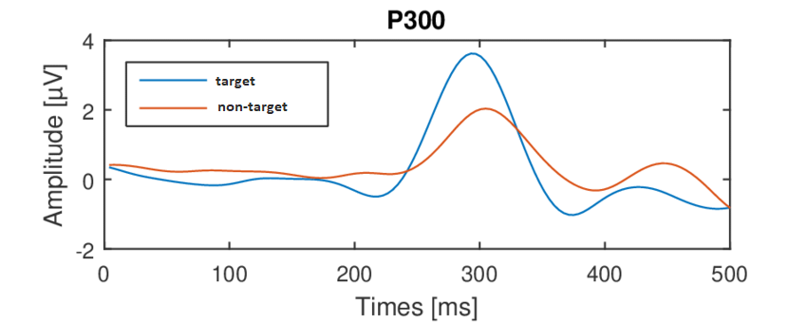
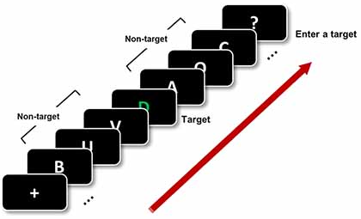
Previous works - Enhancing P300
BCI goal - detect features to translate them into commands
P300 - ERP component, positive deflection
Oddball paradigm when a subject detects an occasional target stimulus
The amplitude of the P300 evoked potential is inversely proportional to the probability of infrequent or task-related stimulus
Evoked by passively gazing -> to increase P300 -> mental task (counting) or emphasize stimuli (showing familiar faces, making stimuli bigger, multicoloured stimuli)
P300 amplitude directly proportional to size of stimulus
P300 component evoked at 300 ms after stimuli showed [11]
Oddball paradigm: rare stimulus within series of frequent stimuli [12]

Slide 5
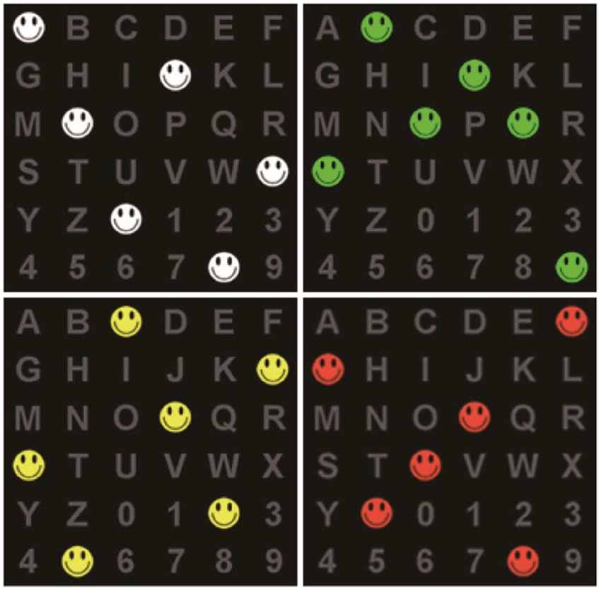
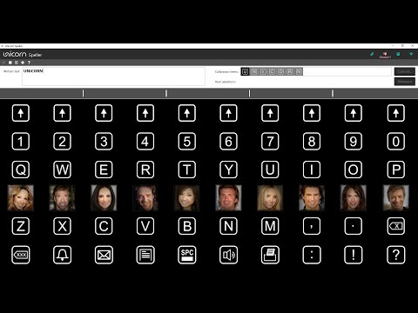
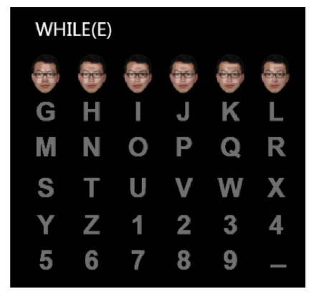
Previous works - Enhancing P300
The main aim of traditional BCI spellers is to increase P3, and they use mental task: color distinction, different stimuli shapes and difficulty modulation [7-9]. However, such BCI spellers cause eye fatigue.
BCI speller with colored smiley faces.
Author: Changchun University of Science and Technology, China
The Unicorn P300 Speller.
Author: Unicorn Brain Interface, Austria.
BCI-Speller with faces stimuli.
Author: Changchun University of Science and Technology, China
Notes:
Add citations to table

Slide 6
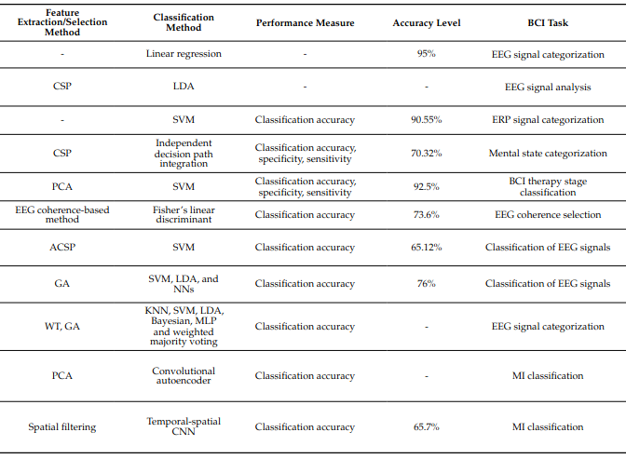
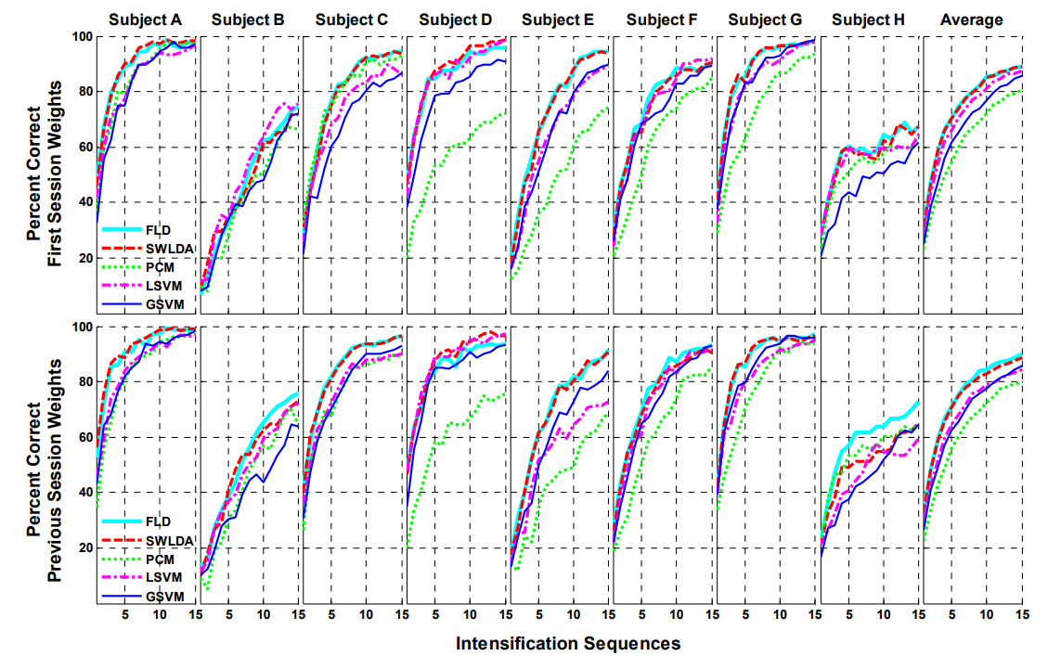
Previous works - Classification techniques
There are a lot of studies on MI-based LDA and CNN classifiers. For ERP-BCI spellers linear models are the popular classification techniques, and a few of them are CNN [10-12]:
5 classification techniques on data collected using the P300 Speller paradigm.
4 linear methods:
  Pearson’s correlation method (PCM)
  Fisher’s Linear Discriminant (FLD)
  stepwise linear discriminant analysis (SWLDA)
  a linear support vector machine (LSVM)
1 nonlinear method:
  Gaussian kernel support vector machine (GSVM)
Compared for classifying offline data from 8 users;
SWLDA and FLD - best overall performance.
Performance curves for each method of training

Slide 7
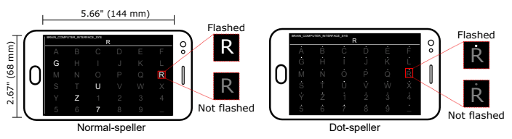
Motivation
Background:
Traditional BCI-spellers - large-sized -> static and inconvenient [4-6]
Stimuli can be unintuitive (different colors and shapes) -> confusing interface and eye fatigue [7-9]
The majority uses linear models for ERP classification [10-12]
Idea:
Small-sized speller & 1mm stimuli -> real-world application (smartphone)
Mental task - sound imagery:
  simple and short
  intense and stronger
LDA and CNN with automatic feature extraction
Normal-speller and the proposed dot-speller with diminutive-sized stimuli

Slide 8
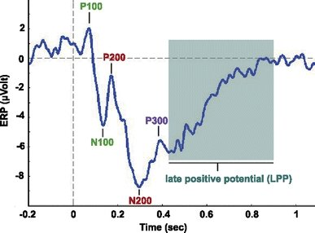
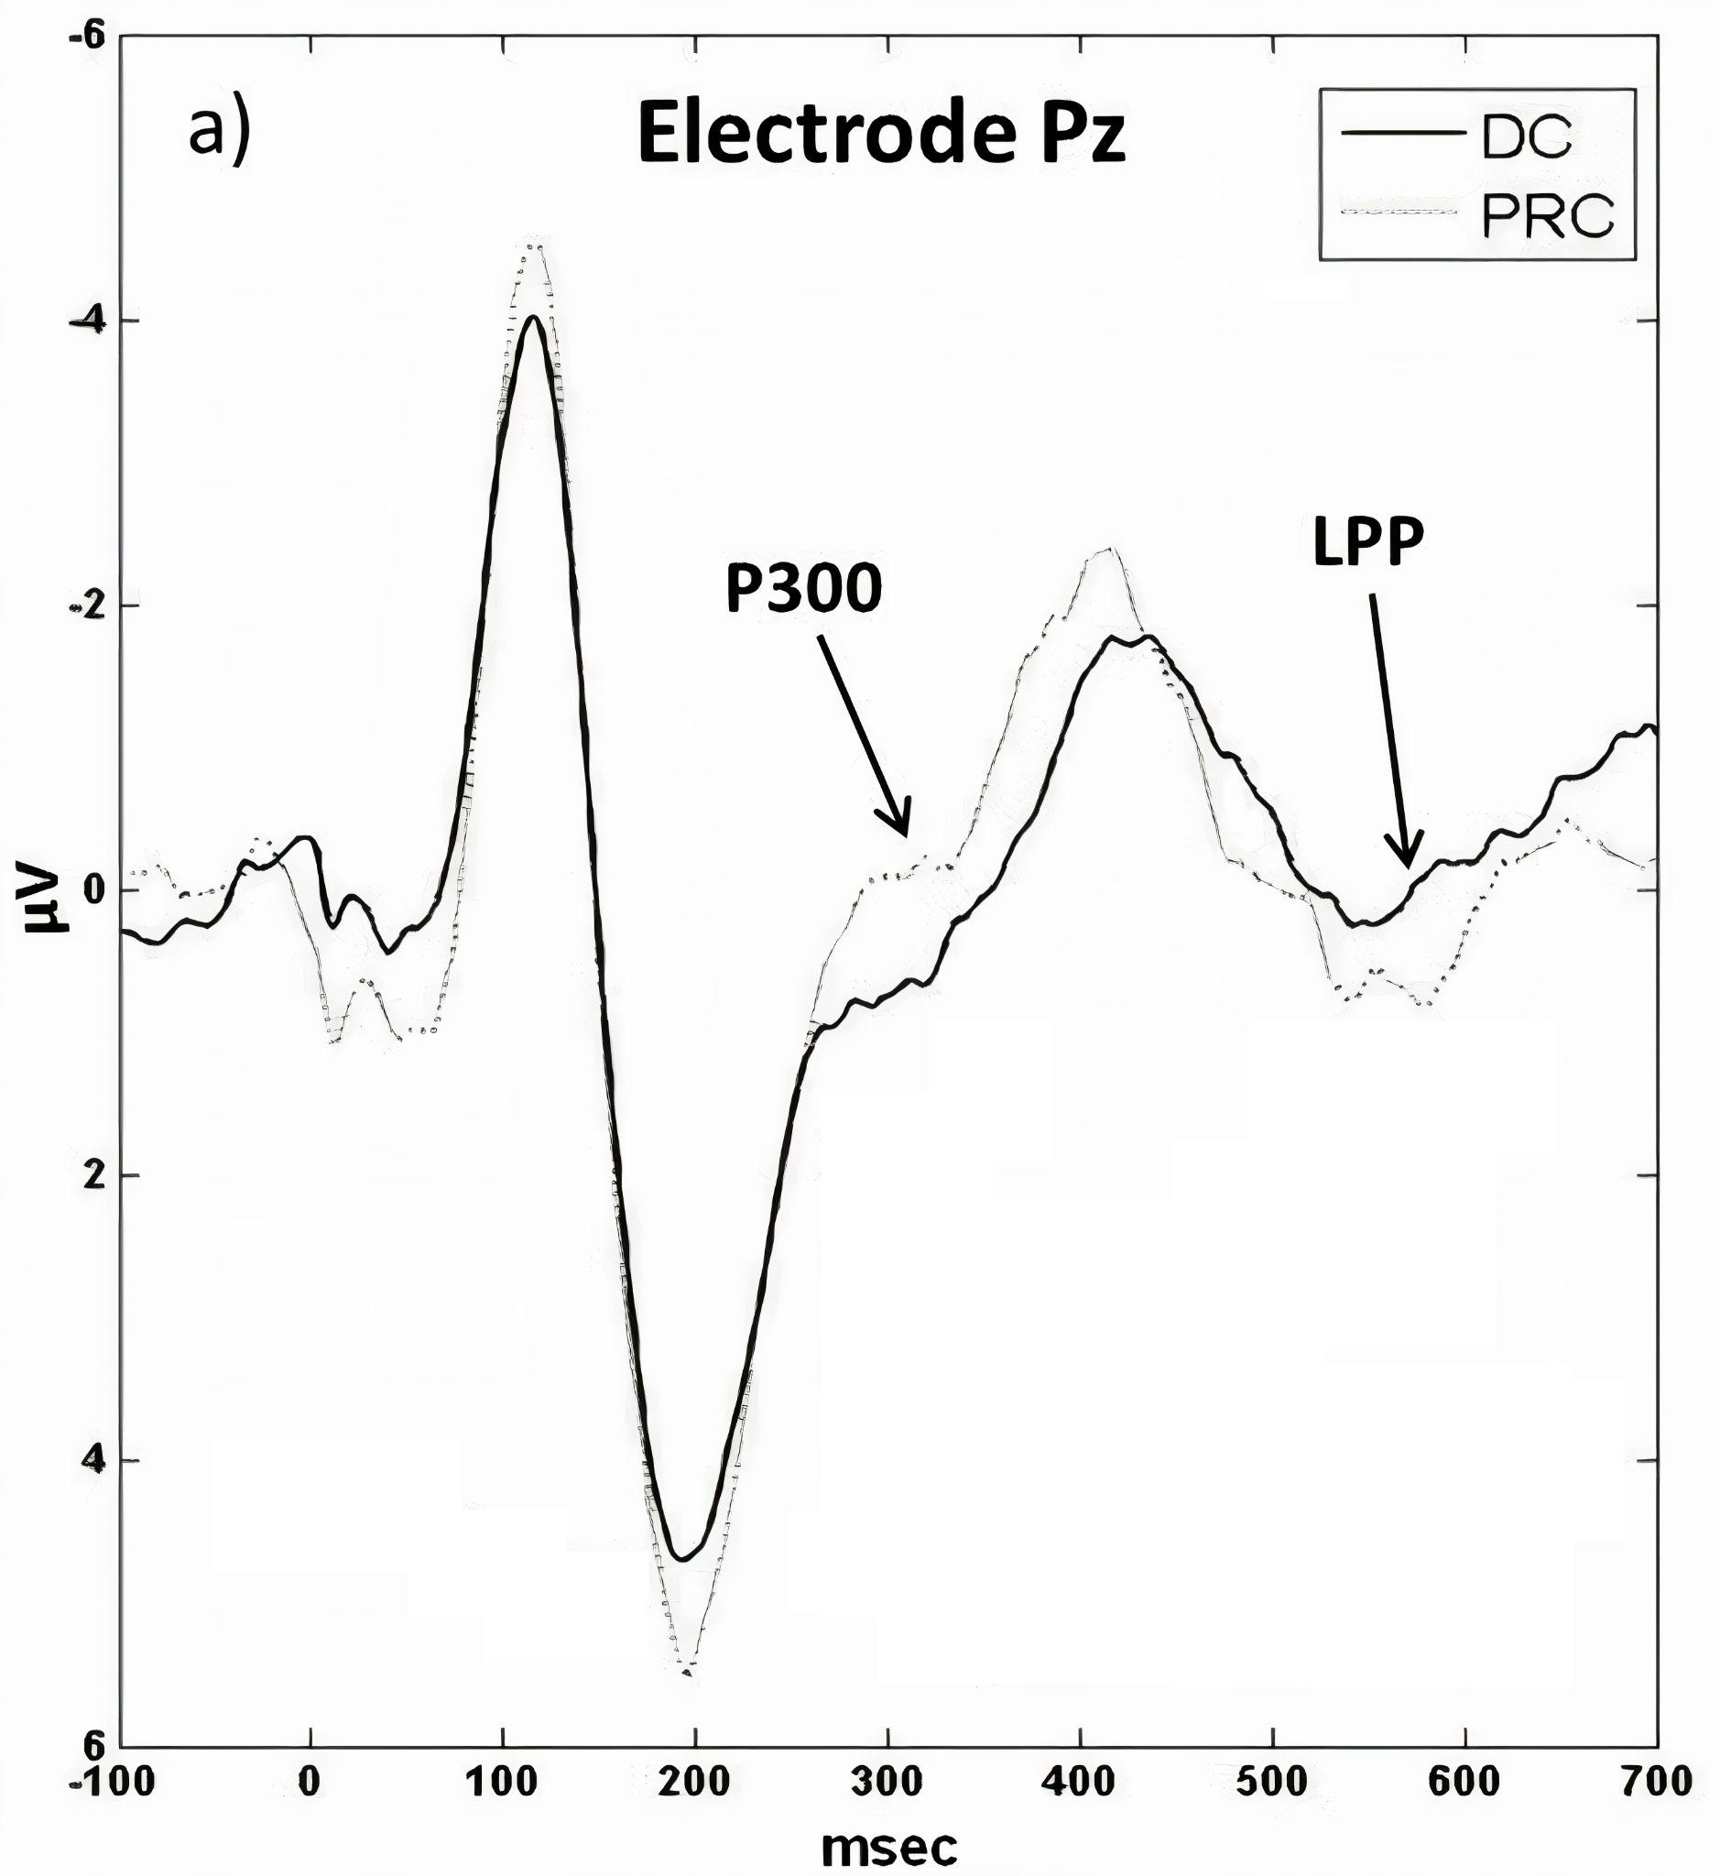
about disadvantage of decreasing stimuli
Problem Statement
add more info - find another figure
Decreasing size of stimuli leads to P300 amplitude reduction, and lower classification performance [13].
Diminutive stimuli makes P300 weaker; however, mental task, such as sound imagery produces Late Positive Potential (LPP) [14].
Although P300 decreases, LPP increases due to mental task -> don’t much effect on performance.
P300 and LPP evoked at 300 ms and 600-700 ms respectively [14]

Slide 9
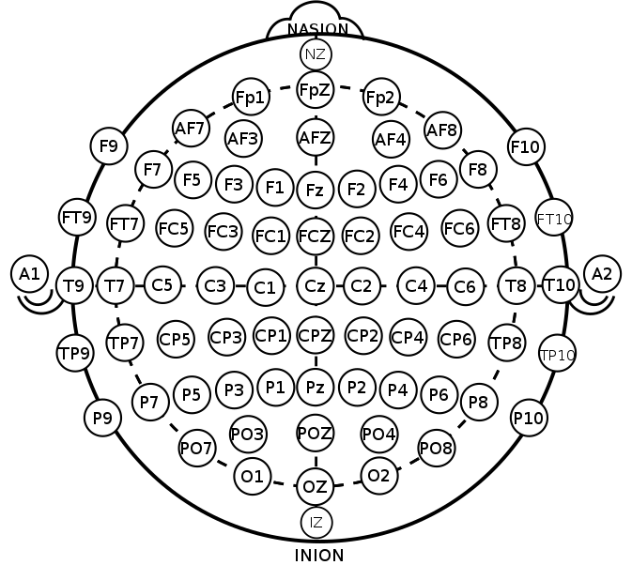
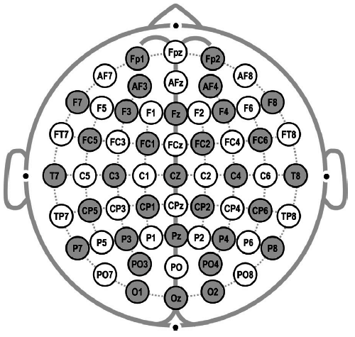
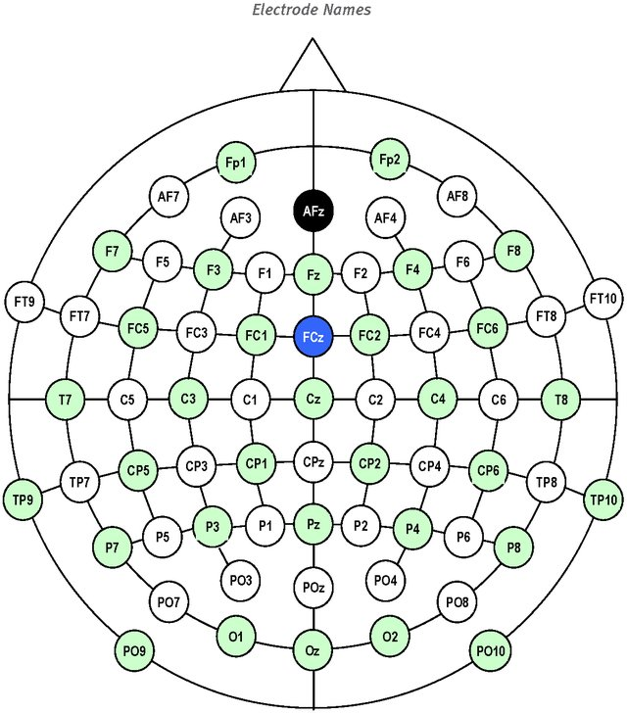
Methodology
Dataset:
14 healthy subjects aged 25-33 (4 females, 5 BCI naive);
approved and certified by the Korea University Hospital Institutional Institutional Review Board (IRB) and the Nazarbayev University Institutional Research Ethics Committee (IREC);
Experimental set:
actiCAP EEG amplifier with 32 channels;
electrodes with 10-20 system placement;
6x6 spelling layout (36 characters, 12 flashes in 1 iteration);
target-to-non-target ratio 2:10;
smartphone environment (Galaxy 9, Samsung with a 1440p
OLED/5.8-inch panel);
The 32 electrodes (green colored) montage used in the study

Slide 10
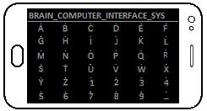
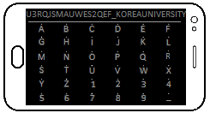
Methodology
spelling sentence on the speller - photo
Experiment details:
normal-speller: 6 characters randomly flashed at once;
dot-speller: 6 tiny dots (located above characters) randomly flashed at once;
Flashing time - 70ms, ISI - 150ms, total - 10 sequence
two tasks: Passive and Active (sound imagery 8kHz freq) concentration;
Experimental procedure:
1 session for each subject;
Train: spell 28 characters including spaces ’_’ -> 3360 trials (28 characters x 10 sequences x 12 flashes);
Test: spell 32 characters with one space ’_’ -> 3840 trials (32 characters x 10 sequences x 12 flashes);
The train & test dataset is then used to create LDA and CNN classifiers: NT vs PC and NT vs AC -> 4 conditions for LDA: normal-passive, normal-active, dot-passive, dot-active, 2 conditions for CNN: dot-passive, dot-active.
Train experiment spelling sentence
Test experiment spelling sentence

Slide 11
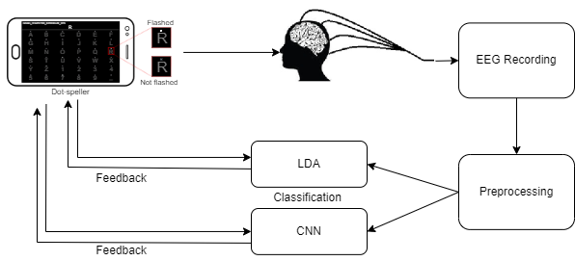
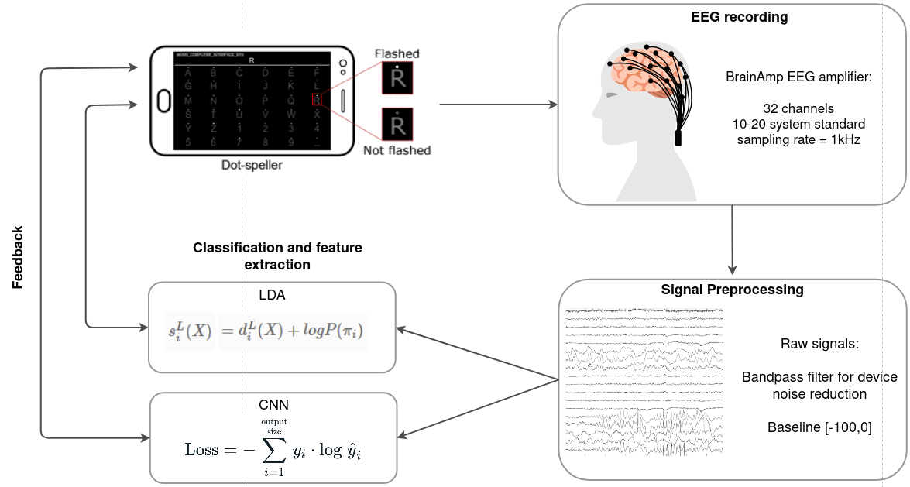
Methodology - Proposed BCI system
The stimuli are presented on the smartphone P300 speller to the user. The user’s brain signals are recorded, and preprocessed signals are given as input to LDA and CNN classifiers. The classifiers give output feedback with predicted character.
EEG system + signal recording: Brain Products hardware and software
BCI speller layout: Matlab (PsychToolbox)
LDA and CNN model for classification: Python (MNE + tensorflow / keras / sklearn)
The proposed speller general diagram

Slide 12
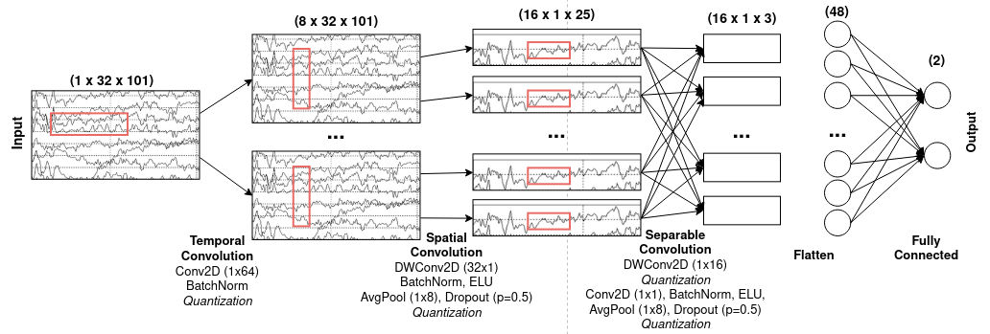
Methodology - EEGNet
Layer | # filters | Size | # params | Output | Activation | Options
Input Reshape Conv2D BatchNorm DepthConv2D BatchNorm Activation AveragePool2D Dropout SepConv2D BatchNorm Activation AveragePool2D Dropout Flatten Dense | F1=8 (D=2)*(F1=8) F2=16 2*(16*101 // 32) | (32,101) (1,32,101) (1,64) (32,1) (1,4) (1,16) (1,8) | 64*8 2*8 32*2*8 2*2*8 16*2*8+16*(2*8) 2*16 | (32,101) (1,32,101) (8,32,101) (8,32,101) (16,1,101) (16,1,101) (16,1,101) (16,1,101 // 4=25) (16,1,25) (16,1,25) (16,1,25) (16,1,25) (16,1,101 // 32) (16,1,3) (16,1,3) 2 | Linear Linear ELU Linear ELU Softmax | mode=same mode=valid, depth=D, max norm=1 p=0.5 or p=0.25 mode = same p=0.5 or p=0.25 max norm=0.25

Slide 13
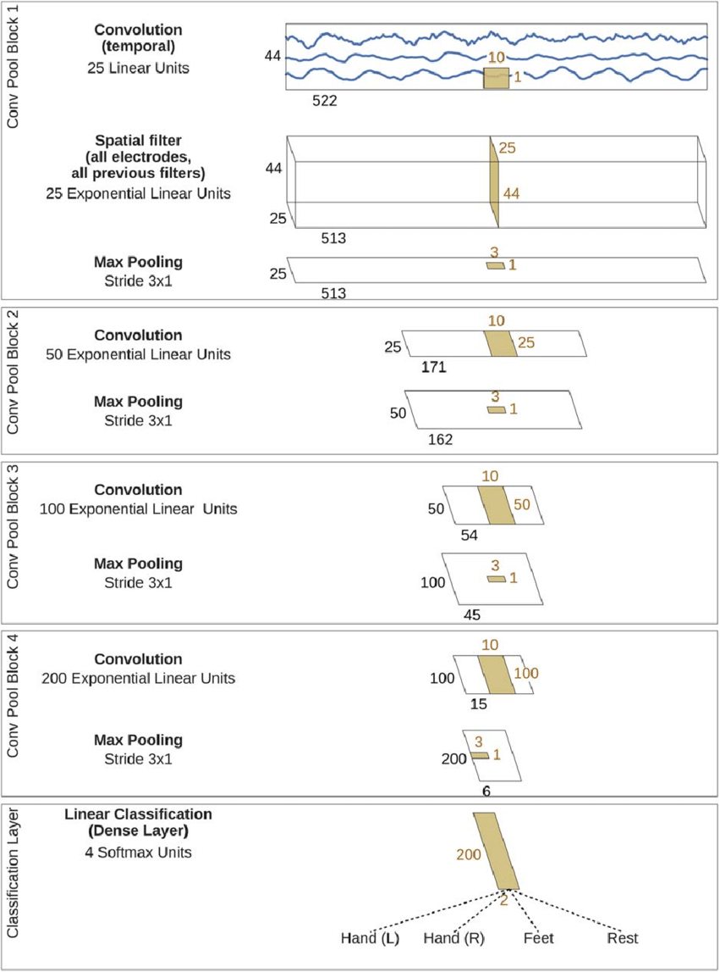
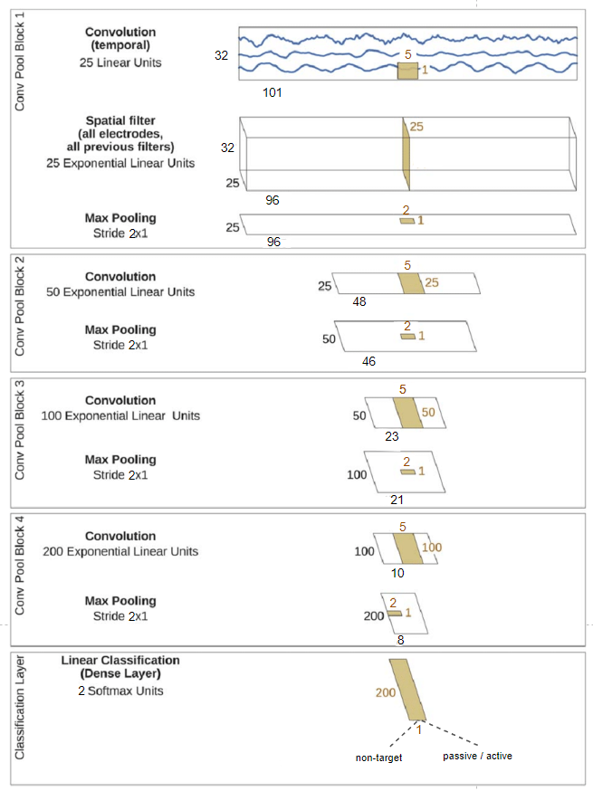
Methodology - DeepConvNet
Layer | #filters | Size | # params | Activation | Options
Input Reshape Conv2D Conv2D BatchNorm Activation MaxPool2D Dropout Conv2D BatchNorm Activation MaxPool2D Dropout Conv2D BatchNorm Activation MaxPool2D Dropout Conv2D BatchNorm Activation MaxPool2D Dropout Flatten Dense | 25 25 50 100 200 N=2 | (32,101) (1,32,101) (1,5) (32,1) (1,2) (1,5) (1,2) (1,5) (1,5) (1,2) | 150 25*25*32+25 2*25=50 25*50*32+50 2*50=100 50*100*32+100 2*100=200 (1,2) 100*200*32+200 2*200=400 | Linear Linear ELU Linear ELU Linear ELU Linear ELU Softmax | mode=valid,max norm=2 mode=valid,max norm=2 e=1e-05,moment=0.1 p=0.5 mode=valid,max norm=2 e=1e-05,moment=0.1 p=0.5 mode=valid,max norm=2 e=1e-05,moment=0.1 p=0.5 mode=valid,max norm=2 e=1e-05,moment=0.1 p=0.5 max norm=0.5
The architecture of DeepConvNet

Slide 14
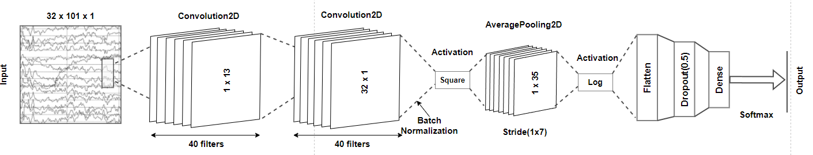
Methodology - ShallowConvNet
The architecture of ShallowConvNet
Layer | # filters | Size | # params | Activation | Options
Input Reshape Conv2D Conv2D BatchNorm Activation AveragePool2D Activation Flatten Dropout Dense | 40 40 N=2 | (32,101) (1,32,101) (1,13) (32,1) (1,35) stride(1,7) | 40*13+40=560 40*40*32=51200 2*40=80 | Linear Linear Square Log Softmax | mode=same, max norm=2 mode=valid, max norm=2 epsilon=1e-05, momentum=0.1 p=0.5 max norm=0.5
Notes:
colors - change

Slide 15
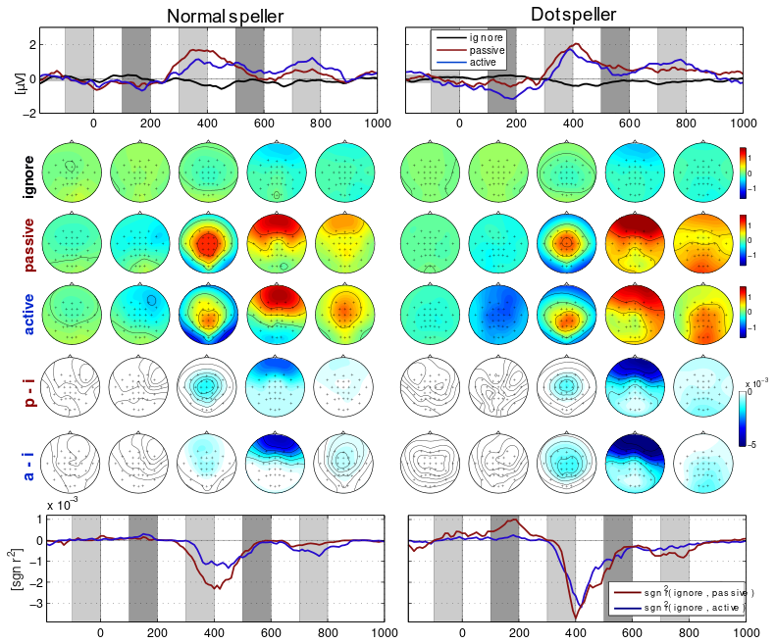
Results - ERP responses
P3 is observed in:
  normal- and dot-speller trials -> oddball BCI paradigms
Peak amplitudes ave. b/w 300-400 ms at Cz:
  normal-passive- 1.657uV normal-active- 0.902uV dot-passive- 1.837uV
  dot-active- 1.394uV
Dot-speller induces more pronounced P3 compared to a normal-speller
PC for dot-speller induces a higher P3 amplitude than AC
AC for both spellers induces LPP response
Average ERP responses at electrode Cz

Slide 16
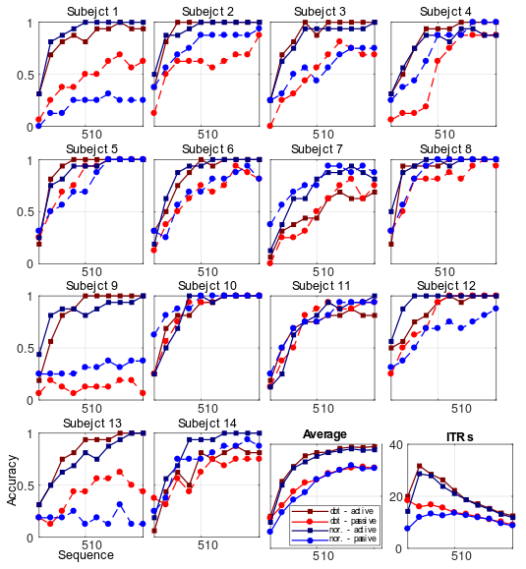
Results - LDA performance in individual sequences
LDA accuracy for normal speller and dot-speller in:
  NT vs AC and NT vs PC
Accumulative averaging of the current trials with previous trials (1-10 sequences)
AC outperform PC in both speller systems
Average accuracy after 4th sequence:
  normal-passive - 53.5%
  normal-active - 83.0%
  dot-passive - 62.9%
  dot-active - 88.8%
After 9th sequence: 76.3%, 94.1%, 78.1%, 96.8%
In the 2-6 and 2-8 sequence:
  AC outperform PC for normal-speller and dot-speller
Maximal ITRs in [bits/min]:
  normal-passive - 13.5
  normal-active - 28.6
  dot-passive - 18.3
  dot-active - 31.6
Decoding accuracy for target and non-target discrimination

Slide 17
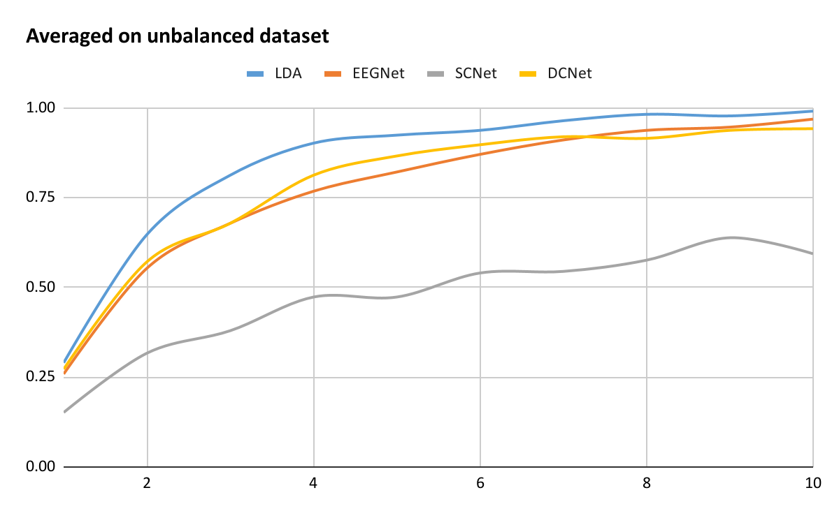
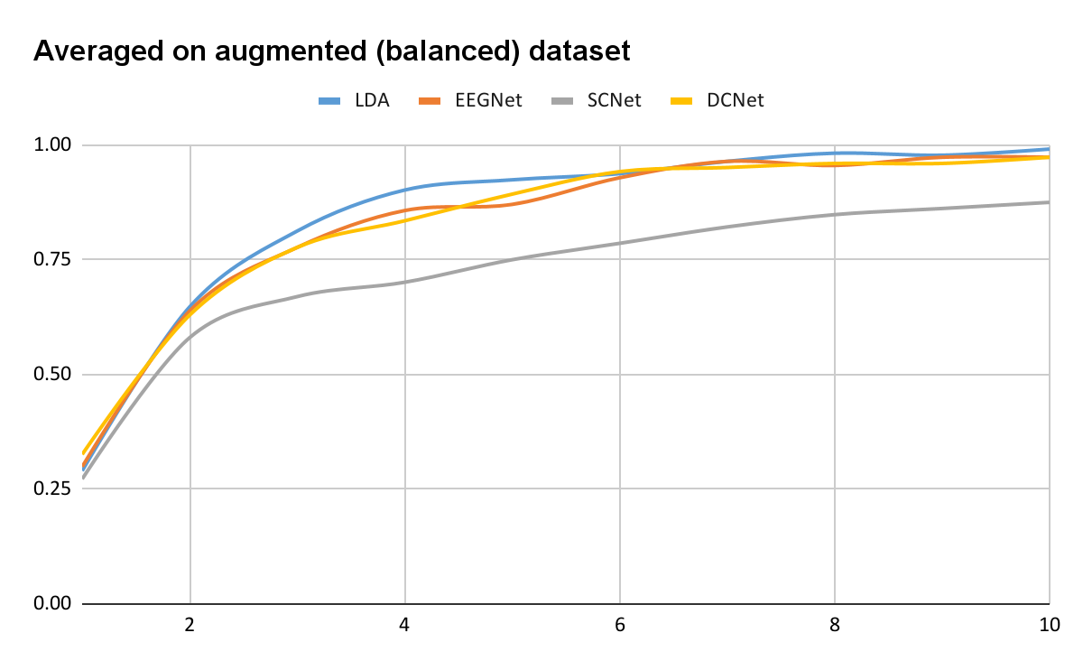
Results - CNN performance in individual sequences
Sequential accuracy of LDA, EEGNet, ShallowConvNet (SCNet), and DeepConvNet (DCNet) for 14 subjects, and the averaged results on data without augmentation (unbalanced), and with augmentation (balanced) data for NT vs AC.
 | 1 | 2 | 3 | 4 | 5 | 6 | 7 | 8 | 9 | 10
LDA | 0.29 | 0.65 | 0.81 | 0.90 | 0.92 | 0.94 | 0.96 | 0.98 | 0.98 | 0.99
EEGNet | 0.26 | 0.55 | 0.68 | 0.77 | 0.82 | 0.87 | 0.91 | 0.94 | 0.95 | 0.97
SCNet | 0.15 | 0.32 | 0.38 | 0.47 | 0.47 | 0.54 | 0.54 | 0.58 | 0.64 | 0.59
DCNet | 0.27 | 0.57 | 0.68 | 0.81 | 0.87 | 0.90 | 0.92 | 0.92 | 0.94 | 0.94
 | 1 | 2 | 3 | 4 | 5 | 6 | 7 | 8 | 9 | 10
LDA | 0.29 | 0.65 | 0.81 | 0.90 | 0.92 | 0.94 | 0.96 | 0.98 | 0.98 | 0.99
EEGNet | 0.30 | 0.64 | 0.78 | 0.86 | 0.87 | 0.93 | 0.96 | 0.96 | 0.97 | 0.97
SCNet | 0.27 | 0.58 | 0.67 | 0.70 | 0.75 | 0.79 | 0.82 | 0.85 | 0.86 | 0.88
DCNet | 0.33 | 0.63 | 0.78 | 0.83 | 0.89 | 0.94 | 0.95 | 0.96 | 0.96 | 0.97

Slide 18
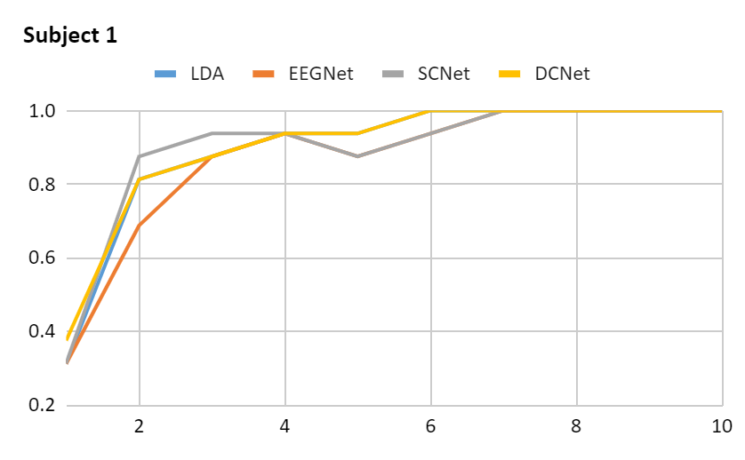
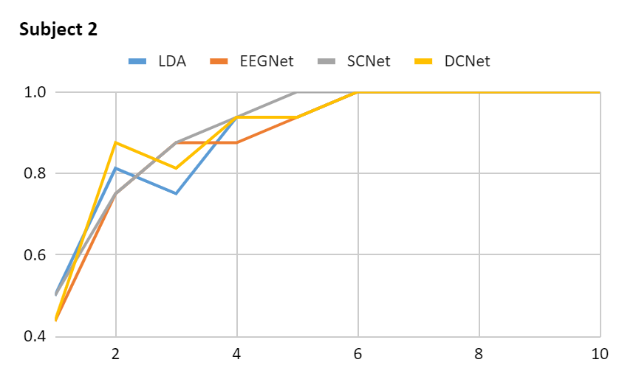
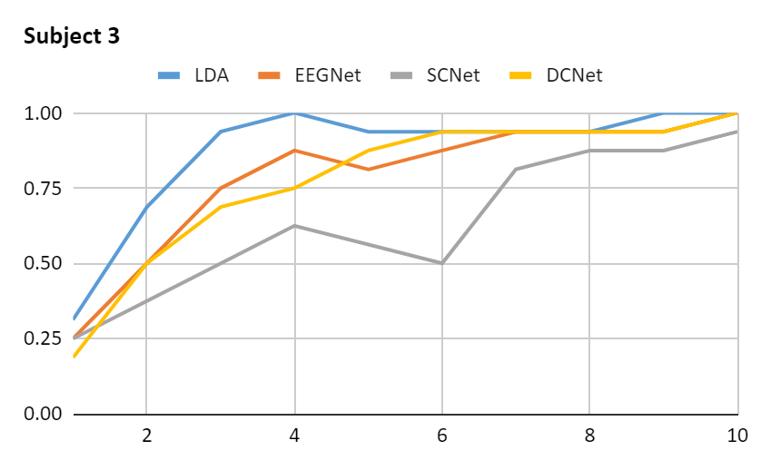
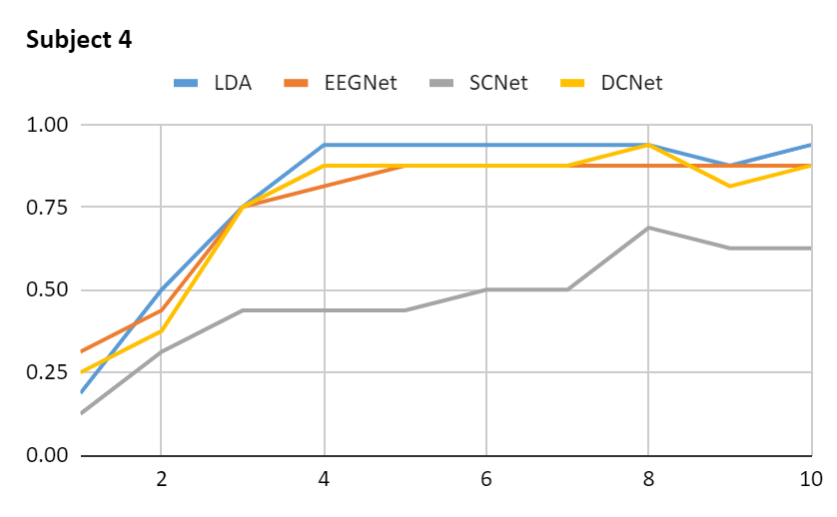
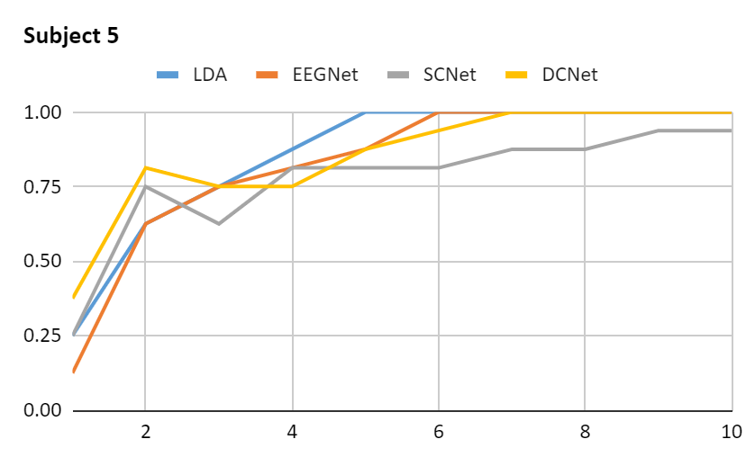
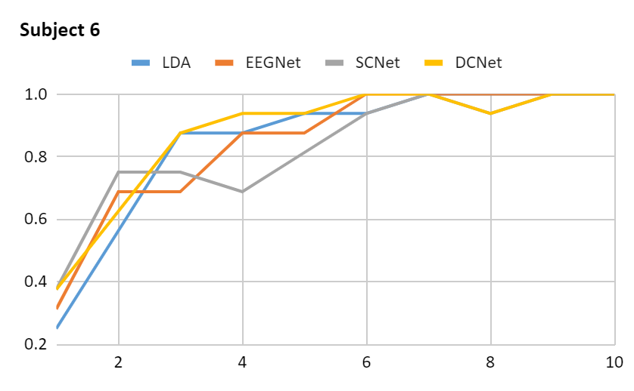
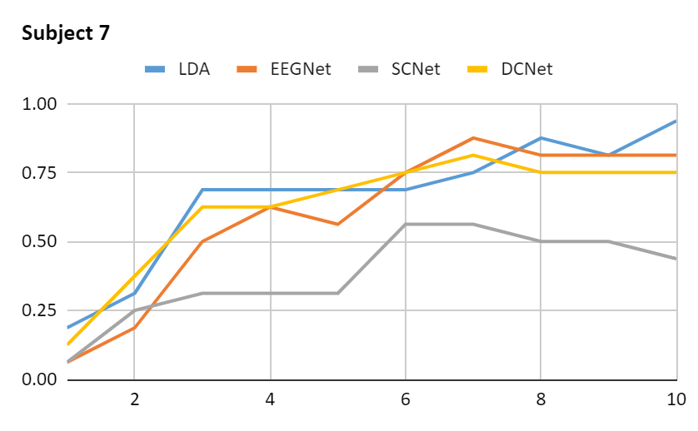
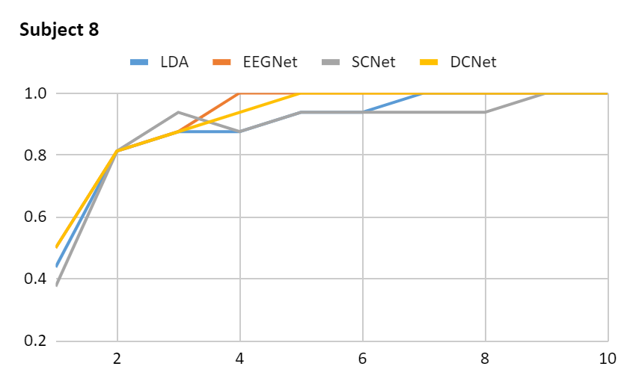
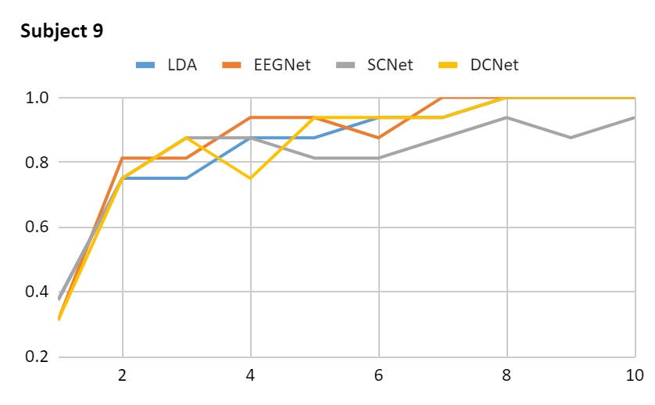
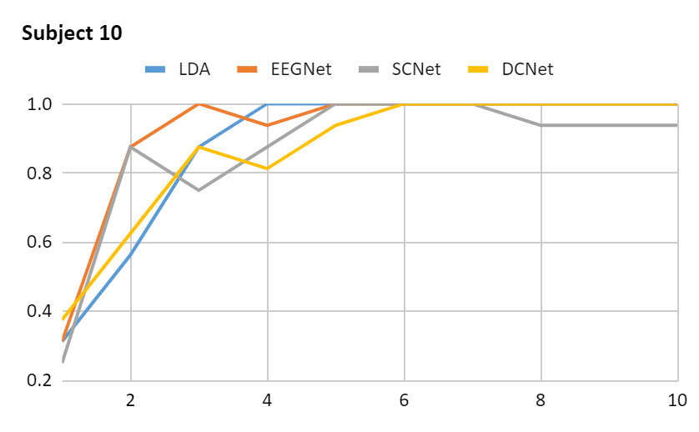
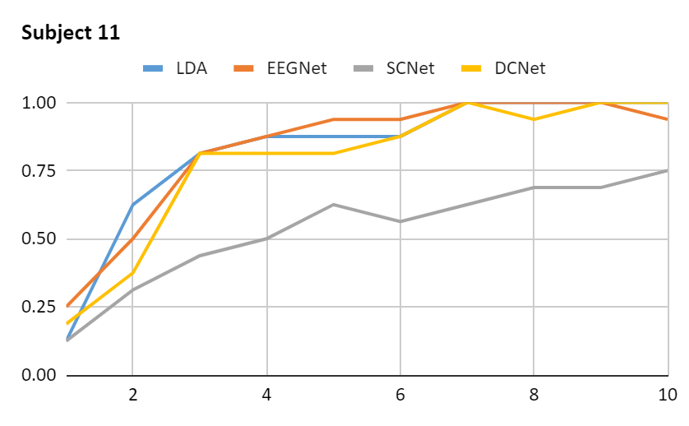
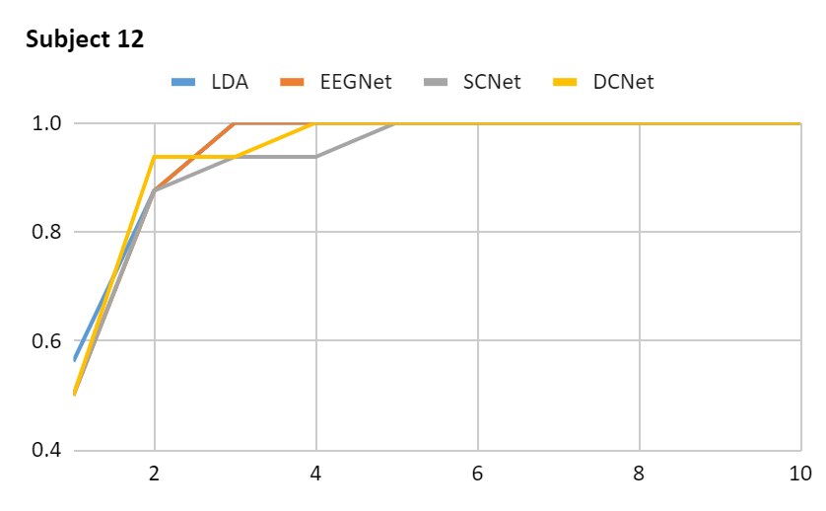
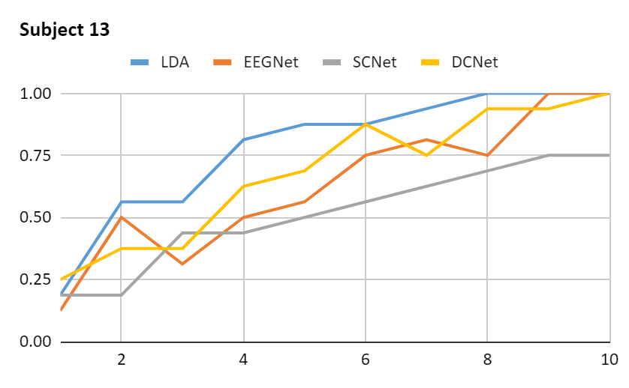
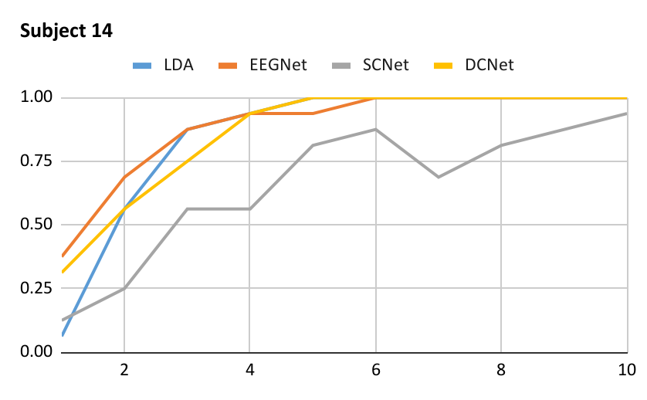
Results - CNN sequential performance balanced
Sequential accuracy of LDA, EEGNet, ShallowConvNet (SCNet), and DeepConvNet (DCNet) for 14 subjects, and the averaged results on data with augmentation (i.e. balanced dataset) for NT vs AC.

Slide 19
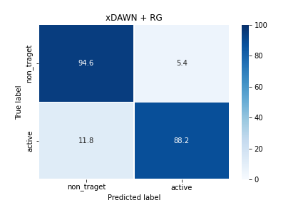
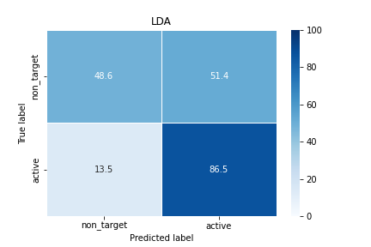
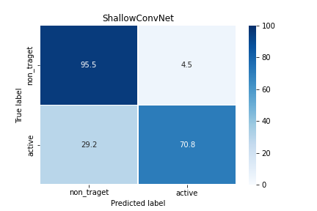
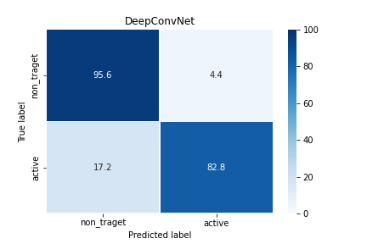
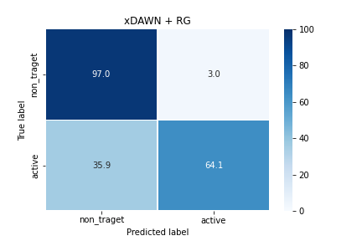
Results - NT vs AC single trial accuracy
Single-trial classification analysis provides a dimensionality reduction to project the high-dimensional EEG data onto a discriminative space.
DeepConvNet model demonstrate higher classification on NT vs AC conditions, while LDA has lowest results.
DeepConvNet model has MaxPool layer -> important features
LDA -> high-dimensions -> overfitting
EEGNet
Confusion matrices of models for NT vs. AC classes for 1st subject

Slide 20
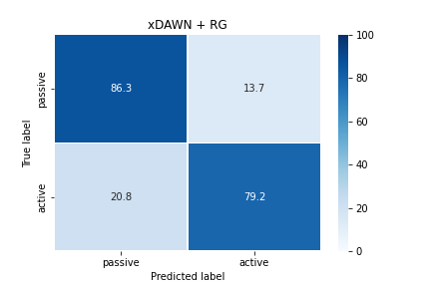




Preliminary Results - PC vs AC single trial accuracy
In the experiments there NT vs AC it is clear that AC is target class, so the classification is easy.
However, we have also PC and AC tasks, and fitting these conditions to LDA and CNN showed comparable results.
Models can differ between:
  user intentionally gazing (AC)
  unintentionally (PC)
So such findings can be applied to future BCI spellers with such conditions.
ShallowConvNet achieved high classification accuracy on PC vs AC tasks than other models, while LDA has lowest.
LDA is intended for classification problems where the output variable is categorical (explicit).
Confusion matriсes of models for PC vs. AC classes for 1st subject

Slide 21






Preliminary Results - 3 class single trial accuracy
3 class classification trained and tested on ShallowConvNet model: NT vs T (AC and PC)
unbalanced dataset: NT > AC and PC, misclassification
theorize: after augmentation higher accuracy

Slide 22
Discussion
BCI speller with diminutive-sized visual stimuli and sound imagery as mental task -> evaluate the practical viewpoint of real-world BCI applications
Relies on oddball paradigm performance, but with a focus on a less obtrusive visual interface
To test the efficacy of tiny visual stimulation -> traditional speller & dot-speller are compared -> sound imagery activities versus passive gazing -> significant implications for future BCI interfaces
Intervals for discriminating AC and PC: 300-400 ms (P300) and 700-800 ms (LPP)
PC has larger P300 component than the AC task -> LPP has the reverse outcome -> user’s active mental task -> potent feature
PC - incorrect orders, whereas AC is far more trustworthy in terms of purpose -> AC greatly exceeded PC in terms of intention
LDA outperformed CNN in individual sequences, CNN is better in single trial than LDA
PC vs AC can be applied to show intentional and unintentional gazing
multi classification can be applied to speller but with augmentation and improved preprocessing steps

Slide 23
Limitation of the study
Experiments:
  Small sample size: the limited number of volunteers -> difficult to find
  Usability: conducted on healthy people with normal or corrected vision
  Duration: time for calibration, training and testing -> BCI headset and electrodes installments
Classification:
  Dataset suitability: open-sourced models were tested on different data -> applying and fitting own dataset is time consuming and gives different results
  P300 dependency: The amplitude and latency of P300 wave are subject dependent -> the wave amplitude has a positive association with the uncertainty of occurrence of the target stimuli while its latency depends on the time needed for a subject to cognitively evaluate the target stimuli

Slide 24
Conclusion
The contribution of this work is to develop an efficient and feasible BCI speller, including a simple headset design, a robust LDA and CNN-based classifier, and a new spelling layout
Novel method for reducing the impact of external visual stimuli while retaining excellent classification accuracy
The speller system is implemented on a smartphone with stimulus size for normal - 0.8 cm, and dot - 0.1 mm
Smaller stimuli size - the lower performance -> smaller-sized and closer-positioned letters limit ERP responses which reduces system performance
To generate endogenous ERP components -> mental task (sound imagery)
PC and AC on normal- and dot-speller were compared -> mental exercise considerably increased performance, and the dot-speller demonstrated high accuracy
Average spelling accuracy for LDA (sequential):
  passive tasks: normal - 76.3% and dot-layout - 78.1%
  active tasks: normal - 94.1% and dot-layout - 96.8% - comparable results
Average spelling accuracy for CNN results (sequential) for NT vs AC dot-speller:
  Before augmenting the data:
    EEGNet - 97%, ShallowConvNet - 59%, DeepConvNet - 94%
  After augmentation:
    EEGNet - 97%, ShallowConvNet - 88%, DeepConvNet - 97%

Slide 25
Implications for future research
The experiments were done on healthy (normal or corrected vision) people -> research is needed to determine whether the suggested feature is suitable for users with vision impairments
The new spelling layout presented in this paper has the potential to make future BCI spelling systems more reliable and user-friendly
Preliminary results of PC vs AC classification can be used to develop new BCI speller with intentionally and unintentionally gazing
Include predictive variables (e.g. age, gender, BCI experience) for better classification

Slide 26
Thank you!
Q & A
Notes:
citations fix

Slide 27
Reference list
[1] Nicolas-Alonso, L.F., Gomez-Gil, J.: Brain-computer interfaces, a review. Sensors 12(2), 1211–1279 (2012)
[2] Lee, M.H., Kwon, O.Y., Kim, Y.J., Kim, H.K., Lee, Y.E., Williamson, J., Fazli, S., Lee, S.W.: EEG dataset and OpenBMI toolbox for three BCI paradigms: an investigation into BCI illiteracy. GigaScience 8(5), giz002 (2019)
[3] Obeidat, Q.T., Campbell, T.A., Kong, J.: Spelling with a small mobile brain computer interface in a moving wheelchair. IEEE Transactions on Neural Systems and Rehabilitation Engineering 25(11), 2169–2179 (2017)
[4] Sellers, E.W., Arbel, Y., Donchin, E.: 12 BCIs that use P300 event-related potentials. Brain-computer interfaces: principles and practice p. 215 (2012)
[5] Xu, M., Xiao, X., Wang, Y., Qi, H., Jung, T.P., Ming, D.: A brain–computer interface based on miniature-event-related potentials induced by very small lateral visual stimuli. IEEE Transactions on Biomedical Engineering 65(5), 1166–1175 (2018)
[6] Jing Jin, Brendan Z Allison, Tobias Kaufmann, Andrea Kübler, Yu Zhang, Xingyu Wang, and Andrzej Cichocki. The changing face of P300 BCIs: a comparison of stimulus changes in a P300 bci involving faces, emotion, and movement. PloS one, 7(11), 2012
[7] Yeom, S.K., Fazli, S., Müller, K.R., Lee, S.W.: An efficient ERP-based brain-computer interface using random set presentation and face familiarity. PloS one 9(11) (2014)
[8] Lee, M.H., Williamson, J., Won, D.O., Fazli, S., Lee, S.W.: A high performance spelling system based on EEG-EOG signals with visual feedback. IEEE Transactions on Neural Systems and Rehabilitation Engineering 26(7), 1443–1459 (2018)
[9] Min-Ho Lee, John Williamson, Young-Eun Lee, and Seong-Whan Lee. Mental fatigue in central-field and peripheral-field steady-state visually evoked potential and its effects on event related potential responses. NeuroReport, 29(15), 2018
[10] Z Kubová, J Kremlacek, J Szanyi, J Chlubnová, and M Kuba. Visual eventrelated potentials to moving stimuli: normative data. Physiological Research, 51(2):199–204, 2002
[11] No-Sang Kwak, Klaus-Robert Müller, and Seong-Whan Lee. A convolutional neural network for steady state visual evoked potential classification under ambulatory environment. PloS one, 12(2):e0172578, 2017
[12] Zhenghui Gu, Zhubing Chen, Jintao Zhang, Xichun Zhang, and Zhu Liang Yu. An online interactive paradigm for P300 brain–computer interface speller. IEEE Transactions on Neural Systems and Rehabilitation Engineering, 27(2):152–161, 2019
[13] L.A. Farwell and E. Donchin. Talking off the top of your head: toward a mental prosthesis utilizing event-related brain potentials. Electroencephalography and Clinical Neurophysiology, 70(6):510–523, 1988
[14] Min-Ho Lee, John Williamson, Young-Eun Lee, and Seong-Whan Lee. Mental fatigue in central-field and peripheral-field steady-state visually evoked potential and its effects on event related potential responses. NeuroReport, 29(15), 2018

