Slide 1

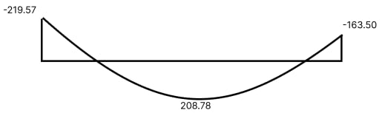
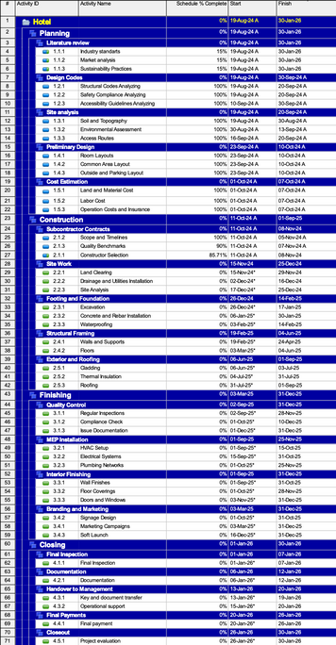
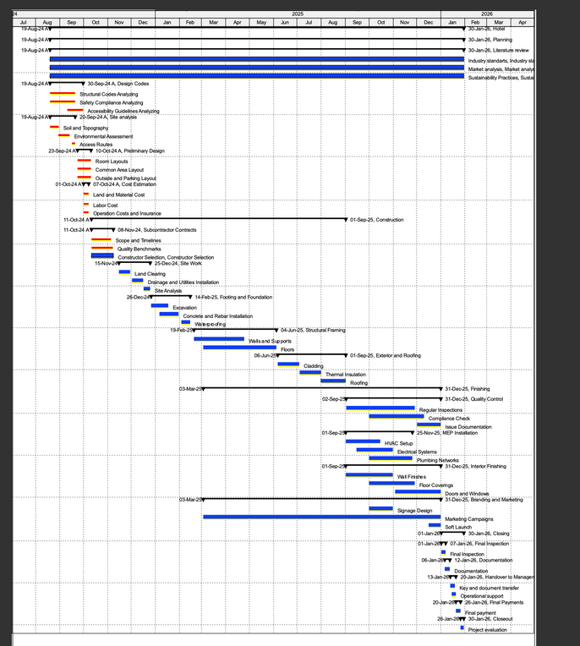
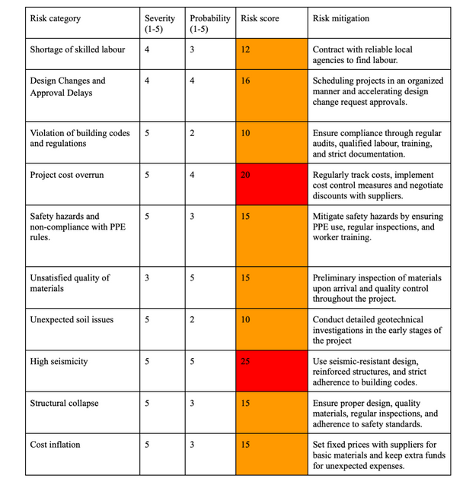

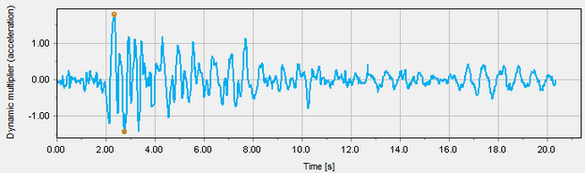
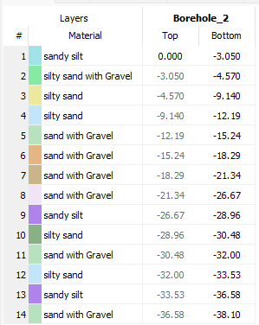
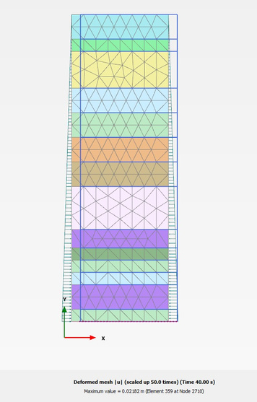

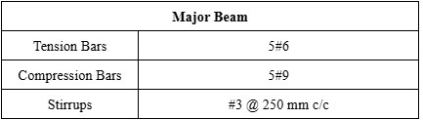

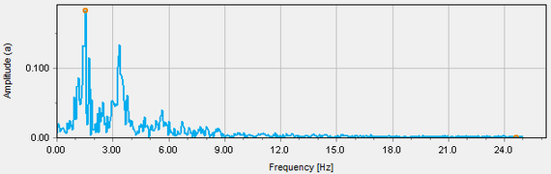

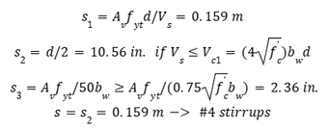

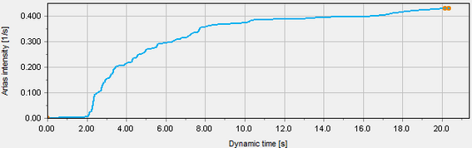



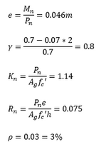


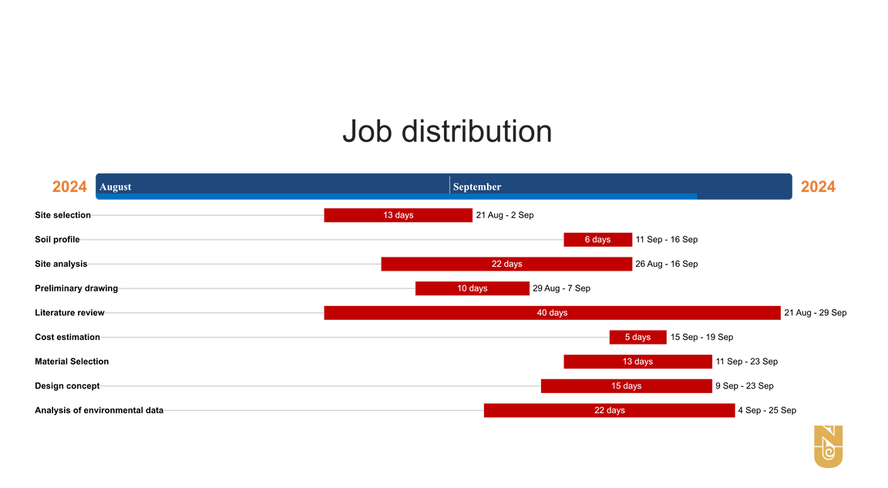

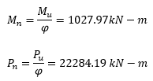
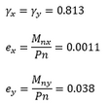

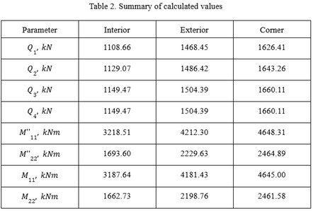
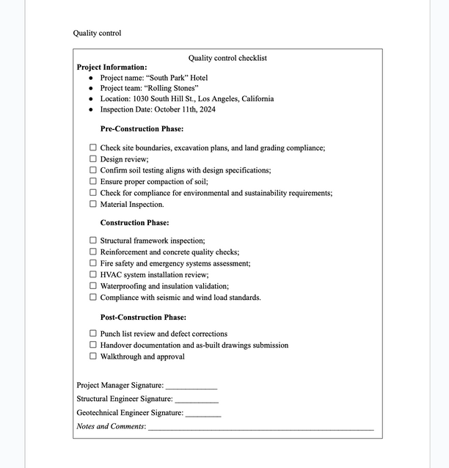
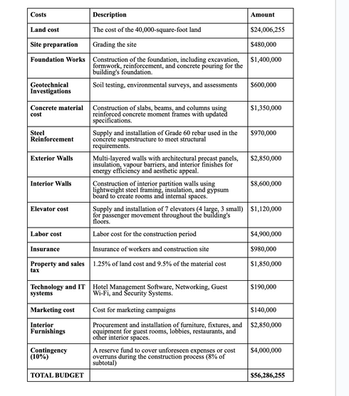
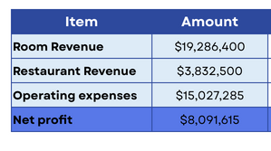
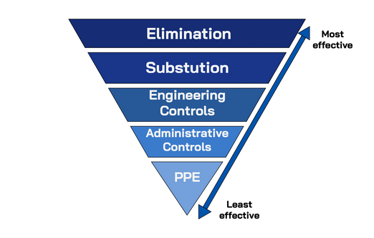



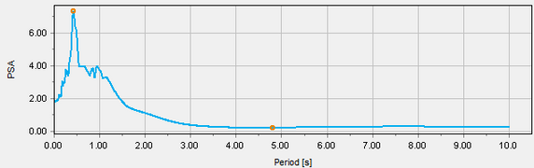


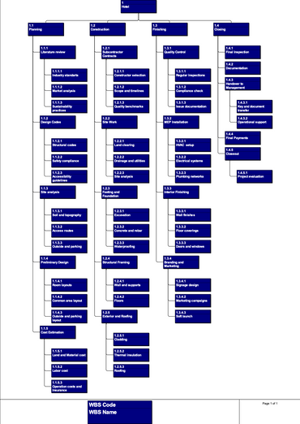


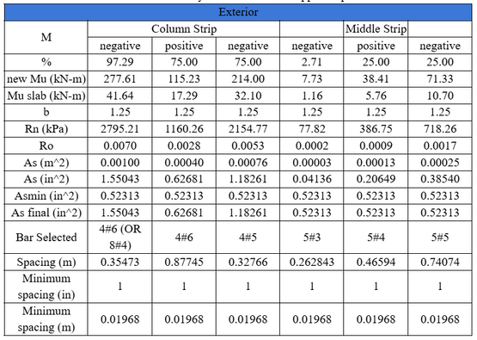
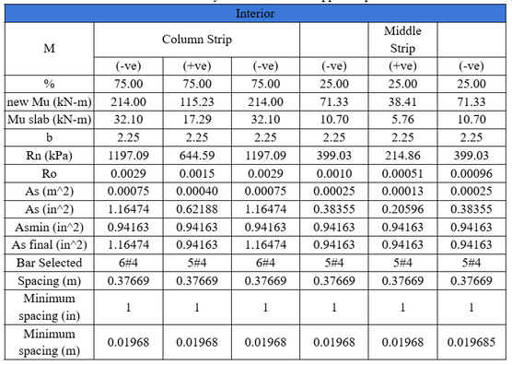
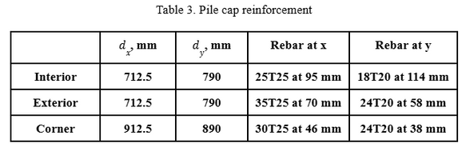
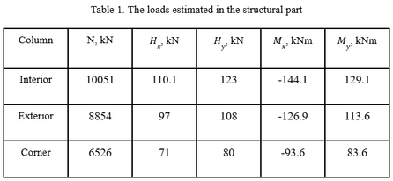
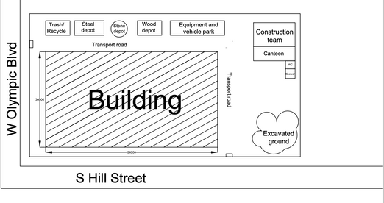
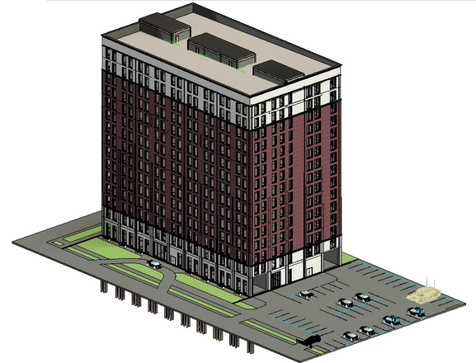
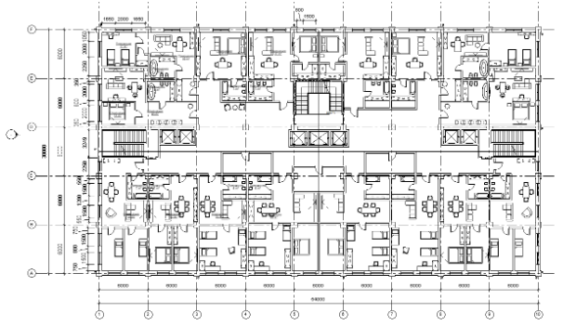
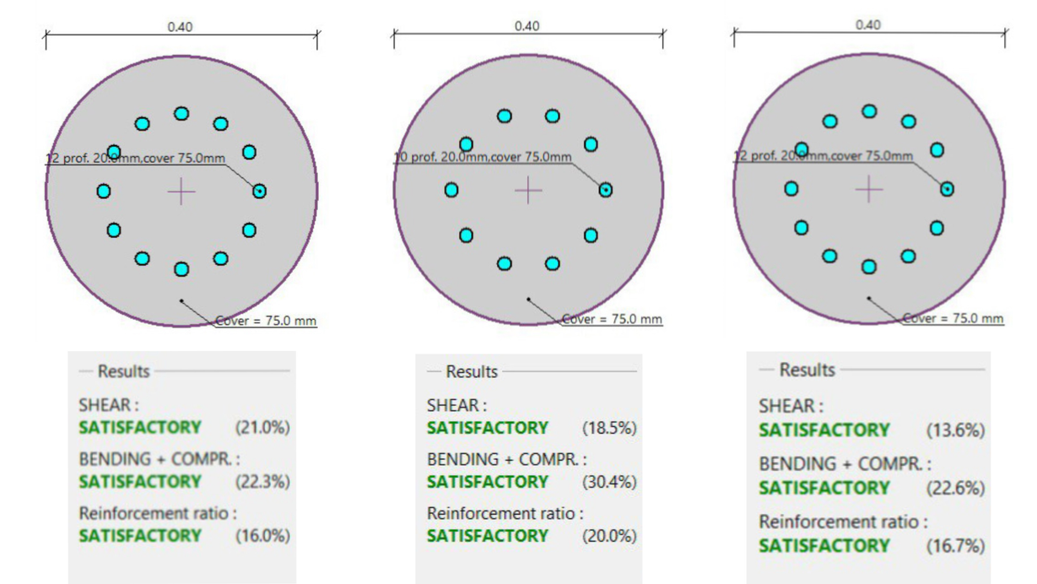
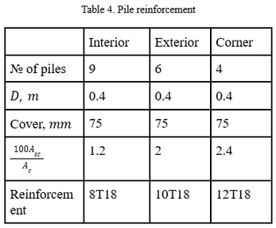
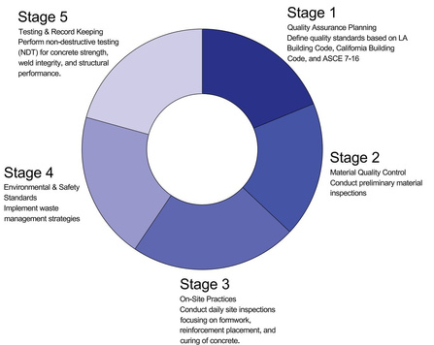
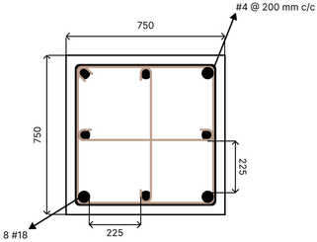
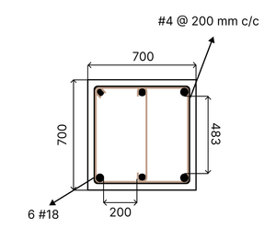
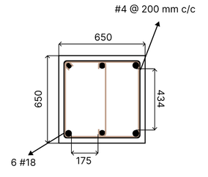
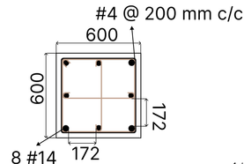
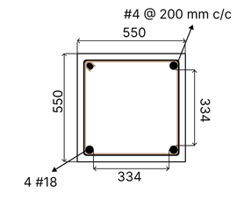
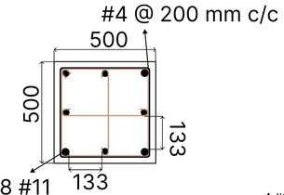
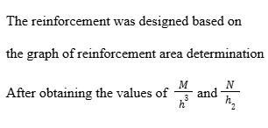
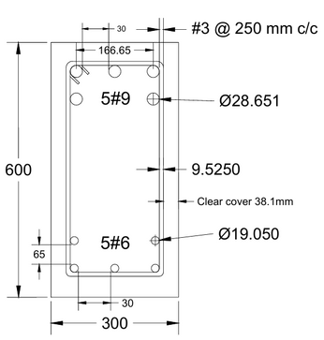
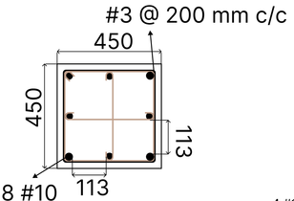
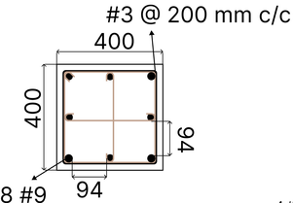
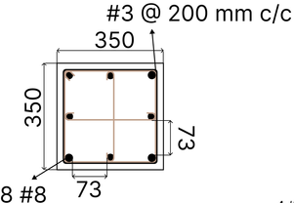
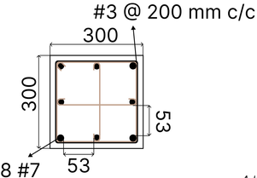
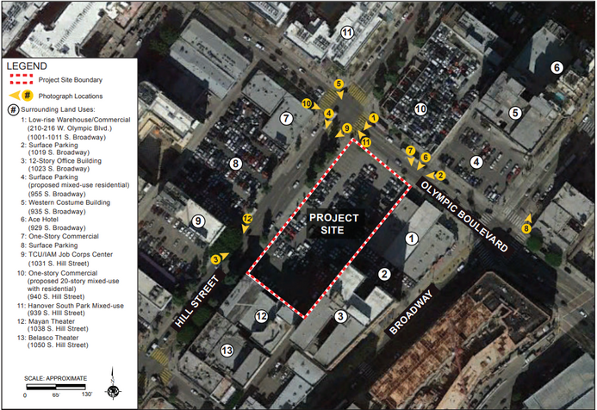
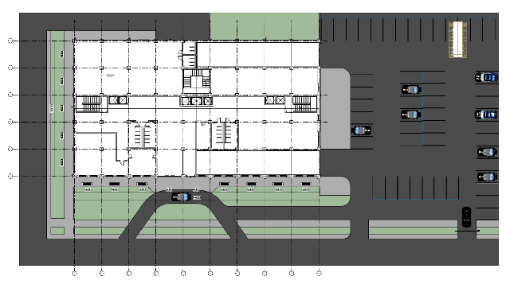
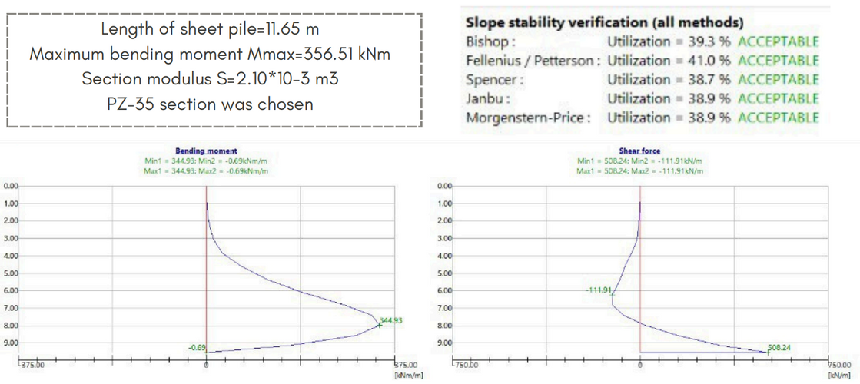
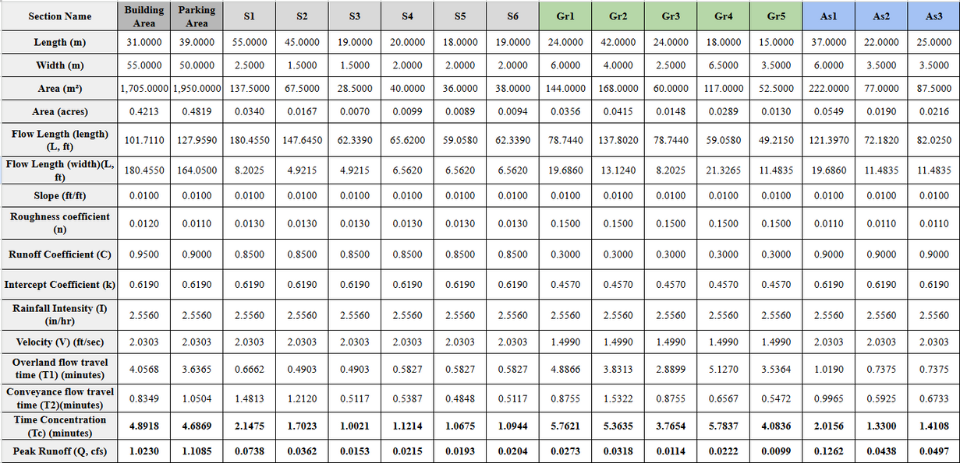
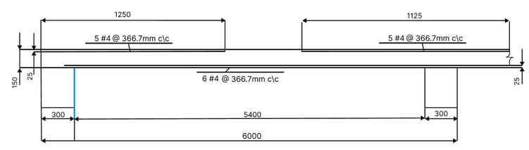

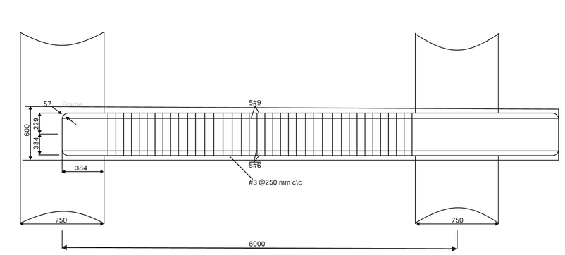
































DESIGN OF 15-STOREY HOTEL BUILDING IN LOS ANGELES, CALIFORNIA, USA
by Rolling Stones
Pile cap reinforcement
Aikelbet Zhumagulova Geotechnical Engineer
Aruzhan Syndarova
Geotechnical Engineer
Assanali Aldan
Structural Engineer
Bexultan Bazarbayev
Construction Manager
Nurmukhammed Mukhtarzhanov
Environmental Engineer
Yelnur Nurgali
Structural Engineer
Project description
Structural Design
Geotechnical Part
GANTT CHART
RISK MANAGEMENT
Abstract
Major beam
Site Response Analysis
The project is a 15-story hotel with 2-story underground parking at 1030 South Hill Street, Los Angeles. It includes a lobby, restaurant, dining room, kitchen, laundry, 7 lifts, and 3 staircases.
Torsion
Soil Profile
Deformed mesh |u|
Critical load combination : 1.2D+1.6L+0.5Lr
Problem statement
Shear reinforcement
The hotel aims to address the need for luxury lodging in LA’s South Park District, overcoming challenges like high costs, limited space, and sustainability.
Project objectives
  Ensure compliance with local regulations, seismic safety, and environmental standards.
  Conduct geotechnical analysis for optimal design.
  Blend with LA's urban environment.
  Use sustainable, energy-efficient systems.
  Manage costs to maximize efficiency and guest satisfaction.
  Enhance operational efficiency and sustainable profitability.
Column
Slenderness ratio check
Stirrups spacing
Biaxial bending check
Interior column
Pile cap reinforcement
QUALITY CONTROL
CHECKLIST
COST ESTIMATION
ANNUAL PROFIT
HIERARCHY OF
CONTROLS
JOB DISTRIBUTION
safe against biaxial bending
Corner column
Edge column
method is valid
WORK BREAKDOWN STRUCTURE
Two-way slab
Pile reinforcement
CONSTRUCTION SITE
PLANNING
Architectural Model
3D view of the building
Plan view of the typical floor
QUALITY CONTROL MEASURES
STAKEHOLDERS
4
STRUCTURAL ENGINEER
Influence
Interest
ENGINEERING TEAM
5
4
4
GEOTECHNICAL
ENGINEER
Influence
AUTHORITIES
Influence
Interest
ENGINEERING TEAM
3
Interest
REGULATORY AUTHORITIES
5
SUPPLIERS
3
Influence
SUPPLIERS OF MATERIALS AND ETC.
Interest
5
LARGE INVESTMENT COMMITTEE
5
4
PROJECT MANAGER
4
CONTRACTORS
3
Influence
Influence
ROLLING STONES
Influence
Influence
Structural detailing
Interest
3
Interest
Interest
DEVELOPMENT COMPANY
Interest
ENGINEERING TEAM
5
COMPANIES
SUBCONTRACTORS
5
INVESTORS
5
5
Influence
Column Floors 2-3
Column Floors 6-7
Column Floor 9
Interest
Column Floors 0-1
Column Floors 4-5
Column Floor 8
3
SOUTH PARK TEAM
4
ENVIRONMENTAL ENGINEER
5
COMPANIES
Influence
Influence
Interest
ENGINEERING TEAM
Interest
MANAGEMENT
COMPANY
5
5
4
OTHER
Influence
Interest
3
Plan view of the site layout
Column Floor 10
Column Floor 11
Column Floor 12
Column Floors 13-15
Environmental Engineering Part
Site layout plan
Sheet pile design
According to The Los Angeles County Department of Public Works - LACDPW - for the proper design of stormwater drainage systems we should use the 10 years interval of reaccurence of storm with 15 minutes duration. The official data NOAA Atlas 14 - Preciptation-Frequency Atlas shows that rainfall amount is 0.639 inches for a maximum
Figure 6. Column reinforcement detailing
Rainfall intencity I =0.639 x (60/15) = 2.556 inches/hour
Figure 7. Major beam reinforcement
For tension reinforcement
Development length of beam
Figure 8. Two-way slab reinforcement
→
Calculation of Lateral Drift Forces under Seismic and Wind Load
For compression reinforcement
→
→
Soil-Structure Interaction
Lap splices
Beam
→
Figure 9. Beam-Column joint
Time Concentration and Peak Runoff Calculations for each sections
Column
→
Life Cycle Cost Analysis and Corrosion
It was decided to use trench drainage open channels to catch all the runoff. There will be 3 channels at each side of the area. The runoff from the top of the building will be collected by gutters and will be connected to the Side Channel.
Channels will be rectangular shaped and the width for them will be 0.7ft. The bottom surface is a concrete, which means n = 0.013 (Manning’s Roughness coefficient) . Slope for channels will be 0.01 which is typical and recommended.
  The concrete exposure environment includes moderate chloride levels and mildly acidic conditions, which remain within acceptable limits according to ACI 222R-19 guidelines.
  Nevertheless, the risk of long-term reinforcement corrosion should still be considered during design.
  Trace amounts of sulfate were also detected in the soil, indicating potential for chemical attack over time.
  To address these concerns, the following protective strategies will be applied:
  ○ Increased concrete cover for structural elements
  ○ Use of supplementary cementitious materials (SCMs) for durability
  ○ Calcium nitrite corrosion inhibitor
Figure 1. Axial Force under Wind Load
Figure 2. Shear Force under Wind Load
Figure 3. Moment under Wind Load
Serviceability
Installation of reinforcement during design stage
Allowable crack width
Figure 10. Impervious membrane
Closer look to corner, interior, exterior group piles
=0.008 in < 0.016 in
Pile layout in PLAXIS 3D
Group piles all over the area of the building were modeled in Plaxis-3D to analyze the soil-structure interaction of the foundation and sheet piles.
By the use of the Manning’s Equation, we can estimate the dimensions for the channel so that the minimum Hydraulic Capacity of the channel could met the Peak Runoff.
Figure 4. Lateral drift under wind load
Figure 5. Lateral drift under seismic load
Figure 11. Life cycle of alternatives
Figure 12. Construction/Repair time
Figure 13. Construction/Repair cost
Construction Procedure
Figure presents the structural design check of the concrete frame under Load Combination 5, identified as the critical case for this project. The results confirm that all structural members satisfy the required strength and serviceability criteria, ensuring compliance with relevant design codes and project performance requirements.
Leadership in Energy and Environmental Design (LEED)
Top view on group piles

