Slide 1
Modeling Immiscible Fluid Displacement in a Porous Medium Using Lattice Boltzmann Method
Magzhan Atykhan
2nd year Master of Mechanical and Aerospace Engineering
magzhan.atykhan@nu.edu.kz
Supervisor: Professor Luis R. Rojas-Solórzano

Slide 2

Outline
Introduction
Conclusions
Model validation
Model setup
Methodology
Results and discussions
2

Slide 3
Introduction
Growth of carbon dioxide (CO2) concentration
CO2 is produced by fuel combustion during energy and power generation
Carbon Dioxide Capture (CCS)
  1st step: capture from industrial and energy sources
  2nd step: transport and store an underground aquifer
The displacement of the non-wetting phase by wetting phase affects CO2 storage in underground aquifers in terms of storage capacity, efficiency, and security
3

Slide 4
Aims of the thesis
Study the CO2 flow, specifically CO2 sequestration and gas penetration in porous media using LBM
Perform forcing scheme analysis to increase stability of the model
Combine different models in order to increase stability of the model at high density and viscosity ratios
Identify gas flow penetration efficiency under different pore geometry and surface wettability conditions
4

Slide 5
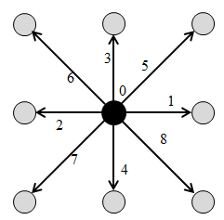
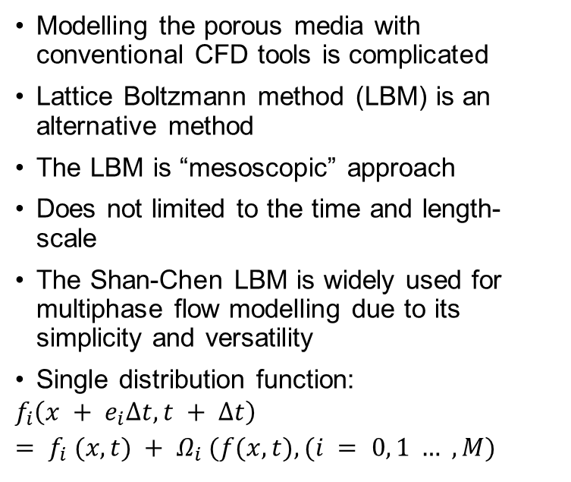
Methodology
Modelling the porous media with conventional CFD tools is complicated
Lattice Boltzmann method (LBM) is an alternative method
The LBM is “mesoscopic” approach
Does not limited to the time and length-scale
The Shan-Chen LBM is widely used for multiphase flow modelling due to its simplicity and versatility
Single distribution function:
$$f_{i}\left(x + e_{i}∆t,t + ∆t\right)= f_{i} (x,t) + Ω_{i} (f(x,t), (i = 0, 1 … , M)$$
D2Q9 model
5

Slide 6
Methodology
The LBM avoids tracking every single molecule
4 main models: the pseudopotential model, the color-fluid model, the mean-field theory, and the free-energy model
Limitations at high density ratio(up to 15) and viscosity ratio due to spurious currents at the interface
Peng-Robinson (P-R) and Carnahan-Starling (C-S) EOS improves the model's stability
Forcing scheme influences stability (velocity-shift, exact difference method (EDM), and Guo's forcing scheme.)
6

Slide 7
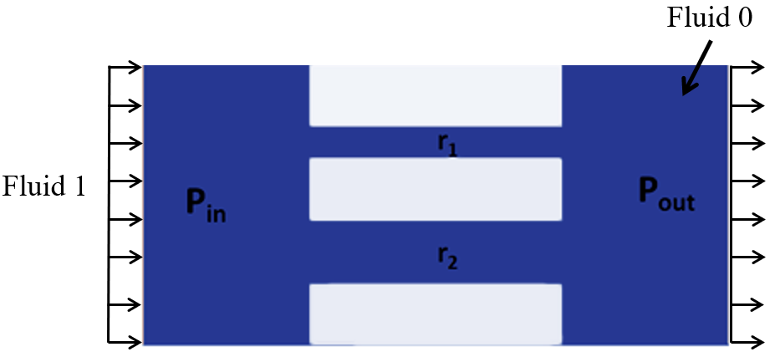

Model validation
Сapillary pressure test
Young-Laplace equation
Conditions:
∆p > P_{c1}
P_{c2}< ∆p < P_{c1}
∆p < P_{c1}
$$P_{c}=2σ∗\frac{\cos\left(θ\right)}{r}$$
Initial domain grid (280x140 lu²)
7

Slide 8
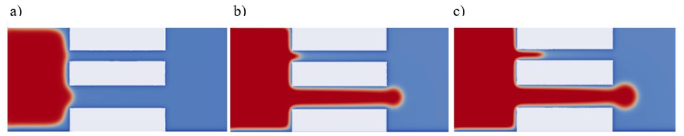
Model validation
Contact angle θ=70º
Viscosity ratio D = 1
Density ratio = 5
r1 =15 lu, r2 = 30lu
P_{c2} = 1.25*10⁻³, P_{c1} = 2.51*10⁻³
Capillary pressure test results: a) ∆p1 = 1.04 *10⁻³, b) ∆p2 = 2.13*10⁻³ and c) ∆p3 = 4.3*10⁻³.
8

Slide 9
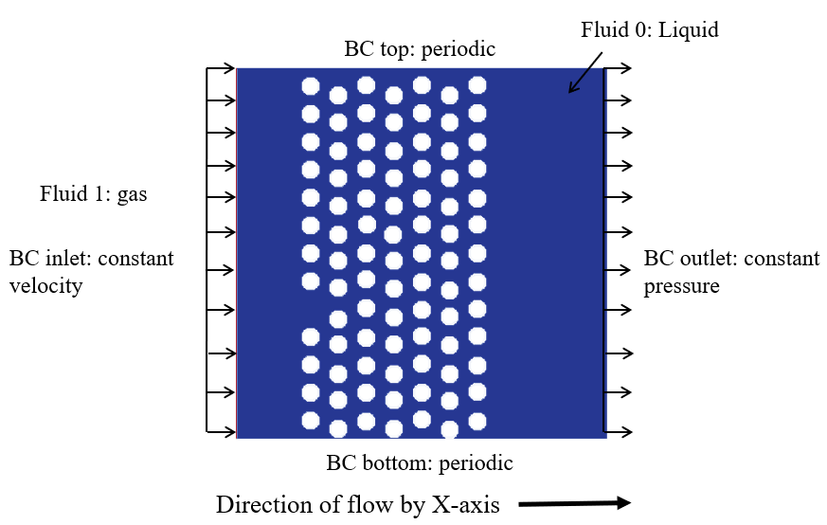
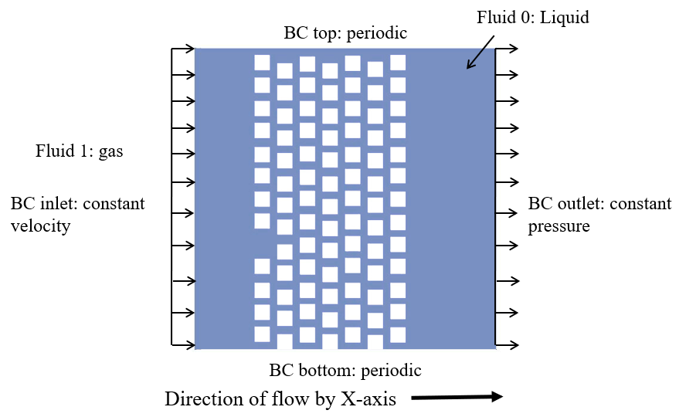
Model setup
The porous domain 401x401 lu²
Circular pores radius =10 lu
20x20 lu2 square pores separated by 10lu
Boundary conditions:
  Top and bottom: periodic
  Inlet: constant velocity
  Outlet: constant pressure
Initial and boundary conditions of the porous domain
9

Slide 10
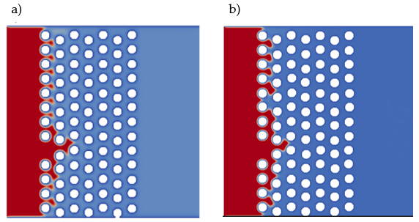
Forcing scheme analysis
  At τ = 1 (relaxation time), both forcing schemes have almost same outcomes
  At τ < 1, EDM is preferable
Gaseous phase (red) penetration for circular pores at t* = 0.175, Ca = 0.038 and θ = 70°, with different forcing schemes: (a) velocity-shift; (b) EDM.
10

Slide 11
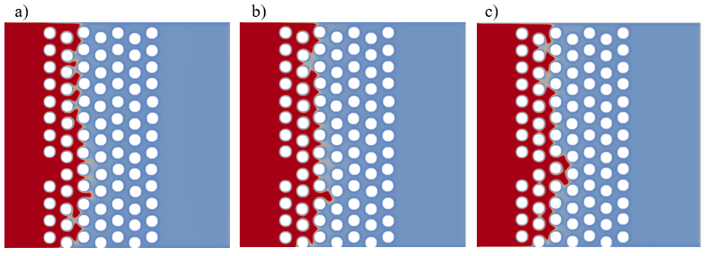
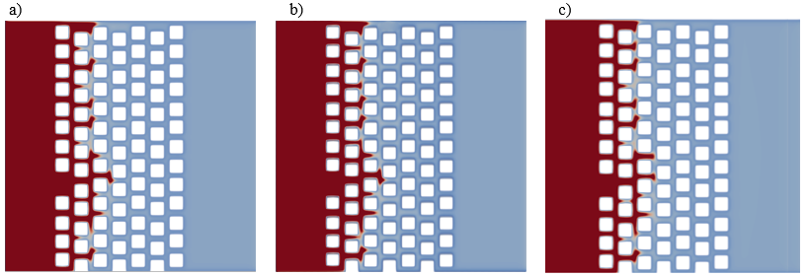
Effect of capillary number
Higher Ca results in more effective penetration
At lower Ca: fingering expands in the span-wise direction, due to low entry Ca
At higher Ca, the fingering favored the stream-wise direction
Gaseous phase (red) penetration at t* = 0.175 with different Ca: (a) Ca = 0.038; (b) Ca = 0.076; (c) Ca = 0.115.
11

Slide 12
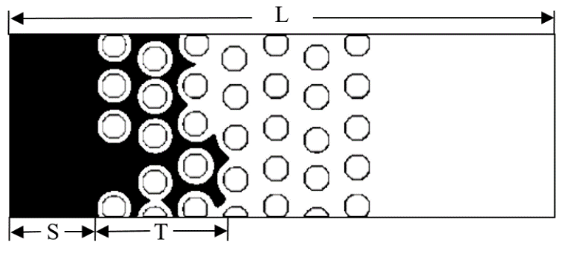
Effect of capillary number
Pore Geometry | Ca | T (lu)
Circular | 0.038 | 84.322
Square | 0.038 | 93.691
Circular | 0.076 | 89.931
Square | 0.076 | 97.447
Circular | 0.115 | 92.812
Square | 0.115 | 103.107
Graphical representation of gaseous phase penetration (L = domain length, S = the slip distance , T = the effective penetration length)
Results of penetration length T for different pore domains at various Ca and t* = 0.175.
12

Slide 13
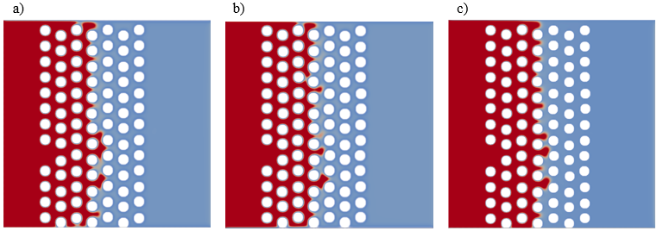
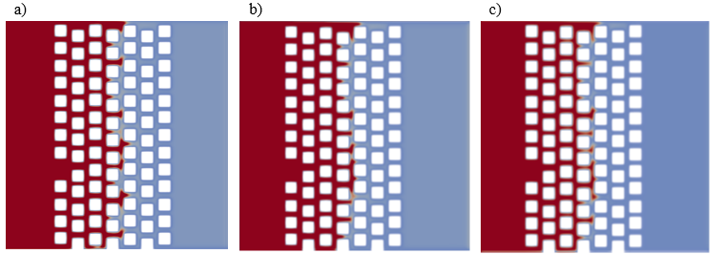
Effect of viscosity ratio
Higher viscosity ratio makes the gas penetration more challenging
At low D, the fingering narrows
Increasing the viscosity ratio increases the displacement's stability
Gaseous phase (red) penetration at t* = 0.275, Ca = 0.038 and: (a) D = 1; (b) D = 2; (c) D = 3.
13

Slide 14
Effect of viscosity ratio
Pore Geometry | D | T (lu)
Circular | 1 | 119.937
Square | 1 | 126.201
Circular | 2 | 113.468
Square | 2 | 118.933
Circular | 3 | 106.619
Square | 3 | 110.051
Results of penetration length T for different pore domains at various D and t* = 0.275.
14

Slide 15
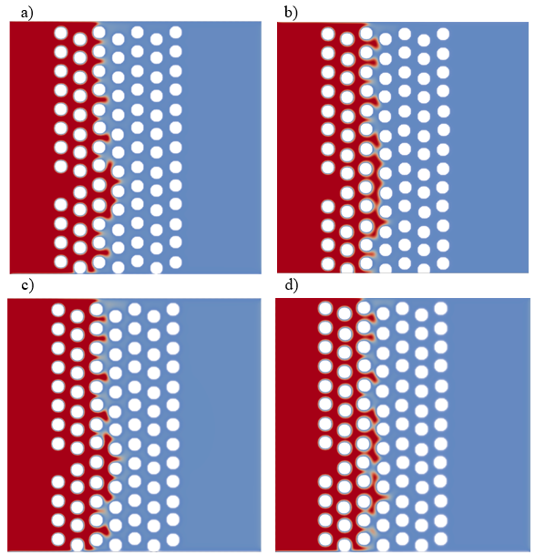
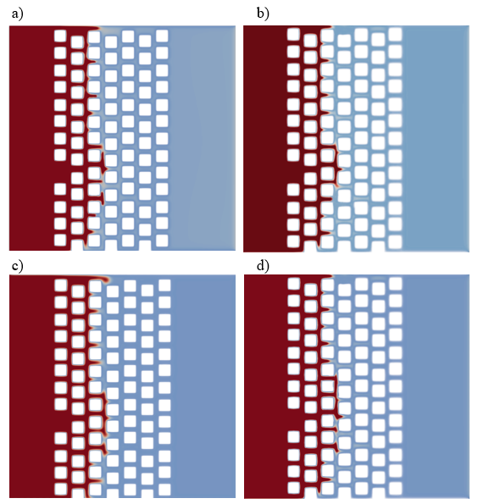
Effect of surface wettability
Gaseous phase penetration for square pores at t* = 0.225 time-step with fixed C = 0.038, D = 1, for various contact angles: (a) θ = 83°; (b) θ = 70°; (c) θ = 50°; (d) θ = 33°.
15

Slide 16
Effect of surface wettability
16

Slide 17
Conclusions
A pseudopotential LBM model with Peng-Robinson EOS is capable to analyse multiphase flow at higher density ratio
The velocity-shift and EDM forcing schemes have the same stability conditions at τ = 1
Higher capillary number (Ca) and surface contact angle increase the gaseous phase penetration length for fixed viscosity ratio (D).
When D is increased with constant Ca and constant surface wettability the gaseous phase penetration length decreases
The gaseous phase evolution length was lower in the circular-shaped pore domain by about 10% and 4% with respect to Ca and D
At different surface contact angles, the square-pore domain's fingering length was less than 3% than that in the circular-shaped domain
Future research aims to examine gas-liquid displacement performance in a non-homogeneous porous medium with increasing the viscosity ratio
17

Slide 18
Thank you for your attention!

