Slide 1
FINITE ELEMENT ANALYSIS of TIRE-SNOW INTERACTION WITH ADDITION OF STUDS
Author’s Elias Abou Fakhr
2nd Year Master in Mechanical and Aerospace Engineering
Supervisor: Associate Professor Christos Spitas
Co-Supervisor: Assistant Professor Sherif Gouda

Slide 2
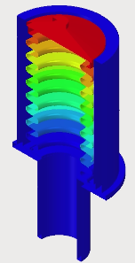
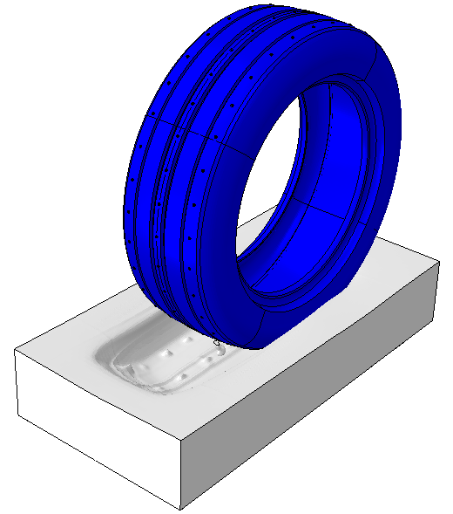
Outline
Outline of the problem/area of application
Aim and objectives
Sate of the art
Scope and constraints
Methodology
Models validation
Results & validation
Introduction to retractable mechanism
Contribution to knowledge
Publication
References

Slide 3
Outline of the problem/area of application
1. Challenges to develop accurate models
            2. Limited understanding of snow properties
            3. Complexity of the tire-snow contact patch
            4. Lack of data

Slide 4
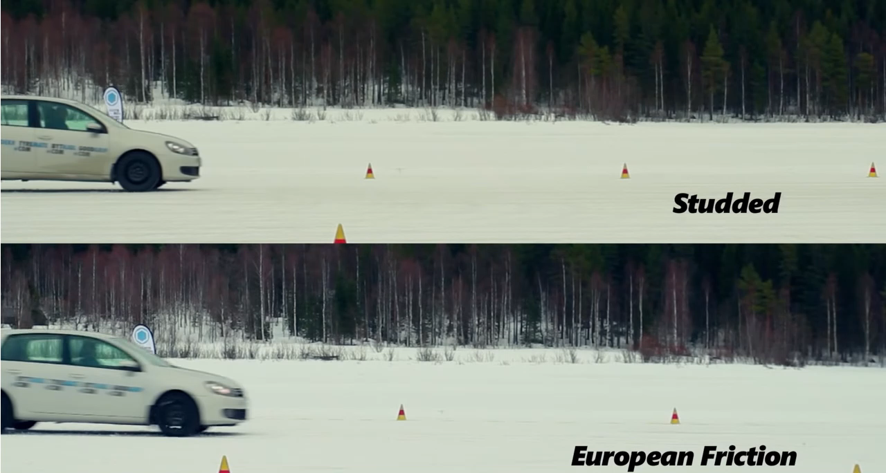
Outline of the problem/area of application-Breaking test

Slide 5
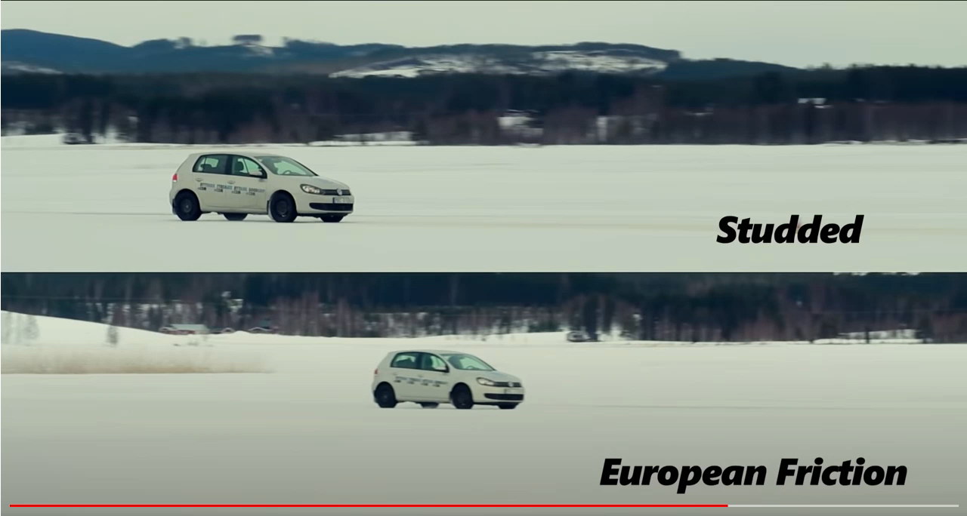
Outline of the problem/area of application-Cornering test

Slide 6
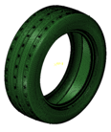
Aim and objectives
Develop a robust studded Tire-Snow Model
Develop a 3D studded Tire model
Apply fabric & steel reinforcement
Implement a 3D snow constitutive model
Tire-Snow Model
Implement an FEA simulation using Abaqus CAE
Introduce a novel design for retractable mechanism

Slide 7
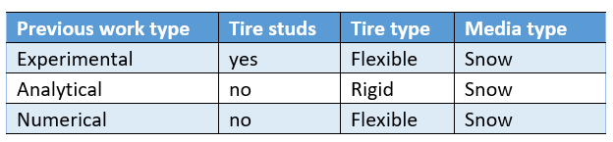
Sate of the art
Figure-1: Summary of previous work.

Slide 8
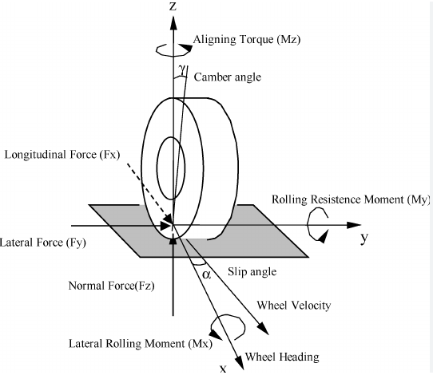
Scope and constraints
This work will provide the following:
  An FEA simulation
  Model validation
  Results for external forces vs slip rate
  Results validation
  Introduction to novel design of retractable mechanism
  Limitations:
  No Tire cornering
  No Lateral movement
  No field or laboratory tests
Null

Slide 9
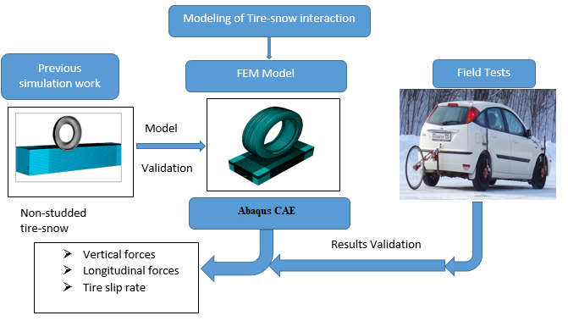
Methodology (Work flow)
Figure-2: Work-flow process

Slide 10
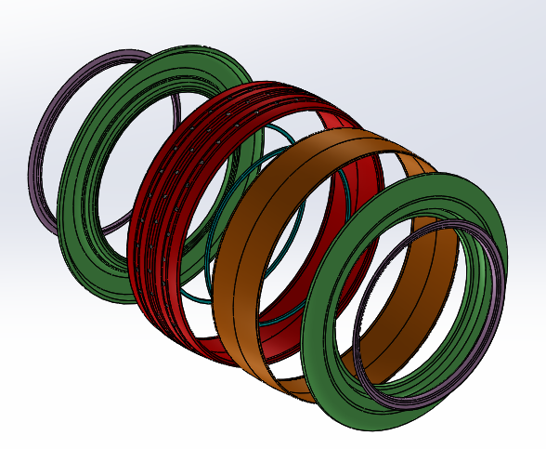
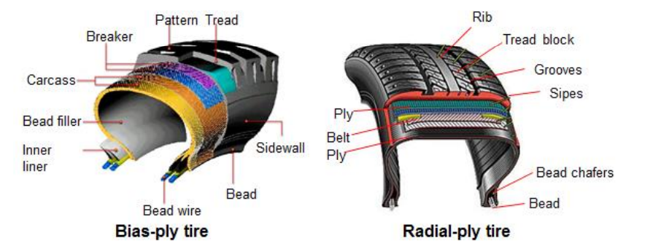
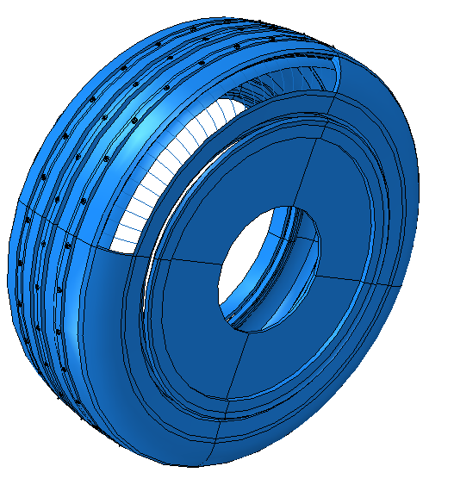
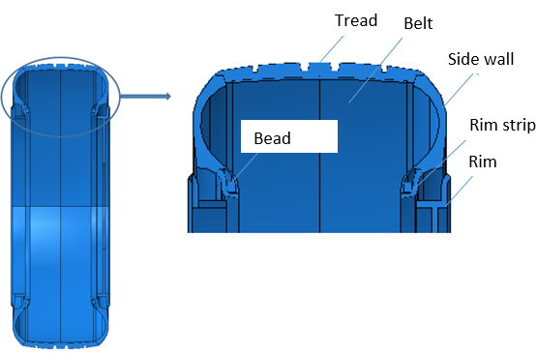
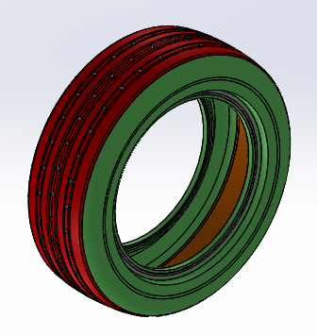
Tire model construction
Rim strip
Tread
Belt
Bead
Rim strip
Side walls
Figure-4: Tire Composition
Figure-3: Tire cross section detail
Figure-5: Tire Assembly

Slide 11
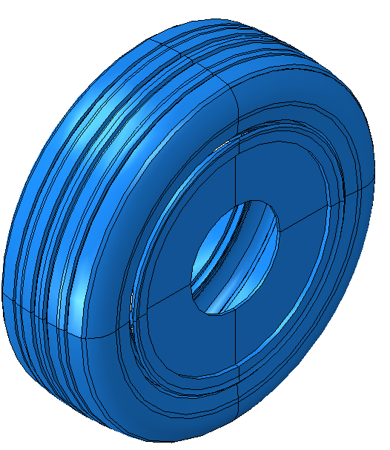
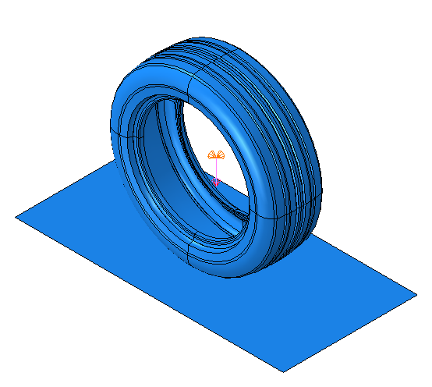
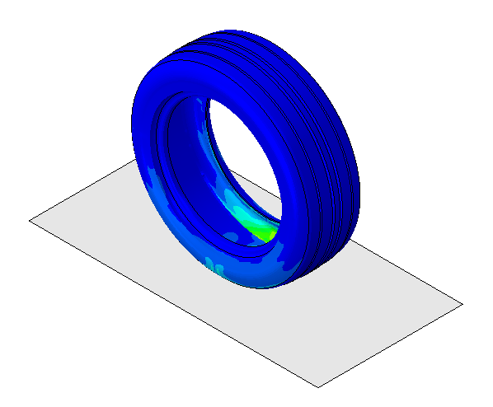
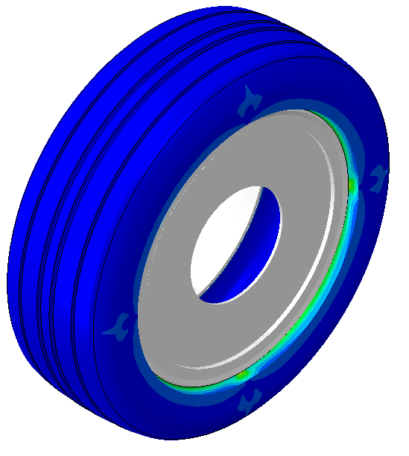
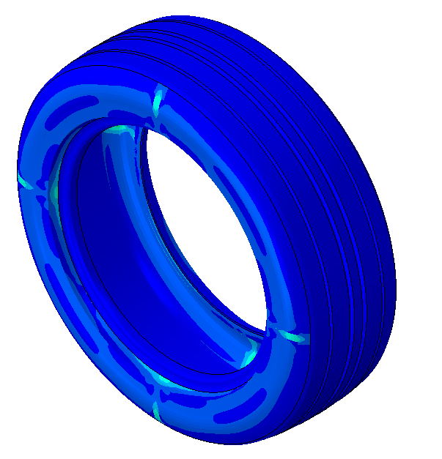
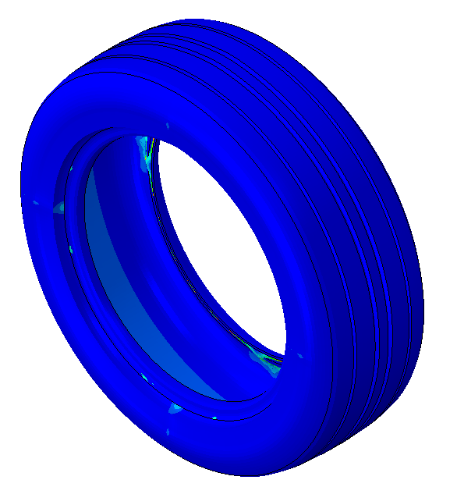
Methodology (FEA process)
Quasi-static analysis
Step 1
Step 2
Step 3
Rim Assembly → Implicit
Pressure inflation→ Implicit
Loading→ Implicit

Slide 12
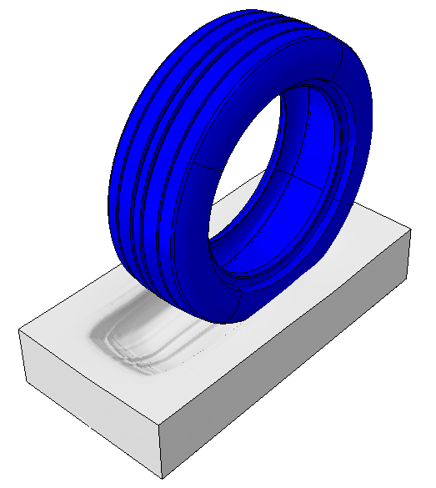
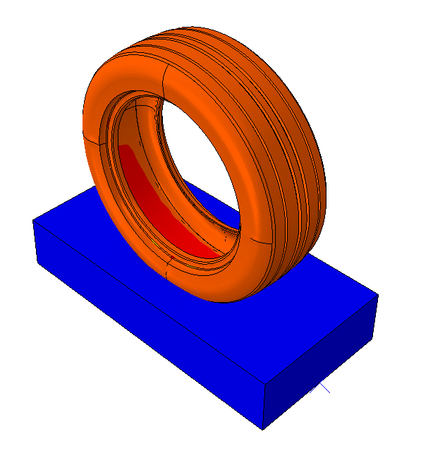
Methodology (FEA process)
Dynamic analysis
Longitudinal Slip
Step 5
Export Implicit to Explicit
Step 4
Rolling on Snow (Explicit)
With retracted studs
Force
Under Loading
Snow Compaction (Explicit)
Step 6
Slip
Rolling on Snow (Explicit)
With extended studs
Longitudinal Slip

Slide 13
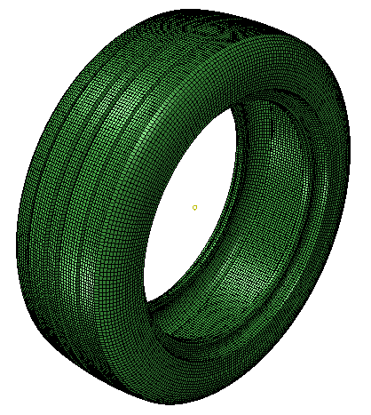
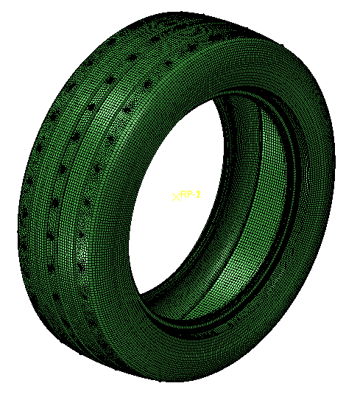
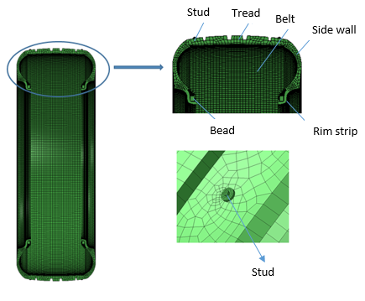
Methodology (FEA Mesh)
FEA Tire model
Elements characteristics
Non-studded
Studded
Item | Type | Element No | Node No | Size minimal (mm)
Tread | C3D8R | 38800 | 58400 | 5
Side wall | S4R | 33781 | 33542 | 5
Belt | S4R | 26181 | 26113 | 5
Rim strip | C3D8R | 7146 | 13240 | 5
Bead | C3D8R | 3568 | 8028 | 3
Stud | R3D4 | 20000 | 20200 | 3
Rim | R3D4 | 10193 | 10281 | 7
PC detail: 16 GB RAM Memory with 6 CPU’s of 3 GHZ
Figure-6: Meshed Tire assembly

Slide 14
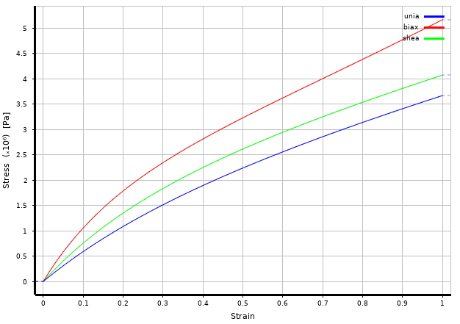

Tire model materials properties
Mooney-Rivlin material model (Hyper-Elastic)
Rubber Material Parameters
Part | Density [kg/m³] | C₁₀ [pa] | C₀₁ [pa] | D₁ [pa] ⁻¹
Belt | 1100 | 1010300 | 75320 | 4E-08
Side Wall | 890 | 23720 | 297650 | 1E-07
Tread | 850 | 406962 | 34680 | 3E-08
Rim Strip | 1100 | 2637214 | 50053.5 | 1.4804E-09
Figure-6: Rubber Stress-Strain plot

Slide 15
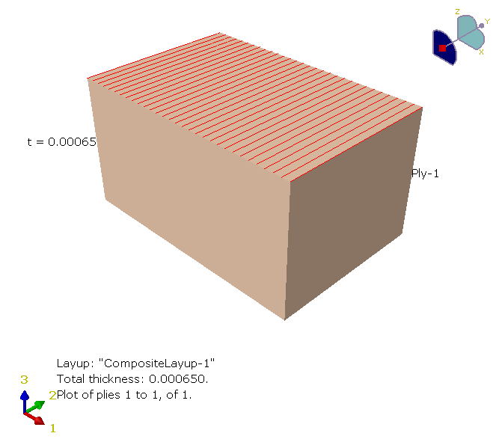
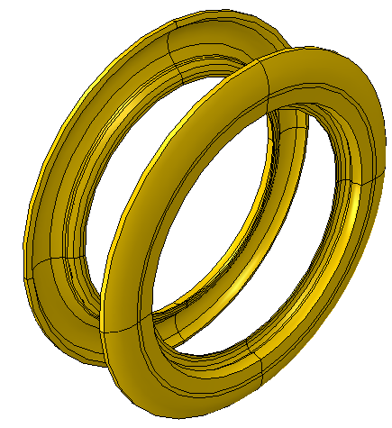
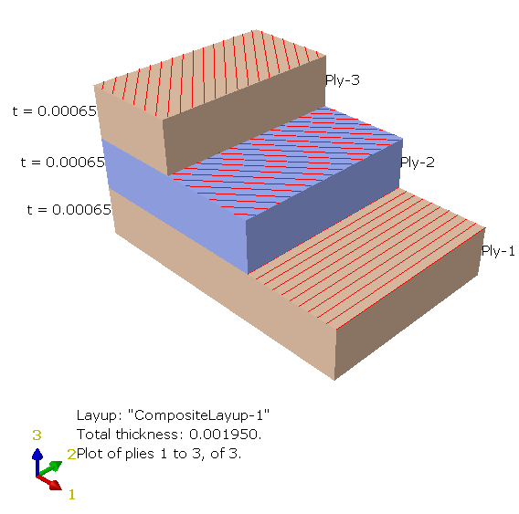
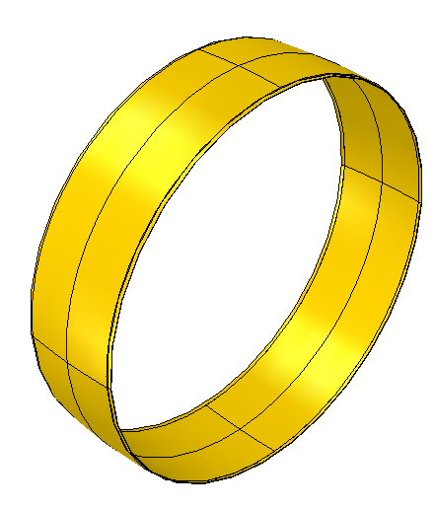
Tire model materials properties
Reinforcement Materials
Parameters | Belt Rebar |  |  | Side wall
α ° | 90 | 40 | -40 | 90
Density(kg/m3 ) | 7500 | 7500 | 7500 | 2000
E (Gpa) | 210 | 210 | 210 | 550
Poisson ratio ν | 0.3 | 0.3 | 0.3 | 0.35
Figure-7: Steel fiber reinforced Belt
Figure-8: Fabric fiber reinforced Side wall

Slide 16

Other Materials detail
Tire model materials properties
Bead material
Part | Density (kg/m3 ) | E (Mpa) | Poisson ratio ν
Bead | 6000 | 15000 | 0.3
Figure-9: Bead (both sides)

Slide 17
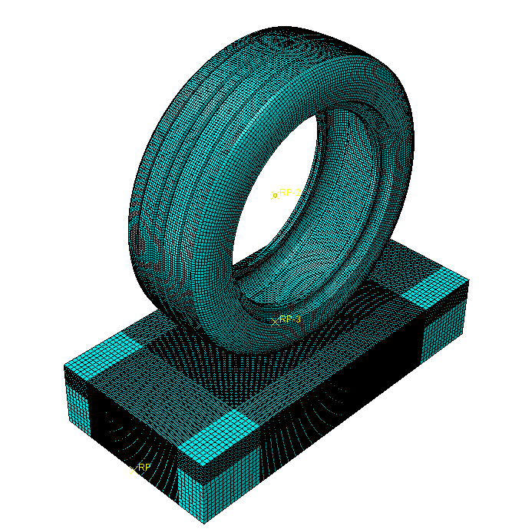
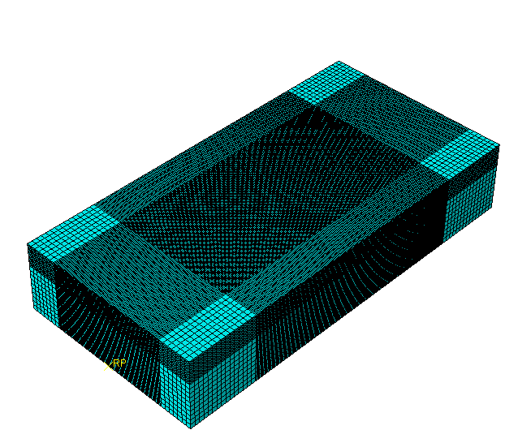
Methodology (Snow-road mesh)
Elements characteristics
Figure-10:Meshed Snow model
Figure-11:Meshed Tire-Snow model
Item | Type | Element No | Node No | Size minimal (mm)
Snow | EC3D8R | 814200 | 852159 | 2.5
Rigid Road | R3D4 | 5000 | 5151 | 10

Slide 18

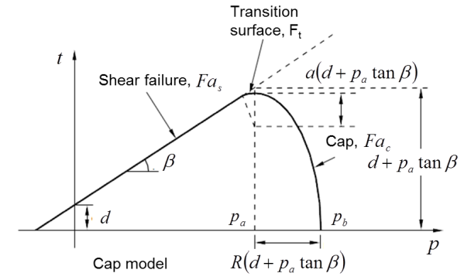
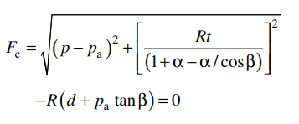



Snow model material properties
Modified Drucker-Prager Cap model
(1)
(2)
(3)
(4)
Figure-12: Modified Drucker-Prager Cap model [12]

Slide 19
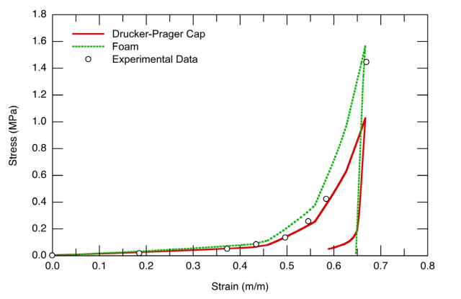
Snow model validation
Modified Drucker-Prager Cap model [12]
Parameters | Elastic | Drucker-Prager cap
Material cohesion: d (Pa) |  | 30,000
Friction angle: β ° |  | 22.53
Cap eccentricity: R |  | 2.2e-2
Initial Cap yield surface position: ԑ |  | 0.001
Transition surface radius: α |  | 0
Flow stress ratio: K |  | 1
Unloading slope κ | 0.005
Poisson ratio: ν | 0.3
Pt (pa) | 11.376
E (Mpa) | 13.79
Figure-13: Comparison of model and experimental data for uniaxial compression tests on Fresh snow

Slide 20
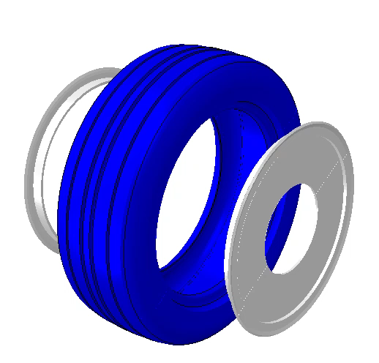

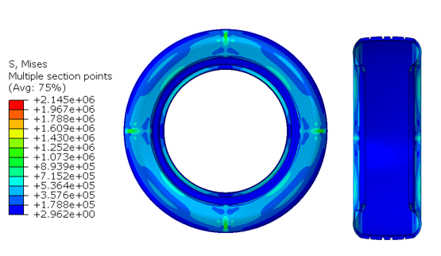
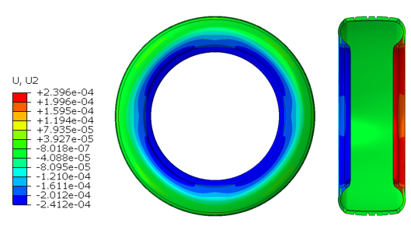
Tire model validation
Rim Assembly → Implicit
a
b
Figure-15: Rim assembly results of Stresses (Mises) (a) , Deformations in Y direction (b)

Slide 21

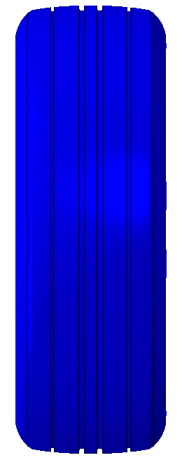
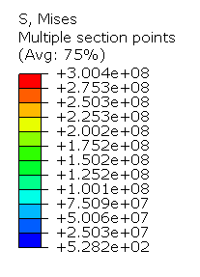
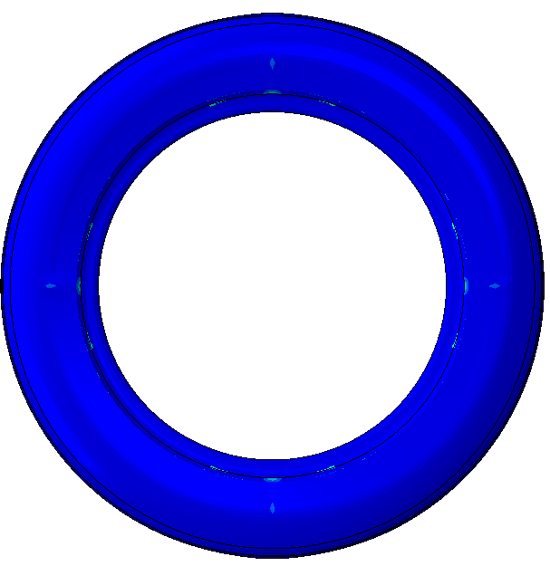
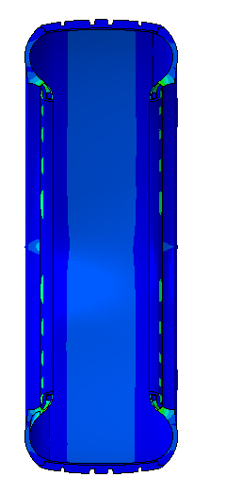
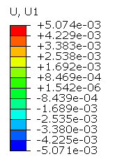
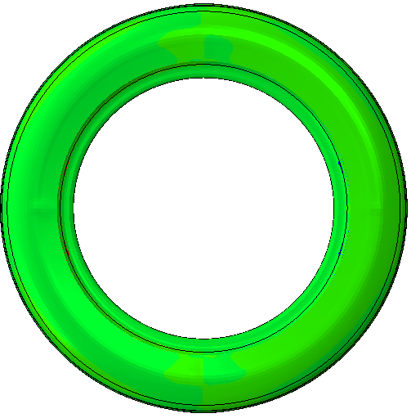
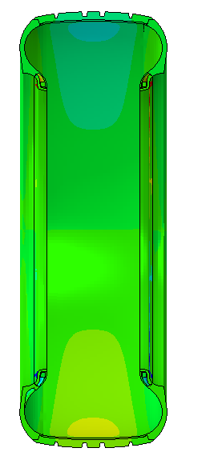
Tire model validation
Pressure inflation→ Implicit
a
b
Figure-15: Pressure inflation( 210 Kpa) results of Stresses (Mises) (a) , Deformations in X direction (b)

Slide 22
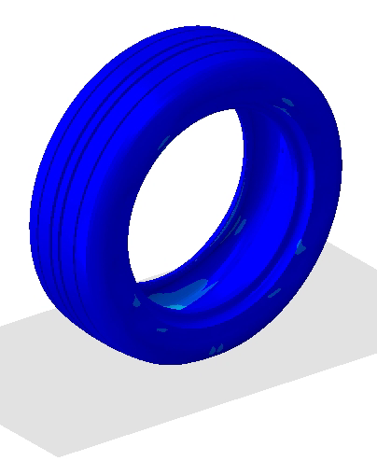
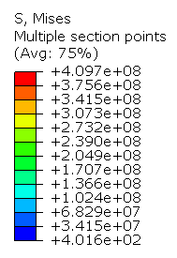
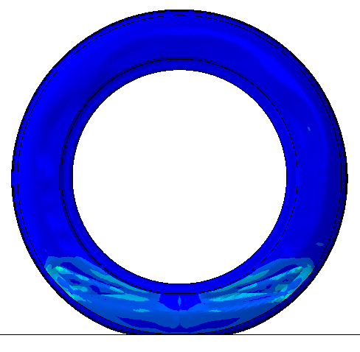
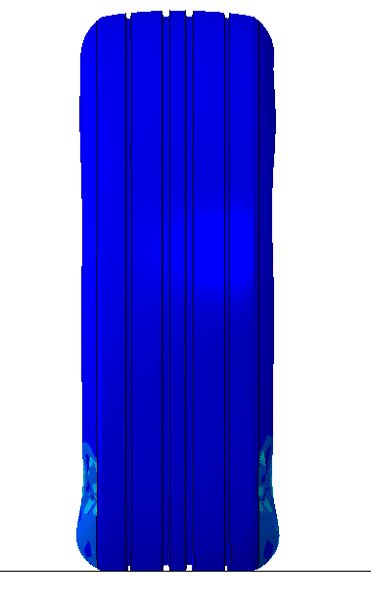
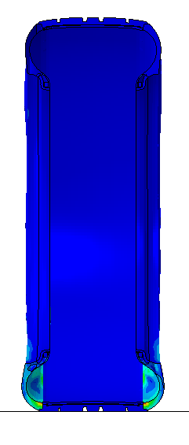
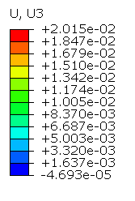




Tire model validation
Loading→ Implicit
a
b
Figure-16: Loading (4.5 KN) results of Stresses (Mises) (a) , Deformations in Z direction (b)

Slide 23


Tire model validation (Benchmarked)
Figure 17. Vertical Load vs vertical deflection (current & previous works)
Figure 18. Contact Area vs vertical load (current & previous works)

Slide 24







Tire-Snow interaction model
Coupled Eulerian-Lagrangian Finite Element
Simulation of Snow compaction
Figure-10: Lagrangian Vs Eulerian
Figure-19:Snow Stresses Mises results

Slide 25









Tire-Snow interaction model
Figure-12: Tire deformation in Y direction
Figure-20: Snow Density contour plot

Slide 26





Tire-Snow interaction model analysis
_{Rolling Resistance}
₌f_{rr}*σn₂*dA
=f_{rr*}F_{x}
Shear Force
Figure-21. Schematic of tire-snow interaction showing superposition of both translation and rotation motions

Slide 27

Tire-Snow interaction model implementation
Tire slip ratio

Slide 28

Tire-Snow interaction model development (Non-studded tire)

Slide 29

Tire-Snow interaction model development (Studded tire)

Slide 30

Longitudinal shear force ( Non-studded tire)

Slide 31

Longitudinal shear force (Studded tire)

Slide 32


Tire-snow interaction results
Figure-22. Normalized tractive force vs time for studded and non-studded tires

Slide 33




Tire-snow interaction results
Figure-23. Normalized tractive force vs slip ratio for studded and non-studded tires

Slide 34


Tire-snow interaction results
Figure-24. Normalized rolling resistance force vs slip ratio for studded and non-studded tires

Slide 35


Tire-snow interaction results
Figure-25. Normalized drawbar pull force vs slip ratio for studded and non-studded tires

Slide 36


Tire-snow interaction results
Figure-26. Normalized moment vs slip ratio for studded and non-studded tires

Slide 37


Results validation
Figure-27. Normalized tractive force vs slip ratio for studded and non-studded tires validated against experimental data.

Slide 38





Introduction to retractable mechanism
Limitations of regular studs
Damage to asphalt
Governmental prohibition
a
b
Existing patents & their limitations
Air leakage problem
Tire structure damage (radial plies)
Limitation to air tires
c
Figure-28:
(a) By Einarson[4] , (b) By Bushnell et all [2], (c) By Gullbrandsson Bolav [3]

Slide 39



Proposed solution
Retractable mechanism Novel design
Figure-29: Mechanism assembly
Figure-30: Tire cross section with retractable studs

Slide 40

Retractable mechanism (Operation)
Micro Solenoid valve
Micro oil pump
Micro oil strainer
Mini oil reservoir
Figure-31: Retractable mechanism operation (P&ID)

Slide 41

Retractable mechanism (Quasi-static)
a
Figure-32: Stress contour plot (Quasi-static analysis)

Slide 42


Retractable mechanism (Quasi-static analysis)
Figure-33: Deformation contour plot
Figure 34. Bellow Force vs displacement graph

Slide 43

Conclusion
Developed a robust studded Tire-Snow Model
Predictive tire stiffness behavior
Tire model was validated against
previous work
Contact area behavior
Predictive plastic stress-strain
behavior
Snow model was validated
against experimental & other models
Compaction behavior
Predictive Longitudinal force vs Slip rate
Tire rolling on snow with
& without studs (Results)
Results validation
Introduction to retractable mechanism design
Efficient, Wear resistant
& Easily installation

Slide 44

Contribution to knowledge

Slide 45


Publication

Slide 46
Thank you for your attention!

Slide 47
References
[1] J. Mierins, “Tire with retractable studs,” 2994065, Jun. 08, 2018
[2] R. B. Bushnell, “All weather tire,” US 2014/0116592, Jan. 05, 2014
[3] B. Gullbrandsson, “Arrangement in studded tires”
[4] E. Einarson, “Retractable studded tire,” 3872908, Mar. 25, 1975
[5] J. R. Anderson, “SNOW TIRE WITH RETRACTABLE STUDS,” 3672421, Jun. 27, 1972
[6] H.-H. Nguyen, J. Cesbron, F. Anfosso Ledee, H. Yin, S. Erlicher, and D. Duhamel, “Dependance of the contact area on the velocity of a rolling tire,” J. Acoust. Soc. Am., vol. 123, p. 3868, Jun. 2008, doi: 10.1121/1.2935745.
[7] S. Taheri, Ab, C. Sandu, Taheri, and S. Taheri, Development and Implementation of a Hybrid Soft Soil Tire Model (HSSTM). 2014.
[8] S. Mu¨ller, M. Uchanski, and K. Hedrick, “Estimation of the Maximum Tire-Road Friction Coefficient,” J. Dyn. Syst. Meas. Control, vol. 125, no. 4, pp. 607–617, Jan. 2004, doi: 10.1115/1.1636773.
[9] H. C. Jung, W. C. Park, and K. M. Jeong, “Finite Element Analysis of Tire Traction Using a Rubber-Ice Friction Model,” Open J. Appl. Sci., vol. 08, no. 11, pp. 495–505, 2018, doi: 10.4236/ojapps.2018.811040.

