Slide 1
High level robot motion planning using POMDP
Shyrailym Shaldambayeva

Slide 2
Planning under uncertainty
Environment:
  Dynamic, cluttered, partially observable
Handling unknown objects:
  Appearance, weight, location, number, occlusion

Slide 3
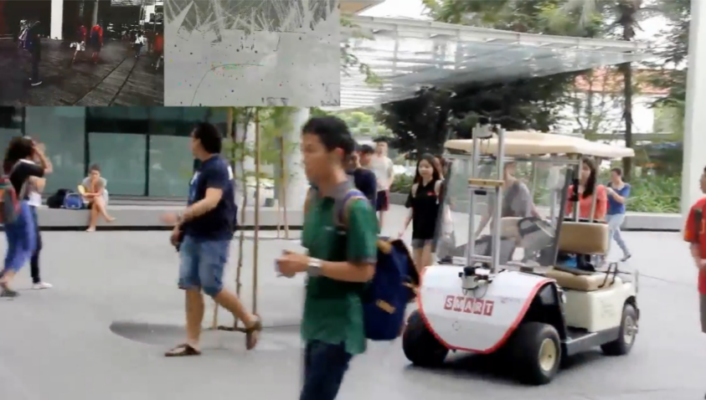
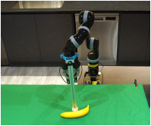
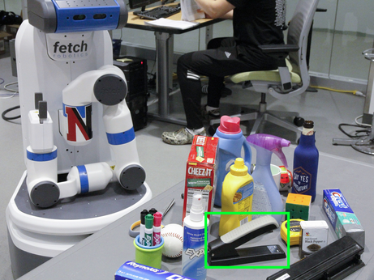
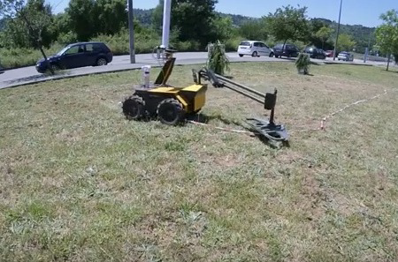
Robotic tasks modelled as POMDPs
Navigation
Grasping
Target tracking
Manipulation, etc.

Slide 4
Presentation Outline

Slide 5
Project goals
Partially observable Markov decision processes (POMDP)
POMDP solvers
Experiments setup
Results
Future work

Slide 6
Project Goals

Slide 7
Explore real world problems modelled and solved as POMDPs
Learn how to define an accurate POMDP model for a particular task
Analyze available open-source POMDP libraries

Slide 8
POMDP

Slide 9
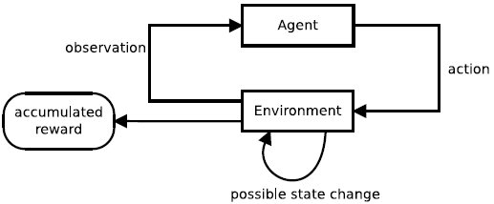
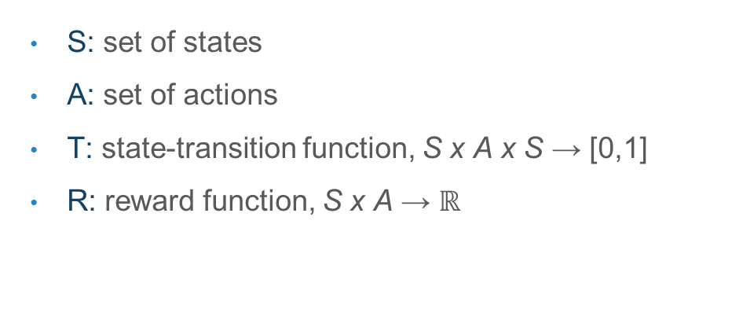
Partially Observable Markov Decision Processes
<S, A, T, R, Ω, O, $γ$, b₀ >
S: set of states
A: set of actions
T: state-transition function, S x A x S → [0,1]
R: reward function, S x A → $ℝ$

Slide 10
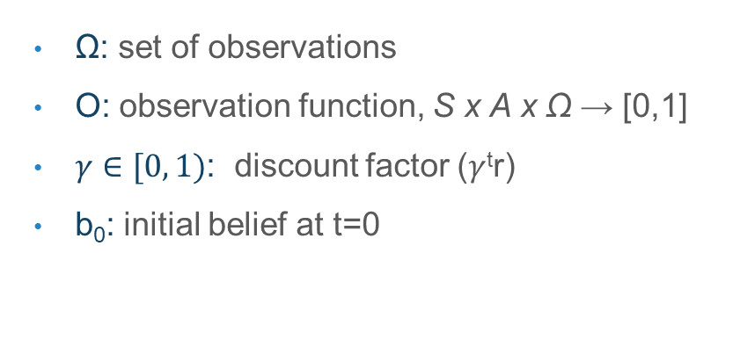
Partially Observable Markov Decision Processes
<S, A, T, R, Ω, O, $γ$, b₀ >
Ω: set of observations
O: observation function, S x A x Ω → [0,1]
$γ∈[0, 1)$: discount factor ($γ$^{t}r)
b₀: initial belief at t=0

Slide 11

Tiger Problem
S: s_{l} or s_{r}
A: LEFT, RIGHT, LISTEN
T: LISTEN → no change
LEFT/RIGHT → s_{l} or s_{r} 50% chance
R: LISTEN → -1
Correct door → +10
Wrong door → -100

Slide 12
Tiger Problem
Ω: TL or TR
O: s_{l} → 0.85 TL, 0.15 TR
s_{r} → 0.85 TR, 0.15 TL
γ: 0.95
b₀ : [0.5, 0.5]

Slide 13
POMDP Solvers

Slide 14
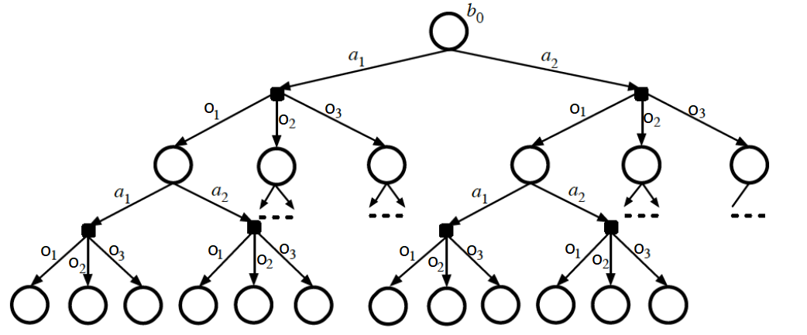



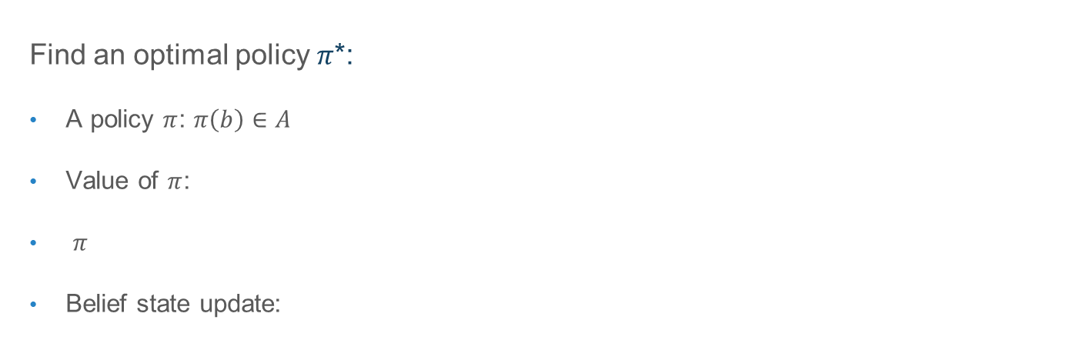
Solving POMDP
Find an optimal policy $π$*:
A policy $π$: $π\left(b\right)∈A$
Value of $π$:
$π$
Belief state update:

Slide 15
Challenges of POMDP
“Curse of dimensionality”
  Exponential growth of belief space with the number of states
“Curse of history”:
  Exponential growth of action-observation histories with the planning horizon

Slide 16
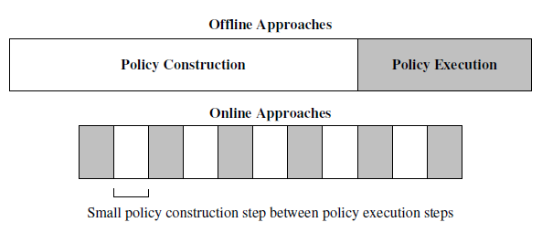
Approximate Algorithms
Offline
Online:
  Branch-and-Bound Pruning
  Monte Carlo Sampling
  Heuristic Search

Slide 17
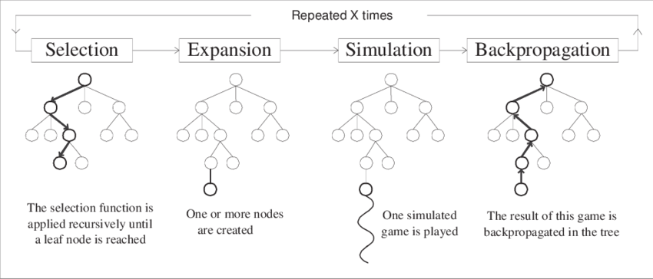
State-of-the-art algorithms
POMCP
DESPOT

Slide 18
Experiments

Slide 19
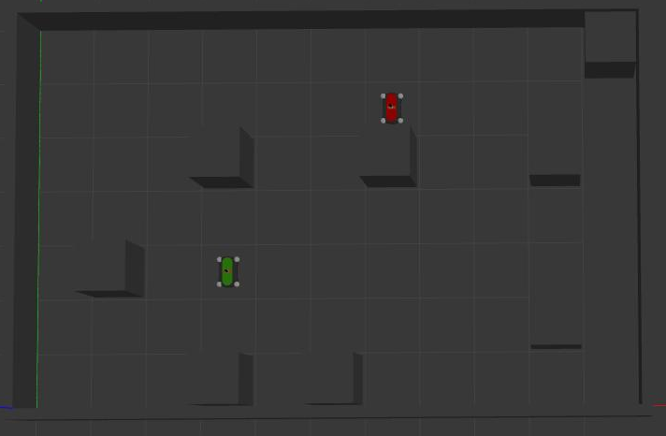
Laser Tag
|S| = 4,830
|A| = 5
|Ω| = ∼1.5 × 10⁶

Slide 20
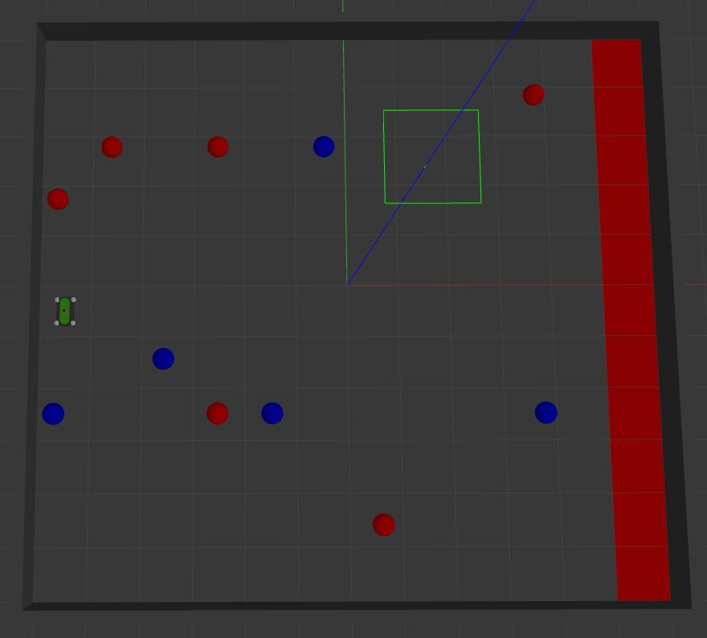
Rock Sample (11, 11)
|S| = 247,808
|A| = 16
|Ω| = 3

Slide 21
Approximate POMDP Planning Software
C++ toolkit for approximate POMDP planning
Easy integration with simulated environments
Includes POMCP and DESPOT
Clear documentation
Ongoing development

Slide 22
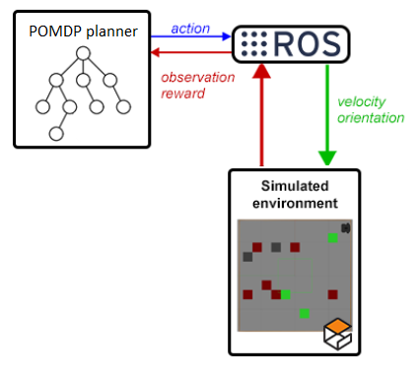
Experiments Setup
POMDP planner (POMCP or DESPOT)
2 ROS nodes
Gazebo simulated environment

Slide 23
Results

Slide 24
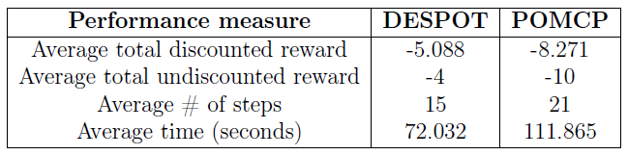
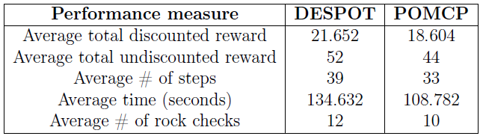
Laser Tag
Rock Sample

Slide 25
Future Work

Slide 26
Conduct experiments in real environment
Model realistic robotic tasks as POMDPs:
  Incorporate camera images as inputs
Use deep neural networks to learn and generalize policies

Slide 27
References
[1] Adhiraj Somani, Nan Ye, David Hsu, and Wee Sun Lee. Despot: Online pomdp planning with regularization. In Advances in neural information processing systems, pages 1772–1780, 2013.
[2] Yuchen Xiao, Sammie Katt, Andreas ten Pas, Shengjian Chen, and ChristopherAmato. Online planning for target object search in clutter under partial observability. In 2019 International Conference on Robotics and Automation (ICRA),pages 8241–8247. IEEE, 2019.
[3] Jue Kun Li, David Hsu, and Wee Sun Lee. Push-Net: Deep planar pushing for objects with unknown physical properties. In Proc. Robotics: Science & Systems, 2018.
[4] Leslie Pack Kaelbling, Michael L Littman, and Anthony R Cassandra. Planning and acting in partially observable stochastic domains. Artificial intelligence, 101(1-2):99–134, 1998.
[5] Andreas Ten Pas. Simulation based planning for partially observable markov decision processes with continuous observation spaces. PhD thesis, Citeseer, 2012.
[6] David Silver and Joel Veness. Monte-carlo planning in large pomdps. In Advances in neural information processing systems, pages 2164–2172, 2010.
[7] Guillaume M JB Chaslot, Mark HM Winands, H JAAP VAN DEN HERIK,Jos WHM Uiterwijk, and Bruno Bouzy. Progressive strategies for monte-carlo tree search. New Mathematics and Natural Computation, 4(03):343–357, 2008.

Slide 28
References
[8] Michael Herrmann. (2015) POMDPs: Partially Observable Markov Decision Processes [PDF presentation] RL13: Reinforcement Learning. Available at: http://www.inf.ed.ac.uk/teaching/courses/rl/slides15/rl13.pdf (Accessed: 27 April 2021).
[9] Stéphane Ross, Joelle Pineau, Sébastien Paquet, and Brahim Chaib-Draa. Online planning algorithms for pomdps. Journal of Artificial Intelligence Research, 32:663–704, 2008.
[10] Alberto Castellini, Enrico Marchesini, and Alessandro Farinelli. Online montecarlo planning for autonomous robots: Exploiting prior knowledge on task simi-larities. In AIRO@ AI* IA, pages 25–32, 2019.

Slide 29
Thank you!

