Slide 1

Cybernetics.
User protection against attacks through communications

Slide 2

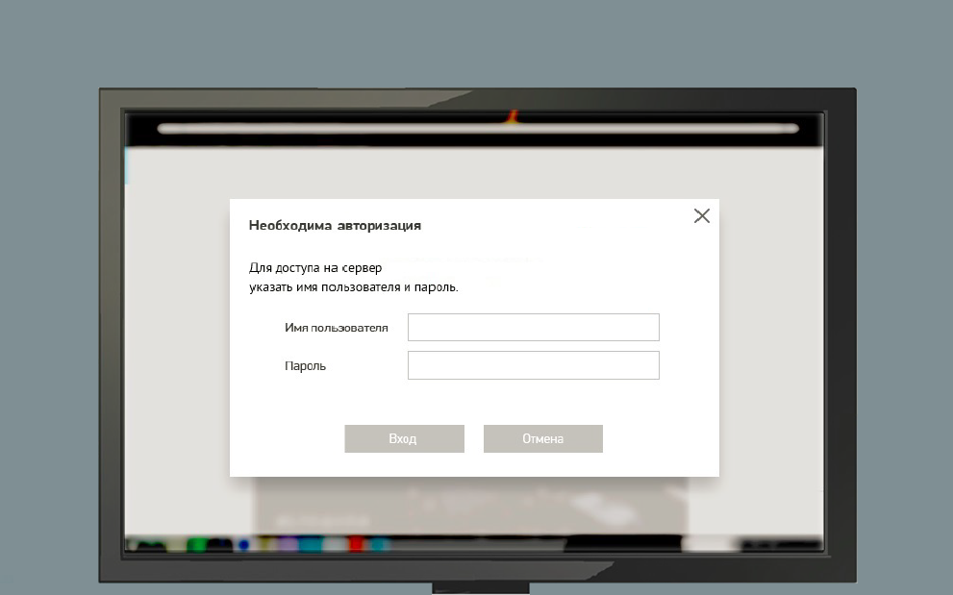
Instructions for training
!
For more information, click on the active items.
To go to the next slide, click the forward arrow.
To go to the previous slide, click the back arrow.

Slide 3

Why is it important?
Human is the weakest link in the protection system of any organization.

Slide 4

What is social engineering?
!
Social engineering is techniques that fraudulently force a person to perform certain actions, including disclosing certain information about himself or his Company, in order to gain access to personal or confidential data.

Slide 5
Phishing targets and tools
!
Phishing - a type of Internet fraud, which is example of the use of social engineering.
The goal of phishing is to gain access for sensitive information fraudulently.
Conducting phishing attacks - e-mail, SMS, phone calls, social networks, messengers.

Slide 6
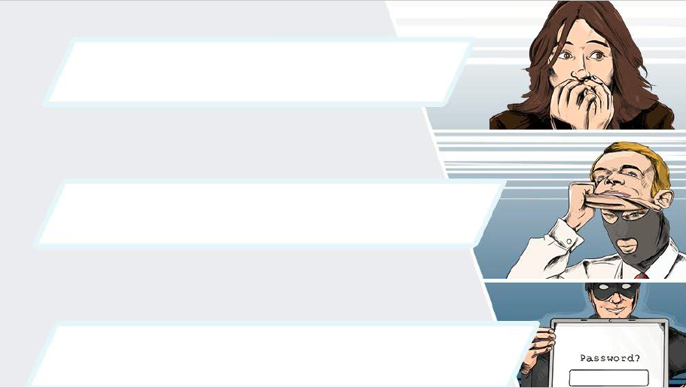
Basic phishing tricks
The challenge of emotions is an attempt to rush, frighten the “victim” or in any other way interest her.
Disguise - an attempt to impersonate representatives of well-known companies, management, colleagues, relatives, etc.
Attempt to force to make any actions (to follow the link, to report something, to enter the login / password, to transfer money, etc.)

Slide 7
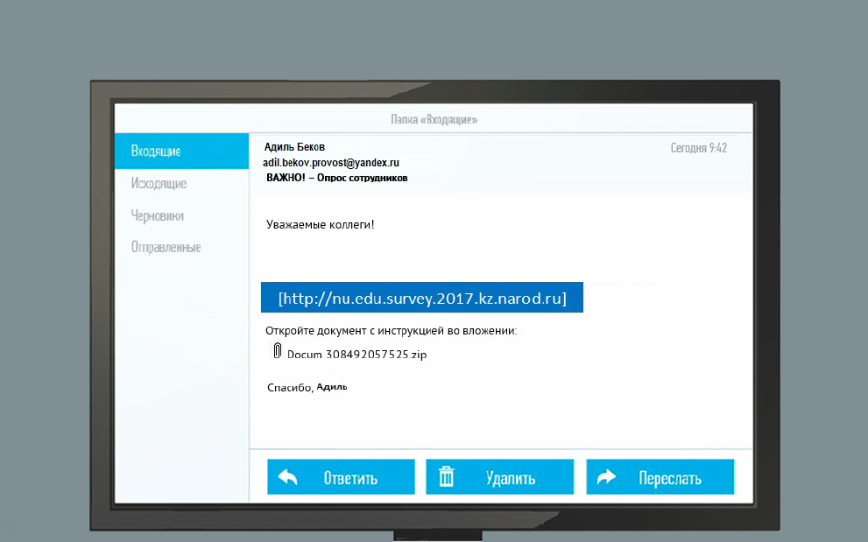
Phishing methods
The urge to follow the link

Slide 8
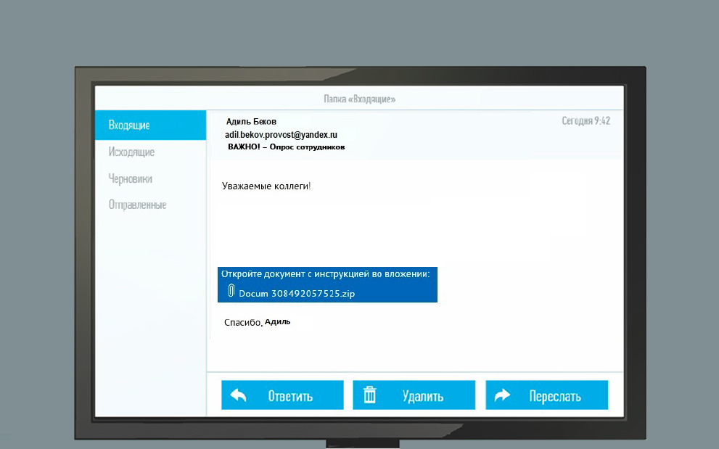
Phishing methods
The urge to download the file

Slide 9
Phishing methods
Request login/password

Slide 10
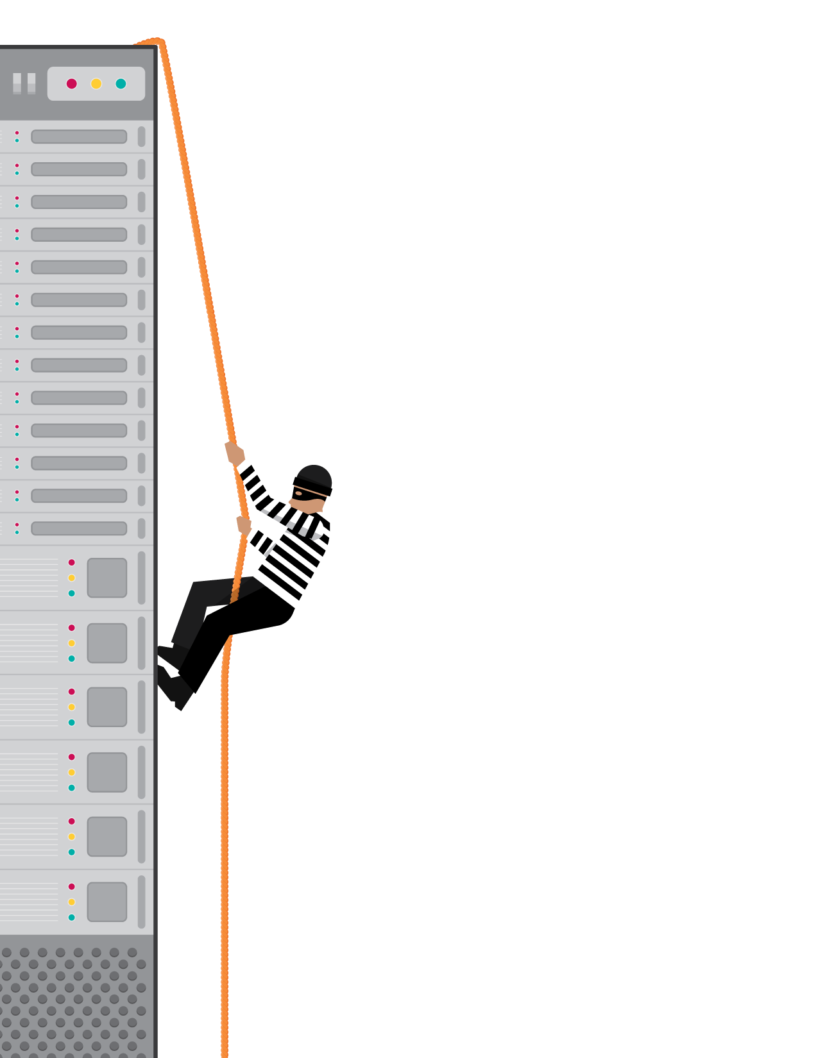
Terms of use of electronic communication
“Presumption of distrust” - be on the alert! Carefully treat incoming letters, SMS and calls, check them for the main signs of phishing.
If you inadvertently opened the attachment, do not exit the "safe browse mode"
Do not open attachments to letters that came from untrusted sources, and do not follow the links in such letters.
Do not give in to emotions. Spend at least 10 minutes to validate the information received.

Slide 11
Terms of use of electronic communication
Look carefully at the sender's address.
Following the links, check the path they follow. To do this, just hover over the link.
Do not agree to follow the instructions. If possible, check the information through duplicate channels (for example, by a known personal phone number). Consult with manager if necessary.
If in doubt, send a letter to technical support.

Slide 12
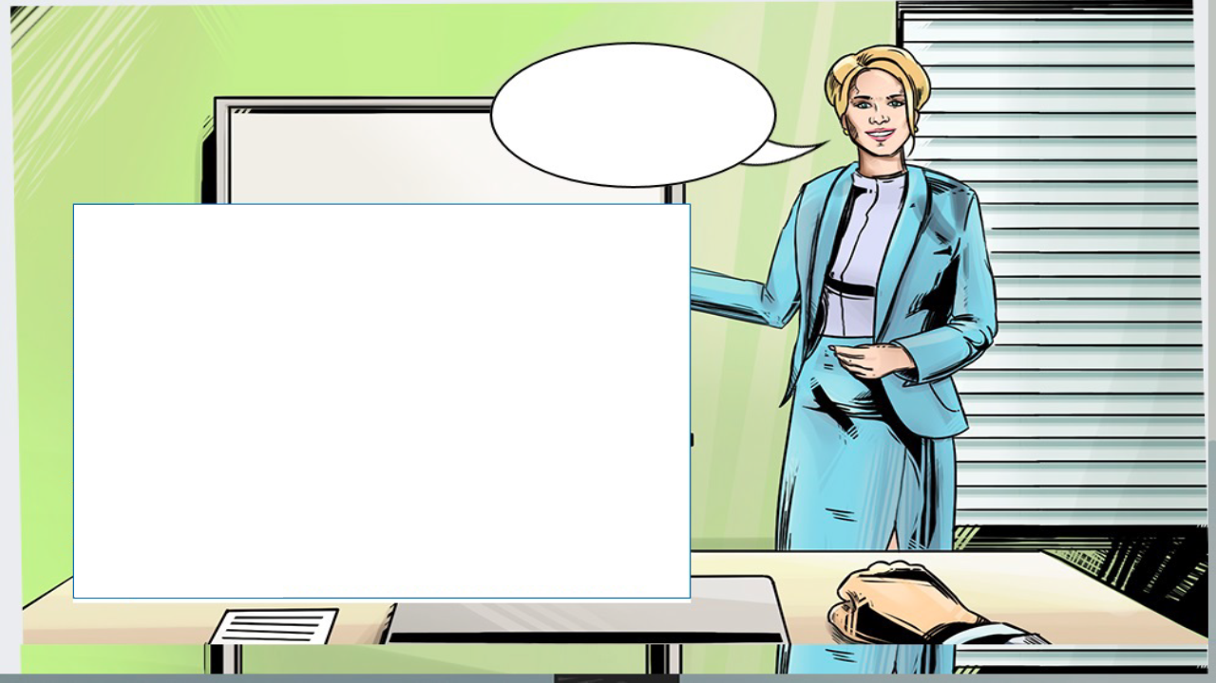
Learn more about e-mail phishing.
1
Sender's address: public service
2
Text or title: calls for immediate action (“urgent”, “important”)
3
Appeal: in general form ("colleagues")
4
Text: the essence of the request is not clear in the letter
5
Attachments and links: please open them
6
Used symbols of the company
7
Spelling and stylistic errors

Slide 13
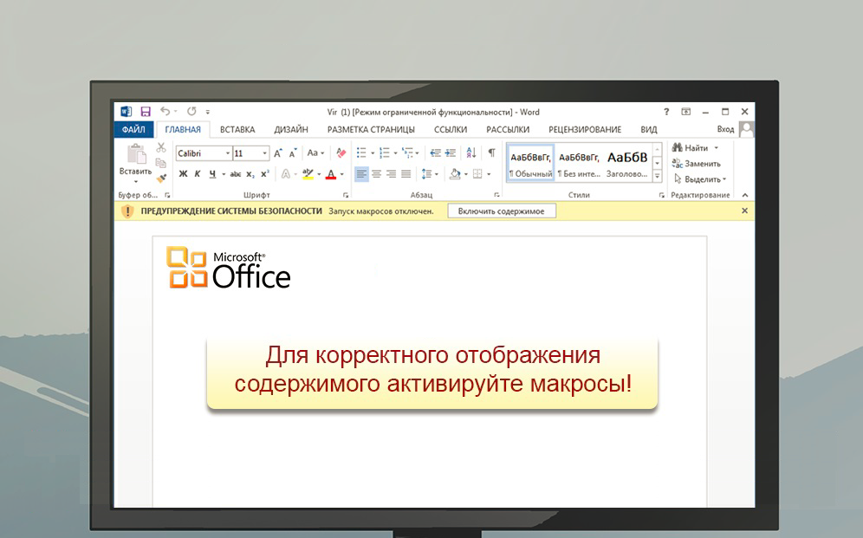
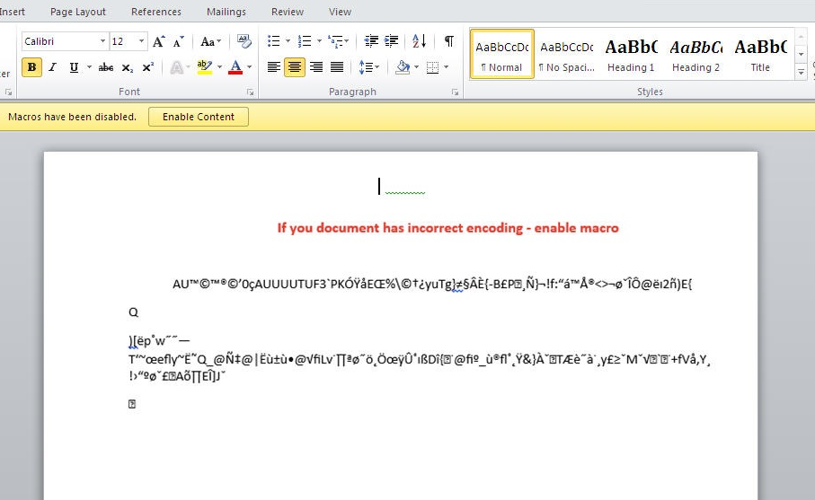
Signs of phishing email
Please enable macros
8
If you opened an attachment from an email received from an untrusted source, do not click the "Enable Content" button - this will start the execution of malicious code

Slide 14
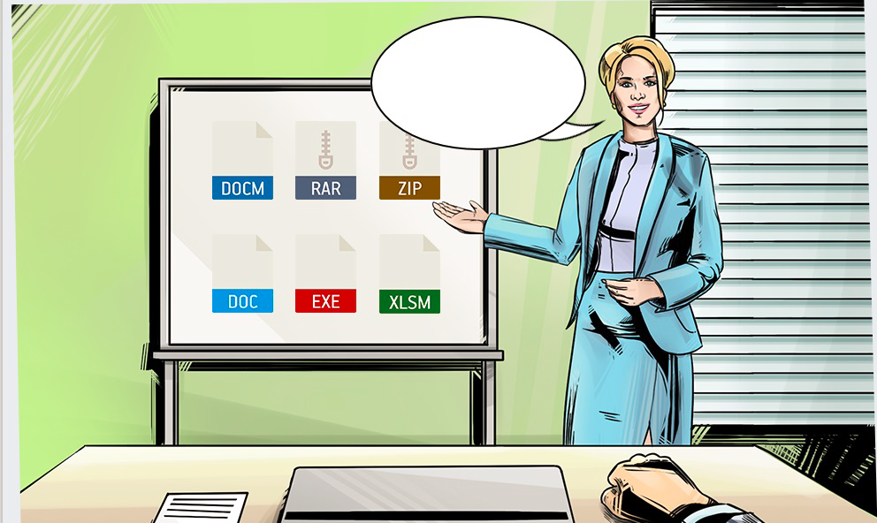
Formats of attachments
The board lists the most dangerous file formats that may be in an attachment.

Slide 15
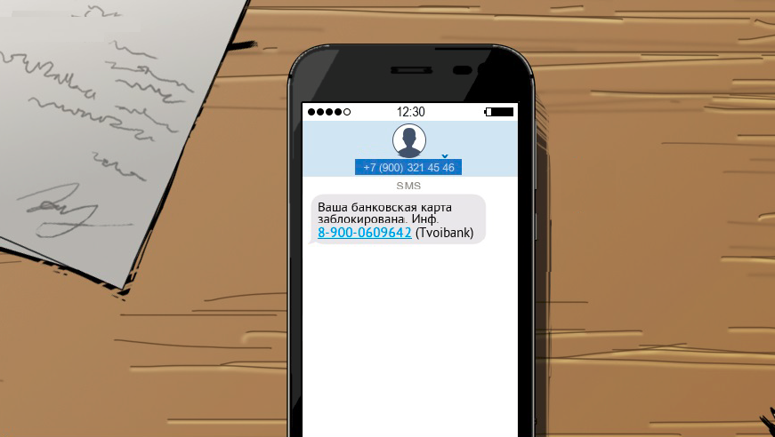
SMS phishing
SMS from an unknown number
1
SMS came from an unknown number. Notification of actions with the card come from the service number of the bank. In addition, alerts from the bank are always in the same SMS-dialogue. If upon receipt of such notification a new dialogue has appeared, this is a sign of fraud.

Slide 16
SMS phishing
Unknown number specified
2
An unknown number not belonging to the bank is indicated in the SMS. You can specify all service numbers of your bank in the agreement with the bank, on a bank card or on the official website of the bank.

Slide 17
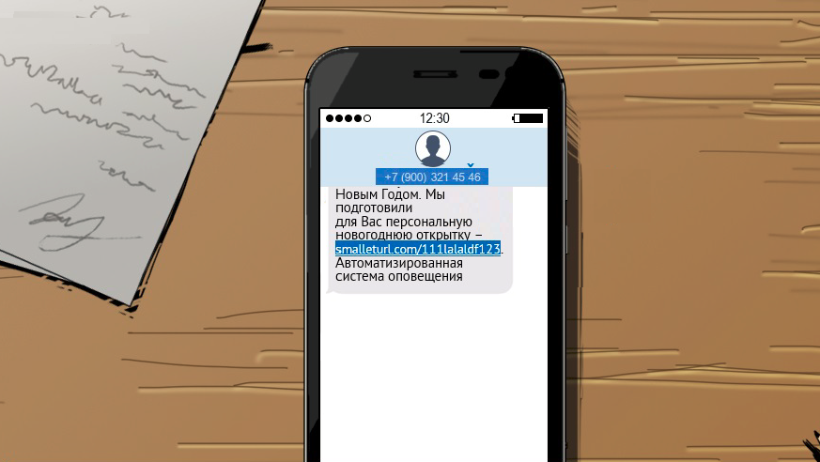
SMS phishing
Link to unknown site
3
The link in the message leads to a site that is not related to the official website of the Company.

Slide 18
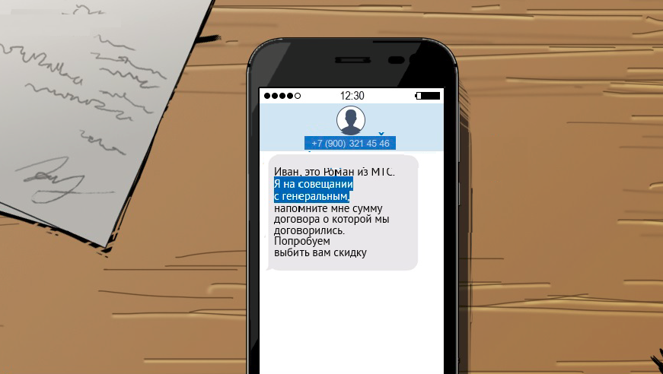
SMS phishing
Promise free benefits
4
The text of the message promises free benefits.

Slide 19
SMS phishing
Limited time offer
5
The text of the message indicates a limited time offer to force the recipient to hurry.

Slide 20
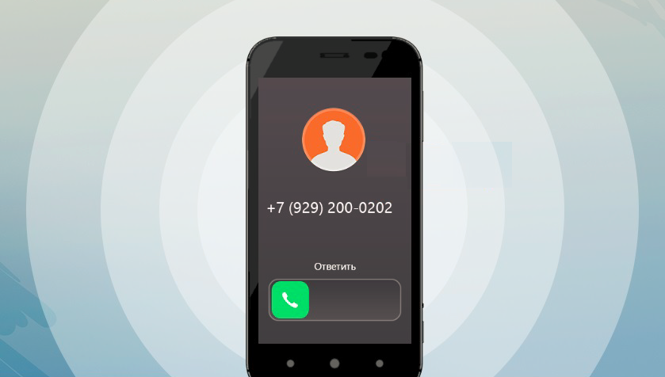
Signs of phone phishing
Unknown phone number
1
The call came from a suspicious number (mobile)

Slide 21

Signs of phone phishing
Attempt to evoke emotions and pressure
!
2
The caller introduced himself as a law enforcement officer

Slide 22
Signs of phone phishing
Attempt to get confidential information
!
3
Request to provide information about the company's activities, as well as additional contact information for the development of the attack.

Slide 23
Thanks for attention!

