Slide 1
Approaches and Techniques for Vendor Negotiations
Doug Way
Associate University Librarian for Collections and Research Services
University of Wisconsin-Madison

Slide 2
What we will cover
Price Negotiations
License Negotiations
Strategies and approaches

Slide 3
Initial Thoughts and Caveats
Everything is negotiable…
But you would don’t want to negotiate everything

Slide 4
Initial Thoughts and Caveats
Experience Matters
Relationships Matter
It’s not personal

Slide 5
Negotiating Price
Two areas of negotiation
  Initial Price/One-time Cost
  Renewals on subscriptions

Slide 6
Negotiating Price
Keep in mind
  For lots of things, especially e-resources, the price is a fantasy
    There are real costs
    There are high profit-margins
  “Older” products often have a lot of room on price
  Sales-people are incentivized to keep prices high

Slide 7
Negotiating Price: Renewals
Difficult to reset price
Focus should generally be on price increases

Slide 8
Negotiating Price: Renewals
Strategies
  Set an inflationary figure AND stick to it
    UW-Madison – 3%

Slide 9
Negotiating Price: Renewals
Strategies
  Language to use in negotiations:
    We’re reviewing our subscriptions…
    Our budget situation...
    We know our peer institutions...
    Can you explain why this price is going up so much?
    We’re a good customer...
  Sales people have to be able to explain why they are giving a discount
  Why relationships matter

Slide 10
Negotiating Price: Renewals
Strategies
  If those approaches do not work
    Talk to the boss
    Bundle
    Multi-year
    Threaten
      Don’t say anything you cannot follow through on
      Keep it vague
      “We may have to…”
    Make a decision
      Pay the increase
      Drop the resource

Slide 11
Negotiating Price: Initial Price
Figure out when to get involved
  What price?
  What kind of products?
When I engage at UW-Madison

Slide 12
Negotiating Price: Initial Price
Almost always offered a discount on one-time products
  Fantasy prices
  Sometimes you can/should take the discount
  Sometimes that is just a starting point

Slide 13
Negotiating Price: Initial Price
This is where experience can matter
  Know past discounts
  Discounting rates vary by vendor
This is where the size of your spend can matter
  The more you buy, the bigger the discount
  Do you spend a little every year or a lot every few years?

Slide 14
Negotiating Price: Initial Price
Strategies
  Bundle
    Purchase lots of products, but offer only one total price you want to pay
      Older products can expect a higher discount rate than newer products
      Let the vendor figure out the discount rate for each product
  End of Vendor’s Fiscal Year
    Know when this is!
      Spend when they’re desperate
  Leverage past, current and future spending
  Spread payments out over multiple years

Slide 15
Negotiating Price: Price & Inflation
Usually journal packages, but not always
  Ebooks
  Databases

Slide 16
Negotiating Price: Price & Inflation
Requires the use of mathematics
  What will you focus on?
    Annual spend?
    Inflation rate?
    Both?

Slide 17
Negotiating Price: Price & Inflation
Strategies
  Long view
    Look beyond the current agreement
  One-time spend
    Often effective at lowering inflation rate
  Multi-year license
    Pay for multiple years at once
    Saves on inflation
    Lowers starting point for future costs

Slide 18
Negotiating License Terms
Broad overview
Four key points

Slide 19
Negotiating License Terms
Standard terms are your friend.
  Your own standard license terms
  Consortial license terms
    Big Ten Academic Alliance: https://www.btaa.org/projects/library/licensing/standardized-agreement-language
  Other standard license terms
    Liblicense: http://liblicense.crl.edu/licensing-information/model-license/
  Standard terms serve as a reference to you
  A place to point vendors

Slide 20
Negotiating License Terms
Decide what you care about.
  What are the essential elements?
  What can’t you live with?
    Often license terms can be more of a deal-breaker than price

Slide 21
Negotiating License Terms
    What’s on the horizon?
      What do you want to push on that you can live without
        Get it on vendor’s radar
        Will vary by institution

Slide 22
Negotiating License Terms
    Consistency is essential.
      You want to know, generally, what you and users can do
      You want to avoid variant terms from product to product

Slide 23
Negotiating License Terms
    One final tip
      License terms form/template

Slide 24
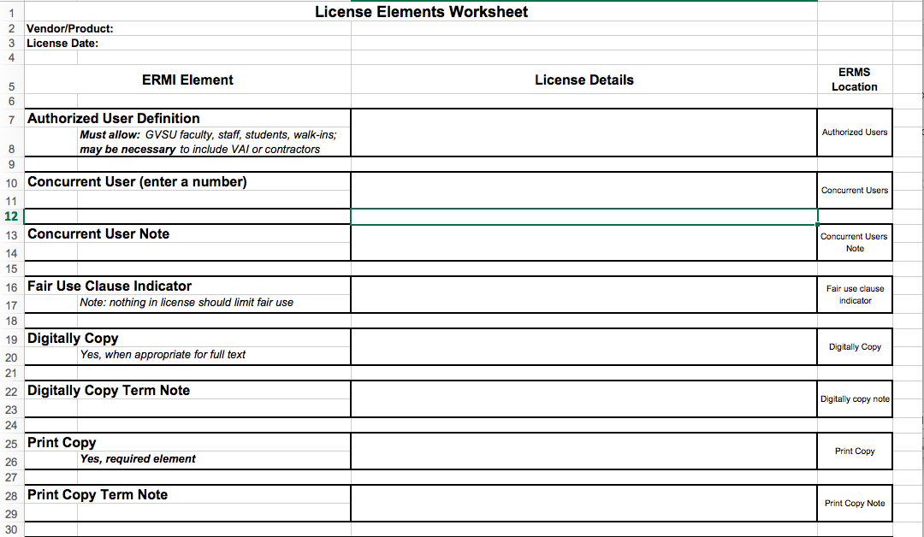
Negotiating License Terms
    One final tip
      License terms form/template

Slide 25
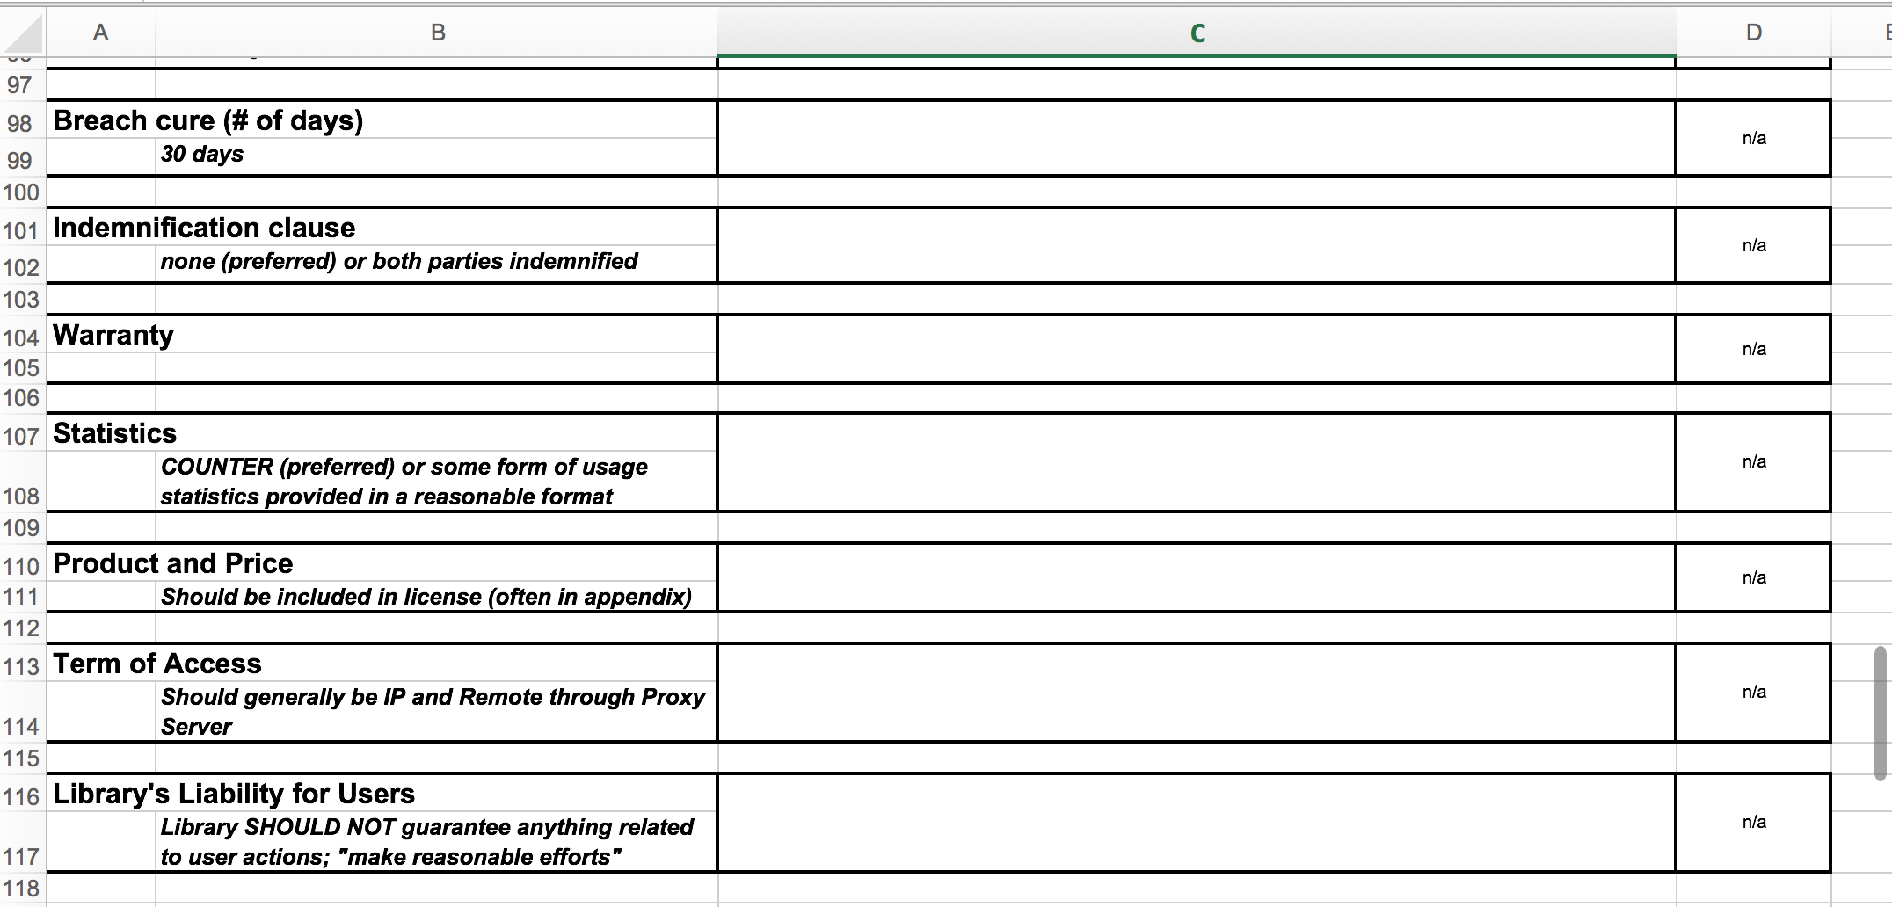
Negotiating License Terms
    One final tip
      License terms form/template

Slide 26
In Conclusion
Everything is negotiable
Establish and leverage relationships
Determine what is important
Have a plan and employ consistent strategies
Get creative—negotiation is as much an art as a science

Slide 27
Thank you
Questions?
Doug Way
doug.way@wisc.edu
works.bepress.com/doug_way

