Slide 1


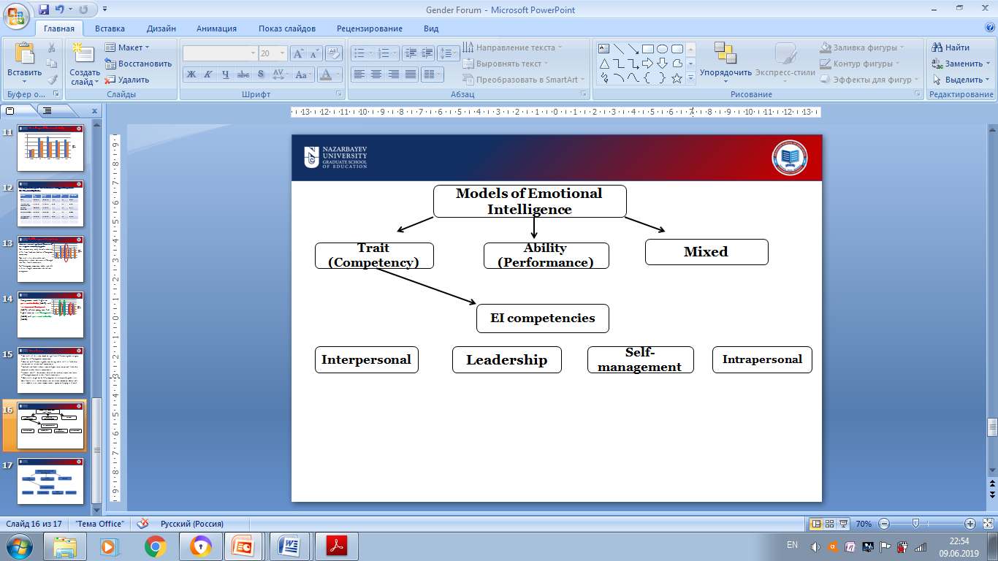
REPLACE THIS BOX WITH YOUR ORGANIZATION’S
HIGH RESOLUTION LOGO
The Relationship between Emotional Intelligence and Academic Achievement among Undergraduate Students in Kazakhstan. The Case of Two Universities.
REPLACE THIS BOX WITH YOUR ORGANIZATION’S
HIGH RESOLUTION LOGO
Lyudmila Fillipova
Nazarbayev University Graduate School of Education | Program – Educational Leadership Higher Education
Background
Conceptual Framework
Findings
Academic achievement and performance of students in higher education settings is an integral part of learning process, however nowadays, the soft skills are not of small importance as well. Back in 1995, intelligence quotient (IQ) was the preeminent indicator of a person’s success in many spheres of life (Goleman, 1996, p.IX). Currently, the success and productivity of a person is not merely restricted to his or her cognitive abilities, but also such notion as Emotional Intelligence or Emotional Quotient (EQ) has to be considered. Emotional intelligence (EI) abilities are of demand for companies. Frequently, “employers of new college graduates emphasize the importance of “soft skills,” they are substantially less satisfied with graduates’ interpersonal and emotional competencies than with their conceptual and analytical skills” (as cited in Landau & Meirovich, 2011, p.89).
The results of this study showed no significant difference in gender category, except for self-management competency.
There was no difference in gender considering such EI skills as leadership, interpersonal or intrapersonal competencies.
Both male and female students reported higher scores on personal leadership compared to other three EI competencies.
However, overall, the outcome indicated that male participants were more self-managed compared to their female counterparts.
Methodology
Ethical Issues
Research design: Quantitative correlational survey study
Sample: The study participants were selected among undergraduate bachelor students from two Kazakhstani universities: Autonomous and Regional. The sample was recruited on non-probability basis, due to voluntary participation in the research study. The factual size of sample consisted of 239 participants, 98 and 141 undergraduate from two universities (autonomous and regional) respectively.
Data collection methods: Online survey questionnaire was used as the data collection tool for the study. The pre-existing survey framework - Emotional Skills Assessment Process (ESAP) developed by Nelson and Low (2011) was used to measure students’ emotional skills.
Academic achievement measurement. The following percentages for participants: 92-100, 84-91, 76-83, 68-75, 59-67, 51-58, 50 and lower were used.
Data collection procedures. The first stage of data collection was obtaining the permission from the Nazarbayev University Institutional Research Ethics Committee resethics@nu.edu.kz, after which it was also necessary to receive an approval on collecting data from the administration of two universities. The survey was delivered via email, still it required the researcher’s personal presence during such procedures as the meeting with the administration of universities, explaining the nature and main details of the research study.
Data analysis: An online survey tool Qualtrics subscription software was used to collect data.
The following statistical analyses had been employed: descriptive, inferential and correlational.
The Statistical Package for the Social Sciences (SPSS) had been used to make the statistical analysis of the collected data.
Since the survey had been distributed via email, the invitation letter and informed consent form had been provided along with the link to the survey.
As the voluntary agreement was only for entering the study, the participants had rights to decline to take part in study and might withdraw from the experiment at any stage. As participants of the study were undergraduate students over 18 years old, they could decide on their own about participation in the survey.
Problem statement
Higher educational institutions emphasize the importance of IQ mastering and pay less attention to other types of intelligences, including emotional intelligence. However, such components of emotional intelligence as interpersonal and intrapersonal competencies are considered to be more significant for life success than IQ (Tucker, Sojka, Barone, & Mccarthy, 2000, p.331). The same situation is happening in Kazakhstan, where contemporary higher education system does not provide due attention to emotional intelligence development (Naurzalina,et al., 2015 p.390). Therefore, researchers claim that emotional intelligence components have to be incorporating into higher educational institutions’ curricula (Tucker, Sojka, Barone, & Mccarthy, 2000, p.331).
Significance
The results of the study would contribute to higher educational system in Kazakhstan, as administrators, managers and faculty members may be provided with the current emotional intelligence level of undergraduate students from two institutions. Other higher educational institutions may use the findings of the current research study in order to facilitate students’ emotional intelligence level inserting related activities in their curricula. Additionally, the results of the research study can be of use for teachers and educators in order to analyze which non-academic factors may influence positively or negatively students’ academic achievement.
Research Purpose and Questions
Graph
The purpose of this quantitative correlational study is to identify the relationship between emotional intelligence and academic achievement among undergraduate students in two Kazakhstani universities.
Q1: What is students` level of emotional intelligence differentiated by two universities?
Q2. How do students’ gender and age correlate with their EI level?
Q3. To what extent do age and gender impact the relationship between students’ academic achievement and their emotional intelligence?
Contacts
References
Lyudmila Fillipova
Nazarbayev University
Email: lyudmila.fillipova@nu.edu.kz
Phone: + 7 702 327 83 35
Goleman, D. (1996). Emotional intelligence: Why it can matter more than IQ / Daniel Goleman.
Landau, J., & Meirovich, G. (2011). DEVELOPMENT OF STUDENTS'EMOTIONAL INTELLIGENCE: PARTICIPATIVE CLASSROOM ENVIRONMENTS IN HIGHER EDUCATION.
Academy of Educational Leadership Journal, 15(3).
Naurzalina, D., Tolegenova, A., Karabalina, A., Almurzayeva, B., Bakiyeva, S., & Sadykova, N. (2015). Impact of Emotional Intelligence on Formation of Meaning-existential Strategy among Students.
Procedia - Social and Behavioral Sciences, 171, 390-395. doi:10.1016/j.sbspro.2015.01.137
Nelson, D., & Low, G. (2011). Emotional intelligence: Achieving academic and career excellence (2nd ed.). Boston, MA: Prentice Hall.
Tucker, M. L., Sojka, J. Z., Barone, F. J., & Mccarthy, A. M. (2000). Training Tomorrows Leaders: Enhancing the Emotional Intelligence of Business Graduates.
Journal of Education for Business, 75(6), 331-337. doi:10.1080/08832320009599036

