Slide 1
PACs, Presidential Systems, Good Governance
By
Riccardo Pelizzo

Slide 2
introduction
The purpose of this presention is to show that
Governance matters
Parliaments can play a role in curbing corruption
And PACs are particularly valuable tools to curb corruption

Slide 3
Introduction-2
The presentation is divided in 3 parts:
Part 1 shows that corruption has social and economic implications and why the reduction or the eradication of corruption is beneficial

Slide 4
Inroduction-3
Part 2 shows
  that parliaments can contribute in several ways to curbing corruption
  that the reduction of corruption is one of the dividends of legislative oversight effectiveness

Slide 5
Introduction-4
Part 3 discusses the requisites for the effective use of oversight tools as well as the tools parliaments can employ to perform their oversight function in presidential regimes
Particular attention is paid to PACs

Slide 6
Part 1. Governance matters
The first point we need to make is: Governance matters!
Lower levels of corruption are associated with:
  Greater wealth
  Lower infant mortality
  Higher literacy rate
  Higher average life expectancy
  And more industrialization

Slide 7
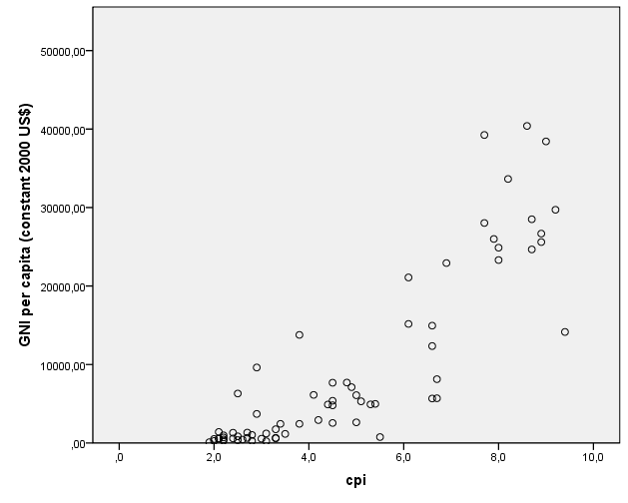
Corruption and wealth

Slide 8
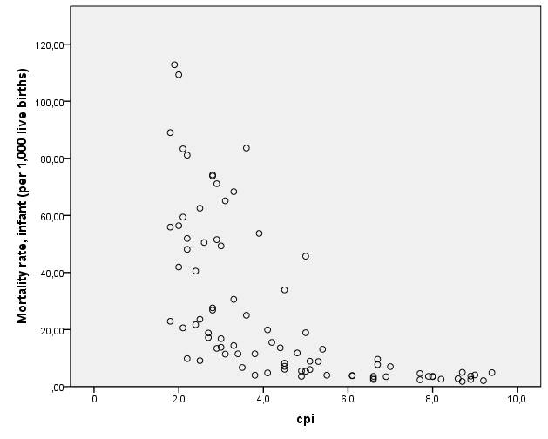
Corruption and infant mortality

Slide 9
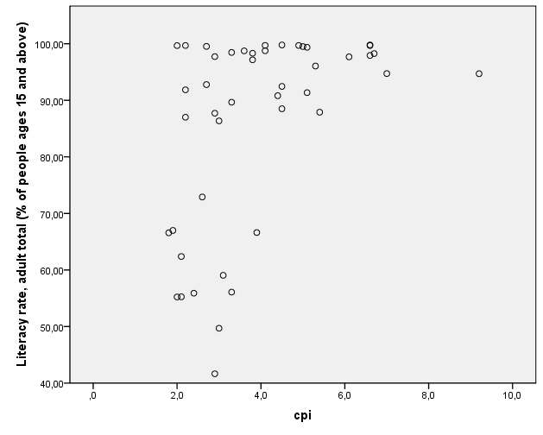
Corruption and literacy

Slide 10
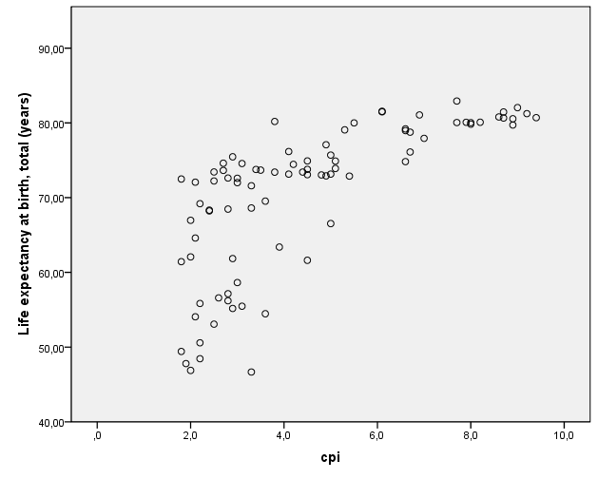
Corruption and life expectancy

Slide 11
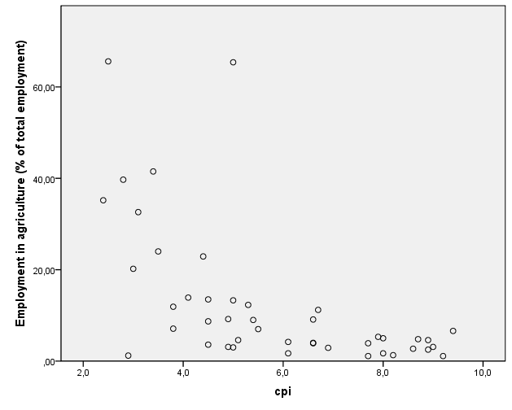
Corruption and employment in agriculture

Slide 12
A preliminary conclusion
Fighting corruption is not simply the right thing to do from an ethical point of view
Fighting corruption is the right thing to do from an economic point of view and from a social point of view

Slide 13
a preliminary conclusion
In less corrupt societies infants have more chances to survive, people get better education, better employment, more money and live longer—people live longer and can afford a better quality of life
The weaker segments of society (infants and old people) are more adequately protected in countries with lower levels of corruption

Slide 14
Part 2. The role of parliament
Various steps can be taken to curb corruption and promote good governance
Parliaments can play a key role in curbing corruption and promoting good governance

Slide 15
The role of parliament
Parliaments can introduce party and campaign finance legislation to prevent electoral corruption
Parliaments can adopt codes of legislative conduct to regulate the behavior of MPs
Parliaments can perform the oversight function and keep governments accountable for the actions and expenditures

Slide 16
The role of parliament
Where legislative oversight is more effective, there is greater accountability
And greater accountability is associated with
More political stability
Less corruption
Higher democratic quality
And greater satisfaction with democracy

Slide 17
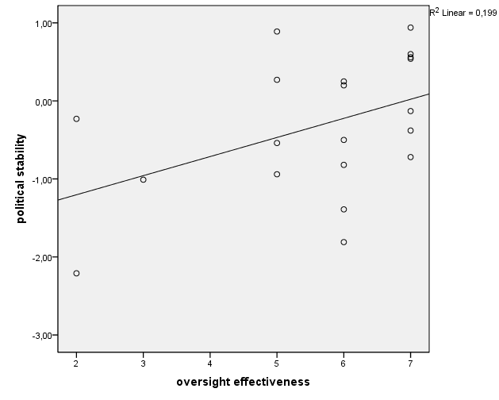
More stability

Slide 18
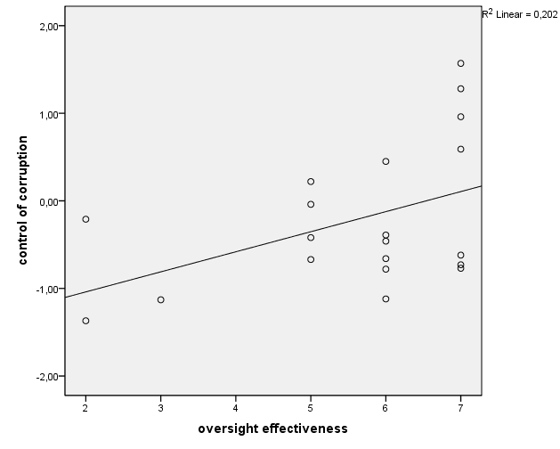
Greater ability to curb corruption

Slide 19
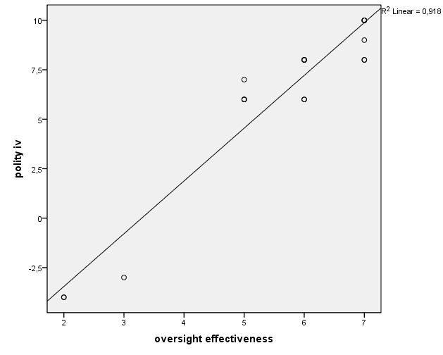
Higher democratic quality

Slide 20
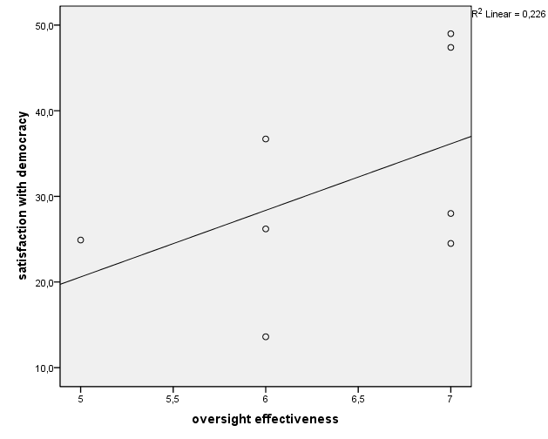
Satisfaction with democracy

Slide 21
Part 3. how to improve the effectiveness of oversight ?
Parliaments’ ability to be effective overseers depends on three conditions:
  Political will
  Resources (human, technical, financial)
  Mandate

Slide 22
Conditions for the effective use of oversight tools
If parliaments have a wide oversight mandate, if they are adequately resourced and if they have the political will, they can use effectively the oversight tools at their disposal

Slide 23
Oversight tools
Questions
Interpellations
Motions
Missions
Reports
Hearings
Inquiry committees
Specialized committees

Slide 24
PACs
Public Accounts Committees (PACs) are the best known specialized committees/oversight committees
Originally found in Commonwealth countries and originally associated with the parliamentary form of government, PACs can now be found outside the commonwealth and in presidential countries (Indonesia, Kiribati, Nigeria, Maldives, Sri Lanka,…)

Slide 25
PAC performance
Size
Size (and quality) of staff
Adequate representation of opposition parties
Opposition chair (if opposition parties not adequately represented)
Length of appointment
Range of powers
Follow up mechanisms
Political will
Affect various aspects of PAC performance

