Slide 1
Thesis Defense
Information-theoretic capacity bounds for dynamic wireless networks via IA (Interference Alignment)
Nursultan Kaidar
ECE student
ID: 201473203
nursultan.kaidar@nu.edu.kz

Slide 2
Outline
Introduction (motivation, importance of IA, schemes and applications)
System model
Results Discussion
Conclusion
Q&A

Slide 3
Introduction
IA background: IA is a growing idea or technique arising from the interference network capacity examination
Why IA is useful? This IA technique decreases the influence of interference
The objective of IA is to align all interfering signals at one interference subspace and obtain full DoF
Motivation: We face the Interference bottleneck when several interfering signals should be aligned properly
Importance of IA
IA schemes and applications

Slide 4
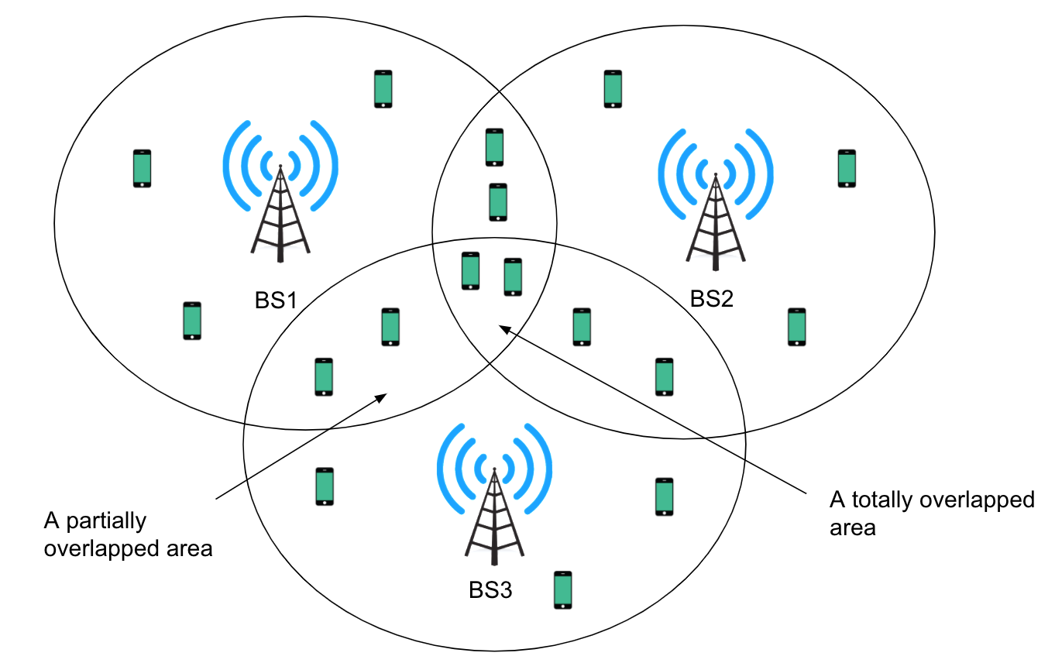
System model
Figure 1 shows the three cell network with three base stations and several users at each cell. A totally overlapping area is the region where all three cells are overlapped at the same place. A partially overlapping is when two cells are overlapped.
Figure 1. The network comprising of three cells, including an overlaid region.

Slide 5
System model
The received signal at the user of interest is written as
$${\overset{˜}{\text{y}}}_{j}^{[k]}=\underset{desiredsignal}{\underset{⏟}{{\text{U}}_{j}^{[k]H}{\text{H}}_{j,j}^{[k]}{\text{V}}_{j}{\text{s}}_{j}}}+\underset{interference}{\underset{⏟}{{\text{U}}_{j}^{[k]H}\overset{L}{\underset{i=1,i≠j}{∑}}{\text{H}}_{j,i}^{[k]}{\text{V}}_{i}{\text{s}}_{i}}}+{\overset{˜}{\text{n}}}_{j}^{[k]},∀j∈L,∀k∈K,$$
(1)
The fundamental IA equations are defined as
$${\text{U}}_{j}^{[k]H}{\text{H}}_{j,i}^{k}{\text{V}}_{i}=\text{0},i≠j,∀i,j∈L,∀k∈K,$$
(2)
$$rank({\text{U}}_{j}^{[k]H}{\text{H}}_{j,j}^{k}{\text{V}}_{j})=d_{j}^{[k]},∀j∈L,∀k∈K,$$
(3)
The signal of BS $i$ is written as
$${\text{s}}_{i}=[c^{[i,1]}c^{[i+1,2]}c^{[i+L{}^{′}-1,L{}^{′}]}]^{T},∀i∈L,1<L^{′}<L,$$
(4)

Slide 6
System model
The received signal (1) can be rewritten using (4) as
$${\overset{˜}{\text{y}}}_{j}^{[k]}=\underset{desired+XCIsignals}{\underset{⏟}{{\text{U}}_{j}^{[k]H}\overset{j}{\underset{i=j-L^{′}+1}{∑}}{\text{H}}_{j,i}^{[k]}{\text{V}}_{i}{\text{s}}_{i}}}+\underset{ICI}{\underset{⏟}{{\text{U}}_{j}^{[k]H}\overset{L}{\underset{l=j+1,l≠i}{∑}}{\text{H}}_{j,l}^{[k]}{\text{V}}_{l}{\text{s}}_{l}}}+{\overset{˜}{\text{n}}}_{j}^{[k]},∀j∈L,∀k∈K^{′}.$$
(5)
The transmit beamforming matrix can be written as
$${\text{V}}_{i}={\text{V}}_{i}^{[ICI]}*{\text{V}}_{i}^{[XCI]},∀i∈L,$$
(6)
Average BEP can be written as
$$P_{b}(E)=∫_{0}^{∞}P_{b}(E|γ)p_{γ}(γ)dγ,$$
(7)

Slide 7
System model
The DoF to all users can be written by
$$θ=\lim_{SNR→∞}\frac{I_{j}^{[k]}(SNR)}{\log_{2}(SNR)}=L^{′},∀j∈L,∀k∈K^{′},1<L^{′}<L,$$
(8)
The feasible DoF can be determined from a network point of view as
$$Θ=\lim_{SNR→∞}\frac{I_{∑}(SNR)}{\log_{2}(SNR)}=LK^{′}L^{′},1<L^{′}<L.$$
(9)
The received signal at specific user of interest can be expressed by
$${\overset{˜}{\text{y}}}_{j}^{[k]}=\underset{desired+XCIsignals}{\underset{⏟}{{\text{U}}_{j}^{[k]H}\overset{L=3}{\underset{i=1,i≠j+1}{∑}}{\text{H}}_{j,i}^{[k]}{\text{V}}_{i}{\text{s}}_{i}}}+\underset{ICI}{\underset{⏟}{{\text{U}}_{j}^{[k]H}{\text{H}}_{j,j+1}^{[k]}{\text{V}}_{j+1}{\text{s}}_{j+1}}}+{\overset{˜}{\text{n}}}_{j}^{[k]},∀j∈L,∀k∈K^{′}.$$
(10)

Slide 8
System model
Since we thought that all cell users want the same signals to be found, we may group cell 1 users to evaluate the ICI's shared space from BS 2
$${\text{K}}_{2}=span({\text{H}}_{1,2}^{[1]H}{\text{U}}_{1}^{[1]})=span({\text{H}}_{1,2}^{[2]H}{\text{U}}_{1}^{[2]}),$$
(11)
The following matrix equation can therefore be defined as fulfilling the intersection subspaces condition (11) and represented as
$$\left[\begin{matrix}{\text{I}}_{N_{t}} & -{\text{H}}_{1,2}^{[1]H} & \text{0} \\ {\text{I}}_{N_{t}} & \text{0} & -{\text{H}}_{1,2}^{[2]H}\end{matrix}\right]\left[\begin{aligned}{\text{K}}_{2} \\ {\text{U}}_{1}^{[1]} \\ {\text{U}}_{1}^{[2]}\end{aligned}\right]={\text{C}}_{1}{\text{D}}_{1}=\text{0},$$
(12)
We deconstruct the equation matrix in (12) into two matrix equations as shown below to decrease the number of receiving antennas' complexity and demand
$$\left[\begin{matrix}{\text{I}}_{N_{t}} & -{\text{H}}_{1,2}^{[1]H}\end{matrix}\right]\left[\begin{aligned}{\overset{˜}{\text{K}}}_{2}^{[1]} \\ {\overset{˜}{\text{U}}}_{1}^{[1]}\end{aligned}\right]={\overset{˜}{\text{C}}}_{1}^{[1]}{\overset{˜}{\text{D}}}_{1}^{[1]}=\text{0},$$
(13)
$$\left[\begin{matrix}{\text{I}}_{N_{t}} & -{\text{H}}_{1,2}^{[2]H}\end{matrix}\right]\left[\begin{aligned}{\overset{˜}{\text{K}}}_{2}^{[2]} \\ {\overset{˜}{\text{U}}}_{1}^{[2]}\end{aligned}\right]={\overset{˜}{\text{C}}}_{1}^{[2]}{\overset{˜}{\text{D}}}_{1}^{[2]}=\text{0},$$
(14)

Slide 9
System model
Like users in cell 1, for users of cells 2 and 3 we describe the span subspaces as below
$${\text{K}}_{3}=span({\text{H}}_{2,3}^{[1]H}{\text{U}}_{2}^{[1]})=span({\text{H}}_{2,3}^{[2]H}{\text{U}}_{2}^{[2]}),$$
(15)
$${\text{K}}_{1}=span({\text{H}}_{3,1}^{[1]H}{\text{U}}_{3}^{[1]})=span({\text{H}}_{3,1}^{[2]H}{\text{U}}_{3}^{[2]}).$$
(16)
Since each user observe a single ${\text{K}}_{i}$ related ICI channel connection under the scenario under consideration, we decide the first ICI accounting factor as follows
$${\text{V}}_{i}^{[ICI]}=null([{\text{K}}_{i}({\text{U}}_{i-1}^{[k]H}{\text{H}}_{i-1,i}^{[k]})^{H}]^{H}),∀i∈L,∀k∈K^{′},$$
(17)
The received signal on each user $k$ within cell 1
$${\overset{˜}{\text{y}}}_{1}^{[k]}={\text{U}}_{1}^{[k]H}{\text{H}}_{1,1}^{[k]}{\text{V}}_{1}^{[ICI]}{\text{V}}_{1}^{[XCI]}{\text{s}}_{1}+\underset{ICI=0}{\underset{⏟}{{\text{U}}_{1}^{[k]H}{\text{H}}_{1,2}^{[k]}{\text{V}}_{2}^{[ICI]}{\text{V}}_{2}^{[XCI]}{\text{s}}_{2}}}+{\text{U}}_{1}^{[k]H}{\text{H}}_{1,3}^{[k]}{\text{V}}_{3}^{[ICI]}{\text{V}}_{3}^{[XCI]}{\text{s}}_{3}+{\overset{˜}{\text{n}}}_{1}^{[k]}$$
$$=\overset{L=3}{\underset{i=1,i≠2}{∑}}{\text{U}}_{1}^{[k]}{\text{H}}_{1,i}^{[k]}{\text{V}}_{i}^{[ICI]}{\text{V}}_{i}^{[XCI]}{\text{s}}_{i}+{\overset{˜}{\text{n}}}_{1}^{[k]},∀k∈K^{′}$$
(18)

Slide 10
System model
The received signal can be generalized in every $j$ cell for any user $k$, as given below
$${\overset{˜}{\text{y}}}_{1}^{[k]}=\overset{L=3}{\underset{i=1,i≠j+1}{∑}}{\text{U}}_{j}^{[k]H}{\text{H}}_{j,i}^{[k]}{\text{V}}_{i}^{[ICI]}{\text{V}}_{i}^{[XCI]}{\text{s}}_{i}+{\overset{˜}{\text{n}}}_{j}^{[k]},∀j∈L,∀k∈K^{′},$$
(19)
Generic channel matrix is determined by
$${\text{H}}_{j,i}=\left[\begin{aligned}{\text{H}}_{j,i}^{[1]} \\ {\text{H}}_{j,i}^{[2]}\end{aligned}\right],∀i,j∈L,$$
(20)
Beamforming matrix can be written as
$${\text{V}}_{i}^{[XCI]}=\left[\begin{matrix}{\text{p}}_{1}^{[i]} & {\text{p}}_{2}^{[i]}\end{matrix}\right],∀i∈L,$$
(21)
The following equations are the columns of the matrix ${\text{V}}_{i}^{[XCI]}$ using (20)
$${\text{p}}_{1}^{[i]}=null({\text{H}}_{j,i}{\text{V}}_{i}^{[ICI]})=null({\text{J}}_{1}^{[i]}),∀i∈L,$$
(22)
$${\text{p}}_{2}^{[i]}=null({\text{H}}_{i,i}{\text{V}}_{i}^{[ICI]})=null({\text{J}}_{2}^{[i]}),∀i∈L,$$
(23)

Slide 11
System model
The received signal for cell $j$ and user $k$ can be written as
$${\overset{˜}{\text{y}}}_{j}^{[k]}={\text{U}}_{j}^{[k]H}\overset{L=3}{\underset{i=1,i≠j+1}{∑}}{\text{H}}_{j,i}^{[k]}{\text{V}}_{i}^{[ICI]}{\text{V}}_{i}^{[XCI]}{\text{s}}_{i}+{\overset{˜}{\text{n}}}_{j}^{[k]}$$
$$=\left[\begin{matrix}{\overset{˜}{h}}_{jj}^{1} & 0 \\ {\overset{˜}{h}}_{jj}^{2} & 0\end{matrix}\right]\left[\begin{aligned}c^{[j,1]} \\ c^{[j+1,2]}\end{aligned}\right]+\left[\begin{matrix}0 & {\overset{˜}{h}}_{ji}^{1} \\ 0 & {\overset{˜}{h}}_{ji}^{2}\end{matrix}\right]\left[\begin{aligned}c^{[i,1]} \\ c^{[j,2]}\end{aligned}\right]+{\overset{˜}{\text{n}}}_{j}^{[k]}$$
$$=\left[\begin{aligned}{\overset{˜}{h}}_{jj}^{1} \\ {\overset{˜}{h}}_{jj}^{2}\end{aligned}\right]c^{[j,1]}+\left[\begin{aligned}{\overset{˜}{h}}_{ji}^{1} \\ {\overset{˜}{h}}_{ji}^{2}\end{aligned}\right]c^{[j,2]}+{\overset{˜}{\text{n}}}_{j}^{[k]}$$
$$=\left[\begin{matrix}{\overset{˜}{h}}_{jj}^{1} & {\overset{˜}{h}}_{ji}^{1} \\ {\overset{˜}{h}}_{jj}^{2} & {\overset{˜}{h}}_{ji}^{2}\end{matrix}\right]\left[\begin{aligned}c^{[j,1]} \\ c^{[j,2]}\end{aligned}\right]+{\overset{˜}{\text{n}}}_{j}^{[k]}$$
$$=\overline{{\text{H}}_{j}^{[k]}}{\text{C}}_{j}+{\overset{˜}{\text{n}}}_{j}^{[k]},∀j∈L,∀k∈K^{′},$$
(24)

Slide 12
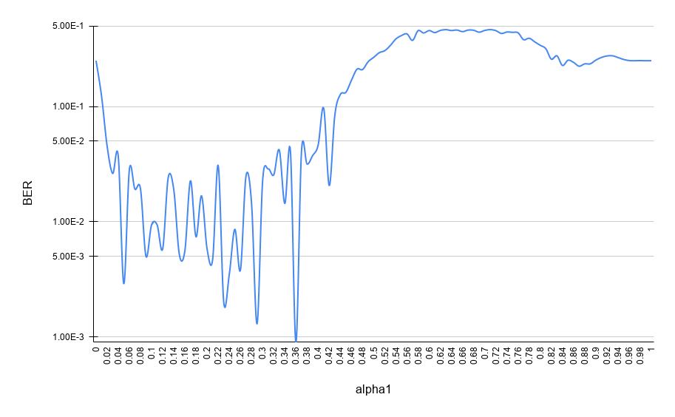
Results Discussion
Figure 2. Average BER for SNR=20 dB, and 100000 iterations.

Slide 13
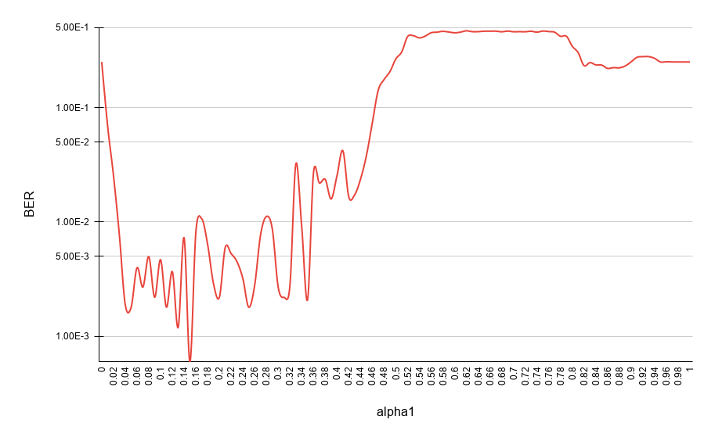
Results Discussion
Figure 3. Average BER for SNR=25 dB, and 100000 iterations.

Slide 14
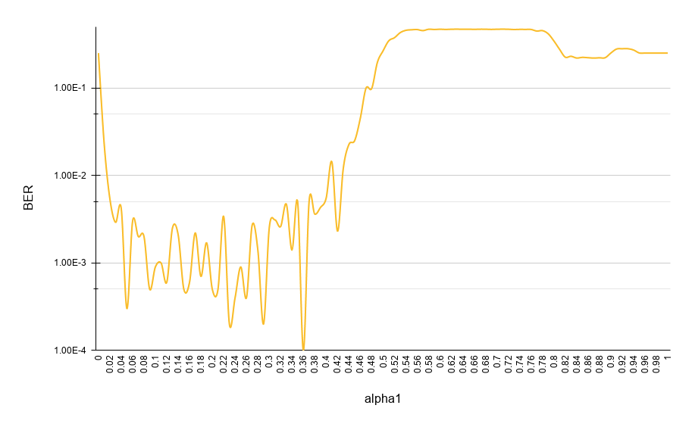
Results Discussion
Figure 4. Average BER for SNR=30 dB, and 100000 iterations.

Slide 15
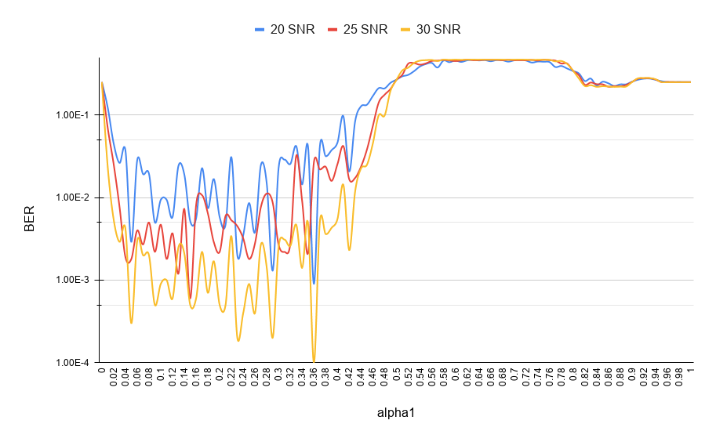
Results Discussion
Figure 5. Merged picture of three average BER figures.

Slide 16
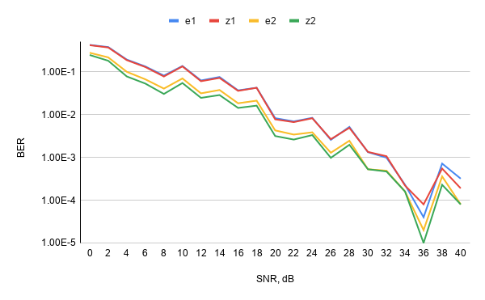
Results Discussion
Figure 6. BER vs. transmit SNR.

Slide 17
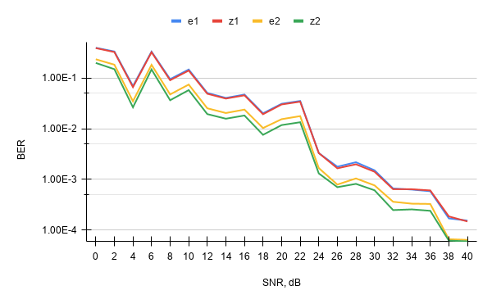
Results Discussion
Figure 7. BER vs. transmit SNR (second case).

Slide 18
Conclusion
Obtained results in terms of average BER for SNR of 20 dB, 25 dB, and 30 dB with the number of iterations equal to 10^5
BER vs. transmit SNR (two cases)
Possible research directions
Future research goals

Slide 19
Reference list
[1] V. R. Cadambe and S. A. Jafar, “Interference alignment and degrees of freedom of the K-user interference channel,” IEEE Transactions on Information Theory, vol. 54, no. 8, pp. 3425 –3441, Aug. 2008.
[2] Y. Wei and T. Lok, "An Iterative Interference Alignment Algorithm for the General MIMO X Channel," IEEE Transactions on Wireless Communications, vol. 18, no. 3, pp. 1847-1859, March 2019.
[3] K. Ghorbani and A. Falahati, "Interference alignment and scheduling in clustered partially connected small cell networks," International Journal of Communication Systems, vol. 33, no. 16, November 2020.
[4] S. A. Jafar, "Interference Alignment — A New Look at Signal Dimensions in a Communication Network," Foundations and Trends in Communications and Information Theory, vol. 7, no. 1, 1–134, 2010.

Slide 20
Thank you for your attention!
Any Questions?

