Slide 1
IN-VIVO TESTING OF THE BIMODAL SCAFFOLDS IN A RABBIT MODEL
Ulpan Nurmanova
School of Engineering and Digital Sciences Department of Chemical and Materials Engineering
Supervisors:
Lead Supervisor Name: Associate Professor Cevat Erisken
Co-supervisor Name: Assistant Professor Dana Akilbekova
April 2023

Slide 2





Presentation Outline
Introduction
Methods
Results & Discussion
Conclusion
Anterior cruciate ligament tears and current treatment approaches
Problem statement, study objectives and hypothesis
Selection of material for graft fabrication and animal model
Experimental Procedure
PET&PCL scaffold fabrication
Fiber diameter measurement
Tensile Mechanical Characterization
Testing the graft in a rabbit animal model
Micro-CT characterization
Statistical analysis
Morphological structure of PET&PCL grafts
Mechanical properties
Evaluation of implants after ACL reconstruction in a rabbit model
Micro-CT evaluation of bone tunnels
Conclusion
Limitations
Future work
Reference list

Slide 3
Introduction
[1]
[4]
[2]
A
B
[5]
[6]
[7]
[3]
C
D
~95
Figure 1: ACL structure and rupture
The proportion of ACL injury among all other knee joint ligaments injuries
Healthy ACL, ACL injury mechanism and ruptured ACL
Human and Rabbit ACL
The table of different species collagen fiber diameter distribution

Slide 4
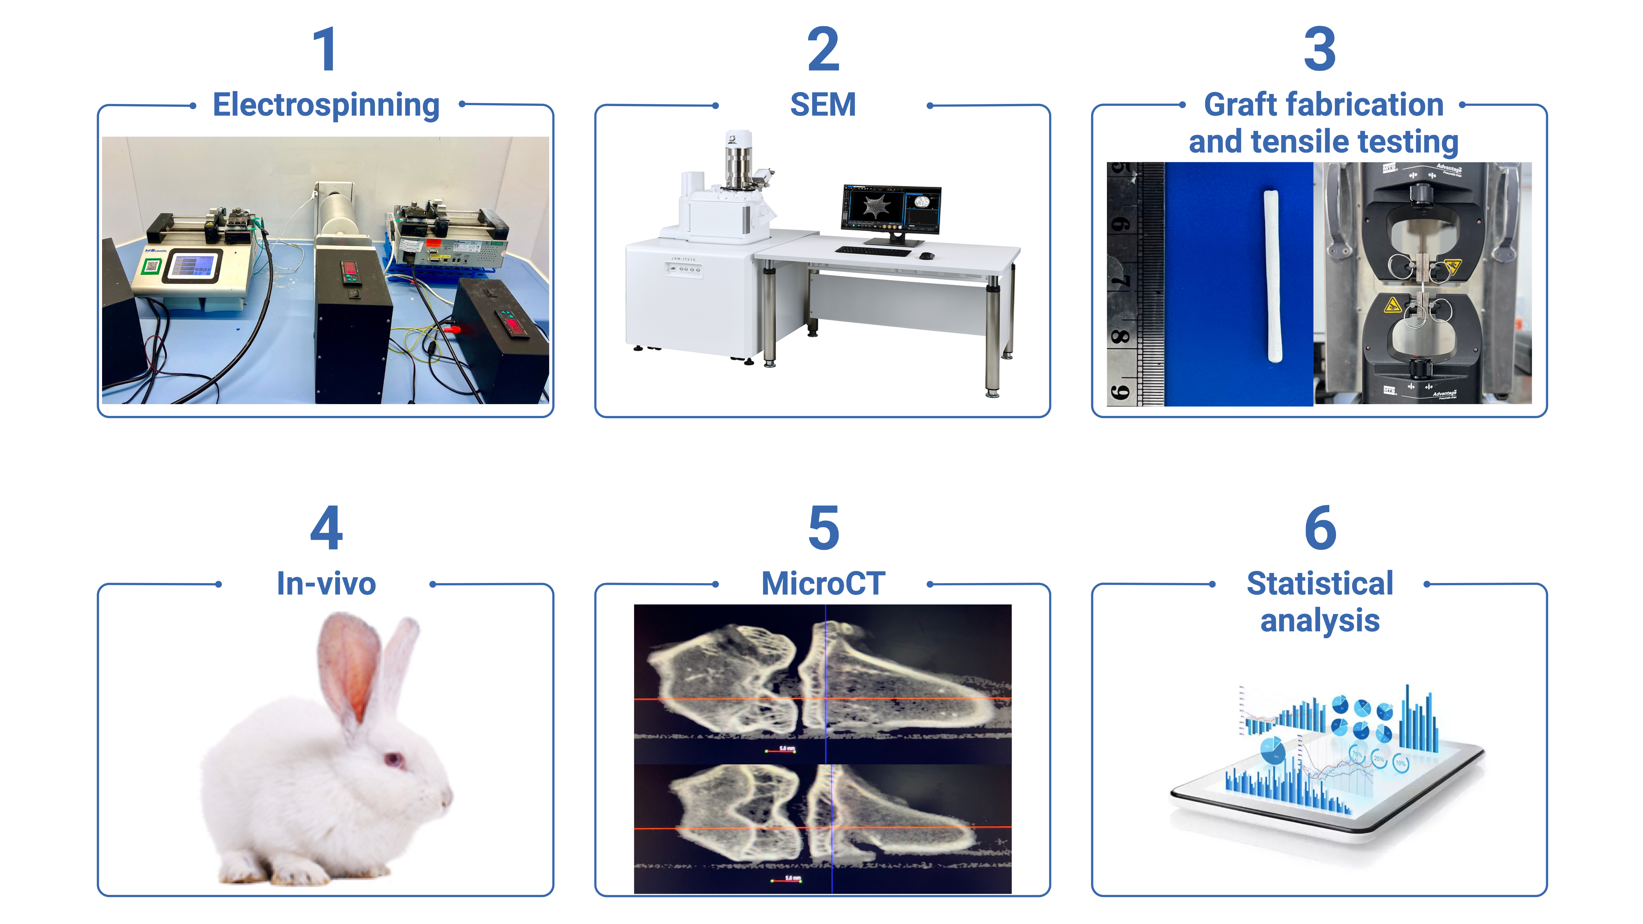
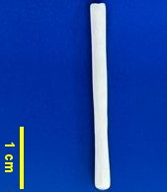
Methodology

Slide 5
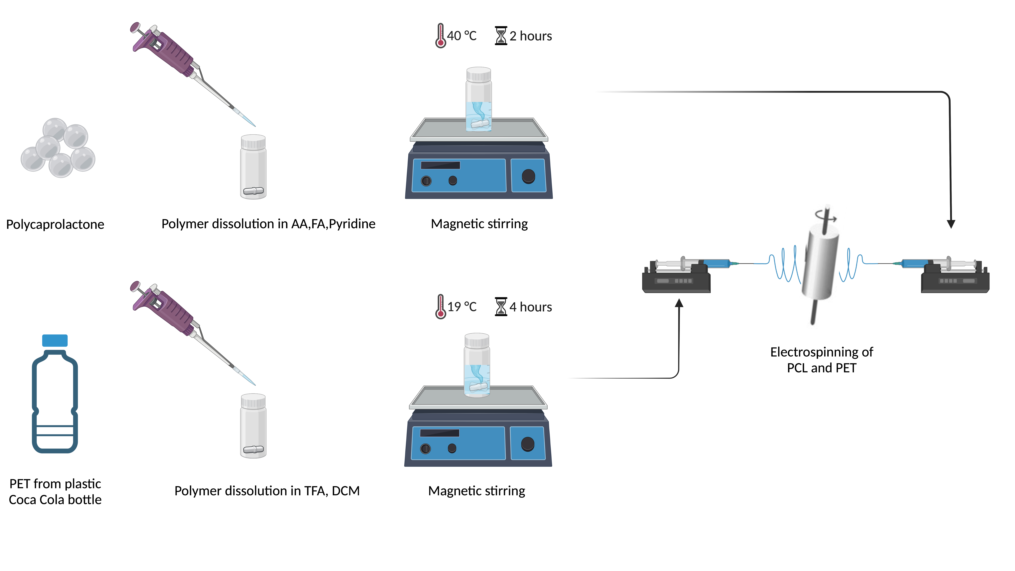
Mesh preparation from PCL and PET by using electrospinning
Figure 2: Illustration of solution preparation for electrospinning

Slide 6
Mesh preparation from PCL and PET by using electrospinning
Table 1: Solution formulation to create PET&PCL bimodal grafts
Graft Type |  | Material Properties |  |  |  |  | Process Parameters
Bimodal PET&PCL rolled grafts |  | TFA (ml) | DCM (ml) | AA (ml) | FA (ml) | Pyridine (ml) | Flow rate (ml/h) | Distance (cm) | Drum Speed (rpm) | Needle Diameter (G) | Voltage (kV)
PET 7.5% | 0.075gr | 0.2 | 0.8 |  |  |  | 0.06 | 15 | 2000 | 21 | 16
PCL 8% | 0.08 gr |  |  | 0.5 | 0.5 | 0.006 | 0.03 | 7 | 2000 | 21 | 9
Table 2: Solution formulation to create PCL bimodal grafts [12]
Graft Type |  | Material Properties |  |  |  | Process Parameters
 |  | PCL (gr) | Acetic Acid (ml) | Formic Acid (ml) | Pyridine (ml) | Flow rate (ml/h) | Distance (cm) | Drum Speed (RPM) | Needle Diameter (G) | Voltage (kV)
Bimodal PCL rolled grafts | 8% | 0.08 | 0.5 | 0.5 | 0.006 | 0.03 | 7 | 2000 | 21 | 9
 | 15% | 0.15 | 0.5 | 0.5 | 0.006 | 0.15 | 7 | 2000 | 21 | 16
TFA- Trifluoroacetic acid; DCM- Dichloromethane; PET- Polyethylene terephthalate; PCL- Polycaprolactone; FA- Formic Acid; AA- Acetic Acid.
[12] S. Kadyr, “Synthetic Polycaprolactone grafts for Anterior Cruciate Ligament,” Nazarbayev University, Astana, KZ, 2022.

Slide 7
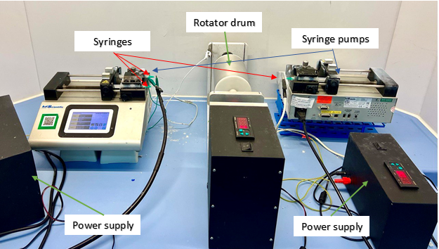
Mesh preparation by using electrospinning from PCL and PET
Figure 3: Setup for fabricating bimodal grafts with aligned fibers

Slide 8
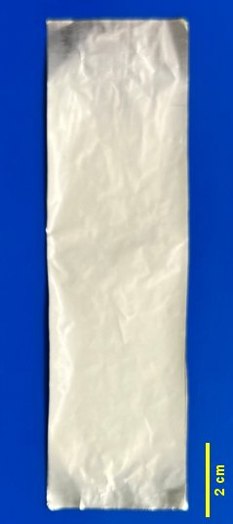
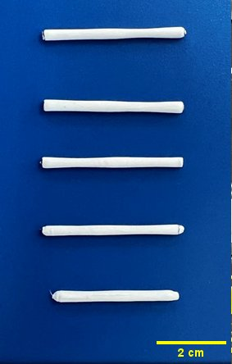
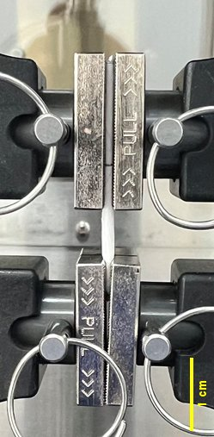
Graft fabrication and mechanical testing
A
B
Figure 4: (A) Fabrication of grafts by rolling the electrospun meshes, (B) installation of the graft on the mechanical testing device

Slide 9
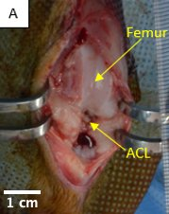
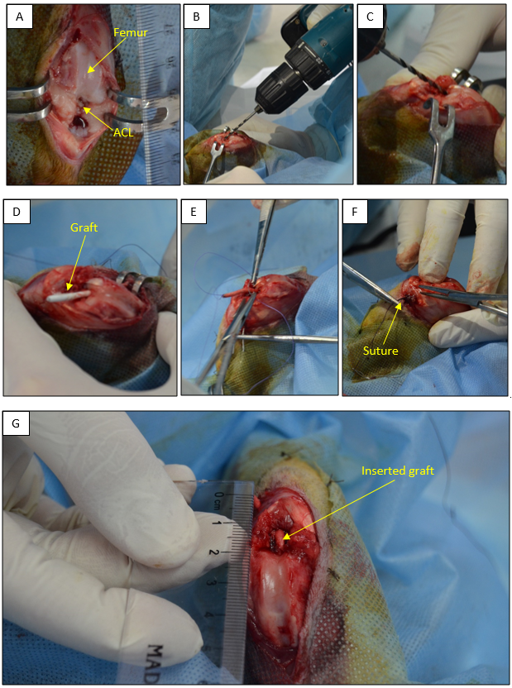
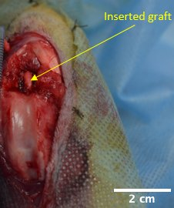
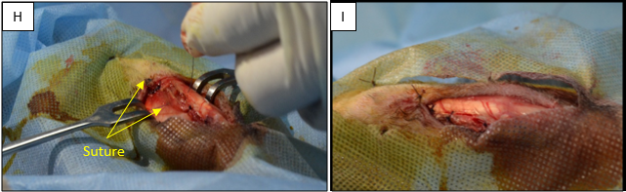
Testing the graft in a rabbit animal model
G
H
Figure 5: Photographs of the ACL replacement surgery on the rabbit. (A) the opened knee joint capsule, (B) formation of bone tunnel in femur, (C) formation of bone tunnel in tibia, (D) the proximal end of the graft passed through the femoral tunnel, (E) sutured distal end of the graft ready to pass through the tibial tunnel (F) distal end of the graft fixed in the tibial side by suturing, (G) nanofiber based rolled PET&PCL graft replaced ACL in the knee joint, (H) and (I) closing the wound by suturing layer by layer.

Slide 10
STATISTICAL ANALYSIS
The mechanical properties of bimodal PET&PCL grafts, bimodal PCL grafts, and a healthy rabbit ACL were compared using a one-way analysis of variance (ANOVA) followed by the Tukey HSD (Honest Significant Difference) posthoc test.
Analysis and comparison of collagen fibril diameter of healthy ACL tissues and fiber diameter of PET&PCL grafts were conducted using an unpaired student-t test.
The difference was considered significant when the p-value was less than 0.05 (p<0.05).

Slide 11
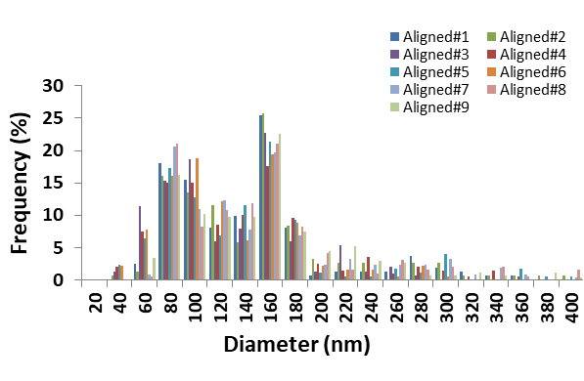
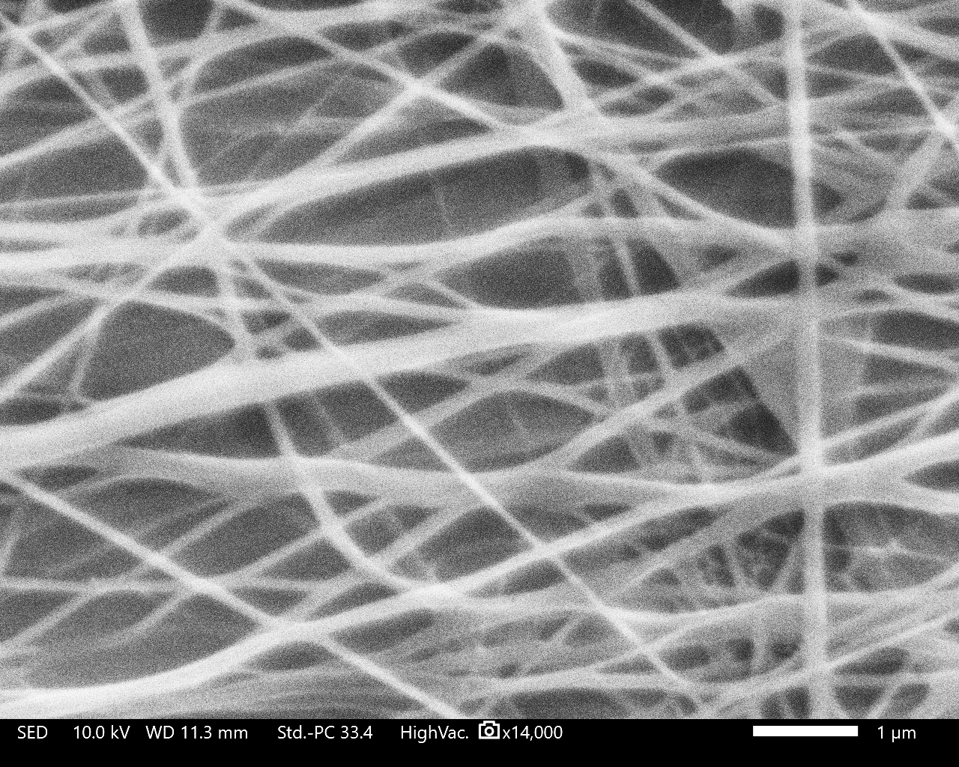
Results and Discussion: PET&PCL graft fiber diameter distribution
A
B
Figure 6: Diameter distribution of (A) bimodal PET&PCL fibers and (B) representative SEM images. Scale bar = 1μm.

Slide 12
Results and Discussion: Comparison of diameter distribution between ACL tissue and PET&PCL scaffolds.
A
Figure 7: Comparison of diameter distribution between ACL tissue and PET&PCL scaffolds. (A) Healthy ACL versus Bimodal PET&PCL, and (B) descriptive statistics. Error bars denote standard deviation.
B
Fibril Diameter (nm) | PET&PCL Scaffold |  | Native ACL tissue
Range | 40-400 |  | 40-200
Peak(s) | 84.4±8.8 | 160 | 95±10.0 | 160
Mean Diameter | 135±10.8* (p=0.0002) |  | 113.5±2.4
* p<0.05

Slide 13
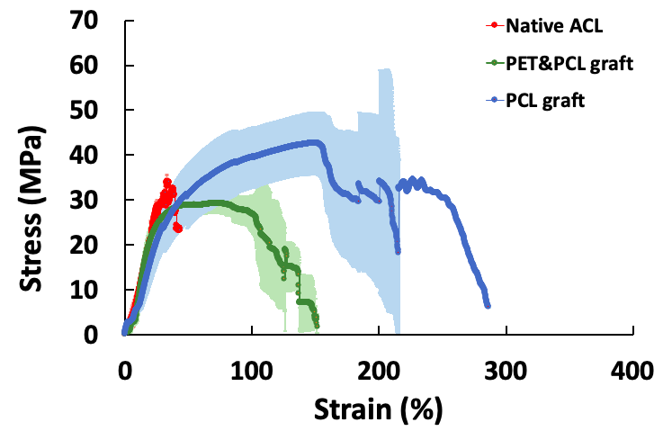
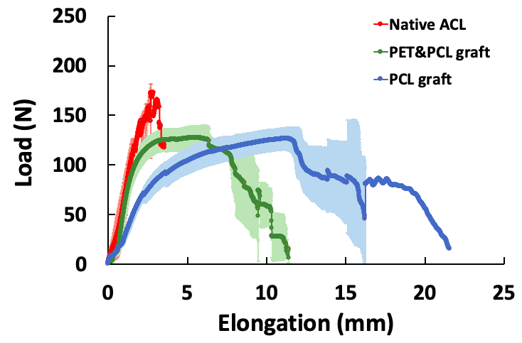
Results and Discussion: Mechanical Properties
A
B
 | Ultimate Stress (N/mm2) | Ultimate Load (N) | Ultimate Strain (mm) | Ultimate Strain (%) | Strain at Break (mm) | Strain at Break (%) | Modulus | Stiffness (N/mm) | Yield Strain | Yield Stress | Yield Load
Native ACL | 27.7±6.8 | 145.8±21.3 | 1.9±0.8#* | 23.4±10.5#* | 2.2±1.1#* | 27.0±13.9#* | 1.9±0.8 | 108.8±27.8# | 18.9±6.31 | 26.1±6.09 | 129.0±8.89#*
PET+PCL graft | 29.5±2.5# | 128.3±12.2 | 5.0±0.9# | 61.7±11.8# | 9.1±0.7 | 113.2±8.7 | 1.8±0.3 | 100.8±15.1# | 17.8±1.9 | 18.4±0.7 | 75.1±4.3#
PCL graft | 42,7±6,9 | 126,5±11,5 | 11.3±0.2 | 140.0±2.9 | 13.4±2.7 | 166.9±33.8 | 1.0±0.4 | 42.2±6.3 | 21.6±3.9 | 16.9±1.9 | 56.5±7.8
C
Figure 8: Comparison of Native ACL tissue, PET&PCL grafts, and PCL grafts in terms of mechanical properties. (A) Stress-strain diagram, (B) Load-elongation diagram, (C) descriptive statistics. An * indicates significant difference from PET&PCL graft and # indicates significant difference from PCL graft at p<0.05. Error bars represent SD.

Slide 14
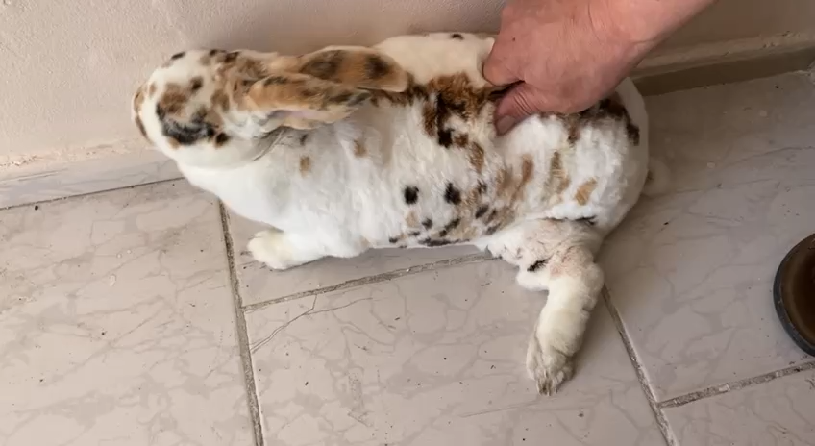
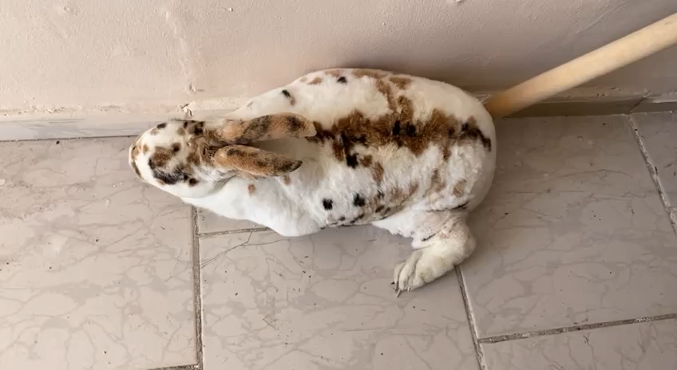
Results and Discussion: PCL graft performance
Video 1,2: PCL graft performance in a rabbit after 5 days.

Slide 15
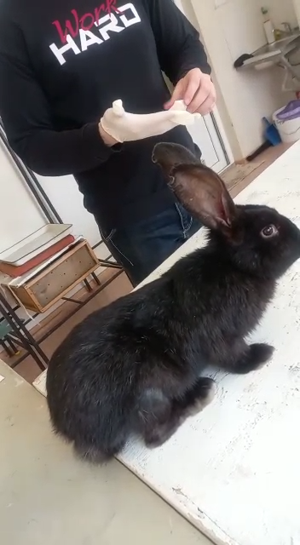
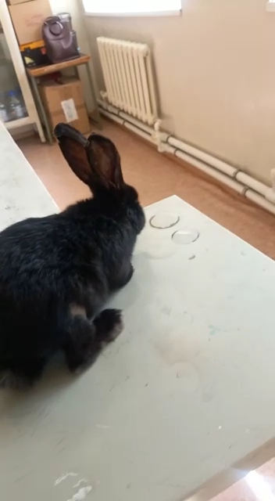
Results and Discussion: PET&PCL graft performance
Video 3: PET&PCL graft performance in a rabbit after 3 days.
Video 4: PET&PCL graft performance in a rabbit after 5 days.

Slide 16
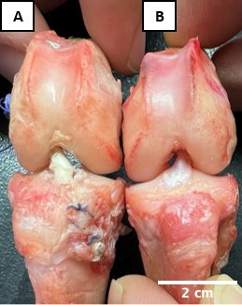
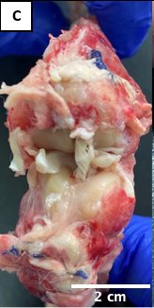
Results and Discussion: Gross view of the knee joints
Figure 9: Gross view of the knee joints harvested from rabbits at Day5. (A) After ACL reconstruction with rolled bimodal PET&PCL graft, (B) intact knee joint (native ACL), (C) after ACL reconstruction with braided bimodal PCL-only graft.

Slide 17
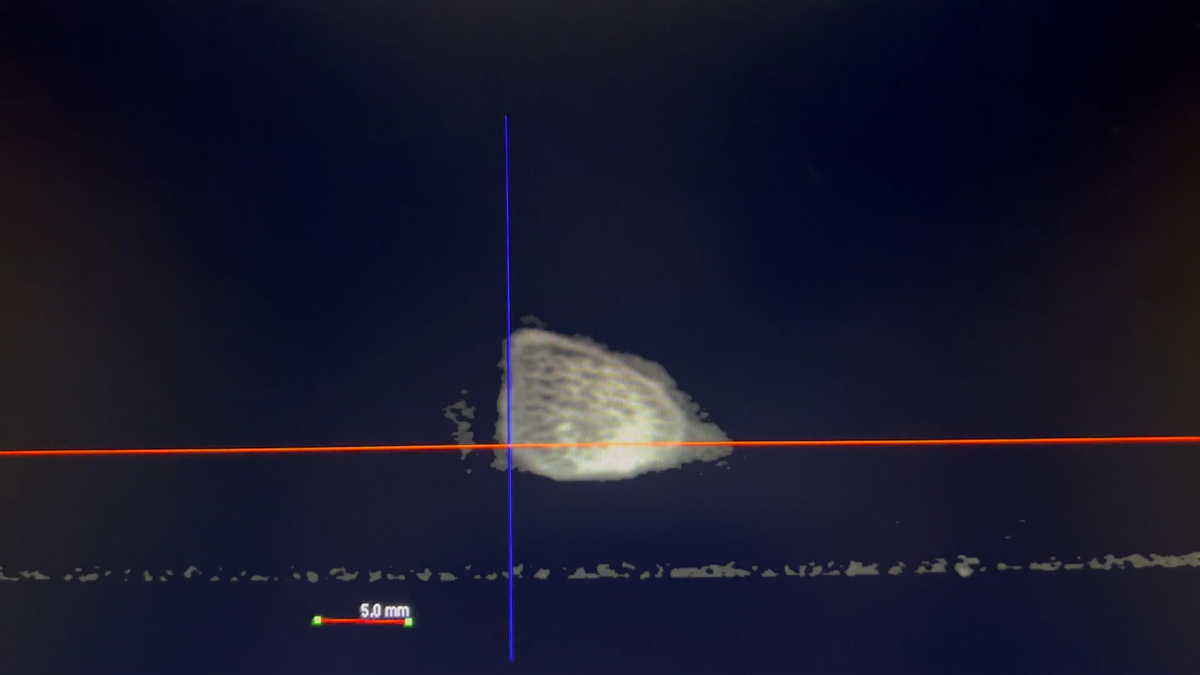
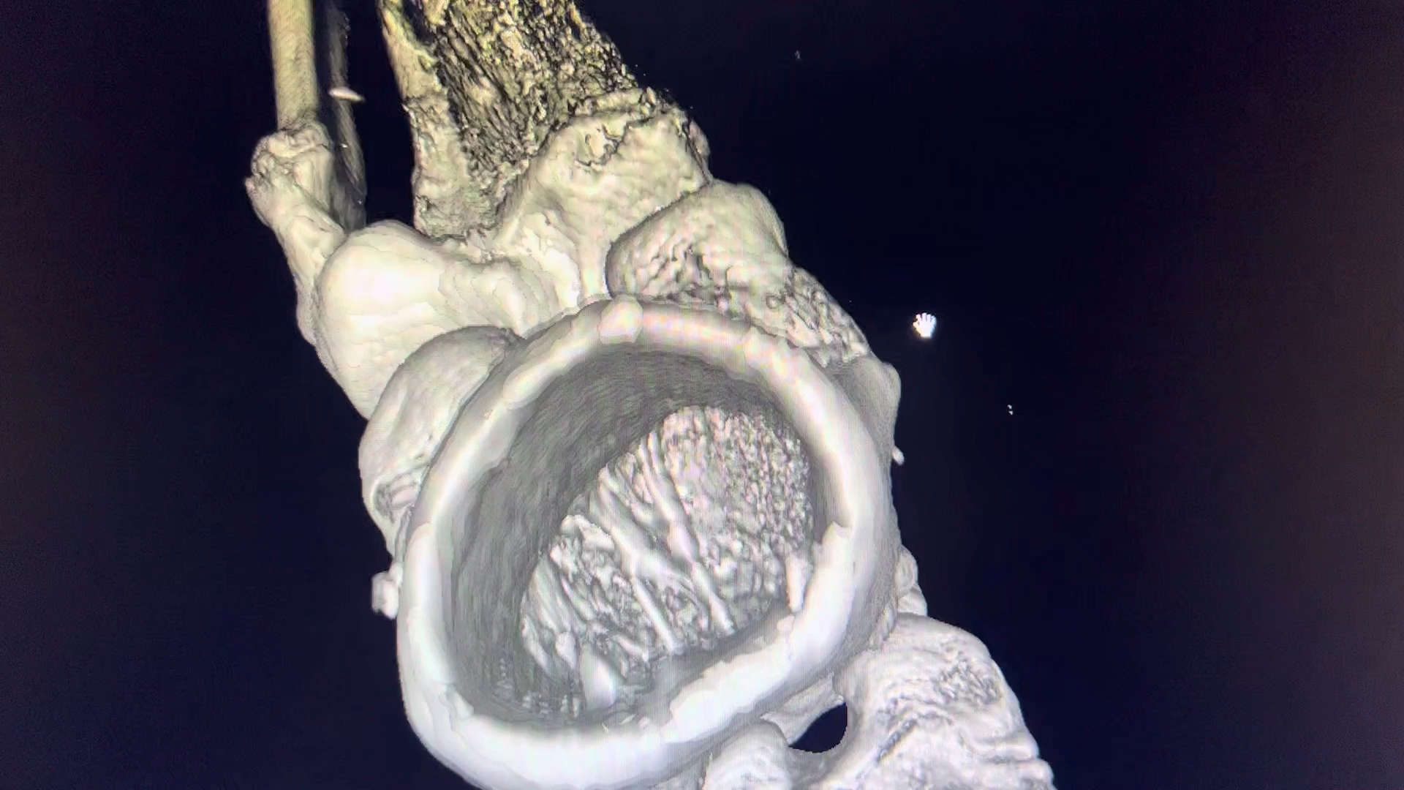
Results and Discussion: Micro-CT
Video 5: Micro-CT video of the rabbit’s knee joint after ACL reconstruction with bimodal PET&PCL graft. Scale bar =5mm
Video 6: Micro-CT 3D visualization of the rabbit’s knee joint after ACL reconstruction with bimodal PET&PCL graft.

Slide 18
Conclusion
The fiber diameter distributions of PET&PCL grafts qualitatively matched the collagen fibril diameter distribution of native ACL tissue, accompanied with similar load, stress, modulus, stiffness and yield strain, yield stress.
PET&PCL grafts have improved stiffness as compared to PCL graft. PCL grafts elongate more leading to joint instability.

Slide 19
LIMITATION:
Small number of animal (n=1) and short observation period do not allow for the assessment of long term performance of PET&PCL grafts
There was no bone formation within the tunnel (as validated by micro-CT examination) because of the short time period after reconstruction
FUTURE WORK:
Investigating ACL fibroblast behavior on this PET&PCL bimodal scaffold.
In-vivo studies on rabbit model with 1 month and 3 month periods

Slide 20
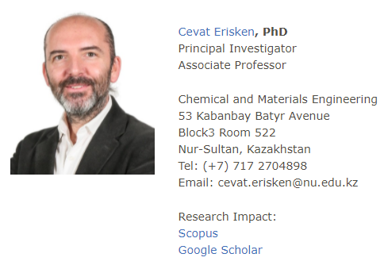

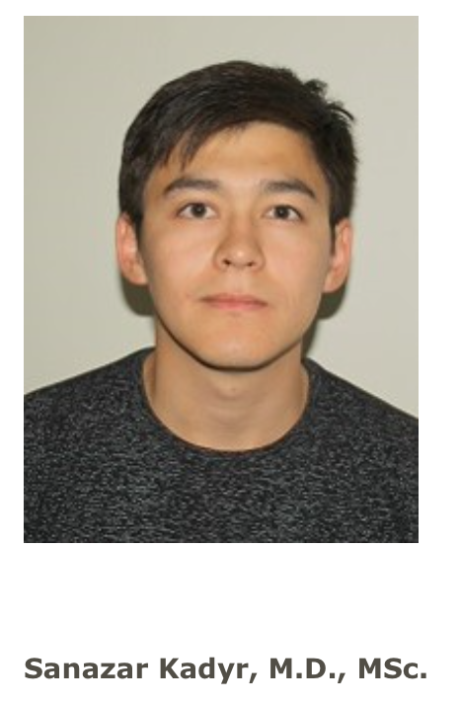

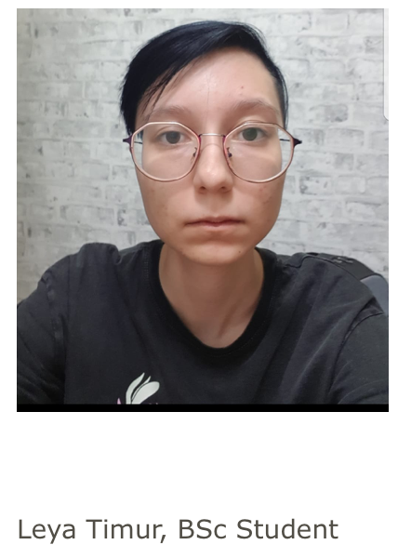
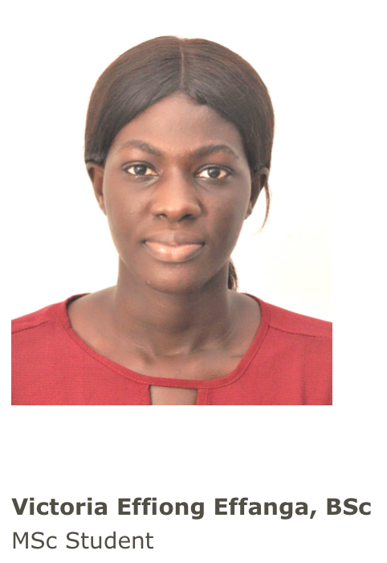



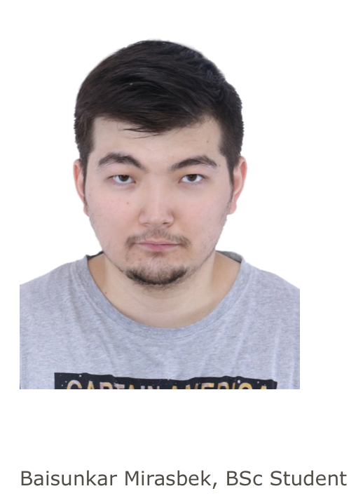

Acknowledgments

Slide 21
Reference list
[1] M. Marieswaran, I. Jain, B. Garg, V. Sharma, and D. Kalyanasundaram, “A Review on Biomechanics of Anterior Cruciate Ligament and Materials for Reconstruction,” Applied Bionics and Biomechanics, vol. 2018, pp. 1–14, 2018, doi: https://doi.org/10.1155/2018/4657824.
[2] T. L. Sanders et al., “Incidence of Anterior Cruciate Ligament Tears and Reconstruction: A 21-Year Population-Based Study,” The American journal of sports medicine, vol. 44, no. 6, pp. 1502–7, 2016, doi: https://doi.org/10.1177/0363546516629944.
[3] S. Bollen, “Epidemiology of knee injuries: Diagnosis and triage,” British Journal of Sports Medicine, vol. 34, no. 3, 2000. http://dx.doi.org/10.1136/bjsm.34.3.227-a
[4] D. Little, J. W. Thompson, L. G. Dubois, D. S. Ruch, M. A. Moseley, and F. Guilak, “Proteomic Differences between Male and Female Anterior Cruciate Ligament and Patellar Tendon,” PLoS ONE, vol. 9, no. 5, pp. 1–14, May 2014, doi: https://doi.org/10.1371/journal.pone.0096526
[5] B. R. Bach, M. E. Levy, J. Bojchuk, S. Tradonsky, C. A. Bush-Joseph, and N. H. Khan, “Single-Incision Endoscopic Anterior Cruciate Ligament Reconstruction Using Patellar Tendon Autograft,” The American Journal of Sports Medicine, vol. 26, no. 1, pp. 30–40, Jan. 1998, doi: https://doi.org/10.1177/03635465980260012201.
[6] M. Bachy, I. Sherifi, F. Zadegan, D. Petrover, H. Petite, and D. Hannouche, “Anterior cruciate ligament surgery in the rabbit,” Journal of Orthopaedic Surgery and Research, vol. 8, no. 1, Aug. 2013, doi: https://doi.org/10.1186/1749-799x-8-27.
[7] B. L. Proffen, M. McElfresh, B. C. Fleming, and M. M. Murray, “A comparative anatomical study of the human knee and six animal species,” The Knee, vol. 19, no. 4, pp. 493–499, Aug. 2012, doi: https://doi.org/10.1016/j.knee.2011.07.005.
[8] Z. Beisbayeva, A. Zhanbassynova, G. Kulzhanova, F. Mukasheva, and C. Erisken, “Change in Collagen Fibril Diameter Distribution of Bovine Anterior Cruciate Ligament upon Injury Can Be Mimicked in a Nanostructured Scaffold,” Molecules, vol. 26, no. 5, p. 1204, Jan. 2021, doi: https://doi.org/10.3390/molecules26051204.
[9] S. Smatov, “Polycaprolactone based nanofiber scaffolds can mimic collagen fibril diameter distribution of healthy and injured sheep Anterior Cruciate Ligament,” Nazarbayev University, Astana, KZ, 2021.
[10] L. Liverani and A. Boccaccini, “Versatile production of Poly(epsilon-Caprolactone) fibers by electrospinning using benign solvents,” Nanomaterials, vol. 6, no. 4, p. 75, 2016. DOI: 10.3390/nano6040075
[11] A. O. Adeoye et al., “A biomimetic synthetic nanofiber-based model for anterior cruciate ligament regeneration,” Front. Bioeng. Biotechnol., vol. 10, p. 969282, 2022.
[12] S. Kadyr, “Synthetic Polycaprolactone grafts for Anterior Cruciate Ligament,” Nazarbayev University, Astana, KZ, 2022.

