Slide 1
Training intelligent tennis adversaries using self-play with ML agents
Author: Bakhtiyar Ospanov
Thesis Supervisor: M. Fatih Demirci

Slide 2
Outline:
Introduction
Related Work – Machine Learning & Unity
Methodology
  Environment design
  Training Configuration
Experiments and Results
Conclusion

Slide 3
Introduction
Problem definition:
  Training intelligent agents in a game of tennis:
    Environment design in Unity
    Reinforcement Learning for training
  Setup:
    Two-player game where agents control rackets to hit a ball over the net.
  Goal:
    The agents must hit the ball so that the opponent cannot hit a valid return.

Slide 4
Introduction
Motivation:
  Machine Learning disrupts industries
  Game engines can be used as simulation environments and ML research platform
  Explicitly programmed algorithms stall the industry
  Playing against an intelligent, creative, and context-aware opponent is more engaging

Slide 5
Related Work
Machine Learning:
  Supervised learning, unsupervised learning, and reinforcement learning
Deep Reinforcement Learning:
  Agent with dynamic behavior
  Keywords:
    Agent, environment, observation, action space, reward, policy
  On-policy vs Off-policy
Similar works:
  A few similar literature
  Learning strategies in table tennis using inverse reinforcement learning [1]
  Robotic Table Tennis with Model-Free Reinforcement Learning [2] – uses PPO but max 34% success return rate
  RL in simulation: Solving rubik’s cube with a robot hand [3], outperforming human in Doom [4], and more

Slide 6
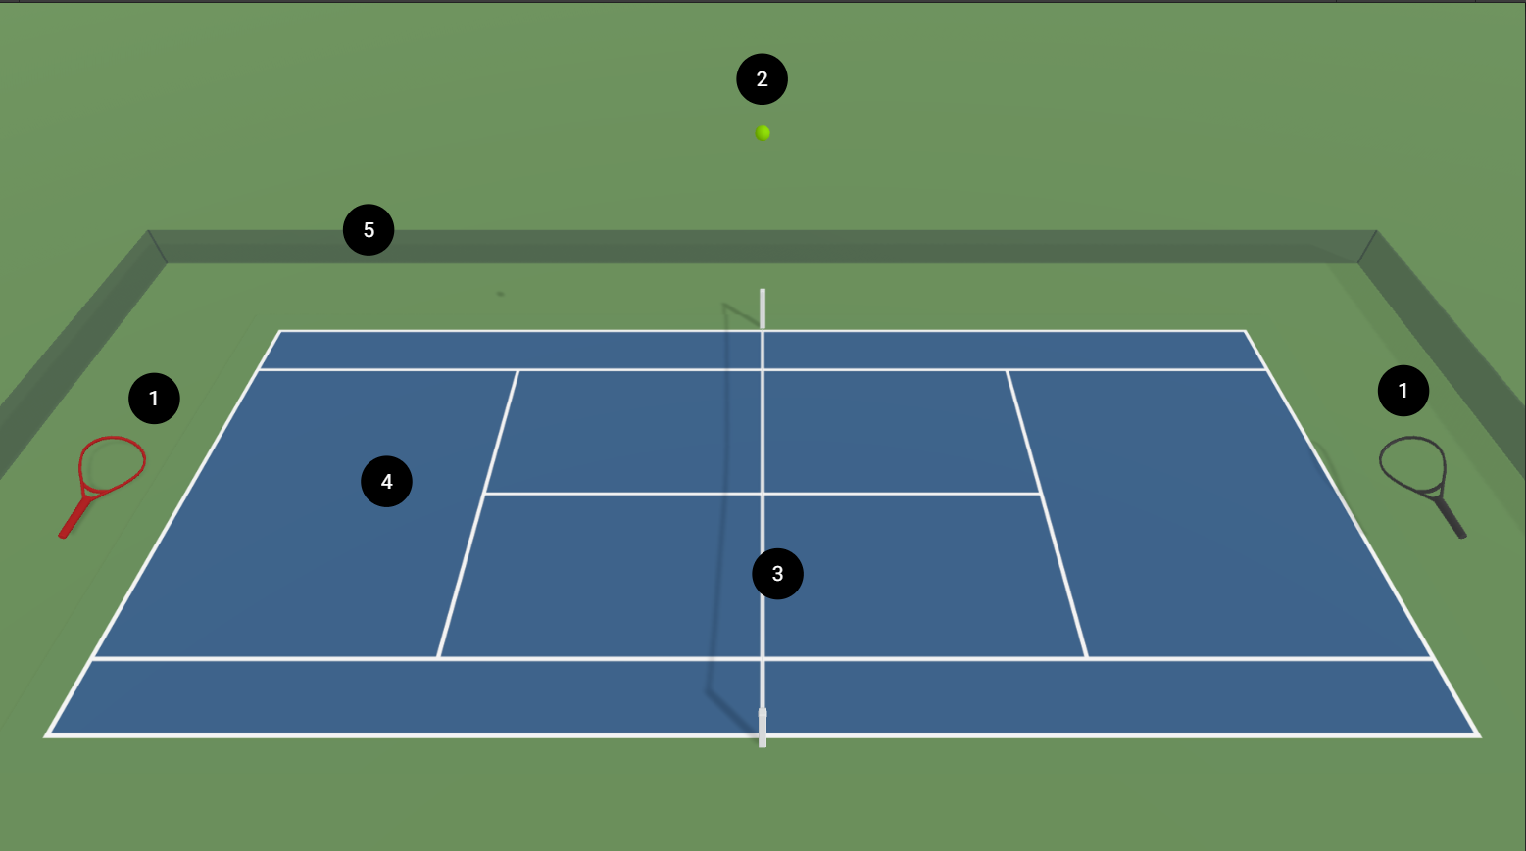
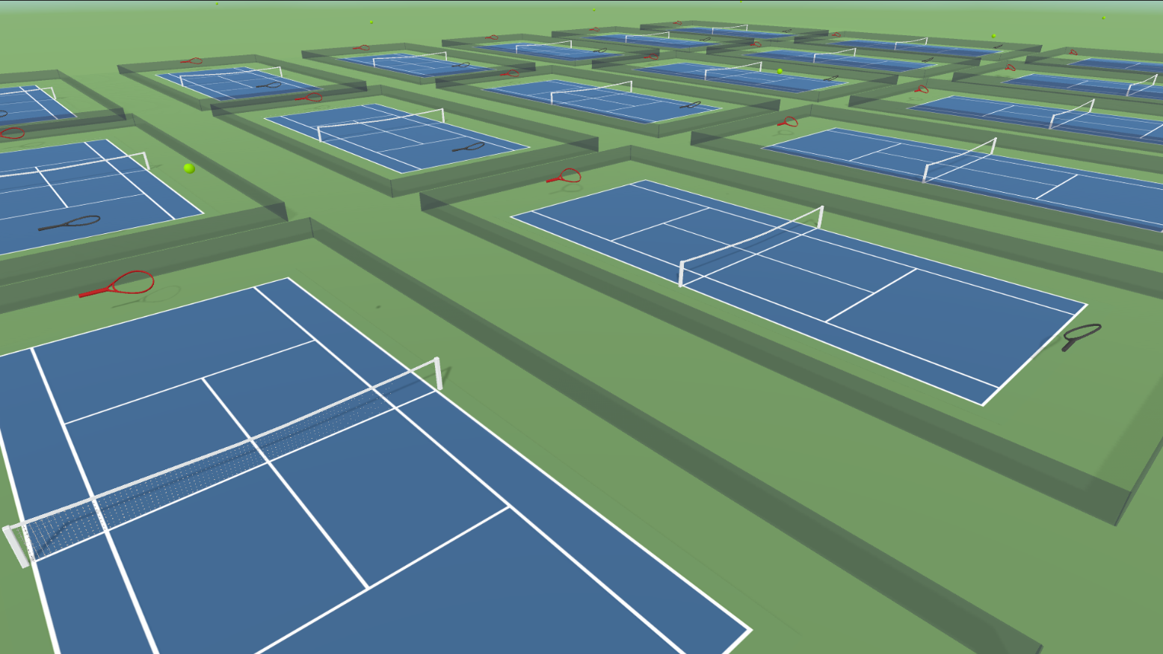
Methodology
Physical environment:
  Collision tracking
  Physic materials: bounciness, static & dynamic friction
  Mass, angular drag, velocity
  Default gravity, time scale x10 (for training), 0.02 sec. for physics updates
(a) Tennis Area prefab: 1 - agents, 2 - ball,
3 - net, 4 - court area, 5 - borders
(b) Training setup: 18 instances of the tennis area
Figure 1. Environment setup

Slide 7
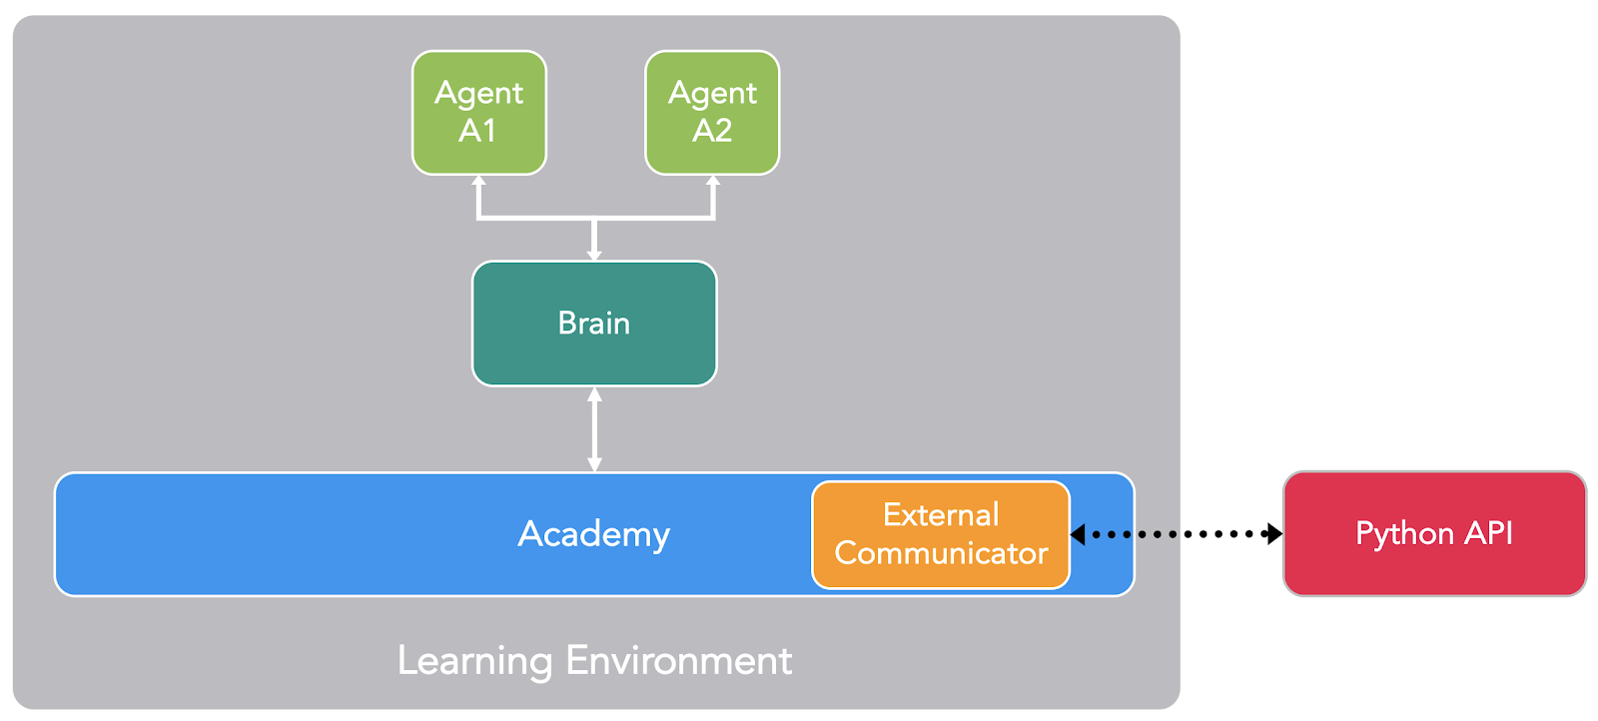
Methodology
Learning environment:
  Academy class communicates with Python API
  The simulation process consists of episodes:
    OnEpisodeBegin(): resetting and randomization
    CollectObservations(): feature vector
    OnActionReceived(): decision-making
    OnEpisodeEnd()
Figure 2. Training setup

Slide 8
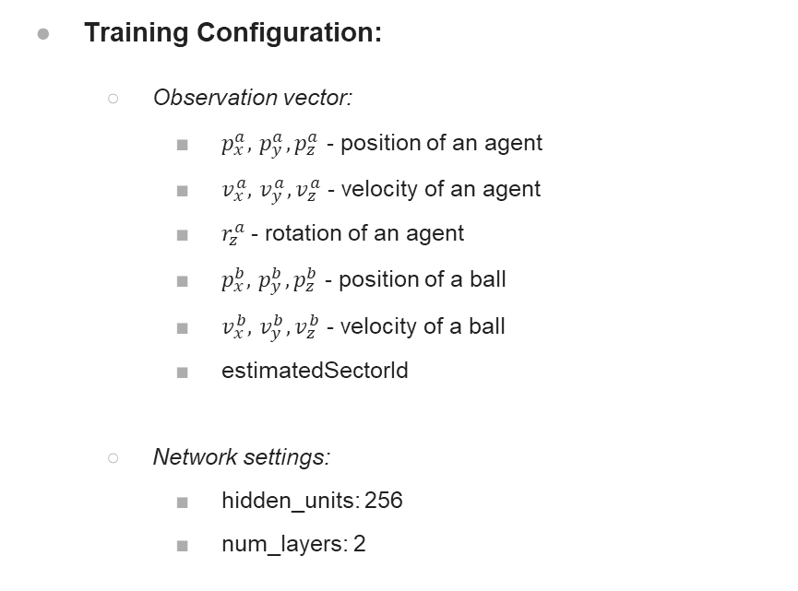
Methodology
Training Configuration:
  Observation vector:
    $p_{x}^{a},{ p}_{y}^{a},p_{z}^{a}$ - position of an agent
    $v_{x}^{a},{ v}_{y}^{a},v_{z}^{a}$ - velocity of an agent
    $r_{z}^{a}$- rotation of an agent
    $p_{x}^{b},{ p}_{y}^{b},p_{z}^{b}$ - position of a ball
    $v_{x}^{b},{ v}_{y}^{b},v_{z}^{b}$ - velocity of a ball
    estimatedSectorId
  Network settings:
    hidden_units: 256
    num_layers: 2
  Hyperparameters (total 27):
    battch_size = 2048
    buffer_size = 20480
    learning_rate = 0.0002 (constant)
    beta = 0.003
    num_epoch = 4
  Self-play setup:
    team_change: 100000
    window: 10
    play_against_latest_model_ratio: 0.5

Slide 9
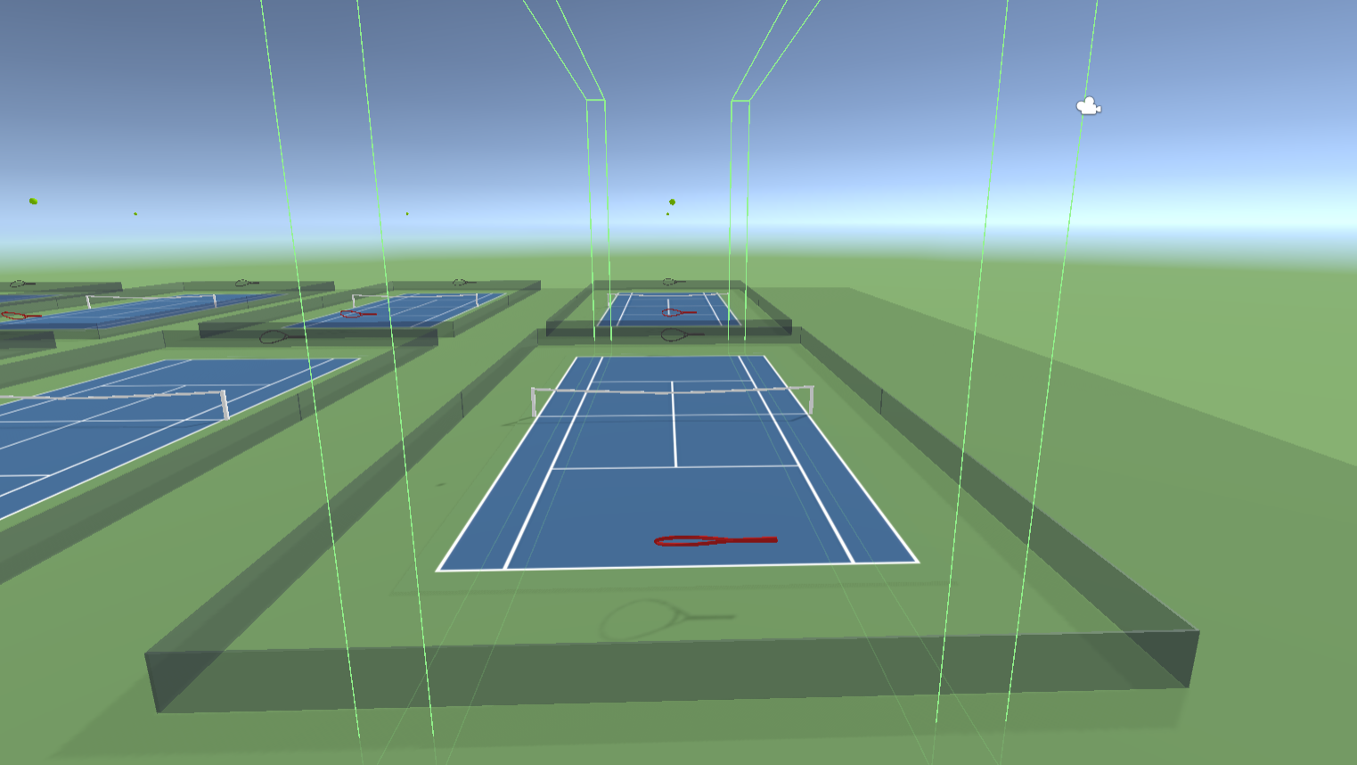
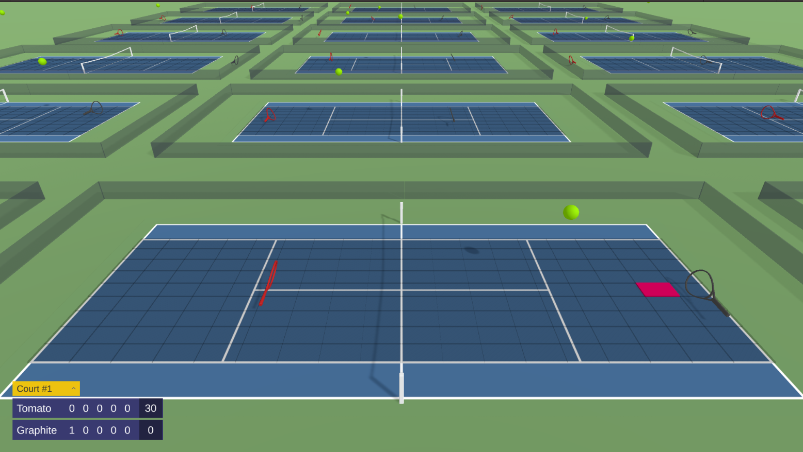
Methodology
Curriculum learning:
  Large search space -> sparse reward signal
  Progressive increase of task difficulty
The ‘estimatedSectorId’:
  Landing sector prediction within 9x9 grid
(a) Limiting walls along court sidelines
(b) Landing sector prediction
Figure 3. The proposed measures to decrease a search space

Slide 10
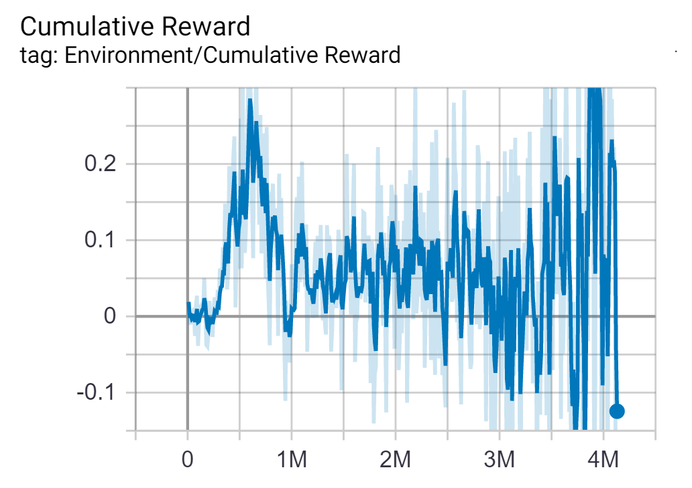
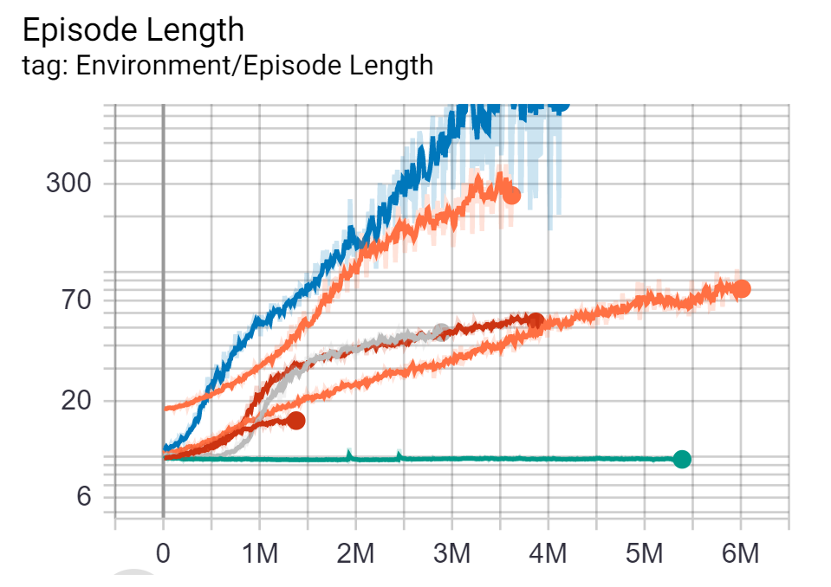
Experiments and Results
The statistics during the training were recorded by ML-Agents Toolkit and tracked via TensorBoard
Sample Cumulative Reward
over a test run
(b) Episodes Lengths for the various
configuration runs
Figure 4. Tracking of Environment metrics

Slide 11
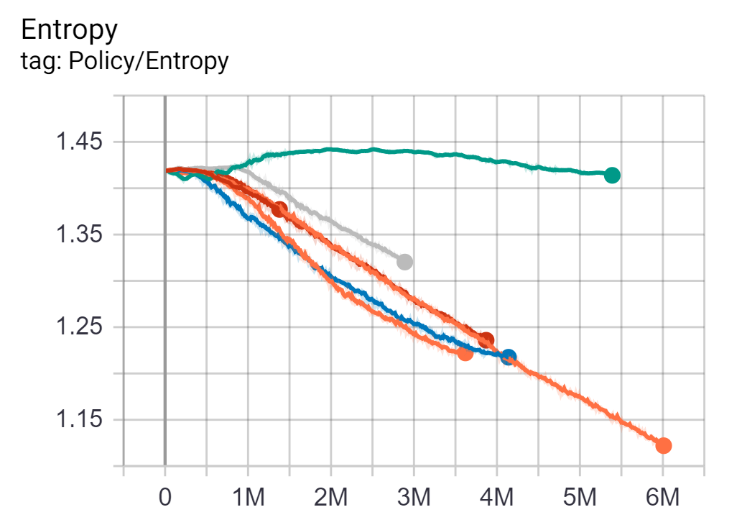
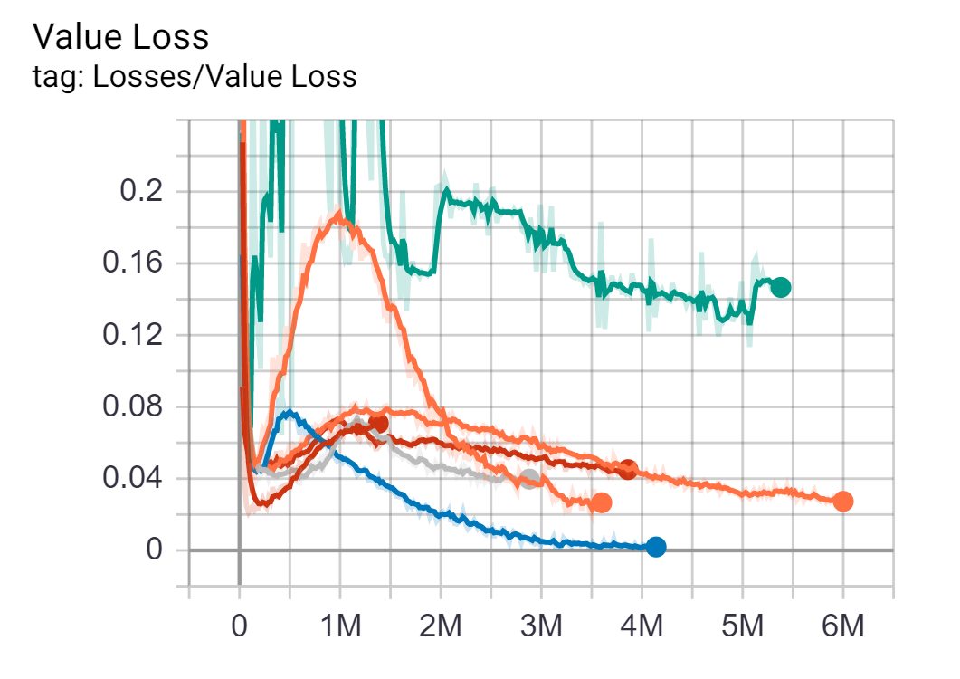
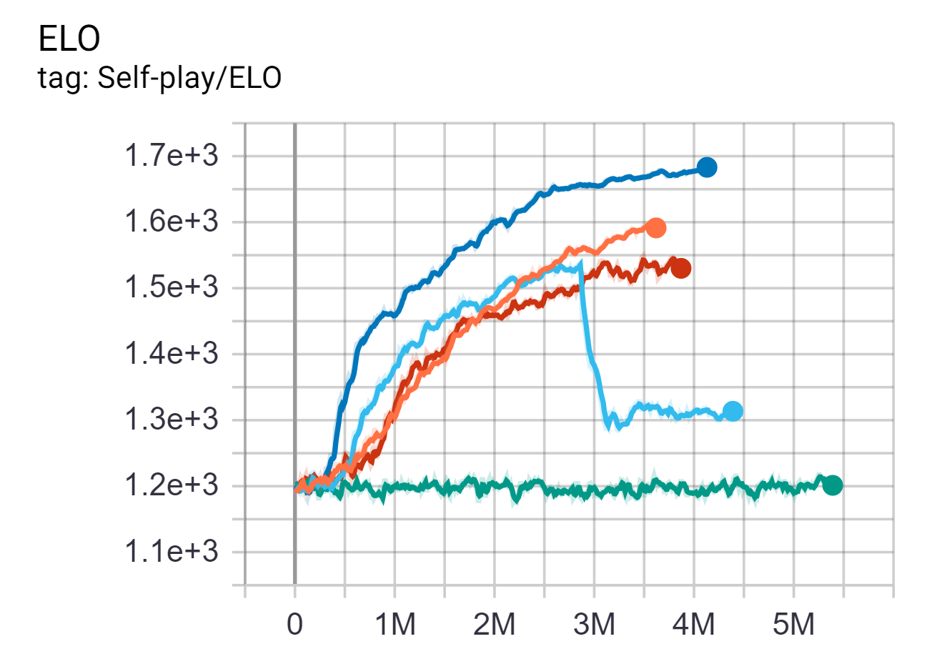
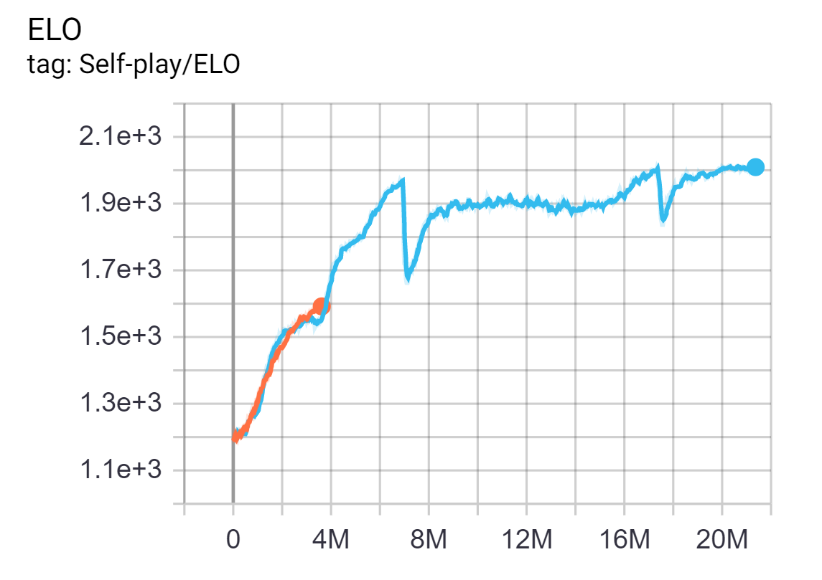
Experiments and Results
(a) Entropy values for the various configuration runs
(b) Value loses for the various configuration runs
(c) Elo ratings for the various configuration runs.
(c) Elo rating for the Curriculum Learning run.
Figure 5. Tracking of Environment metrics

Slide 12
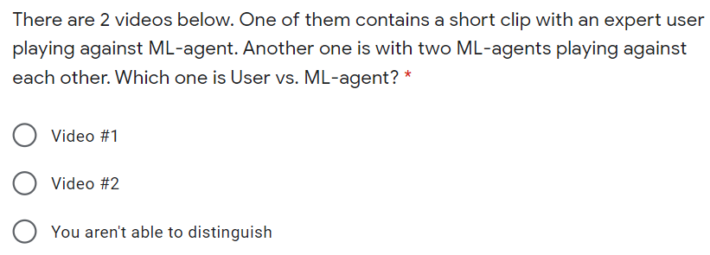
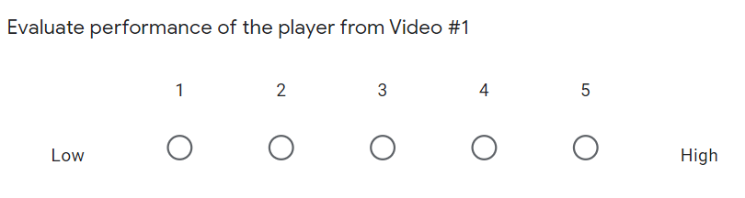
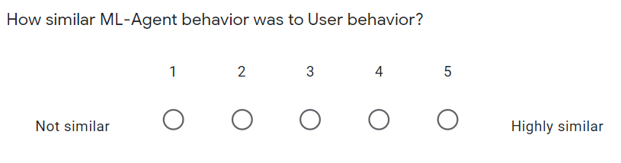
Experiments and Results
A survey:
  13 participants
  Check the ability to distinguish between an expert and ML agent behaviors
  Evaluate behavior performance
Questions:

Slide 13
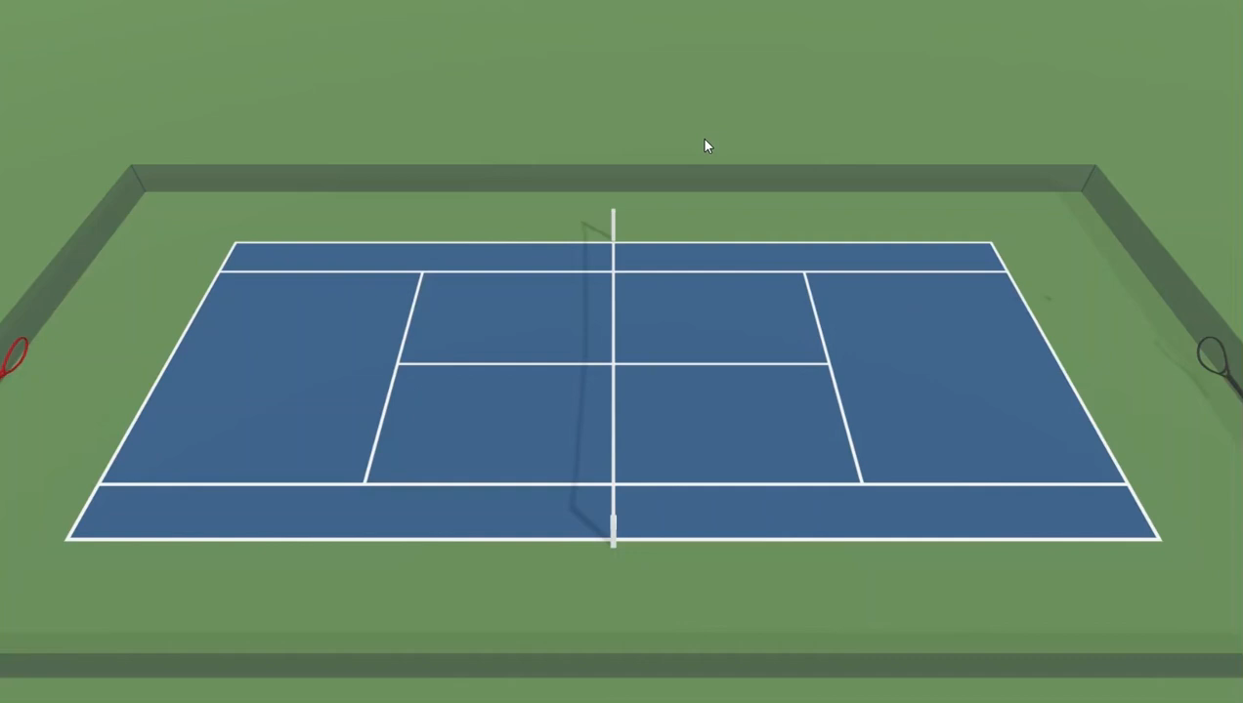
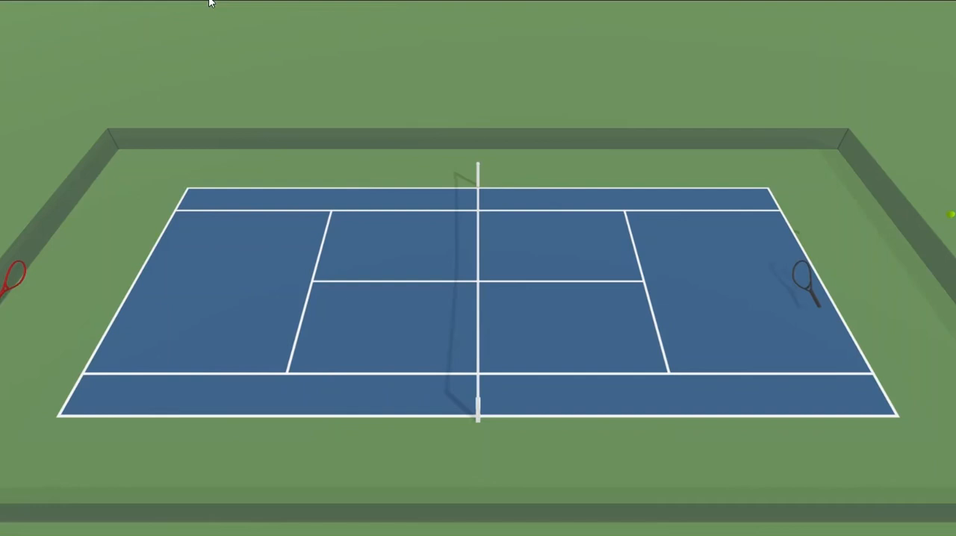
Demo
Video #1
Video #2

Slide 14
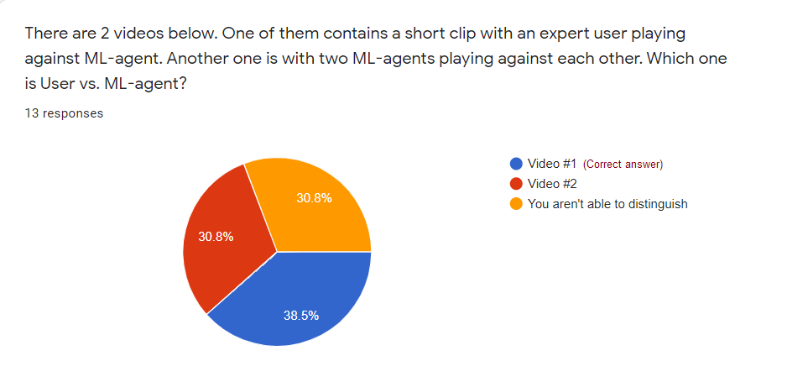
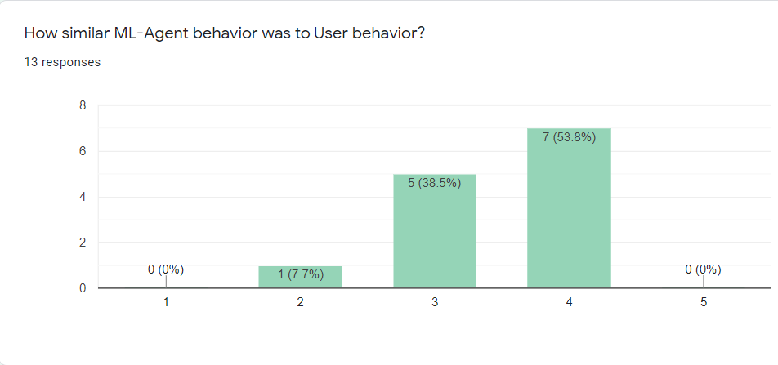
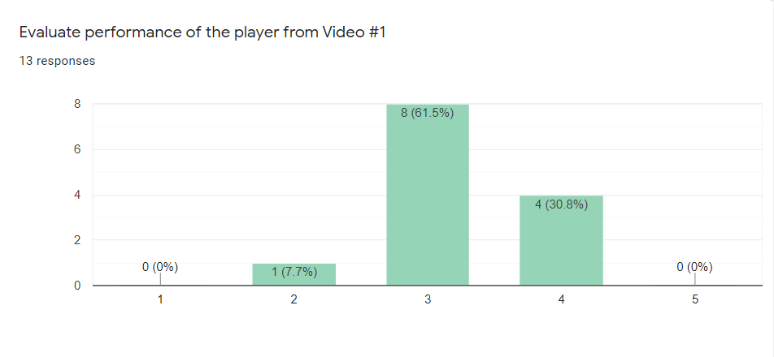
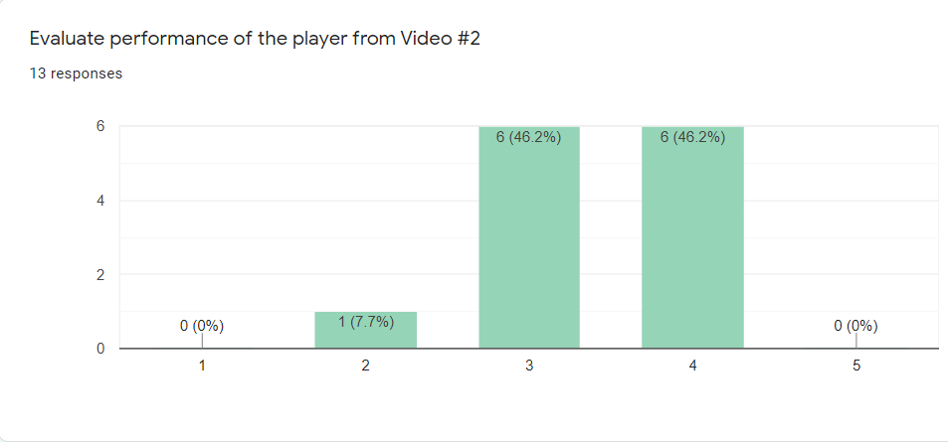
Experiments and Results
(a) Video clips differentiation results
(b) Behavior resemblance evaluation
(c) Expert user performance evaluation
(c) ML agent performance evaluation
Figure 5. Tracking of Environment metrics

Slide 15
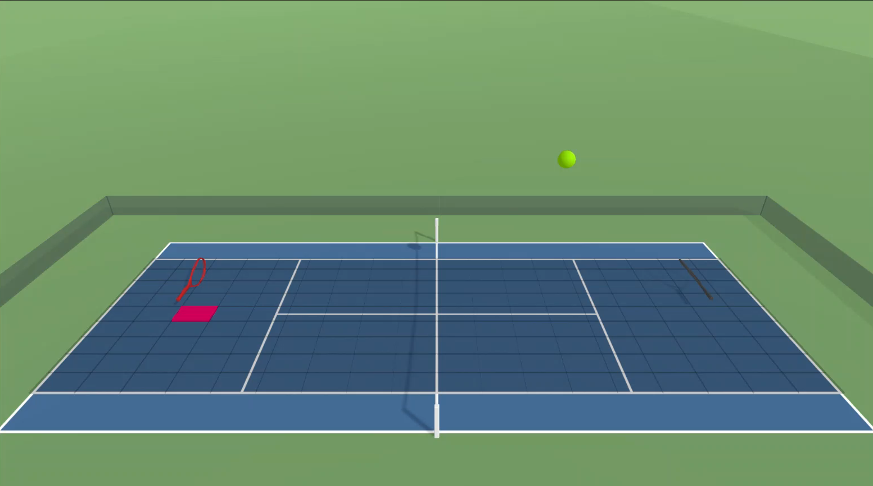
Demo
The agent is able to move along all three axes and rotate around z-axis

Slide 16
Live Demo
Test application:
  The game is built for the WebGL platform
  The neural network is processed by Unity Inference Engine
  5-sets match in game of tennis
  Available at https://bakhtiyar-ospanov.github.io/MLAT/index.html

Slide 17
Conclusion
The well-established environment facilitated the collection of accurate and versatile observations during the training
There are two satisfactory models which are produced as the output of this study:
  Production-ready but limited in movement
  Unrestricted version but unstable
Contribution:
  Physically and visually rich environment
  Training setup
  Trained model

Slide 18
Conclusion
Limitations:
  A small number of questionnaire responders
  Unstable performance in fully unlocked mode due to:
    complex interactions
    large search space
Future research directions:
  Expand pool of survey participants
  Introduce imitation learning:
    Generative Adversarial Imitation Learning
    Behavior Cloning
  Add intrinsic rewards:
    Curiosity reward
    Random Network Distillation

Slide 19
Thank you!
Contact info:
bakhtiyar.ospanov@nu.edu.kz

Slide 20
Reference list
[1] Muelling, K., Boularias, A., Mohler, B., Schölkopf, B., & Peters, J. (2014). Learning strategies in table tennis using inverse reinforcement learning. Biological cybernetics, 108(5), 603-619.
[2] Gao, W., Graesser, L., Choromanski, K., Song, X., Lazic, N., Sanketi, P., ... & Jaitly, N. (2020). Robotic Table Tennis with Model-Free Reinforcement Learning. arXiv preprint arXiv:2003.14398.
[3] I Akkaya OpenAI, Marcin Andrychowicz, Maciek Chociej, Mateusz Litwin, Bob McGrew, Arthur Petron, Alex Paino, Matthias Plappert, Glenn Powell, Raphael Ribas, et al. Solving rubik’s cube with a robot hand. arXiv preprint arXiv:1910.07113, 10, 2019
[4] Guillaume Lample and Devendra Singh Chaplot. Playing fps games with deep reinforcement learning. In Proceedings of the AAAI Conference on Artificial Intelligence, volume 31, 2017

