Slide 1
Design and Implementation of a Compact Radar-Based System Using Planar Antenna Arrays for IoT Applications
Speaker names: Damilya Abzhanova, Aidana Alkenova,
Ali Yerkinbekuly, Kairat Zhumadilov
Supervisor: Mohammad Shabi Hashmi
11.04.2026

Slide 2
Agenda
Problem Statement
Proposed Solution
Stakeholders
Context & Constraints
Top-Level Requirements
Governing Equations
Methodology
Validation of the results
Conclusion
References

Slide 3
Problem Statement
Need a sensing system that:
Detects motion reliably indoors settings
Works in difficult environments
Preserves data privacy
Integrates easily into Internet of Things (IoT) ecosystems
Modern off-the-shelf radars are either expensive or not customizable (Hagele et al, 2025).
Academic solutions lack compactness or integration with IoT pipelines (Strecker et al, 2024).

Slide 4
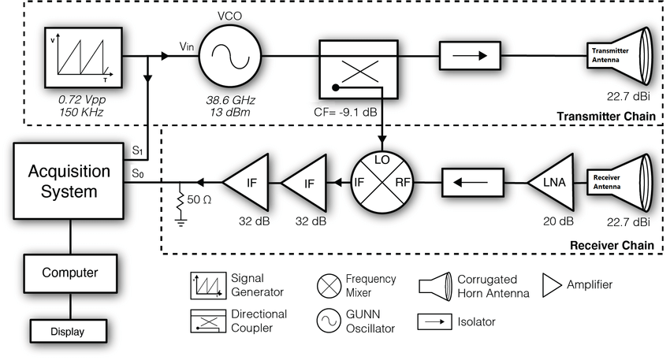
Solution
Compact Frequency-Modulated
Continuous-Wave (FMCW) radar with
Vivaldi Antenna setup was designed, manufactured and assembled.
Output: Range-Doppler Maps
M. A. Khan, S. Ahirwar, V. Sharma, and S. Dhok, “FMCW Radar Block Diagram,” in Performance analysis of FMCW radar-based human motion classification, 2020. [Online].

Slide 5
Stakeholders
Primary Stakeholders:
Project team → design, testing, analysis
Supervisor → guidance, evaluation
ECE Department → capability & research value
Secondary Stakeholders:
Potential industrial IoT companies
Smart-building & automation integrators
Society → safer, more energy-efficient, and privacy-preserving smart environments enabled by improved IoT sensing
Outcome affects academic progress and potential real-world deployment.
[Savills, “5 Tips to Succeed in Stakeholder Engagement,” Savills Prospects – Themes, Aug. 31, 2022.

Slide 6
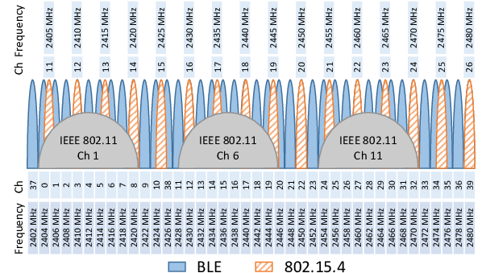
Context & Constraints
Context:
Academic project using Nazarbayev University lab equipment
Aims to outperform Passive Infrared Sensor (PIR) & ultrasonic sensors
Constraints:
Budget limits high-frequency components
Compact IoT Integration required
Industrial, Scientific, Medical (ISM) band regulatory restrictions
Verification repeatability required
N. Radhakrishnan, P. Zand, and M. Nabi, “Analysis of coexistence between IEEE 802.15.4 and IEEE 802.11 in the 2.4 GHz ISM band,” Conference Paper, Oct. 2016.

Slide 7
Top-Level Requirements
Requirement | Threshold
S(1,1) in 2.40–2.48 GHz | ≤ −10 dB
Gain at 2.4 GHz | ≥ 7 dBi
Footprint | ≤ 500 x 500 mm
Detect target accuracy (± 10 cm) | ≥ 3 m
Processing latency | ≤ 0.9 s per frame
Table 3‑A. System Requirements & Acceptance Criteria.

Slide 8
Standards and Compliance
International Standards
IEEE 149-2021 - Antenna measurement procedures
IEEE 145-2013 - Antenna terminology
ETSI EN 300 328 - 2.4 GHz band limits
FCC Part 15 - Regulations of RF emission rules
IEEE Std 2735-2019 - Automotive Radar Performance Metrics
IEC 62301 - Power Consumption Measurement)
IEEE Std 1241-2010 - ADC Terminology and Test Methods
Institutional Compliance
NU lab safety rules
Compliance ensures legality, safety, and reproducible measurements.

Slide 9
Trade-Off (Antenna)
Antenna Type | Key Characteristics
Microstrip Patch Arrays | Low-profile, lightweight; Inexpensive, good gain (~10–12 dBi for small arrays)
Slot Antenna Arrays | Stable radiation pattern; Good polarization purity; Bandwidth up to 10–15%.
Phased Arrays (Active/Passive) | Electronic beam steering; Very high resolution & fast 3D imaging; Highly adaptable
Reflectarray / Transmitarray | High gain with planar geometry; Lightweight and highly scalable
Vivaldi (Tapered Slot) Arrays | Extremely wide bandwidth (excellent range resolution); High gain when used in arrays.
Selected: The Vivaldi antenna was selected at the end because the patch array did not meet the size constraints and could not be fabricated with the available laboratory facilities.
Table 5. Antenna Options.

Slide 10
Trade-Off (Antenna)
Criterion | Target | Weight | Microstrip | Slot | Vivaldi | Phased | Reflectarray
BOM Cost | ≤ 150,000 KZT | 0.20 | 10 | 8 | 4 | 4 | 6
Bandwidth | ≥ 100 MHz | 0.20 | 6 | 8 | 10 | 8 | 4
Size / Footprint | ≤ 500×500 mm | 0.15 | 10 | 8 | 4 | 8 | 6
Gain Requirement | ≥ 10 dBi | 0.15 | 8 | 8 | 10 | 10 | 10
Timeline | Fabricable ≤ 4 weeks | 0.20 | 9 | 7 | 4 | 6 | 6
Total Score | — | 1.00 | 8.83 | 8.17 | 7.00 | 6.67 | 7.00
Table 5‑A. Trade-off Matrix (scores 0–10)

Slide 11
Trade-Off (Measurements & Testing)
Measurement Options Evaluated:
Vector Network Analyzer (VNA) – S-parameter & gain measurement
Spectrum Analyzer + Oscilloscope – chirp and spectrum monitoring
Selected: VNA
✔ Accurate S-parameter measurements (S11, S21) for antenna matching and RF validation
✔ Standardized by IEEE Std 149-2021 for antenna characterization
✔ Enables direct comparison between simulation (CST) and measurements
✔ Widely used in FMCW radar front-end testing

Slide 12
Trade-Off (ML methods)
Machine Learning Methods Evaluated:
Feature-based Support-Vector Machine (SVM)
Random Forest / Gradient Boosting
MobileNetV2 CNN (Range–Doppler Maps)
Implemented Model: CNN
✔ Automatically learns spatial radar signatures
✔ Lightweight deep network (optimized for embedded systems)
✔ Higher classification accuracy than classical ML models
✔ Scalable for real-time radar applications

Slide 13
Trade-Off (Radar Systems)
Radar Systems Evaluated:
FMCW radar (off-the-shelf modules)
Microstrip-based FMCW radar
Ultra-Wideband (UWB) radar
Selected: Microstrip-based FMCW radar
✔ Custom RF design with optimized antennas, couplers, and mixers
✔ Lower cost and easier fabrication than commercial modules
✔ Widely used architecture for 2.4 GHz FMCW radar systems

Slide 14
Engineering Design Decisions
Constraint | Engineering Decision | Justification
Budget limit on RF parts | Microstrip-based FMCW radar | Scalable + low-cost fabrication
Need compact IoT integration | Patch antenna / Compact vivaldi antenna architecture | Fits indoor embedded deployment
Regulatory Band Restriction | Selected 2.4 GHz frequency for operation | License-Free Band and compatibility with equipment
Limited dataset for classification | MobileNetV2 CNN | Efficient learning from RD maps with moderate dataset size
Verification repeatability required | VNA testing selected | IEEE Std 149 measurement standard

Slide 15
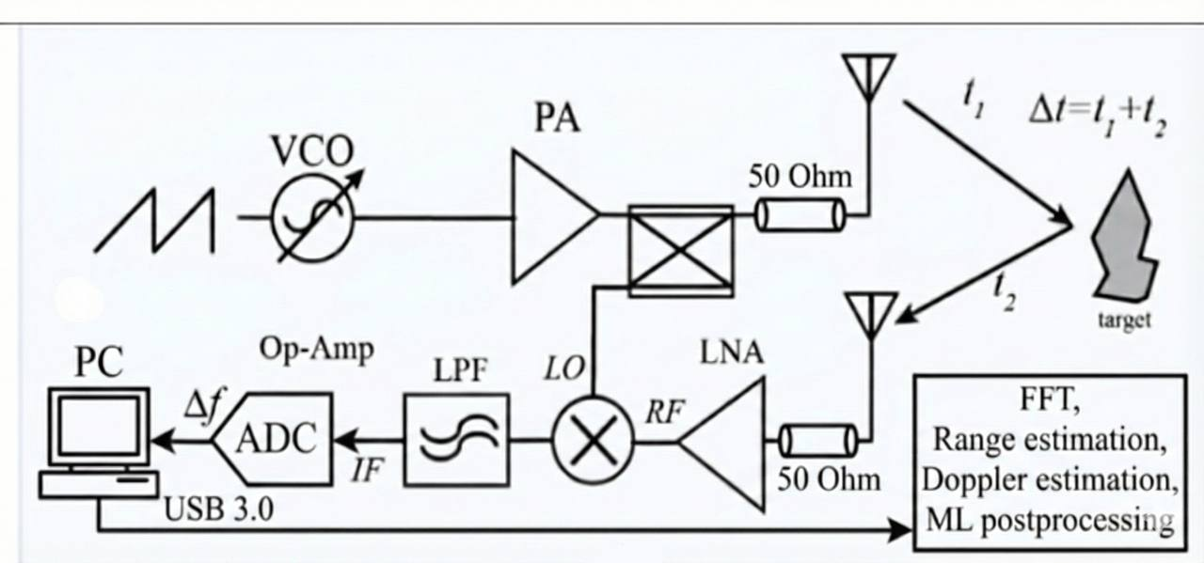
Final System Architecture
Radar Hardware Components:
Voltage-Controlled Oscillator (VCO) Controller
VCO
Radar Components (Mixer, Coupler, LF P-Amp)
RX (Receive) Antenna
TX (Transmit) Antenna
9V Battery Supply
Active Low-Pass Filter
Key Functions:
FMCW chirp generation
Beat-frequency extraction
Range-doppler estimation
IoT communication
Notes:
FMCW chirp generated by VCO and distributed as the master LO signal.
Transmit path uses a PA and microstrip antenna to radiate the chirp.
Echo signal collected by the receive antenna and boosted by the LNA.
A branchline mixer combines the received RF with the LO to produce the IF beat signal.
A directional coupler ensures proper LO/RF routing and isolation between paths.
IF signal is filtered, buffered, and sent to the ADC for processing.

Slide 16
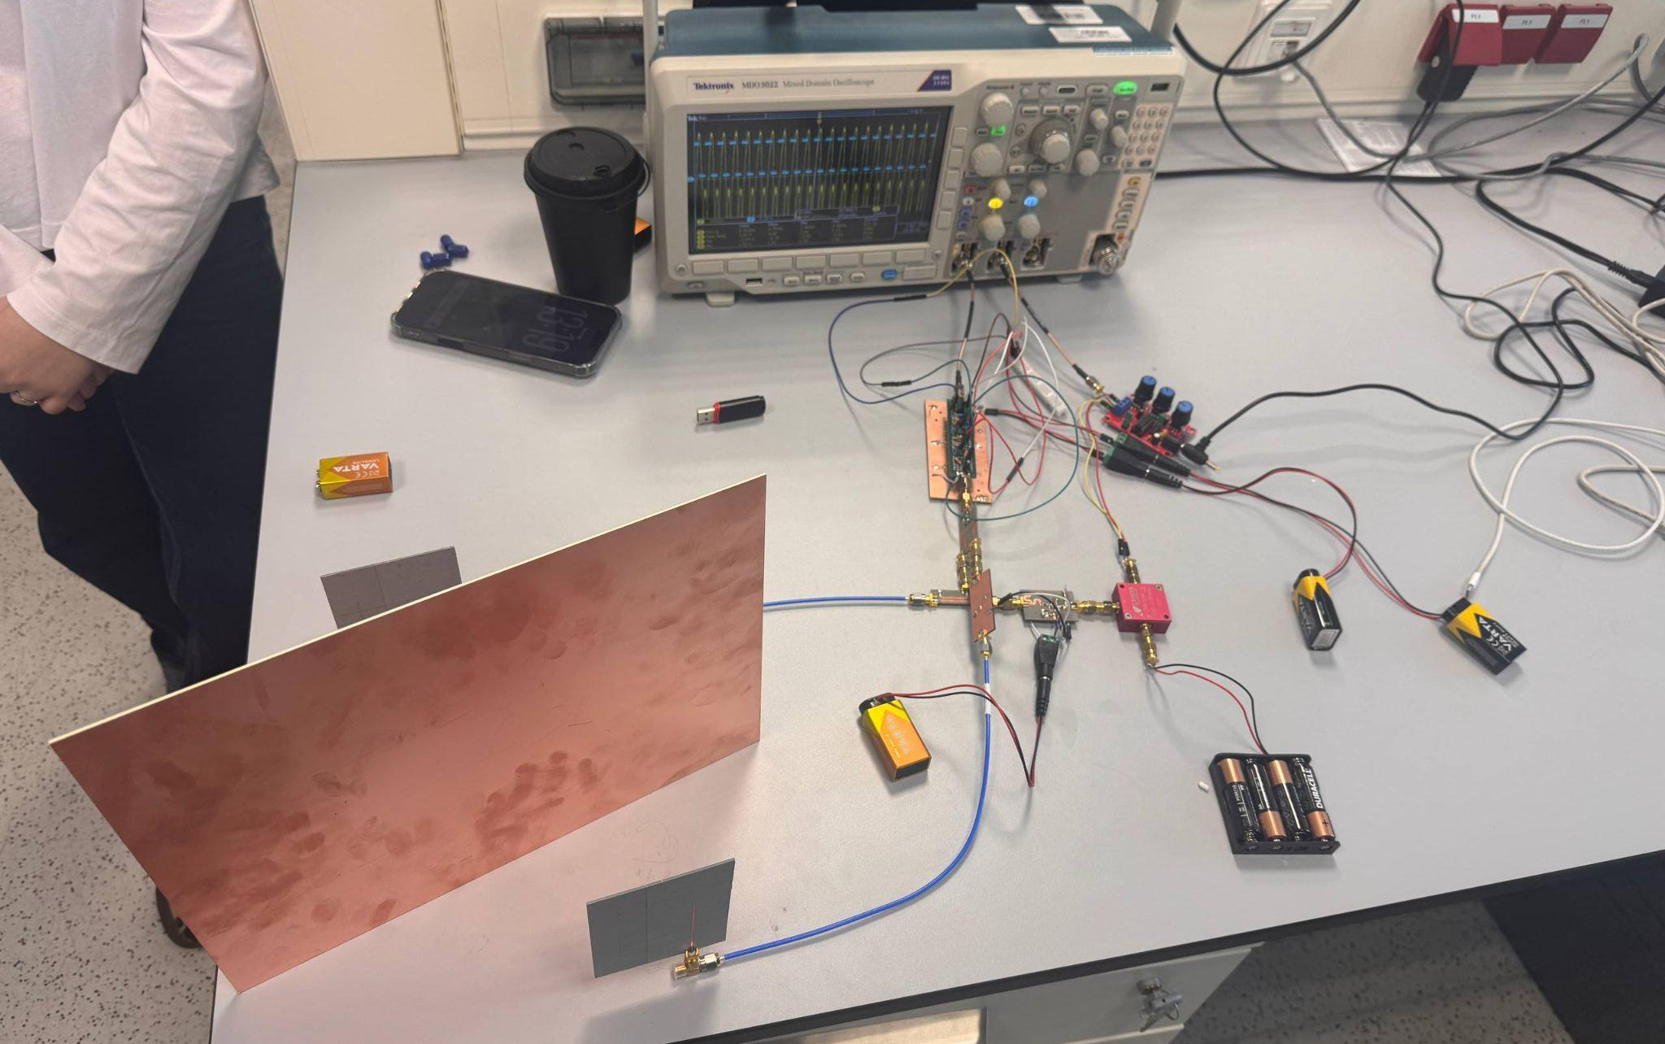
System Architecture Implementation
7
1
5
3
2
6
4

Slide 17
Verification and Validation (V&V) Req-s
Req ID | Requirement (measurable) | Verification method | Pass/Fail Threshold
R1 | The radar shall detect a target at 3 m range with 10 cm accuracy | Functional test | PASS (>3 m range)
R2 | The antenna array shall exhibit S11 ⩽ -10 dB in the 2.40-2.48 GHz band. | VNA measurement | PASS (S11 ⩽ -10 dB across 2.40-2.48 GHz)
R3 | The antenna array shall provide gain ⩾ 7 dBi in the main lobe at 2.45 GHz. | Anechoic chamber measurements | PASS (Peak gain ⩾ 7 dBi; main-lobe width consistent with design)
R4 | Processing latency per measurement frame ≤ 1 s | MATLAB execution-time measurement (tic/toc) | PASS (703 ms avg)

Slide 18
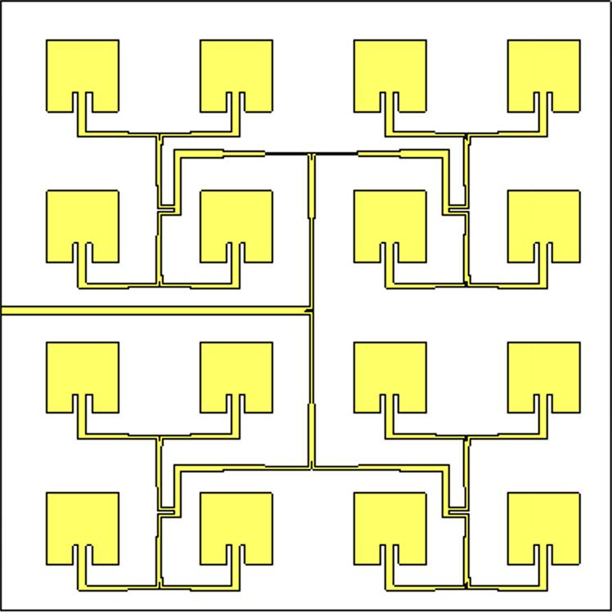
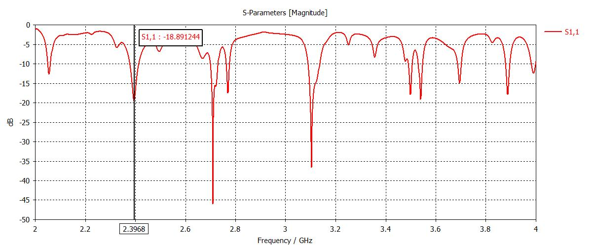
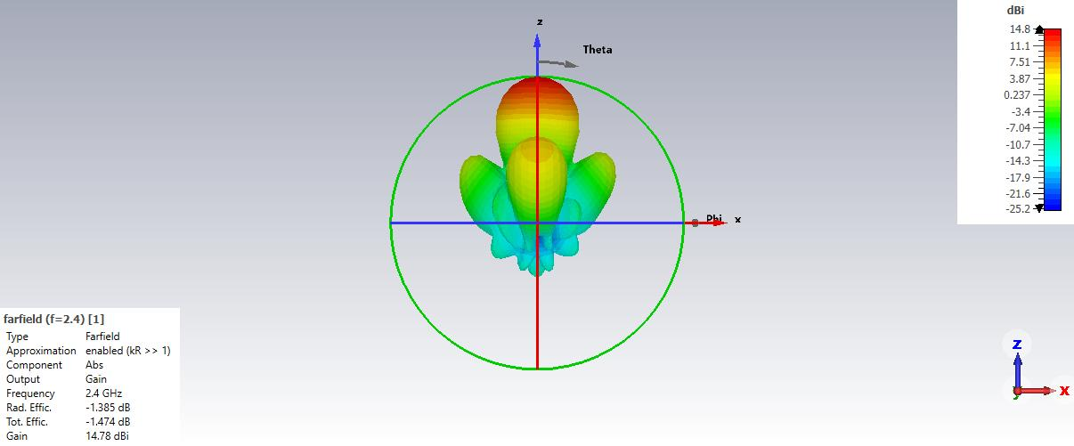
V&V Results: Microstrip Patch Array Antenna

Slide 19
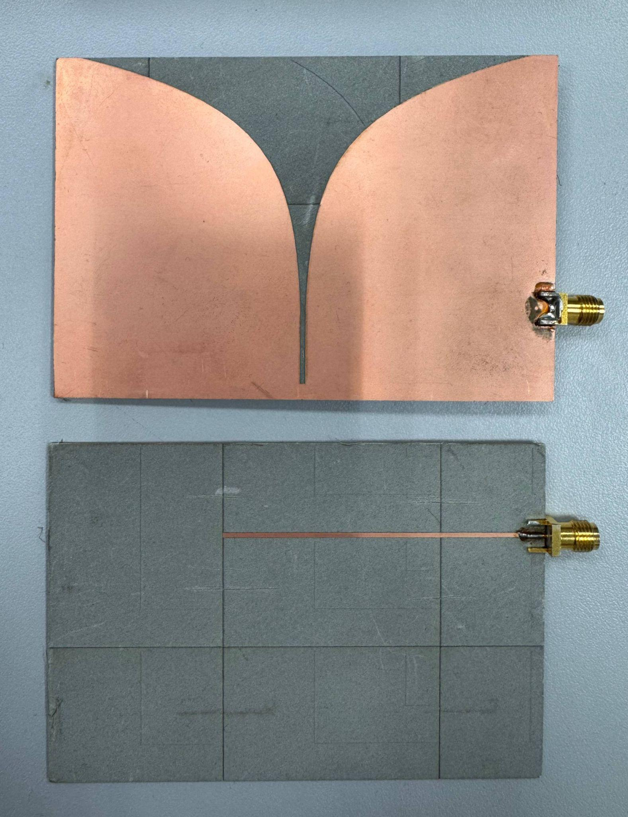
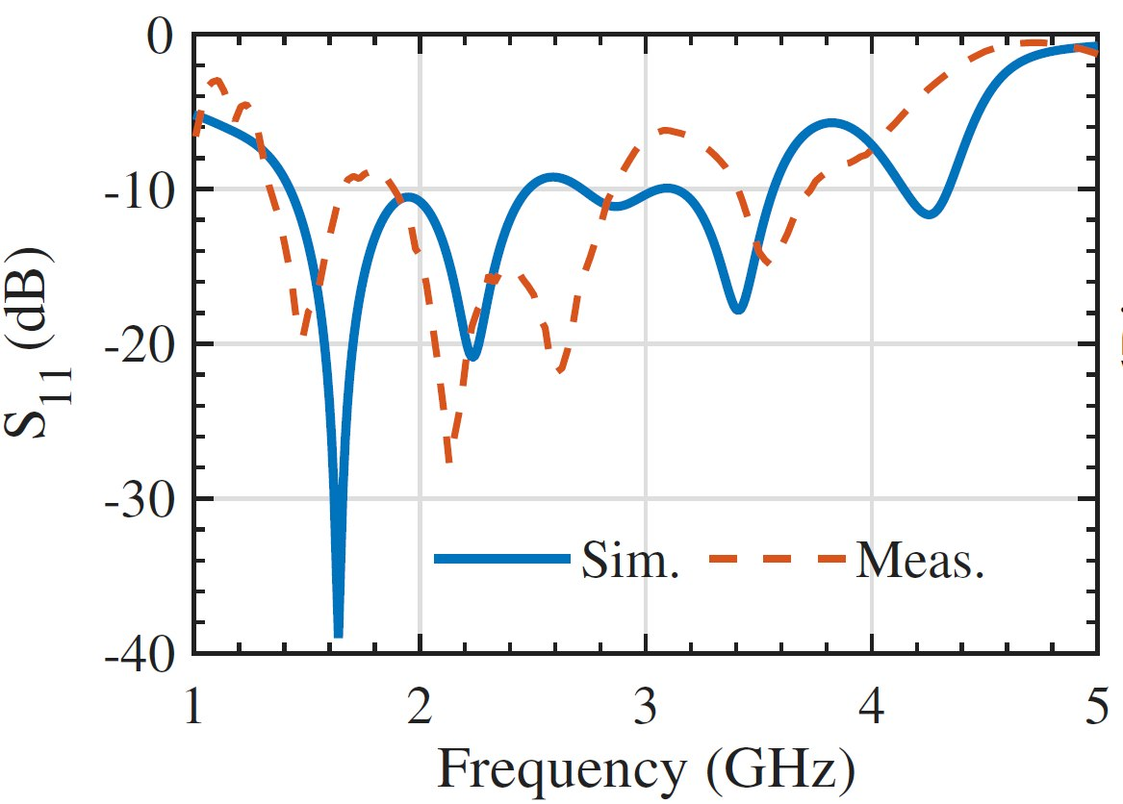
V&V Results: Vivaldi Antenna
100mm
60mm
RO3006B

Slide 20
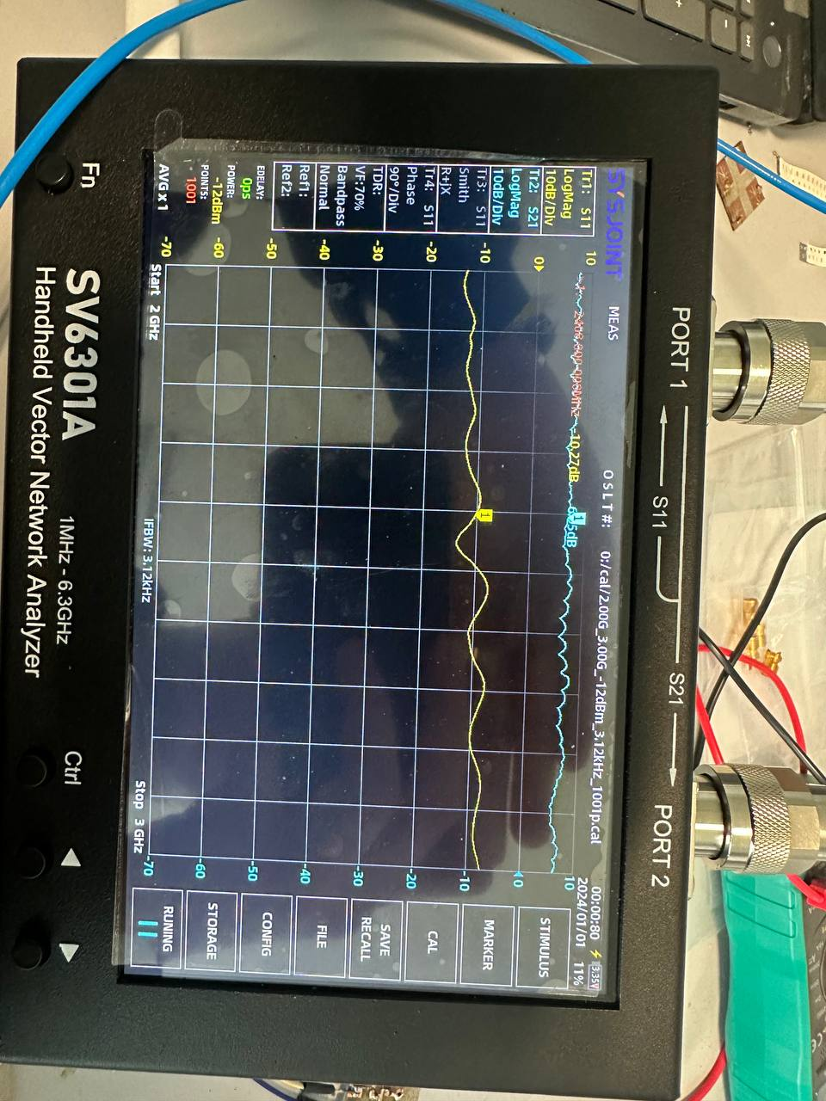
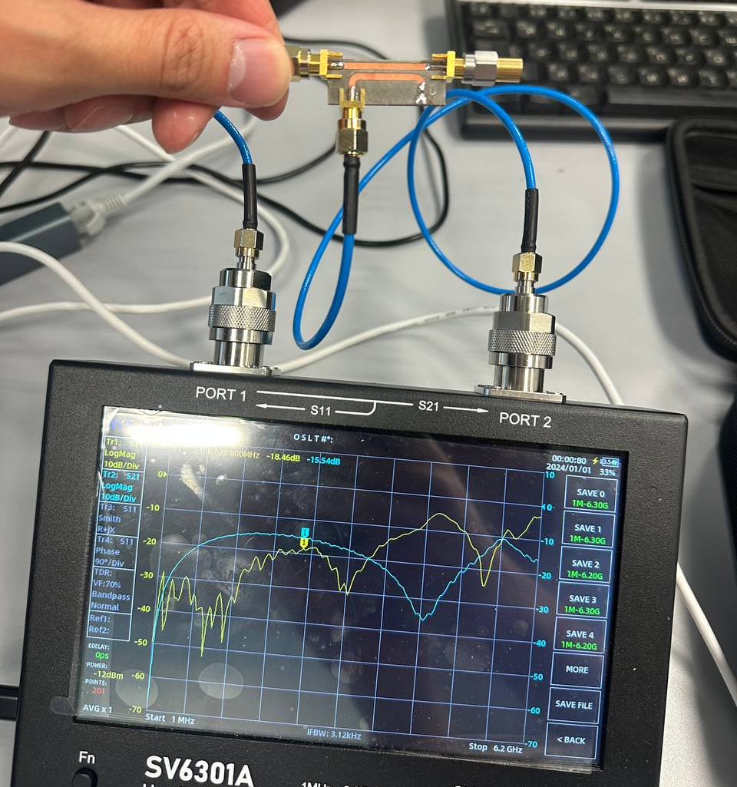
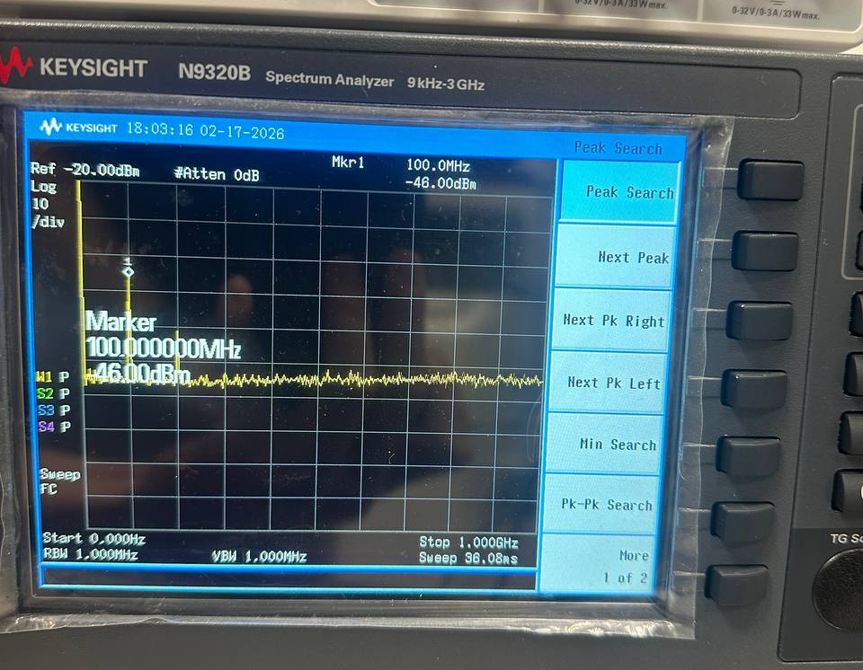
V&V Results: Radar Components
Coupler:
S(1,1): -18.46 dB,
S(2,1): -15.54 dB
Low-Noise Amplifier:
S(1,1): -10.27 dB
S(2,1): 6.05 dB
Mixer:
Port 1: 2.5 GHz Port 2: 2.4 GHz
Output: 100 MHz

Slide 21
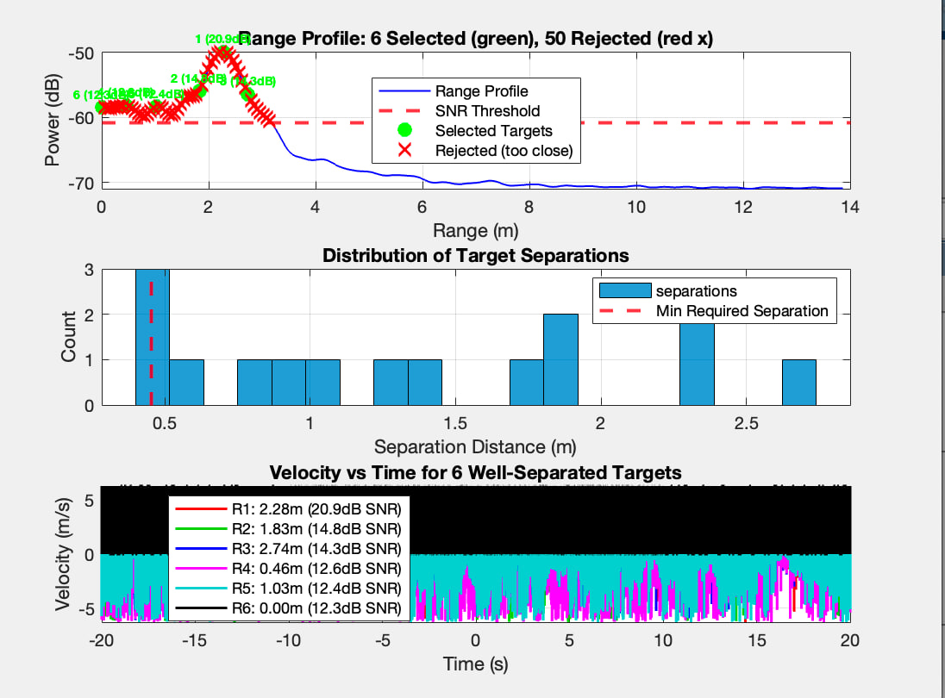
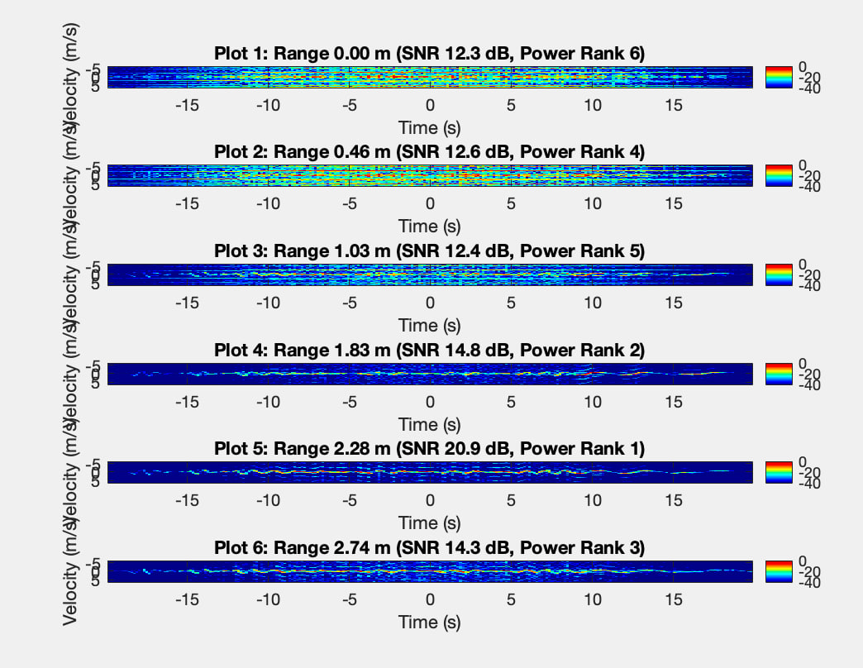
V&V Results: Assembled System

Slide 22
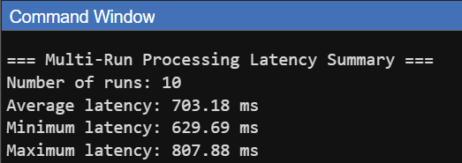
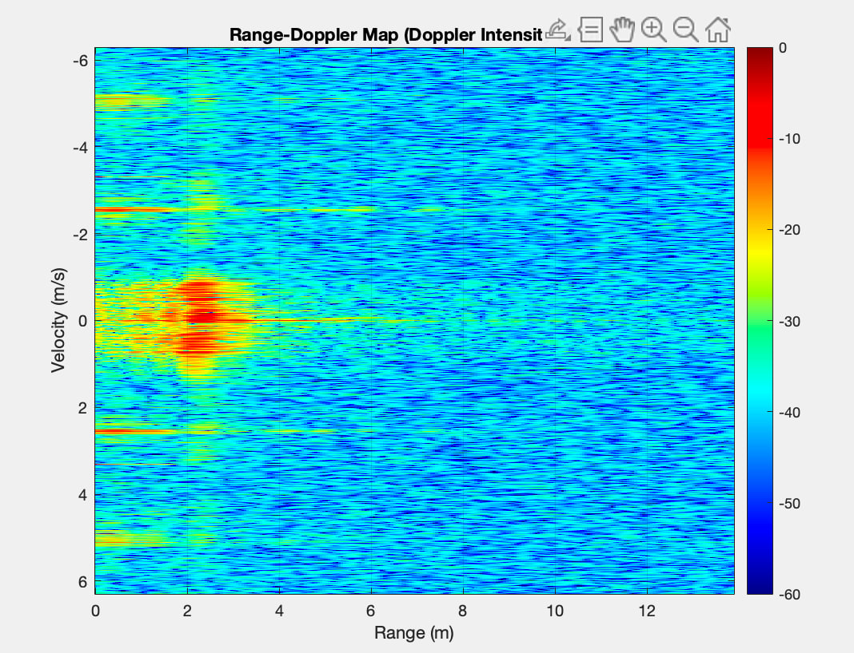
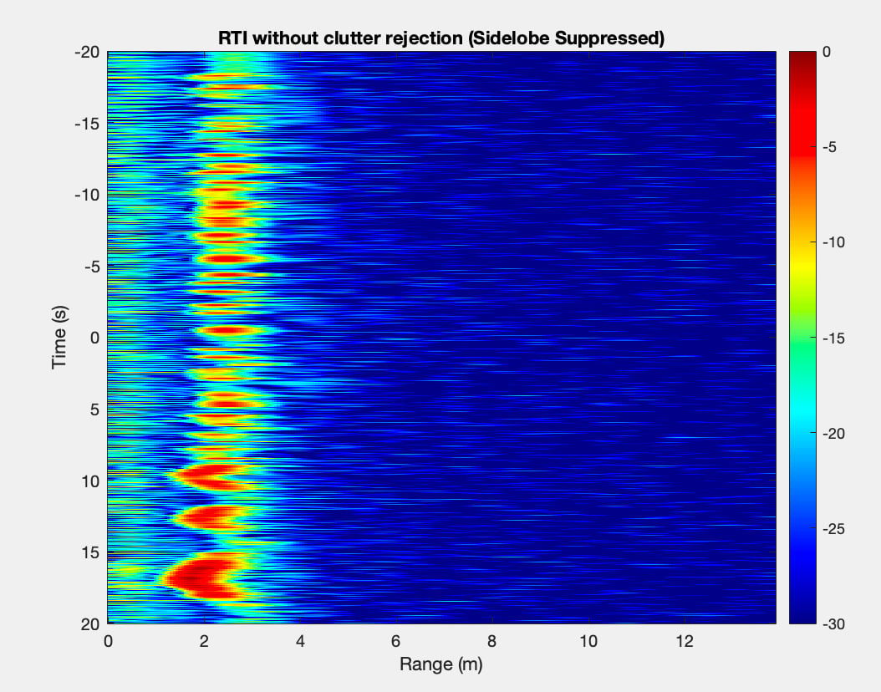
V&V Results: Assembled System

Slide 23
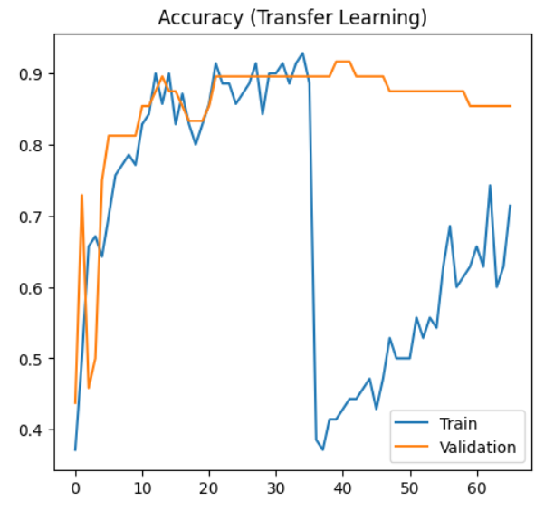
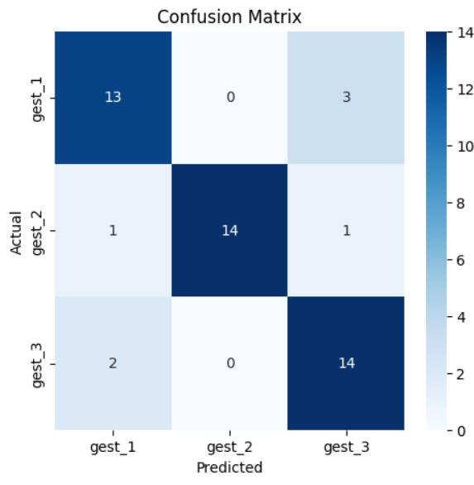
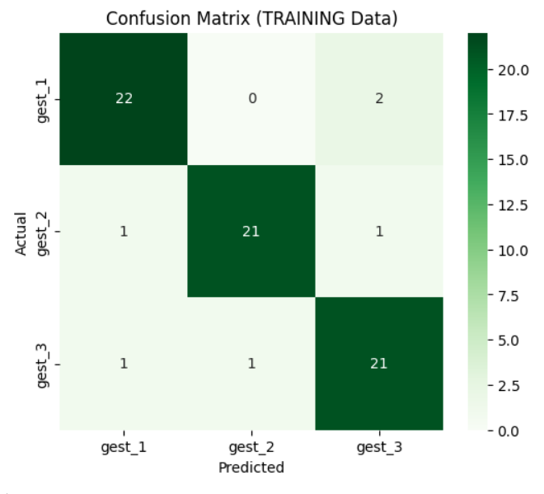
V&V Results: ML Classification Performance

Slide 24
Professional Considerations
RF transmit power kept within safe laboratory exposure limits
Compliance with lab safety procedures (grounding, PPE, supervised equipment use)
Ethical handling of experimental measurement data
Secure local data storage (no external cloud sharing)
Accessible documentation and clear presentation formatting for reproducibility

Slide 25
Limitations and Future Work
Limitations:
Antenna design was modified due to laboratory fabrication size constraints
Validation performed mainly in controlled indoor conditions
Limited dataset size for motion classification training
Future Work:
Implement full patch array with large-format PCB for higher gain and directivity
Expand dataset with additional motion scenarios and subjects
Improve antenna gain and RF front-end efficiency
Perform full system power characterization

Slide 26
Team Contribution and Responsibilities
Damilya Abzhanova -
Antenna & EM Design Lead
Designing microstrip patch, vivaldi antennas for 2.4 GHz
Performing CST EM simulations and optimizations
Verifying antenna performance using S-parameter analysis
Supporting antenna integration into the radar system
Aidana Alkenova -
Measurement & Integration Lead
Conducting VNA measurements for antenna and RF front-end validation
Performing subsystem testing and experimental verification
Integrating RF components into the complete radar setup
Supporting verification and validation experiments

Slide 27
Team Contribution and Responsibilities
Kairat Zhumadilov -
Radar System & Hardware Lead
Implementing FMCW radar architecture using microstrip components (mixer, coupler, etc.)
Configuring VCO-based chirp signal generation
Managing hardware assembly and system-level debugging
Ali Yerkinbekuly -
Signal Processing & Data Analysis Lead
Developing Range–Doppler processing pipeline
Preparing radar dataset for motion classification
Implementing MobileNetV2 classification model
Evaluating performance using accuracy metrics and confusion matrix

Slide 28
Conclusion
Designed and implemented a compact 2.4 GHz FMCW radar system using microstrip RF components
Validated antenna and RF performance through VNA measurements
Developed a Range–Doppler processing pipeline for motion detection
Achieved motion classification using MobileNetV2 on radar data
Demonstrated a low-cost, privacy-preserving sensing solution for indoor IoT applications
This project demonstrates the feasibility of integrating compact FMCW radar with deep learning for practical smart sensing systems.

Slide 29
Thank you!

