Slide 1

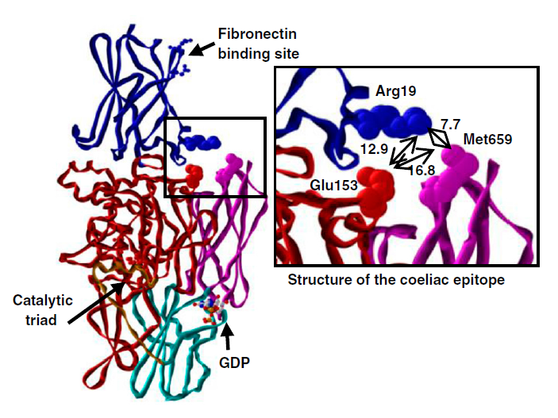
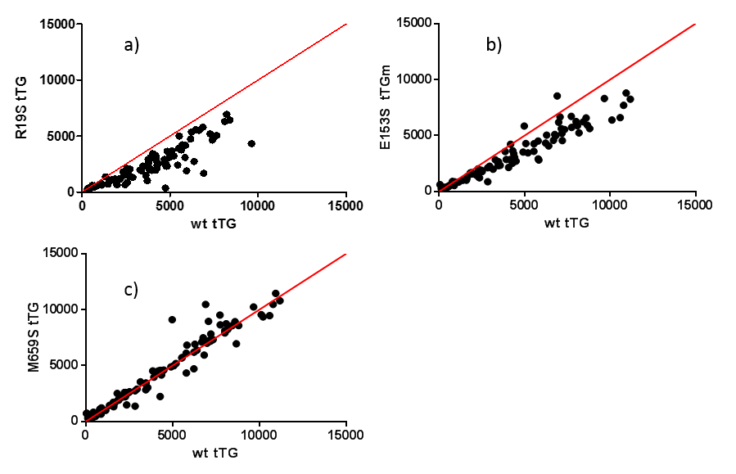
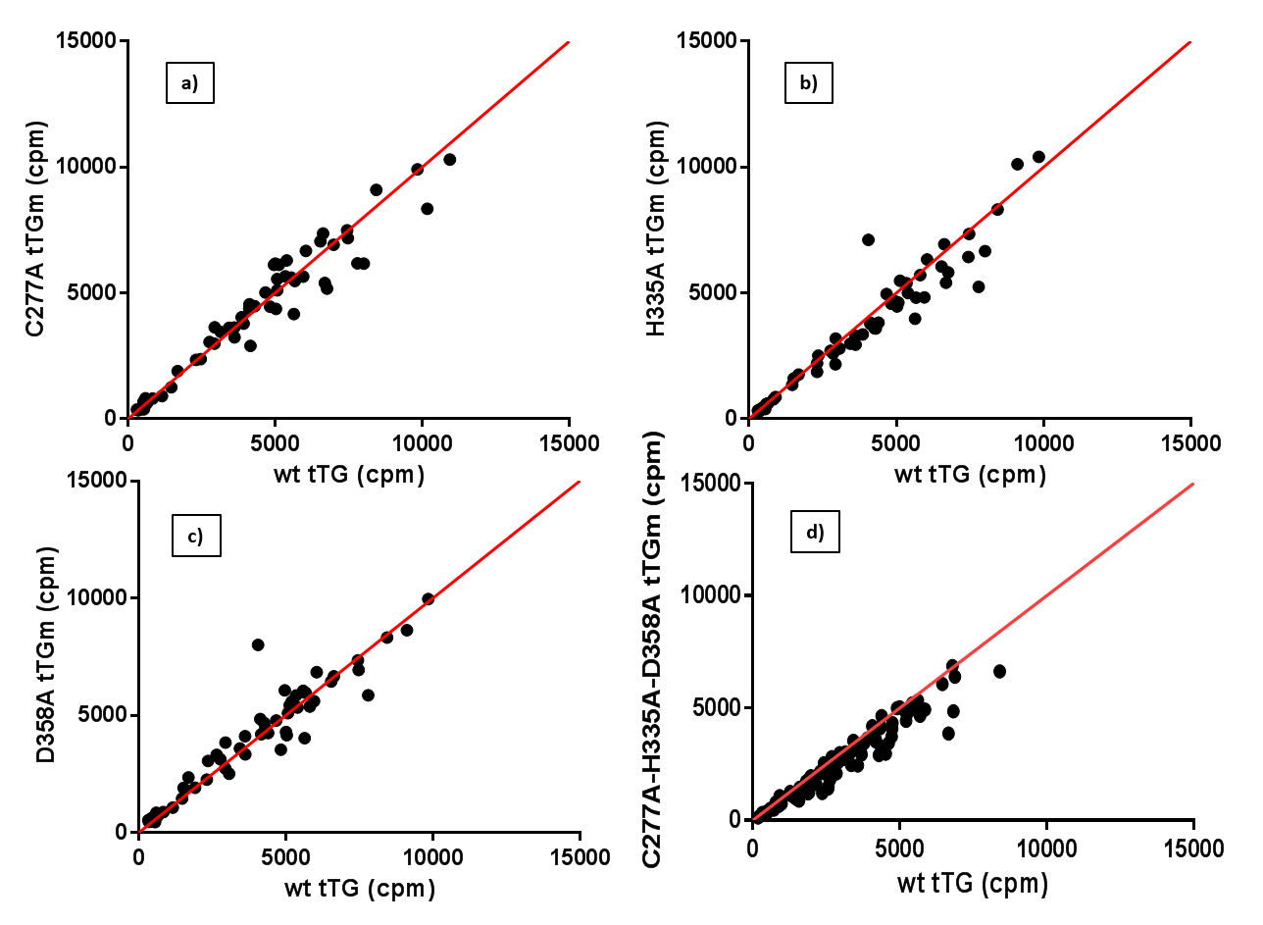
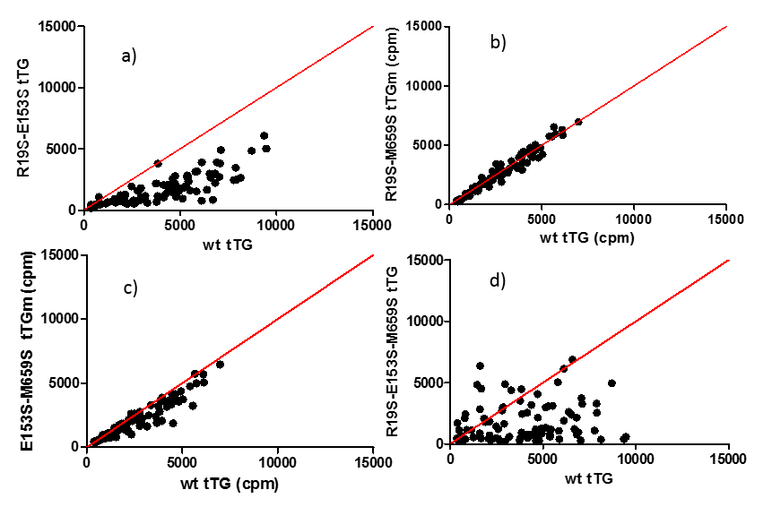



Autoantibodies to tissue transglutaminase target epitopes dependent on residues
in the N-terminal domain
A Kozhakhmetova¹, R Wyatt¹, K Elvers¹, D Emery¹, C Williams¹, P Annis², V Lampasona³, K Gillespie¹, A Williams¹
¹Diabetes and Metabolism, School of Clinical Sciences, University of Bristol, UK
²Cork University Hospital, Eire
³Istituto Scientifico San Raffaele, Milan, Italy
BACKGROUND
Tissue transglutaminase (tTG), is the main autoantigen of coeliac disease (CD). Specific tTG epitopes, including N-and C-terminal sites as well as the catalytic triad, have been reported to be targeted by autoantibodies in CD, but the findings are controversial [1-5].
RESULTS
2. Antibody binding of the tTG protein with mutated N- and C-terminal site amino acids:
Arg19, Glu153, Met659
N- and C-terminal amino acids:
Arg19
Glu153
Met659
1) Single (R19S, E153S, M659S) tTG mutants
HYPOTHESIS
We aimed to confirm which of the tTG sites, catalytic core, C- or N-terminus, are critical for antibody binding as this could aid the design of more specific assays and inform studies of disease pathogenesis.
Objectives:
1. Mutating distinct residues of the tTG protein (at 1 to 6 places);
2. Testing the binding of mutated antigens with tTG antibodies in sera from TGA positive patients.
Catalytic triad:
Cys277
His335
Asp358
Figure 1. Tissue transglutaminase The three-dimensional structure of tTG in the closed conformation. The N-terminal site is shown in blue, C-terminal site in pink, and catalytic core in red [5].
Figure 3. Antibody binding (cpm) of single R19S, E153S and M659S mutants of the tTG antigen vs wild type tTG in sera of TGA positive patients
The median relative binding for tTG mutants was 66.2% (p<0.001) for R19S (a), 76% (p<0.001) for E153S (b) and 102% (p<0.05) for M659S (c)
1. Antibody binding of the tTG protein with mutated catalytic triad amino acids:
Cys277, His335, Asp358
METHODS
Plasmid DNA encoding human tTG was mutated at sites in the catalytic core (Cys277, His335, Asp358 to alanine), N- (Arg19, Glu153 to serine) and C-terminal domains (Met659 to serine) using PAGE-purified mutagenic primers.
Antibody binding to a panel of ³⁵S-labelled tTG mutant antigens synthesized in vitro was assessed by radioimmunoassay in sera from 111 TGA-positive individuals (mean age 40 years, range 1.1-80 years) out of 445 patients sent for measurement of CD-associated autoantibodies to the Cork University Hospital, Eire.
Wilcoxon signed-ranks test (SPSS) was used for statistical analysis (a two-tailed p˂0.05 was considered significant).
Single (C277A, H335A, D358A) and triple (C/D/H) tTG mutants
2) Double (R/E, R/M, E/M) and triple (R/E/M) tTG mutants
Figure 2. Antibody binding (cpm) of single C277A, D358A, H335A and triple C/D/H mutants of the tTG antigen vs wild type tTG in sera of TGA positive patients
The median relative binding for tTG mutants was 99.8% (p>0.05) for C277A (a), 92.6% (p<0.001) for H335A (b), 105.8% (p<0.05) for D358A (c) and 85% (p<0.001) for the triple mutant (d)
Figure 4. Antibody binding (cpm) of double R/E, R/M, E/M and triple R/E/M mutants of the tTG antigen vs wild type tTG in sera of TGA positive patients
The median relative binding for tTG mutants was 48% (p<0.001) for double R19S/E153S (a), 94% (p=0.031) for R19S/M659S (b), 87% (p<0.001) for E153S/M659S (c) and 48% (p<0.001) for triple R19S/E153S/M659S (d) mutants
REFERENCES
BYRNE, G., RYAN, F., JACKSON, J., FEIGHERY, C. & KELLY, J. 2007. Mutagenesis of the catalytic triad of tissue transglutaminase abrogates coeliac disease serum IgA autoantibody binding. Gut, 56, 336-41.
CHEN, X., HNIDA, K., GRAEWERT, M. A., ANDERSEN, J. T., IVERSEN, R., TUUKKANEN, A., SVERGUN, D. & SOLLID, L. M. 2015. Structural Basis for Antigen Recognition by Transglutaminase 2-specific Autoantibodies in Celiac Disease. J Biol Chem, 290, 21365-75.
COMERFORD, R., KELLY, J., FEIGHERY, C. & BYRNE, G. 2015. IgG anti-tTG responses in different autoimmune conditions differ in their epitope targets and subclass usage. Mol Immunol, 67, 369-76.
IVERSEN, R., DI NIRO, R., STAMNAES, J., LUNDIN, K. E., WILSON, P. C. & SOLLID, L. M. 2013. Transglutaminase 2-specific autoantibodies in celiac disease target clustered, N-terminal epitopes not displayed on the surface of cells. J Immunol, 190, 5981-91.
SIMON-VECSEI, Z., KIRÁLY, R., BAGOSSI, P., TÓTH, B., DAHLBOM, I., CAJA, S., CSOSZ, É., LINDFORS, K., SBLATTERO, D., NEMES, É., MÄKI, M., FÉSÜS, L. & KORPONAY-SZABÓ, I. R. 2012. A single conformational transglutaminase 2 epitope contributed by three domains is critical for celiac antibody binding and effects. Proc Natl Acad Sci U S A, 109, 431-6
3. Antibody binding of the tTG protein with mutated catalytic triad and terminal sites amino acids: C/D/H/R/E/M
Six-site (C/D/H/R/E/M) tTG mutant
Mutants | N tested samples | Decreased binding | Increased binding | RB % | Z | P
Catalytic triad
C277A | 66 | 33 | 33 | 100 | -0.3 | 0.723
H335A | 66 | 50 | 16 | 93 | -4.0 | 6.1E-5
D358A | 66 | 22 | 44 | 106 | -2.3 | 0.019
C/D/H | 111 | 99 | 12 | 85 | -8.1 | 3.7E-16
Terminal sites
M659S | 94 | 34 | 60 | 102 | -2.9 | 0.004
E153S | 94 | 85 | 9 | 76 | -6.8 | 1E-11
R19S | 94 | 92 | 2 | 66 | -8.4 | 4.2E-17
R/E | 96 | 94 | 2 | 48 | -8.4 | 3.1E-17
R/M | 92 | 60 | 32 | 94 | -2.1 | 0.031
E/M | 92 | 80 | 12 | 87 | -7.4 | 1.6E-13
R/E/M | 96 | 91 | 5 | 48 | -8.0 | 1.1E-15
Catalytic/Terminal sites
C/D/H/R/E/M | 111 | 107 | 4 | 60 | -9.0 | 2.2E-19
Figure 5. Antibody binding (cpm) of six-site C/D/H/R/E/M mutant of the tTG antigen vs wild type tTG in sera of TGA positive patients
The median relative binding for tTG six-site mutant was 60% (p<0.001)
Table. Antibody binding characteristics of the mutant tTG antigens (in comparison with wild type tTG)
RB – relative binding (median); p - two-tailed. Mutation of the catalytic core Cys277, His335 and Asp358 amino acids resulted in minor changes in binding (median decrease 15% for the triple tTG mutant); mutation of the N- and C-terminal sites Arg19, Glu153 and Met659 amino acids resulted in reduction of antibody binding (median decrease was 52% for both double R/E and triple R/E/M tTG mutants, and 6-13% for R/M and E/M tTG mutants); combined 6-site mutation of the tTG antigen resulted in reduction of antibody binding (median decrease 40%)
SUMMARY
The N-terminal domain of tTG involving amino acids Arg19 and Glu153 is important to the integrity of tTG autoantibody epitopes in CD. Simultaneous mutation of these two amino acids has the highest impact on antibody-binding to tTG, while modifying catalytic core previously reported as being important, had little effect on binding. Effect of C-terminal mutation is more variable. These findings suggest that a major epitope is located in the N-terminal, but additional regions of the antigen are likely to contribute to antibody-binding. Characterization of mechanisms and epitopes involved in anti-tTG autoimmunity is important for development of targeted therapeutic manipulations in CD patients or at-risk individuals.

